Slide 1
Your Task

Slide 2
Use the techniques you are practicing here to collaboratively demonstrate one plausibly true thing about a topic that interests you.
Reflect on the process of demonstrating that thing
Present your finding, your process and the fruits of your reflection to the group on THURSDAY 05/29.

Slide 3
Over the next two weeks we expect you to
Form a group (Jerry has an exercise!)
Articulate a topic or question of shared interest
Identify and gather relevant data
Parse data and insert it into a sql database you design, pay attention to linking variables
Run queries or other analyses on your data to demonstrate your one true thing
Prepare a presentation that describes your question, your process, your findings, and what doing this taught you about working with “big data”
Have Fun

Slide 4

Men and women review books using different language (scraped and topic modeled data from Goodreads.com)

Slide 5
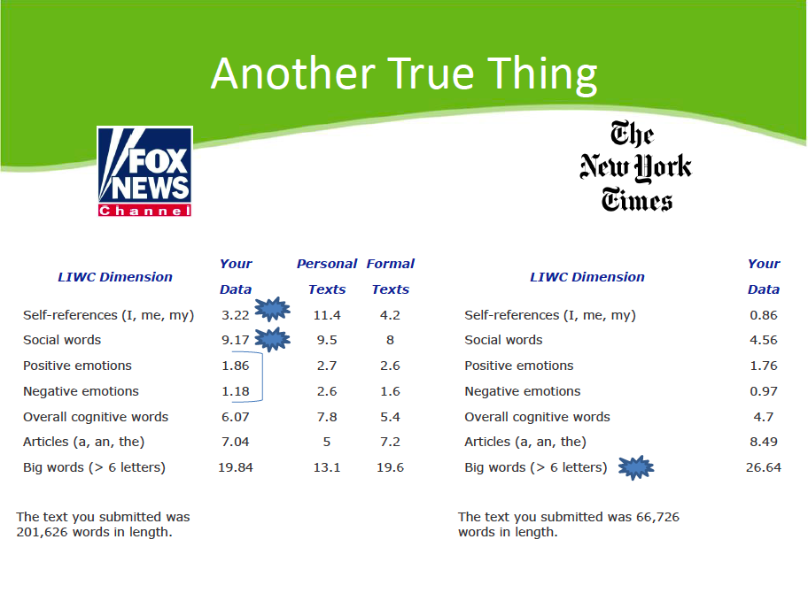
Fox News and the New York Times evince different sentiments in discussions of climate change.

Slide 6
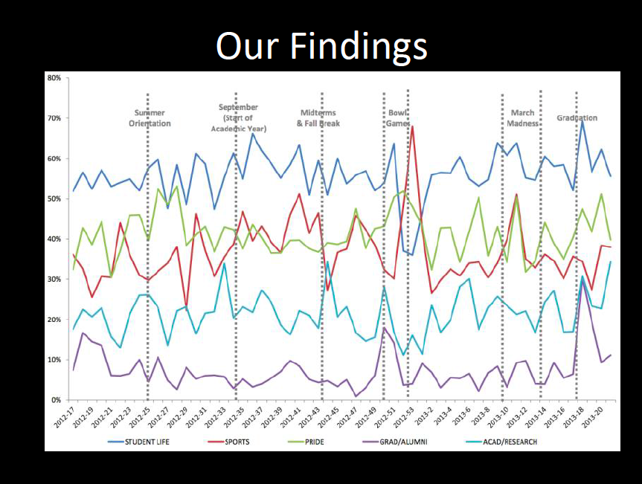
Big ten college facebook posts mostly talk about stuff other than academics.

Slide 7
How to present your true thing
Here’s who is in our group
Our motivating question was…
We tried to answer this by…
We had to completely change direction when we discovered that…
Here is our fact: ___________________
Here is how we got there and what we learned along the way

Slide 8
Go forth and do interesting stuff.

