Slide 1

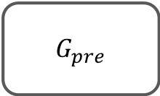
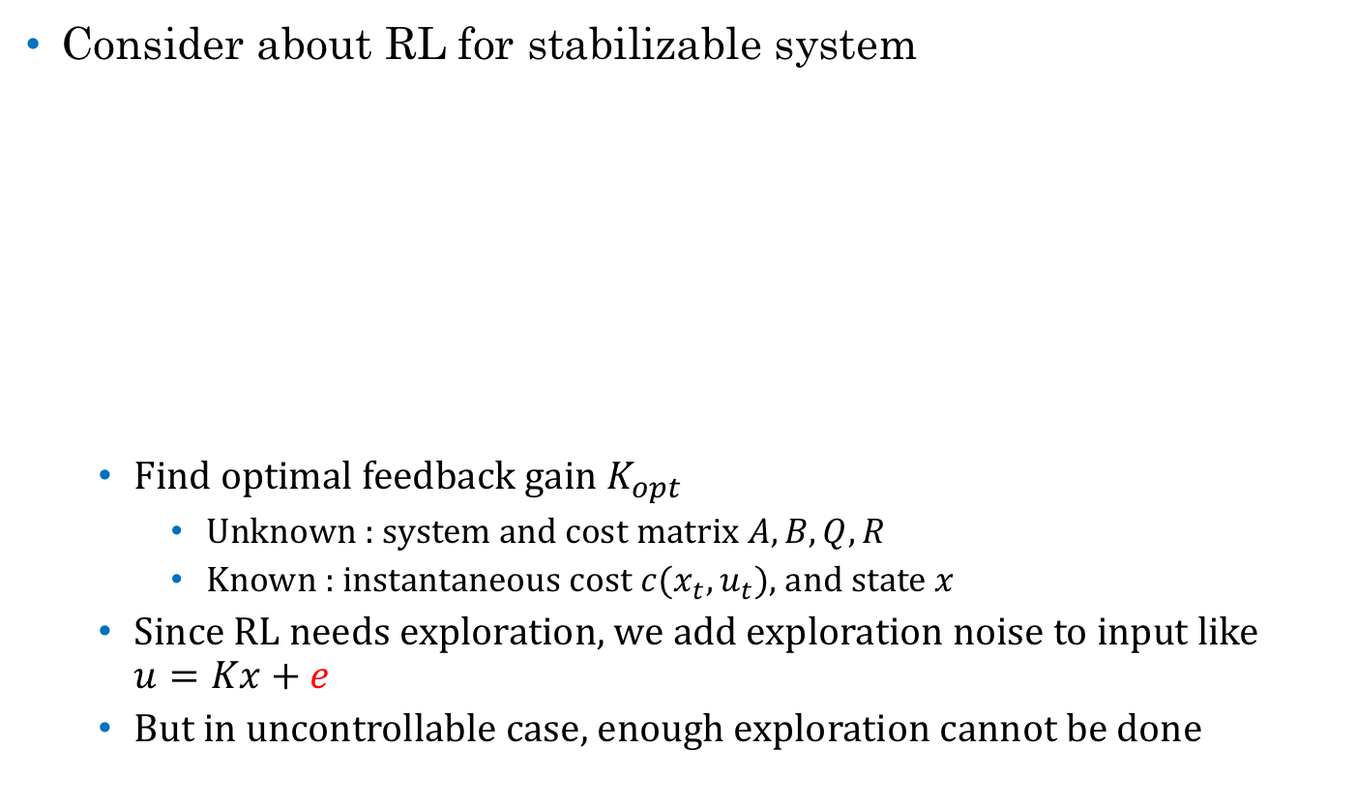



Weekly Report
Consider about RL for stabilizable system
Find optimal feedback gain $K_{opt}$
Unknown : system and cost matrix $A,B,Q,R$
Known : instantaneous cost $c(x_{t},u_{t})$, and state $x$
Since RL needs exploration, we add exploration noise to input like $u=Kx+e$
But in uncontrollable case, enough exploration cannot be done
$$G_{pre}$$
$$x$$
$$u$$
$G_{pre}$ is stabilizable
$$K$$

Slide 2











Weekly Report
Consider about RL for stabilizable system
Motivation : Optimize $G_{pre}$, but can control only $E$ (Edge).
$$G_{pre}$$
$$G$$
$$\min{\sum_{t=0}^{∞}{\left(x^{T}Rx +u^{T}Qu\right)},}s.t. u=Kx$$
$$G_{pre} :x= \left( \begin{matrix}x_{g} \\ x_{e}\end{matrix} \right)$$
$$E$$
$x_{g} :$ uncontrollable (but stabilize)
$x_{e} :$ controllable
$$x$$
$$Q$$
$$u$$

Slide 3
Weekly Report
Colloquium
Reinforcement Learning of LQR for stabilizable system
(If could…)
Also talk about :
Optimal control for stochastic system
Adaptive filter

