Slide 1
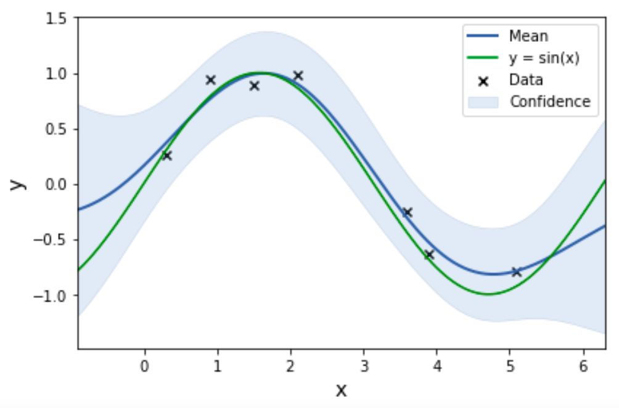



Weekly Report
GP regression of single output function $f(x)$
$$f\left(x_{∗}\right)\sim 𝒩(m\left(x_{∗}\right), σ^{2}\left(x_{∗}\right))$$
$$(x=x_{∗})$$
(95%) high probability confidence interval
$$m\left(x_{∗}\right)−2σ\left(x_{∗}\right)≤f\left(x_{∗}\right)≤m\left(x_{∗}\right)+2σ(x_{∗})$$

Slide 2


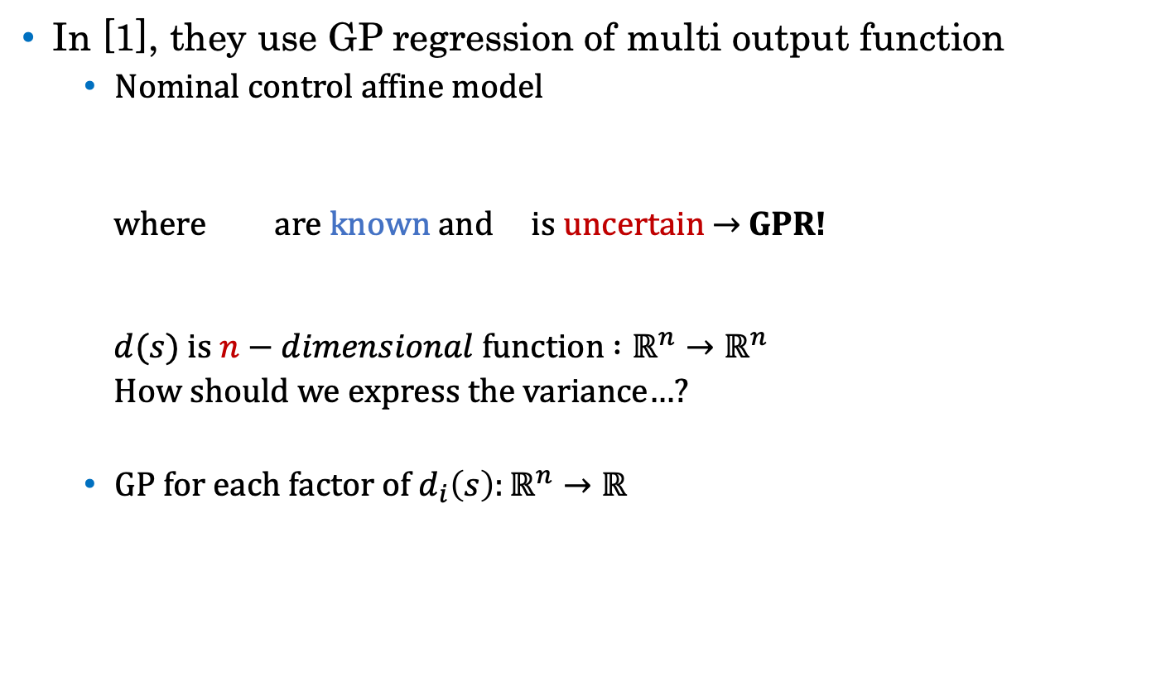
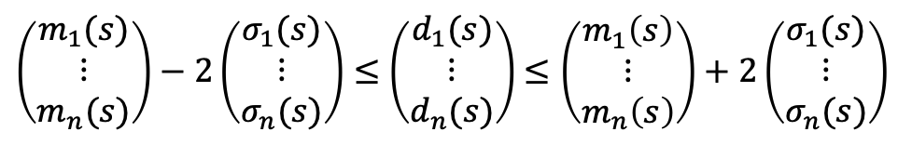
Weekly Report
In [1], they use GP regression of multi output function
Nominal control affine model
where are known and is uncertain → GPR!
$d(s)$ is $n−dimensional$function $:ℝ^{n}→ℝ^{n}$
How should we express the variance…?
GP for each factor of $d_{i}\left(s\right):ℝ^{n}→ℝ$
In this case
$\left(\begin{matrix}m_{1}(s) \\ ⋮ \\ m_{n}(s)\end{matrix}\right)−2\left(\begin{matrix}σ_{1}(s) \\ ⋮ \\ σ_{n}(s)\end{matrix}\right)≤$ $\left(\begin{matrix}d_{1}(s) \\ ⋮ \\ d_{n}(s)\end{matrix}\right)$ $≤\left(\begin{matrix}m_{1}\left(s\right) \\ ⋮ \\ m_{n}\left(s\right)\end{matrix}\right)+2\left(\begin{matrix}σ_{1}(s) \\ ⋮ \\ σ_{n}(s)\end{matrix}\right)$
$$m(s)$$
$$σ(s)$$
[1] : R. Cheng, G. Orosz, R. M. Murray, and J. W. Burdick. “ End-to-end safe reinforcement learning through barrier functions for safety-critical continuous control tasks. ” Thirty-Third AAAI Conference on Artificial Intelligence (AAAI-19), 2019.

Slide 3
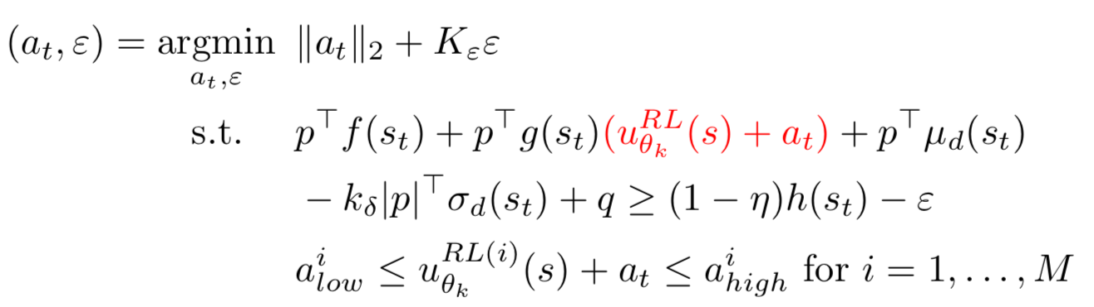

Weekly Report
What is proved ①
If there exists a solution to (*) for all $s∈C$(set of safe states) with $ε=0$, the set $C$ will be forward invariant w.p. $1−δ$.
If there exists a state $s∈C$ such that (*) has solution with $ε=ε_{max}>0$. If for all $s∈C$, the solution to (*) satisfies $ε<$ $ε_{max}$, then set $C_{ε}$(larger set to $C$) will be forward invariant w.p. $1−δ$.
(*)

Slide 4


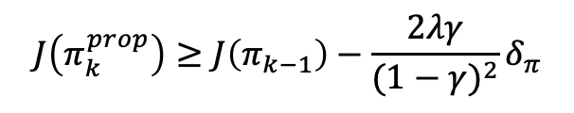

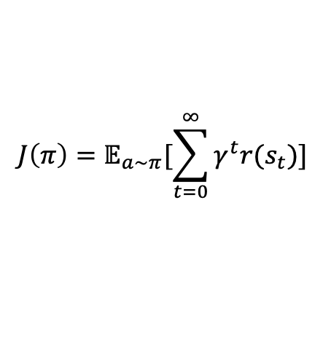

Weekly Report
What is proved ②
If we use TRPO for RL, the algorithm achieve performance guarantee
$$J\left(π_{k}^{prop}\right)≥J\left(π_{k−1}\right)−\frac{2λγ}{{(1−γ)}^{2}}δ_{π}$$
$$J\left(π\right)=𝔼_{a\sim π}[\sum_{t=0}^{∞}{γ^{t}r(s_{t})}]$$
$$π_{k}^{prop}$$
Unsafe Inputs
$$u_{k}$$
$$u_{k−1}^{prop}$$
$${+ u}_{k}^{CBF}$$
$$π_{opt}$$
$$π_{k−1}$$
Set of
Safe Inputs
$$π_{k−1}^{prop}$$

