Slide 1






Weekly Report
Self-triggered control (cf. : Event-triggered control)
Controller decides action signal and next observation time
(State feedback) control low function: $π\left(s\right)=\left[\begin{matrix}a(s) & τ(s)\end{matrix}\right]$
observation
observation
$$t_{k}$$
$$t_{k+1}$$
Constant input: $a=a_{k}$
$$a=a_{k+1}$$
Interval $τ_{k}$ second

Slide 2
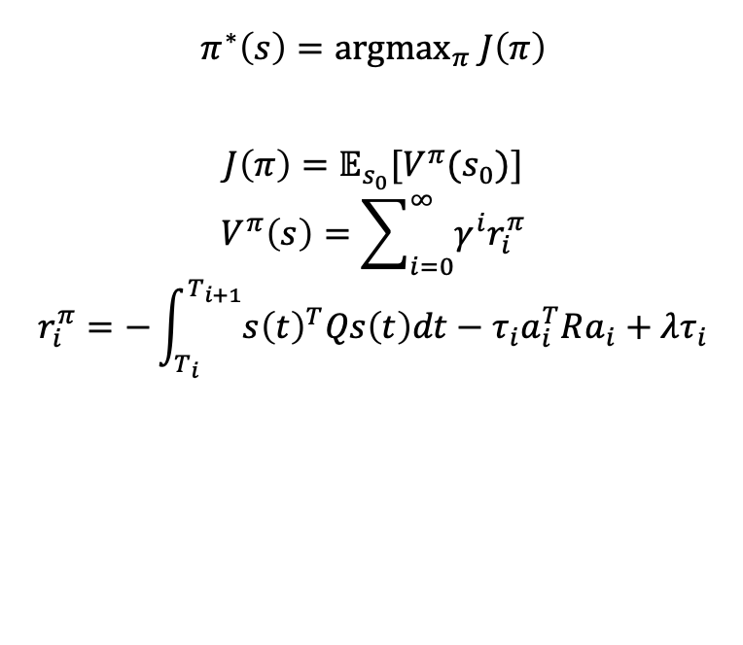

Weekly Report
Reinforcement learning for optimal self-triggered control $π^{∗}$
Assume every i-th step’s access to data tuple $(s_{t}, r_{i}^{π})$
$$π^{∗}\left(s\right)={argmax}_{π} J\left(π\right)$$
$$J\left(π\right)=𝔼_{s_{0}}[V^{π}(s_{0})]$$
$$V^{π}\left(s\right)=\sum_{i=0}^{∞}{γ^{i}r_{i}^{π}}$$
$$r_{i}^{π}=−\int_{T_{i}}^{T_{i+1}}{{s\left(t\right)}^{T}Qs\left(t\right)dt}−τ_{i}a_{i}^{T}Ra_{i}+λτ_{i}$$

Slide 3




Weekly Report
We can regard this task as a simple RL framework
It will converge to optimal policy by long long iteration
I want to discuss unique feature of this problem for master thesis
Ex.) step size ratio of gradient method for $a_{μ}\left(s\right), τ_{φ}(s)$
Black Box System
$$a_{i},τ_{i}$$
$$r_{i},s_{i+1}$$
agent
$$∇_{μ} J\left(π\right),∇_{φ} J\left(π\right)$$

