Slide 1


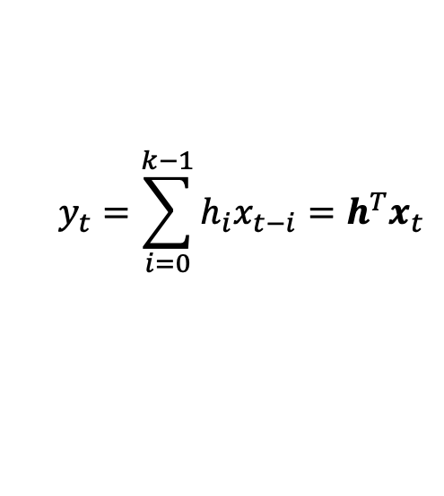
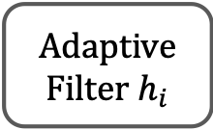


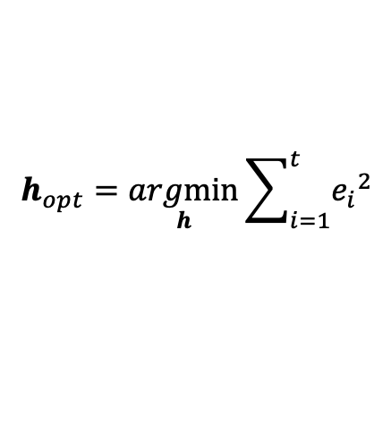


Weekly Report
Correction of colloquium
Recursive Least Square
Unknown system
$$d$$
$$y_{t}=\sum_{i=0}^{k−1}{h_{i}x_{t−i}}=h^{T}x_{t}$$
$$e_{t}=d_{t}−y_{t}$$
$$x$$
Adaptive Filter $h_{i}$
$$−$$
$$e$$
$$y$$
$$h_{opt}=\underset{h}{argmin}{\sum_{i=1}^{t}{{e_{i}}^{2}}}$$

Slide 2



Weekly Report
Update coefficient recursively in every timesteps as following:
RLS update
$$k_{t}=\frac{P_{t}x_{t+1}}{1+{x_{t+1}}^{T}P_{t}x_{t+1}}$$
$$P_{t+1}=[I−k_{t}{x_{t}}^{T}]P_{t}$$
$$h_{t+1}=h_{t}+k_{t}(d_{t}−y_{t})$$
$h_{t}={(x_{t}{x_{t}}^{T})}^{−1}x_{t}d_{t}$ : LS solution
correction
$$h_{t}={(X_{t}{X_{t}}^{T})}^{−1}X_{t}d_{t}$$
$$X_{t}=\left[x_{1},⋯,x_{t}\right]$$
$$d_{t}={\left[d_{1},⋯,d_{t}\right]}^{T}$$

Slide 3







Weekly Report
Study theme
Recall : safe reinforcement learning
Unsafe Inputs
$$π_{θ_{k+1}}^{RL}$$
$$u_{k}$$
$${+ u}_{k}^{CBF}$$
$$u_{θ_{k}}^{RL}$$
$$π_{opt}$$
$$π_{k}$$
$$π_{θ_{k}}^{RL}$$
Set of
Safe Inputs

Slide 4
Weekly Report
Problem formulation
Nominal control affine model
where are known and is uncertain
We want to search optimal policy maintaining safety

Slide 5
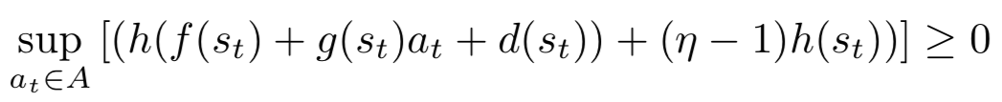

Weekly Report
Control Barrier Function (CBF)
Safe set
To maintain safety during learning process, the set above must be forward invariant.
Condition for function $h(s)$ to be CBF
If $h(s)$ is a CBF, it is certified that safe inputs exist[1]
[1] : A. D. Ames, X. Xu, J. W. Grizzle and P. Tabuada. “Control Barrier Function Based Quadratic Programs for Safety Critical Systems.” in IEEE Transactions on Automatic Control, vol. 62, no. 8, pp/ 3861-3876, 2017.

Slide 6
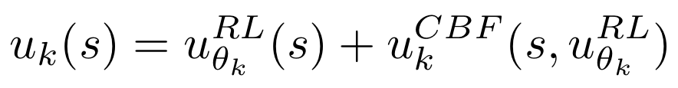
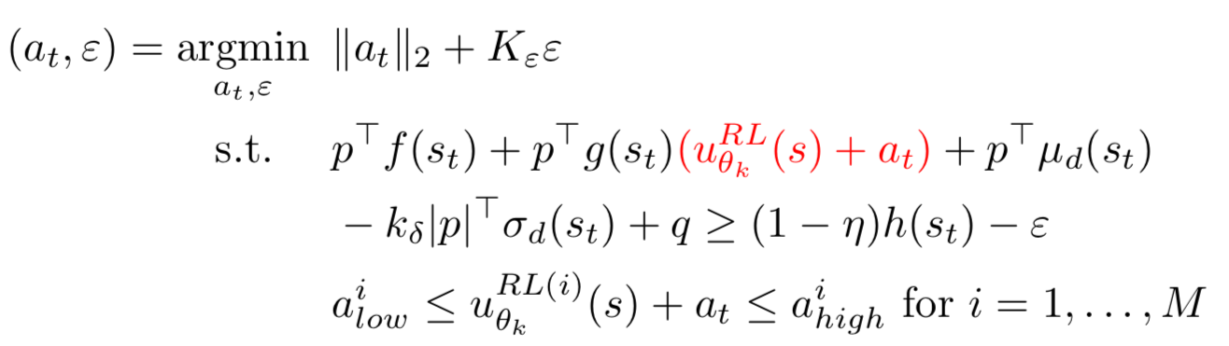




Weekly Report
Construct safe input using CBF[2]
$u_{k}^{CBF}$ is a solution of
Safe inputs
$$u_{k}$$
$$u_{θ_{k}}^{RL}$$
$$h\left(s\right)=p^{T}s+q$$
[2] : R. Cheng, G. Orosz, R. M. Murray, and J. W. Burdick. “ End-to-end safe reinforcement learning through barrier functions for safety-critical continuous control tasks. ” Thirty-Third AAAI Conference on Artificial Intelligence (AAAI-19), 2019.

Slide 7
Weekly Report
Related research
J. Achiam, D. Held, A. Tamar and P. Abbeel. “Constrained Policy Optimization.” Proceedings of the 32nd International Conference on Machine Learning, vol. 70, pp. 22-31, 2017.
Chow et.al, “A Lyapunov-based Approach to Safe Reinforcement Learning. ” 32nd Conference on Neural Information Processing Systems, pp. 8103-8112, 2018.

