Slide 1
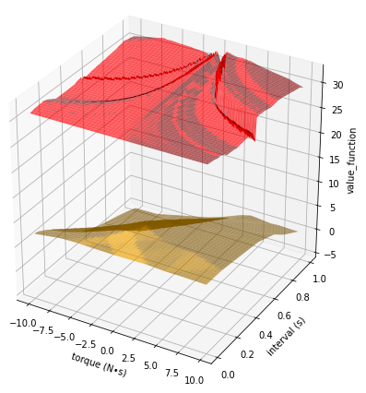
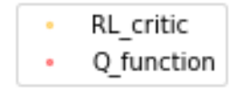
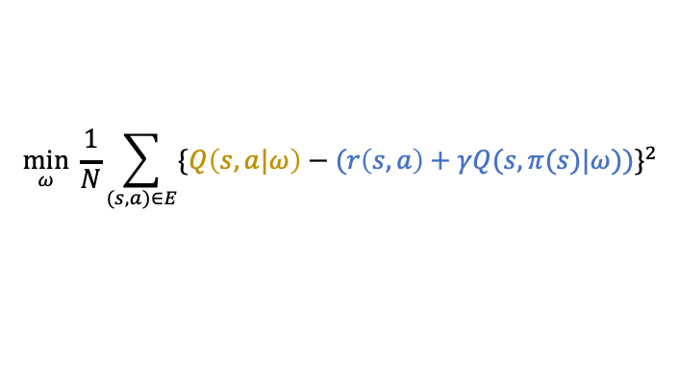

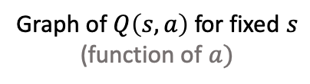
Weekly Report
Low accuracy of Q-function approximation
Graph of $Q\left(s,a\right)$ for fixed $s$
(function of $a)$
Q-function are learned with supervised learning (Least Square)
Low accuracy may come from..
Optimization algorithm
Data bias in $E$
$$\min_{ω}{\frac{1}{N}}\sum_{(s,a)∈E}^{ }{\{Q\left(s,a|ω\right)−(r\left(s,a\right)+γQ(s,π(s)|ω))\}^{2}}$$
teacher data
(This may be the reason)

Slide 2
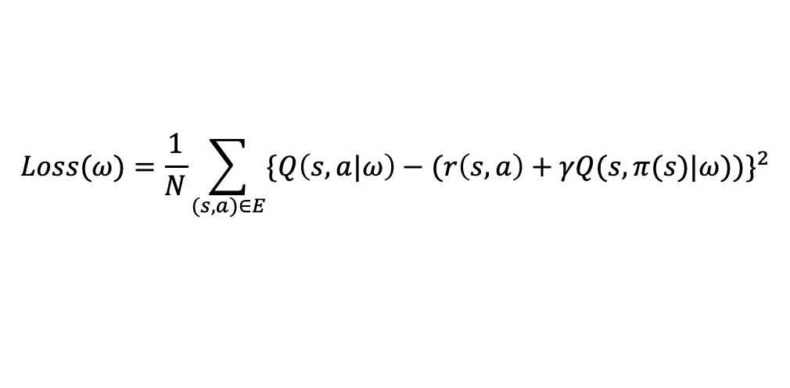
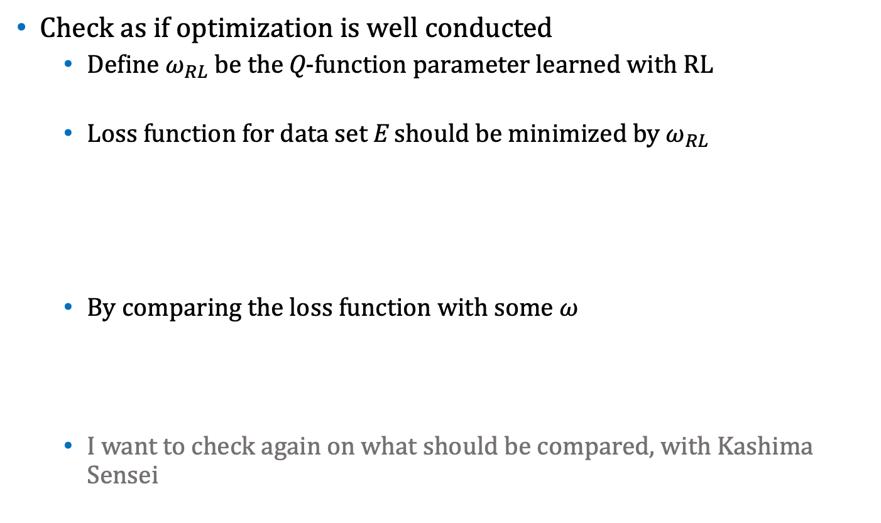

Weekly Report
Check as if optimization is well conducted
Define $ω_{RL}$ be the Q-function parameter learned with RL
Loss function for data set E should be minimized by $ω_{RL}$
By comparing the loss function with some $ω$
I want to check again on what should be compared, with Kashima Sensei
$$Loss(ω)=\frac{1}{N}\sum_{(s,a)∈E}^{ }{\{Q\left(s,a|ω\right)−(r\left(s,a\right)+γQ(s,π(s)|ω))\}^{2}}$$
$$Loss\left(ω\right)=17, Loss\left(ω_{RL}\right)=0.02$$

Slide 3
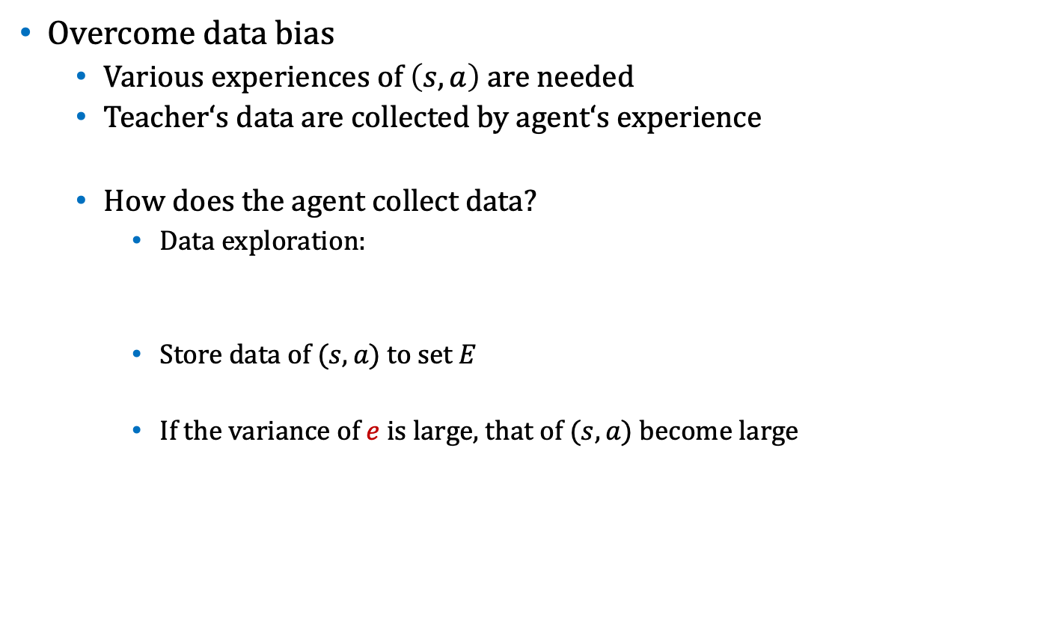

Weekly Report
Overcome data bias
Various experiences of $\left(s,a\right)$ are needed
Teacher‘s data are collected by agent‘s experience
How does the agent collect data?
Data exploration:
Store data of $(s,a)$ to set E
If the variance of $e$ is large, that of $(s,a)$ become large
$$a=π_{θ}\left(s\right)+e$$
Notes:
a を全探索しないでノイズ乗せて1ステップだけで分散上げようとして

Slide 4


Weekly Report
DDPG requires agent to experience states on control path w.r.t. current policy $π_{θ}$
Exploration-Exploitation Dilemma
Large variance noise
Can try different action
Being away from $π_{θ}$ control path
Small variance noise
Can achieve $π_{θ}$ control path
Cannot try different action
Dilemma

Slide 5






Weekly Report
Adaptive noise scaling
By changing action…
if the change of next state is large $⟺\frac{∂s^{′}}{∂a}$ is Large
$→$ small noise
if the change of next state is small $⟺\frac{∂s^{′}}{∂a}$ is Small
$→$ large noise
$$s^{′}$$
$$a=π(s)$$
$$s$$
$${\hat{s}}^{′}$$
$$\hat{a}$$

Slide 6
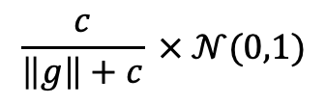

Weekly Report
Try following noise scaling
Because I have not summarized my consideration, I want to report the result on colloquium next week
$$\frac{c}{\left\|g\right\|+c} × 𝒩(0,1)$$
: $c$ is hyper parameter

Slide 7
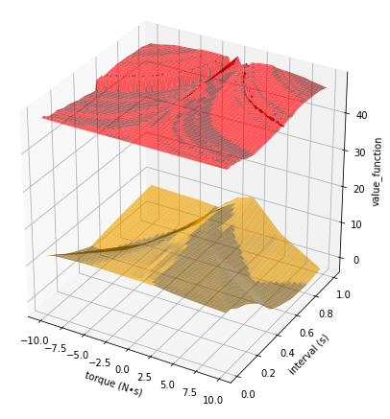
Weekly Report
Try noise
$$\frac{c}{\left\|g\right\|+c} × 𝒩(0,1)$$
: $c$ is hyper parameter

