Slide 1
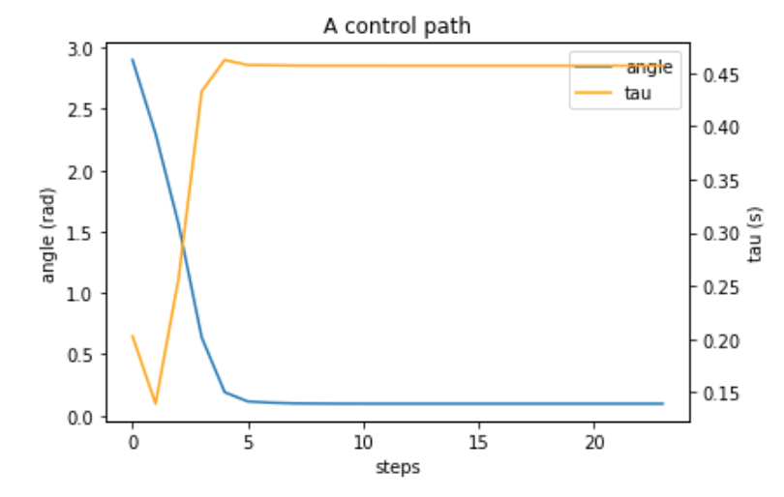
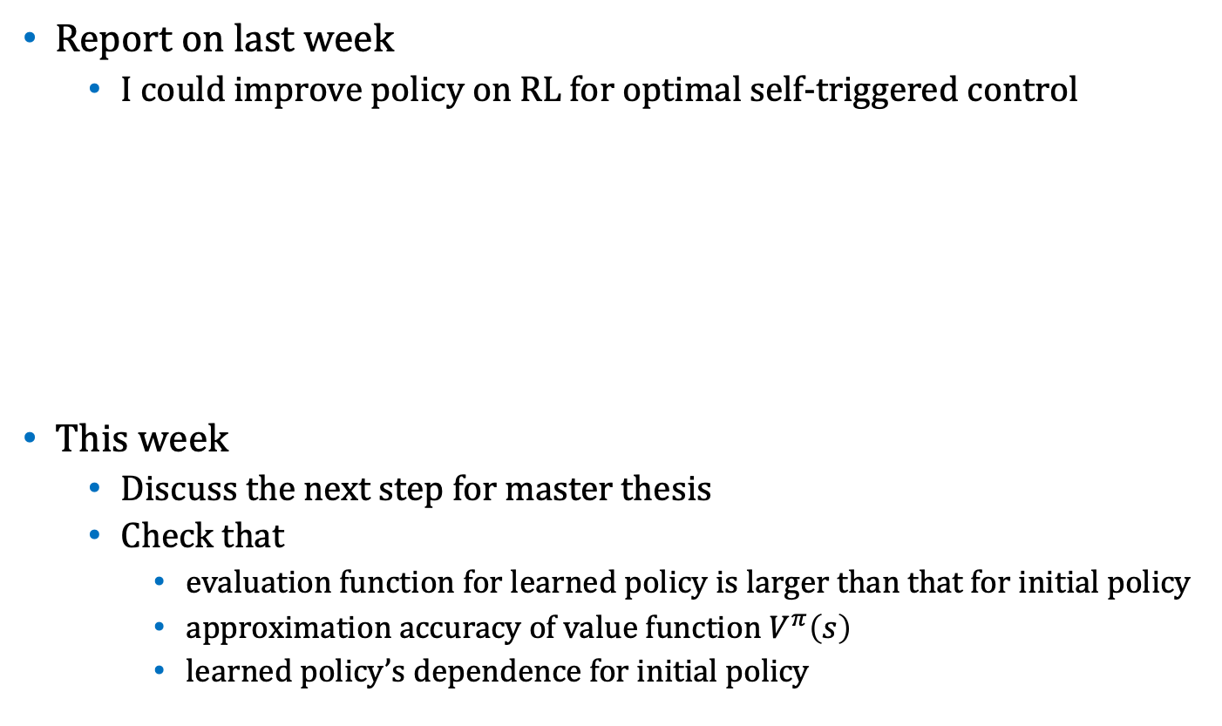
Weekly Report
Report on last week
I could improve policy on RL for optimal self-triggered control
This week
Discuss the next step for master thesis
Check that
evaluation function for learned policy is larger than that for initial policy
approximation accuracy of value function $V^{π}\left(s\right)$
learned policy’s dependence for initial policy
There is no guarantee that this policy is the best policy …
Wide interval around origin and frequent otherwise
Stabilize the system

Slide 2
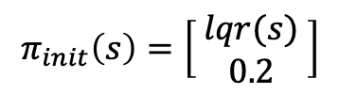


Weekly Report
1: Comparison of evaluation function
Policies
Evaluation criteria: $J\left(π\right)=𝔼_{s_{0}}[\sum_{i=0}^{∞}{γ^{i }r(s_{i},π(s_{i}))}]$
Result
$J\left(π_{init}\right)=−14.769< J\left(π_{RL}\right)=45.092$
$$π_{init}\left(s\right)=\left[ \begin{matrix}lqr(s) \\ 0.2\end{matrix} \right]$$
v.s.
$π_{RL}\left(s\right)$: learned policy

Slide 3
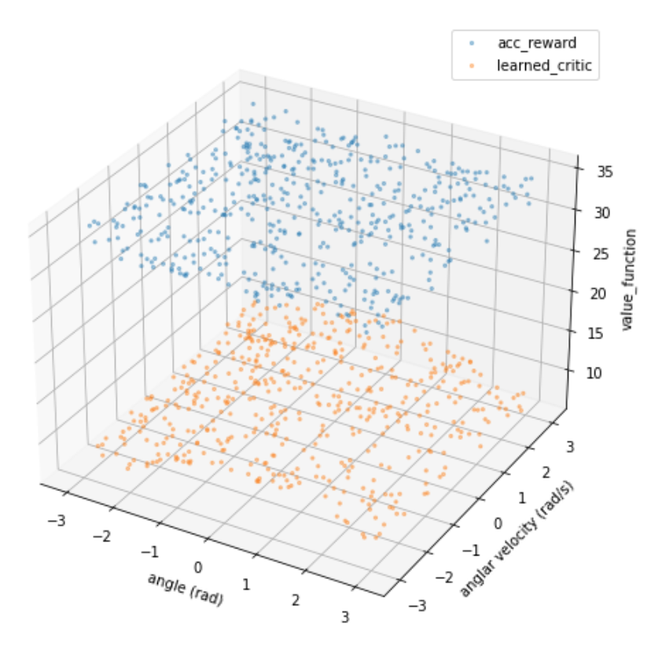


Weekly Report
2: Approximation accuracy of value function $V^{π}\left(s\right)$
$V^{π}\left(s\right)=Q^{π}\left(s,π(s)\right)$
Agent fits $Q\left(s,a|ω\right)$to approximate $Q^{π}\left(s,a\right)$
Evaluation criteria
Does $Q\left(s,π(s)|ω\right)$ approximates $\sum_{i=0}^{∞}{γ^{i }r(s_{i},π(s_{i}))}$ well?
definition of $V^{π}\left(s\right)$

Slide 4
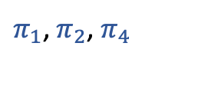
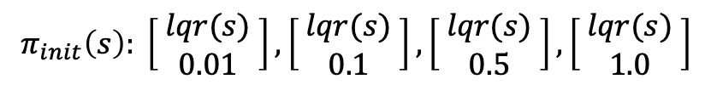

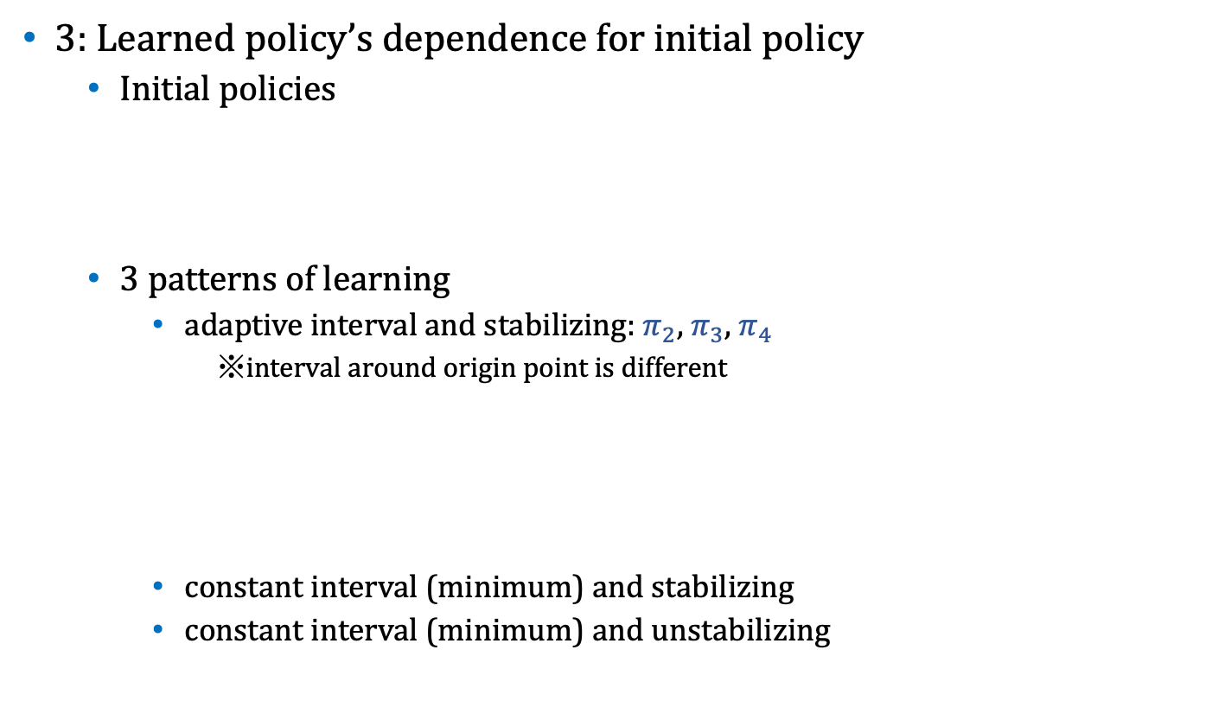



Weekly Report
3: Learned policy’s dependence for initial policy
Initial policies
3 patterns of learning
adaptive interval and stabilizing: $π_{2}$, $π_{3}\text{, }π_{4}$
※interval around origin point is different
constant interval (minimum) and stabilizing
constant interval (minimum) and unstabilizing
$$π_{init}\left(s\right): \left[ \begin{matrix}lqr(s) \\ 0.01\end{matrix} \right],\left[ \begin{matrix}lqr(s) \\ 0.1\end{matrix} \right],\left[ \begin{matrix}lqr(s) \\ 0.5\end{matrix} \right],\left[ \begin{matrix}lqr(s) \\ 1.0\end{matrix} \right]$$
$$π_{1}$$
$$π_{2}$$
$$π_{3}$$
$$π_{4}$$
$π_{1}$, $π_{2}\text{, }π_{4}$

