Slide 1
Weekly Report
Report on last week
It was possible to apply RL to event-triggered control
It will be applicable to self-triggered control as well
(At least with same steps,) it was not conducted well
Algorithm did not converge
Conjecture:
The control performance changes rapidly with little parameter change
If the conjecture is valid, research the condition and consider solution
Check the validity (conclusion: NO)

Slide 2
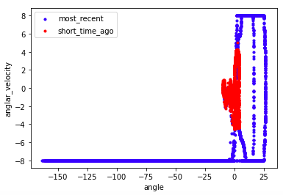
Weekly Report
Recently experienced data
This scatter plot does not show control path
Although parameter changes slightly, control path changes drastically(?)
(rad/s)
(rad)

Slide 3
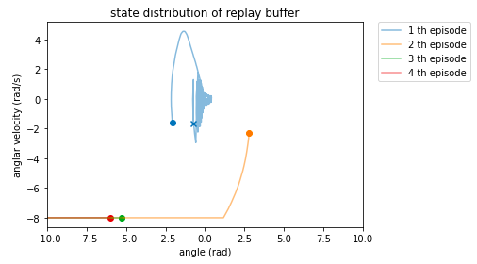
Weekly Report
Depict control path for each episode(new starting point)
It is not possible to see why policy became bad with this picture
(P1) Control path suddenly changed in second episode (conjecture)
(P2) Overfit to blue path
(P3) Other reason
Assume
Policy parameters are updated in all steps
Initial policy stabilize all initial states

Slide 4
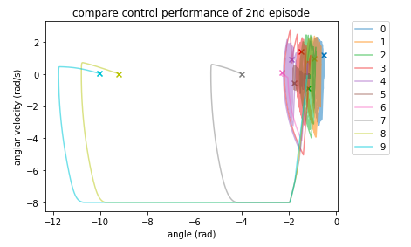
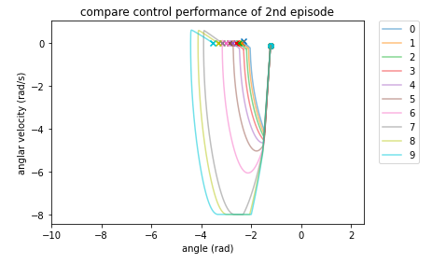
Weekly Report
How the policy changes in 2nd episode
Pick up policy in equally step interval
ex.) step 100, 200, 300, ...
(Attention: policy are not updated in each path)
Control path does not change suddenly
The conjecture is not valid
detail

Slide 5
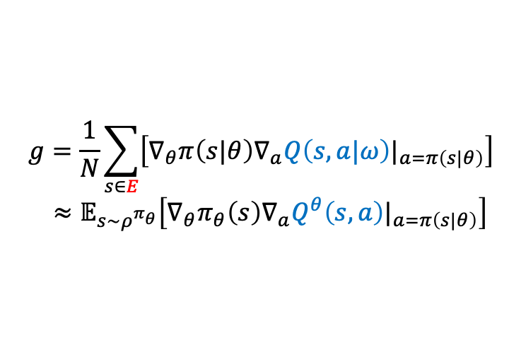
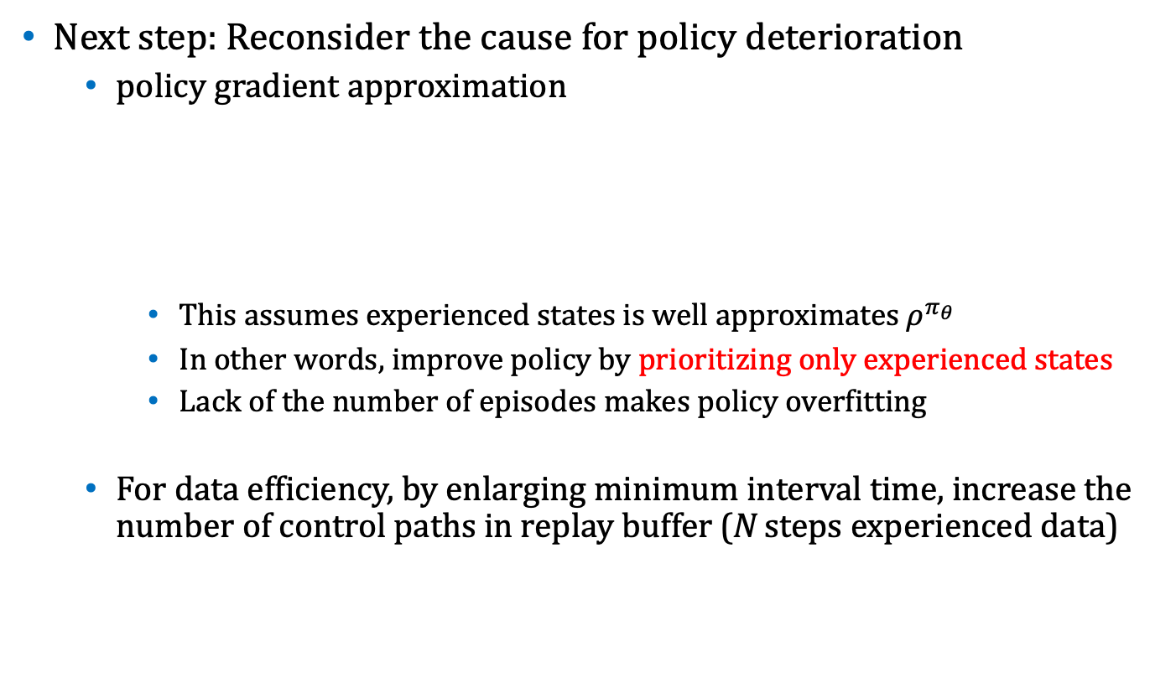
Weekly Report
Next step: Reconsider the cause for policy deterioration
policy gradient approximation
This assumes experienced states is well approximates $ρ^{π_{θ}}$
In other words, improve policy by prioritizing only experienced states
Lack of the number of episodes makes policy overfitting
For data efficiency, by enlarging minimum interval time, increase the number of control paths in replay buffer (N steps experienced data)
$$g=\frac{1}{N}\sum_{s∈E}{\left[∇_{θ}π\left(s|θ\right)∇_{a}Q\left(s,a|ω\right)|_{a=π\left(s|θ\right)}\right]}$$ $≈𝔼_{s\sim ρ^{π_{θ}}}\left[∇_{θ}π_{θ}\left(s\right)∇_{a}Q^{θ}\left(s,a\right)|_{a=π\left(s|θ\right)}\right]$

Slide 6
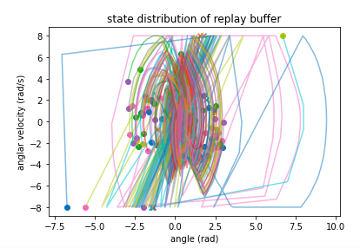
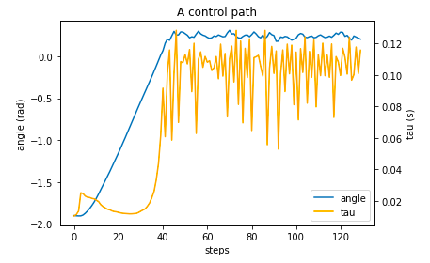
Weekly Report
By changing learning configuration as last slide, policy may improved
Distribution of replay buffer
Learned policy
There is no divergent paths
There is no guarantee that this policy is the best policy …
Wide interval around origin and frequent otherwise
Stabilize the system

Slide 7
Weekly Report
This week
Reconsider and discuss the theme
Ideas for stable learning
Configuration of optimizer (learning late hyperparameter etc..)
Safe learning

