Slide 1


Weekly Report
My report in last week
System dynamics
Ground truth dynamics: $s_{t+1}=f_{true}\left(s_{t}\right)+g(s_{t})a_{t}$,
where $f_{true}$, $g$ are Lipsitz continuous
Agent knows nominal dynamics i.e., $f$, $g$ is known and $d$ is unknown
$s_{t+1}=f\left(s_{t}\right)+d(s_{t})+g\left(s_{t}\right)a_{t}$ : nominal model
GP

Slide 2



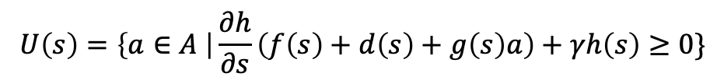
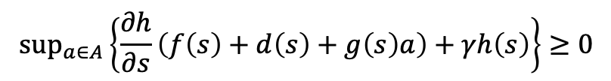
Weekly Report
Safety constraint
If CBF $h(s)$ is given, set of safe states is defined as
Because $h\left(s\right)$ is CBF, following condition is hold for $∀s∈$ $S_{safe}$
Set of safe actions
Safe policy set
$$S_{safe}=\left\{s∈S \right| h(s)≥0\}$$
$$\sup_{a∈A}\left\{\frac{∂h}{∂s}\left(f\left(s\right)+d\left(s\right)+g\left(s\right)a\right)+γh\left(s\right)\right\}≥0$$
$$U\left(s\right)=\left\{a∈A \right|\frac{∂h}{∂s}\left(f\left(s\right)+d\left(s\right)+g\left(s\right)a\right)+γh\left(s\right)≥0\}$$
$$Π_{safe}=\left\{π∈Π \right| \sum_{a∈U(s)}{π(a|s)}=1, ∀s∈S_{safe}\}$$

Slide 3

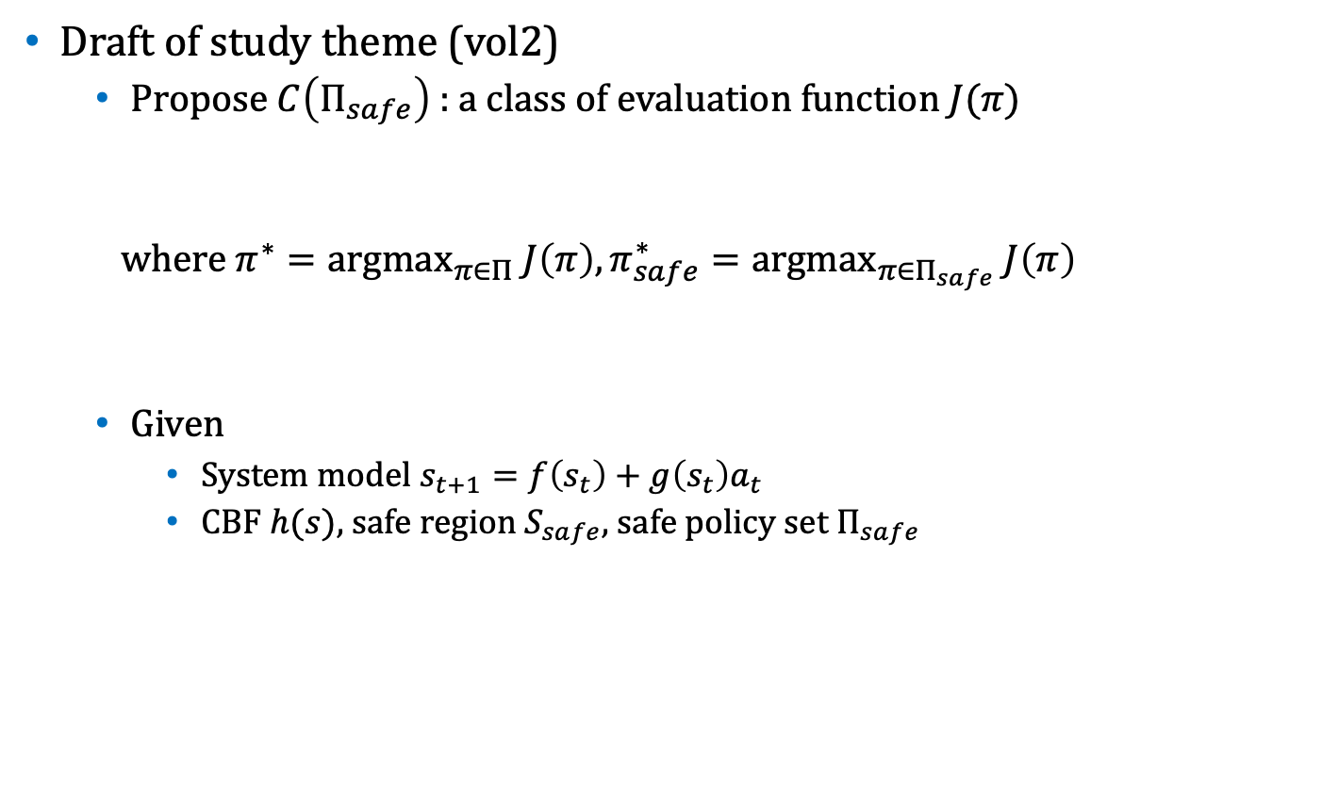


Weekly Report
Draft of study theme (vol2)
Propose $C\left(Π_{safe}\right)$ : a class of evaluation function $J(π)$
where $π^{∗}={argmax}_{π∈Π} J\left(π\right), π_{safe}^{∗}={argmax}_{π∈Π_{safe}} J\left(π\right)$
Given
System model $s_{t+1}=f\left(s_{t}\right)+g\left(s_{t}\right)a_{t}$
CBF $h(s)$, safe region $S_{safe}$, safe policy set $Π_{safe}$
$$C\left(Π_{safe}\right)=\left\{ J\left(∙\right) \right| J\left(π^{∗}\right)=J(π_{safe}^{∗})\}$$
$$U\left(s\right)=\left\{a∈A \right|\frac{∂h}{∂s}\left(f\left(s\right)+d\left(s\right)+g\left(s\right)a\right)+γh\left(s\right)≥0\}$$
$$Π_{safe}=\left\{π∈Π \right| \sum_{a∈U(s)}{π(a|s)}=1, ∀s∈S_{safe}\}$$

Slide 4
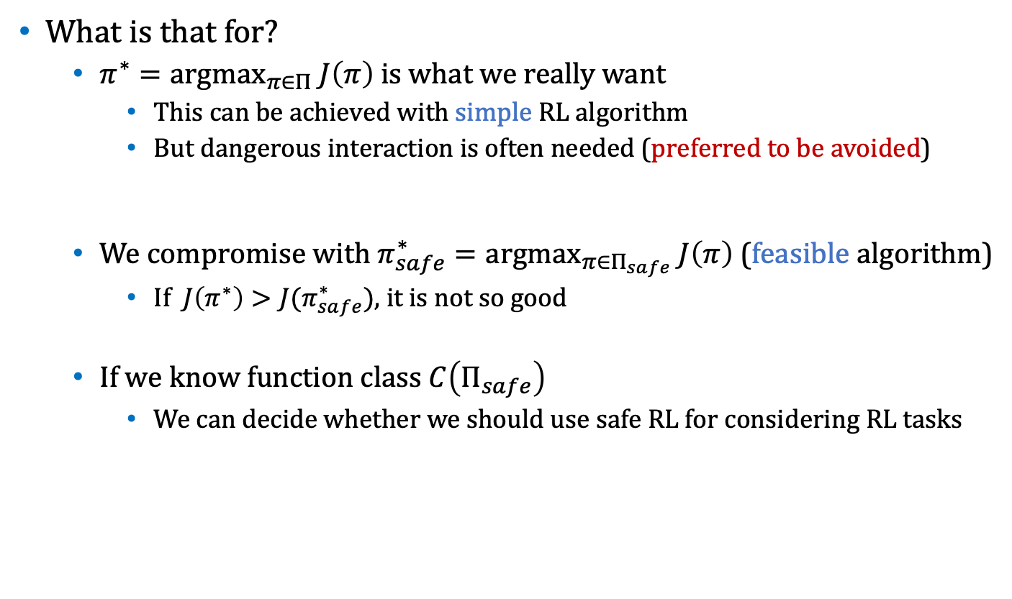
Weekly Report
What is that for?
$π^{∗}={argmax}_{π∈Π} J\left(π\right)$ is what we really want
This can be achieved with simple RL algorithm
But dangerous interaction is often needed (preferred to be avoided)
We compromise with $π_{safe}^{∗}={argmax}_{π∈Π_{safe}} J\left(π\right)$ (feasible algorithm)
If $J\left(π^{∗}\right)>J(π_{safe}^{∗})$, it is not so good
If we know function class $C\left(Π_{safe}\right)$
We can decide whether we should use safe RL for considering RL tasks

