Slide 1
Weekly Report
Read papers
[1]: T. Yu, G. Thomas, L. Yu, S. Ermon, J. Zou, S. Levine, C. Finn and T. Ma. “MOPO: Model-based Offline Policy Optimization.” arXiv preprint arXiv: 2005.13239, 2020.
[2]: M. Janner, J. Fu, M. Zhang and S. Levine. “When to Trust Your Model: Model-Based Policy Optimization.” In Advances in Neural Information Processing Systems, pp. 12498-12509, 2019. (in progress)
MOPO[1] is an application of MBPO[2] to offline RL

Slide 2
Weekly Report
MOPO[1] is (a)model-based (b)offline RL
(a) model-based approach
has better efficiency of data sampling
has (not small) issue of evaluation error ← MBPO[2]
(b) offline approach
avoid interaction between environment (possibly dangerous)
does not have method to avoid the distributional shift ← MOPO[1]
It is known that model-based RL is superior to model-free RL in offline fashion.

Slide 3

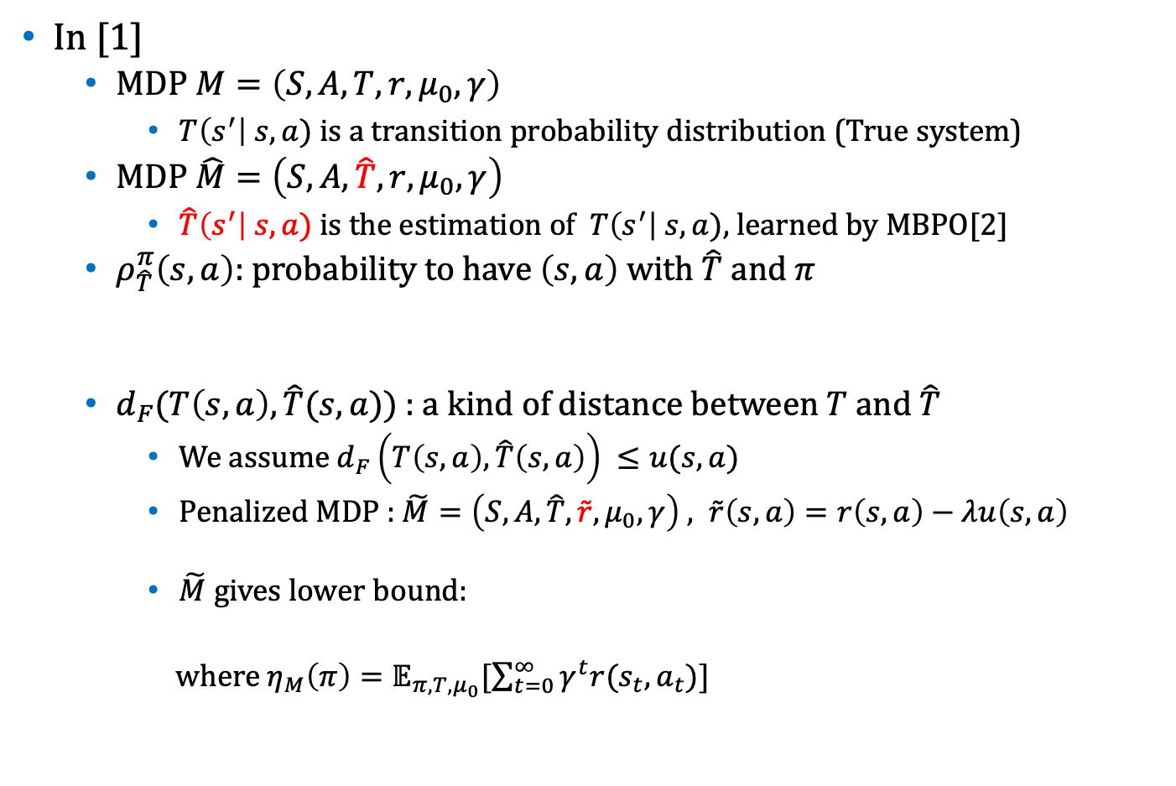
Weekly Report
In [1]
MDP $M=\left(S,A,T,r,μ_{0},γ\right)$
$T\left(s^{′}\right| s,a)$is a transition probability distribution (True system)
MDP $\hat{M}=\left(S,A,\hat{T},r,μ_{0},γ\right)$
$\hat{T}\left(s^{′}\right| s,a)$is the estimation of $T\left(s^{′}\right| s,a),$learned by MBPO[2]
$ρ_{\hat{T}}^{π}\left(s,a\right):$ probability to have $\left(s,a\right)$ with $\hat{T}$ and $π$
$d_{F}(T\left(s,a\right),\hat{T}(s,a))$ : a kind of distance between $T$ and $\hat{T}$
We assume $d_{F}\left(T\left(s,a\right),\hat{T}\left(s,a\right)\right) ≤u(s,a)$
Penalized MDP : $\tilde{M}=\left(S,A,\hat{T},\tilde{r},μ_{0},γ\right) , \tilde{r}\left(s,a\right)=r\left(s,a\right)−λu\left(s,a\right)$
$\tilde{M}$ gives lower bound:
where $η_{M}\left(π\right)=𝔼_{π,T,μ_{0}}[\sum_{t=0}^{∞}{γ^{t}r(s_{t},a_{t})}]$
$$η_{M}\left(π\right) ≥η_{\tilde{M}}\left(π\right)$$

Slide 4

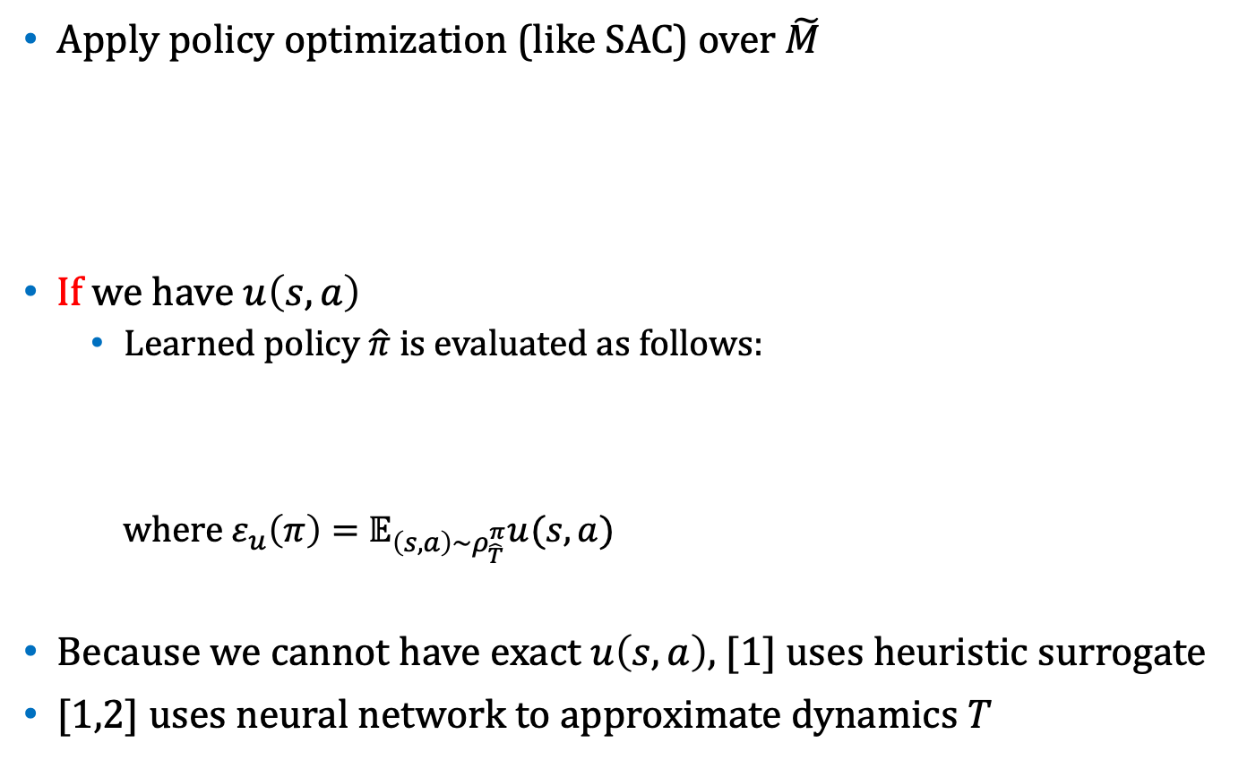

Weekly Report
Apply policy optimization (like SAC) over $\tilde{M}$
If we have $u\left(s,a\right)$
Learned policy $\hat{π}$is evaluated as follows:
where${ ε}_{u}\left(π\right)=$ $𝔼_{\left(s,a\right)\sim ρ_{\hat{T}}^{π}}u(s,a)$
Because we cannot have exact $u\left(s,a\right)$, [1] uses heuristic surrogate
[1,2] uses neural network to approximate dynamics $T$
$$\hat{π} ={argmax}_{π}{ η}_{\tilde{M}}\left(π\right)$$
$$η_{M}\left(\hat{π}\right) ≥ \sup_{π}\{η_{M}\left(π\right) −2λε_{u}(π)\}$$

