Slide 1
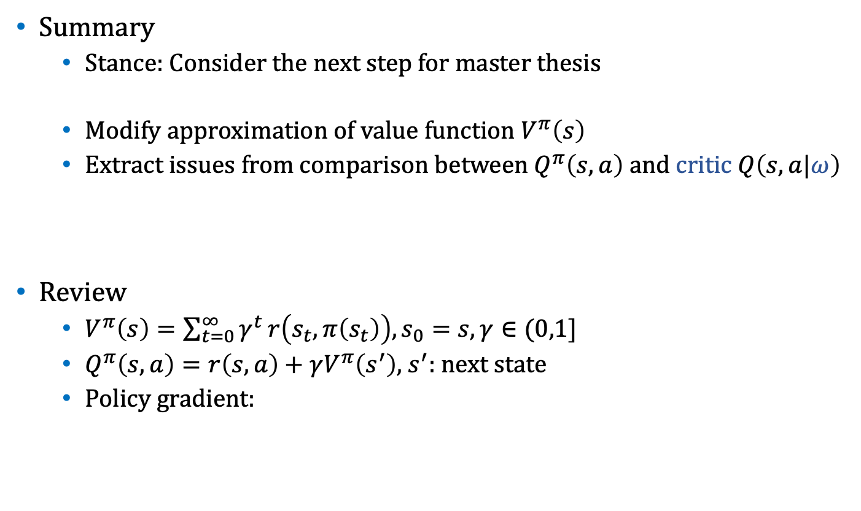
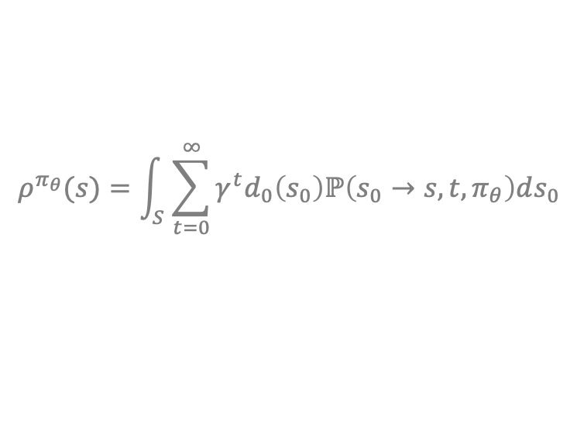
Weekly Report
Summary
Stance: Consider the next step for master thesis
Modify approximation of value function $V^{π}\left(s\right)$
Extract issues from comparison between $Q^{π}\left(s,a\right)$ and critic $Q\left(s,a|ω\right)$
Review
$V^{π}\left(s\right)=\sum_{t=0}^{∞}{γ^{t}}r\left(s_{t},π\left(s_{t}\right)\right), s_{0}=s,γ∈(0,1]$
$Q^{π}\left(s,a\right)=r\left(s,a\right)+$ $γV^{π}\left(s^{′}\right)$, $s^{′}:$ next state
Policy gradient:
approximates
$$∇_{θ}J\left(π_{θ}\right)=𝔼_{s\sim ρ^{π_{θ}}}[∇_{θ}π_{θ}\left(s\right)∇_{a}Q^{π_{θ}}\left(s,a\right)|_{a=π_{θ}\left(s\right)}]$$
$$ρ^{π_{θ}}(s)=\int_{S}^{ }{\sum_{t=0}^{∞}{γ^{t}d_{0}\left(s_{0}\right)ℙ\left(s_{0}→s,t,π_{θ}\right)ds_{0}}}$$

Slide 2
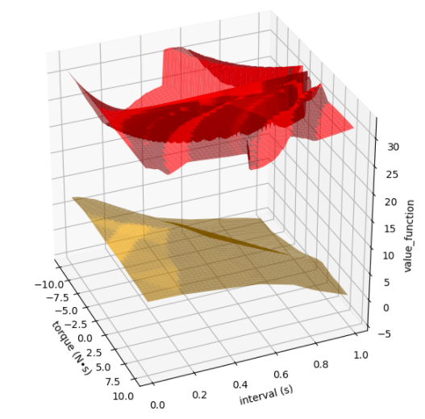
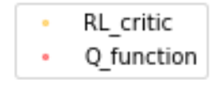

Weekly Report
Comparison between $Q^{π}\left(s,a\right)$ and critic $Q\left(s,a|ω\right)$
DDPG assumes that $∇_{a}Q^{π}\left(s,a\right)=∇_{a}Q\left(s,a|ω\right)$
(at least) the shape of $Q$ function for one $s$should be similar
Shape of 2 functions at $s=\left[0,0\right]$($a$ is 2 dimension)
・Critic could not learn Q function
during reinforcement learning

Slide 3
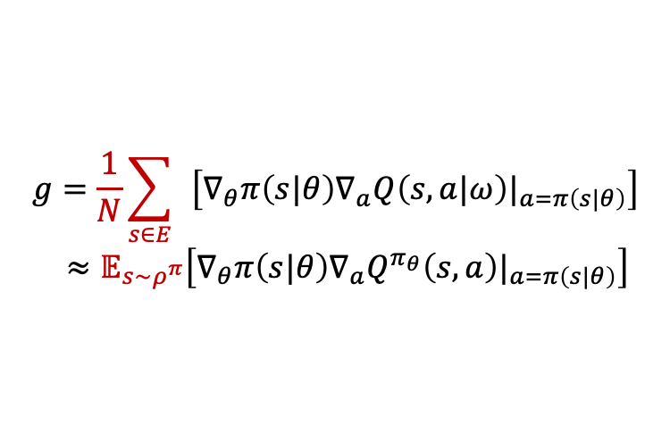
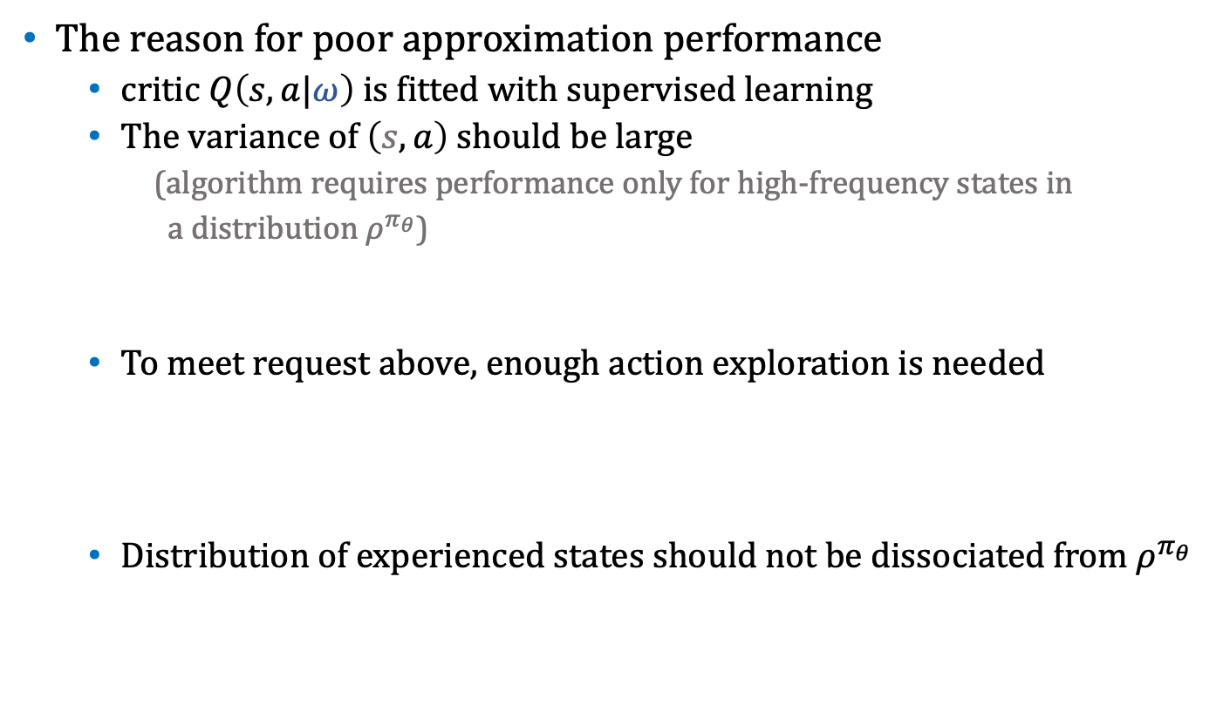
Weekly Report
The reason for poor approximation performance
critic $Q\left(s,a|ω\right)$ is fitted with supervised learning
The variance of $\left(s,a\right)$ should be large
(algorithm requires performance only for high-frequency states in
a distribution $ρ^{π_{θ}}$)
To meet request above, enough action exploration is needed
Distribution of experienced states should not be dissociated from $ρ^{π_{θ}}$
Exploration-Exploitation Dilemma
$$g=\frac{1}{N}\sum_{s∈E}{ }\left[∇_{θ}π\left(s|θ\right)∇_{a}Q\left(s,a|ω\right)|_{a=π\left(s|θ\right)}\right]$$ $≈𝔼_{s\sim ρ^{π}}\left[∇_{θ}π\left(s|θ\right)∇_{a}Q^{π_{θ}}\left(s,a\right)|_{a=π\left(s|θ\right)}\right]$
actor’s gradient
experienced data

Slide 4

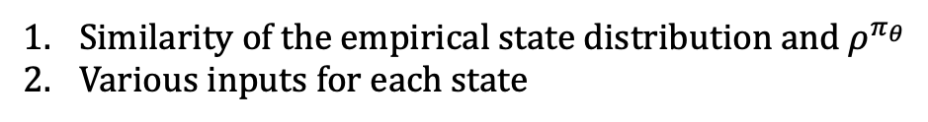







Weekly Report
Idea of thesis
To propose a method of good exploration noise ($u=π\left(s\right)+e$)
Adaptive noise scaling($≃$ variance) w.r.t. control path
$s^{′}$ needs $f,g$of $\dot{s}=f\left(s\right)+g\left(s\right)a$
Similarity of the empirical state distribution and $ρ^{π_{θ}}$
Various inputs for each state
$$s^{′}$$
$s^{′}$ is a function of $(s,a,τ)$
$$a,τ$$
$$s$$
If $\frac{∂s^{′}}{∂a},\frac{∂s^{′}}{∂τ}$ is large
→ small noise
else:
→ large noise
$${\hat{s}}^{′}$$
$$\hat{a},\hat{τ}$$

Slide 5

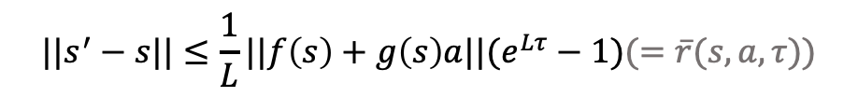





Weekly Report
Lost generality when we use system dynamics i.e. $f,g$
[1] shows the upper bound of state change on self-trigger control
$$||s^{′}−s||≤\frac{1}{L}||f\left(s\right)+g\left(s\right)a||(e^{Lτ}−1)(=\overline{r}(s,a,τ))$$
$f,g$: Lipcshitz continuous
$$u,τ$$
Draft of noise scaling
・derivative of radius
・size of this circle
$$s$$
$$s^{′}$$
$$\overline{r}$$
[1]: G. Yang, C. Belta and R. Tron, "Self-triggered Control for Safety Critical Systems Using Control Barrier Functions,"
2019 American Control Conference (ACC), Philadelphia, PA, USA, 2019, pp. 4454-4459.

Slide 6
criticがQ関数を近似できていない
その原因は経験データの偏りにある
経験データの分散を上げる為の探索ノイズを大きくしたい
単純にノイズを大きくすればいいってものでもない
ノイズの大きさの工夫について考えたい

