Slide 1

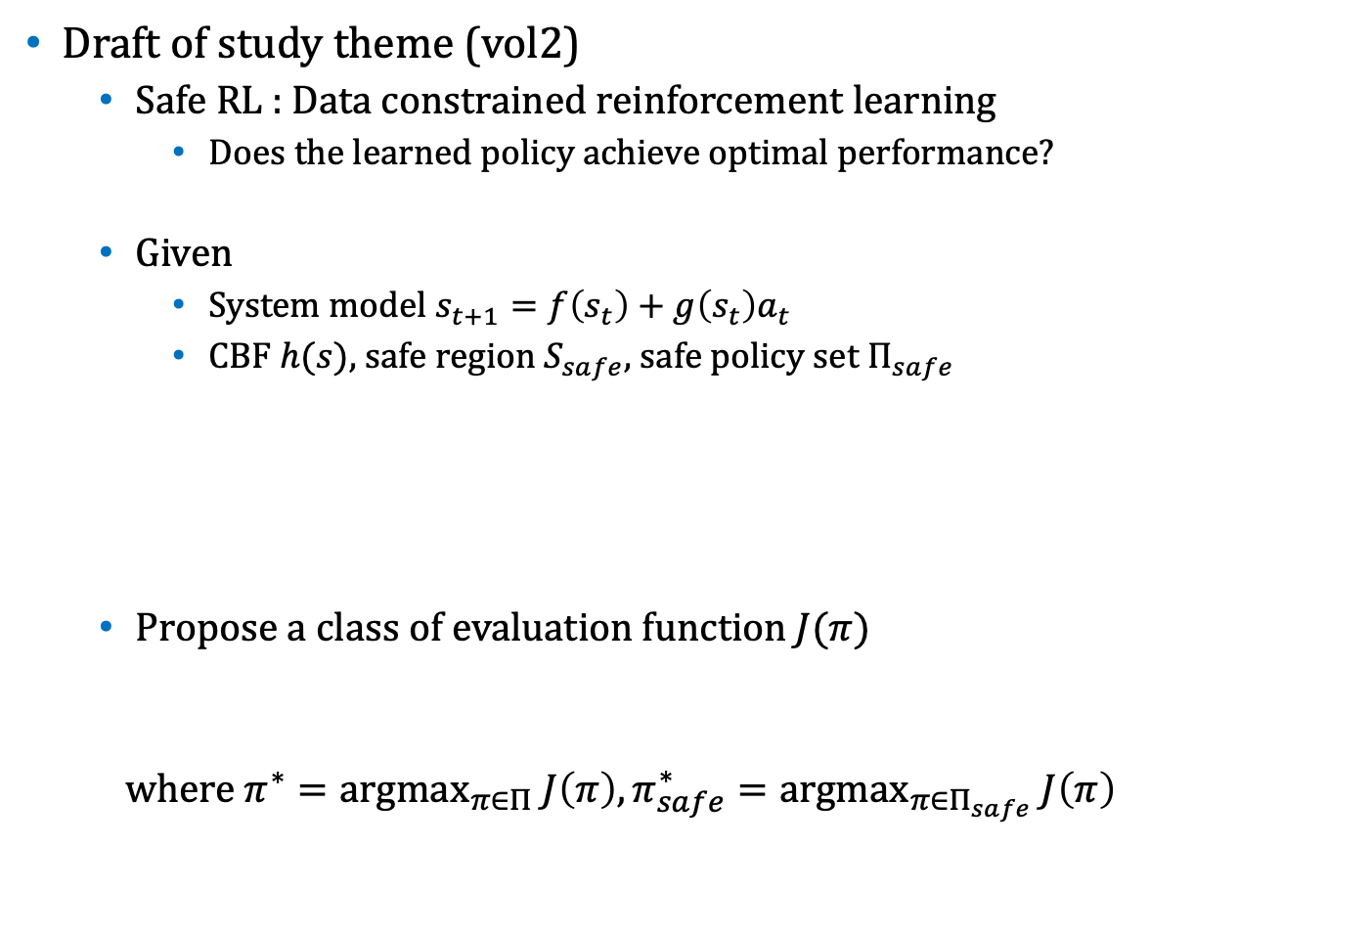
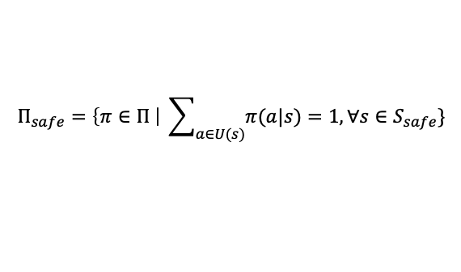

Weekly Report
Draft of study theme (vol2)
Safe RL : Data constrained reinforcement learning
Does the learned policy achieve optimal performance?
Given
System model $s_{t+1}=f\left(s_{t}\right)+g\left(s_{t}\right)a_{t}$
CBF $h(s)$, safe region $S_{safe}$, safe policy set $Π_{safe}$
Propose a class of evaluation function $J(π)$
where $π^{∗}={argmax}_{π∈Π} J\left(π\right), π_{safe}^{∗}={argmax}_{π∈Π_{safe}} J\left(π\right)$
$$U\left(s\right)=\left\{a∈A \right|\frac{∂h}{∂s}\left(f\left(s\right)+g\left(s\right)a\right)+γh\left(s\right)≥0\}$$
$$Π_{safe}=\left\{π∈Π \right| \sum_{a∈U(s)}{π(a|s)}=1, ∀s∈S_{safe}\}$$
$$C\left(Π_{safe}\right)=\left\{ J\left(∙\right) \right| J\left(π^{∗}\right)=J(π_{safe}^{∗})\}$$

Slide 2
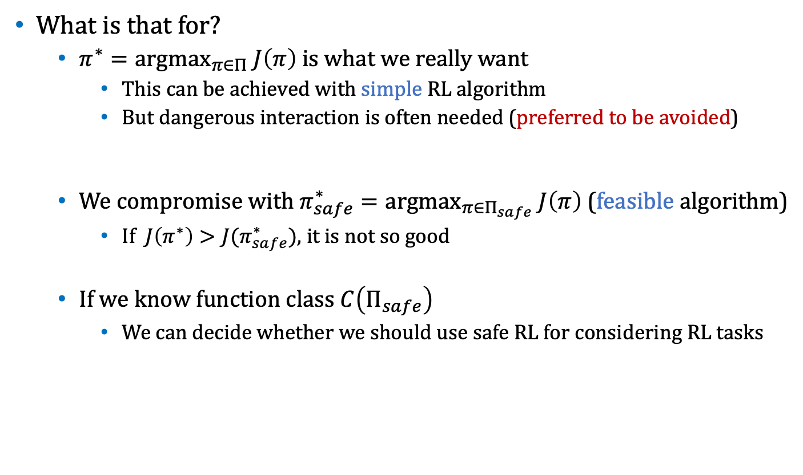
Weekly Report
What is that for?
$π^{∗}={argmax}_{π∈Π} J\left(π\right)$ is what we really want
This can be achieved with simple RL algorithm
But dangerous interaction is often needed (preferred to be avoided)
We compromise with $π_{safe}^{∗}={argmax}_{π∈Π_{safe}} J\left(π\right)$ (feasible algorithm)
If $J\left(π^{∗}\right)>J(π_{safe}^{∗})$, it is not so good
If we know function class $C\left(Π_{safe}\right)$
We can decide whether we should use safe RL for considering RL tasks

