Slide 1



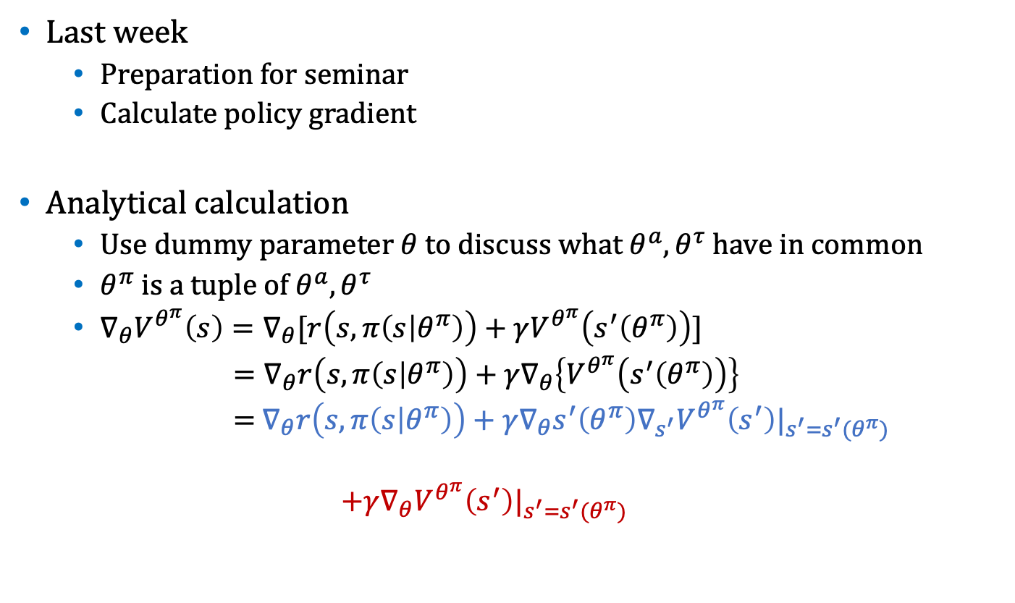



Weekly Report
$$θ^{a}$$
Last week
Preparation for seminar
Calculate policy gradient
Analytical calculation
Use dummy parameter $θ$ to discuss what $θ^{a},θ^{τ}$ have in common
$θ^{π}$ is a tuple of $θ^{a},θ^{τ}$
$∇_{θ}V^{θ^{π}}\left(s\right)=∇_{θ}[r\left(s,π\left(s | θ^{π}\right)\right)+γV^{θ^{π}}\left(s^{′}\left(θ^{π}\right)\right)]$
$=∇_{θ}r\left(s,π\left(s | θ^{π}\right)\right)+{γ∇}_{θ}\left\{V^{θ^{π}}\left(s^{′}\left(θ^{π}\right)\right)\right\}$
$=$ $∇_{θ}r\left(s,π\left(s | θ^{π}\right)\right)+γ∇_{θ}s^{′}\left(θ^{π}\right)∇_{s^{′}}V^{θ^{π}}\left(s^{′}\right)|_{s^{′}=s^{′}(θ^{π})}$
$$+{γ∇}_{θ}V^{θ^{π}}\left(s^{′}\right)|_{s^{′}=s^{′}(θ^{π})}$$
$$s_{1}$$
$$a(s)$$
$$τ(s)$$
$$s_{2}$$
$$θ^{τ}$$
1st step’s term
recursive term

Slide 2

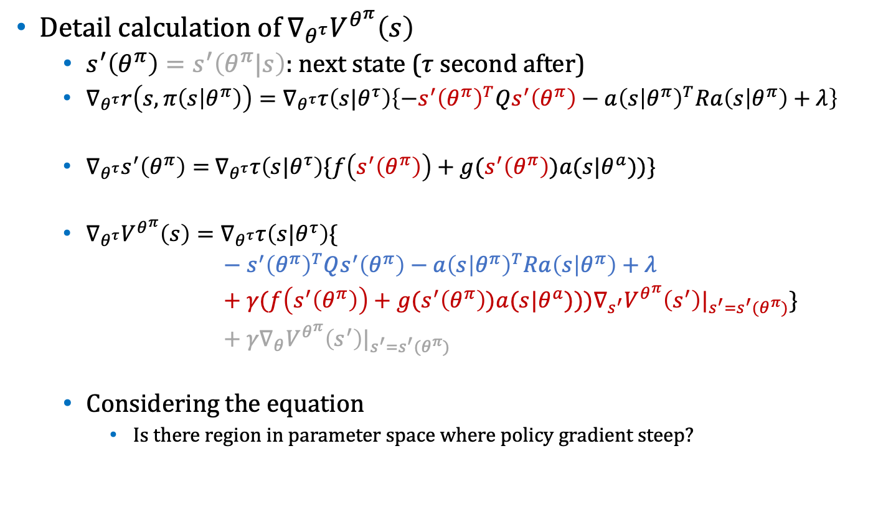

Weekly Report
Detail calculation of$∇_{θ^{τ}}V^{θ^{π}}\left(s\right)$
$s^{′}\left(θ^{π}\right)=s^{′}\left(θ^{π}|s\right)$: next state ($τ$ second after)
$∇_{θ^{τ}}r\left(s,π\left(s | θ^{π}\right)\right)=∇_{θ^{τ}}τ\left(s|θ^{τ}\right)\left\{−{s^{′}\left(θ^{π}\right)}^{T}Qs^{′}\left(θ^{π}\right)−{a\left(s | θ^{π}\right)}^{T}Ra\left(s | θ^{π}\right)+λ\right\}$
$∇_{θ^{τ}}s^{′}\left(θ^{π}\right)=$ $∇_{θ^{τ}}τ\left(s|θ^{τ}\right)\{f\left(s^{′}\left(θ^{π}\right)\right)+g(s^{′}\left(θ^{π}\right))a(s|θ^{a}))\}$
$∇_{θ^{τ}}V^{θ^{π}}\left(s\right)=∇_{θ^{τ}}τ\left(s|θ^{τ}\right)\{$
$− {s^{′}\left(θ^{π}\right)}^{T}Qs^{′}\left(θ^{π}\right)−{a\left(s | θ^{π}\right)}^{T}Ra\left(s | θ^{π}\right)+λ$
$+ γ(f\left(s^{′}\left(θ^{π}\right)\right)+g(s^{′}\left(θ^{π}\right))a(s|θ^{a})))∇_{s^{′}}V^{θ^{π}}\left(s^{′}\right)|_{s^{′}=s^{′}(θ^{π})}\}$
$+ γ∇_{θ}V^{θ^{π}}\left(s^{′}\right)|_{s^{′}=s^{′}(θ^{π})}$
Considering the equation
Is there region in parameter space where policy gradient steep?
$$∇_{τ}r\left(s,π\left(s | θ^{π}\right)\right)$$
$$∇_{τ}s^{′}\left(θ^{π}\right)$$

Slide 3
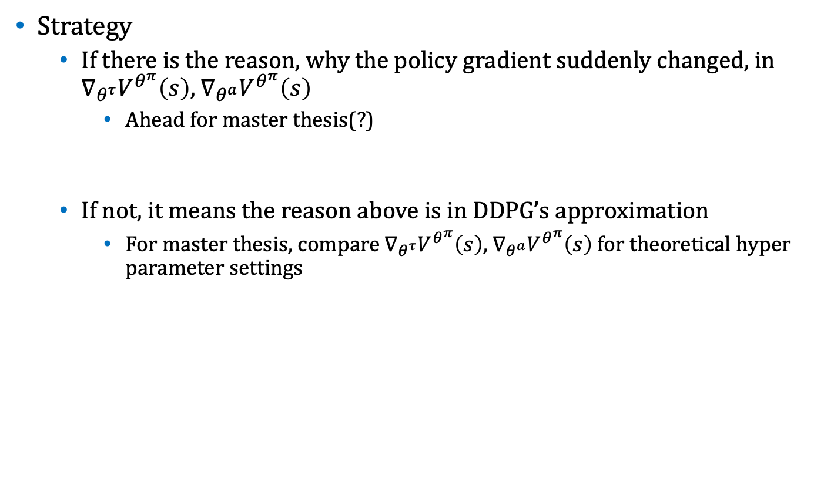
Weekly Report
Strategy
If there is the reason, why the policy gradient suddenly changed, in $∇_{θ^{τ}}V^{θ^{π}}\left(s\right)$, $∇_{θ^{a}}V^{θ^{π}}\left(s\right)$
Ahead for master thesis(?)
If not, it means the reason above is in DDPG’s approximation
For master thesis, compare $∇_{θ^{τ}}V^{θ^{π}}\left(s\right)$, $∇_{θ^{a}}V^{θ^{π}}\left(s\right)$ for theoretical hyper parameter settings

Slide 4

Weekly Report
Is there validity to divide policy function into two NNs?
$θ$ expresses the combined network: $θ=\left[\begin{matrix}θ^{a} & θ^{τ}\end{matrix}\right]$
Because small changes of $θ^{a}$, $θ^{τ}$ does not affect the output of the other NN, $∇_{θ^{a}}J\left(θ^{π}\right),∇_{θ^{τ}}J\left(θ^{π}\right)$ can be calculated simply.
Is there validity to set the argument of $τ$ to be only $s$, without $a$?
$$θ^{a}$$
$$s_{1}$$
$$a(s)$$
$$τ(s)$$
$$s_{2}$$
$$θ^{τ}$$

