Slide 1
Week 1
BBM 105- Introduction to Computer Engineering

Slide 2
Today’s Schedule
Course outline and logistics
An overview of Introduction to Computer Engineering
BBM105- Introduction to Computer Engineering, 2018 Fall

Slide 3
Course Logistics
Instructors:
  Ali Seydi Keçeli (Section 1): aliseydi@cs.hacettepe.edu.tr
  Tuğba Erdoğan (Section 2): tugba@cs.hacettepe.edu.tr
Invitation to Computer Science, C++ Version, Fourth Edition

Slide 4
About this course
An introductory course in computer science
Presents a breadth-first overview of the discipline
Covers core issues such as algorithms, hardware design, computer organization, system software, language models, and social&ethical issues of computing
Invitation to Computer Science, C++ Version, Fourth Edition
Notes:
In this course we will teach you about the foundations of computer science
An introduction to these core ideas, exposes you to the overall of richness and beauty of the field.

Slide 5
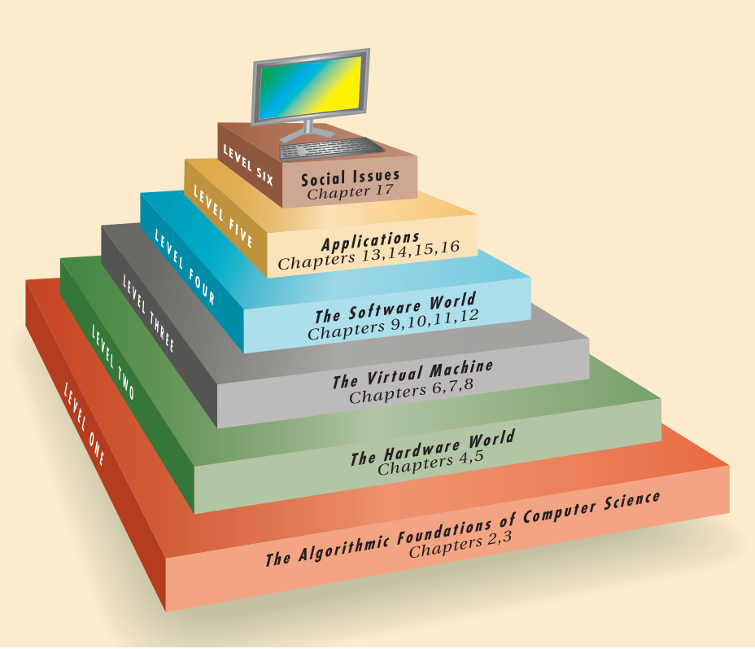
Course Outline
Invitation to Computer Science, C++ Version, Fourth Edition

Slide 6
Level 1: Algorithmic foundations of CS
Presents important ideas such as design of algorithms, algorithmic problem solving, abstraction, pseudocode, iteration and efficiency.
Illustrates these ideas using well-known examples such as searching a list, finding minima, maxima, sorting a list
Also algorithmic efficiency
Invitation to Computer Science, C++ Version, Fourth Edition

Slide 7
Level 2: Hardware world
Algorithms will be executed by real computers to produce real output
Logic design, and computer organization
  Binary numbers, boolean logic, gates and circuits
Von neuman architecture: how the algorithm can be represented in machine language
Invitation to Computer Science, C++ Version, Fourth Edition

Slide 8
Level 3: Virtual Machine
Describes how system software abstracts the hardware complexity
Virtual environments are services provided by virtual machine
operation systems, computer networks, database systems
Show how much easier the algorithm in virtual environment containing editors, translators, and loaders
Invitation to Computer Science, C++ Version, Fourth Edition
Notes:
Hardware complexity is the motivation of the level 3

Slide 9
Level 4: Software World
Overview of the features found in modern programming languages
Software Engineering, Artificial Intelligence
Invitation to Computer Science, C++ Version, Fourth Edition

Slide 10
Communication
Course webpage
  The course webpage will be updated regularly throughout the semester with lecture notes
We will be using Piazza for course related discussions and announcements.
Please enroll the class on Piazza by the following link: https://piazza.com/class/jmzzpnxenwb660
Invitation to Computer Science, C++ Version, Fourth Edition

Slide 11
Reference Books
  Schneider, G. Michael, and Judith Gersting. Invitation to computer science. Cengage Learning, 2018.
  Brookshear, J. Glenn. Computer science: an overview. Addison-Wesley Publishing Company, 2008.
Invitation to Computer Science, C++ Version, Fourth Edition

Slide 12
Grading Policy
Grading this course will be based on
  Midterm (50%)
  Final exam (50%)
Invitation to Computer Science, C++ Version, Fourth Edition

Slide 13
Summary
Computer science is a young and exciting discipline
By presenting the field in all its richness, to give a deeper appreciation for the many diverse and interesting areas of the field.
Invitation to Computer Science, C++ Version, Fourth Edition

