Slide 1
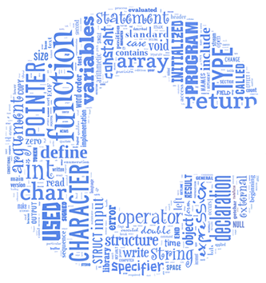
BBM 102 – Introduction to Programming II
Spring 2018
C Review
Instructors: Dr. Cumhur Yiğit Özcan, Dr. Ali Seydi Keçeli, Dr. Aydın Kaya
TAs: Selim Yılmaz, Bahar Gezici, Cemil Zalluhoğlu

Slide 2
Today
Introduction
  About the class
  Organization of this course
C Review & Pointers
  Variables
  Operators
  Control Structures
  Functions
  Pointers

Slide 3
Today
Introduction
  About the class
  Organization of this course
C Review & Pointers
  Variables
  Operators
  Control Structures
  Functions
  Pointers

Slide 4
About the Course
We will start the term by recapping what you have learned about the C language in the previous term.
We will also be covering some additional subjects that are;
  Dynamic Memory Management
  Structs
  File I/O

Slide 5
About the Course
This course will help students understand object-oriented programming principles and apply them in the construction of Java programs.
  The course is structured around basic topics such as classes, objects, encapsulation, inheritance, polymorphism, abstract classes and interfaces and exception handling.
BBM 104 Introduction to Programming Lab.: The students will gain programming experience via a set of programming assignments and quizes.
Requirements: You must know basic programming (i.e. BBM101).

Slide 6
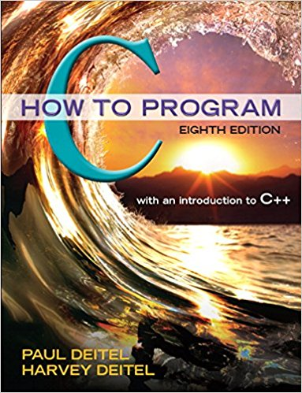
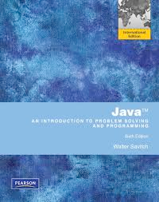
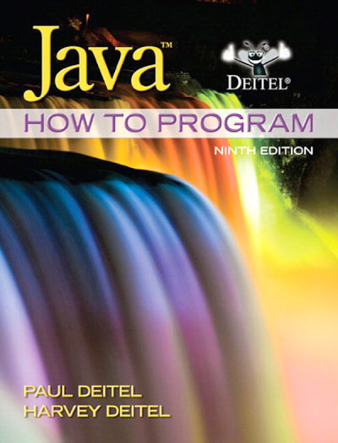
Reference Book
C – How to Program, Paul Deitel and Harvey Deitel, Pearson, 2016
Java – An Introduction to Problem Solving And Programming, Walter Savitch, Pearson, 2012
Java – How to Program, Paul Deitel and Harvey Deitel Prentice Hall, 2012

Slide 7

Communication
The course web page will be updated regularly throughout the semester with lecture notes, programming assignments, announcements and important deadlines.
http://web.cs.hacettepe.edu.tr/~bbm102

Slide 8
Getting Help
Office Hours
  See the web page for details
BBM 104 Introduction to Programming
  Assignments and quizes.
  No recitations for this semester.
Communication
  Announcements and course related discussions through
  BBM 102: http://piazza.com/hacettepe.edu.tr/spring2019/bbm102/home
  BBM 104: http://piazza.com/hacettepe.edu.tr/spring2019/bbm104/home

Slide 9
Course Work and Grading
Two Midterm Exams (25 + 25 = 50%)
  Closed book and notes
Final Exam (50%)
  Closed book
  To be scheduled by the registrar.

Slide 10
Course Work and Grading
Week | Date | Title
1 | 27-Feb | C Review & Pointers
2 | 6-Mar | Arrays & Dynamic Memory
3 | 13-Mar | Structs & File Input/Output
4 | 20-Mar | Java Introduction
5 | 27-Mar | Classes & Objects, Encapsulation
6 | 3-Apr | Inheritance
7 | 10-Apr | Midterm Exam 1
8 | 17-Apr | Polymorphism
9 | 24-Apr | Abstract Classes & Interfaces
10 | 1-May | - May 1st
11 | 8-May | Collections
12 | 15-May | Exceptions
13 | 22-May | Midterm Exam 2
14 | 29-May | Streams & Input Output

Slide 11
BBM 104 Introduction to Programming Laboratory
Programming Assignments (PAs)
  Four assignments throughout the semester.
  Each assignment has a well-defined goal such as solving a specific problem.
  You must work alone on all assignments.
Quizes
  Five quizzes throughout the semester.
Important Dates
  See the course web page for the schedule.

Slide 12
Policies
Work Groups
  You must work alone on all assignments unless stated otherwise.
Submission
  Assignments due at 23.59 (no extensions!)
  Electronic submissions (no exceptions!)
Lateness Penalties
  Get penalized 10% per day
  No late submission is accepted 3 days after due date

Slide 13

Cheating
What is cheating?
  Sharing code: by copying, retyping, looking at, or supplying a file
  Coaching: helping your friend to write a programming assignment, line by line
  Copying code from previous course or from elsewhere on WWW
What is NOT cheating?
  Explaining how to use systems or tools
  Helping others with high-level design issues

Slide 14

Cheating
Penalty for cheating:
  Removal from the course with failing grade.
Detection of Cheating:
  We do check: Our tools for doing this are much better than most cheaters think!

Slide 15
Today
Introduction
  About the class
  Organization of this course
C Review & Pointers
  Variables
  Operators
  Control Structures
  Functions
  Pointers

Slide 16
A Simple C Program
/* Hello World! Example */
#include <stdio.h>
int main()
{
printf("Hello World!\n");
return 0;
}
Hello world!

Slide 17
Variable Declarations
A declaration consists of a data type name followed by a list of (one or more) variables of that type:
char c;
int ali, bora;
float rate;
double trouble;
A variable may be initialized in its declaration:
char c = ‘a’;
int a = 220, b = 448;
float x = 1.23e-6; /*0.00000123*/
double y = 27e3; /*27,000*/

Slide 18
Variable Declarations
Variables that are not initialized may have garbage values.
#include <stdio.h>
int main()
{
int a;
double b;
char c;
float d;
printf("int: %d \n", a);
printf("double: %lf \n", b);
printf("char: %c \n", c);
printf("float: %f \n", d);
return 0;
}
int: 2 double: 0.000000 Char: a float: 0.000000

Slide 19
Operators
#include <stdio.h>
int main()
{
int a = 5, b = 6, c; float d;
a = a - 1;
b += 3;
c = b / a;
d = b / (float)a;
printf("a: %d \n", a);
printf("b: %d \n", b);
printf("c: %d \n", c);
printf("d: %f \n", d);
return 0;
}
a: 4 b: 9 c: 2 d: 2.250000

Slide 20
Control Structures
Selection Statements
  C provides three types of selection structures in the form of statements
  The if selection statement either selects (performs) an action if a condition is true or skips the action if the condition is false.
  The if..else selection statement either performs an action if a condition is true and performs a different action if the condition is false.
  The switch selection statement performs one of many different actions depending on the value of an expression.

Slide 21
Control Structures
Iteration Statements
  C provides three types of iteration structures in the form of statements
  The while iteration statement keeps performing an action while a condition is true.
  The do..while iteration statement keeps performing an action while a condition is true. In contrast to while, it will perform the action at least once even if the condition is false initially.
  The for iteration statement keeps performing an action while a condition is true. In contrast to while it involves two special parts, one for an action to be performed initially, and the other for to be performed at the end of every iteration.

Slide 22
Control Structures
if Statement
if(x < 0)
{
printf("negative\n");
}
if..else Statement
if(first > second)
max = first;
else
max = second;

Slide 23
Control Structures
Multiple Conditions
disc = b * b – 4 * a * c;
if(disc < 0)
{
num_sol = 0;
}
else
{
if(disc == 0)
{
num_sol = 1;
}
else
{
num_sol = 2;
}
}
Notice that the else clause here holds just one statement (an if..else statement), so we can omit the braces around it.

Slide 24
Control Structures
Multiple Conditions
disc = b * b – 4 * a * c;
if(disc < 0)
{
num_sol = 0;
}
else
if(disc == 0)
{
num_sol = 1;
}
else
{
num_sol = 2;
}
Actually all of the other if and else clauses also hold just one statement. Therefore we can get rid of all the braces.

Slide 25
Control Structures
Multiple Conditions
disc = b * b – 4 * a * c;
if(disc < 0)
num_sol = 0;
else
if(disc == 0)
num_sol = 1;
else
num_sol = 2;
We can remove unnecessary whitespaces (space, tab, newline etc.) to re-arrange the code into a form which is easier to read.
disc = b * b – 4 * a * c;
if(disc < 0)
num_sol = 0;
else if(disc == 0)
num_sol = 1;
else
num_sol = 2;

Slide 26
Control Structures
Switch Statement
  Useful when a variable or expression is tested for all the values it can assume and different actions are taken
  Series of case labels and an optional default case
switch (a_variable or expr)
{
case value1: actions
case value2 : actions
...
default: actions
}
    break; exits from the structure

Slide 27
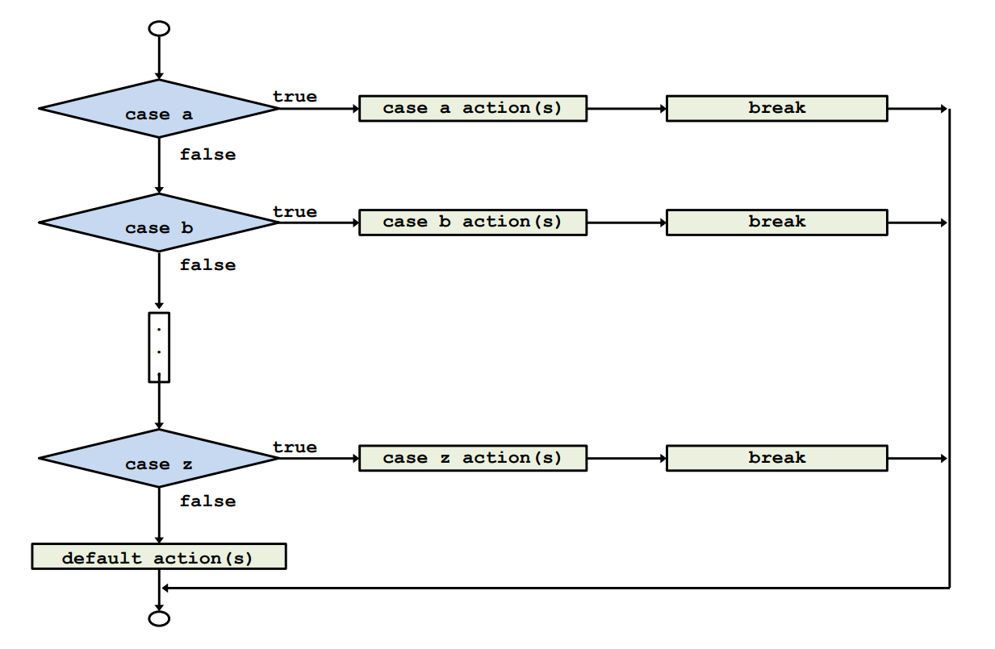
Control Structures

Slide 28
Control Structures
#include <stdio.h>
int main()
{
  int month, year, days, leapyear;
  printf("Enter a month and a year:");
  scanf("%d %d", &month, &year);
  if(((year % 4 == 0) && (year % 100 != 0)) || (year % 400 == 0))
  leapyear = 1;
  else
  leapyear = 0;
  switch(month){
  case 4 :
  case 6 :
  case 9 :
  case 11: days = 30; break;
  case 2 :
  if(leapyear == 1)
  days = 29;
  else
  days = 28;
  break;
  default :
  days = 31;
  }
  printf("There are %d days in that month in that year.\n", days);
  return 0;
}

Slide 29
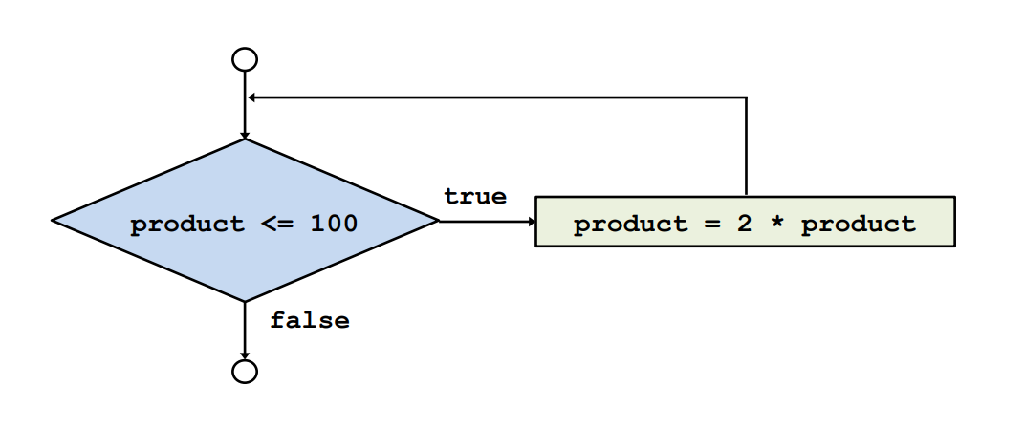
Control Structures
While Loop
int product = 2;
while (product <= 100)
product = 2 * product;

Slide 30
Control Structures
A class of 10 students took a quiz. The grades (integers in the range 0 to 100) for this quiz are available to you. Determine the class average on the quiz
The algorithm
  Set total to 0
  Set counter to 1
  If the counter is less than or equal to 10 go to 4, else go to 8
  Input the next grade
  Add the grade into the total
  Add 1 to the counter
  Go to 3
  Set the class average to the total divided by ten
  Print the class average

Slide 31
Control Structures
/* Class average program with counter-controlled repetition */
#include <stdio.h>
int main()
{
int counter, grade, total, average;
/* initialization phase */
total = 0;
counter = 1;
/* processing phase */
while (counter <= 10) {
printf("Enter grade: ");
scanf("%d", &grade);
total = total + grade;
counter = counter + 1;
}
/* termination phase */
average = total / 10.0;
printf("Class average is %d\n", average);
return 0; /* indicate program ended successfully */
}
Enter grade: 98 Enter grade: 76 Enter grade: 71 Enter grade: 87 Enter grade: 83 Enter grade: 90 Enter grade: 57 Enter grade: 79 Enter grade: 82 Enter grade: 94 Class average is 81

Slide 32
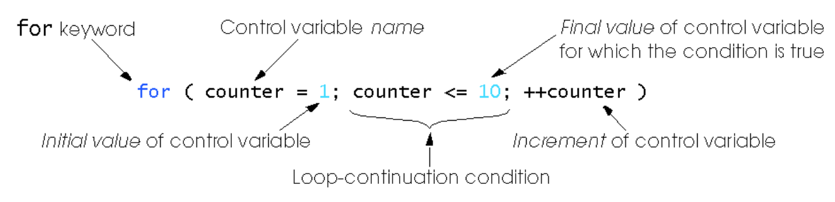
Control Structures
For Loop
  Format when using for loops
  Example
  for(counter = 1; counter <= 10; counter++)
  printf("%d\n", counter);
1 2 3 4 5 6 7 8 9 10

Slide 33
Control Structures
Initialization and increment can be comma-separated lists
for (i = 0, j = 0; j + i <= 10; j++, i++)
printf("%d\n", j + i);
Example: Print the sum of all numbers from 2 to 100
/*Summation with for */
#include <stdio.h>
int main()
{
int sum = 0, number;
for (number = 2; number <= 100; number += 1)
sum += number;
printf("Sum is %d\n", sum);
return 0;
}
Sum is 5049

Slide 34
Control Structures
The do..while repetition structure
  Similar to the while structure
  Condition for repetition is tested after the body of the loop is performed
    All actions are performed at least once.
  Format:
  do {
  statement;
  } while (condition);

Slide 35
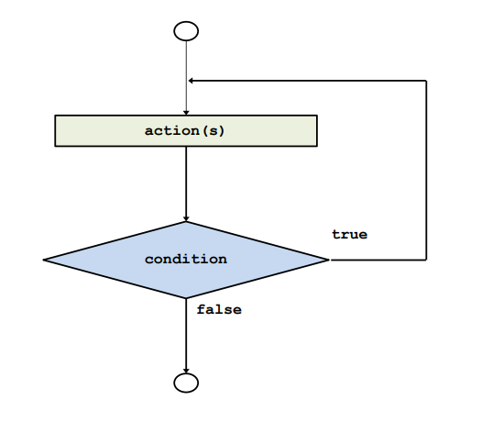
Control Structures
Do/While Loop

Slide 36
Control Structures
/*Using the do/while repetition structure */
#include <stdio.h>
int main()
{
int counter = 1;
do {
printf("%d ", counter);
counter = counter + 1;
} while (counter <= 10);
return 0;
}
1 2 3 4 5 6 7 8 9 10

Slide 37
Control Structures
When a loop body includes another loop construct this is called a nested loop.
In a nested loop structure the inner loop is executed from the beginning every time the body of the outer loop is executed.
for (i = 1; i <= num_lines; ++i)
{
for (j = 1; j <= i; ++j)
printf("*");
printf("\n");
}
* ** *** **** ***** ****** ******* ********

Slide 38
Control Structures
break
  Causes immediate exit from a while, for, do..while or switch statement
  Program execution continues with the first statement after the structure.
  Common uses of break statement
    Escape early from a loop
    Skip the remainder of a switch statement

Slide 39
Control Structures
break example
#include <stdio.h>
int main()
{
int x;
for(x = 1; x <= 10 ; x++)
{
if(x == 5)
break;
printf("%d ", x);
}
printf("\nBroke out of the loop at x = %d ", x);
return 0;
}
1 2 3 4 Broke out of loop at x = 5

Slide 40
Control Structures
continue
  Skips the remaining statements in the body of a while, for or do..while statement
    Proceeds with the next iteration of the loop
  while and do..while
    Loop-continuation test is evaluated immediately after the continue statement is executed
  for
    Increment expression is executed, then the loop-continuation test is evaluated

Slide 41
Control Structures
continue example
#include <stdio.h>
int main()
{
int x;
for(x = 1; x <= 10 ; x++)
{
if( x == 5) {
continue;
printf("%d ", x);
}
printf("\nUsed continue to skip printing the value 5");
return 0;
}
1 2 3 4 6 7 8 9 10 Used continue to skip printing the value 5

Slide 42
Functions
Functions are used for packaging a set of actions
It may be easier to design a complex program starting with small working modules (i.e. functions)
  And then we can combine these modules to form the software
Functions are re-useable
  Shorter
  Easier to understand
  Less error-prone
  Easier to manage (e.g. easier to fix the bugs or add new features)

Slide 43
Functions
A function definition has the following form:
return_type function_name (parameter-declarations)
{
variable-declarations
function-statements
}
return_type : specifies the type of the function and corresponds to the type of value returned by the function
  void: indicates that the function returns nothing
function_name : name of the function being defined
parameter-declarations : specify the types and names of the parameters of the function, separated by commas

Slide 44
Functions
When a return statement is executed, the execution of the function is terminated and the program control is immediately passed back to the calling environment.
If an expression follows the keyword return, the value of the expression is returned to the calling environment as well
A return statement can be one of the following two forms:
  return;
  return expression;

Slide 45
Functions
Let’s define a function to compute the cube of a number:
int cube (int num) {
int result;
result = num * num * num;
return result;
}
    This function can be called as:
int n = cube(5);

Slide 46
Functions
Example: void function
void prn_message(void) /* function definition */
{
printf("A message for you: ");
printf("Have a nice day!\n");
}
int main (void)
{
prn_message (); /* function invocation */
return 0;
}
A message for you: Have a nice day!

Slide 47
Functions
A function can have zero or more parameters.
In declaration:
int f (int x, double y, char c);
In function calling:
value = f (age, 100 * score, initial);
the formal parameter list (parameter variables and their types are declared here)
actual parameter list (cannot tell what their type are from here)

Slide 48
Functions
The number of parameters in the actual and formal parameter lists must be consistent
Parameter association is positional: the first actual parameter matches the first formal parameter, the second matches the second, and so on
Actual parameters and formal parameters must be of compatible data types
Actual parameters may be a variable, constant, any expression matching the type of the corresponding formal parameter

Slide 49
Block Structure
A block is a sequence of variable declarations and statements enclosed within braces.
Block structure and the scope of a variable
  int factorial(int n)
  {
  if (n < 0) return -1;
  else if (n == 0) return 1;
  else
  {
  int i, result = 1;
  for (i = 1;i <= n; i++)
  result *= i;
  return result;
  }
  }

Slide 50
External Variables
Local variables can only be accessed in the function in which they are defined.
If a variable is defined outside any function at the same level as function definitions, it is available to all the functions defined below in the same source file
  → external variable
Global variables: external variables defined before any function definition
  Their scope will be the whole program
  Avoid using external variables as much as you can

Slide 51
Example
Let’s write a function that computes sum from 1 to n
#include <stdio.h>
int compute_sum (int n)
{
int sum;
sum = 0;
for ( ; n > 0; --n)
sum += n;
printf("%d\n", n);
return sum;
}
int main (void)
{
int n, sum;
n = 3;
printf("%d\n", n);
sum=compute_sum(n);
printf("%d\n",n);
printf("%d\n", sum);
return 0;
}
3 0 3 6

Slide 52

Example
Let’s write a function that swaps two variables
#include <stdio.h>
void swap (int a, int b)
{
int temp;
temp = a;
a = b;
b = temp;
printf("In swap\n");
printf("a: %d\n", a);
printf("b: %d\n", b);
}
int main (void)
{
int a = 3, b = 5;
printf("a: %d\n", a);
printf("b: %d\n", b);
swap(a, b);
printf("After swap\n");
printf("a: %d\n", a);
printf("b: %d\n", b);
return 0;
}
a: 3 b: 5 In swap a: 5 b: 3 After swap a: 3 b: 5

Slide 53
Pointers
What actually happens when we declare variables?
  char a;
  int b;
C reserves a byte in memory to store a, four bytes to store b.
Where is that memory? At an address.
Under the hood, C has been keeping track of variables and their addresses.

Slide 54
Pointers
We can work with memory addresses too. We can use variables called pointers.
A pointer is a variable that contains the address of a variable.
Pointers provide a powerful and flexible method for manipulating data in your programs; but they are difficult to master.
  Close relationship with arrays and strings.

Slide 55
Pointers
Pointers allow you to reference a large data structure in a compact way.
Pointers facilitate sharing data between different parts of a program.
  Call-by-Reference
Dynamic memory allocation: Pointers make it possible to reserve new memory during program execution.

Slide 56
Pointers
Pointer variables
  Contain memory addresses as their values
  Normal variables contain a specific value (direct reference)
  Pointers contain address of a variable that has a specific value (indirect reference)
  Indirection – referencing a pointer value
count
7
countPtr
count
7

Slide 57
Pointers
& (address operator)
  Returns the address of operand
  int y = 5;
  int *yPtr;
  yPtr = &y; /* yPtr gets address of y */
  yPtr points to y
yPtr
y
y
500000
600000
600000
5
5
yPtr
Address of y is value of yPtr

Slide 58
Pointers
* (indirection/dereferencing operator)
  Returns a synonym/alias of what its operand points to
  *yPtr returns y (because yPtr points to y)
  * can be used for assignment
    *yPtr = 7; /* changes value of y to 7 */
* and & are inverses
  They cancel each other out

Slide 59
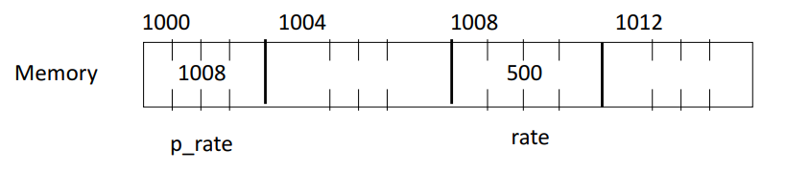
Pointers
int rate;
int *p_rate;
rate = 500;
p_rate = &rate;
/* Print the values */
printf("rate = %d\n", rate); /* direct access */
printf("rate = %d\n", *p_rate); /* indirect access */

Slide 60
Pointers
The address of a is the value of aPtr
The * operator returns an alias to what its operand points to. aPtr points to a, so *aPtr returns a.
#include <stdio.h>
int main()
{
int a; /* a is an integer */
int *aPtr; /* aPtr is a pointer to an integer */
a = 7;
aPtr = &a; /* aPtr set to address of a */
printf("The address of a is %p\nThe value of aPtr is %p", &a, aPtr);
printf("\n\nThe value of a is %d\nThe value of *aPtr is %d", a, *aPtr);
printf("\n\nShowing that * and & are inverses of each other.\n&*aPtr = %p\n*&aPtr = %p\n", &*aPtr, *&aPtr);
return 0;
}
Notice how * and & are inverses
The address of a is 0012FF88 The value of aPtr is 0012FF88 The value of a is 7 The value of *aPtr is 7 Showing that * and & are inverses of each other. &*aPtr = 0012FF88 *&aPtr = 0012FF88

Slide 61
Pointers
int a, b, *p;
a = b = 7;
p = &a;
printf("*p = %d\n",*p);
*p = 3;
printf("a = %d\n",a);
p = &b;
*p = 2 * *p – a;
printf("b = %d \n", b);
*p = 7 a = 3 b = 11

Slide 62
Pointers
float x, y, *p;
x = 5;
y = 7;
p = &x;
y = *p;
Thus,
y = *p;
y = *&x;
y = x;
All equivalent

Slide 63
Pointers
The NULL Value
  The value null means that no value exists.
  The null pointer is a pointer that ‘intentionally’ points to nothing.
  If you don’t have an address to assign to a pointer, you can use NULL
  NULL value is actually 0 integer value, if the compiler does not provide any special pattern.
    Do not use NULL value as integer!
countPtr = &count;
countPtr = NULL;
countPtr
count
countPtr
7
NULL

Slide 64
Pointers
Call by reference with pointer arguments
  Pass address of argument using & operator
  Allows you to change actual location in memory
* operator
  Used as alias/nickname for variable inside of function
  void double_it (int *number)
  {
  *number = 2 * (*number);
  }
*number used as nickname for the variable passed

Slide 65
Pointers
void set_to_zero(int var)
{
var = 0;
}
You would make the following call:
  set_to_zero(x);
This function has no effect whatsoever. Instead, pass a pointer:
void set_to_zero(int *var)
{
*var = 0;
}
You would make the following call:
    set_to_zero(&x);
This is referred to as call-by-reference.

Slide 66

Example
Let’s write a function that swaps two variables
#include <stdio.h>
void swap (int *a, int *b)
{
int temp;
temp = *a;
*a = *b;
*b = temp;
printf("In swap\n");
printf("a: %d\n", *a);
printf("b: %d\n", *b);
}
int main (void)
{
int a = 3, b = 5;
printf("a: %d\n", a);
printf("b: %d\n", b);
swap(&a, &b);
printf("After swap\n");
printf("a: %d\n", a);
printf("b: %d\n", b);
return 0;
}
a: 3 b: 5 In swap a: 5 b: 3 After swap a: 5 b: 3

Slide 67
Pointers
A pointer type is also a data type and we can create pointers of all types
Therefore we can define pointers to pointers, or pointers to pointers of pointers, …
  int a = 5, b = 8;
  int *aPtr = &a, *bPtr = &b;
  int **aPtrPtr = &aPtr;
  int **bPtrPtr = &bPtr;
aPtrPtr
aPtr
a
5

Slide 68
Example
Let’s write a function that swaps two pointers
#include <stdio.h>
void swap_ptr(int **a, int **b){
int *temp;
temp = *a;
*a = *b;
*b = temp;
return;
}
int main (void){
int a = 3, b = 5;
int *aPtr = &a, *bPtr = &b;
swap_ptr(&aPtr, &bPtr);
printf("aPtr: %d\n", *aPtr);
printf("bPtr: %d\n", *bPtr);
return 0;
}
aPtr: 5 bPtr: 3

Slide 69
Example
Using call-by-reference to return more than one value
#include <stdio.h>
void divide(int a, int b, int *division, int *remainder){
*division = 0;
while(a > b){
a -= b;
(*division)++;
}
*remainder = a;
return;
}
int main (void){
int a = 17, b = 5;
int division, remainder;
divide(a, b, &division, &remainder);
printf("division: %d\n", division);
printf("remainder: %d\n", remainder);
return 0;
}
division: 3 remainder: 2

