Slide 1
BBM 102 – INTRODUCTION TO PROGRAMMING II
SPRING 2018
ARRAYS & HEAP
Instructors: Dr. Cumhur Yiğit Özcan, Dr. Ali Seydi Keçeli, Dr. Aydın Kaya

Slide 2
Content
In this chapter, you will learn:
  To introduce the array data structure
  To understand the use of arrays
  To understand how to define an array, initialize an array and refer to individual elements of an array
  To be able to pass arrays to functions
  To be able to define and manipulate multi-dimensional arrays
  To be able to use arrays as pointers
  To be able to create variable-length arrays whose size is determined at execution time

Slide 3
Introduction
Arrays
  Structures of related data items
  Static entity – same size throughout program
  Dynamic data structures will be discussed later

Slide 4
Arrays
Array
  Group of consecutive memory locations
  Same name and type
To refer to an element, specify
  Array name
  Position number
Format:
    arrayname[ position number ]
  First element at position 0
  n element array named c:
    c[ 0 ], c[ 1 ]...c[ n – 1 ]

Slide 5
Name of array (Note that all elements of this array have the same name, c)
c[0]
-45
c[1]
6
c[2]
0
c[3]
72
c[4]
1543
c[5]
-89
c[6]
0
c[7]
62
c[8]
-3
c[9]
1
c[10]
6453
c[11]
78
Position number of the element within array c

Slide 6
Arrays
Array elements are like normal variables
    c[ 0 ] = 3;
    printf( "%d", c[ 0 ] );
  Perform operations in subscript.
    c[ 3 ] == c[ x ]
    c[x+1] == c[4]
    c[x-1] == c[2]

Slide 7
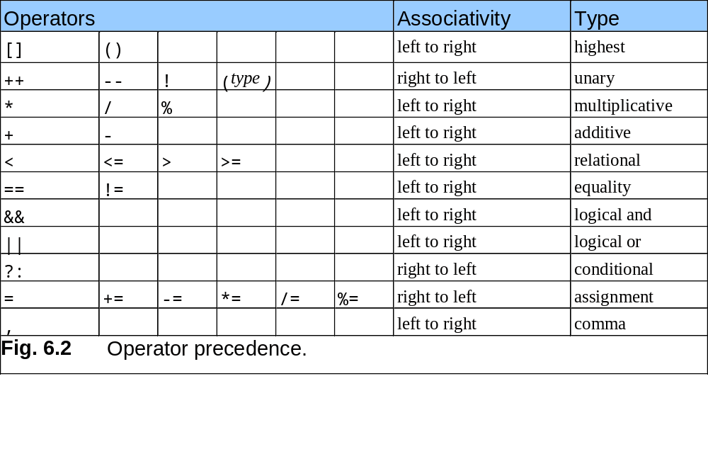
Arrays

Slide 8
double x[8];
x[0] | x[1] | x[2] | x[3] | x[4] | x[5] | x[6] | x[7]
16.0 | 12.0 | 6.0 | 8.0 | 2.5 | 12.0 | 14.0 | -54.5
i=5
printf(“%d %.1f”, 4, x[4]);
4 2.5
printf(“%d %.1f”, i, x[i]);
5 12.0
printf(“%.1f”, x[i]+1);
13.0
printf(“%.1f”, x[i]+i);
17.0
printf(“%.1f”, x[i+1]);
14.0
invalid
printf(“%.1f”, x[i+i]);
May result in a run-time error
Display incorrect results
printf(“%.1f”, x[2*i]);
invalid
printf(“%.1f”, x[2*i-3]);
-54.5
printf(“%.1f”, x[(int)x[4]]);
6.0
printf(“%.1f”, x[i++]);
12.0
printf(“%.1f”, x[--i]);
12.0

Slide 9
double x[8];
x[0] | x[1] | x[2] | x[3] | x[4] | x[5] | x[6] | x[7]
16.0 | 12.0 | 6.0 | 8.0 | 2.5 | 12.0 | 14.0 | -54.5
i=5
x[i-1] = x[i]
x[i] = x[i+1]
x[i]-1 = x[i]
Illegal assignment statement!

Slide 10
Defining Arrays
When defining arrays, specify
  Type of array
  Name
  Number of elements
    arrayType arrayName[ numberOfElements ];
  Examples:
    int c[ 10 ];
    float myArray[ 3284 ];
Defining multiple arrays of same type
  Format similar to regular variables
  Example:
    int b[ 100 ], x[ 27 ];

Slide 11
Examples Using Arrays
Initializers
    int n[ 5 ] = { 1, 2, 3, 4, 5 };
  If not enough initializers, elements with missing values become 0
      int n[ 5 ] = { 0 }
    All elements 0
  C arrays have no bounds checking
If size omitted, initializers determine it
    int n[ ] = { 1, 2, 3, 4, 5 };
  5 initializers, therefore 5 element array

Slide 12
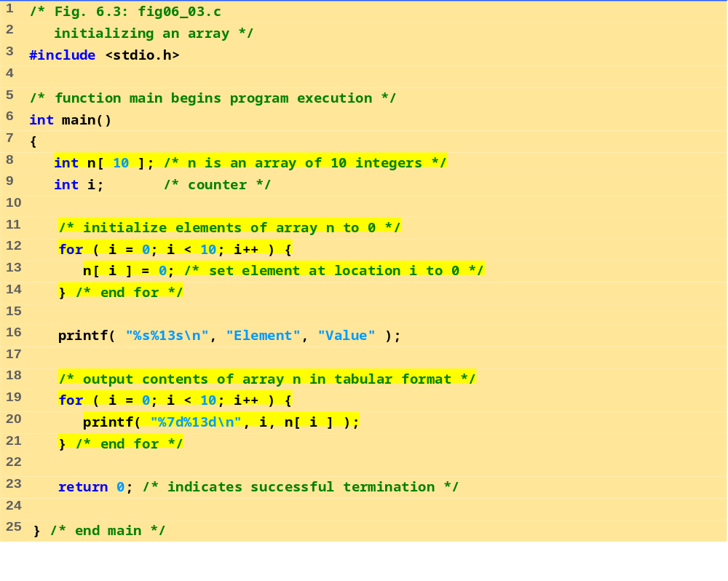
Initializing an Array

Slide 13
Program Output
Element Value
0 0
1 0
2 0
3 0
4 0
5 0
6 0
7 0
8 0
9 0

Slide 14
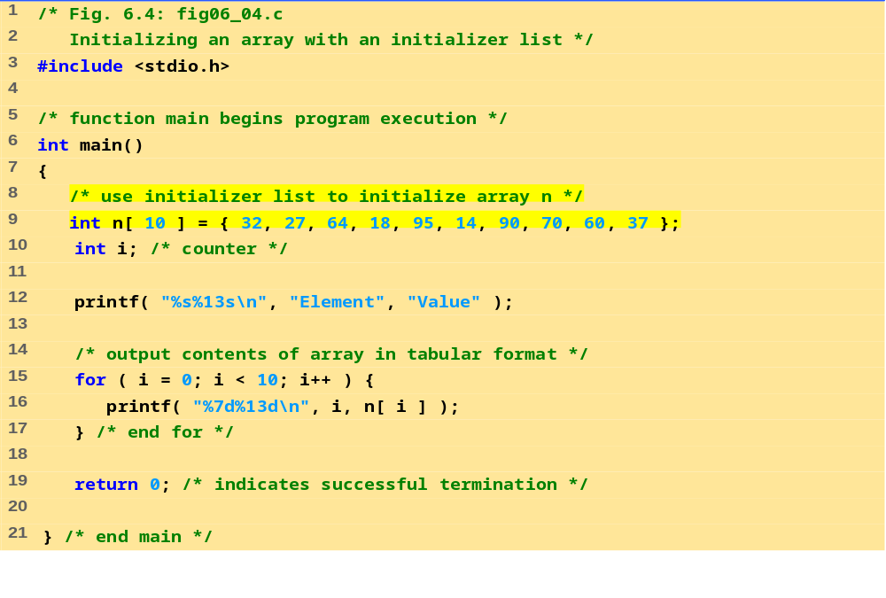
FIG06_04.C

Slide 15
Program Output
Element Value
0 32
1 27
2 64
3 18
4 95
5 14
6 90
7 70
8 60
9 37

Slide 16
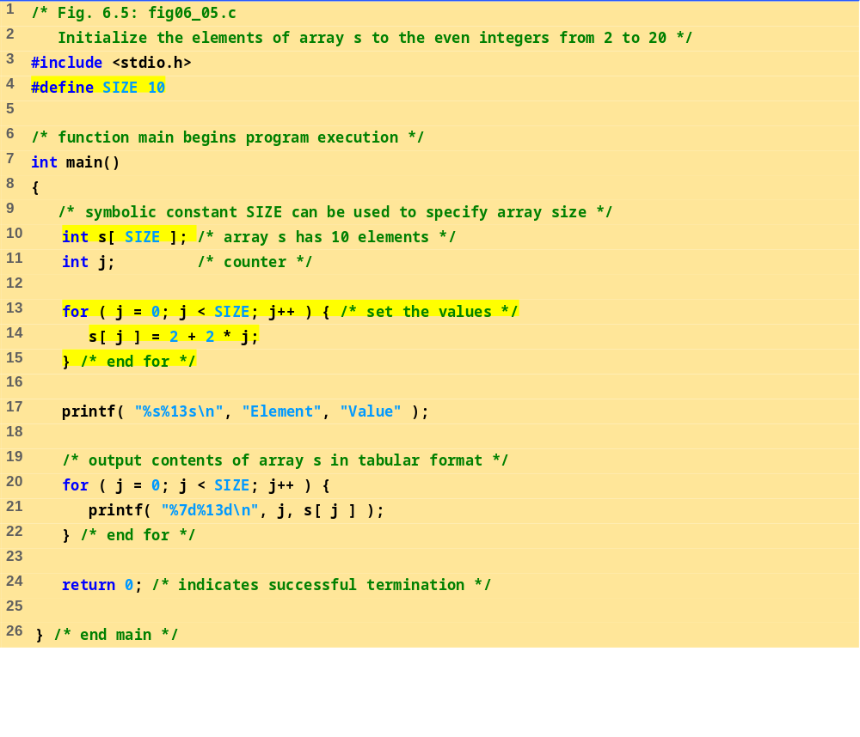
FIG06_05.C

Slide 17
Program Output
Element Value
0 2
1 4
2 6
3 8
4 10
5 12
6 14
7 16
8 18
9 20

Slide 18
Examples
Reading values into an array
int i, x[100];
for (i=0; i < 100; i=i+1)
{
printf("Enter an integer: ");
scanf("%d",&x[i]);
}
Summing up all elements in an array
int sum = 0;
for (i=0; i<=99; i=i+1)
sum = sum + x[i];

Slide 19
Examples
Finding the location of a given value (item) in an array.
i = 0;
while ((i<100) && (x[i] != item))
i = i + 1;
if (i == 100)
loc = -1; // not found
else
loc = i; // found in location i

Slide 20
Examples
Shifting the elements of an array to the left.
/* store the value of the first element in a
* temporary variable
*/
temp = x[0];
for (i=0; i < 99; i=i+1)
x[i] = x[i+1];
//The value stored in temp is going to be the value of the last element:
x[99] = temp;

Slide 21
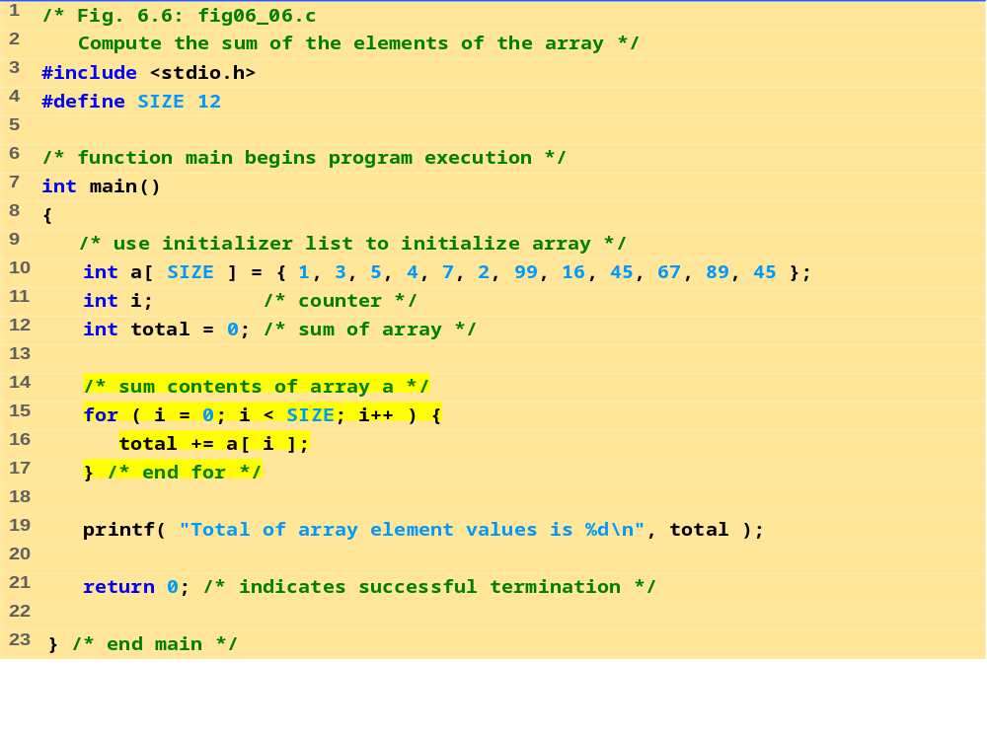
Total of array element values is 383

Slide 22
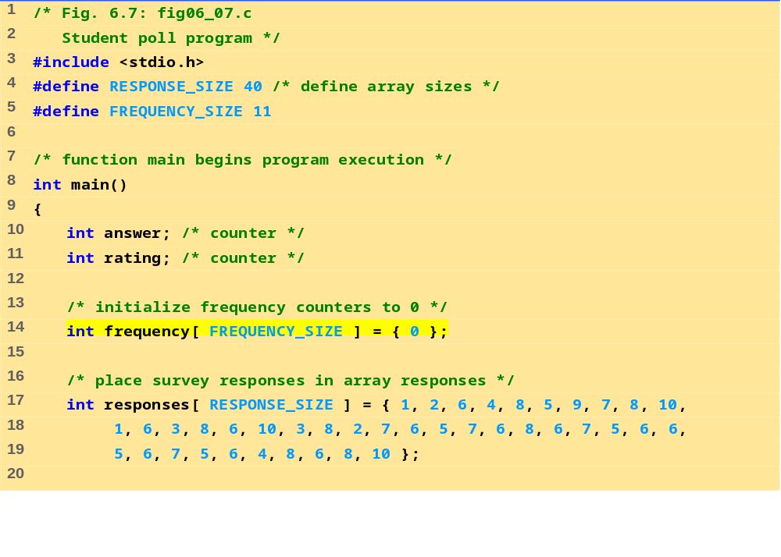

Slide 23
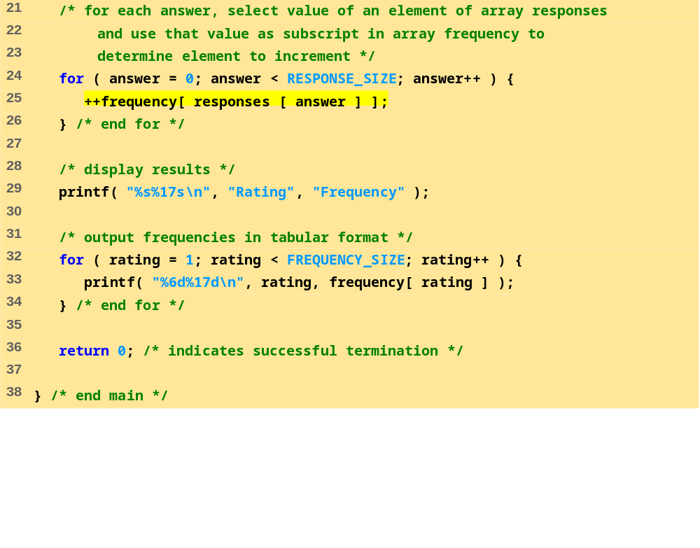
Rating Frequency
1 2
2 2
3 2
4 2
5 5
6 11
7 5
8 7
9 1
10 3

Slide 24
1 /* Histogram printing program */
2
3 #include <stdio.h>
4 #define SIZE 10
5
6 int main()
7 {
8 int n[ SIZE ] = { 19, 3, 15, 7, 11, 9, 13, 5, 17, 1 };
9 int i, j;
10
11 printf( "%s%13s%17s\n", "Element", "Value", "Histogram" );
12
13 for ( i = 0; i <= SIZE - 1; i++ ) {
14 printf( "%7d%13d ", i, n[i]) ;
15
16 for ( j = 1; j <= n[ i ]; j++ ) /* print one bar */
17 printf( "%c", '*' );
18
19 printf( "\n" );
20 }
21
22 return 0;
23 }

Slide 25
Program Output
Element Value Histogram
0 19 *******************
1 3 ***
2 15 ***************
3 7 *******
4 11 ***********
5 9 *********
6 13 *************
7 5 *****
8 17 *****************
9 1 *

Slide 26
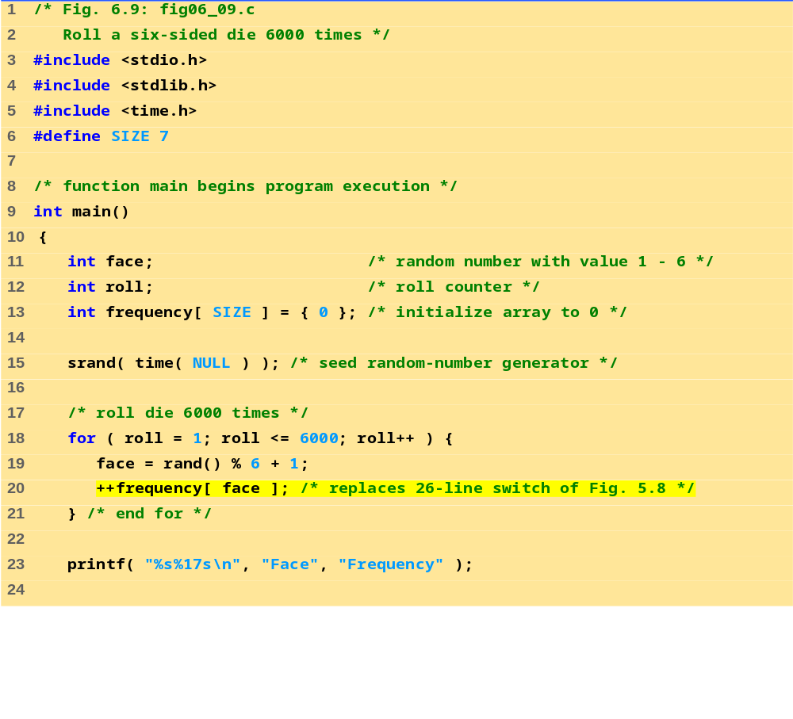

Slide 27
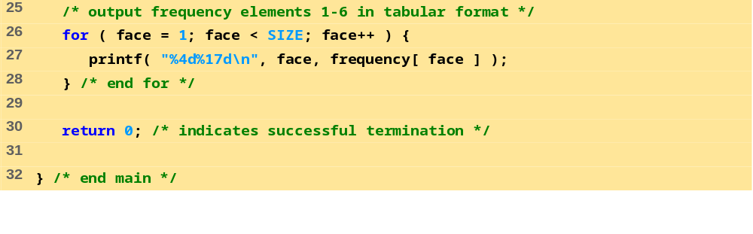
Program Output
Face Frequency
1 1029
2 951
3 987
4 1033
5 1010
6 990

Slide 28
Multi-Dimensional Arrays
Multiple subscripted arrays
  Tables with rows and columns (m by n array)
  Like matrices: specify row, then column
Column 0
Column 1
Column 2
Column 3
Row 0
a[ 0 ][ 0 ]
a[ 0 ][ 1 ]
a[ 0 ][ 2 ]
a[ 0 ][ 3 ]
Row 1
a[ 1 ][ 0 ]
a[ 1 ][ 1 ]
a[ 1 ][ 2 ]
a[ 1 ][ 3 ]
Row 2
a[ 2 ][ 0 ]
a[ 2 ][ 1 ]
a[ 2 ][ 2 ]
a[ 2 ][ 3 ]
Column subscript
Array name
Row subscript

Slide 29
Multi-Dimensional Arrays
Initialization
  int b[ 2 ][ 2 ] = { { 1, 2 }, { 3, 4 } };
  Initializers grouped by row in braces
  If not enough, unspecified elements set to zero
    int b[ 2 ][ 2 ] = { { 1 }, { 3, 4 } };
Referencing elements
  Specify row, then column
    printf( "%d", b[ 0 ][ 1 ] );
1 2
3 4
1 0
3 4

Slide 30
Example:Multi-Dimensional Array
#include <stdio.h>
int main()
{
int i; /* counter */
int j; /* counter */
/* initialize array1, array2, array3 */
int array1[ 2 ][ 3 ] = { { 1, 2, 3 }, { 4, 5, 6 } };
int array2[ 2 ][ 3 ] = { 1, 2, 3, 4, 5 };
int array3[ 2 ][ 3 ] = { { 1, 2 }, { 4 } };
printf( "Values in array1 by row are:\n" );
for ( i = 0; i <= 1; i++ ) { /* loop through rows */
for ( j = 0; j <= 2; j++ )
printf( "%d ", array1[ i ][ j ] ); /* output column values */
printf( "\n" );
}

Slide 31
Example:Multi-Dimensional Array
printf( "Values in array2 by row are:\n" );
for ( i = 0; i <= 1; i++ ) { /* loop through rows */
for ( j = 0; j <= 2; j++ )
printf( "%d ", array2[ i ][ j ] ); /* output column values */
printf( "\n" );
}
printf( "Values in array3 by row are:\n" );
for ( i = 0; i <= 1; i++ ) { /* loop through rows */
for ( j = 0; j <= 2; j++ )
printf( "%d ", array3[ i ][ j ] );
printf( "\n" );
}
return 0;
}
Values in array1 by row are:
1 2 3
4 5 6
Values in array2 by row are:
1 2 3
4 5 0
Values in array3 by row are:
1 2 0
4 0 0

Slide 32
Pointers and Arrays
Arrays are implemented as pointers.
Consider:
  double list[3];
  &list[1] : is the address of the second element
  &list[i] : the address of list[i] which is calculated by the formula
base address of the array + i * 8

Slide 33
The Relationship between Pointers and Arrays
Arrays and pointers are closely related
  Array name is like a constant pointer
  Pointers can do array subscripting operations
Declare an array b[ 5 ] and a pointer bPtr
  To set them equal to one another use:
      bPtr = b;
    The array name (b) is actually the address of first element of the array b[ 5 ]
      bPtr = &b[ 0 ]
    Explicitly assigns bPtr to address of first element of b

Slide 34
The Relationship between Pointers and Arrays
  Element b[ 3 ]
    Can be accessed by *( bPtr + 3 )
      Where n is the offset. Called pointer/offset notation
    Can be accessed by bptr[ 3 ]
      Called pointer/subscript notation
      bPtr[ 3 ] same as b[ 3 ]
    Can be accessed by performing pointer arithmetic on the array itself
      *( b + 3 )

Slide 35
Example (cont.)
/* Using subscripting and pointer notations with arrays */
#include <stdio.h>
int main(void)
{
int i, offset, b[4]={10,20,30,40};
int *bPtr = b;
/* Array is printed with array subscript notation */
for (i=0; i < 4; i++)
printf(“b[%d] = %d\n”, i, b[i]);

Slide 36
Example (cont.)
/* Pointer/offset notation where the pointer is
the array name */
for (offset=0; offset < 4; offset++)
printf(“*(b + %d) = %d\n”,offset,*(b + offset));
/* Pointer subscript notation */
for (i=0; i < 4; i++)
printf(“bPtr[%d] = %d\n”, i, bPtr[i]);
/* Pointer offset notation */
for (offset = 0; offset < 4; offset++)
printf(“*(bPtr + %d) = %d\n”, offset”
“*(bPtr + offset)”);
return 0;
}

Slide 37
Example (cont.)
b[ 0 ] = 10
b[ 1 ] = 20
b[ 2 ] = 30
b[ 3 ] = 40
*( b + 0 ) = 10
*( b + 1 ) = 20
*( b + 2 ) = 30
*( b + 3 ) = 40
bPtr[ 0 ] = 10
bPtr[ 1 ] = 20
bPtr[ 2 ] = 30
bPtr[ 3 ] = 40
*( bPtr + 0 ) = 10
*( bPtr + 1 ) = 20
*( bPtr + 2 ) = 30
*( bPtr + 3 ) = 40

Slide 38
Passing Arrays as Parameters
Arrays are passed to functions by reference
  the called functions can modify the element values in the callers’ original arrays
  individual array elements are passed by value exactly as simple variables are
The function’s parameter list must specify that an array will be received
int SumIntegerArray(int a[], int n)
It indicates that SumIntegerArray expects to receive an array of integers in parameter a and the number of array elements in parameter n
The size of the array is not required between the array brackets

Slide 39
Passing Arrays as Parameters
int SumIntegerArray(int a[], int n)
{
int i, sum;
sum = 0;
for (i=0; i < n; i++) {
sum += a[i];
}
return sum;
}
Assume
int sum, list[5];
are declared in the main function. We can make the following function call:
sum = SumIntegerArray(list, 5);

Slide 40
Strings
Character arrays
  String “first” is really a static array of characters
  Character arrays can be initialized using string literals
    char string1[] = "first";
    Null character '\0' terminates strings
    string1 actually has 6 elements
      equivalent to char string1[] = { 'f', 'i', 'r', 's', 't', '\0' };
  Can access individual characters
    string1[ 3 ] is character ‘s’
  Array name is address of array, so & not needed for scanf
      scanf( "%s", string2 );
    Reads characters until whitespace encountered
    Can write beyond end of array, be careful

Slide 41
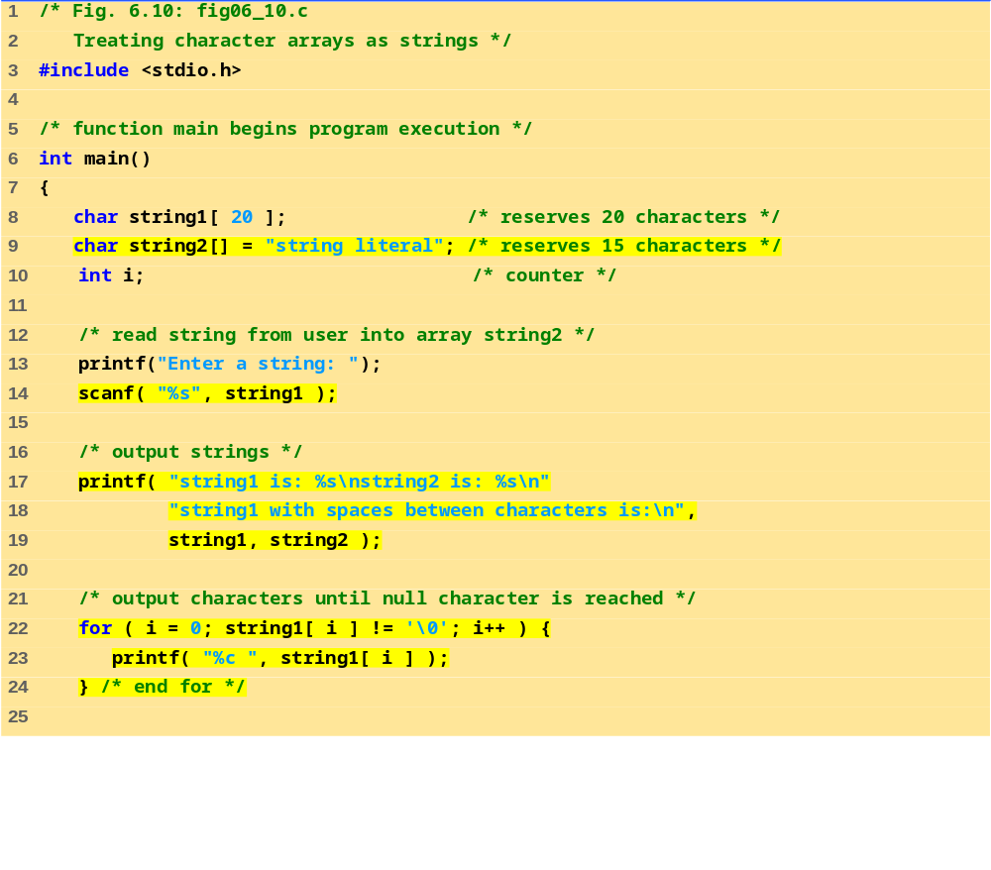
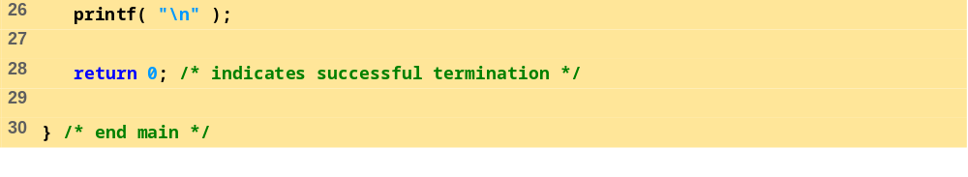

Slide 42
Program Output
Enter a string: Hello there
string1 is: Hello
string2 is: string literal
string1 with spaces between characters is:
H e l l o

Slide 43
Example: String Copy
/* Copying a string using array notation and pointer notation. */
#include <stdio.h>
void copy1( char *s1, const char *s2 );
void copy2( char *s1, const char *s2 );
int main()
{
char string1[ 10 ]; /* create array string1 */
char *string2 = "Hello"; /* create a pointer to a string */
char string3[ 10 ]; /* create array string3 */
char string4[] = "Good Bye"; /* create a pointer to a string */
copy1( string1, string2 );
printf( "string1 = %s\n", string1 );
copy2( string3, string4 );
printf( "string3 = %s\n", string3 );
return 0;
}

Slide 44
Example
Program Output
/* copy s2 to s1 using array notation */
void copy1( char *s1, const char *s2 )
{
int i;
for ( i = 0; s2[ i ] != '\0'; i++ )
s1[ i ] = s2[ i ];
s1[ i ] = NULL;
} /* end function copy1 */
/* copy s2 to s1 using pointer notation */
void copy2( char *s1, const char *s2 )
{
/* loop through strings */
for ( ; *s2 != '\0'; s1++, s2++ )
*s1 = *s2;
*s1 = NULL;
} /* end function copy2 */
string1 = Hello
string3 = Good Bye

Slide 45
Arrays of Pointers
Arrays can contain pointers
For example: an array of strings
    char *suit[ 4 ] = { "Hearts", "Diamonds",
    "Clubs", "Spades" };
  Strings are pointers to the first character
  char * – each element of suit is a pointer to a char
  The strings are not actually stored in the array suit, only pointers to the strings are stored
  suit array has a fixed size, but strings can be of any size
suit[0]
’H’
’e’
’a’
’r’
’t’
’s’
’\0’
suit[1]
’D’
’i’
’a’
’m’
’o’
’n’
’d’
’s’
’\0’
suit[2]
’C’
’l’
’u’
’b’
’s’
’\0’
suit[3]
’S’
’p’
’a’
’d’
’e’
’s’
’\0’

Slide 46
sizeof function
sizeof
  Returns size of operand in bytes
  For arrays: size of 1 element * number of elements
  if sizeof( int ) equals 4 bytes, then
      int myArray[ 10 ];
      printf( "%d", sizeof( myArray ) );
    will print 40
sizeof can be used with
  Variable names
  Type name
  Constant values

Slide 47
Example
/* sizeof operator when used on an array name returns the number of
bytes in the array. */
#include <stdio.h>
size_t getSize( float *ptr ); /* prototype */
int main(){
float array[ 20 ]; /* create array */
printf( "The number of bytes in the array is %d"
"\nThe number of bytes returned by getSize is %d\n",
sizeof( array ), getSize( array ) );
return 0;
}
size_t getSize( float *ptr ) {
return sizeof( ptr );
}
Program Output
The number of bytes in the array is 80
The number of bytes returned by getSize is 4

Slide 48
Example
/* Demonstrating the sizeof operator */
#include <stdio.h>
int main()
{
char c; /* define c */
short s; /* define s */
int i; /* define i */
long l; /* define l */
float f; /* define f */
double d; /* define d */
long double ld; /* define ld */
int array[ 20 ]; /* initialize array */
int *ptr = array; /* create pointer to array */

Slide 49
Example
printf( " sizeof c = %d\tsizeof(char) = %d"
"\n sizeof s = %d\tsizeof(short) = %d"
"\n sizeof i = %d\tsizeof(int) = %d"
"\n sizeof l = %d\tsizeof(long) = %d"
"\n sizeof f = %d\tsizeof(float) = %d"
"\n sizeof d = %d\tsizeof(double) = %d"
"\n sizeof ld = %d\tsizeof(long double) = %d"
"\n sizeof array = %d"
"\n sizeof ptr = %d\n",
sizeof c, sizeof( char ), sizeof s,
sizeof( short ), sizeof i, sizeof( int ),
sizeof l, sizeof( long ), sizeof f,
sizeof( float ), sizeof d, sizeof( double ),
sizeof ld, sizeof( long double ),
sizeof array, sizeof ptr );
return 0;
}

Slide 50
Example
Program Output
sizeof c = 1 sizeof(char) = 1
sizeof s = 2 sizeof(short) = 2
sizeof i = 4 sizeof(int) = 4
sizeof l = 4 sizeof(long) = 4
sizeof f = 4 sizeof(float) = 4
sizeof d = 8 sizeof(double) = 8
sizeof ld = 8 sizeof(long double) = 8
sizeof array = 80
sizeof ptr = 4

Slide 51
Dynamic Memory Management
Static memory allocation: space for the object is provided in the binary at compile-time
Dynamic memory allocation: blocks of memory of arbitrary size can be requested at run-time
The four dynamic memory management functions are malloc, calloc, realloc, and free.
These functions are included in the header file <stdlib.h>.

Slide 52
Dynamic Memory Management
void *malloc(size_t size);
allocates storage for an object whose size is specified by size:
  It returns a pointer to the allocated storage,
  NULL if it is not possible to allocate the storage requested.
  The allocated storage is not initialized in any way.
e.g. float *fp, fa[10];
fp = (float *) malloc(sizeof(fa));
allocates the storage to hold an array of 10 floating-point elements, and assigns the pointer to this storage to fp.

Slide 53
Dynamic Memory Management
void *calloc(size_t nobj, size_t size);
allocates the storage for an array of nobj objects, each of size size.
  It returns a pointer to the allocated storage,
  NULL if it is not possible to allocate the storage requested.
  The allocated storage is initialized to zeros.
e.g. double *dp, da[10];
dp=(double *) calloc(10,sizeof(double));
allocates the storage to hold an array of 10 double values, and assigns the pointer to this storage to dp.

Slide 54
Dynamic Memory Management
void *realloc(void *p, size_t size);
changes the size of the object pointed to by p to size.
  It returns a pointer to the new storage,
  NULL if it is not possible to resize the object, in which case the object (*p) remains unchanged.
  The new size may be larger (the original contents are preserved and the remaining space is unitialized) or smaller (the contents are unchanged upto the new size) than the original size.

Slide 55
Dynamic Memory Management
e.g. char *cp;
cp =(char *) malloc(sizeof(char) * 9);
strcpy(cp, “computer”);
cp points to an array of 9 characters containing the null-terminated
string computer.
cp = (char *) realloc(cp, sizeof(sizeof(char) * 8));
discards the trailing ‘\0’ and makes cp point to an array if 8 characters containing the characters in computer
cp=(char *)realloc(cp, sizeof(sizeof(char) * 16));
cp points to an array of 16 characters, the first 9 of which contain
the null-terminated string computer and the remaining 7 are uninitialized.

Slide 56
Dynamic Memory Management
void *free(void *p);
deallocates the storage pointed to by p, where p is a pointer to the storage previously allocated by malloc, calloc, or realloc.
e.g. free(fp);
free(dp);
free(cp);

Slide 57
Dynamic Memory Management
When using dynamic memory allocation, test for a NULL pointer return value, which indicates unsuccessful operation
free dynamically allocated memory when it is no longer needed to avoid memory leaks
Then set the pointer to NULL to eliminate possible further accesses to that memory
  Referring to memory that has been deallocated is an error that typically results in the program crashing
Trying to free memory not allocated dynamically is an error

Slide 58
Example
#include<stdio.h>
#include<stdlib.h>
int main(void) {
int *array, *p;
int i,no_elements;
printf("Enter number of elements: ");
scanf("%d",&no_elements);
printf("Enter the elements: ");
array = ( int* )malloc( no_elements*sizeof( int ) );
for(p=array,i=0; i<no_elements; i++, p++)
scanf("%d",p);
printf("Elements: ");
for(p=array,i=0; i<no_elements; i++, p++)
printf("%d ",*p);
printf("\n");
Notes:
Enter number of elements: 4
Enter the elements: 2 3 4 5
Elements: 2 3 4 5
Enter two new elements: 6 7
Elements: 2 3 4 5 6 7

Slide 59
Example
array = ( int* )realloc(array, (no_elements+2)*sizeof( int ) );
printf("Enter two new elements: ");
for(p=array,i=0; i<no_elements; i++, p++) ;
for(; i<no_elements+2; i++, p++)
scanf("%d",p);
printf("Elements: ");
for(p=array,i=0; i<no_elements+2; i++, p++)
printf("%d ",*p);
printf("\n");
free(array);
return 0;
}
Enter number of elements: 4
Enter the elements: 2 3 4 5
Elements: 2 3 4 5
Enter two new elements: 6 7
Elements: 2 3 4 5 6 7
Program Output
Notes:
Enter number of elements: 4
Enter the elements: 2 3 4 5
Elements: 2 3 4 5
Enter two new elements: 6 7
Elements: 2 3 4 5 6 7

Slide 60
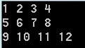
Example: Dynamic Allocation of 2D Array (1)
#include <stdio.h>
#include <stdlib.h>
#define ROW 3
#define COLUMN 4
/* Using a single pointer */
int main()
{
int *arr = (int *)malloc(ROW * COLUMN * sizeof(int));
int i, j, count = 0;
for (i = 0; i < ROW; i++)
for (j = 0; j < COLUMN; j++)
*(arr + i*COLUMN + j) = ++count;
for (i = 0; i < ROW; i++){
for (j = 0; j < COLUMN; j++)
printf("%d ", *(arr + i*COLUMN + j));
printf ("\n")
}
return 0;
}

Slide 61
Example: Dynamic Allocation of 2D Array (2)
#include <stdio.h>
#include <stdlib.h>
#define ROW 3
#define COLUMN 4
/* Using an array of pointers */
int main()
{
int i, j, count;
int *arr[ROW];
for (i=0; i<ROW; i++)
arr[i] = (int *)malloc(COLUMN * sizeof(int));
// Note that arr[i][j] is same as *(*(arr+i)+j)
count = 0;
for (i = 0; i < ROW; i++)
for (j = 0; j < COLUMN; j++)
arr[i][j] = ++count; // OR *(*(arr+i)+j) = ++count
for (i = 0; i < ROW; i++){
for (j = 0; j < COLUMN; j++)
printf("%d ", arr[i][j]);
printf ("\n")
}
return 0;
}

Slide 62
Example: Dynamic Allocation of 2D Array (3)
#include <stdio.h>
#include <stdlib.h>
#define ROW 3
#define COLUMN 4
/* Using pointer to a pointer */
int main()
{
int i, j, count;
int **arr = (int **)malloc(ROW * sizeof(int *));
for (i=0; i<ROW; i++)
arr[i] = (int *)malloc(COLUMN * sizeof(int));
// Note that arr[i][j] is same as *(*(arr+i)+j)
count = 0;
for (i = 0; i < ROW; i++)
for (j = 0; j < COLUMN; j++)
arr[i][j] = ++count; // OR *(*(arr+i)+j) = ++count
for (i = 0; i < ROW; i++){
for (j = 0; j < COLUMN; j++)
printf("%d ", arr[i][j]);
printf ("\n")
}
return 0;
}

Slide 63
Example: Dynamic Allocation of 2D Array (4)
#include<stdio.h>
#include<stdlib.h>
#define ROW 3
#define COLUMN 4
/* Using double pointer and one malloc call for all rows */
int main()
{
int **arr;
int count = 0,i,j;
arr = (int **)malloc(sizeof(int *) * ROW);
arr[0] = (int *)malloc(sizeof(int) * COLUMN * ROW);
for(i = 0; i < ROW; i++)
arr[i] = (*arr + COLUMN * i);
for (i = 0; i < ROW; i++)
for (j = 0; j < COLUMN; j++)
arr[i][j] = ++count; // OR *(*(arr+i)+j) = ++count
for (i = 0; i < ROW; i++){
for (j = 0; j < COLUMN; j++)
printf("%d ", arr[i][j]);
printf ("\n")
}
return 0;
}

