Slide 1
BBM 102 – INTRODUCTION TO PROGRAMMING II
SPRING 2018
Structs & File IO
Instructors: Dr. Cumhur Yiğit Özcan, Dr. Ali Seydi Keçeli, Dr. Aydın Kaya
*source: Deitel&Deitel – C How To Program

Slide 2
Structures
  Collections of related variables (aggregates) under one name
    Can contain variables of different data types
  Commonly used to define records to be stored in files
  Combined with pointers, can create linked lists, stacks, queues, and trees

Slide 3
Structure Definitions
Example 1:
      struct card {
      char *face;
      char *suit;
      };
  struct introduces the definition for structure card
  card is the structure name and is used to declare variables of the structure type
  card contains two members of type char *
    These members are face and suit

Slide 4
Structure Definitions
A structure definition does not reserve space in memory
  Instead creates a new data type used to define structure variables
Variables can be defined as below:
      struct card {
      char *face;
      char *suit;
      } oneCard, deck[ 52 ], *cPtr;
Or defined like other variables:
      struct card {
      char *face;
      char *suit;
      };
      struct card oneCard, deck[ 52 ], *cPtr;

Slide 5
Structure Definitions
Example 2:
struct point {
int x;
int y;
};
struct point pt; /* defines a variable pt which
is a structure of type
struct point */
pt.x = 15;
pt.y = 30;
printf(“%d, %d”, pt.x, pt.y);

Slide 6
Structure Definitions
/* Structures can be nested. One representation of a rectangle is a pair of points that denote the diagonally opposite corners. */
struct rect {
struct point pt1;
struct point pt2;
};
struct rect screen;
/* Print the pt1 field of screen */
printf(“%d, %d”,screen.pt1.x,screen.pt1.y);
/* Print the pt2 field of screen */
printf(“%d, %d”,screen.pt2.x,screen.pt2.y);

Slide 7
Structure Definitions
Valid Operations
  Assigning a structure to a structure of the same type
  Taking the address (&) of a structure
  Accessing the members of a structure
  Using the sizeof operator to determine the size of a structure

Slide 8
Initializing Structures
Initializer lists
  Example:
    struct card oneCard = { "Three", "Hearts" };
Assignment statements
  Example:
    struct card threeHearts = oneCard;
  Could also define and initialize threeHearts as follows:
    struct card threeHearts;
    threeHearts.face = “Three”;
    threeHearts.suit = “Hearts”;

Slide 9
Accessing Members of Structures
Accessing structure members
  Dot operator (.) used with structure variables
    struct card myCard;
    printf( "%s", myCard.suit );
  Arrow operator (->) used with pointers to structure variables
    struct card *myCardPtr = &myCard;
    printf( "%s", myCardPtr->suit );
  myCardPtr->suit is equivalent to
    ( *myCardPtr ).suit

Slide 10
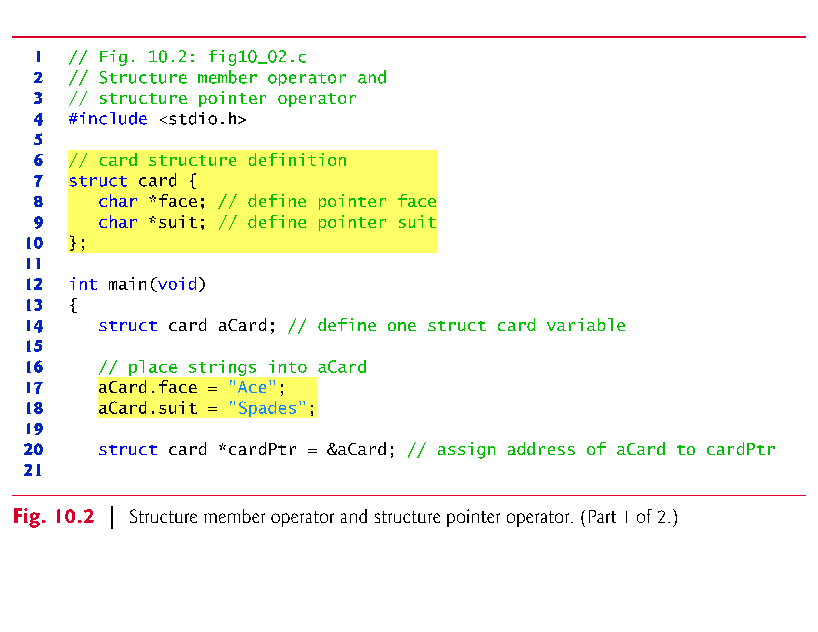
© 2016 Pearson Education, Ltd. All rights reserved.

Slide 11
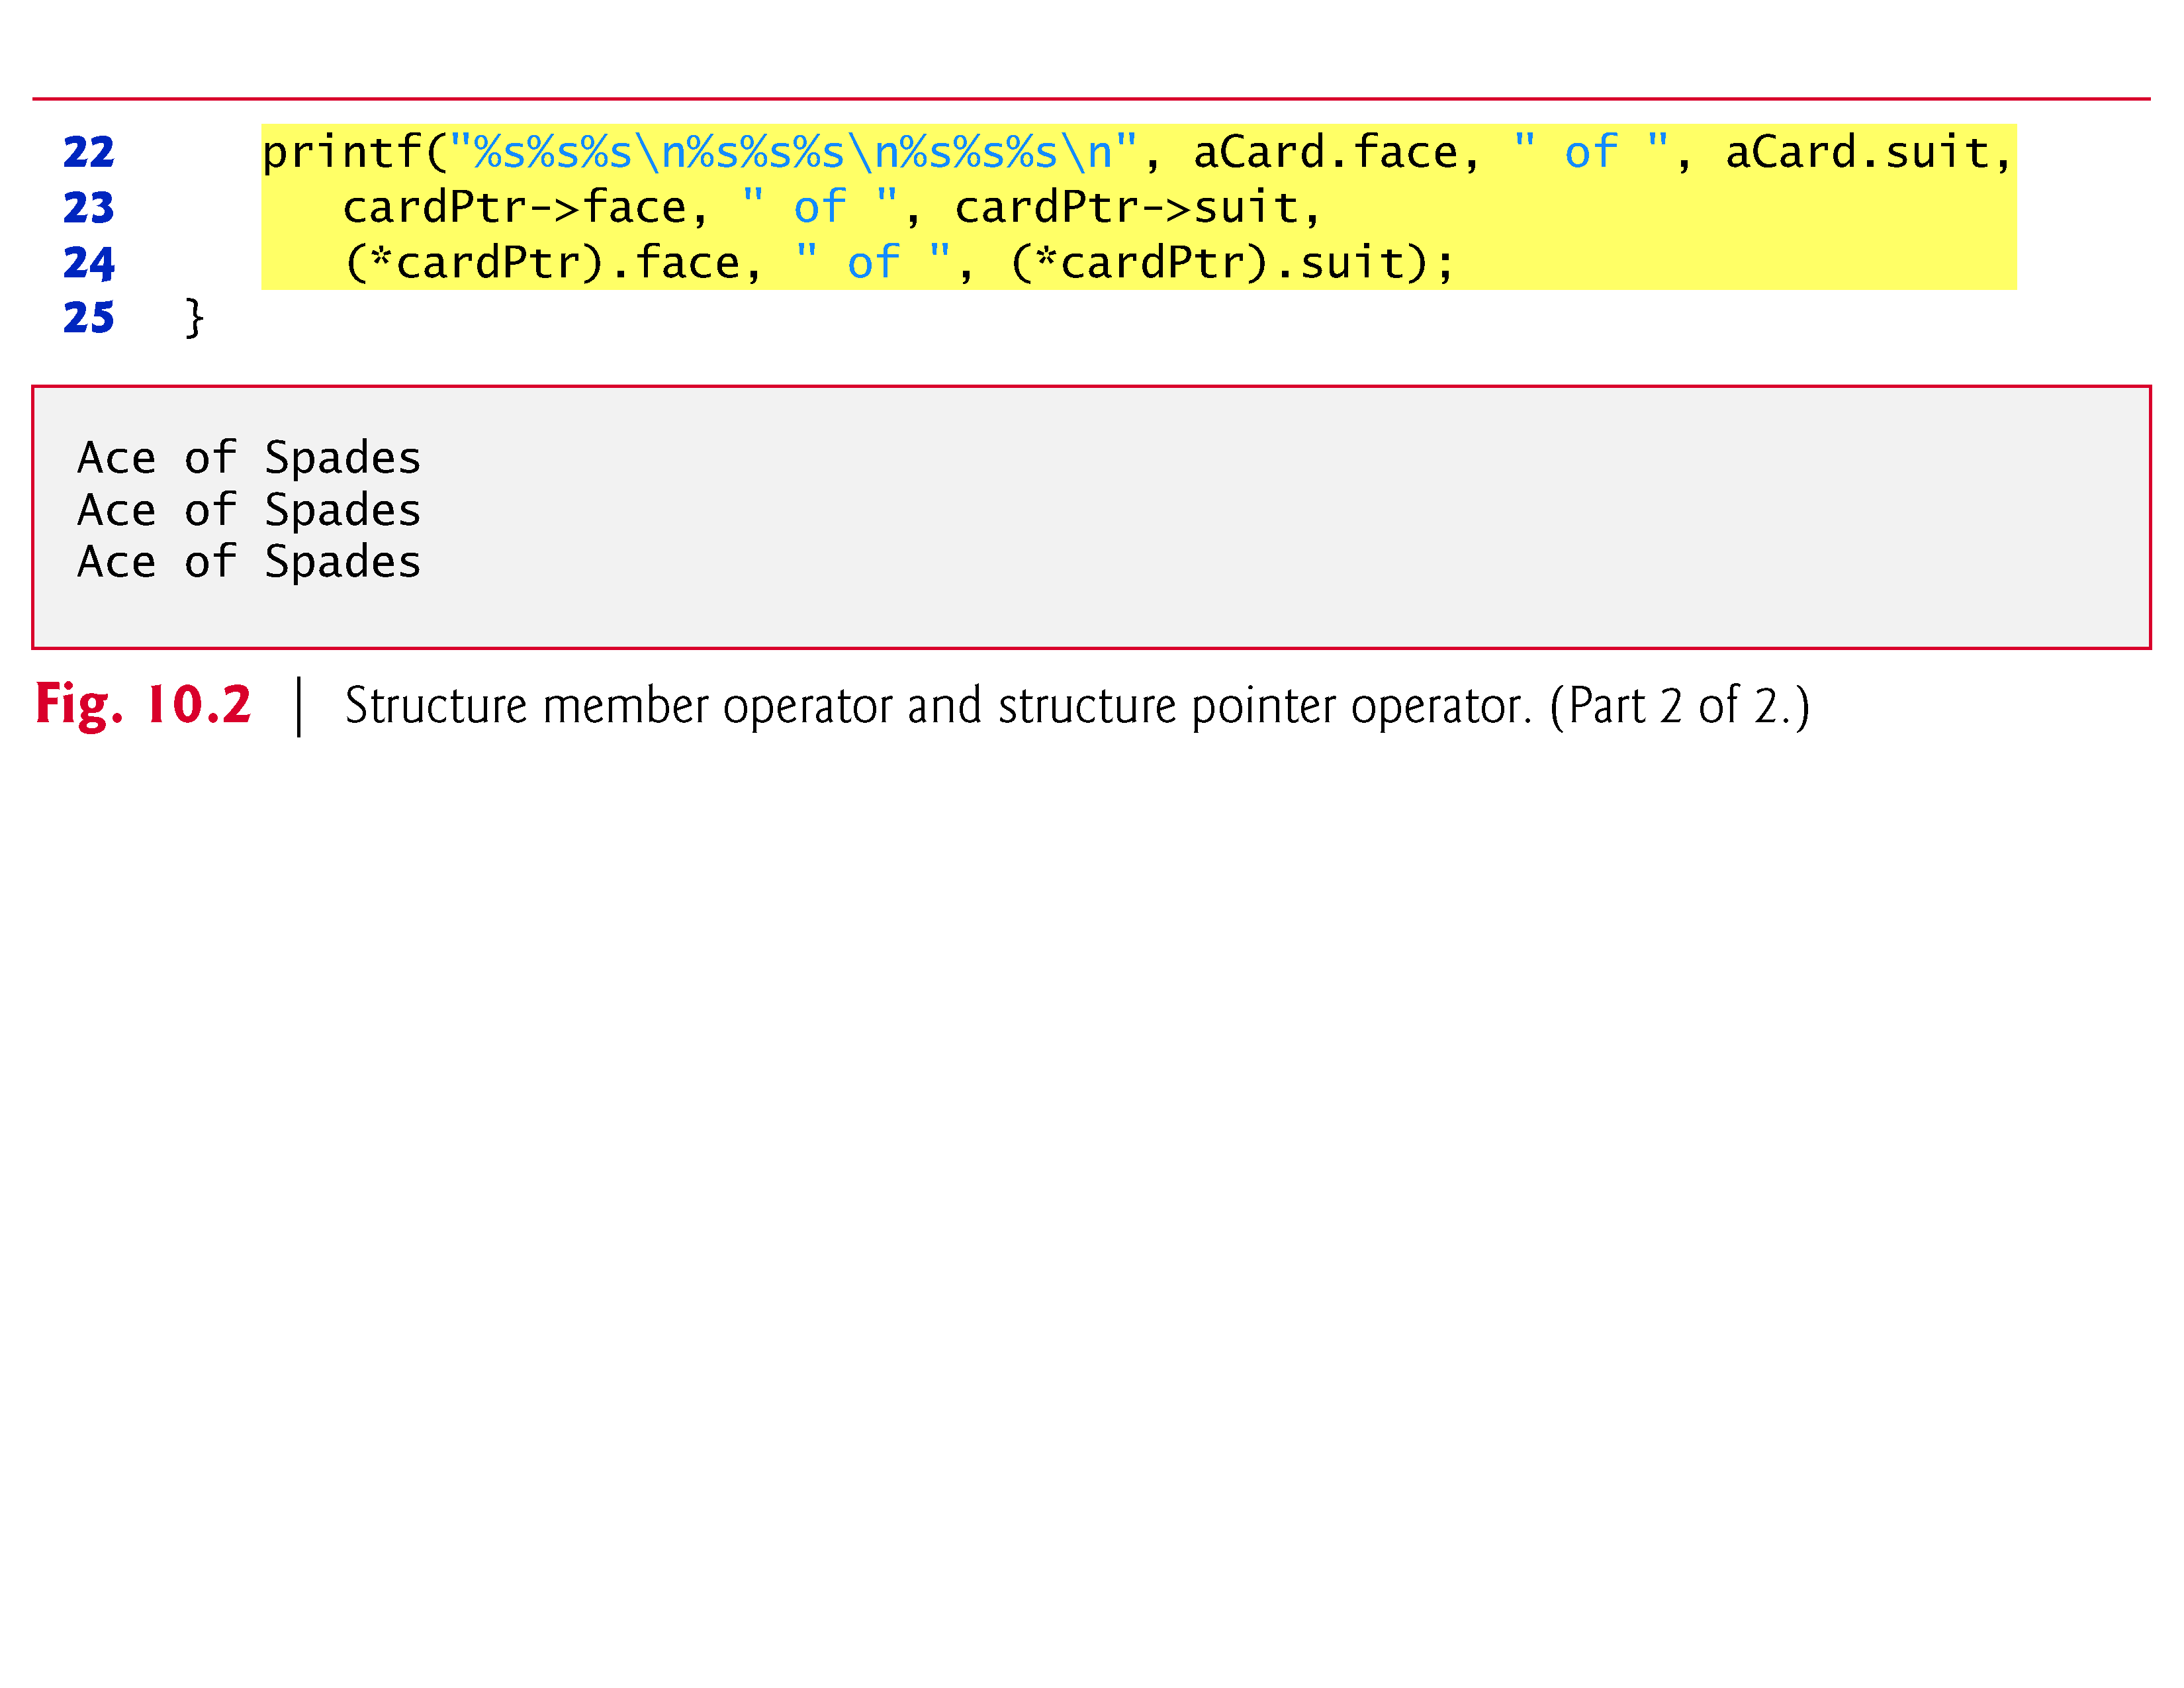
© 2016 Pearson Education, Ltd. All rights reserved.

Slide 12
typedef
typedef
  Creates synonyms (aliases) for previously defined data types
  Use typedef to create shorter type names
  Example:
      typedef struct point pixel;
  Defines a new type name pixel as a synonym for type struct point
      typedef struct Card *CardPtr;
  Defines a new type name CardPtr as a synonym for type struct Card *
  typedef does not create a new data type
    Only creates an alias

Slide 13
Using Structures With Functions
Passing structures to functions
  Pass entire structure
    Or, pass individual members
  Both pass call by value
To pass structures call-by-reference
  Pass its address
  Pass reference to it
To pass arrays call-by-value
  Create a structure with the array as a member
  Pass the structure

Slide 14
Using Structures with Functions 1
#include<stdio.h> /* Demonstrates passing a structure to a function */
struct data{
int amount;
char fname[30];
char lname[30];
}rec;
void printRecord(struct data x){
printf(“\nDonor %s %s gave $%d”, x.fname, x.lname, x.amount);
}
int main(void){
printf(“Enter the donor’s first and last names\n”);
printf(“separated by a space: ”);
scanf(“%s %s”,rec.fname, rec.lname);
printf(“Enter the donation amount: ”);
scanf(“%d”,&rec.amount);
printRecord(rec);
return 0;
}

Slide 15
Using Structures with Functions 2
/* Make a point from x and y components. */
struct point makepoint (int x, int y)
{
struct point temp;
temp.x = x;
temp.y = y;
return (temp);
}
/* makepoint can now be used to initialize a structure */
struct rect screen;
struct point middle;
screen.pt1 = makepoint(0,0);
screen.pt2 = makepoint(50,100);
middle = makepoint((screen.pt1.x + screen.pt2.x)/2,
(screen.pt1.y + screen.pt2.y)/2);

Slide 16
/* add two points */
struct point addpoint (struct point p1, struct point p2)
{
p1.x += p2.x;
p1.y += p2.y;
return p1;
}
Both arguments and the return value are structures in the
function addpoint.

Slide 17
Structures and Pointers
struct point *p; /* p is a pointer to a structure
of type struct point */
struct point origin;
p = &origin;
printf(“Origin is (%d, %d)\n”, (*p).x, (*p).y);
Parenthesis are necessary in (*p).x because the precedence of the structure member operator (dot) is higher than *.
The expression *p.x ≡ *(p.x) which is illegal because x is not a pointer.

Slide 18
Structures and Pointers
Pointers to structures are so frequently used that an alternative is provided as a shorthand.
If p is a pointer to a structure, then
p -> field_of_structure
refers to a particular field.
We could write
printf(“Origin is (%d %d)\n”, p->x, p->y);

Slide 19
Assignments
struct student {
char *last_name;
int student_id;
char grade;
};
struct student temp, *p = &temp;
temp.grade = ‘A’;
temp.last_name = “Casanova”;
temp.student_id = 590017;
Expression Equiv. Expression Value
temp.grade p -> grade A
temp.last_name p -> last_name Casanova
temp.student_id p -> student_id 590017
(*p).student_id p -> student_id 590017

Slide 20
Structures and Pointers
Both . and -> associate from left to right
Consider
struct rect r, *rp = &r;
The following 4 expressions are equivalent.
r.pt1.x
rp -> pt1.x
(r.pt1).x
(rp->pt1).x
struct rect {
struct point pt1;
struct point pt2;
};

Slide 21
Arrays of Structures
Usually a program needs to work with more than one instance of data.
For example, to maintain a list of phone #s in a program, you can define a structure to hold each person’s name and number.
struct entry {
char fname[10];
char lname[12];
char phone[8];
};

Slide 22
Arrays of Structures
A phone list has to hold many entries, so a single instance of the entry structure isn’t of much use. What we need is an array of structures of type entry.
After the structure has been defined, you can define the array as follows:
struct entry list[1000];

Slide 23
struct entry list[1000]
list[0].fname
list[0].lname
list[0]
list[0].phone
list[1].fname
list[1]
list[1].lname
list[1].phone
list[999].fname[2]
list[999].fname
list[999].lname
list[999]
list[999].phone

Slide 24
To assign data in one element to another array element, you write
list[1] = list[5];
To move data between individual structure fields, you write
strcpy(list[1].phone, list[5].phone);
To move data between individual elements of structure field arrays, you write
list[5].phone[1] = list[2].phone[3];

Slide 25
#define CLASS_SIZE 100
struct student {
char *last_name;
int student_id;
char grade;
};
int main(void)
{
struct student temp,
class[CLASS_SIZE];
... /*Do some operation to fill class structure*/
printf (“Number of A’s in class: %d\n”, countA(class));
}
int countA(struct student class[])
{
int i, cnt = 0;
for (i = 0; i < CLASS_SIZE; ++i)
cnt += class[i].grade == ‘A’;
return cnt;
}

Slide 26
Arrays of structures can be very powerful programming tools, as can pointers to structures.
struct part {
int number;
char name [10];
};
struct part data[100];
struct part *p_part;
p_part = data;
printf(“%d %s”, p_part->number, p_part -> name);

Slide 27
The above diagram shows an array named x that consists of 3 elements. The pointer ptr was initialized to point at x[0]. Each time ptr is incremented, it points at the next array element.
x[0]
x[1]
x[2]
100 | 101 | 102 | 103 | 104 | 105 | 106 | 107 | 108
Memory addresses
ptr++
ptr++
100
103
106

Slide 28
/* Array of structures */
#include <stdio.h>
#define MAX 4
struct part {
int number;
char name[10];
};
struct part data[MAX]= {1, “Smith”, 2, “Jones”, 3, “Adams”, 4, “Will”};
int main (void)
{
struct part *p_part;
int count;
p_part = data;
for (count = 0; count < MAX; count++) {
printf(“\n %d %s”, p_part -> number, p_part -> name);
p_part++;
}
return 0;
}

Slide 29
Example: High-Performance Card Shuffling and Dealing Simulation
The program in Fig. 10.3 is based on the card shuffling and dealing simulation discussed in Chapter 7.
The program represents the deck of cards as an array of structures and uses high-performance shuffling and dealing algorithms.
© 2016 Pearson Education, Ltd. All rights reserved.

Slide 30
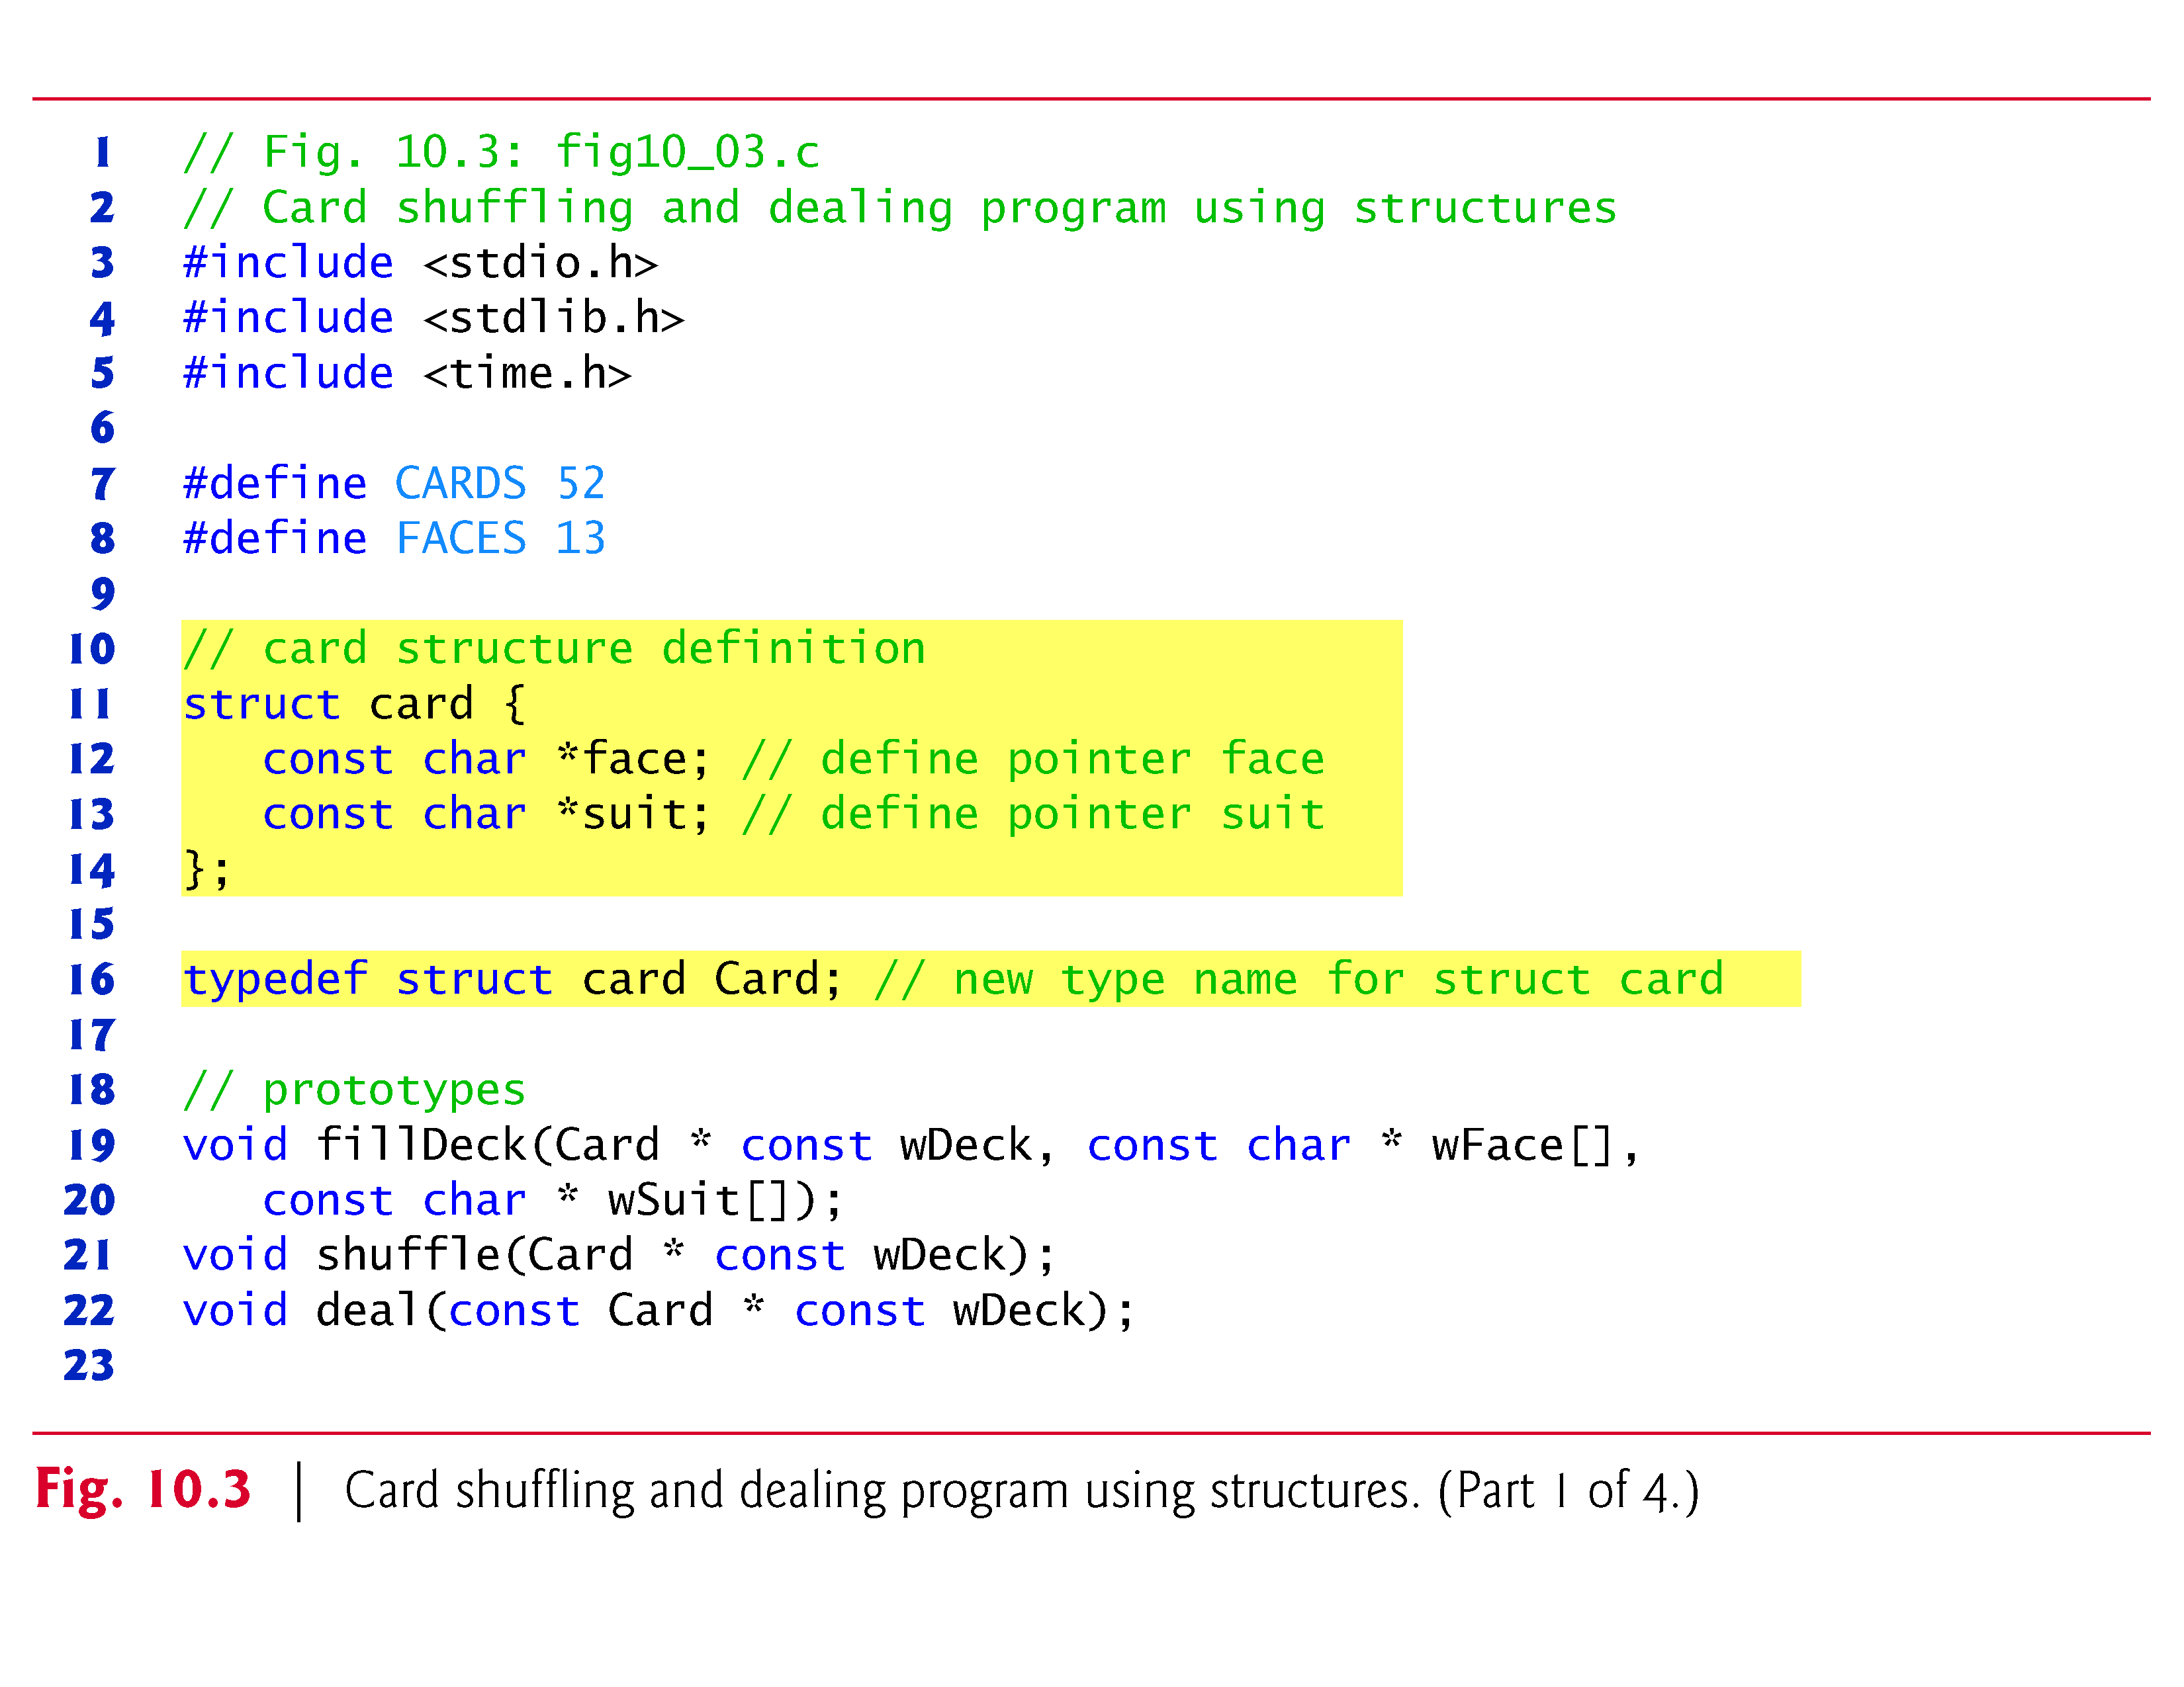
© 2016 Pearson Education, Ltd. All rights reserved.

Slide 31
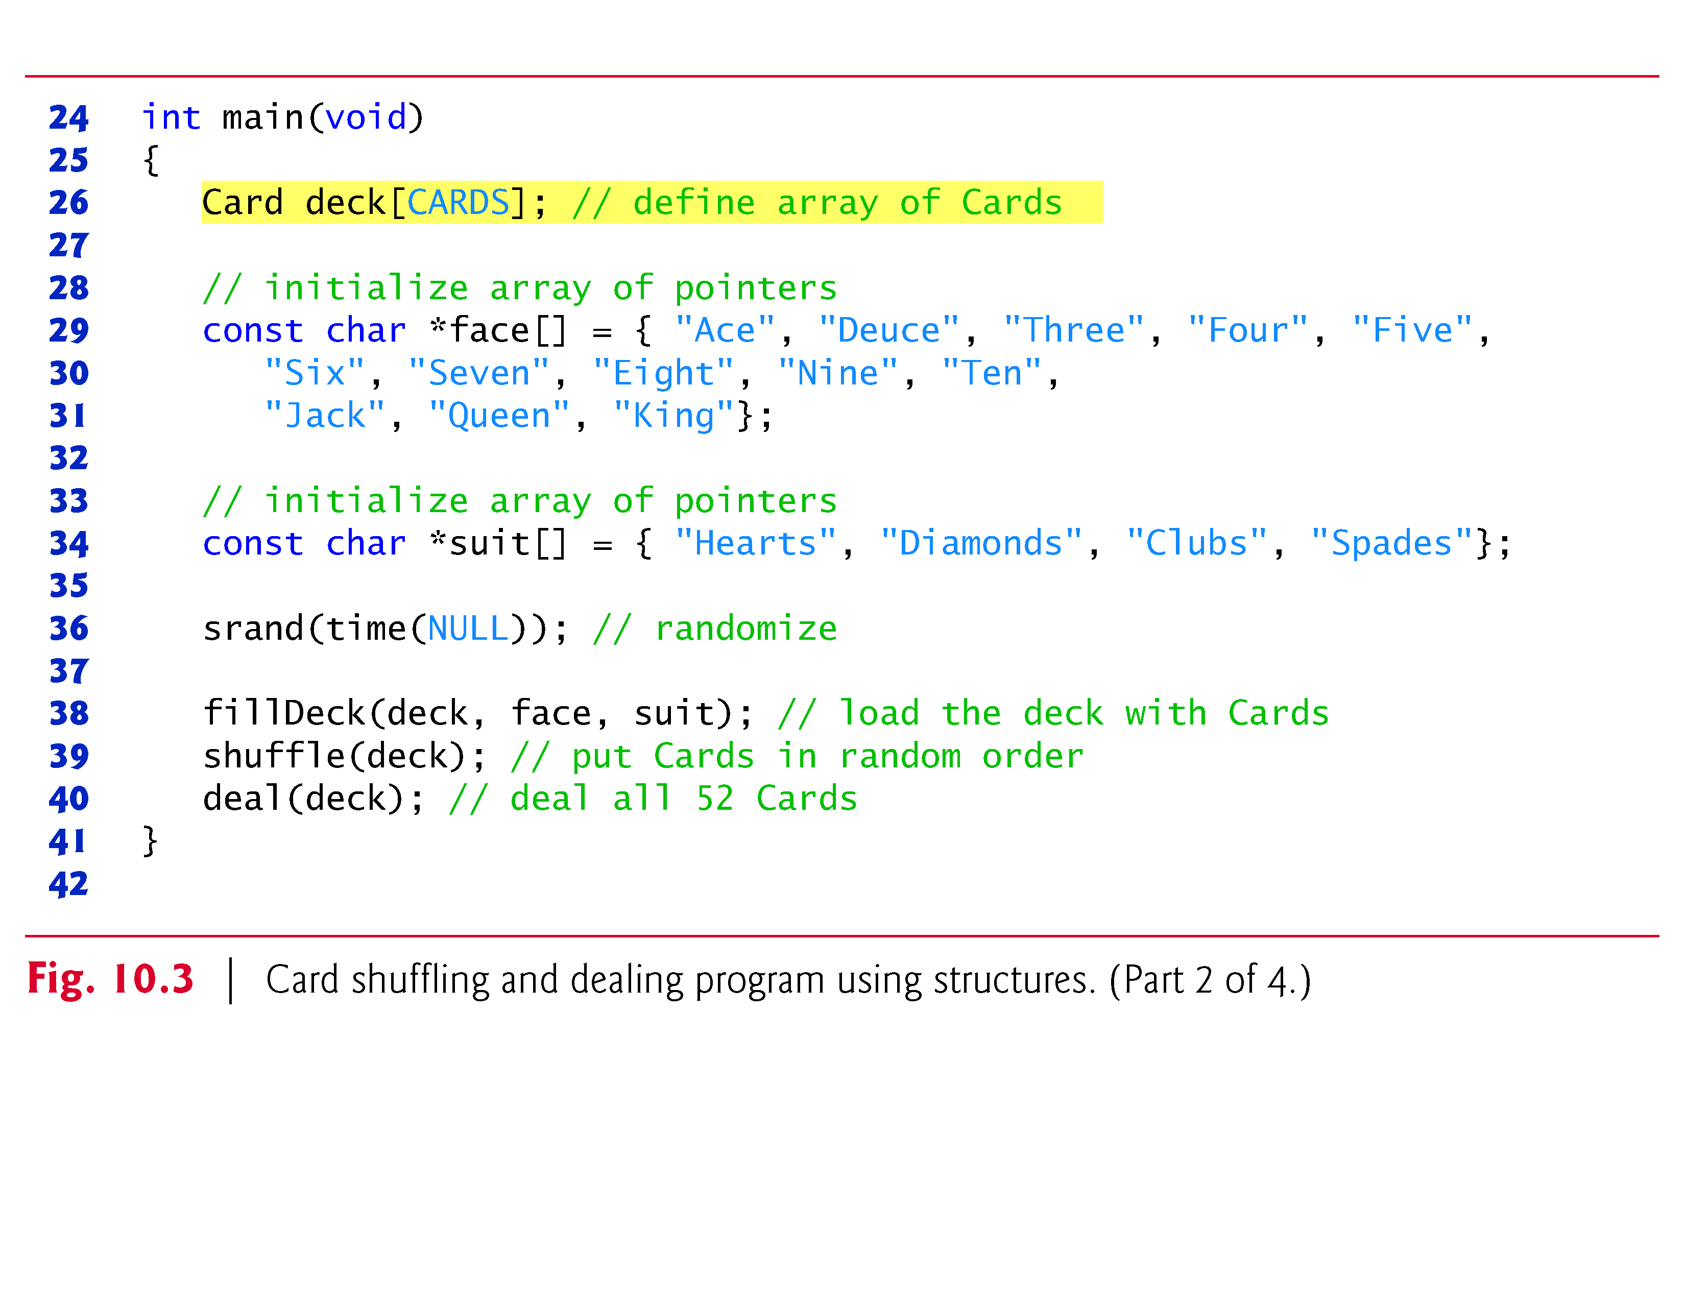
© 2016 Pearson Education, Ltd. All rights reserved.

Slide 32
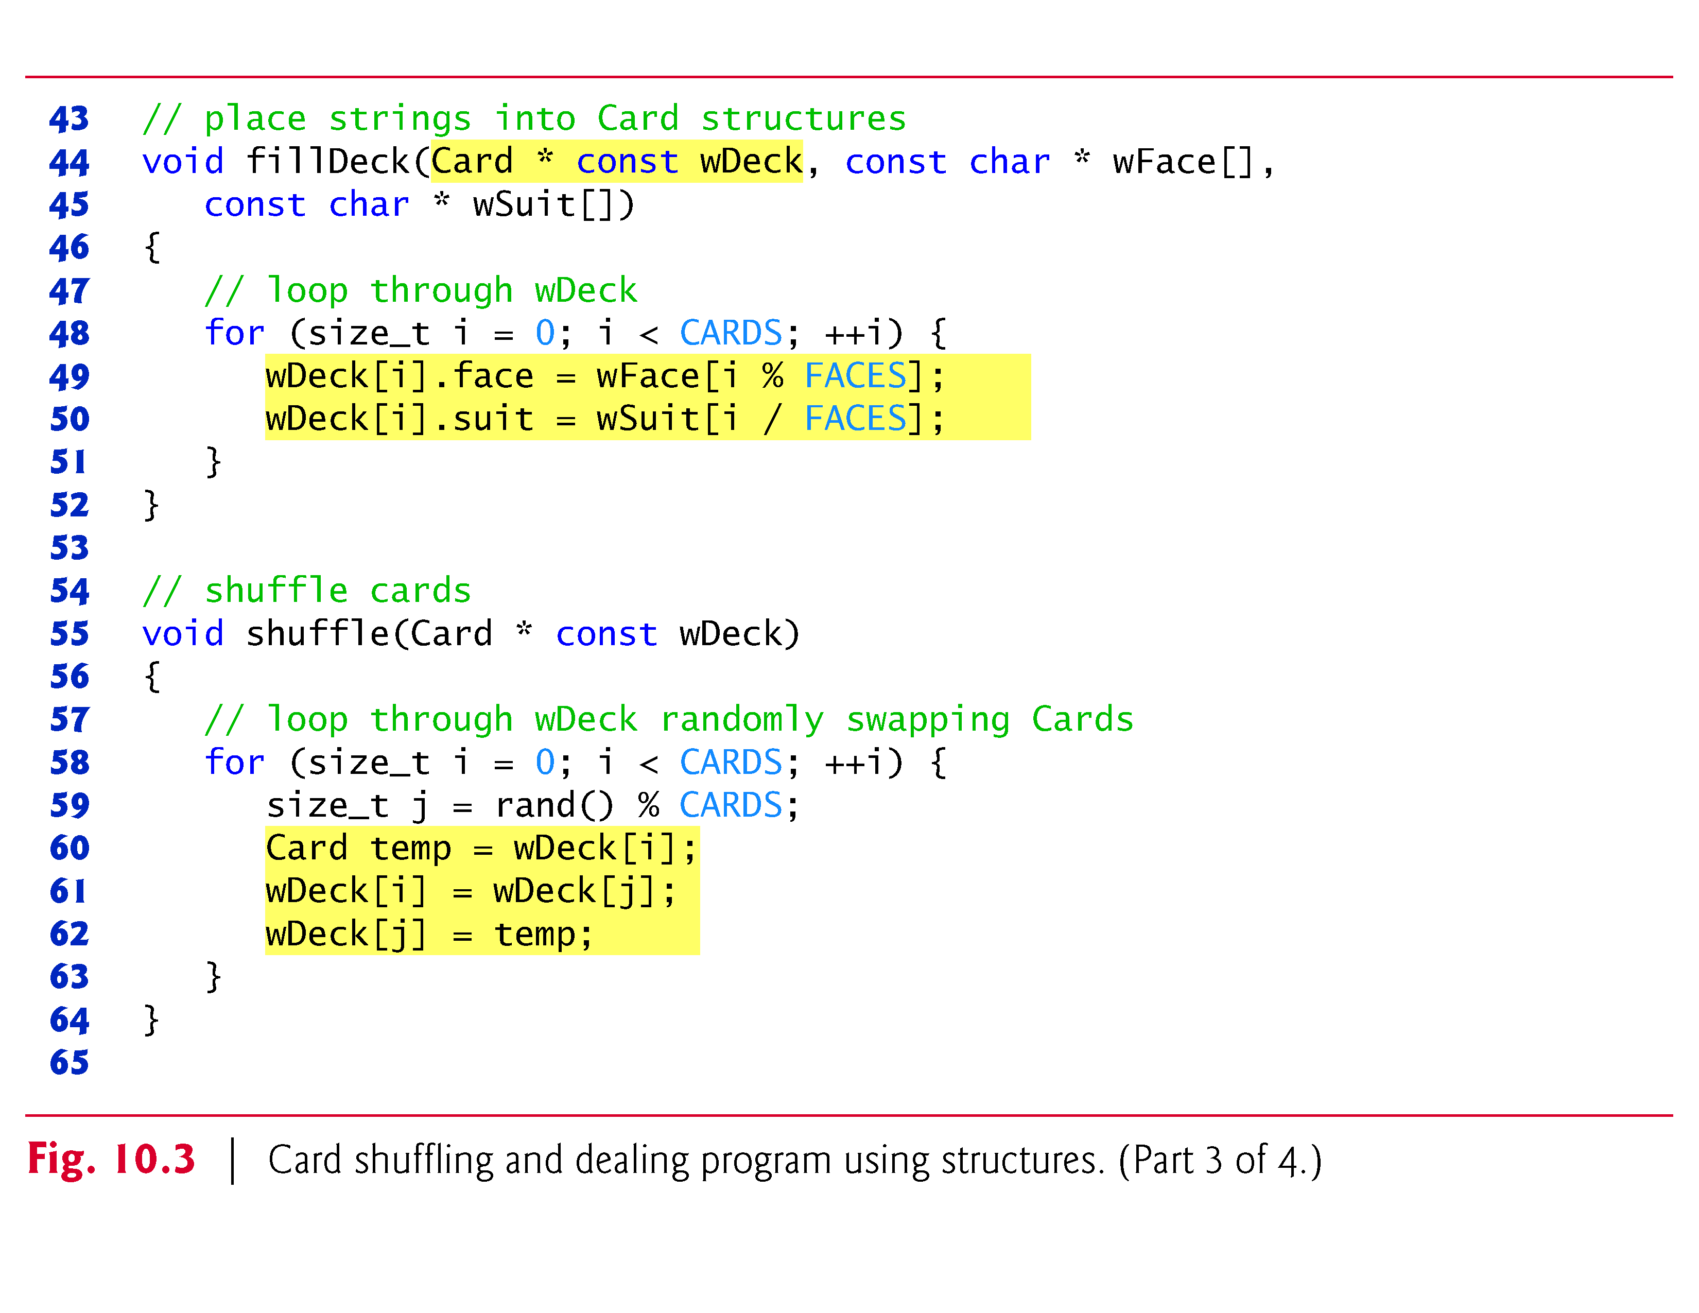
© 2016 Pearson Education, Ltd. All rights reserved.

Slide 33
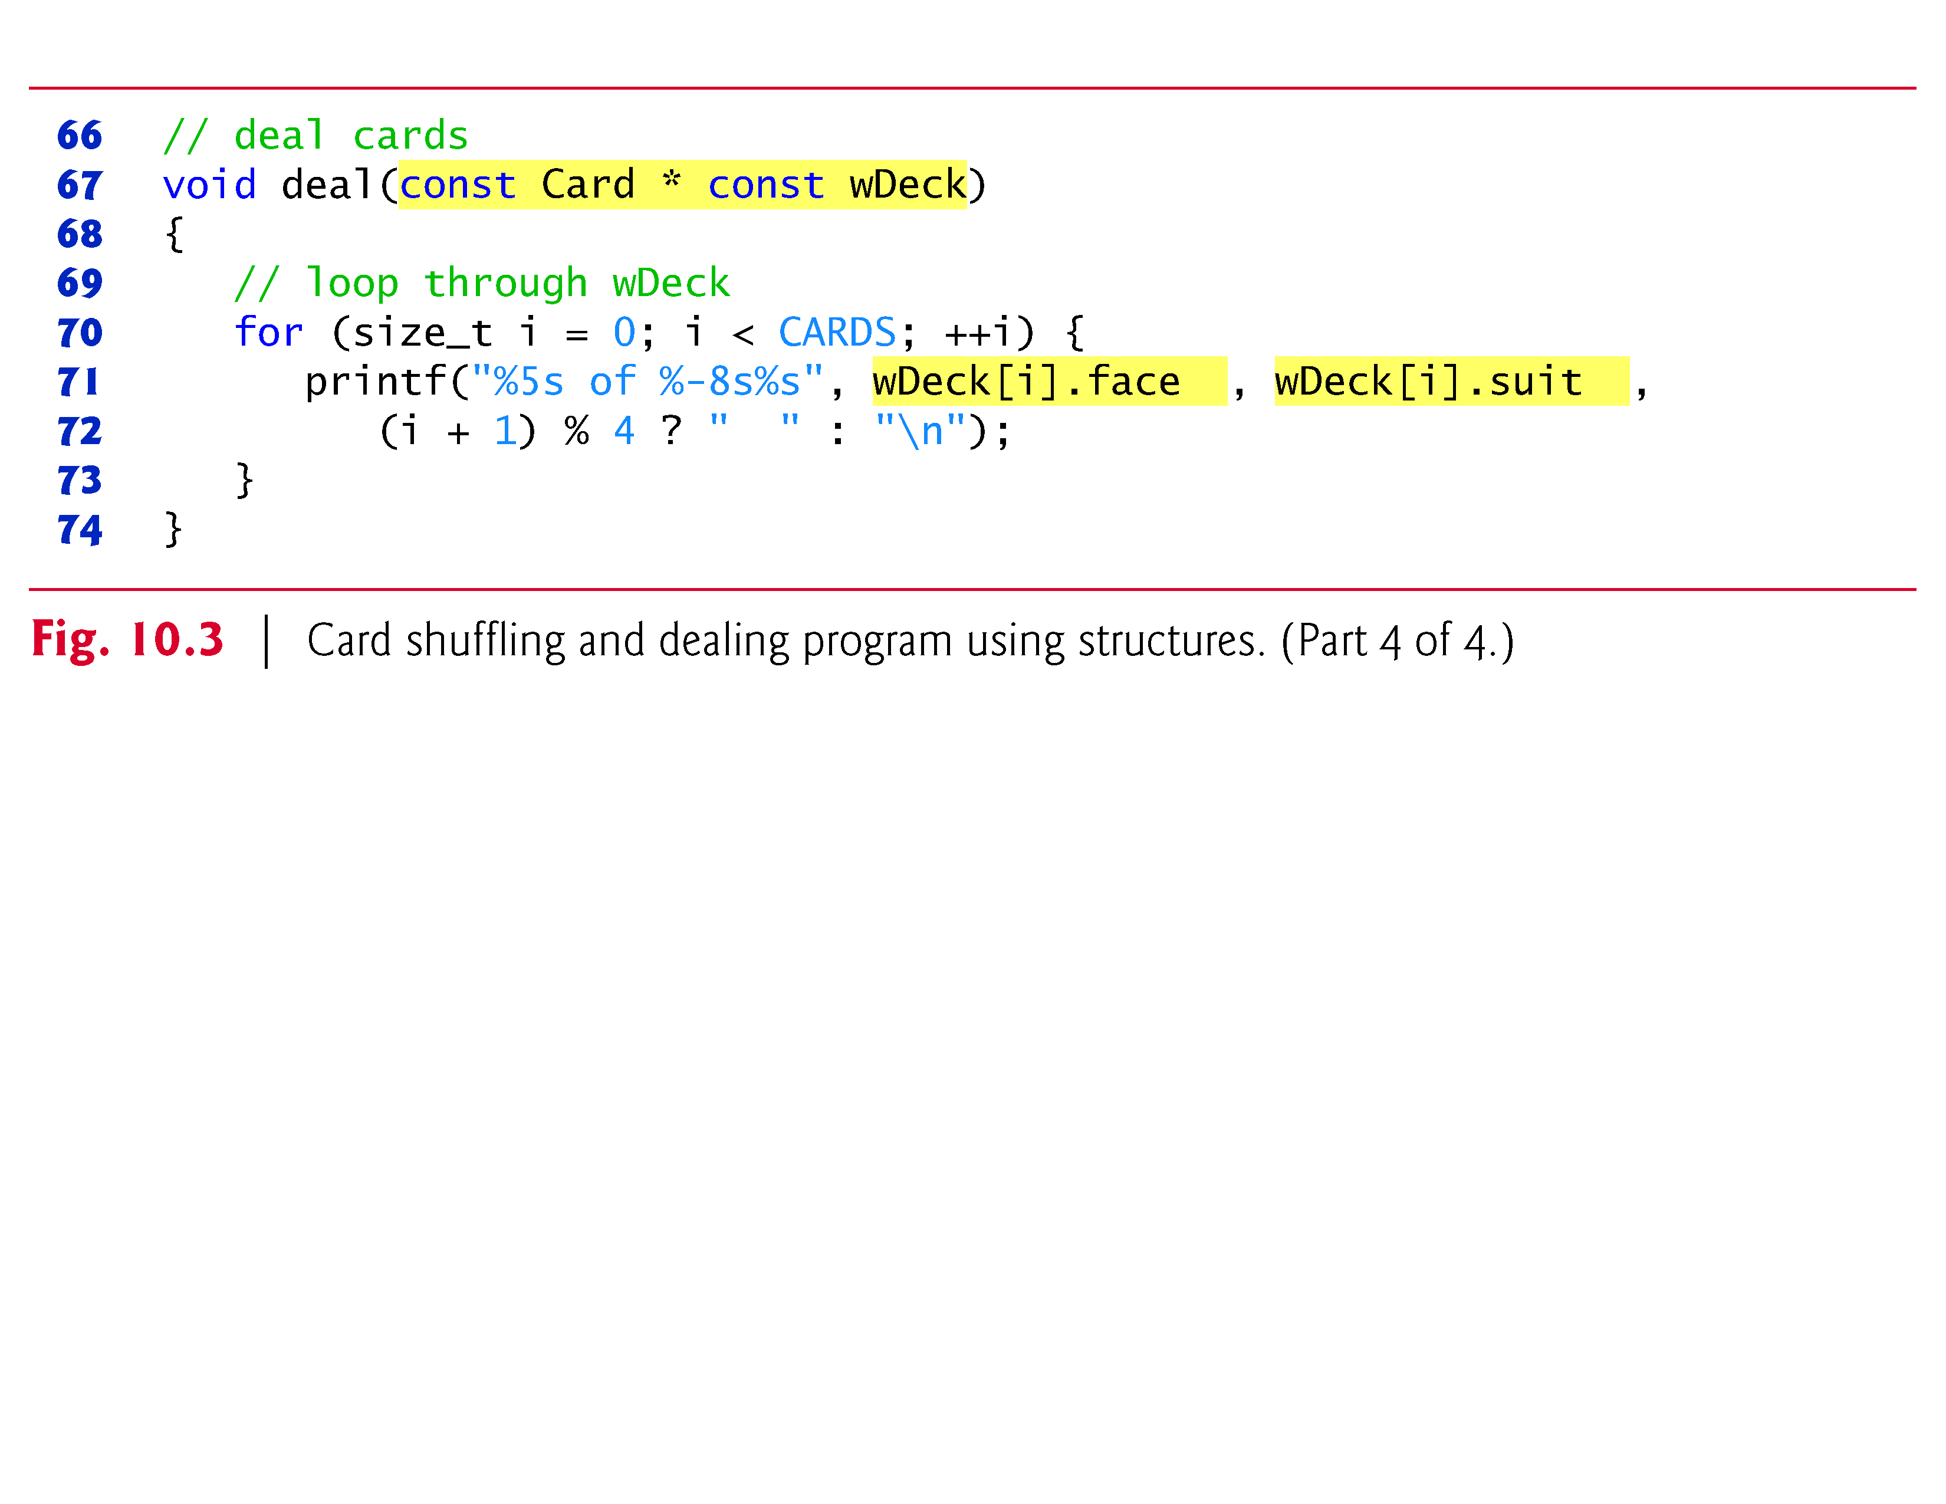
© 2016 Pearson Education, Ltd. All rights reserved.

Slide 34
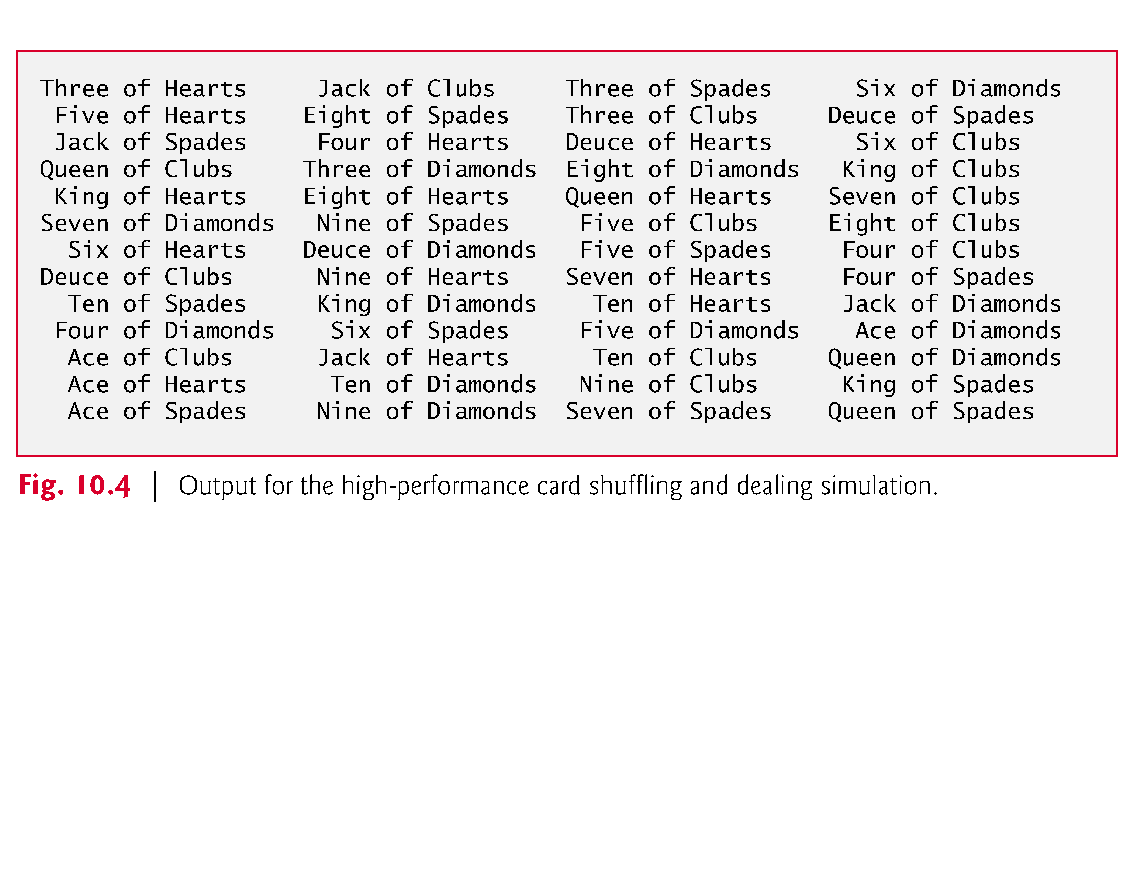
© 2016 Pearson Education, Ltd. All rights reserved.

Slide 35
Unions
union
  Memory that contains a variety of objects over time
  Only contains one data member at a time
  Members of a union share space
  Conserves storage
  Only the last data member defined can be accessed
union definitions
  Same as struct
      union Number {
      int x;
      float y;
      };
      union Number value;

Slide 36
Unions
Valid union operations
  Assignment to union of same type: =
  Taking address: &
  Accessing union members: .
  Accessing members using pointers: ->

Slide 37
/* number union definition */
union number {
int x; /* define int x */
double y; /* define double y */
}; /* end union number */
int main(){
union number value; /* define union value */
value.x = 100; /* put an integer into the union */
printf(“Put a value in the integer member.\n”);
printf(“ int: %d\n double:%f\n\n", value.x, value.y );
value.y = 100.0; /* put a double into the same union */
printf(“Put a value in the floating member.\n”);
printf(“ int: %d\n double:%f\n\n", value.x, value.y );
return 0; /* indicates successful termination */
} /* end main */

Slide 38
Put a value in the integer member.
int: 100
double:-92559592117433136000000000000000000000000000000000000000000000.000000
Put a value in the floating member.
int: 0
double: 100.000000

Slide 39
FILE INPUT/OUTPUT
In this chapter, you will learn:
  To be able to create, read, write and update files.
  To become familiar with sequential access file processing.
  To become familiar with random-access file processing.

Slide 40
Introduction
Data files
  Can be created, updated, and processed by C programs
  Are used for permanent storage of large amounts of data
    Storage of data in variables and arrays is only temporary
When you use a file to store data for use by a program, that file usually consists of text (alphanumeric data) and is therefore called a text file.

Slide 41
The Data Hierarchy
Data Hierarchy:
  Bit – smallest data item
    Value of 0 or 1
  Byte – 8 bits
    Used to store a character
      Decimal digits, letters, and special symbols
  Field – group of characters conveying meaning
    Example: your name
  Record – group of related fields
    Represented by a struct or a class
    Example: In a payroll system, a record for a particular employee that contained his/her identification number, name, address, etc.

Slide 42
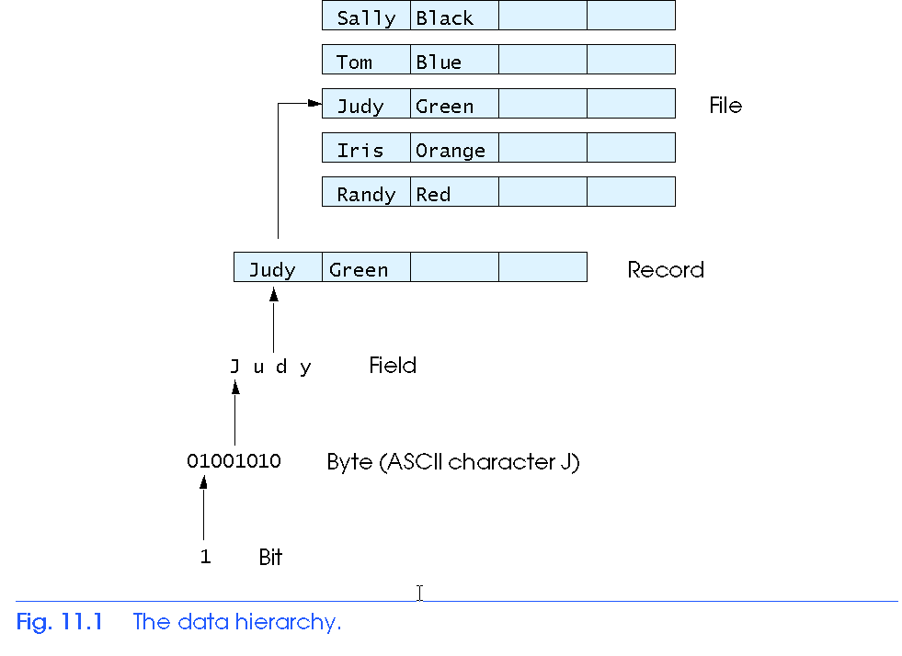
The Data Hierarchy
Data Hierarchy (continued):
  File – group of related records
    Example: payroll file
  Database – group of related files

Slide 43
Files and Streams
C views each file as a sequence of bytes
  File ends with the end-of-file marker
    Or, file ends at a specified byte
Stream created when a file is opened
  Provide communication channel between files and programs
  Opening a file returns a pointer to a FILE structure
    Example file pointers:
    stdin - standard input (keyboard)
    stdout - standard output (screen)
    stderr - standard error (screen)

Slide 44
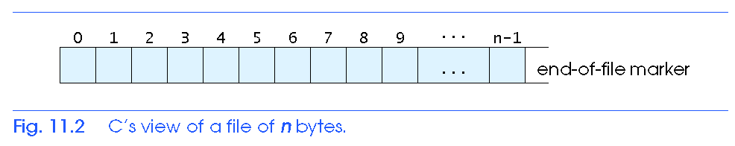
Files and Streams
FILE structure
  File descriptor
    Index into operating system array called the open file table
  File Control Block (FCB)
    Operating system uses it to administer the file (file size, date, name, etc). This structure allows programs to open many files.

Slide 45
Files and Streams
Read/Write functions in standard library
  fscanf / fprintf
    File processing equivalents of scanf and printf
  fgetc
    Reads one character from a file
    Takes a FILE pointer as an argument
    fgetc( stdin ) equivalent to getchar()
  fputc
    Writes one character to a file
    Takes a FILE pointer and a character to write as an argument
    fputc( 'a', stdout ) equivalent to putchar( 'a' )
  fgets
    Reads a line from a file
  fputs
    Writes a line to a file

Slide 46
1 /*
2 Create a sequential file */
3 #include <stdio.h>
4
5 int main()
6 {
7 int account;
8 char name[ 30 ];
9 double balance;
10 FILE *cfPtr; /* cfPtr = clients.dat file pointer */
11
12 if ( ( cfPtr = fopen( "clients.dat", "w" ) ) == NULL )
13 printf( "File could not be opened\n" );
14 else {
15 printf( "Enter the account, name, and balance.\n" );
16 printf( "Enter EOF to end input.\n" );
17 printf( "? " );
18 scanf( "%d%s%lf", &account, name, &balance );
19
20 while ( !feof( stdin ) ) {
21 fprintf( cfPtr, "%d %s %.2f\n", account, name, balance );
22
23 printf( "? " );
24 scanf( "%d%s%lf", &account, name, &balance );
25 }
26
27 fclose( cfPtr );
28 }
29
30 return 0;
31 }

Slide 47
Program Output
Enter the account, name, and balance.
Enter EOF to end input.
? 100 Jones 24.98
? 200 Doe 345.67
? 300 White 0.00
? 400 Stone -42.16
? 500 Rich 224.62
? ^Z

Slide 48
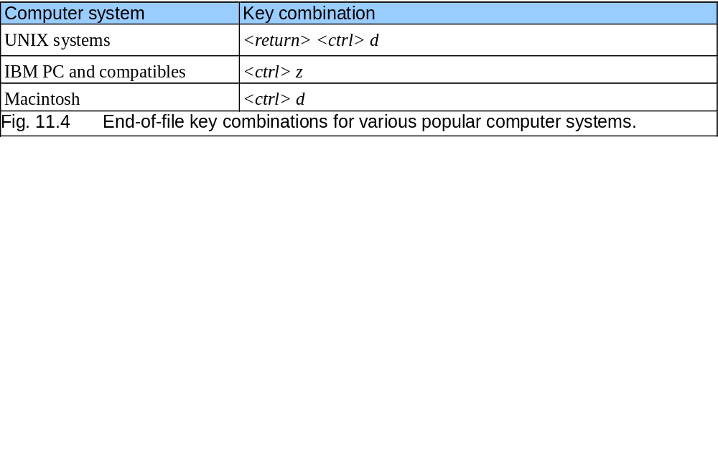
Creating a Sequential Access File
Creating a File
  FILE *myPtr;
    Creates a FILE pointer called myPtr
  myPtr = fopen(filename, openmode);
    Function fopen returns a FILE pointer to file specified
    Takes two arguments – file to open and file open mode
    If open fails, NULL returned

Slide 49
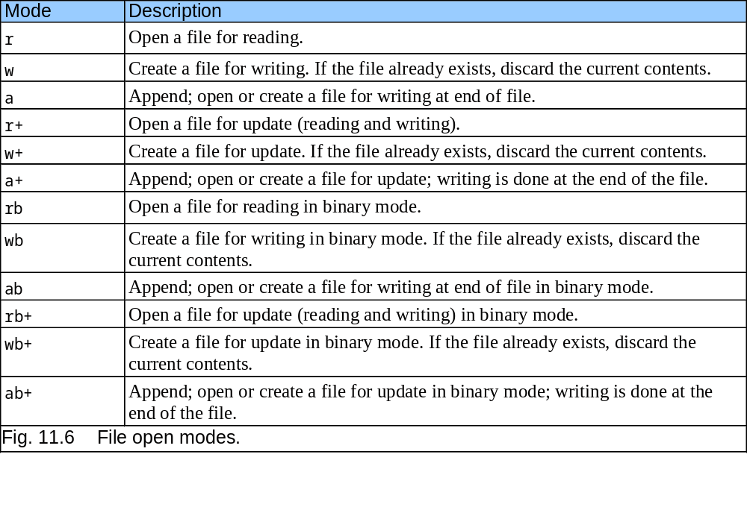
Creating a Sequential Access File

Slide 50
Creating a Sequential Access File
  fprintf
    Used to print to a file
    Like printf, except first argument is a FILE pointer (pointer to the file you want to print in)
  feof( FILE pointer )
    Returns true if end-of-file indicator (no more data to process) is set for the specified file
  fclose( FILE pointer )
    Closes specified file
    Performed automatically when program ends
    Good practice to close files explicitly
Details
  Programs may process no files, one file, or many files
  Each file must have a unique name and should have its own pointer

Slide 51
Reading Data from a File
Reading a sequential access file
  Create a FILE pointer, link it to the file to read
    myPtr = fopen( “myfile.dat", "r" );
  Use fscanf to read from the file
    Like scanf, except first argument is a FILE pointer
    fscanf( myPtr, "%d%s%f", &accounnt, name, &balance );
  Data read from beginning to end
  File position pointer
    Indicates number of next byte to be read / written
    Not really a pointer, but an integer value (specifies byte location)
    Also called byte offset
  rewind( myPtr )
    Repositions file position pointer to beginning of file (byte 0)

Slide 52
1
2 /* Reading and printing a sequential file */
3 #include <stdio.h>
4
5 int main()
6 {
7 int account;
8 char name[ 30 ];
9 double balance;
10 FILE *cfPtr; /* cfPtr = clients.dat file pointer */
11
12 if ( ( cfPtr = fopen( "clients.dat", "r" ) ) == NULL )
13 printf( "File could not be opened\n" );
14 else {
15 printf( "%-10s%-13s%s\n", "Account", "Name", "Balance" );
16 fscanf( cfPtr, "%d%s%lf", &account, name, &balance );
17
18 while ( !feof( cfPtr ) ) {
19 printf( "%-10d%-13s%7.2f\n", account, name, balance );
20 fscanf( cfPtr, "%d%s%lf", &account, name, &balance );
21 }
22
Account Name Balance
100 Jones 24.98
200 Doe 345.67
300 White 0.00
400 Stone -42.16
500 Rich 224.62
23 fclose( cfPtr );
24 }
25
26 return 0;
27 }

Slide 53
Example: Merge two files
#include <stdio.h>
int main()
{ FILE *fileA, /* first input file */
*fileB, /* second input file */
*fileC; /* output file to be created */
int num1, /* number to be read from first file */
num2; /* number to be read from second file */
int f1, f2;
/* Open files for processing */
fileA = fopen("class1.txt","r");
fileB = fopen("class2.txt","r");
fileC = fopen("class.txt","w");

Slide 54
/* As long as there are numbers in both files, read and compare numbers one by one. Write the smaller number to the output file and read the next number in the file from which the smaller number is read. */ f1 = fscanf(fileA, "%d", &num1); f2 = fscanf(fileB, "%d", &num2); while ((f1!=EOF) && (f2!=EOF)){ if (num1 < num2){ fprintf(fileC,"%d\n", num1); f1 = fscanf(fileA, "%d", &num1);
} else if (num2 < num1) { fprintf(fileC,"%d\n", num2); f2 = fscanf(fileB, "%d", &num2);
} else { /* numbs are equal:read from both files */ fprintf(fileC,"%d\n", num1); f1 = fscanf(fileA, "%d", &num1); f2 = fscanf(fileB, "%d", &num2);
}
}

Slide 55
while (f1!=EOF){/* if reached end of second file, read the remaining numbers from first file and write to output file */ fprintf(fileC,"%d\n", num1); f1 = fscanf(fileA, "%d", &num1);
} while (f2!=EOF){ if reached the end of first file, read the remaining numbers from second file and write to output file */ fprintf(fileC,"%d\n", num2); f2 = fscanf(fileB, "%d", &num2);
}
/* close files */ fclose(fileA); fclose(fileB); fclose(fileC); return 0;
} /* end of main */

Slide 56
Reading Data from a Sequential Access File
Sequential access file
  Cannot be modified without the risk of destroying other data
  Fields can vary in size
    Different representation in files and screen than internal representation
    1, 34, -890 are all ints, but have different sizes on disk
300 White 0.00 400 Jones 32.87 (old data in file)
If we want to change White's name to Worthington,
300 Worthington 0.00
300 White 0.00 400 Jones 32.87
Data gets overwritten
300 Worthington 0.00ones 32.87

Slide 57
Random-Access Files
Random access files
  Access individual records without searching through other records
  Instant access to records in a file
  Data can be inserted without destroying other data
  Data previously stored can be updated or deleted without overwriting
Implemented using fixed length records
  Sequential files do not have fixed length records
0
100
200
300
400
500
}
byte offsets
}
}
}
}
}
}
100
bytes
100
bytes
100
bytes
100
bytes
100
bytes
100
bytes

Slide 58
Creating a Randomly Accessed File
Data in random access files
  Unformatted (stored as "raw bytes")
    All data of the same type (ints, for example) uses the same amount of memory
    All records of the same type have a fixed length
    Data not human readable

Slide 59
Creating a Randomly Accessed File
Unformatted I/O functions
  fwrite
    Transfer bytes from a location in memory to a file
  fread
    Transfer bytes from a file to a location in memory
  Example:
    fwrite( &number, sizeof( int ), 1, myPtr );
    &number – Location to transfer bytes from
    sizeof( int ) – Number of bytes to transfer
    1 – For arrays, number of elements to transfer
      In this case, "one element" of an array is being transferred
    myPtr – File to transfer to or from

Slide 60
Creating a Randomly Accessed File
Writing structs
  fwrite( &myObject, sizeof (struct myStruct), 1, myPtr );
  sizeof – returns size in bytes of object in parentheses
To write several array elements
  Pointer to array as first argument
  Number of elements to write as third argument

Slide 61
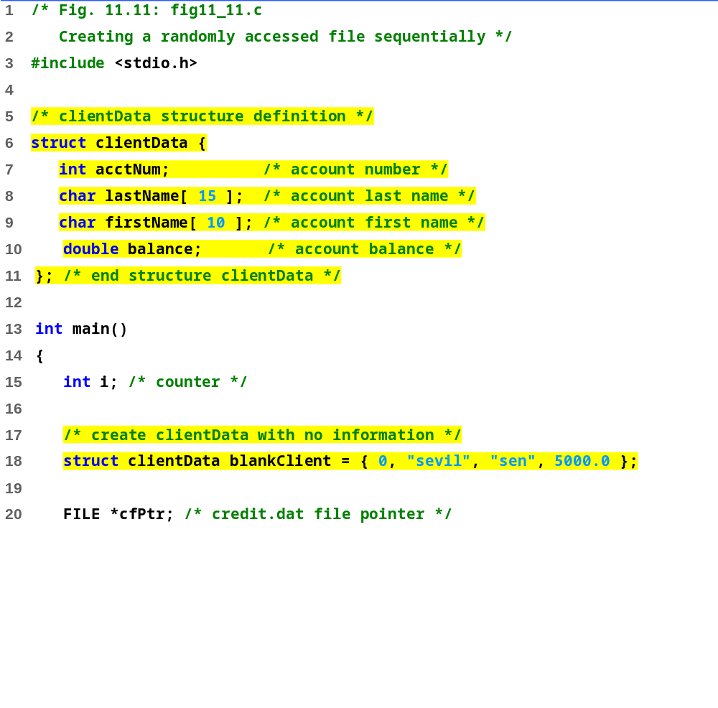

Slide 62
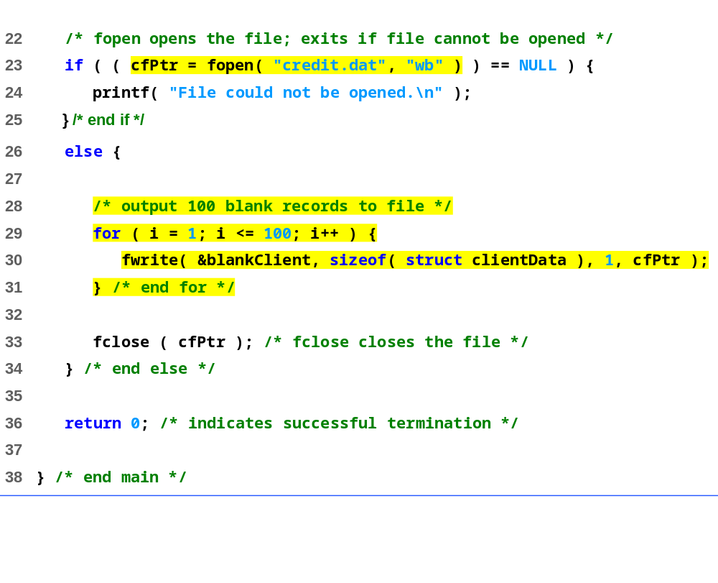

Slide 63
Writing Data Randomly to a Randomly Accessed File
fseek
  Sets file position pointer to a specific position
  fseek( pointer, offset, symbolic_constant );
    pointer – pointer to file
    offset – file position pointer (0 is first location)
    symbolic_constant – specifies where in file we are reading from
    SEEK_SET – seek starts at beginning of file
    SEEK_CUR – seek starts at current location in file
    SEEK_END – seek starts at end of file

Slide 64
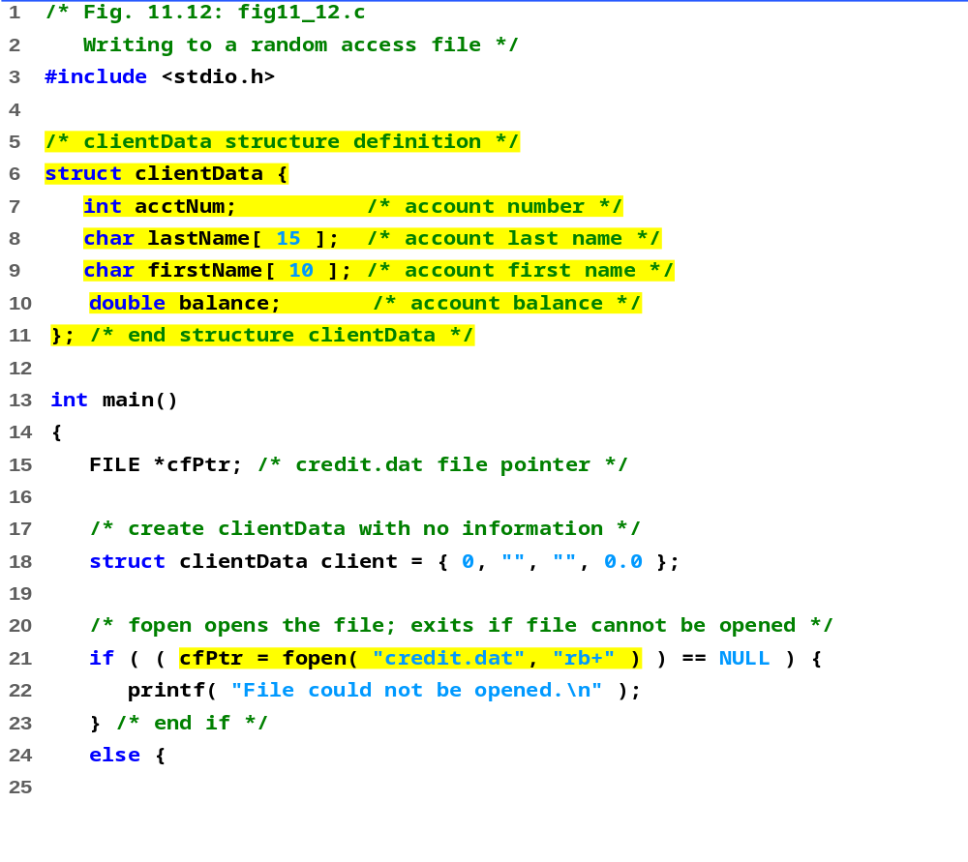

Slide 65
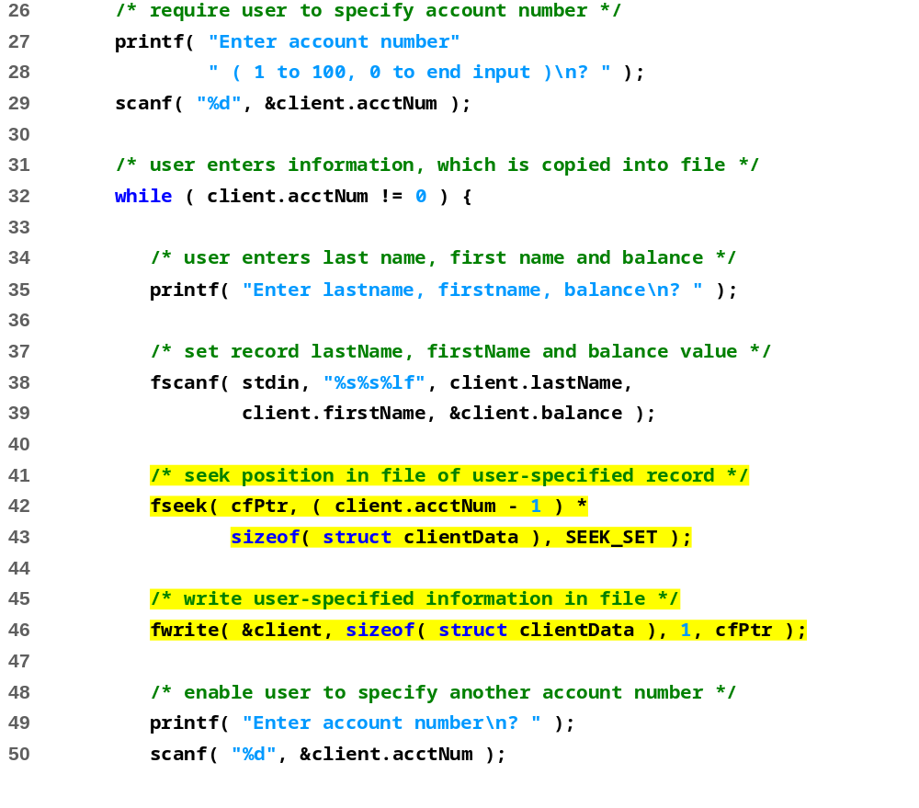

Slide 66
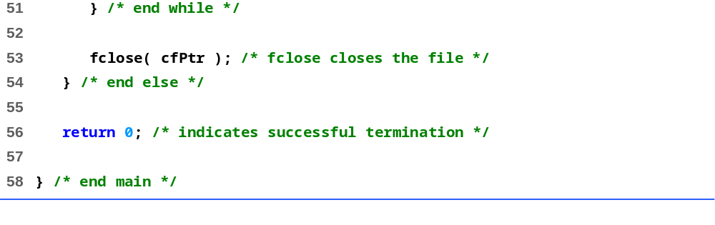
Enter account number ( 1 to 100, 0 to end input )
? 37
Enter lastname, firstname, balance
? Barker Doug 0.00
Enter account number
? 29
Enter lastname, firstname, balance
? Brown Nancy -24.54
Enter account number
? 96
Enter lastname, firstname, balance
? Stone Sam 34.98
Enter account number
? 88
Enter lastname, firstname, balance
? Smith Dave 258.34
Enter account number
? 33
Enter lastname, firstname, balance
? Dunn Stacey 314.33
Enter account number
? 0

Slide 67
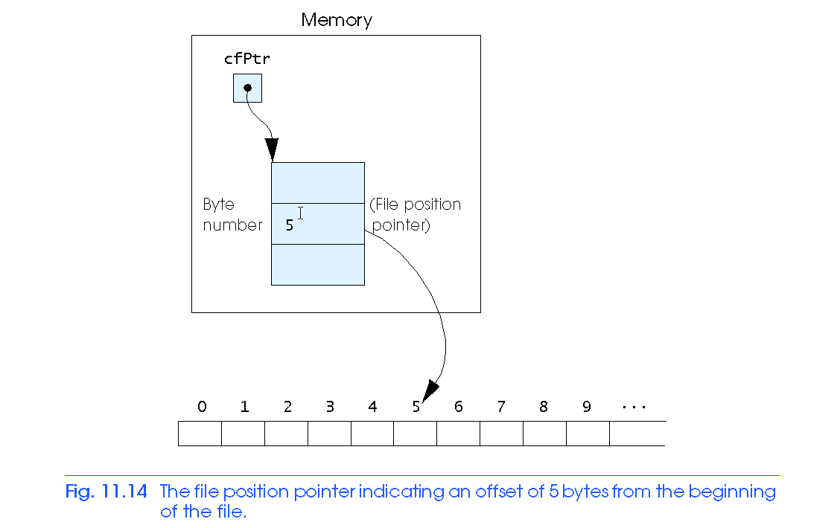
Writing Data Randomly to a Randomly Accessed File

Slide 68
Reading Data Randomly from a Randomly Accessed File
fread
  Reads a specified number of bytes from a file into memory
    fread( &client, sizeof (struct clientData), 1, myPtr );
  Can read several fixed-size array elements
    Provide pointer to array
    Indicate number of elements to read
  To read multiple elements, specify in third argument

Slide 69
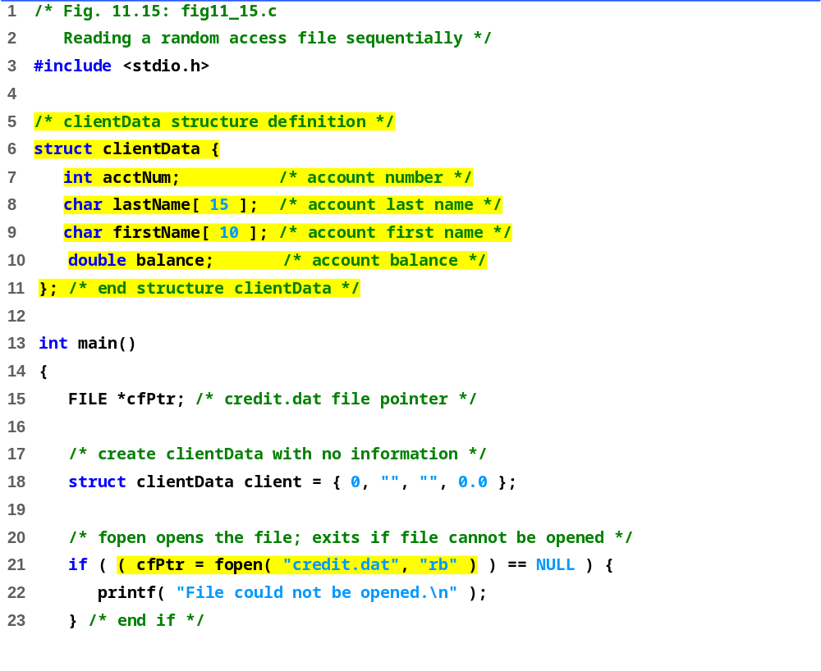

Slide 70
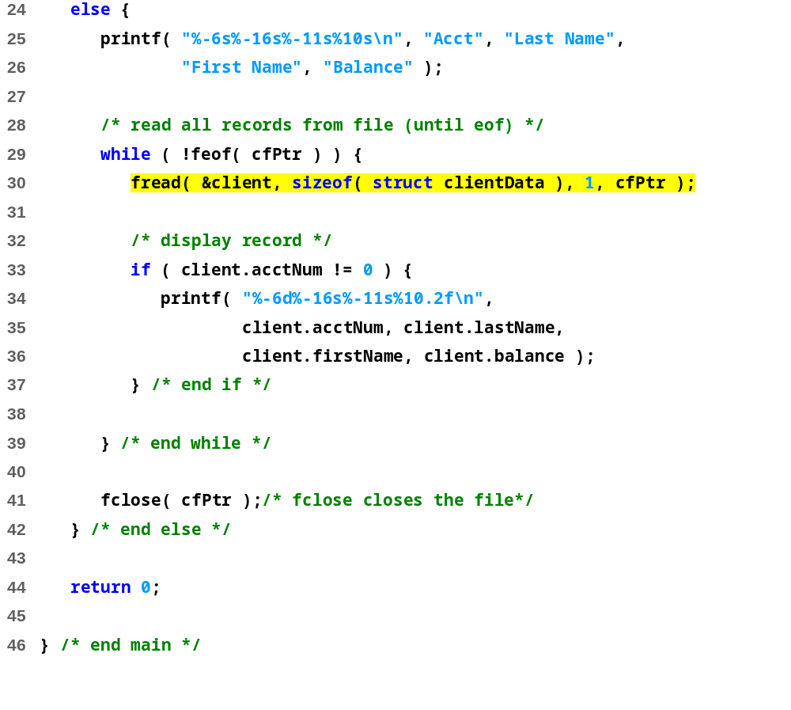
Acct Last Name First Name Balance
29 Brown Nancy -24.54
33 Dunn Stacey 314.33
37 Barker Doug 0.00
88 Smith Dave 258.34
96 Stone Sam 34.98

