Slide 1
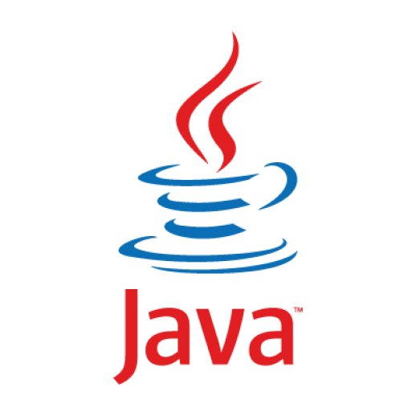
BBM 102 – Introduction to Programming II Spring 2018
Introduction to Java &
Introduction to Object Orientation

Slide 2
Today
Introduction to Java
Java as a Platform
Your First Java Program
Basic Programming Elements
Object Oriented Paradigm
Principles of Object Orientation
Classes and Objects
Sample Object Designs

Slide 3

What is Java?
Informal. Brewed coffee.

Slide 4
What is Java?
A technology which is both a programming language and a platform.
Developed by Sun Microsystems.
First public version was released in 1995.

Slide 5
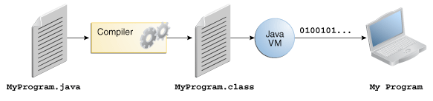
Software Development with Java
All source code is first written in plain text files ending with the “.java” extension.
Those source files are then compiled into “.class” files by the javac compiler.
A “.class” file does not contain code that is native to your processor; it instead contains bytecodes — the machine language of the Java Virtual Machine (Java VM).
The java launcher tool then runs your application with an instance of the Java Virtual Machine, i.e. your code is run by JVM.
http://docs.oracle.com/javase/tutorial/getStarted/intro/definition.html

Slide 6
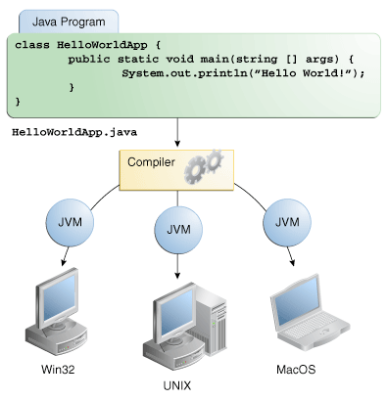
Platform Independence: Write Once Run Anywhere
Because the Java VM is available on many different operating systems, the same .class files are capable of running on Microsoft Windows, the Solaris™ Operating System (Solaris OS), Linux, or Mac OS.
http://docs.oracle.com/javase/tutorial/getStarted/intro/definition.html

Slide 7
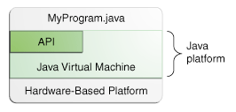
The Java Platform
A platform is the hardware or software environment in which a program runs.
The Java platform has two components:
The Java Virtual Machine: It's the base for the Java platform and is ported onto various hardware-based platforms
The Java Application Programming Interface (API): It is a large collection of ready-made software components that provide many useful capabilities.
As a platform-independent environment, the Java platform can be a bit slower than native code.
However, advances in compiler and virtual machine technologies are bringing performance close to that of native code without threatening portability.
http://docs.oracle.com/javase/tutorial/getStarted/intro/definition.html

Slide 8
Your First Java Program
HelloWorld.java
public class HelloWorld {
public static void main(String[] args) {
System.out.println("Hello world!");
}
}
$ javac HelloWorld.java ← Compile
$ java HelloWorld ← Run
Hello world!

Slide 9
Basic Programming Elements
Variables, Types and Expressions
Flow of Control
Branching
Loops

Slide 10
Variables
Variables in a program are used to store data such as numbers and letters. They can be thought of as containers of a sort.
You should choose variable names that are helpful. Every variable in a Java program must be declared before it is used for the first time.
A variable declaration consists of a type name, followed by a list of variable names separated by commas. The declaration ends with a semicolon.
^{Syntax:}
data_type variable_name [ = initial_value ];
int styleNumber, numberOfChecks, numberOfDeposits;
^{double amount, interestRate;}
^{char answer;}

Slide 11
Primitive Data Types
Type Name | Kind of Value | Memory Used | Range of Values
byte | Integer | 1 byte | -128 to 127
short | Integer | 2 bytes | -32,768 to 32,767
int | Integer | 4 bytes | -2,147,483,648 to 2,147,483,647
long | Integer | 8 bytes | -9,223,372,036,8547,75,808 to 9,223,372,036,854,775,807
float | Floating-point | 4 bytes | ±3.40282347 × 10+38 to ±1.40239846 × 10−45
double | Floating-point | 8 bytes | ±1.79769313486231570 × 10+308 to ±4.94065645841246544 × 10−324
char | Single character (Unicode) | 2 bytes | All Unicode values from 0 to 65,535
boolean |  | 1 bit | True or false
There are also Class Data Types which we will cover later.

Slide 12
Identifiers
The technical term for a name in a programming language, such as the name of a variable, is an identifier.
An identifier can contain only letters, digits 0 through 9, and the underscore character “_”.
The first character in an identifier cannot be a digit.
There is no limit to the length of an identifier.
Java is case sensitive (e.g., personName and personname are two different variables).
^{Identifier Valid?}
^{outputStream}
^{4you}
^{my.work}
^{FirstName}
^{_tmp}
^{public}
^{Yes}
^{No}
^{No}
^{Yes}
^{Yes}
^{No}
public is a
reserved word.

Slide 13
Java Reserved Words
abstract | assert | boolean | break | byte | case
catch | char | class | const | continue | default
double | do | else | enum | extends | false
final | finally | float | for | goto | if
implements | import | instanceof | int | interface | long
native | new | null | package | private | protected
public | return | short | static | strictfp | super
switch | synchronized | this | throw | throws | transient
true | try | void | volatile | while

Slide 14
Naming Conventions
Class types begin with an uppercase letter (e.g. String).
Primitive types begin with a lowercase letter (e.g. float).
Variables of both class and primitive types begin with a lowercase letters (e.g. firstName, classAverage).
Multiword names are "punctuated" using uppercase letters.

Slide 15
Assignment Statements
An assignment statement is used to assign a value to a variable.
The "equal sign" is called the assignment operator
Syntax: where expression can be another variable, a literal or constant, or something to be evaluated by using operators.
^{variable_name = expression;}
^{amount = 100;}
^{interestRate = 0.12;}
^{answer = ‘Y’;}
fullName = firstName + “ “ + lastName;

Slide 16
Initializing Variables
A variable that has been declared, but not yet given a value is said to be uninitialized.
Uninitialized class variables have the value null.
Uninitialized primitive variables may have a default value.
It's good practice not to rely on a default value.
Data Type | Default Value
byte | 0
short | 0
int | 0
long | 0L
float | 0.0f
double | 0.0d
char | '\u0000'
String (or any object) | null
boolean | FALSE

Slide 17
Constants
Literal expressions such as 2, 3.7, or 'y' are called constants.
Integer constants can be preceded by a + or - sign, but cannot contain commas.
Floating-point constants can be written with digits after a decimal point or using e notation.
765000000.0 can be written as 7.65e8
0.000483 can be written as 4.83e-4

Slide 18
Imprecision in Floating Point Numbers
Floating-point numbers often are only approximations since they are stored with a finite number of bits.
Hence 1.0/3.0 is slightly less than 1/3.
1.0/3.0 + 1.0/3.0 + 1.0/3.0 is less than 1.

Slide 19
Named Constants
Java provides a mechanism that allows you to define a variable, initialise it, and moreover fix the variable’s value so that it cannot be changed. public static final Type Variable = Constant;
The convention for naming constants is to use all uppercase letters, with an underscore symbol “_” between words. public static final double PI = 3.14159; public static final int DAYS_PER_WEEK = 7; … float area = PI * r * r ; int daysInYear = 52 * DAYS_PER_WEEK ;

Slide 20
Assignment Compatibility
Java is strongly typed.
A value of one type can be assigned to a variable of any type further to the right (not to the left):
byte → short → int → long → float → double
You can assign a value of type char to a variable of type int.

Slide 21
Type Conversion (Casting)
Implicit conversion
Explicit conversion
double doubleVariable = 5; // 5.0
^{int intVariable = 5; // 5}
doubleVariable = intVariable; // 5.0
^{double doubleVariable = 5.0;}
int intVariable = doubleVariable ; // Illegal
int intVariable = (int) doubleVariable ; // Legal, 5

Slide 22
Operators and Precedence
Precedence
First: The unary operators: plus (+), minus(-), not (!), increment (++) and decrement (--)
Second: The binary arithmetic operators: multiplication (*), integer division (/) and modulus (%)
Third: The binary arithmetic operators: addition (+) and subtraction (-)
When binary operators have equal precedence, the operator on the left acts before the operator(s) on the right.
When unary operators have equal precedence, the operator on the right acts before the operation(s) on the left.
Parenthesis can change the precedence.

Slide 23
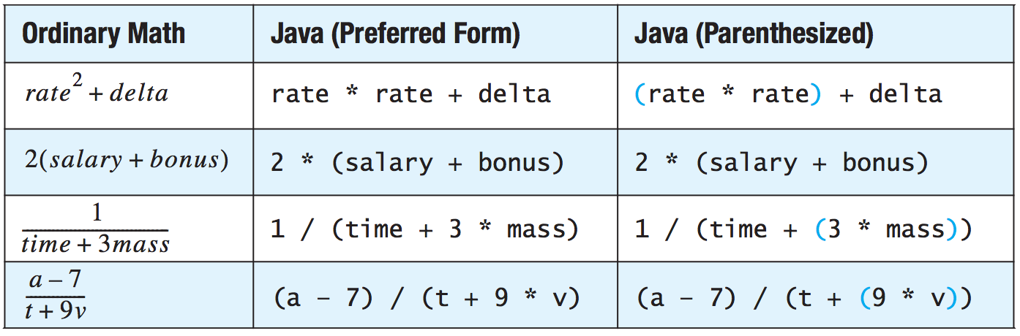
Operators and Precedence - Example
Figure from “Java - An Introduction to Problem Solving and Programming, Walter Savitch, Pearson, 2012”

Slide 24
Arrays
Array is a sequence of values.
Array indices begin at zero.
Defining Arrays
Initialising Arrays
Base_Type[] Array_Name = new Base_Type[Length];
int[] numbers = new int[100]; // or,
int[] numbers;
numbers = new int[100];
double[] reading = {3.3, 15.8, 9.7}; // or,
double[] reading = new double[3];
reading[0] = 3.3;
reading[1] = 15.8;
reading[2] = 9.7;

Slide 25
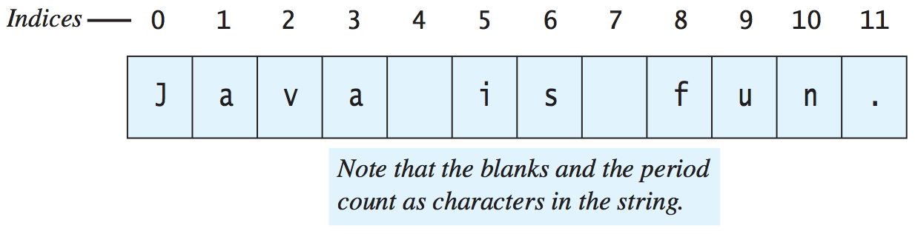
Strings
A value of type String is a
Sequence (Array) of characters treated as a single item
Character positions start with 0
Can be declared in three ways:
String greeting;
greeting = "Hello World!”;
String greeting = "Hello World!”;
String greeting = new String("Hello World!”);
Figure from “Java - An Introduction to Problem Solving and Programming, Walter Savitch, Pearson, 2012”

Slide 26
Concatenating Strings
You can connect—or join or paste—two strings together to obtain a larger string. This operation is called concatenation and is performed by using the “+” operator.
String greeting, sentence;
greeting = "Hello”;
sentence = greeting + “ my friend!”;
System.out.println(sentence); // Hello my friend!
String solution = “The answer is ” + 42;
System.out.println(solution); // The answer is 42
// Java converts the number constant 42 to the
// string constant "42" and then concatenates the
// two strings

Slide 27
String Methods
Homework: Investigate the methods given below. You will be responsible in the exams.
charAt (Index) | length()
compareTo(A_String) | replace(OldChar, NewChar)
concat(A_String) | substring(Start)
equals(Other_String) | substring(Start,End)
equalsIgnoreCase(Other_String) | toLowerCase()
indexOf(A_String) | toUpperCase()
lastIndexOf(A_String) | trim()

Slide 28
Boolean Type
Java has the logical type boolean
Type boolean has two literal constants
true
false
int number = −5;
boolean isPositive = (number > 0); // False

Slide 29
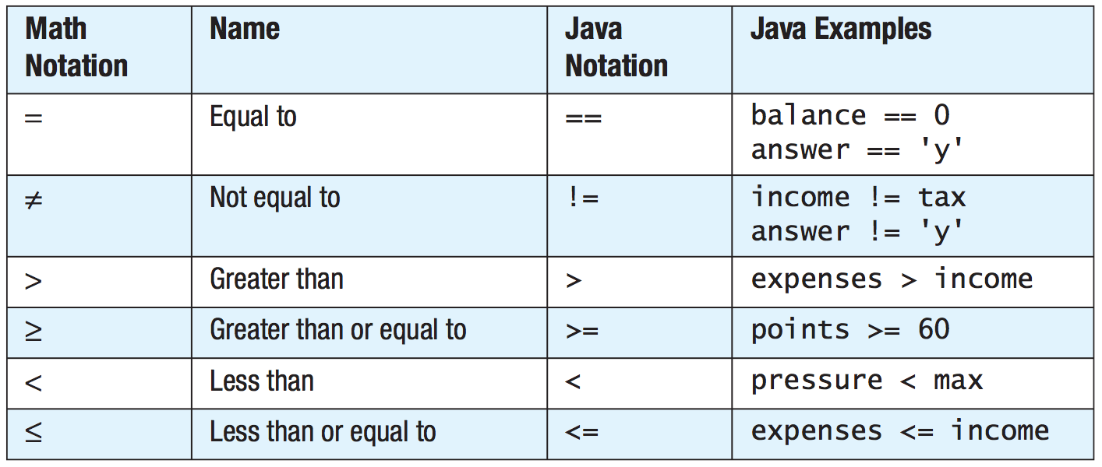
Java Comparison Operators
Figure from “Java - An Introduction to Problem Solving and Programming, Walter Savitch, Pearson, 2012”

Slide 30
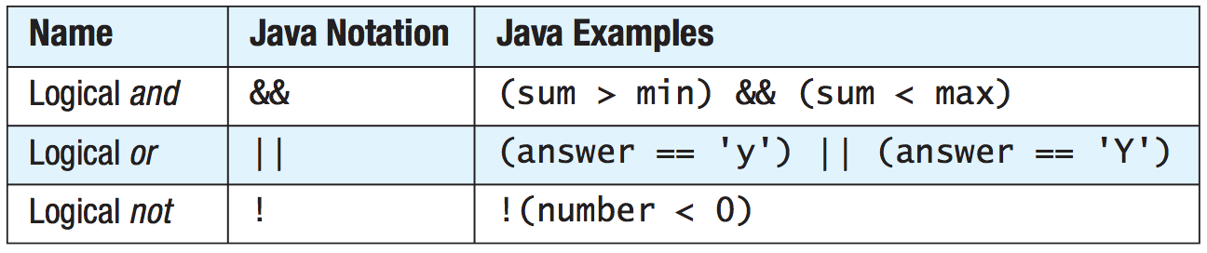
Java Logical Operators
Figure from “Java - An Introduction to Problem Solving and Programming, Walter Savitch, Pearson, 2012”

Slide 31
Flow of Control
Flow of control is the order in which a program performs actions.
A branching statement chooses between two or more possible actions.
If-else, switch statements
A loop statement repeats an action until a stopping condition occurs.
For, while, do-while loops

Slide 32
Basic if Statement
Syntax
if (Expression)
Action
If the Expression is true then execute Action
Action is either a single statement or a group of statements within braces
if (value2 < value1) { // Rearrange numbers so
int tmp = value1; // value2 variable should
value1 = value2; // hold the bigger value
value2 = tmp;
}

Slide 33
if-else Statement
Syntax
if (Expression)
Action1
else Action2
If Expression is true then execute Action1 otherwise execute Action2
The actions are either a single statement or a list of statements within braces
int maximum;
if (value1 < value2) { // is value2 larger?
maximum = value2; // yes: value2 is larger
}
else { // (value1 >= value2)
maximum = value1; // no: value2 is not larger
}

Slide 34
if-else Statement
If statements can be nested (also called as multi-way, multi-branch if statement)
if (a == ‘0’)
System.out.println (“zero”);
else if (a == ‘1’)
System.out.println (“one”);
else if (a == ‘2’)
System.out.println (“two”);
else if (a == ‘3’)
System.out.println (“three”);
else if (a == ‘4’)
System.out.println (“four”);
else
System.out.println (“five+”);

Slide 35
Switch Statement
Switch statement can be used instead of multi-way if statement.
Syntax switch(controlling_expression) { case expression1: action1; break; case expression2: action2; break; … default: actionN; }
Every case ends with break statement.

Slide 36
Switch Statement
Switch statements are more readable than nested if statements
switch (a) {
case ‘0’:
System.out.println (“zero”); break;
case ‘1’:
System.out.println (“one”); break;
case ‘2’:
System.out.println (“two”); break;
case ‘3’:
System.out.println (“three”); break;
case ‘4’:
System.out.println (“four”); break;
default:
System.out.println (“five+”); break;
}

Slide 37
The Conditional (Ternary) Operator
The ? and : together are called the conditional operator or ternary operator. can be written as:
if (n1 > n2)
max = n1;
else
max = n2;
max = (n1 > n2) ? n1 : n2;

Slide 38
for Loops
The for loop is a pretest loop statement. It has the following form. for (initialisation; boolean-expression; increment){ nested-statements }
initialisation is evaluated first.
boolean-expression is tested before each iteration of the loop.
increment is evaluated at the end of each iteration.
nested-statements is a sequence of statements. If there is only one statement then the braces may be omitted

Slide 39
Varying Control Variable
for ( int i = 1; i <= 100; i++ )
from 1 to 100 in increments of 1
for ( int i = 100; i >= 1; i-- )
from 100 to 1 in increments of -1
for ( int i = 7; i <= 77; i += 7 )
from 7 to 77 in increments of 7
for ( int i = 20; i >= 2; i -= 2 )
from 20 to 2 in decrements of 2

Slide 40
For Loop Example
String[] classList = {"Jean", "Claude", "Van",
"Damme"};
for (int i=0; i<classList.length; i++) {
System.out.println(classList[i]);
}
Jean
Claude
Van
Damme
Jean
Claude
Van
Damme
for (String name : classList) {
System.out.println(name);
}

Slide 41
While Loop
The while loop is a pretest loop statement. It has the following form. while (boolean-expression) { nested-statements }
boolean-expression is an expression that can be true or false.
nested-statements is a sequence of statements. If there is only one statement then the braces can be omitted.
The boolean expression is tested before each iteration of the loop. The loop terminates when it is false.

Slide 42
While Loop Example
int[] numbers = { 1, 5, 3, 4, 2 };
int i=0, key = 3;
boolean found = false;
while (!found){
if (numbers[i++] == key)
found=true;
}
if (found)
System.out.println("Key is found in the array");
else
System.out.println("Key is NOT found!");
key = 33;
Let’s look for something that does not exist.
Is there a problem here?

Slide 43
While Loop Example
int[] numbers = { 1, 5, 3, 4, 2 };
int i=0, key = 3;
boolean found = false;
while (!found && i<numbers.length){
if (numbers[i++] == key)
found=true;
}
if (found)
System.out.println("Key is found in the array");
else
System.out.println("Key is NOT found!");
key = 33;
Make sure that the loop ends somehow.
Figure from “Java - An Introduction to Problem Solving and Programming, Walter Savitch, Pearson, 2012”

Slide 44
Do-While Loop
The do-while loop is a post-test loop statement. It has the following form. do { nested-statements } while (boolean-expression);
nested-statements is a sequence of statements. If there is only one statement then the braces may be omitted.
boolean-expression is an expression that can be true or false.
The boolean expression is tested after each iteration of the loop. The loop terminates when it is false.

Slide 45
Do-While Example
Scanner scan = new Scanner(System.in);
int myNumber;
do {
System.out.println(
"Enter a number between 0 and 100: ");
myNumber = scan.nextInt();
} while (!(myNumber >= 0 && myNumber <= 100));
System.out.println("You entered a valid number");

Slide 46
Break Statement
The break statement is used in loop (for, while, and do-while) statements and switch statements to terminate execution of the statement. A break statement has the following form. break;
After a break statement is executed, execution proceeds to the statement that follows the enclosing loop or switch statement.
Use break statements sparingly (if ever).

Slide 47
Continue Statement
A continue statement
Ends current loop iteration
Begins the next one
Use of continue statement is not recommended
Introduce unneeded complications

Slide 48
Breaking a Loop
int[] numbers = { 1, 5, 3, 4, 2 };
int i = 0, key = 3;
while (i < numbers.length) {
if (numbers[i] == key)
break;
i++;
}
if (i < numbers.length)
System.out.println("Key is found in the array");
else
System.out.println("Key is NOT!");

Slide 49
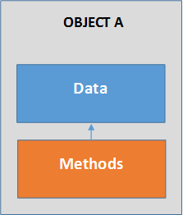
Object-Oriented Paradigm
Centered on the concept of the object
Object
Is data with methods
Data (attributes) can be simple things like number or character strings, or they can be other objects.
Defines things that are responsible for themselves
Data to know what state the object is in.
Method (code) to function properly.

Slide 50
What is an Object?
Informally, an object represents an entity which is either physical, conceptual or software.
Physical entity
Conceptual entity
Software entity
Truck
Bank Account
Chemical Process
Linked List
OOAD Using the UML - Introduction to Object Orientation, v 4.2, 1998-1999 Rational Software

Slide 51
Basic Principles of Object Orientation
Object Orientation
Abstraction
Encapsulation
Modularity
Hierarchy
OOAD Using the UML - Introduction to Object Orientation, v 4.2, 1998-1999 Rational Software

Slide 52
What is Abstraction?
Abstraction is one of the fundamental ways that we as humans cope with complexity.
Salesperson
Not saying
which salesperson
just a salesperson in general!
Product
Customer
Dahl, Dijkstra, and Hoare suggest that “abstraction arises from a recognition of similarities between certain objects, situations, or processes in the real world, and the decision to concentrate upon these similarities and to ignore for the time being the differences”.
OOAD Using the UML - Introduction to Object Orientation, v 4.2, 1998-1999 Rational Software

Slide 53
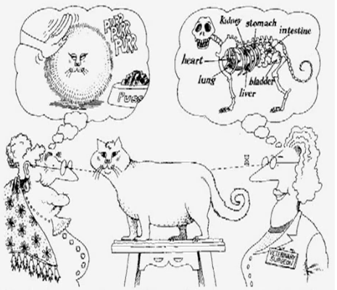
What is Abstraction?
Abstraction focuses upon the essential characteristics of some object, relative to the perspective of the viewer.

Slide 54
What is Abstraction?
Abstraction is the process of removing physical, spatial, or temporal details or attributes in the study of objects or systems in order to more closely attend to other details of interest.
The essence of abstractions is preserving information that is relevant in a given context, and forgetting information that is irrelevant in that context.

Slide 55
What is Encapsulation?
Hide implementation from clients
Clients depend on interface
Information Hiding:
How does an object encapsulate?
What does it encapsulate?
Abstraction and encapsulation are complementary concepts: Abstraction focuses on the observable behavior of an object, whereas encapsulation focuses on the implementation that gives rise to this behavior.
OOAD Using the UML - Introduction to Object Orientation, v 4.2, 1998-1999 Rational Software

Slide 56
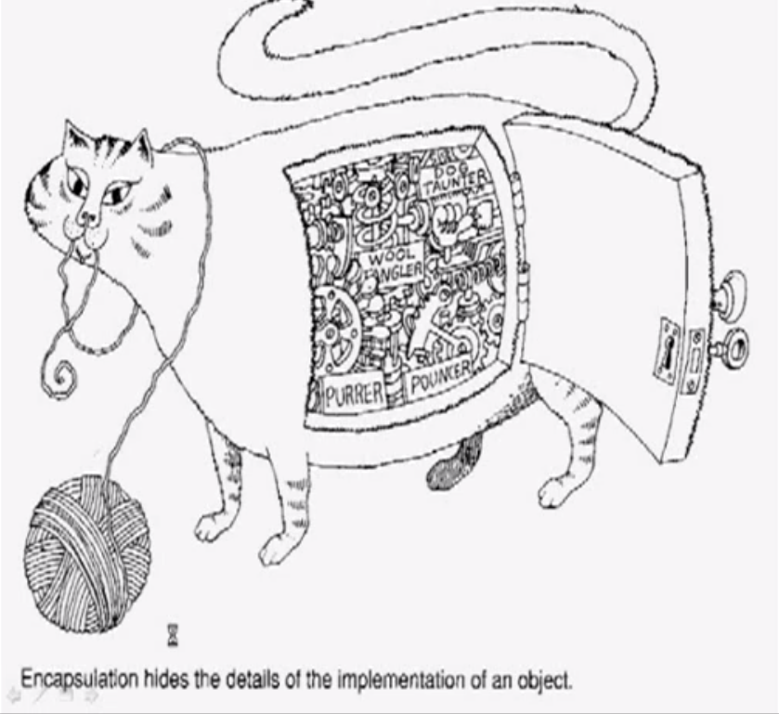
What is Encapsulation?

Slide 57
What is Modularity?
The breaking up of something complex into manageable pieces.
Order Entry
Order Processing System
Order Fulfillment
Billing

Slide 58
What is Hierarchy?
Increasing
abstraction
Vehicle
Car
Bus
Truck
Decreasing
abstraction
SUV
MPV
Mini
Midi
Elements at the same level of the hierarchy should be at the same level of abstraction.

Slide 59
What is Really an Object?
Formally, an object is a concept, abstraction, or thing with sharp boundaries and meaning for an application.
An object is something that has:
State (property, attribute)
Behavior (operation, method)
Identity

Slide 60
What is a Class?
A class is a description of a group of objects with common properties (attributes), behavior (operations), relationships, and semantics
An object is an instance of a class
A class is an abstraction in that it:
Emphasizes relevant characteristics
Suppresses other characteristics

Slide 61
Example Class
Class
Course
Attributes
Name
Location
Days offered
Credit hours
Start time
End time
Behavior
Add a student
Delete a student
Get course roster
Determine if it is full
a + b = 10
OOAD Using the UML - Introduction to Object Orientation, v 4.2, 1998-1999 Rational Software

Slide 62
Representing Classes
A class is represented using a compartmented rectangle
Professor
a + b = 10
Professor Clark
OOAD Using the UML - Introduction to Object Orientation, v 4.2, 1998-1999 Rational Software

Slide 63
Class Compartments
A class is comprised of three sections
The first section contains the class name
The second section shows the structure (attributes)
The third section shows the behavior (operations)
Class Name
Professor
Attributes
name
empID
Represented in UML
(Unified Modeling Language)
submitGrades( )
Operations
setQuota4Class( )
takeSabbatical( )
OOAD Using the UML - Introduction to Object Orientation, v 4.2, 1998-1999 Rational Software

Slide 64
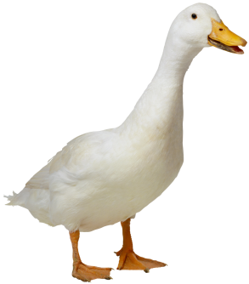
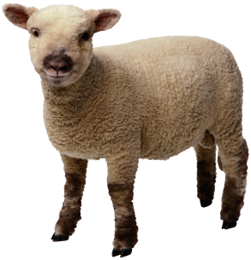
How Many Classes do you See?
OOAD Using the UML - Introduction to Object Orientation, v 4.2, 1998-1999 Rational Software

Slide 65



Relationship between Classes and Objects
A class is an abstract definition of an object
It defines the structure and behavior of each object in the class
It serves as a template for creating objects
Objects are grouped into classes
Objects
Class
Professor
Professor Mellon
Professor Smith
Professor Jones

Slide 66
State of an Object (property or attribute)
The state of an object encompasses all of the (usually static) properties of the object plus the current (usually dynamic) values of each of these properties.
Object
Attribute Value
Class
CourseOffering
number = 101
startTime = 900
endTime = 1100
CourseOffering
Attribute
number
startTime
endTime
CourseOffering
number = 104
startTime = 1300
endTime = 1500

Slide 67
Behavior of an Object (operation or method)
Behavior is how an object acts and reacts, in terms of its state changes and message passing.
Class
CourseOffering
addStudent
deleteStudent
getStartTime
getEndTime
Operation

Slide 68
Identity of an Object
Each object has a unique identity, even if the state is identical to that of another object.
Professor “J Clark” teaches Biology
Professor “J Clark” teaches Biology
OOAD Using the UML - Introduction to Object Orientation, v 4.2, 1998-1999 Rational Software

Slide 69
Sample Class: Automobile
Attributes
manufacturer’s name
model name
year made
color
number of doors
size of engine
Methods
Define attributes (specify manufacturer’s name, model, year, etc.)
Change a data item (color, engine, etc.)
Display data items
Calculate cost

Slide 70
Sample Class: Circle
Attributes
Radius
Center Coordinates
X and Y values
Methods
Define attributes (radius and center coordinates)
Find area of the circle
Find circumference of the circle

Slide 71
Sample Class: Baby
Attributes
Name
Gender
Weight
Decibel
# poops so far
Methods
Get or Set specified attribute value
Poop

Slide 72
Summary
So far, we covered basics of objects and object oriented paradigm.
We tried to think in terms of objects.
From now on, we should be seeing objects everywhere ☺
Or, we should be realizing that we were seeing objects everywhere already.
This is actually something you do naturally. Why not do programming that way?
We will continue next week with actually creating objects by using Java.

Slide 73
Acknowledgments
The course material used to prepare this presentation is mostly taken/adopted from the list below:
Software Enginering (9th ed) by I.Sommerville, Pearson, 2011.
Object Oriented Analysis and Design with Applications, Grady Booch, Robert A. Maksimchuk, Michael W. Engle, Bobbi J. Young, Jim Conallen and Kelli A. Houston, Addison Wesley, 2007.
OOAD Using the UML - Introduction to Object Orientation, v 4.2, 1998-1999 Rational Software
Java - An Introduction to Problem Solving and Programming, Walter Savitch, Pearson, 2012.
Ku-Yaw Chang, Da-Yeh University.

