Slide 1
BBM 102 – Introduction to Programming II Spring 2018
Classes & Objects, Encapsulation in Java

Slide 2
Today
Classes & Objects
Defining Classes, Objects and Methods
Accessor and Mutator Methods
Constructors
Static Members
Wrapper Classes
Parameter Passing
Delegation
Encapsulation
Information Hiding
Encapsulation
The public and private Modifiers
UML Class Diagrams
Overloading
Packages

Slide 3
Class and Method Definitions
Java program consists of objects
Objects of class types
Objects that interact with one another
Program objects can represent
Objects in real world
Abstractions
Software components

Slide 4
Java Classes
A class is a collection of fields (data) and methods (procedure or function) that operate on that data.
Circle
Class Name
center
radius
Attributes
circumference()
area()
Operations

Slide 5
Defining a Java Class
Syntax:
Bare bone class definition:
class ClassName{
[fields declaration]
[methods declaration]
}
/* This is my first java class.
It is not complete yet. */
class Circle {
// fields will come here
// methods will come here
}

Slide 6
Adding Fields to Class Circle
Add fields
The fields are also called the instance variables.
Each object, or instance of the class has its own copy of these instance variables
Do not worry about what public means at the moment.
Access modifiers (public, private and protected will be covered later)
class Circle {
public double x, y; // center coordinates
public double r; // radius of the circle
}

Slide 7
Adding Methods to a Class
A class with only data fields has no life.
Objects created by such a class cannot respond to any message.
Methods are declared inside the body of the class.
The general form of a method declaration is:
methodName(parameter-list) part of the declaration is also known as the method signature.
Method signatures in a class must be unique!
type MethodName (parameter-list)
{
Method-body;
}

Slide 8
Adding Methods to Class Circle
public class Circle {
public double x, y; // center of the circle
public double r; // radius of the circle
// Method to return circumference
public double circumference() {
return 2 * 3.14 * r;
}
// Method to return area
public double area() {
return 3.14 * r * r;
}
}

Slide 9
Defining Reference Variables of a Class
A class can be thought as a type
A variable (reference) can be defined as of that type (class)
Circle circleA, circleB;
circleA
circleB
null
null
Points to nothing (Null Reference)
Points to nothing (Null Reference)

Slide 10
Creating Objects of a Class
Objects are created by using the new keyword
Circle circleA;
circleA = new Circle();
Circle circleB = new Circle();
circleA
circleB
Two different
circle objects!

Slide 11
Creating Objects of a Class
circleA = new Circle();
circleB = new Circle() ;
circleB = circleA;
Before Assignment
After Assignment
circleA
circleB
circleA
circleB
This object does not have a reference anymore: inaccessable!

Slide 12

Garbage Collection
The object which does not have a reference cannot be used anymore.
Such objects become a candidate for automatic garbage collection.
Java collects garbage periodically and releases the memory occupied by such objects to be used in the future.

Slide 13
Using Objects
Object’s data is accessed by using the dot notation
Object’s methods are invoked by same (dot) notation.
Circle circleA = new Circle();
circleA.x = 25.0;
circleA.y = 25.0;
circleA.r = 3.0;
double area = circleA.area();

Slide 14
A Complete Circle Class
public class Circle {
public double x, y; // center of the circle
public double r; // radius of the circle
// Methods to return circumference and area
public double circumference() {
return 2 * 3.14 * r;
}
public double area() {
return 3.14 * r * r;
}
public static void main(String[] args) {
Circle circleA = new Circle();
circleA.x = 25.0;
circleA.y = 25.0;
circleA.r = 3.0;
double area = circleA.area();
System.out.println("Area of the circle is " + area);
}
}

Slide 15
Class Files and Separate Compilation
Each Java class definition is usually written in a file by itself
File begins with the name of the class
Ends with .java
Class can be compiled separately

Slide 16
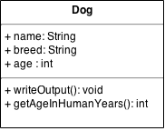
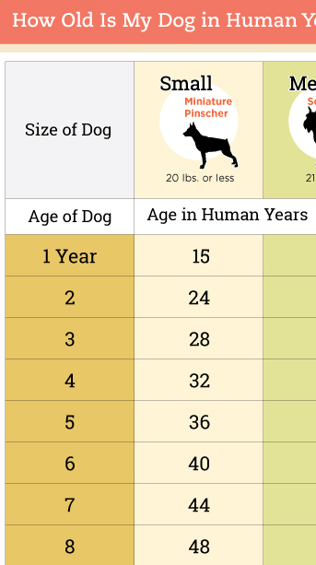
public class Dog {
public String name; // Instance variables
public String breed;
public int age;
public void writeOutput() {
System.out.println("Name: " + name);
System.out.println("Breed: " + breed);
System.out.println("Age in calendar years: " + age);
System.out.println("Age in human years: " +
getAgeInHumanYears());
}
public int getAgeInHumanYears() {
int humanAge = 0;
if (age <= 2) {
humanAge = age * 11;
} else {
humanAge = 22 + ((age - 2) * 5);
}
return humanAge;
}
}
// Method that returns nothing: void method
// Method that returns a value
Example Dog Class

Slide 17


public class DogDemo {
public static void main(String[] args) {
Dog balto = new Dog();
balto.name = "Balto";
balto.age = 8;
balto.breed = "Siberian Husky";
balto.writeOutput();
Dog scooby = new Dog();
scooby.name = "Scooby";
scooby.age = 42;
scooby.breed = "Great Dane";
System.out.println(scooby.name + " is a " + scooby.breed + ".");
System.out.print("He is " + scooby.age + " years old, or ");
int humanYears = scooby.getAgeInHumanYears();
System.out.println(humanYears + " in human years.");
}
}
DogDemo class contains only a main method.
Program’s output
Name: Balto
Breed: Siberian Husky
Age in calendar years: 8
Age in human years: 52
Scooby is a Great Dane.
He is 42 years old, or 222 in human years.

Slide 18
Accessor and Mutator Methods
A public method that returns data from a private instance variable is called an accessor method, a get method, or a getter.
The names of accessor methods typically begin with get.
A public method that changes the data stored in one or more private instance variables is called a mutator method, a set method, or a setter.
The names of mutator methods typically begin with set.

Slide 19
Circle Class with Getters/Setters
public class Circle {
public double x, y; // center of the circle
public double r; // radius of the circle
public double getX() { return x; }
public void setX(double centerX) { x = centerX; }
public double getY() { return y; }
public void setY(double centerY) { y = centerY; }
public double getR() { return r; }
public void setR(double radius) { r = radius; }
// Methods to return circumference and area
…
}

Slide 20
Constructors
A constructor is a special method that gets invoked “automatically” at the time of object creation.
Constructors are normally used for initializing objects with default values unless different values are supplied.
Constructors have the same name as the class name.
Constructors cannot return values.
A class can have more than one constructor as long as they have different signatures (i.e., different input arguments syntax).

Slide 21
Circle Class with Constructor
public class Circle {
public double x, y; // center of the circle
public double r; // radius of the circle
// Constructor
public Circle(double centerX, double centerY, double radius) {
x = centerX;
y = centerY;
r = radius;
}
// Methods to return circumference and area
...
}
Circle aCircle = new Circle(10.0, 20.0, 5.0);

Slide 22
Multiple Constructors
Sometimes we may want to initialize in a number of different ways, depending on the circumstance.
This can be supported by having multiple constructors having different input arguments (signatures).

Slide 23
Circle Class with Multiple Constructors
public class Circle {
public double x, y; // center of the circle
public double r; // radius of the circle
// Constructor
public Circle(double centerX, double centerY, double radius) {
x = centerX;
y = centerY;
r = radius;
}
public Circle(double radius) {
x = 0; y = 0; r = radius;
}
public Circle() {
x = 0; y = 0; r = 1.0;
}
// Methods to return circumference and area
...
}
Circle aCircle = new Circle(10.0, 20.0, 5.0);
Circle bCircle = new Circle(5.0);
Circle cCircle = new Circle();

Slide 24
Default and No-Argument Constructors
Every class must have at least one constructor
If no constructors are declared, the compiler will create a default constructor
Takes no arguments and initializes instance variables to their initial values specified in their declaration or to their default values
Default values are zero for primitive numeric types, false for boolean values and null for references

Slide 25
Common Programming Error
If a class has constructors, but none of the public constructors are no-argument constructors, and a program attempts to call a no-argument constructor to initialize an object of the class, a compilation error occurs.
A constructor can be called with no arguments only if the class does not have any constructors (in which case the default constructor is called) or if the class has a public no-argument constructor.

Slide 26
The Keyword this
this keyword can be used to refer to the object itself.
It is generally used for accessing class members (from its own methods) when they have the same name as those passed as arguments.
public class Circle {
public double x, y; // center of the circle
public double r; // radius of the circle
public double getX() { return x; }
public void setX(double x) { this.x = x; }
public double getY() { return y; }
public void setY(double y) { this.y = y; }
public double getR() { return r; }
public void setR(double r) { this.r = r; }
// Methods to return circumference and area
…
}

Slide 27
Static Variables
Java supports definition of variables that can be accessed without creating objects of a class.
Such members are called Static members.
This feature is useful when we want to create a variable common to all instances of a class.
One of the most common example is to have a variable that could keep a count of how many objects of a class have been created.
Java creates only one copy for a static variable which can be used even if the class is never instantiated.

Slide 28
Using Static Variables
Define the variable by using the static keyword
public class Circle {
// Class variable, one for the Circle class.
// To keep number of objects created.
public static int numCircles = 0;
// Instance variables, one for each instance
// of the Circle class.
public double x,y,r;
// Constructor
Circle (double x, double y, double r){
this.x = x;
this.y = y;
this.r = r;
numCircles++;
}
}
Circle circleA = new Circle(10, 12, 20);
// numCircles = 1
Circle circleB = new Circle(5, 3, 10);
// numCircles = 2

Slide 29
Instance vs. Static Variables
Instance variables: One copy per object. Every object has its own instance variables.
e.g. x,y,r (center and radius of the circle)
Static variables: One copy per class.
e.g. numCircles (total number of circle objects created)

Slide 30
Static Methods
A class can have methods that are defined as static.
Static methods can be accessed without using objects. So, there is NO need to create objects.
Static methods are generally used to group related library functions that don’t depend on data members of its class.
e.g., Math library functions.

Slide 31
Using Static Methods
class Comparator {
public static int max(int a, int b) {
if (a > b)
return a;
else
return b;
}
public static String max(String a, String b) {
if (a.compareTo(b) > 0)
return a;
else
return b;
}
}
// Max methods are directly accessed using ClassName.
// NO Objects created.
System.out.println(Comparator.max(5, 10));
System.out.println(Comparator.max(“ANKARA”, “SAMSUN”));

Slide 32
More Static Methods: The Math Class
It is like including libraries in C language
It contains standard mathematical methods
They are all static
Java.lang.Math
Math.pow(2.0, 3.0) // 8
Math.max(5, 6) // 6
Math.round(6.2) // 6
Math.sqrt(4.0) // 2.0

Slide 33
Object Cleanup
Recall: Memory deallocation is automatic in Java
No dangling pointers and no memory leak problem.
Java allows to define finalize method, which is invoked (if defined) just before the object destruction.
This presents an opportunity to perform record maintenance operation or clean up any special allocations made by the user.
The finalize method will be called by the Garbage Collector, but when this will happen is not deterministic. Try to avoid finalize.
protected void finalize() throws IOException {
Circle.numCircles = Circle.numCircles--;
System.out.println(“Number of circles:”+ Circle.num_circles);
}

Slide 34
Wrapper Classes
Each of Java's primitive data types has a class dedicated to it.
Boolean, Byte, Character, Integer, Float, Double, Long, Short
These are known as wrapper classes, because they "wrap" the primitive data type into an object of that class.
They contain useful predefined constants and methods
The wrapper classes are part of the java.lang package, which is imported by default into all Java programs.
Since Java 5.0 we have autoboxing and unboxing.
// Defining objects of wrapper class
Integer x = new Integer(33);
Integer y = 33; // Autoboxing
int yInt = y; // Unboxing
// Convert string to an integer
String s = "123”;
int i = Integer.parseInt(s);
//Converting from hexadecimal to decimal
Integer hex2Int = Integer.valueOf("D", 16);

Slide 35
Parameter Passing
Java works as «Call by Value» for parameter-passing.
Copy of the primitive types
Copy of the reference of the Class types.
Copy of the reference to the object is passed into the method, original value unchanged, but you may change the attributes of the objects.

Slide 36
public class ReferenceTest {
public static void main (String[] args){
Circle c1 = new Circle(5, 5, 20);
Circle c2 = new Circle(1, 1, 10);
System.out.println ( “c1 Radius = “ + c1.getRadius());
System.out.println ( “c2 Radius = “ + c2.getRadius());
parameterTester(c1, c2);
System.out.println ( “c1 Radius = “ + c1.getRadius());
System.out.println ( “c2 Radius = “ + c2.getRadius());
}
public static void parameterTester(Circle circleA, Circle circleB){
circleA.setRadius(15);
circleB = new Circle(0, 0, 100);
System.out.println ( “circleA Radius = “ + circleA.getRadius());
System.out.println ( “circleB Radius = “ + circleB.getRadius());
}
}
c1 Radius = 20.0
c2 Radius = 10.0
circleA Radius = 15.0
circleB Radius = 100.0
c1 Radius = 15.0
c2 Radius = 10.0

Slide 37
Delegation
Ability for a class to delegate its responsibilities to another class.
A way of making an object invoking services of other objects through containership.

Slide 38
Using Delegation
public class Point {
private double xCoord;
private double yCoord;
public double getXCoord(){
return xCoord;
}
public double getYCoord(){
return yCoord;
}
}
public class Circle {
private Point center;
public double getCenterX(){
return center.getXCoord(); // Delegation
}
public double getCenterY(){
return center.getYCoord(); // Delegation
}
}

Slide 39
Information Hiding
Programmer using a class method need not know details of implementation
Only needs to know what the method does
Information hiding:
Designing a method so it can be used without knowing details
Also referred to as encapsulation
Method design should separate what from how

Slide 40
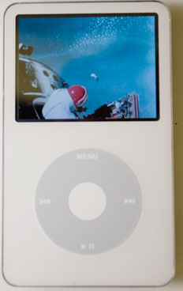
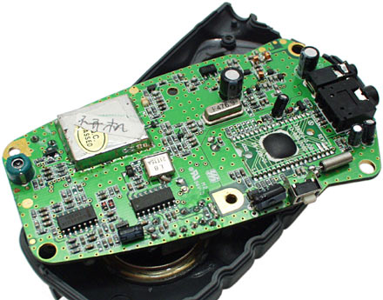
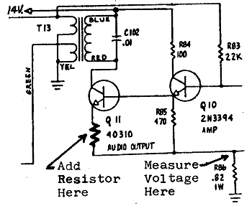
Encapsulation
Encapsulation: Hiding implementation details of an object from its clients.
Encapsulation provides abstraction.
separates external view (behavior) from internal view (state)
Encapsulation protects the integrity of an object's data.

Slide 41
Visibility Modifiers
All parts of a class have visibility modifiers
Java keywords
public, protected, private
do not use these modifiers on local (method) variables (syntax error)
public means that constructor, method, or field may be accessed outside of the class.
part of the interface
constructors and methods are generally public
private means that part of the class is hidden and inaccessible by code outside of the class
part of the implementation
data fields are generally private

Slide 42
The public and private Modifiers
Type specified as public
Any other class can directly access that object by name
Classes are generally specified as public
Instance variables are usually not public
Instead specify as private

Slide 43
Private fields
A field can be declared private.
No code outside the class can access or change it.
private type name;
Examples:
private int id;
private String name;
Client code sees an error when accessing private fields:
PointMain.java:11: x has private access in Point
System.out.println("p1 is (" + p1.x + ", " + p1.y + ")");
^

Slide 44
Accessing private state
We can provide methods to get and/or set a field's value:
// A "read-only" access to the x field ("accessor")
public int getX() {
return x;
}
// Allows clients to change the x field ("mutator")
public void setX(int newX) {
x = newX;
}
Client code will look more like this:
System.out.println("p1: (" + p1.getX() + ", " + p1.getY() + ")");
p1.setX(14);

Slide 45
Programming Example
public class Rectangle
{
private int width;
private int height;
private int area;
public void setDimensions (int newWidth, int newHeight)
{
width = newWidth;
height = newHeight;
area = width * height;
}
public int getArea ()
{
return area;
}
}
Note setDimensions method : This is the only way the width and height may be altered outside the class
Statement such as box.width = 6; is illegal since width is private
Keeps remaining elements of the class consistent

Slide 46
Point class
// A Point object represents an (x, y) location.
public class Point {
private int x;
private int y;
public Point(int initialX, int initialY) {
x = initialX;
y = initialY;
}
public double distanceFromOrigin() {
return Math.sqrt(x * x + y * y);
}
public int getX() {
return x;
}
public int getY() {
return y;
}
public void setLocation(int newX, int newY) {
x = newX;
y = newY;
}
public void translate(int dx, int dy) {
x = x + dx;
y = y + dy;
}
}

Slide 47
Client code
public class PointMain4 {
public static void main(String[] args) {
// create two Point objects
Point p1 = new Point(5, 2);
Point p2 = new Point(4, 3);
// print each point
System.out.println("p1: (" + p1.getX() + ", " + p1.getY() + ")");
System.out.println("p2: (" + p2.getX() + ", " + p2.getY() + ")");
// move p2 and then print it again
p2.translate(2, 4);
System.out.println("p2: (" + p2.getX() + ", " + p2.getY() + ")");
}
}
OUTPUT :
p1 is (5, 2)
p2 is (4, 3)
p2 is (6, 7)

Slide 48
Encapsulation
Consider example of driving a car
We see and use break pedal, accelerator pedal, steering wheel – know what they do
We do not see mechanical details of how they do their jobs
Encapsulation divides class definition into
Class interface
Class implementation

Slide 49
Encapsulation
Class interface
Tells what the class does
Gives headings for public methods and comments about them
Class implementation
Contains private variables
Includes implementations of public and private methods

Slide 50
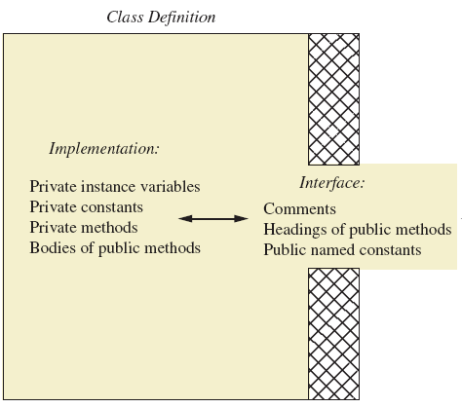
Encapsulation
A well encapsulated class definition
Programmer who uses the class

Slide 51
Encapsulation – Best Practices
Preface class definition with comment on how to use class
Declare all instance variables in the class as private.
Provide public accessor methods to retrieve data and provide public methods to manipulate data
Such methods could include public mutator methods.
Place a comment before each public method heading that fully specifies how to use the method.
Make any helping methods private.
Write comments within class definition to describe implementation details.

Slide 52
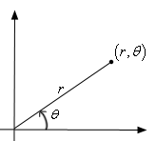
Benefits of encapsulation
Provides abstraction between an object and its clients.
Protects an object from unwanted access by clients.
A bank app forbids a client to change an Account's balance.
Allows you to change the class implementation.
Point could be rewritten to use polar coordinates (radius r, angle θ), but with the same methods.
Allows you to constrain objects' state (invariants).
Example: Only allow Points with non-negative coordinates.

Slide 53
Outline
Time1.java
(1 of 2)
private instance variables
Declare public method setTime
Validate parameter values before setting instance variables

Slide 54
Outline
Time1.java
(2 of 2)
format strings

Slide 55
Outline
Time1Test.java(1 of 2)
Create a Time1 object
Call toUniversalString method
Call toString method

Slide 56
Outline
Call setTime method
Time1Test.java
(2 of 2)
Call setTime method with invalid values

Slide 57
Software Development Observations & Tips
When one object of a class has a reference to another object of the same class, the first object can access all the second object’s data and methods (including those that are private).
When implementing a method of a class, use the class’s set and get methods to access the class’s private data. This simplifies code maintenance and reduces the likelihood of errors.
This architecture helps hide the implementation of a class from its clients, which improves program modifiability

Slide 58
final Instance Variables
final instance variables
Keyword final
Specifies that a variable is not modifiable (is a constant)
final instance variables can be initialized at their declaration
If they are not initialized in their declarations, they must be initialized in all constructors
If an instance variable should not be modified, declare it to be final to prevent any erroneous modification.

Slide 59
static final Instance Variables
A final field should also be declared static if it is initialized in its declaration.
Once a final field is initialized in its declaration, its value can never change.
Therefore, it is not necessary to have a separate copy of the field for every object of the class.
Making the field static enables all objects of the class to share the final field.
Example: public static final double PI = 3.141592;

Slide 60
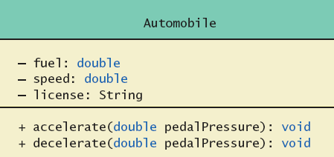
UML Class Diagrams
An automobile class outline as a UML class diagram

Slide 61
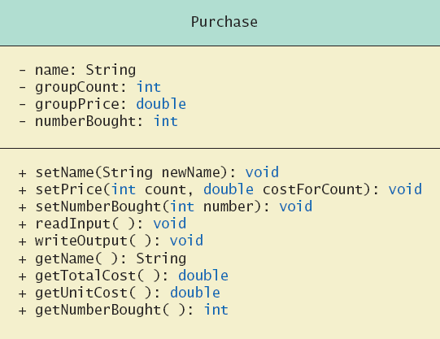
UML Class Diagrams
Example: Purchase class
Minus signs imply private access
Plus signs imply public access

Slide 62
UML Class Diagrams
Contains more than interface, less than full implementation
Usually written before class is defined
Used by the programmer defining the class
Corresponds to the interface used by programmer who uses the class

Slide 63
How to Import a Library
Import the reusable class into a program
Single-type-import declaration
Imports a single class
Example: import java.util.Random;
Type-import-on-demand declaration
Imports all classes in a package
Example: import java.util.*;

Slide 64
Overloading Basics
When two or more methods have same name within the same class
Java distinguishes the methods by number and types of parameters
If it cannot match a call with a definition, it attempts to do type conversions
A method's name and number and type of parameters is called the signature

Slide 65
Programming Example
/** This class illustrates overloading. */
public class Overload {
public static void main (String [] args) {
double average1 = Overload.getAverage (40.0, 50.0);
double average2 = Overload.getAverage (1.0, 2.0, 3.0);
char average3 = Overload.getAverage ('a', 'c'); System.out.println ("average1 = " + average1);
System.out.println ("average2 = " + average2); System.out.println ("average3 = " + average3); }
public static double getAverage (double first, double second) { return (first + second) / 2.0; }
public static double getAverage (double first, double second, double third) { return (first + second + third) / 3.0; }
public static char getAverage (char first, char second) {
return (char) (((int) first + (int) second) / 2); }
}
average1= 45.0
average2= 2.0
average3 = b

Slide 66
Overloading and Type Conversion
Overloading and automatic type conversion can conflict
Remember the compiler attempts to overload before it does type conversion
Use descriptive method names, avoid overloading when possible

Slide 67
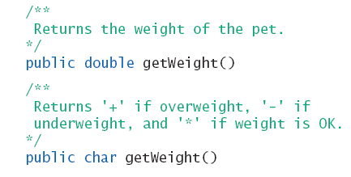
Overloading and Return Type
You can not overload a method where the only difference is the type of value returned

Slide 68
Summary
Classes, objects, and methods are the basic components used in Java programming.
Constructors allow seamless initialization of objects.
Classes can have static members, which serve as global members of all objects of a class.
Objects can be passed as parameters and they can be used for exchanging messages.

Slide 69
Summary
Usage of visibility modifiers for encapsulation
Separation of interface and implementation is important
Class designers use UML notation to describe classes
Use packages for software reusability
Overloading must be done with care

