Slide 1
BBM 102 – Introduction to Programming II Spring 2018
Polymorphism

Slide 2
Today
Inheritance revisited
Comparing objects : equals() method
instanceof keyword
Polymorphism

Slide 3
Visibility Revisited
All variables and methods of a parent class, even private members, are inherited by its children
As we've mentioned, private members cannot be referenced by name in the child class
However, private members inherited by child classes exist and can be referenced indirectly
Because the parent can refer to the private member, the child can reference it indirectly using its parent's methods
The super reference can be used to refer to the parent class, even if no object of the parent class exists

Slide 4
Inheritance Design Issues
Every derivation from the main class should be an is-a relationship
Think about a potential future class hierarchy
Design classes to be reusable and flexible
Find common characteristics of classes and push them as high in the class hierarchy as appropriate, i.e. “generalize” the behavior
Override methods as appropriate to tailor or change the functionality of a child
Add new variables to children, but don't redefine (shadow) inherited variables

Slide 5
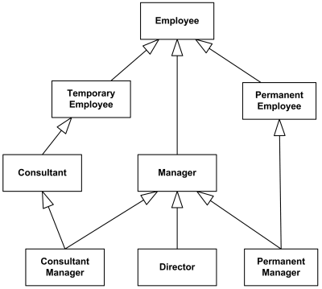
Inheritance Design Issues
An example class hierarchy
More generalized
More specialized

Slide 6
Inheritance Design Issues
Allow each class to manage its own data; use the super reference to invoke the parent's constructor to set up its data
Even if there are no current uses for them, override general methods such as toString and equals with appropriate definitions
Use visibility modifiers carefully to provide needed access without violating encapsulation

Slide 7
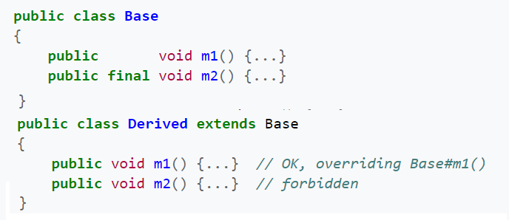
Restricting Inheritance
The final modifier can be used to cut down inheritance
If the final modifier is applied to a method, then that method cannot be overridden in any descendent classes
If the final modifier is applied to an entire class, then that class cannot be used to derive any children at all

Slide 8
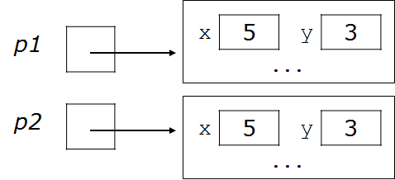
Comparing objects
The == operator does not work with objects.
== compares references to objects, not their contents or state.
Example:
Point p1 = new Point(5, 3);
Point p2 = new Point(5, 3);
if (p1 == p2) { // false
System.out.println("equal");
}

Slide 9
equals() and the Object class
equals()method, general syntax:
public boolean equals(Object <name>) {
<statement(s) that return a boolean value> ;
}
The parameter to equals must be of type Object.
Object is a general type that can match any object.
Having an Object parameter means any object can be passed.

Slide 10
The equals() method
The equals method compares the contents / state of objects.
equals should be used when comparing Strings, Points, ...
if (str1.equals(str2)) {
System.out.println("the strings are equal");
}
If you write your own class, its equals method will behave just like the == operator.
Point p1 = new Point(5, 3);
Point p2 = new Point(5, 3);
if (p1.equals(p2)) { // false
System.out.println("equal");
}
This is the behavior we inherit from class Object.

Slide 11
Initial flawed equals()method
We can change this behavior by writing an equals method.
Ours will override the default behavior from class Object.
The method should compare the state of the two objects and return true for cases like the above.
A flawed implementation of the equals method:
public boolean equals(Point other) {
if (x == other.x && y == other.y) {
return true;
} else {
return false;
}
}

Slide 12
Flaws in equals() method
It should be legal to compare a Point to any object (not just other Point objects):
// this should be allowed
Point p = new Point(7, 2);
if (p.equals("hello")) { // false
...
equals should always return false if a non-Point is passed.

Slide 13
Another flawed version
Another flawed equals implementation:
public boolean equals(Object o) {
return x == o.x && y == o.y;
}
It does not compile:
Point.java:36: cannot find symbol
symbol : variable x
location: class java.lang.Object
return x == o.x && y == o.y;
^
The compiler is saying, "o could be any object. Not every object has an x field."

Slide 14
Type-casting objects
Solution: Type-cast the object parameter to a Point.
public boolean equals(Object o) {
Point other = (Point) o;
return x == other.x && y == other.y;
}
Casting objects is different than casting primitives.
We're really casting an Object reference into a Point reference.
We're promising the compiler that o refers to a Point object.

Slide 15
Casting objects diagram
Client code:
Point p1 = new Point(5, 3);
Point p2 = new Point(5, 3);
if (p1.equals(p2)) {
System.out.println("equal");
}
public boolean equals(Object o) {
Point other = (Point) o;
return x == other.x && y == other.y;
}
o
x | 5 | y | 3
other
p1
...
p2
x | 5 | y | 3

Slide 16
Comparing different types
When we compare Point objects to other types:
Point p = new Point(7, 2);
if (p.equals("hello")) { // should be false
...
}
Currently the code crashes:
Exception in thread "main"
java.lang.ClassCastException: java.lang.String
at Point.equals(Point.java:25)
at PointMain.main(PointMain.java:25)
The culprit is the line with the type-cast:
public boolean equals(Object o) {
Point other = (Point) o;

Slide 17
The instanceof keyword
We can use a keyword called instanceof to ask whether a variable refers to an object of a given type.
The instanceof keyword, general syntax:
<variable> instanceof <type>
The above is a boolean expression.
Example:
String s = "hello";
Point p = new Point();
expression | result
s instanceof Point | false
s instanceof String | true
p instanceof Point | true
p instanceof String | false
null instanceof String | false

Slide 18
Final version of equals method
// Returns whether o refers to a Point object with
// the same (x, y) coordinates as this Point object.
public boolean equals(Object o) {
if (o instanceof Point) {
// o is a Point; cast and compare it
Point other = (Point) o;
return x == other.x && y == other.y;
} else {
// o is not a Point; cannot be equal
return false;
}
}
This version correctly compares Points to any type of object.

Slide 19
Polymorphism

Slide 20
Polymorphism
Polymorphism means many (poly) shapes (morph) : "having many forms"
Enables you to “program in the general” rather than “program in the specific.”
Polymorphism enables you to write programs that process objects that share the same superclass as if they’re all objects of the superclass.

Slide 21
Polymorphism
A polymorphic reference is a variable that can refer to different types of objects at different points in time
All object references in Java are potentially polymorphic and can refer to an object of any type compatible with its defined type
Compatibility of class types can be based on either Inheritance or Interfaces (which we will see later)

Slide 22
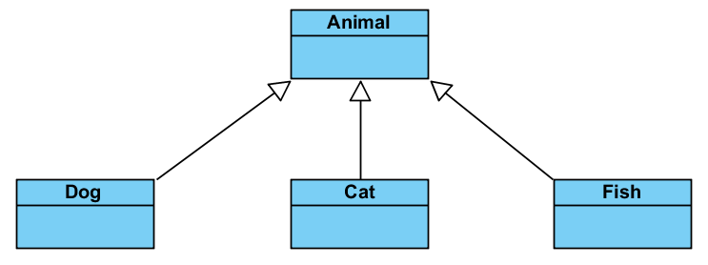
An Example Class Hierarchy

Slide 23
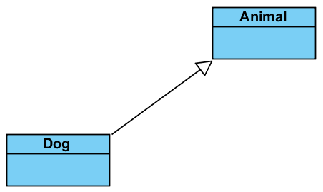
A Polymorphic Example
Dog myDog;
myDog = new Dog();
Animal myAnimal;
myAnimal = myDog;

Slide 24
Everything is an Object!
When we say:
myDog = new Dog();
the Dog constructor gets called.
It, in turn, must call the Animal constructor
When you don’t extend anything, by default you extend Object
Thus the Animal constructor calls the Object constructor
Looking at an object in memory it will look like something like this:
Object
reference
Dog
Object
Animal
myDog
Dog

Slide 25
Polymorphism Explained
The rule is very simple
A reference can refer to an object which is either
The same type as the reference
Has a superclass of the same type as the reference
So all of the following are legal
Dog d = new Dog();
Animal a = new Dog();
Object o = new Dog();
Object
reference
Dog
Object
Animal
Dog

Slide 26
An Illegal Example
We are able to assign an object of a sub-class into an object of a super-class as in:
Animal MyAnimal = new Dog();
But the reverse is not true. We can’t assign a superclass object into a sub-class object.
Dog MyDog = new Animal(); // illegal
All dogs are animals but
not all animals are dogs

Slide 27
Object
Dog
Animal
Object
Dog d;
d = new Dog();
Dog d;
d = new Animal();
Dog d;
d = new Object();
Object
Object
Object
REF
Animal
REF
Animal
REF
Dog
Dog
Animal a;
a = new Dog();
Animal a;
a = new Animal();
Animal a;
a = new Object();
Object
Object
Object
REF
Animal
REF
Animal
REF
Reference
Dog
Animal
Object o;
o = new Dog();
Object o;
o = new Animal();
Object o;
o = new Object();
Object
Object
Object
REF
Animal
REF
Animal
REF
Dog
Object

Slide 28
Polymorphism Examples
Example: Suppose we create a program that simulates the movement of several types of animals for a biological study. Classes Fish, Frog and Bird represent the three types of animals under investigation.
Each class extends superclass Animal, which contains a method move and maintains an animal’s current location as x-y coordinates. Each subclass implements method move.
A program maintains an Animal array containing references to objects of the various Animal subclasses. To simulate the animals’ movements, the program sends each object the same message once per second—namely, move.

Slide 29
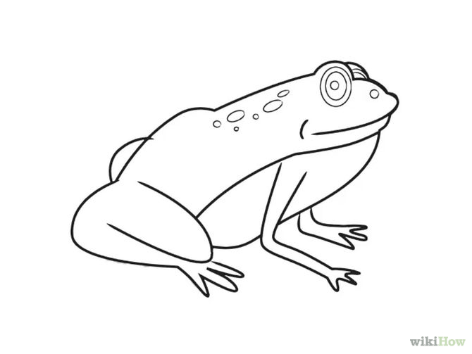


Polymorphism Examples
Each specific type of Animal responds to a move message in a unique way:
a Fish might swim three meters
a Frog might jump five meters
a Bird might fly ten meters.
The program issues the same message (i.e., move) to each animal object, but each object knows how to modify its x-y coordinates appropriately for its specific type of movement.
Relying on each object to know how to “do the right thing” in response to the same method call is the key concept of polymorphism.
The same message sent to a variety of objects has “many forms” of results—hence the term polymorphism.

Slide 30

Polymorphism Examples (Cont.)
Example: Space Objects in a Video Game
A video game manipulates objects of classes Martian, Venusian, Plutonian, SpaceShip and LaserBeam. Each inherits from SpaceObject and overrides its draw method.
A screen manager maintains a collection of references to objects of the various classes and periodically sends each object the same message—namely, draw.
Each object responds in a unique way.
A Martian object might draw itself in red with green eyes and the appropriate number of antennae.
A SpaceShip object might draw itself as a bright silver flying saucer.
A LaserBeam object might draw itself as a bright red beam across the screen.
The same message (in this case, draw) sent to a variety of objects has “many forms” of results.

Slide 31
Polymorphism Examples (Cont.)
A screen manager might use polymorphism to facilitate adding new classes to a system with minimal modifications to the system’s code.
To add new objects to our video game:
Build a class that extends SpaceObject and provides its own draw method implementation.
When objects of that class appear in the SpaceObject collection, the screen manager code invokes method draw, exactly as it does for every other object in the collection, regardless of its type.
So the new objects simply “plug right in” without any modification of the screen manager code by the programmer.

Slide 32
Demonstrating Polymorphic Behavior
A superclass object cannot be treated as a subclass object, because a superclass object is not an object of any of its subclasses.
The is-a relationship applies only up the hierarchy from a subclass to its direct (and indirect) superclasses, and not down the hierarchy.
The Java compiler does allow the assignment of a superclass reference to a subclass variable if you explicitly cast the superclass reference to the subclass type
A technique known as downcasting that enables a program to invoke subclass methods that are not in the superclass.

Slide 33
Demonstrating Polymorphic Behavior (Cont.)
When a superclass variable contains a reference to a subclass object, and that reference is used to call a method, the subclass version of the method is called.
The Java compiler allows this “crossover” because an object of a subclass is an object of its superclass (but not vice versa).
When the compiler encounters a method call made through a variable, the compiler determines if the method can be called by checking the variable’s class type.
If that class contains the proper method declaration (or inherits one), the call is compiled.
At execution time, the type of the object to which the variable refers determines the actual method to use.
This process is called dynamic binding.

Slide 34
Method Calls and Polymorphism
Assume the Dog class extends the Animal class, redefining the “makeNoise” method.
Consider the following:
Animal myAnimal = new Dog();
myAnimal.makeNoise();
Note: The Animal reference is referring to a Dog object. And it is the Dog’s makeNoise method that gets invoked!

Slide 35
Dynamic Binding
Very simple rule.
No matter what the reference type is, Java will search the object and execute the lowest occurrence of a method it finds.
class Object has a toString method
Assume that both Animal and Dog have overridden the toString method
Object o
Object
toString()
Animal a
Animal
toString()
A
Dog
Object
Dog d
Dog
toString()
o.toString();
a.toString();
d.toString();

Slide 36
Polymorphism
With polymorphism, we can design and implement systems that are easily extensible
New classes can be added with little or no modification to the general portions of the program, as long as the new classes are part of the inheritance hierarchy.
The only parts of a program that must be altered for new classes are those that require direct knowledge of the new classes.

Slide 37
Polymorphism
A variable of a type T can legally refer to an object of any subclass of T.
Employee person = new Lawyer();
System.out.println(person.getSalary()); // 50000.0
System.out.println(person.getVacationForm()); // pink
You can call any methods from Employee on the variable person, but not any methods specific to Lawyer (such as Sue).
Once a method is called on the object, it behaves in its normal way (as a Lawyer, not as a normal Employee).

Slide 38
Polymorphism + parameters
You can declare methods to accept superclass types as parameters, then pass a parameter of any subtype.
public class EmployeeMain {
public static void main(String[] args) {
Lawyer lisa = new Lawyer();
Secretary steve = new Secretary();
printInfo(lisa);
printInfo(steve);
}
public static void printInfo(Employee empl) {
System.out.println("salary = " + empl.getSalary());
System.out.println("days = " + empl.getVacationDays());
System.out.println("form = " + empl.getVacationForm());
System.out.println();
}
}
OUTPUT:
salary = 50000.0
vacation days = 21
vacation form = pink
salary = 50000.0
vacation days = 10
vacation form = yellow

Slide 39
You can declare arrays of superclass types, and store objects of any subtype as elements.
public class EmployeeMain2 {
public static void main(String[] args) {
Employee[] employees = {new Lawyer(), new Secretary(),
new Marketer(), new LegalSecretary()};
for (int i = 0; i < employees.length; i++) {
System.out.println("salary = " +
employees[i].getSalary());
System.out.println("vacation days = " +
employees[i].getVacationDays());
System.out.println();
}
}
}
OUTPUT:
salary = 50000.0
vacation days = 15
salary = 50000.0
vacation days = 10
salary = 60000.0
vacation days = 10
salary = 55000.0
vacation days = 10

Slide 40
Polymorphism vs. Inheritance
Inheritance is required in order to achieve polymorphism (we must have class hierarchies).
Re-using class definitions via extension and redefinition
Polymorphism is not required in order to achieve inheritance.
An object of class A acts as an object of class B (an ancestor to A).

Slide 41
References and Inheritance
Assigning a child object to a parent reference is considered to be a widening conversion, and can be performed by simple assignment
The widening conversion is the most useful
Assigning a parent object to a child reference can be done, but it is considered a narrowing conversion and two rules/guidelines apply:
A narrowing conversion must be done with a cast
A narrowing conversion should only be used to restore an object back to its original class (back to what it was “born as” with the new operator)

Slide 42
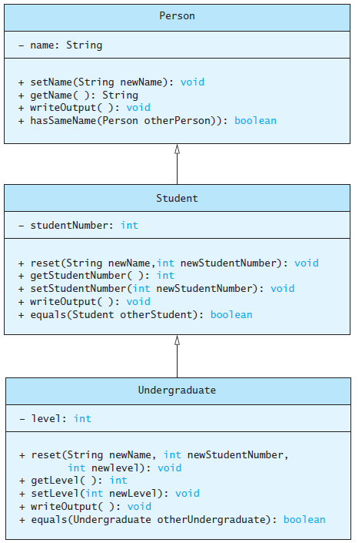
Polymorphism Example
Consider an array of Person
Person[] people = new Person[4];
Since Student and Undergraduate are types of Person, we can assign them to Person variables
people[0] = new Student("DeBanque, Robin", 8812);
people[1] = new Undergraduate("Cotty, Manny", 8812, 1);

Slide 43
Example
Given:
Person[] people = new Person[4];
people[0] = new Student("DeBanque, Robin", 8812);
When invoking:
people[0].writeOutput();
Which writeOutput() is invoked, the one defined for Student or the one defined for Person?
Answer: The one defined for Student

Slide 44
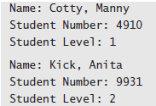
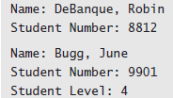
Example
public class PolymorphismDemo { public static void main(String[] args) { Person[] people = new Person[4]; people[0] = new Undergraduate("Cotty, Manny", 4910, 1); people[1] = new Undergraduate("Kick, Anita", 9931, 2); people[2] = new Student("DeBanque, Robin", 8812);
people[3] = new Undergraduate("Bugg, June", 9901, 4);
for (Person p : people) { p.writeOutput(); System.out.println(); } } }

Slide 45
A polymorphism problem
Assume that the following four classes have been declared:
(continued on next slide)
public class Foo {
public void method1() {
System.out.println("foo 1");
}
public void method2() {
System.out.println("foo 2");
}
public String toString() {
return "foo";
}
}

Slide 46
A polymorphism problem (cont’d)
public class Bar extends Foo {
public void method2() {
System.out.println("bar 2");
}
}
public class Baz extends Foo {
public void method1() {
System.out.println("baz 1");
}
public String toString() {
return "baz";
}
}
public class Mumble extends Baz {
public void method2() {
System.out.println("mumble 2");
}
}

Slide 47
A polymorphism problem (cont’d)
What would be the output of the following client code?
Foo[] pity = {new Baz(), new Bar(), new Mumble(), new Foo()};
for (int i = 0; i < pity.length; i++) {
System.out.println(pity[i]);
pity[i].method1();
pity[i].method2();
System.out.println();
}

Slide 48
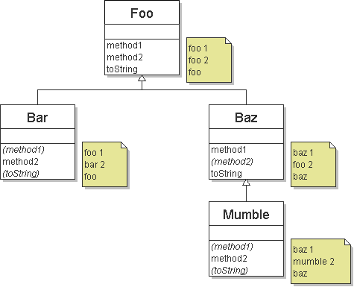
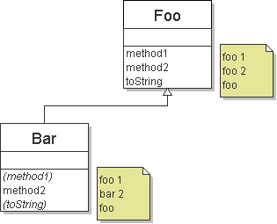
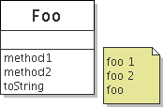
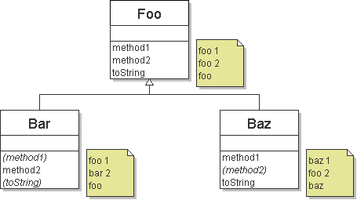
Finding output with diagrams
One way to determine the output is to diagram each class and its methods, including their output:
Add the classes from top (superclass) to bottom (subclass).
Include any inherited methods and their output.

Slide 49
Finding output with tables
Another possible technique for solving these problems is to make a table of the classes and methods, writing the output in each square.
method | Foo | Bar | Baz | Mumble
method1
method2
toString
method | Foo | Bar | Baz | Mumble
method1 | foo 1 | foo 1 | baz 1 | baz 1
method2 | foo 2 | bar 2 | foo 2 | mumble 2
toString | foo | foo | baz | baz
method | Foo | Bar | Baz | Mumble
method1 | foo 1 |  | baz 1
method2 | foo 2 | bar 2 |  | mumble 2
toString | foo |  | baz

Slide 50
Polymorphism answer
Foo[] pity = {new Baz(), new Bar(), new Mumble(), new Foo()};
for (int i = 0; i < pity.length; i++) {
System.out.println(pity[i]);
pity[i].method1();
pity[i].method2();
System.out.println();
}
Output:
baz
baz 1
foo 2
foo
foo 1
bar 2
baz
baz 1
mumble 2
foo
foo 1
foo 2

Slide 51
public class Spam extends Yam {
public void b() {
System.out.print("Spam b ");
}
}
public class Yam extends Lamb {
public void a() {
System.out.print("Yam a ");
super.a();
}
public String toString() {
return "Yam";
}
}
Ham[] food = {new Spam(), new Yam(), new Ham(), new Lamb()};
for (int i = 0; i < food.length; i++) {
System.out.println(food[i]);
food[i].a();
System.out.println(); // to end the line of output
food[i].b();
System.out.println(); // to end the line of output
System.out.println();
}

Slide 52
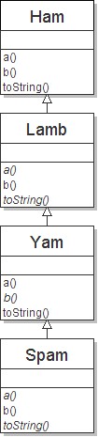
The class diagram
public class Ham {
public void a() {
System.out.print("Ham a ");
b();
}
public void b() {
System.out.print("Ham b ");
}
public String toString() {
return "Ham";
}
}
public class Lamb extends Ham {
public void b() {
System.out.print("Lamb b ");
}
}
public class Yam extends Lamb {
public void a() {
System.out.print("Yam a ");
super.a();
}
public String toString() {
return "Yam";
}
}
public class Spam extends Yam {
public void b() {
System.out.print("Spam b ");
}
}
Another problem

Slide 53
The Question
What would be the output of the following client code?
Ham[] food = {new Spam(), new Yam(), new Ham(), new Lamb()};
for (int i = 0; i < food.length; i++) {
System.out.println(food[i]);
food[i].a();
food[i].b();
System.out.println();
}

Slide 54
The table
Fill out the following table with each class's behavior:
method | Ham | Lamb | Yam | Spam
a
b
toString

Slide 55
Polymorphism at work!
Notice that Ham's a method calls b. Lamb overrides b.
This means that calling a on a Lamb will also have a new result.
Lamb 's a output: Ham a Lamb b
public class Ham {
public void a() {
System.out.print("Ham a ");
b();
}
public void b() {
System.out.print("Ham b ");
}
public String toString() {
return "Ham";
}
}
public class Lamb extends Ham {
public void b() {
System.out.print("Lamb b ");
}
}

Slide 56
The answer
Ham[] food = {new Spam(), new Yam(), new Ham(), new Lamb()};
for (int i = 0; i < food.length; i++) {
System.out.println(food[i]);
food[i].a();
food[i].b();
System.out.println();
}
Output:
Yam
Yam a Ham a Spam b
Spam b
Yam
Yam a Ham a Lamb b
Lamb b
Ham
Ham a Ham b
Ham b
Ham
Ham a Lamb b
Lamb b

Slide 57
Acknowledgments
The course material used to prepare this presentation is mostly taken/adopted from the list below:
Java - How to Program, Paul Deitel and Harvey Deitel, Prentice Hall, 2012
Java - An Introduction to Problem Solving and Programming, Walter Savitch, Pearson, 2012
Reges/Stepp. Building Java Programs: A Back to Basics Approach, 3rd edition
Mike Scott, CS314 Course notes, University of Texas Austin

