Slide 1
BBM 102 – Introduction to Programming II Spring 2019
Streams and Input/Output

Slide 2
Today
Streams and Files
Text/Binary Files
java.io.File class
Revisiting java.util.Scanner
Java I/O Library
Decorator Pattern
InputStreams and OutputStreams
Readers and Writers
Sequential Access vs Random Access
java.io.RandomAccessFile
Serialization

Slide 3
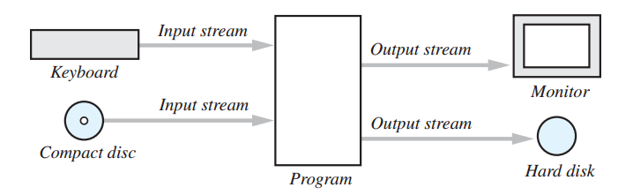
Streams
A stream is a flow of data. The data might be characters, numbers, or bytes consisting of binary digits.
If the data flows into your program, the stream is called an input stream (example: System.in).
If the data flows out of your program, the stream is called an output stream (example: System.out).

Slide 4
Files
The keyboard and the screen deal with temporary data
Files provide a way to store data permanently
All of the data in any file is stored as bits, or 0s and 1s.
Files are categorized as text files and binary files

Slide 5
Text/Binary Files
Text files
The bits represent printable (easily readable by humans when printed) characters.
The characters are coded with a "character set", ASCII, ISO-8859-1, utf-8..
They can be edited with a " text editor "
Examples: Program source files (.java, .c), files saved with a text editor, e.g. Notepad.exe
Binary Files
The bits represent other types of encoded information, such as executable instructions or numeric data
They are easily read by the computer but not humans
They are not "printable" files
Examples: Executables (.exe), images (.jpg, .png), music (.mp3), or video (.avi, .mov) files

Slide 6
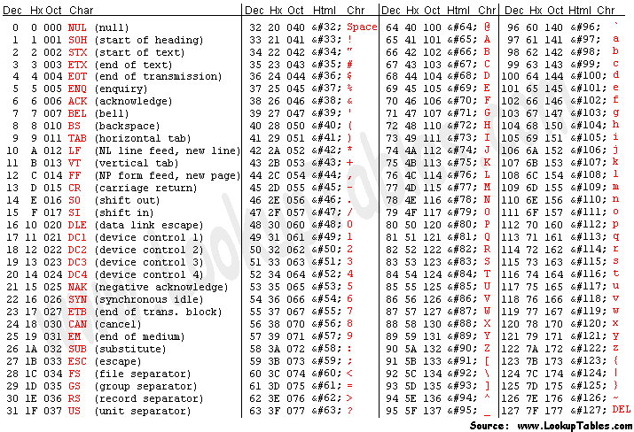
ASCII (American Standard Code for Information Interchange) Code Table

Slide 7

Extended ASCII Codes

Slide 8
Text/Binary Files
Confused? Let’s see an example: We want to write the number 127 into a file.
If we write it into an ASCII coded text file:
Three bytes will be used for each character: 1 , 2, and 7
Binary values of these characters: 00110001, 00110010, 00110111
If we write it into a binary file:
One byte (variable is defined as byte): 01111111
Two bytes (variable is defined as short): 00000000 01111111
Four bytes (variable is defined as int): 00000000 00000000 00000000 01111111

Slide 9
java.io.File
Do not be deceived with the name of it! Class represents a path rather than a file!
Can be used to
Check if the path exists or not
Check if the path is a file or a directory
Check/edit the file/directory’s readable, writable, executable, hidden properties
Create/delete file/directory
Get the contents of a directory
Get the last modification date and time of the file/directory

Slide 10
FileExample Program
public class FileExample {
public static void main(String[] args) {
File path = new File("h:\\example");
if (!path.exists()) { // It does not exist, create a directory!
path.mkdir();
} else if (path.isDirectory()) { // It is a directory! List the contents
String[] contentOfDirectory = path.list();
for (String filename : contentOfDirectory) {
System.out.println(filename);
}
} else { // It is a file! Display the properties of the file
System.out.println("Read:" + path.canRead() +
", Write: " + path.canWrite() + ", Hidden: " + path.isHidden());
}
}
}

Slide 11
Revisiting java.util.Scanner
Class Scanner is an easy way to read input from keyboard, remember?
// create a scanner System.in (keyboard)
Scanner scanner = new Scanner(System.in);
// read a string from keyboard and write it to System.out (monitor)
System.out.println(scanner.next());
It takes an inputstream to its constructor and reads from it
What if we give a File object to the constructor?
// create a scanner for the file example.txt
scanner = new Scanner(new File("c:example.txt"));
// read a string from the file and write it to System.out (monitor)
System.out.println(scanner.next());

Slide 12
Scanner example: display contents of a file
public static void main(String[] args) {
Scanner scanner = null;
try {
scanner = new Scanner(new File(args[0]));
while (scanner.hasNext()) {
System.out.println(scanner.nextLine());
}
} catch (Exception e) {
e.printStackTrace();
} finally {
if (scanner != null) scanner.close();
}
}

Slide 13
Java I/O Library
Mostly under the package java.io
Includes classes, interfaces and exceptions for
Input/Output
Binary/Text
Sequential/Random Access
JDK versions improved the library in time, adding new classes/interfaces.

Slide 14
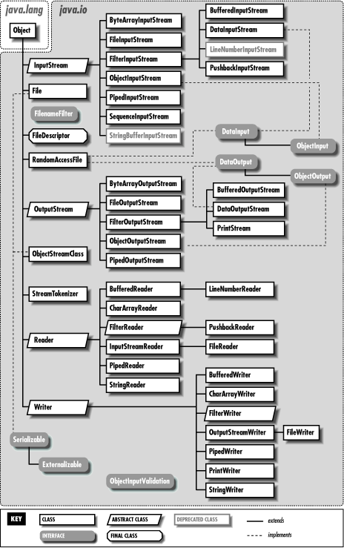
Binary Input
(byte oriented)
Random Access
Binary Output
(byte oriented)
Text Input
(character oriented)
Text Output
(character oriented)

Slide 15
Creating a text file
An easy way to create a text file is using java.io.PrintWriter
public static void main(String[] args) {
PrintWriter outputStream = null;
try {
outputStream = new PrintWriter("c:out.txt"); // open the file
outputStream.println("Example line.."); // write something to the file
} catch(FileNotFoundException e) {
System.out.println("Error opening the file!");
} finally {
if (outputStream != null) outputStream.close(); // close the file
}
}

Slide 16
Example: from keyboard to file
public static void main(String[] args) {
PrintWriter outputStream = null;
Scanner scanner = null;
try {
outputStream = new PrintWriter(args[0]); // open the file
scanner = new Scanner(System.in); // create scanner for keyboard
String str = scanner.nextLine(); // get the first line
while (!str.equalsIgnoreCase("exit")) { // if it is not «exit»
outputStream.println(str); // write it to the file
str = scanner.nextLine(); // get a new line
}
} catch(FileNotFoundException e) {
System.out.println("Error opening the file!");
} finally {
if (outputStream != null) outputStream.close(); // close the file
if (scanner != null) scanner.close(); // close the scanner
}
}

Slide 17
Decorator Pattern
Software Design Patterns
"In software engineering, a design pattern is a general reusable solution to a commonly occurring problem within a given context in software design" (wikipedia)
Design patterns gained popularity in computer science after the book Design Patterns: Elements of Reusable Object-Oriented Software was published in 1994 by the so-called "Gang of Four" (Erich Gamma, Richard Helm, Ralph Johnson, and John Vlissides ), which is frequently abbreviated as ”GoF".

Slide 18
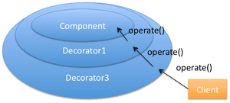
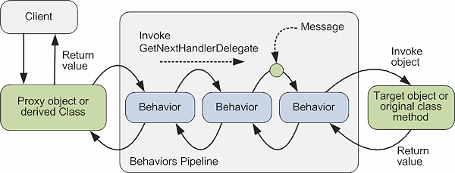
Decorator Pattern
Decorator Pattern adds a new functionality to an existing object
A decorator class decorates an inner object and uses its methods to serve in a different way

Slide 19
Decorator Pattern in java.io
InputStream and Reader classes (and their subclasses) has basic methods called read() for reading a single byte or an array of bytes
OutputStream and Writer classes (and their subclasses) has basic methods called write() for writing a single byte or an array of bytes
Problem: A new access to the disk for each byte will slow down the application seriously
Solution: Bytes may be collected before reading from or writing to the disk. This will reduce the number of physical disk operations
Decorator classes
java.io.BufferedInputStream, java.io.BufferedReader
java.io.BufferedOutputStream, java.io.BufferedWriter

Slide 20
BufferedReader example
public static void main(String[] args) {
BufferedReader reader = null;
try {
reader = new BufferedReader(new FileReader(new File(args[0])));
String line;
while ((line = reader.readLine()) != null) {
System.out.println(line);
}
} catch (Exception e) {
e.printStackTrace();
} finally {
if (reader != null) reader.close();
}
}

Slide 21
A more complicated decoration example
Let's say that we have a bunch of Java objects in a Gzipped file named ‘objects.gz’ and that we want to read them a bit quickly
// First open an inputstream of it:
FileInputStream fis = new FileInputStream("objects.gz");
// We want speeeed, so let's buffer it in memory:
BufferedInputStream bis = new BufferedInputStream(fis);
// The file is gzipped, so we need to ungzip it:
GzipInputStream gis = new GzipInputStream(bis);
// We need to read those Java objects:
ObjectInputStream ois = new ObjectInputStream(gis);
// Now we can finally use it:
SomeObject someObject = (SomeObject) ois.readObject();

Slide 22
InputStream and subclasses
InputStream’s job is to represent classes that produce input from different sources. These sources can be:
An array of bytes (java.io.ByteArrayInputStream)
A String object (java.io.StringBufferInputStream)
A file (java.io.FileInputStream)
A "pipe," (java.io.PipedInputStream)
Pipe works like a physical pipe: You put things in at one end and they come out the other.
A sequence of other streams, so you can collect them together into a single stream (java.io.SequenceInputStream)
Other sources, such as an Internet connection

Slide 23
OutputStream and subclasses
An array of bytes (java.io.ByteArrayOutputStream)
A file (java.io.FileOutputStream)
A "pipe," (java.io.PipedOutputStream)
Pipe works like a physical pipe: You put things in at one end and they come out the other.

Slide 24
Homework
Go over the input and out stream classes mentioned in the previous two slides!
Try to understand at least how they basically work.

Slide 25
Decorating InputStreams
java.io.DataInputStream: read primitives (int, char, long, etc.) from a stream in a portable fashion.
java.io.BufferedInputStream: prevents a physical read every time you want more data.
java.io.LineNumberInputStream: Keeps track of line numbers in the input stream; you can call getLineNumber( ) and setLineNumber (int).
This class incorrectly assumes that bytes adequately represent characters.
java.io.PushbackInputStream: Has a one-byte pushback buffer so that you can push back the last character read.

Slide 26
Decorating OutputStreams
java.io.DataOutputStream: write primitives (int, char, long, etc.) from a stream in a portable fashion.
java.io.BufferedOutputStream: prevent a physical write every time you send a piece of data.
java.io.PrintStream: For producing formatted output. While DataOutputStream handles the storage of data, PrintStream handles display

Slide 27
Example Program: create a copy of a file
public static void main(String[] args) throws Exception {
BufferedInputStream bis = null;
BufferedOutputStream bos = null;
try {
bis = new BufferedInputStream(new FileInputStream(new File(args[0])));
bos = new BufferedOutputStream(new FileOutputStream(new File(args[1])));
byte oneByte;
// read a byte. -1 will be returned at the end of the file.
while ((oneByte = bis.read()) != -1) {
bos.write(oneByte); // write the byte to the output
}
} finally {
if (bis != null) bis.close(); // close the streams
if (bos != null) bos.close();
}
}

Slide 28
Is it too slow?
public static void main(String[] args) throws Exception {
BufferedInputStream bis = null;
BufferedOutputStream bos = null;
byte[] bytes = new byte[1024 * 16]; // bytes will be read in this by 16K chunks
try {
bis = new BufferedInputStream(new FileInputStream(new File(args[0])));
bos = new BufferedOutputStream(new FileOutputStream(new File(args[1])));
int size;
while ((size = bis.read(bytes)) > -1) {
bos.write(bytes);
}
} finally {
if (bis != null) bis.close();
if (bos != null) bos.close();
}
}

Slide 29
Another example: download a web page
// please note that exception handling is not coded properly!!
public static void main(String[] args) throws Exception {
URL url = new URL("http://web.cs.hacettepe.edu.tr/~bbm102/");
BufferedInputStream bis = new BufferedInputStream(url.openStream());
BufferedOutputStream bos = new BufferedOutputStream(
new FileOutputStream(new File("downloadedPage.html")));
for (int c = bis.read(); c != -1; c = bis.read()) {
bos.write(c);
}
bis.close();
bos.close();
}

Slide 30
Readers and Writers
InputStream and OutputStream classes provide functionality in the form of byte oriented I/O
Reader and Writer were added to the library with Java 1.1. These classes provide Unicode-compliant, character-based I/O
Almost all of the original Java I/O stream classes have corresponding Reader and Writer classes

Slide 31
InputStream/OutputStream Reader/Writer correspondings
InputStream/OutputStream | Reader/Writer
InputStream | Reader adapter: InputStreamReader
OutputStream | Writer adapter: OutputStreamWriter
FilelnputStream | FileReader
FileOutputStream | FileWriter
StringBufferlnputStream | StringReader
(no corresponding class) | StringWriter
ByteArrayInputStream | CharArrayReader
ByteArrayOutputStream | CharArrayWriter
PipedInputStream | PipedReader
PipedOutputStream | PipedWriter

Slide 32
Decorator correspondings
InputStream/OutputStream | Reader/Writer
BufferedInputStream | BufferedReader
BufferedOutputStream | BufferedWriter
PrintStream | PrintWriter
LineNumberInputStream | LineNumberReader
PushbacklnputStream | PushbackReader

Slide 33
Example program: copy a file line by line
public static void main(String[] args) throws Exception {
BufferedReader br = null;
PrintWriter pw = null;
try {
br = new BufferedReader(new FileReader(new File(args[0])));
pw = new PrintWriter(
new BufferedWriter(new FileWriter(new File(args[1]))));
String line;
while ((line = br.readLine()) != null) { // read a line. null at the end of the file
pw.println(line); // write a line
}
} finally {
if (br != null) br.close();
if (pw != null) pw.close();
}
}

Slide 34
Random Access
Reading the next byte/string/number or writing to the next location is called sequential access.
Sequential access is easy and efficient when you don’t know the contents of a file or just want to create a copy of it for example.
On the other hand, if you know the sizes of records in a file, you can move in the file to read or change a specific record. This is random access.
All records don’t have to be the same size; you just have to determine how big they are and where they are placed in the file.

Slide 35
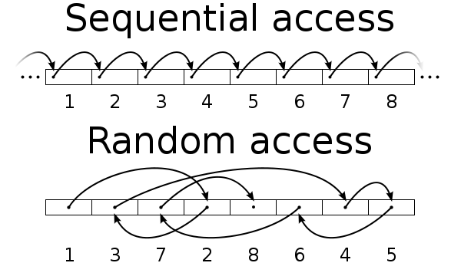
Let’s clarify it by an image

Slide 36
java.io.RandomAccessFile
Used for random access.
Is not part of the InputStream or OutputStream hierarchy. It’s a completely separate class, written from scratch.
Some methods:
getFilePointer( ): find out where you are in the file
seek( ): move to a new point in the file
length(): return the length of the file
the constructors require a second argument (identical to fopen() in C) indicating whether you are just randomly reading ("r") or reading and writing ("rw"). There’s no support for write-only files

Slide 37
Example program: Editing courses Course.java
public class Course {
private String code;
private String name;
private int credit;
public Course(String c, String n, int cr) {
this.setCode(c);
this.setName(n);
this.credit = cr;
}
public int getCredit() { return credit; }
public void setCredit(int c) { this.credit = c; }
public String getCode() { return code; }
public void setCode(String code) {
this.code = to40Chars(code);
}
public String getName() { return name; }
public void setName(String name) {
this.name = to40Chars(name);
}
private String to40Chars(String str) {
String tmp = str;
for (int i = str.length(); i < 40; i++) {
tmp += ' ';
}
return tmp.substring(0, 40);
}
public String toString() {
return code + " - " +
name + " - " +
credit;
}
}

Slide 38
Program.java
RandomAccessFile is given a mode while opening the file. rw: read/write (similar to c)
public static void main(String[] args) throws Exception {
// create course objects
Course[] courses = new Course[4];
courses[0] = new Course("BBM101", "Programlamaya Giris I", 3);
courses[1] = new Course("BBM102", "Programlamaya Giris II", 3);
courses[2] = new Course("BBM103", "Programlamaya Giris Lab I", 3);
courses[3] = new Course("BBM104", "Programlamaya Giris Lab II", 3);
// open the file. It will be accessed randomly
RandomAccessFile raf = new RandomAccessFile(new File("courses.txt"), "rw");
// write the courses to a file. Each course is a record
for (int i = 0; i < courses.length; i++) {
raf.writeBytes(courses[i].getCode()); // write the code as string
raf.writeBytes(courses[i].getName()); // write the name as string
raf.writeInt(courses[i].getCredit()); // write the credit as int
}

Slide 39
Program.java (continued)
// let’s read the second course’s data and create a course object
byte[] bytes = new byte[40]; // data will be read in this as chunks of 40 bytes
// seek to the 2nd record. each record is 40 + 40 + 4 bytes long.
raf.seek((40 + 40 + 4) * (2 - 1));
raf.read(bytes);
String code = new String(bytes); // first 40 byte is the code of the course
raf.read(bytes); // second 40 byte is the name of the course
String name = new String(bytes);
raf.read(bytes, 0, 4); // read 4 bytes: the credit
int credit = ByteBuffer.wrap(bytes).getInt(); // convert byte array to int
System.out.println(new Course(code, name, credit)); // create and print the course
n – 1 records must be skipped to seek to the nth record
credit
code
name

Slide 40
Program.java
// let’s update the name of the 4th course
// seek to the beginning of name of 4th course
raf.seek((40 + 40 + 4) * (4 - 1) + 40);
// write the new name of the course
raf.writeBytes("Programlamaya Giris Laboratory II");
// close the file
raf.close();
} // end of main
Seek to the name field
Seek to the 4th record

Slide 41
Homework
Investigate file opening modes in Java!
read, write, append, …

Slide 42
Serialization
"Serialization is the process of translating data structures or object state into a format that can be stored (for example, in a file or memory buffer, or transmitted across a network connection link) and reconstructed (deserialization) later in the same or another computer environment" (ref: wikipedia)
In Java, serialization is usually used to save/read objects to/from files using ObjectOutputStream and ObjectInputStream
A class must implement java.io.Serializable interface to be serializable. It is a marker interface (has no methods to implement)

Slide 43
Serialization Rules in Java
All primitive types are serializable.
Transient fields (with transient modifier) are NOT serialized, (i.e., not saved or restored). A class that implements Serializable must mark transient fields of classes that do not support serialization (e.g., a file stream).
Static fields (with static modifier) are Not serialized.
If member variables of a serializable object reference to a non-serializable object, the code will compile but a RuntimeException will be thrown.

Slide 44
Example Program: save/read the students
public class Student
implements java.io.Serializable {
private int id;
private String firstName;
private String lastName;
transient private String dummy;
public Student(int id, String firstName,
String lastName, String dummy) {
this.id = id;
this.firstName = firstName;
this.lastName = lastName;
this.dummy = dummy;
}
// getters and setters are written here
public String toString() {
return id + " - " +
firstName + " " +
lastName + " " +
dummy;
}
}

Slide 45
Program.java
public static void main(String[] args) throws Exception {
// create students
Student[] students = new Student[2];
students[0] = new Student(20131234, "Ali", "Doğru", "dummy1");
students[1] = new Student(20135678, "Veli", "Yanlış", "dummy2");
// create the file
ObjectOutputStream oos = new ObjectOutputStream(new
FileOutputStream(new File("students.dat")));
for (int i = 0; i < students.length; i++) {
oos.writeObject(students[i]); // write the object to file serializing
System.out.println(students[i]); // print the object
}
oos.close(); // close the file

Slide 46
Program.java (continued)
// let’s read and display the saved objects on the screen
// open the file
ObjectInputStream ois = new ObjectInputStream(
new FileInputStream(new File("students.dat")));
for (int i = 0; i < students.length; i++) {
// read the student object from file deserializing
Student s = (Student) ois.readObject();
System.out.println(s);
}
ois.close();
}

Slide 47
Output of the program
Objects written to the file:
20131234 - Ali Doğru - dummy1
20135678 - Veli Yanlış - dummy2
Objects read from the file:
20131234 - Ali Doğru - null
20135678 - Veli Yanlış – null
Note that, transient field named dummy is not serialized. So, it is null when the objects are deserialized!

Slide 48
java.nio.*
Be aware of a bit more complex library of Java: The "new" I/O
It was introduced in JDK 1.4 in the java.nio.* packages
It’s main goal is speed. It uses channels and buffers for I/O (closer to the operating system’s way of performing I/O)
It supports a non-blocking I/O model.

Slide 49
Summary
A stream is an object that either
Delivers data from your program to a destination, such as a file or screen, (output stream) or
Takes data from a source, such as a file or the keyboard, and delivers data to your program (input stream)
Files are handled as text or binary files
Java has classes to handle binary (byte oriented) or text (character oriented) files
Decoration is used to give extra functionality to existing objects. Java I/O library benefits the decoration pattern
Java supports both sequential and random file access
Serialization is the job of converting an object to a bit stream that can be saved or transferred to be deserialized later
Java’s nio library is a fast option for I/O

Slide 50
Acknowledgements
The course material used to prepare this presentation is partially taken/adopted from the list below:
Thinking in Java 4th Ed., Bruce Eckel, Prentice Hall, 2006
Java - An Introduction to Problem Solving and Programming, Walter Savitch, Pearson, 2012

