Slide 1
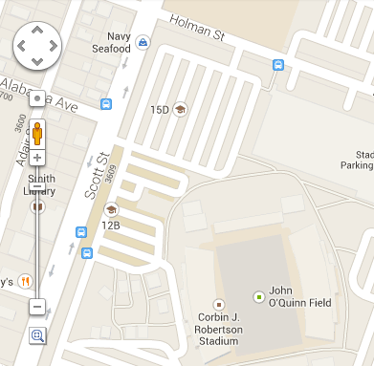
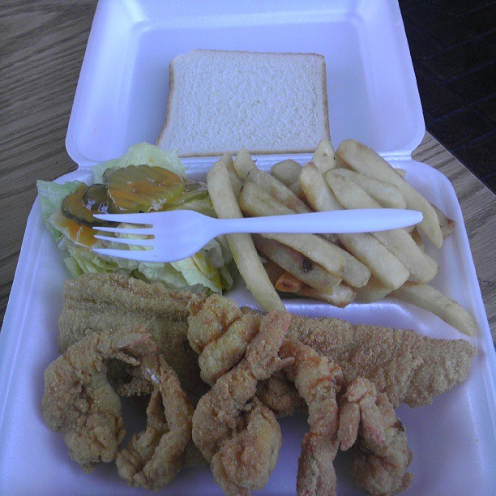
Phone: 713-741-0620
Hours: 10am – 10pm
Address: 3502 Scott Street
Houston, TX 77004
Navy Seafood
Home | Menu | About Us | Contact Us
1 Fish & 6 Shrimp
10% Off Any Order Tomorrow

Slide 2

Phone: 713-741-0620
Hours: 10am – 10pm
Address: 3502 Scott Street
Houston, TX 77004
Navy Seafood
Home | Menu | About Us | Contact Us
Navy’s Menu
10% Off Any Order Tomorrow
MIXED ORDERS*
FAMILY ORDERS*
1 Fish, 3 Shrimp
12 Piece fish $15.99
1 Fish, 6 Shrimp
30 Shrimp $14.99
1 Fish, 3 Oysters Teriyaki
$3.69
$6.16
$5.25
2
5
1

