Slide 1
SK Hynix AI memory sales surge to 52.6T
2026-06-17
Notes:
SK Hynix absorbed demand from AI data centers with HBM, high-layer NAND, and enterprise storage devices.

Slide 2
SK hynix
Global memory semiconductor leader, HBM3E-specialist (KOSPI 2-th)
■ Memory semiconductor designer-manufacturer Supplies DRAM and NAND-based solutions, packaging for HBM, server DDR, mobile LPDDR, storage ■ HBM3E, high-stack server memory HBM3E uses 8- and 12-stack layers, fast interfaces, and proven NVIDIA supply ■ DRAM-NAND packaging integration Mass-produces DRAM and NAND, integrates controllers, packaging, testing, and serves server, AI customers
Notes:
It captured AI data center demand with HBM, high-layer NAND, and enterprise SSDs, and differentiated itself through global customer certification, mass production capability, and advanced packaging with high yield.

Slide 3
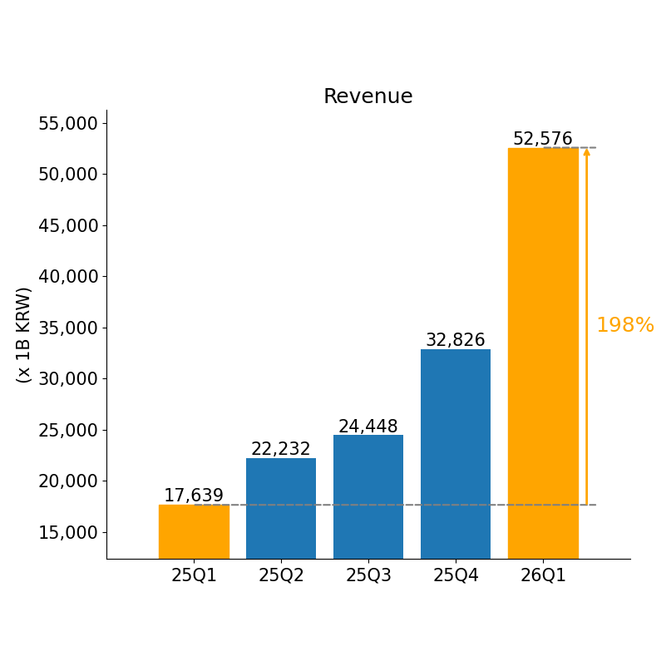
26/1Q results
Record 26Q1 breakout, year-over-year surge
Korean reports say memory prices rose on AI server demand, HBM shipments, and DRAM recovery
Notes:
In the most recent quarter, revenue increased significantly due to rising memory prices, growing AI server demand, higher shipment volumes, and an improved mix of premium products.

Slide 4
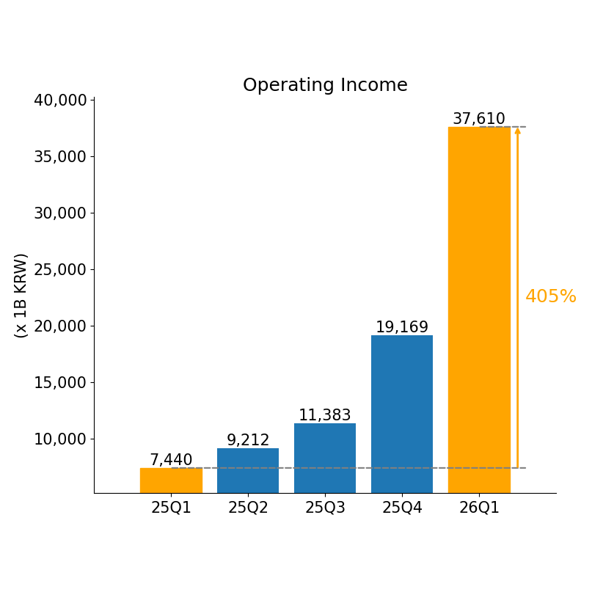
26/1Q results
26Q1 profit breakout surge
Korean media cited memory price rebound, higher-value products, AI server demand, and inventory correction
Notes:
Operating profit in 25Q1 and 25Q4 steadily increased, surged in 26Q1, and was significantly higher than the same period last year due to rising memory prices, AI demand, and improved factory efficiency.

Slide 5
Key Issues
HBM demand adjustment, memory recovery, Nasdaq review
■ Order and authentication delays HBM demand remains strong, but customer timing, contract renegotiations, and delays persist ■ Universal memory inventory adjustment delay NAND and DRAM rebounds delayed by slower inventory reduction and weak PC-smartphone demand ■ Nasdaq Listing Review Uncertainty US listing may widen funding and investors, but raises disclosure, dilution, volatility concerns
Notes:
Delays in expanding high-bandwidth memory for AI servers, delayed recovery in general-purpose memory demand, and restrictions related to China, along with overseas production constraints, are affecting market share, pricing, and investment efficiency.

Slide 6
Memory-price recovery, AI server demand
Watch semiconductor exports, DRAM prices, AI servers, Nasdaq tech
Notes:
Performance is improving thanks to demand for AI servers, data centers, enterprise storage devices, and increased memory prices and shipment volumes, while risks from China, overseas production, and policy remain. Thank you.

