Slide 1
---
13초 컷 – 회사 하나 공부하자!
Text
2024-10-28
Quarterly Performances

Slide 2
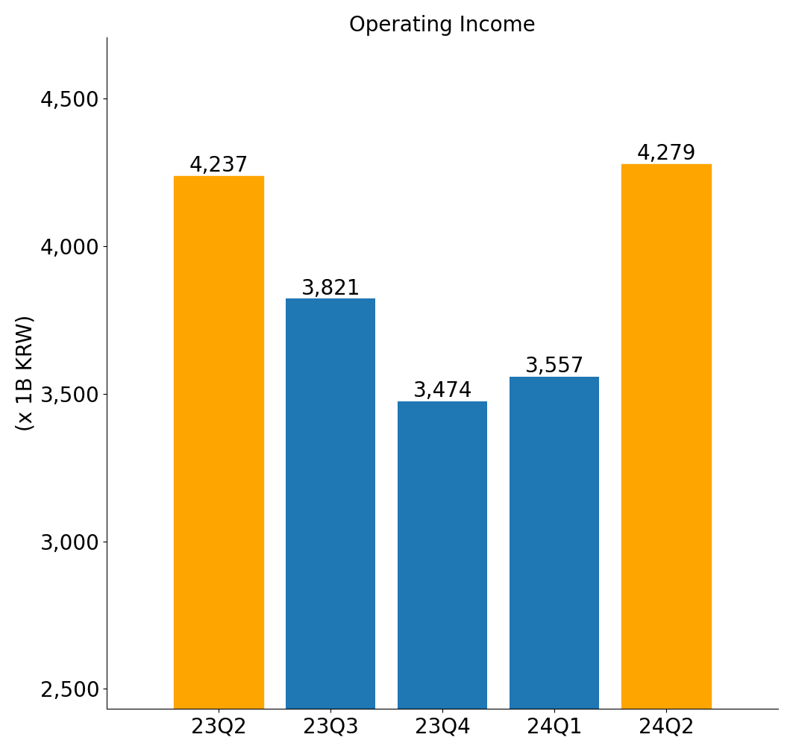
Text

Slide 3
Thank you

