Slide 1
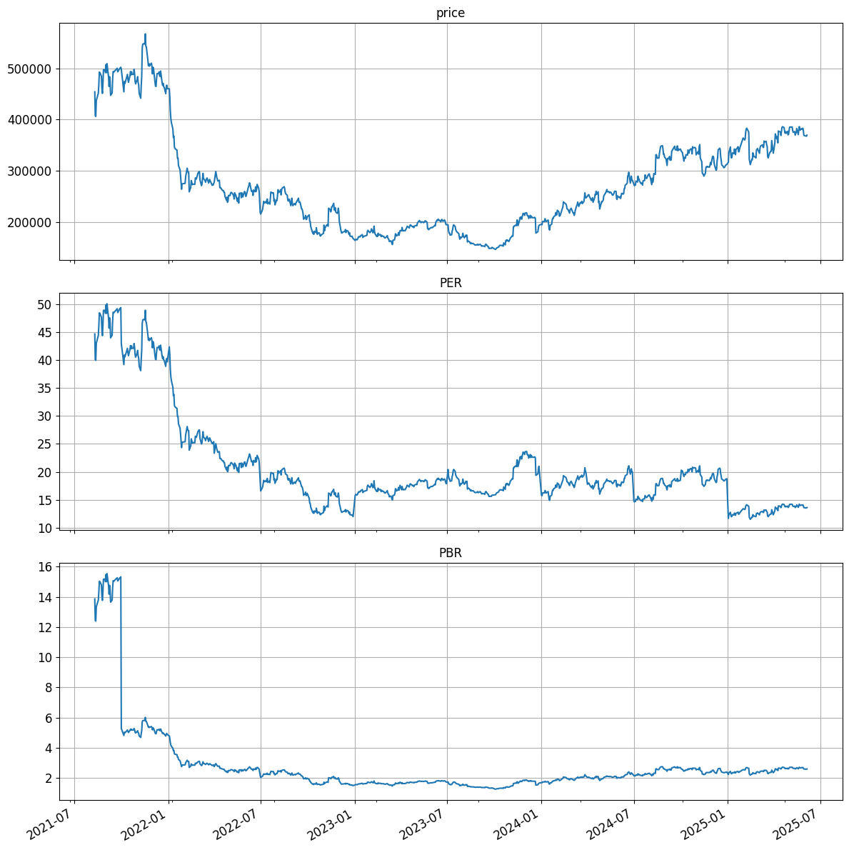
크래프톤 (259960)
2025-06-07
rank:1 selected: -TT top30: YYY
24Q 20Q 16Q 12Q 8Q avg
NaN NaN 19.0 21.0 21.0 20.33

Slide 2
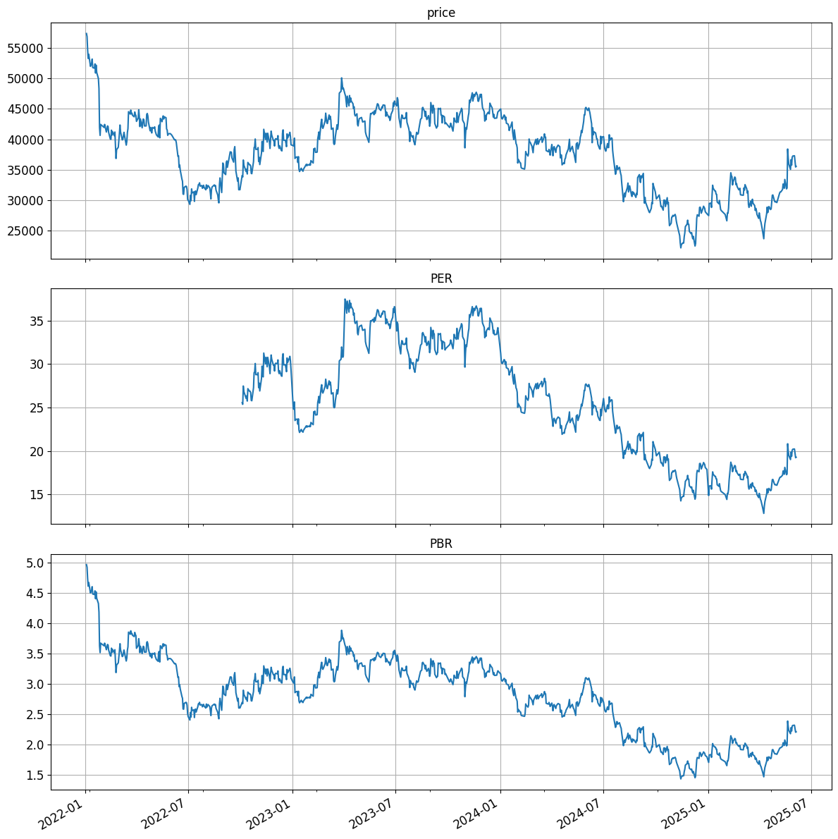
덕산네오룩스 (213420)
2025-06-07
rank:2 selected: -T top30: YY
24Q 20Q 16Q 12Q 8Q avg
NaN NaN NaN 19.0 21.0 20.0

