Slide 1
CyberSkills2Work The National Cybersecurity Workforce Development Program

Slide 2
Industrial Control Systems Security
Acknowledgement
This program is funded by the National Security Agency National Centers of Academic Excellence in Cybersecurity (NCAE-C) Program.
For additional information, please visit www.CyberSkills2Work.org.
Course Title
CRN
©2024 CyberSkills2Work - Institution Name

Slide 3

Intrusion Detection
^{Module 8}
Notes:
Welcome to Intrusion Detection - the first lesson in the Forensics and Recovery Module.
Intrusion detection (ID), in the context of Industrial Control Systems (ICS), refers to the process of monitoring and analyzing network traffic, system behaviors, and operational data within an ICS environment to identify unauthorized access, anomalous activities, or potential cyber threats that could compromise the confidentiality, integrity, or availability of critical infrastructure (CIA triad).
Unlike traditional IT / Enterprise environments however, detecting a breach within an ICS environment is crucial to help maintain real-time operation constraints and to ensure the availability of resources. This does not mean that integrity and confidentiality of systems are ignored; they are simply prioritized below availability. We will discuss this concept in detail later in the lesson.
Image Resource: (6) Designing An Intrusion Detection System | LinkedIn

Slide 4
8.0 Lesson Objectives
Understand the fundamental role intrusion detection plays in IT/OT systems
Learn how to identify indicators of compromise (IOC)
Learn how to implement IDS/IPS in OT systems.
Learn how to generate alerts, including:
How to write detection rules
How to reduce false positive and false negatives
Become familiar with Security Incident and Event Management platforms, like ELK, Splunk.

Slide 5
Events and Incidents
An event is a general occurrence in a network or system that typically does not negatively impact a system or affect its security posture.
Example: a user with several failed login attempts (because they simply forgot their password)
An incident is a specific type of event, or series of related events, that negatively impacts a system and/or its security posture
Examples: malware is delivered to the internal network, a breach is detected, a natural disaster like a hurricane.
Notes:
Events are typically benign occurrences, such as a security log indicating a user had more than 3 failed login attempts on their workstation. An event like this can easily be remedied by contacting the employee and resetting their password, if necessary.
An incident is the occurrence of some type of malicious or malignant activity, including overt human action (like a DOS attack or phishing attempts) and natural disasters, specifically those that disrupt network or physical operations.

Slide 6
What is an Alert?
An alert is an automated notification generated by an Intrusion Detection System, an Intrusion Prevention System, a Security Incident Event Management platform, or a related security tool designed to generate alerts based on predefined rules, heuristics, or anomalies.
Purpose of Alerts:
Threat Detection (identifies signs of malicious activity)
Intrusion Detection (contains actionable information)
Monitoring Compliance (adherence to security policies)
Notes:
Types of Alerts in Intrusion Detection
Signature-Based Alerts:
Triggered when activity matches a known signature or pattern of malicious behavior.
Example: Detecting a specific malware hash or exploit payload.
Anomaly-Based Alerts:
Generated when activity deviates from established baselines or normal behavior.
Example: A sudden spike in outbound data traffic.
Behavioral-Based Alerts:
Detected based on unusual actions or sequences of actions.
Example: Lateral movement between systems in a network.
Threshold-Based Alerts:
Triggered when a predefined threshold is exceeded.
Example: More than 5 failed login attempts from the same IP in 10 minutes.
Alert Lifecycle
Detection:
The IDS/IPS monitors traffic or system activity and matches it against predefined rules, signatures, or baselines.
Alert Generation:
If a match is found or an anomaly is detected, an alert is generated and logged.
Notification:
Alerts are forwarded to security teams via dashboards, emails, SMS, or other communication channels.
Triage:
Analysts review and prioritize the alert based on severity and context.
Investigation:
Detailed analysis is performed to confirm whether the alert indicates a true or false positive.
Response:
If confirmed as a threat, appropriate actions (e.g., blocking IPs, isolating systems) are taken.

Slide 7
Indicators of Compromise
An indicator of compromise (IOC) is evidence that someone may have breached an organization’s network or endpoint. This forensic data doesn’t just indicate a potential threat, it signals that an attack, such as malware, compromised credentials, or data exfiltration, has already occurred. - Microsoft
Notes:
An Indicator of Compromise is any data artifact that can be used to detect a malicious activity or security breach. This can include suspicious file hashes, unusual IP addresses, or patterns of behavior that deviate from the norm.
An incident can contain one ore more IOCs, so it is helpful to understand the different types of IOCs one might find in an ICS environment.
IOC Definition - What Are Indicators of Compromise (IOC)? | Microsoft Security

Slide 8
What is Intrusion Detection?
Definition: The implementation of manual and/or automated procedures and tools used to detect malicious activity involving physical and logical resources.
Involves physical resources (servers, PLCs, RTUs, HMIs, network cabling)
Involves logical resources (network communications, TCP/UDP ports, software applications)
The first layer of defense for network operations and security operation centers (SOCs)
Notes:
Intrusion detection refers to the systematic use of manual and/or automated methods, procedures, and tools to identify and report on malicious activity targeting both physical and logical assets within an environment. In an industrial control system (ICS) setting, this can include abnormal activities that threaten the functionality, safety, or reliability of operational technology (OT) components critical to process control.
An incident is usually detected using :
Manual Detection Techniques
Automated Detection Techniques
This involves the use of alerts generated by IDS/IPS, SIEMs, detection algorithms, and Machine Learning platforms.
Physical Resources:
Servers: Host critical applications, databases, and ICS-specific systems. Intrusion detection involves monitoring access, resource usage, and logs for signs of compromise, such as unauthorized logins or unusual process activity.
Programmable Logic Controllers (PLCs): These devices execute operational commands. Intrusion detection monitors for unauthorized access to PLCs or anomalies in their programming and execution.
Remote Terminal Units (RTUs): Devices that interface with field equipment. Detection focuses on monitoring command traffic to RTUs to identify unauthorized manipulation.
Human-Machine Interfaces (HMIs): User interfaces for operators to control industrial processes. Detection includes monitoring for unauthorized user actions or abnormal interactions.
Network Cabling and Hardware: Physical connections that transmit control data. Intrusion detection can include examining network traffic for signs of tampering or unauthorized packet injection.
Logical Resources:
Computer Networks: The backbone for communication in ICS. Intrusion detection tools monitor network traffic for unauthorized access, lateral movement, or command injection targeting ICS protocols like Modbus, DNP3, and OPC-UA.
Ports: Logical entry points for communication, such as TCP/UDP ports. Intrusion detection includes scanning for open, unused ports or abnormal port activity that could indicate a breach.
Software Applications: ICS software, SCADA systems, and operational tools are targeted by malware and exploits. Monitoring involves detecting unusual software behavior, unauthorized installations, or changes to application configurations.
Definition Source: Ian T. Burres

Slide 9
Intrusion Detection Systems (IDS)
More specific than the general field or practice of intrusion detection.
Involves the use of either hardware devices or software applications
Primarily a passive system that alerts administrators to potential threats
Not capable of mitigating risks
Capable of reporting and logging alerts
Completely dependent on effective rule generation
Notes:
Intrusion Detection Systems (IDS) focus specifically on identifying malicious activity within a defined scope, such as monitoring network traffic or host activities. Unlike the broader concept of intrusion detection, which may encompass various methodologies and practices, IDS is an implemented system (hardware or software) designed to monitor and identify specific threats in real-time.
IDS can be deployed as hardware appliances, software applications, or a combination of both:
Hardware IDS: Physical devices that monitor traffic at critical network junctions, like between internal and external networks.
Example of hardware intrusion detection systems are motion sensors, thermal cameras, and dedicated hardware units (like Waterfall) designed to perform intrusion detection functions.
Software IDS: Applications installed on servers, endpoints, or network management systems that analyze traffic, logs, or processes. These systems work by integrating seamlessly into the monitored environment to detect potential intrusions effectively.
Example of software intrusion detection systems are Suricata, Snort, and the Elastic Security Stack.
Primarily a Passive System That Alerts Administrators to Potential Threats:
IDS operates passively by observing and analyzing traffic or system events without directly intervening. Such as:
Raises alerts when suspicious activity is detected.
Allows administrators to investigate and respond to incidents. This passive nature makes IDS less intrusive to existing network performance compared to active systems like Intrusion Prevention Systems (IPS). (Which we will discuss on the next slide)
Not Capable of Mitigating Risks:
While IDS excels at detection, it does not inherently block or prevent threats. It requires:
Manual Intervention: Security teams act on alerts by isolating affected systems or blocking malicious traffic.
Integration with Other Tools: To automate responses, IDS can feed alerts to firewalls, IPS, or Security Information and Event Management (SIEM) systems (like Splunk or ELK). The lack of built-in mitigation makes IDS a complementary tool rather than a standalone defense mechanism.
Capable of Reporting and Logging Alerts:
IDS generates detailed logs and reports that include:
Event Metadata: Source and destination IPs, timestamps, and protocol details.
Alert Details: Type of anomaly detected, such as suspicious patterns, unauthorized access, or known malware signatures. These logs are invaluable for forensic analysis, compliance auditing, and improving future detection capabilities.
Completely Dependent on Effective Rule Generation:
The performance of an IDS relies heavily on the quality and accuracy of its detection rules. These rules dictate:
What to Monitor: Specific signatures, behaviors, or traffic patterns.
How to Respond: Severity levels and alert mechanisms. Poorly written or outdated rules can lead to:
False Positives: Legitimate activity flagged as malicious, overwhelming administrators with unnecessary alerts.
False Negatives: Actual threats passing undetected due to insufficient rule coverage. Continuous rule updates and fine-tuning are critical for effective IDS operation.

Slide 10
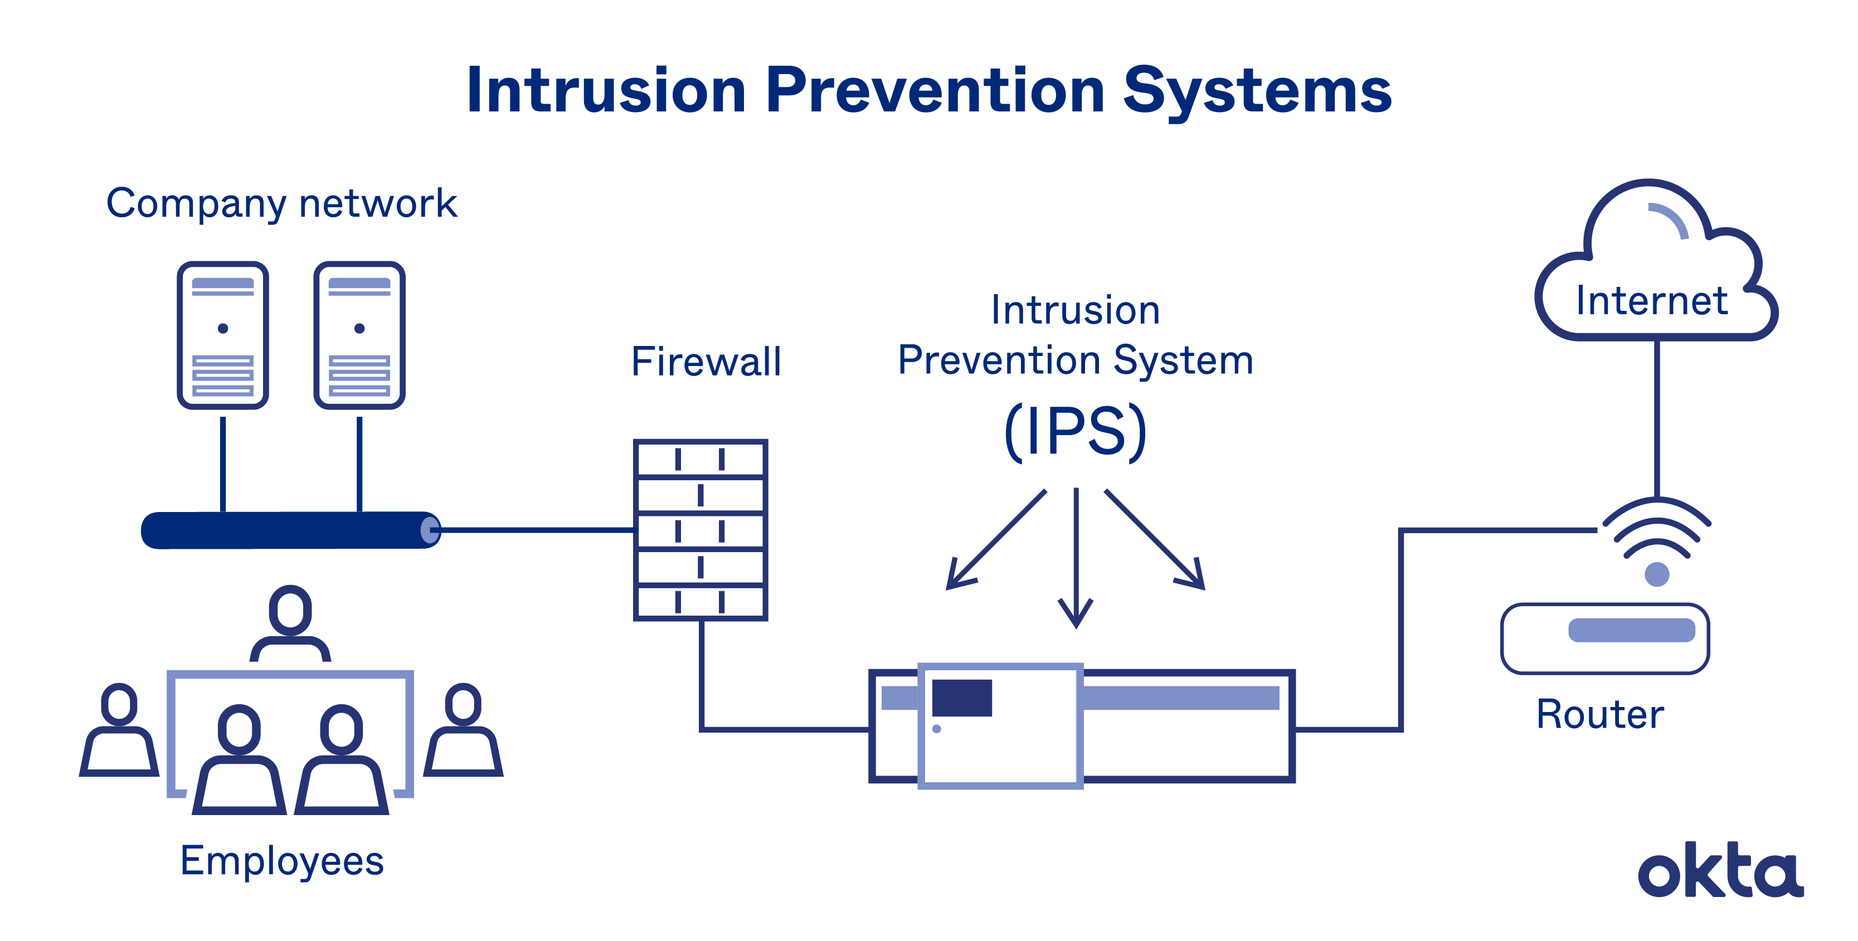
Intrusion Prevention Systems (IPS)
Actively blocks and prevents malicious activities detected in the network or system.
Goes beyond detection to mitigate risks
Notes:
Intrusion Prevention Systems automatically take predefined actions (e.g., blocking IPs, dropping packets, resetting connections) to stop threats. IPS are capable of reducing the need for immediate human intervention.
IPS Technologies:
Tools: Snort (IPS mode), Suricata (IPS mode), Palo Alto Networks, Cisco Firepower
Often integrated into next-generation firewalls (NGFWs) or as standalone solutions.
IPS in ICS:
Actively prevents malicious activities like unauthorized command execution or protocol-based attacks.
Must be carefully configured to avoid unintended disruptions in critical control processes.
Requires deep understanding of ICS traffic to minimize false positives.
Monitors industrial protocols (e.g., Modbus, DNP3, OPC-UA) for anomalies.
Ensures real-time monitoring without disrupting sensitive operations.
Useful for detecting abnormal PLC/HMI communications or unauthorized changes to control processes.
Image Source: Intrusion Prevention System: What Is An IPS? How Do They Work? | Okta UK

Slide 11
Types of IDS/IPS
Network-based IDS (NIDS)
Host-based IDS(HIDS)
Signature-based IDS
Behavioral-based IDS
Anomaly-based IDS
Heuristic IDS
Hybrid IDS
Notes:
Network-based Intrusion Detection System (NIDS):
Monitors traffic on a network for suspicious activities.
Deployed at strategic points, such as network boundaries or within subnets, to analyze packets flowing across the network.
Examples: Snort, Suricata.
Host-based Intrusion Detection System (HIDS):
Installed on individual hosts or endpoints to monitor system activities, such as file access, process creation, and configuration changes.
Provides visibility into specific devices and is effective at detecting insider threats or attacks targeting the host.
Examples: OSSEC, Tripwire.
Signature-based IDS:
Detects threats by comparing traffic and activities against a database of known attack signatures or patterns.
Effective for identifying known attacks but cannot detect novel or unknown threats.
Example: Detecting a specific malware's behavior pattern.
Behavioral-based IDS:
Uses machine learning, statistical analysis, or heuristics to identify deviations from established baseline behaviors.
Can detect zero-day attacks or novel threats but is prone to false positives if baselines are not accurate.
Example: Detecting abnormal communication between a PLC and HMI in an ICS network.
Hybrid IDS:
Combines both signature-based and anomaly-based detection for improved accuracy and threat coverage.
Balances between detecting known threats and identifying new ones.

Slide 12
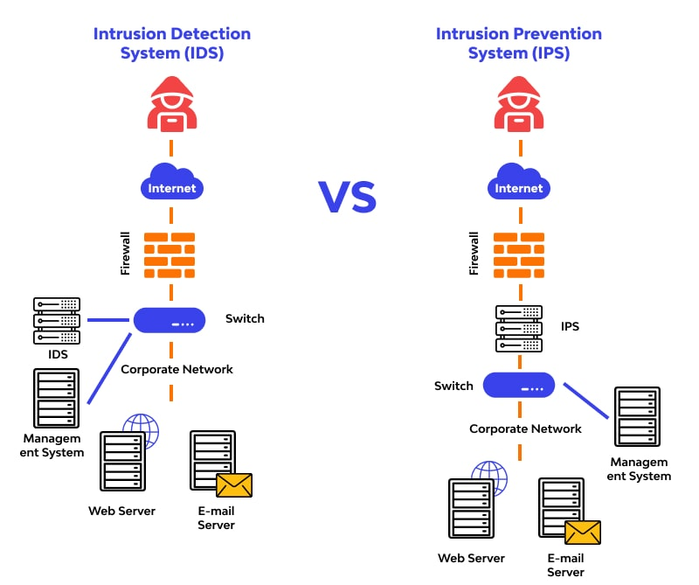
Placement in the Network
Notes:
IDS:
Deployed at strategic points in the network, often at monitoring ports or taps to observe mirrored traffic.
Positioned out-of-band to avoid interrupting traffic flow.
IPS:
Deployed inline within the network, typically between firewalls and internal systems, to inspect and control all traffic.
Actively filters packets before they reach their destination.
It is important to understand that Intrusion Prevention Systems are not firewalls, which are designed to inspect traffic at a basic level (blocking or allowing packets based on source/destination IP addresses, port numbers, or protocols). IPS can perform deep packet inspection, can identify and block threats embedded within allowed traffic, such as SQL injection attacks, and can inspect traffic within the network. Once network traffic propagates beyond the firewall, only an IDS or IPS is capable of automated inspection.
Graphic Source: What is an Intrusion Prevention System (IPS)❓

Slide 13
IPS/IDS in Industrial Control Systems
Monitoring Industrial Protocols:
Modbus, DNP3, OPC-UA
Baseline behavior analysis
Ex. PLC-to-PLC communications
Threat detection
Inline Traffic Filtering
Stopping known attacks
Examples: Suricata/Snort in IPS mode, Dragos Platform and Nozomi Networks (IDS only)
Notes:
Monitoring Industrial Protocols:
IDS monitors OT-specific protocols (e.g., Modbus, DNP3, OPC-UA) to detect anomalies or unauthorized commands.
Baseline Behavior Analysis:
It establishes a baseline of normal operational behavior, such as expected PLC-to-PLC communications, and flags deviations (e.g., unexpected commands or traffic patterns).
Threat Detection:
Detects cyber threats such as malware, lateral movement, and unauthorized access that could compromise ICS integrity.
Inline Traffic Filtering:
IPS systems are placed inline in the ICS network to block malicious activities, such as unauthorized write commands to PLCs or abnormal protocol usage.
Stopping Known Attacks:
IPS using signature-based detection could be used to block known threats like malware or exploits targeting ICS components.
Suricata in IPS Mode (Configured for ICS Protocols):
Deployed inline to block traffic containing known attack signatures, such as Stuxnet-like payloads.
Example: Blocking an unauthorized Modbus command attempting to change setpoints in a power plant.
Dragos Platform:
Combines visibility with active threat mitigation in ICS environments.
Capable of automatically discovering and profiling all assets in an OT environment
Uses Intelligence-Driven Threat Detection using updated modeling, configuration, and threat behaviors
Uses expert-authored playbooks. (More on this later)
Example: Blocking a malware payload attempting to propagate through an ICS network.

Slide 14
Security Information and Event Management (SIEMs)
Collects, analyzes, and correlates log data from various sources within a networked environment
Capable of generating alerts
Can be used to create intrusion detection rules
Often used in conjunction with an IDS/IPS
Uses Indexes
Examples:
Splunk
ELK Stack
IBM Security QRadar
Notes:
Log Collection:
The collected data often includes events, audit logs, and error logs, which provide insight into network activity and potential security threats.
Log Analysis:
Analyzes the raw data to identify patterns, trends, and anomalies that may indicate malicious activity or misconfigurations.
Correlation: Combines data from various sources to detect complex attack patterns, such as multi-stage attacks or coordinated attempts to breach the network.
Customizable Alerts:
\Alerts can be configured based on predefined thresholds, detection rules, or specific event triggers.
Real-Time Monitoring:
Some systems offer real-time alerting, allowing organizations to respond immediately to emerging threats.
Integration with SIEMs (regarding IDS/IPS):
Alerts are often routed to Security Information and Event Management (SIEM) platforms for centralized monitoring and incident response.
Splunk
A powerful data analytics platform capable of collecting, analyzing, and visualizing large volumes of machine-generated data.
Use Case: Helps detect intrusions by analyzing logs from firewalls, IDS/IPS systems, and endpoints, providing real-time alerts and dashboards for security teams.
ELK Stack (Elasticsearch, Logstash, Kibana)
An open-source platform for log collection, processing, and visualization.
Use Case: Aggregates logs from ICS devices and network components to identify anomalies, such as abnormal Modbus traffic or unauthorized remote access.
IBM Security Qradar
A SIEM platform that provides log management, threat detection, and security analytics.
Use Case: Correlates logs from IDS/IPS, SCADA systems, and OT endpoints to detect complex threats targeting industrial environments.
Note: In a Security Information and Event Management (SIEM) system, an "index" refers to a structured organization of collected log data, allowing for efficient searching and retrieval of specific events based on various attributes like timestamps, source IP addresses, user identities, or event types, essentially acting as a categorized directory to quickly access relevant information within the vast number of logs - ChatGPT

Slide 15
ELK Stack
Quickly becoming the most popular SIEM implemented in ICS environments
Core Components of the ELK Stack
Elasticsearch
Logstash
Kibana
Optional Components:
Beats
Filebeat, Heartbeat, etc…
Elastic Agents
Notes:
Elasticsearch
Purpose: A distributed search and analytics engine that stores, indexes, and searches data.
Role in the Stack:
Acts as the primary data store for logs and other structured or unstructured data.
Provides a RESTful API for interacting with data.
Enables powerful search and filtering capabilities using Lucene Query Syntax.
Supports scalability with distributed architecture.
Key Features:
Full-text search.
Aggregations: For analyzing trends and patterns in data.
High availability: Through clustering and sharding.
Near real-time search and indexing.
Logstash
Purpose: A server-side data collection pipeline that ingests, processes, and forwards data.
Role in the Stack:
Collects logs, metrics, and other data from a variety of sources.
Transforms and enriches the data to a structured format.
Routes the processed data to Elasticsearch (or other destinations).
Key Features:
Input Plugins: Supports multiple data sources (e.g., syslog, filebeat, metrics).
Filter Plugins: Provides tools for parsing and transforming data (e.g., grok for pattern matching, mutate, and geoip for enrichment).
Output Plugins: Sends data to various destinations (e.g., Elasticsearch, Kafka, AWS S3).
Extensibility: Highly customizable to suit complex workflows.
Kibana
Purpose: A visualization tool for exploring and analyzing data stored in Elasticsearch.
Role in the Stack:
Acts as the front-end interface for users to interact with Elasticsearch data.
Allows users to create dashboards, charts, and visualizations.
Provides tools for monitoring and managing the stack.
Key Features:
Interactive Dashboards: Create visualizations like bar charts, pie charts, heat maps, and more.
Data Exploration: Perform ad hoc queries and filters.
Alerting and Monitoring: Set up alerts for specific conditions in the data.
Customizable UI: Tailor the interface to meet specific use cases.
Security Features: Manage access and permissions with Elastic Security.
Optional Components in the Elastic Stack
In addition to ELK, the Elastic Stack includes additional tools to enhance functionality:
Beats
Purpose: Lightweight data shippers that send data to Logstash or Elasticsearch.
Common Types:
Filebeat: Monitors and forwards log files.
Metricbeat: Collects metrics from systems and services.
Packetbeat: Captures and analyzes network traffic.
Heartbeat: Monitors the availability of services via ping or HTTP checks.
Auditbeat: Collects audit data for security purposes.
Elastic Agent
Purpose: A unified agent for collecting logs, metrics, and security data.
Benefit: Simplifies deployment and management compared to using multiple Beats.
Example: A Windows machine added as an agent, which can subsequently forward logs from the Security component of Event Viewer.

Slide 16
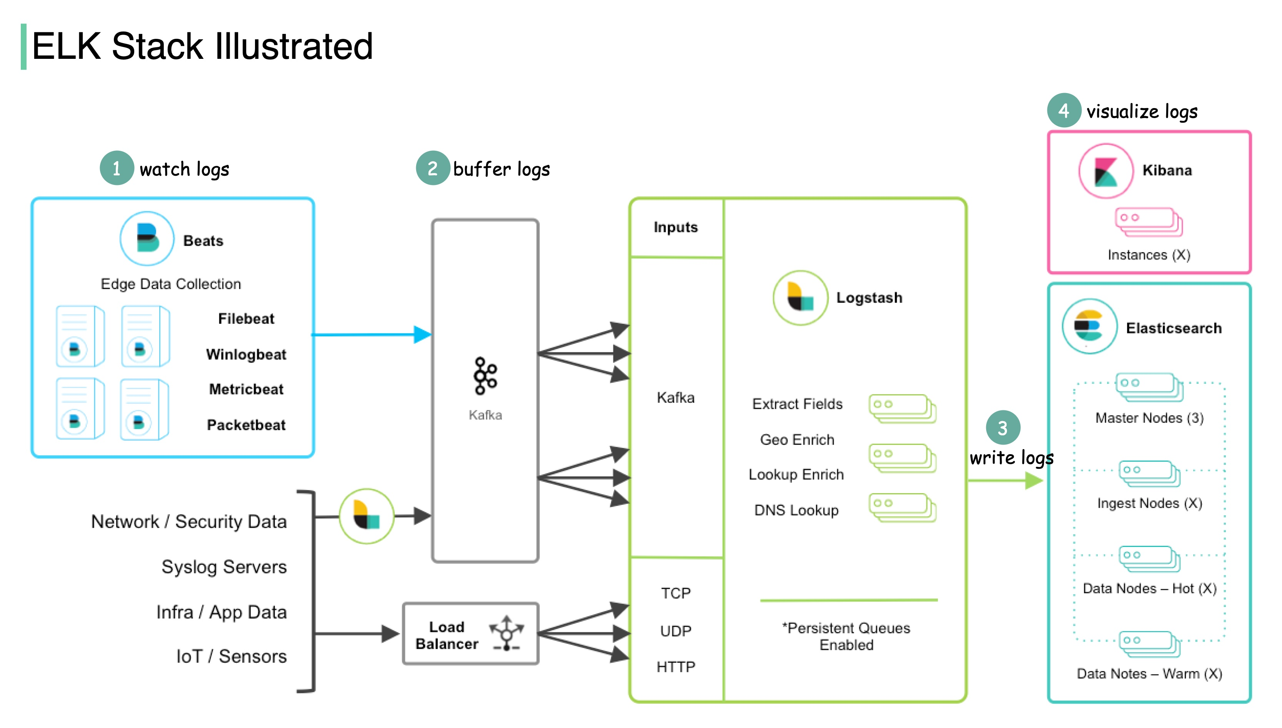
Illustration of the ELK Stack
Notes:
A simple illustration showing the different components of the ELK stack and how they are interconnected. In an ICS environment, the ELK Stack typically operates in the Operational Technology (OT) network or a dedicated monitoring environment that bridges both OT and IT networks. Its role is to collect, process, store, and analyze logs, metrics, and events generated by ICS devices, networks, and supporting systems.
OT Network Integration
Primary Use: Monitoring the health and security of industrial processes.
ELK Stack components are deployed within the OT network to monitor logs and telemetry data from:
Supervisory Control and Data Acquisition (SCADA) systems.
Programmable Logic Controllers (PLCs).
Human-Machine Interfaces (HMIs).
Remote Terminal Units (RTUs).
Data Sources:
Device logs (e.g., PLC diagnostics).
SCADA system events.
Network traffic between ICS components.
Placement:
Collectors like Filebeat and Metricbeat run on ICS servers or specialized gateways to send data to Logstash or Elasticsearch.
Logstash resides in a secure environment for parsing and enriching data before storage in Elasticsearch.
IT/OT Convergence Layer
Purpose: Acts as a bridge between the IT and OT networks while maintaining security boundaries.
ELK components can be placed in this layer to aggregate data from both networks without exposing the OT network directly to external threats.
Example:
Network logs from OT devices (collected via Beats) are routed to Logstash in the convergence zone for filtering and transformation.
Elasticsearch and Kibana may reside in the IT domain for centralized monitoring and visualization.
Image Source: Alex Xu a X: "The diagram below shows how ELK Stack works: Step 1 - Beats collects data from various data sources. For example, Filebeat and Winlogbeat work with logs, and Packetbeat works with network traffic. https://t.co/tyVT7hDUv1" / X

Slide 17
Intrusion Detection Rules
Predefined conditions or patterns that specify:
what an IDS/IPS should monitor
how it should respond to malicious activity
what severity/priority level to use when categorizing incidents
Rules are stored on the server and sensors
Rules are contained in rulesets
System ruleset
Custom ruleset
Notes:
Predefined Conditions or Patterns
Rules are the foundation of how an IDS/IPS operates, defining what the system should detect, how it should respond, and how incidents are prioritized.
What an IDS/IPS Should Monitor:
Rules specify the types of traffic, protocols, or system behavior that the IDS/IPS should analyze for potential threats.
Example: Monitoring Modbus TCP traffic in an industrial network for unauthorized read/write commands.
How It Should Respond to Malicious Activity:
Rules dictate the actions taken when a threat is detected, such as generating an alert, logging the event, or actively blocking the traffic in an IPS.
Example: Blocking traffic from a specific IP address after detecting a port scan.
What Severity/Priority Level to Use When Categorizing Incidents:
Rules assign priority levels to incidents, helping security teams differentiate between minor anomalies and critical threats.
Example: Flagging an unauthorized file access attempt as high priority versus routine failed login attempts marked as low priority (maybe the user forgot their password).
Rules Are Stored on the Server and Sensors
Server:
The central IDS/IPS management system stores the master copy of all rules and configurations.
Administrators update and manage rules on the server, and these updates are then pushed to sensors deployed across the network.
Sensors:
Sensors are deployed at various points in the network (e.g., at gateways, between subnets) and locally monitor traffic or activity based on the uploaded rules.
Sensors compare live traffic against their rule sets in real-time, taking appropriate action as defined by the rules.
Rules Are Contained in Rulesets
Rules are organized into logical groups called rulesets, simplifying management and ensuring that related rules are applied consistently across the system.
System Ruleset:
A default ruleset provided by the IDS/IPS vendor or community, containing rules for common attack patterns and vulnerabilities.
Examples include rules for detecting:
SQL injection attacks.
Known malware signatures.
Protocol violations, such as malformed HTTP requests.
ELK and Splunk provide thousands of pre-generated rules that cover the most common attack vectors.
Custom Ruleset:
Administrators can define custom rules tailored to their specific network or operational needs.
Example: Writing a rule to monitor unauthorized Modbus commands in an industrial control system.
Custom rules allow organizations to address unique threats that may not be covered in the system ruleset.

Slide 18
Anatomy of an Intrusion Detection Rule
The rule header
Action
Protocol
Source / Destination IP
Rule options
Message (msg)
Content
flags
Metadata and comments
Notes:
Rule Header
The rule header defines the basic characteristics of the traffic the rule applies to. It includes the action, protocol, source and destination IP addresses, ports, and direction of traffic.
Key Elements of the Rule Header:
Action: Specifies what the IDS should do when a rule matches.
Common actions: alert, log, pass, activate, dynamic, drop, reject.
Example: alert generates an alert when traffic matches the rule.
Protocol: Identifies the protocol to be monitored.
Supported protocols: tcp, udp, icmp, or ip (any protocol).
Example: tcp monitors TCP traffic.
Source and Destination IP Addresses: Specifies the source and destination IP ranges.
Example: any any monitors traffic from any source and to any destination.
Networks can be specified using CIDR notation (e.g., 192.168.1.0/24).
Ports: Defines the source and destination port numbers or ranges.
Example: any 80 monitors traffic on port 80 (HTTP).
Direction: Indicates the direction of the traffic flow.
-> monitors traffic from source to destination.
<-> monitors bidirectional traffic.
Rule Options
The rule options define the specific conditions to evaluate when the traffic matches the header. They are enclosed in parentheses and consist of keywords and arguments.
Common Rule Options:
Message (msg):
Provides a human-readable description of the rule.
Example: msg:"Potential SQL Injection";
Content (content):
Specifies the payload or data to look for within the packet.
Example: content:"SELECT * FROM";
Offset and Depth:
Refines content matching by specifying where in the payload to search.
Example: offset:10; depth:20; searches between bytes 10 and 20.
Flags (flags):
Monitors specific TCP flags (e.g., SYN, ACK, FIN).
Example: flags:S; matches packets with the SYN flag set.
Thresholds:
Limits the frequency of alerts for a given rule.
Example: threshold:type limit, track by_src, count 1, seconds 60; generates only one alert per source every 60 seconds.
Reference (reference):
Provides a reference to external documentation, such as CVE entries or attack databases.
Example: reference:cve,2021-12345;
SID (Signature ID):
A unique identifier for the rule.
Example: sid:10001;
Rev (Revision Number):
Tracks the version of the rule.
Example: rev:1;
Metadata and Comments
Metadata: Used to include additional information about the rule, such as its classification, priority, or author.
Example: metadata:service http;
Comments: Lines starting with # provide documentation or explanations for the rule.
Example: # Detects SQL injection attempts in HTTP traffic

Slide 19
Example of ID Rules
Suricata Rule:
alert tcp any any -> 192.168.1.0/24 502 (msg:"ICS Breach Attempt - Unauthorized Modbus Write Command"; content:"\x05"; offset:7; depth:1; dsize:>8; flow:to_server,established; classtype:attempted-admin; sid:1000001; rev:1;)
Snort Rule:
alert tcp any any -> 192.168.1.0/24 80 (msg:"SQL Injection Attempt"; content:"SELECT * FROM"; nocase; threshold:type limit, track by_src, count 1, seconds 60; sid:100001; rev:1;)
Notes:
How It Works (Suricata ICS Rule):
The rule detects Modbus traffic destined for an ICS device on port 502.
It matches traffic containing the 0x05 function code, which represents a "Write Single Coil" command, often used in attacks to manipulate physical processes.
If such traffic is detected, an alert is generated, notifying the security team of a potential ICS breach attempt.
Detailed Explanation of the Rule:
Header:
alert: The action to take when the rule matches (generates an alert).
tcp: The protocol being monitored.
any any: The rule applies to any source IP and port.
->: The direction of traffic (from source to destination).
192.168.1.0/24 502: The destination is the network range 192.168.1.0/24 on port 502 (the default Modbus TCP port).
Options:
msg:"ICS Breach Attempt - Unauthorized Modbus Write Command";: A human-readable message that appears in alerts.
content:"\x05";: Looks for the Modbus "Write Single Coil" command (function code 0x05), indicating an attempt to write to a device.
offset:7;: Starts searching at byte 7 in the packet payload, where the Modbus function code is typically located.
depth:1;: Limits the search to 1 byte (the function code field).
dsize:>8;: Ensures the payload size is greater than 8 bytes, as valid Modbus commands typically have larger payloads.
flow:to_server,established;: Ensures the traffic is flowing to the server and is part of an established TCP connection.
classtype:attempted-admin;: Classifies the event as an attempted unauthorized administrative action.
sid:1000001;: A unique identifier for this rule.
rev:1;: Specifies this is the first revision of the rule.

Slide 20
Writing Rules in Elastic
According to the Elastic Guide*
Define the rule type. The configuration for this step varies depending on the rule type.
Configure basic rule settings.
Configure advanced rule settings (optional).
Set the rule’s schedule.
Set up rule actions (optional).
Set up response actions (optional).
* Create a detection rule | Elastic Security Solution [8.17] | Elastic
Notes:
Detection rules require:
Elasticsearch and Kibana setup with the Elastic Security app enabled.
Data ingested into Elasticsearch (e.g., via Filebeat, Metricbeat, or Logstash).
Proper field mappings in your index for searchable data.
Types of Detection Rules
Elastic supports different types of detection rules:
KQL Rules (Kibana Query Language): Simpler query syntax for searching data.
Lucene Rules: Use Lucene query syntax for more advanced search patterns.
EQL Rules (Event Query Language): For sequence-based queries, ideal for identifying relationships between multiple events.
Custom Rules: Written in JSON for specific conditions.

Slide 21
Custom Query Rules
Select Custom Query in Kibana
Define which Elasticsearch indices the rule searches for alerts
Use the filter and query fields
Example query:
event.action:"Process Create (rule: ProcessCreate)" and process.name:"vssadmin.exe" and process.args:("delete" and "shadows")
Notes:
The custom rule above detects when the vssadmin delete shadows Windows command is executed, using Index pattern: winlogbeat-*
Shadows refers to Windows Shadow Copies, also known as Volume Shadow Copies or Shadow Copy of Shared Folders. This is a feature in Windows operating systems that allows the creation of backup snapshots of files or volumes. This technology is part of the Volume Shadow Copy Service (VSS) and is commonly used for restoring previous versions of files or recovering data. We will explore this topic in more detail during the lesson on digital forensics.
Resources: Create a detection rule | Elastic Security Solution [7.17] | Elastic

Slide 22
Python in Intrusion Detection
Algorithm Development
Data Processing and Analysis
Pandas, Numpy, Matplotlib/Seaborn
Integration with Machine Learning
Scikit Learn, TensorFlow, PyTorch
Log Parsing and Event Correlation
Automation
Integration
Snort, Suricata, ELK
Notes:
NOTE: While we will not be covering how to program in Python, it is important to know how engineers can use the Python programming language to improve their intrusion detection capabilities. If you wish to learn more about how to implement Python code, including algorithm development for intrusion detection, please refer to this publication:
Practical Threat Detection Engineering: A Hands-On Guide to Planning, Developing, and Validating Detection Capabilities" is authored by Megan Roddie, Jason Deyalsingh, and Gary J. Katz. It was published by Packt Publishing on July 21, 2023. Packt
The book is available in both paperback and eBook formats, with the paperback edition comprising 328 pages. Amazon
The ISBN-13 for the paperback edition is 978-1801076715. Amazon UK - Reference provided by ChatGPT
Algorithm Development
Python enables the quick development of intrusion detection algorithms due to its simple syntax and extensive libraries.
Developers can rapidly prototype new detection methods or systems without the need for extensive boilerplate code.
Data Processing and Analysis
Intrusion detection often involves processing vast amounts of log and network data. Python libraries like:
Pandas: For log analysis and data manipulation.
NumPy: For numerical computations.
Matplotlib/Seaborn: For visualizing trends and anomalies in data.
These tools make Python a great choice for analyzing network traffic or system logs to identify potential threats.
Integration with Machine Learning
Anomaly Detection: Machine learning models can identify unusual patterns in network traffic or behavior.
Python libraries like scikit-learn, TensorFlow, and PyTorch allow the creation of machine learning-based IDS to detect zero-day attacks or advanced persistent threats (APTs).
Log Parsing and Event Correlation
Parsing logs from various systems (e.g., firewalls, servers, or applications) is essential in intrusion detection. Python's:
re module: For pattern matching in log files.
Loguru and ElasticSearch Python client: For log management and querying.
Python can correlate events from disparate sources to identify coordinated attack patterns.
Automation of Intrusion Response
Python scripts can automate responses to detected threats, such as:
Blocking malicious IPs.
Updating firewall rules.
Notifying administrators via email or alerts.
Libraries like paramiko (for SSH automation) and requests (for interacting with APIs) are helpful for this purpose.
Integration with Existing Security Tools
Python is often used to integrate and extend the functionality of other intrusion detection tools, such as:
Snort: Using Python scripts for custom rule generation or log processing.
Suricata: Extending its capabilities via Python bindings.

Slide 23
Intrusion Detection Laboratory using Splunk’s Boss of the SOC
Notes:
In this laboratory, students will access the Boss of the SOC training portal located here: Splunk Boss of the SOC
Access to the lab requires a login with Splunk (students simply need to register for an account using their personal or student email accounts). The training platform is completely free, so students will NOT incur any costs associated with this training exercise.
Once logged in, students should navigate to the “Learn” section and should choose Hunting an APT with Splunk – Initial Access.
On the next page, the student will see a tab title “Resources.” This tab will redirect the student to an online virtual simulation of a Splunk instance.
A few of the topics covered by the training module include:
Rule creation
Index exploration
Custom Queries
Threat Intelligence Hypothesis
MITRE’s ATT&CK MATRIX
APTs
And several more …
Many of the procedures and commands used in the Splunk tutorial are directly transferrable to Elastic SIEM environment. Unfortunately, Elastic Security does not provide a free training platform.

Slide 24
7.1.2 Learning Objectives
Learn to inspect logs in Windows and Linux/Unix systems
Understand how to collect logs in an ICS environments
Learn how to properly store logs
Learn how to take measure to prevent the deletion of logs by bad actors
Learn to maintain the integrity of logs for legal purposes

Slide 25
Windows Logs
Detailed records of system, security, and application event that occur on a Windows operating system.
Types of Windows Logs:
Application Logs
Security Logs
System Logs
Setup Logs
Forwarded Events
Notes:
Windows logs are organized into different categories, accessible via the Event Viewer tool:
Application Logs
Purpose: Tracks events generated by installed applications.
Examples:
Application errors (e.g., crashes or failed updates).
Warnings (e.g., low disk space notifications).
Informational messages (e.g., successful application starts).
Sources: Applications or programs installed on the system.
Security Logs
Purpose: Records events related to security, such as logon attempts and resource access.
Examples:
Successful or failed login attempts.
File or object access.
Privilege usage or escalation.
Audit policy changes.
Sources: Windows security subsystem, Active Directory (if applicable).
System Logs
Purpose: Tracks system-level events generated by the operating system and its components.
Examples:
Driver errors or failures.
Service start/stop events.
Hardware issues.
Sources: Windows system components, drivers, and services.
Setup Logs
Purpose: Tracks events related to system installation and updates.
Examples:
Windows updates.
Installation of roles or features.
System setup and configuration changes.
Sources: Windows Installer, Windows Update.
Forwarded Events
Purpose: Collects events forwarded from other systems for centralized monitoring.
Examples:
Logs from domain controllers or other endpoints sent to a central server.
Sources: Configured through event forwarding policies.

Slide 26
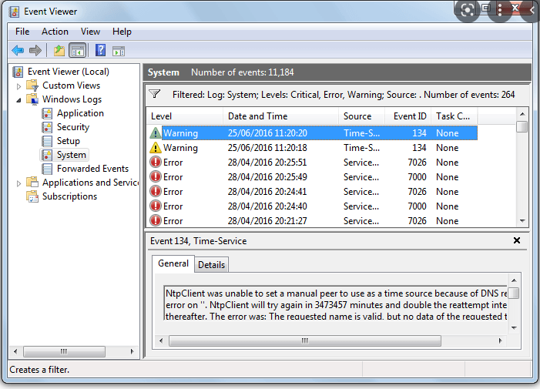
Example Windows Logs (Event Viewer)
Notes:
Event Viewer is accessible from:
Command Prompt: Run eventvwr.msc
GUI: search for "Event Viewer" in the Start menu.
Powershell: Get-WinEvent -ListLog *
Third-Party Tools:
SIEMs (e.g., Splunk, Elastic, QRadar) for centralized log analysis and monitoring.
Sysmon (Windows Sysinternals) for detailed process and network activity logging.
We will be using many of the tools contained within the Sysinternals Suite throughout Module 7
Image Source - Event log to record Tulip error messages - Product Suggestions - Tulip Community

Slide 27
Linux/Unix Logs
Linux logs record the following information:
System Information
Authentication and Authorization
Boot Records
Kernel Messages and Events
Schedule Tasks (Cron Logs)
Package Installations
Mail server activity
Application Usage
Systemd Journals
Notes:
Linux logs are usually stored as plain text files in the /var/log directory. Some of the key log files include:
System Logs
/var/log/syslog (Debian/Ubuntu):
Captures general system activity logs.
Includes events from the kernel, services, and applications.
/var/log/messages (RHEL/CentOS/Fedora):
Similar to syslog, but used in Red Hat-based distributions for general system logs.
Authentication Logs
/var/log/auth.log (Debian/Ubuntu):
Contains logs related to authentication and authorization.
Tracks SSH logins, sudo usage, and login failures.
/var/log/secure (RHEL/CentOS/Fedora):
The equivalent file for authentication logs in Red Hat-based distributions.
Boot Logs
/var/log/boot.log:
Logs generated during the boot process.
Useful for diagnosing boot-related issues.
Kernel Logs
/var/log/kern.log:
Logs kernel messages and events.
Useful for troubleshooting hardware issues and kernel debugging.
Cron Logs
/var/log/cron:
Logs related to scheduled tasks run by cron or anacron.
Package Management Logs
/var/log/dpkg.log (Debian/Ubuntu):
Tracks package installations, updates, and removals.
/var/log/yum.log (RHEL/CentOS):
Logs package management activities using YUM or DNF.
Mail Logs
/var/log/mail.log:
Tracks mail server activity, including sent and received emails.
/var/log/maillog (RHEL/CentOS/Fedora):
The equivalent mail log file in Red Hat-based distributions.
Application Logs
Logs for specific applications are usually found in /var/log/ or custom directories defined by the application.
Example: /var/log/apache2/access.log for Apache HTTP server logs.
Systemd Journal
Managed by journald and accessed using the journalctl command.
Logs are stored in binary format under /var/log/journal/.

Slide 28
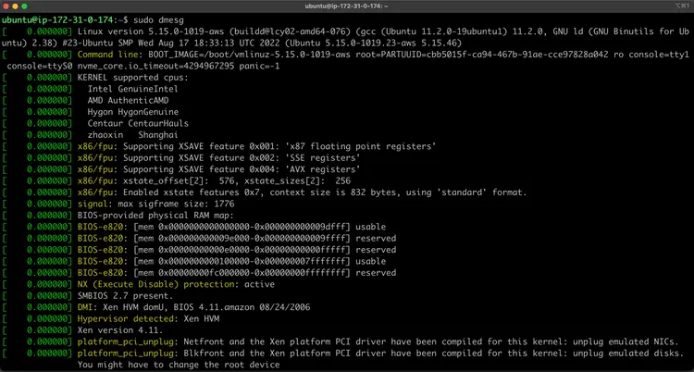
Example Linux/Unix Logs (dmesg)

Slide 29
Optional Labtainer Linux Log Exercise
Open your Ubuntu Labtainer virtual machine and start the lab by issuing the following command from the CLI:
labtainer sys-log
If you have not setup a Labtainer environment, you may do so by following the instructions container here:
Labtainers - Center for Cybersecurity and Cyber Operations - Naval Postgraduate School
Notes:
This is an Optional Exercise to help familiarize yourself with logs in the Linux operating system. There are several other related exercises pertaining to logs that you are free to explore.
If you do not have a Windows computer, you can create a Windows 10 virtual machine using Microsoft's Media Creation Tool: Download Windows 10
You can subsequently run the VM using VMWare Pro or VirtualBox (VMWare Pro is recommended).

Slide 30
Collecting Log in ICS Environments
Collecting logs in an Industrial Control System (ICS) environment requires a careful approach to ensure that sensitive operational data is captured without disrupting critical processes.
Notes:
In Industrial Control Systems, the standardization and formatting of logs is not as mature as in conventional computer systems. It is common for a single system or component to generate a set of logs that are stored in the same directory but are in a completely different format. This poses a significant challenge when it comes to collect[ing] and process[ing] these logs. Yet another challenge is the widespread use of industry-specific network protocols (Modbus, PROFINET, BACNET, S7 Protocol, IEC 60870-5-104, IEC-61850, etc.) that a singe ICS might use for interacting with various devices. - NXLOG Collecting logs from Industrial Control Systems

Slide 31
Identifying Sources for Log Data in ICS
Control Systems
Network Infrastructure
Operating Systems
Applications
Security Devices
Physical Devices
Notes:
Key components in an ICS environment that generate logs include:
Control Systems
Supervisory Control and Data Acquisition (SCADA) systems.
Programmable Logic Controllers (PLCs).
Remote Terminal Units (RTUs).
Distributed Control Systems (DCS).
Network Infrastructure
Firewalls, routers, and switches managing network traffic.
VPN servers facilitating remote access.
Operating Systems
Windows or Linux servers running ICS applications. Recall that Windows is the predominate OS used in ICS; in fact, legacy Windows systems like DOS are still in use.
Workstations used by operators or engineers.
Applications
ICS management software and HMIs.
Historian systems that store operational data.
Security Devices
Intrusion Detection Systems (IDS) and Intrusion Prevention Systems (IPS).
Security Information and Event Management (SIEM) solutions (if deployed).
Physical Devices
Sensors and actuators generating operational data.
Access control systems for physical security (card readers, biometric scanners, IoT devices, cameras, etc).

Slide 32
Log Collection Methods
Syslog
SNMP
Native Logging Features
Log Forwarders (including IPS Universal Forwarders)
Network Monitoring
Remote Device Polling
SIEM Integration
ICS-Specific Tools
Notes:
Syslog
Use the Syslog protocol to collect logs from devices that support it (e.g., firewalls, Linux-based systems).
Configure a centralized Syslog server to aggregate logs.
SNMP (Simple Network Management Protocol)
Use SNMP traps or polling to collect log data from network devices.
Suitable for devices like routers, switches, and firewalls.
Native Logging Features
Enable native logging on ICS software or devices (e.g., SCADA or HMI).
Export logs in supported formats (e.g., CSV, JSON).
Log Forwarders
Use tools like Winlogbeat (for Windows Event Logs) or Filebeat to forward logs to a central logging platform.
Collect logs from ICS workstations and servers.
Network Monitoring
Deploy network traffic monitoring tools, such as packet capture (PCAP) or NetFlow, to analyze communications between ICS devices.
Use tools like Wireshark or Zeek for protocol analysis.
Remote Device Polling
Some PLCs and RTUs may require specific protocols like Modbus or DNP3 to retrieve event logs.
Use industrial gateways or middleware to interface with devices that don’t support modern logging protocols.
SIEM Integration
Use a Security Information and Event Management (SIEM) system to centralize log collection and analysis.
Popular SIEMs include Splunk, QRadar, and Elastic SIEM.
ICS-Specific Tools
Use ICS-tailored tools like:
OSISoft PI System for process data collection and monitoring.
Nozomi Networks or Claroty for ICS-specific threat detection.

Slide 33
Log Aggregation
Involves collecting, centralizing, and analyzing logs from various industrial systems, devices, and security tools.
Important for: threat detection, incident response and forensics, compliance and auditing
OT-Focused Log Aggregation Tools:
Splunk for ICS
IBM Qradar
LogRhythym
Azure Sentinel
Notes:
Log aggregation in OT and ICS environments involves collecting, centralizing, and analyzing logs from various industrial systems, devices, and security tools. Since OT environments prioritize reliability and uptime, log aggregation must be performed efficiently and securely to ensure system integrity while detecting potential threats.
Why Log Aggregation is Important in OT & ICS?
• Cybersecurity Threat Detection – Helps detect anomalies, unauthorized access, and potential cyberattacks on industrial systems.
• Incident Response & Forensics – Provides historical logs for investigating security incidents and system failures.
• Compliance & Auditing – Ensures compliance with industry regulations (e.g., NERC CIP, IEC 62443, ISO 27001).
• Operational Insights & Troubleshooting – Identifies system inefficiencies, failures, or misconfigurations in ICS networks.
Key Sources of Logs in OT & ICS
1. Industrial Control Systems (ICS) Devices
• Programmable Logic Controllers (PLCs)
• Remote Terminal Units (RTUs)
• Human-Machine Interfaces (HMIs)
• Supervisory Control and Data Acquisition (SCADA) Systems
2. Network & Security Devices
• Industrial Firewalls (e.g., Fortinet, Palo Alto, Siemens SCALANCE)
• Intrusion Detection Systems (IDS) & Intrusion Prevention Systems (IPS)
• Secure Remote Access Solutions
• SIEM (Security Information and Event Management) Tools
3. Endpoints & OT Workstations
• Engineering Workstations (EWS)
• Data Historians
• Industrial IoT (IIoT) Devices
4. Application & System Logs
• Historian Logs (e.g., OSIsoft PI System, GE Proficy Historian)
• SCADA Logs
• OT Network Communication Logs
OT-Focused Log Aggregation Tools
These tools collect, normalize, and analyze logs from different OT systems while ensuring minimal impact on real-time operations.
Security Information and Event Management (SIEM) for OT
• Splunk for Industrial Control Systems – Collects logs from SCADA, PLCs, and network devices, enabling real-time analysis.
• IBM QRadar SIEM for ICS – Provides centralized log collection, threat detection, and compliance reporting.
• LogRhythm SIEM for OT – Designed for industrial networks, offering log correlation and behavioral analytics.
• Azure Sentinel with Defender for IoT – Cloud-based log aggregation with AI-driven analytics for OT environments.
OT-Specific Log Aggregation Platforms
• Nozomi Networks Guardian – Collects logs from industrial networks, detects threats, and integrates with SIEM tools.
• Claroty xDome – Aggregates OT logs, identifies vulnerabilities, and provides security insights.
• Dragos Platform – OT-native security platform with log monitoring and threat intelligence.
Open-Source Log Aggregation & Monitoring for OT
• Elastic Stack (ELK: Elasticsearch, Logstash, Kibana) – Can be configured for OT environments to collect and analyze logs.
• Graylog – Provides centralized logging and real-time monitoring for ICS and OT logs.
• OSSEC – Host-based log analysis and intrusion detection system for industrial endpoints.

Slide 34
Log Aggregation Exercise
In this exercise, you will learn how to aggregate log data using:
Windows machines (to mimic Engineering workstations, Data Historians, etc.)
OT Network monitoring platforms, to simulate ingesting data from OT networks.
1-2 OT devices, like IEDs and HMIs.
You will subsequently explore the traffic and logs and provide a summary of your findings to your instructor.
Notes:
All of the material contained in this lab can be found in the course supplemental materials folder, including an instructor guide.

Slide 35
Example Workflow
SCADA System Logs
IDS/IPS
Can forward logs to SIEMS
Firewalls
PLCS
Most modern PLCs have the capability to log data
Older models are not capable of generating logs
Log Server
Log aggregation from SCADA, firewalls, and PLCs
SIEM
Correlates logs, generates alerts
Notes:
Example Workflow
SCADA System: Logs operator actions and alarms.
IDS/IPS: Logs crucial information about attack vectors and can forward logs to SIEMs
Firewall: Logs inbound and outbound traffic.
PLC: Logs configuration changes (older models cannot generate logs).
Log Server: Aggregates logs from SCADA, firewalls, and PLCs.
SIEM: Correlates logs, detects anomalies, and generates alerts.

Slide 36
Proper Storage of Logs to Maintain Forensic Integrity
Proper storage of logs is critical in ensuring that they can be trusted as reliable evidence during investigations or audits. The goal is to prevent tampering, ensure data preservation, and maintain a clear chain of custody.
Authenticity
Integrity
Non-Repudiation
Availability
Retention
Notes:
Principles of Forensic Log Storage
Authenticity
Logs must be original and unaltered from the time they were generated.
Use cryptographic techniques (e.g., hashing, digital signatures) to verify authenticity.
For instance, MD5 hashing algorithm
Integrity
Logs must be protected from unauthorized modification or deletion.
Implement access controls and audit trails to track any changes.
Non-Repudiation
Ensure that logs cannot be denied as originating from a specific source.
Use trusted time stamps and digital signatures.
Availability
Logs must remain accessible when needed for investigation or legal purposes.
Use reliable backup and redundancy mechanisms.
Retention
Logs should be stored according to legal and regulatory requirements (e.g., GDPR, PCI-DSS, NIST).

Slide 37
Best Practices for Log Storage
Centralized Log Storage
Encrypt Logs
Use Write-Once, Read-Many Media
Implement Log Hashing
Time Stamping
Implement Access Control
Regular Backups
Redundancy
Immutable Logging
Log Retention Policies
Notes:
Centralized Log Storage
Collect and store logs on a centralized log server or Security Information and Event Management (SIEM) system.
Centralization simplifies access control, analysis, and monitoring.
Encrypt Logs
Encrypt logs in transit and at rest to protect sensitive data.
Use secure transport protocols like TLS or SSH for log transmission.
Apply disk-level encryption (e.g., AES-256) for stored logs.
Use Write-Once, Read-Many (WORM) Media
Store critical logs on WORM storage (e.g., optical disks or immutable cloud storage) to prevent tampering.
Example: Amazon S3 Object Lock or similar immutable storage solutions.
Implement Log Hashing
Generate cryptographic hashes (e.g., SHA-256) for logs at the time of creation or ingestion.
Periodically verify hashes to detect unauthorized modifications.
Time Stamping
Use a trusted time-stamping authority (TSA) or synchronized network time protocol (NTP) servers.
Ensure all logs have accurate, consistent timestamps for chronological analysis.
Implement Access Control
Restrict log access to authorized personnel only.
Use Role-Based Access Control (RBAC) or Mandatory Access Control (MAC).
Keep audit logs of who accessed or modified log storage.
Regular Backups
Create regular, automated backups of logs.
Store backups in secure, geographically distributed locations to ensure disaster recovery.
Redundancy
Use redundant storage systems (e.g., RAID arrays, cloud storage) to prevent data loss.
Replicate logs to multiple locations for failover and resilience.
Immutable Logging
Configure logging systems to use append-only storage, where logs cannot be modified or deleted after they are written.
Maintain Log Retention Policies
Define clear policies for how long logs should be retained.
Example: Retain critical security logs for at least one year or as required by compliance standards.

Slide 38
Challenges in ICS Log Collection
Legacy Systems
Resource Constraints
Latency Sensitivity
Data Volume
Notes:
Legacy Systems:
Many ICS devices use outdated protocols or lack modern logging capabilities.
Use protocol converters or middleware for integration.
Resource Constraints:
ICS devices may have limited CPU or memory, making extensive logging impractical.
Latency Sensitivity:
Avoid introducing latency or performance issues in real-time systems.
Data Volume:
Large-scale environments generate vast amounts of data, requiring scalable storage and analysis solutions.

Slide 39
Logging Standards and Compliance
Ensure compliance with standards and regulations such as:
NERC CIP: For energy sector ICS.
ISA/IEC 62443: Industrial cybersecurity framework.
ISA/IEC 62443 Series of Standards – ISA
NIST SP 800-82: Guidelines for securing ICS environments.
SP 800-82 Rev. 2, Guide to Industrial Control Systems (ICS) Security | CSRC
Notes:
A "NERC log" refers to a record kept by an entity within the North American electric grid, required to comply with the North American Electric Reliability Corporation (NERC) standards, documenting events related to the operation and security of the bulk power system, including potential noncompliance issues, system disturbances, and critical cyber activity, which must be maintained and submitted to the appropriate regional entity for compliance monitoring; essentially, it's a detailed log used to track and report potential reliability concerns within the power grid as mandated by NERC regulations. – Google AI
ISA/IEC is a consensus-based automation and control systems cybersecurity standard. More on this topic can be found here: ISA/IEC 62443 Series of Standards – ISA
NIST SP 800-82 is the National Institute of Standards and Technolgies Guide to Industrial Control Systems (ICS) Security. More on this set of standards can be found here: SP 800-82 Rev. 2, Guide to Industrial Control Systems (ICS) Security | CSRC

Slide 40
Learning Objectives 7.1.3
Implement techniques and tools to monitor processes and user activity
Complete the Intrusion Detection Practical Exercise.

Slide 41
Monitoring Tools
Industry Specific OT Monitoring Tools:
OT Network Monitoring Platforms
Nozomi Networks
Dragos
Tenable.ot, Claroty
Indegy (Acquired by Tenable)
Cisco Cyber Vision
Forescout OT Security
Endpoint Monitoring Tools
CrowdStrike, SentinalOne
Notes:
Nozomi Networks
Purpose: ICS/SCADA network monitoring and threat detection.
Key Features:
Real-time visibility into operational technology (OT) networks.
Behavioral analysis of ICS devices and processes.
Integration with SIEMs for centralized analysis.
Claroty
Purpose: Security for OT and industrial environments.
Key Features:
Asset discovery and continuous monitoring.
Anomaly detection using behavior analytics.
Integration with IT and OT security platforms.
Dragos
Purpose: Industrial cybersecurity and threat detection.
Key Features:
Monitors ICS-specific protocols (e.g., Modbus, DNP3).
Provides threat intelligence specific to OT.
Incident response and forensic tools for industrial networks.
Excellent asset identification and discovery capabilities.
Tenable.ot
Purpose: Vulnerability management for OT environments.
Key Features:
Passive monitoring of OT traffic and devices.
Detects configuration changes and unauthorized access.
Risk assessment for ICS components.
Indegy (Acquired by Tenable)
Purpose: Industrial process monitoring and security.
Key Features:
Tracks user actions on industrial systems.
Detects configuration changes and unauthorized activities.

Slide 42
Monitoring Tools (cont’d)
Protocol Analyzers:
Wireshark
Can decode protocols like Modbus, DNP3
Network Security Monitors:
Zeek (formerly Bro)
SolarWinds NPM
Was breached in September 2019
FireEye (the developer) later rebranded as Trellix
Still in use today
SolarWinds Cyberattack Demands Significant Federal and Private-Sector Response (infographic) | U.S. GAO
Notes:
Wireshark
Purpose: Packet analysis for industrial network traffic.
Key Features:
Decodes protocols like Modbus, BACnet, and DNP3.
Identifies anomalous traffic and unauthorized communications.
Zeek (formerly Bro)
Purpose: Network traffic analysis and intrusion detection.
Key Features:
Monitors ICS network protocols.
Provides detailed logs of user activities and network flows.
SolarWinds NPM
Purpose: Network performance monitoring for IT and OT environments.
Key Features:
Tracks network device status and performance metrics.
Alerts on unusual traffic or device behavior.
Additional Resources for SolarWinds compromise: SolarWinds Software Compromise in Industrial Environments

Slide 43
Monitoring Tools (cont’d)
SIEM Platforms
Splunk, ELK, IBM Q-RADAR
IDS/IPS
Snort 3, Suricata for ICS, Trend Micro TippingPoint
Windows Event Logs and Linux Audit Logs
ObserveIT
SentryOne SQL Sentry
Syslog-ng
Notes:
SIEM Platforms
Examples: Splunk, QRadar, Elastic SIEM, ArcSight.
Purpose: Centralized log collection, analysis, and alerting.
Key Features:
Tracks user logins, command executions, and configuration changes.
Detects suspicious patterns, such as unauthorized access.
Provides compliance reporting.
Windows Event Logs and Linux Audit Logs
Purpose: Native tools for user and process activity monitoring.
Key Features:
Monitors logins, privilege escalations, and file access.
Can be forwarded to centralized log servers for analysis.
CyberArk
Purpose: Privileged access management (PAM).
Key Features:
Monitors and controls privileged user actions.
Provides session recording and audit trails.
ObserveIT (by Proofpoint)
Purpose: Insider threat detection and user activity monitoring.
Key Features:
Tracks user actions across endpoints.
Provides detailed session recordings for forensic investigations.
SentryOne SQL Sentry
Purpose: Database monitoring for industrial systems.
Key Features:
Tracks database access and query performance.
Alerts on unusual database activity.

Slide 44
Monitoring Tools (cont’d)
Process Monitoring Tools:
Sysmon (part of the Sysinternals Suite)
SCADA-Specific Tools
PRTG Network Monitor
Notes:
Sysmon (System Monitor)
Purpose: Advanced system activity monitoring on Windows.
Key Features:
Logs process creation, network connections, and file modifications.
Useful for detecting malware or unauthorized actions.
SCADA-Specific Tools
Most SCADA systems (e.g., GE iFIX, Siemens WinCC) include built-in process monitoring.
Key Features:
Logs operator actions and process changes.
Provides real-time dashboards for process visualization.
PRTG Network Monitor
Purpose: Comprehensive IT/OT monitoring tool.
Key Features:
Monitors system processes, network devices, and applications.
Alerts on performance issues or unauthorized changes.

Slide 45
Monitoring Tools (cont’d)
Endpoint Monitoring Tools:
CrowdStrike Falcon
SentinelOne
Symantec Endpoint Protection
Trend Micro Industrial Endpoint Security
Rockwell Automation Endpoint Protection
Notes:
CrowdStrike Falcon
Purpose: Endpoint detection and response (EDR) for ICS workstations.
Key Features:
Monitors file changes and process activities.
Detects malware and suspicious user actions.
SentinelOne
Purpose: Endpoint protection with AI-driven monitoring.
Key Features:
Tracks user behavior and system processes.
Automatically responds to threats.
Symantec Endpoint Protection
Purpose: Comprehensive endpoint security for ICS environments.
Key Features:
Monitors file, process, and registry changes.
Provides detailed activity logs for users.
Trend Micro Industrial Endpoint Security
Purpose: Provides advanced endpoint protection specifically tailored for Industrial Control Systems (ICS) and Operational Technology (OT) environments.
Features:
Protection against malware, ransomware, and targeted attacks.
Application control and device control to block unauthorized applications or devices.
Minimal resource impact, designed for ICS/OT systems with low processing capacity.
Compatibility with legacy systems common in industrial environments.
Centralized management for efficient deployment and monitoring.
Rockwell Automation Endpoint Protection
Purpose: A cybersecurity solution designed to secure endpoints in industrial automation systems.
Features:
Built-in protection for Rockwell Automation platforms like ControlLogix and FactoryTalk.
Application whitelisting to allow only approved software to run on critical systems.
Real-time threat detection to prevent unauthorized access and malware.
Integration with Rockwell’s industrial systems for seamless management and monitoring.
Designed to meet industrial cybersecurity standards and ensure operational integrity.

Slide 46
Sysinternals Suite
Sysinternals is a suite of advanced utilities created by Microsoft to help IT professionals, developers, and security analysts diagnose, troubleshoot, and monitor Windows-based systems and OT devices. While Sysinternals tools are not specifically designed for Industrial Control Systems (ICS), they can be effectively used to detect, analyze, and respond to suspicious activity in ICS environments that run on Windows-based systems (such as SCADA servers, HMIs, and engineering workstations).
Notes:
Definition Source - ChatGPT

Slide 47
Key Feature of Sysinternals
Real-Time Monitoring
Malware Detection
Forensic Analysis
Lightweight and Portable
Comes natively with newer version of the Windows OS
Must be installed on older systems
Not natively supported on Windows OS’s prior to Windows 7.
Notes:
Real-Time Monitoring: Tools for real-time analysis of processes, network activity, and file system changes.
Malware Detection: Detect suspicious processes, hidden services, or anomalous behaviors indicative of compromise.
Forensic Analysis: Gather evidence for investigations, including logs of user activity or system changes.
Lightweight and Portable: Tools are portable and run without installation, minimizing their impact on critical systems.

Slide 48
Key Sysinternals Tools for OT
Process Explorer (Procexp)
Process Monitor (Procmon)
Autoruns
TCPView
Sysmon
PsTools
Disk Usage (Du)
BgInfo
SigCheck
AccessChkl
Notes:
Process Explorer
Purpose: Monitors running processes in real-time, providing detailed insights.
Use in ICS:
Detect malicious or unauthorized processes on SCADA servers or workstations.
Identify processes consuming excessive resources, which may indicate malware.
Inspect process attributes, such as loaded DLLs, memory usage, and parent-child relationships.
Example: Use to detect malware masquerading as legitimate ICS applications.
Process Monitor (ProcMon)
Purpose: Tracks file system, registry, and network activity in real-time.
Use in ICS:
Detect unauthorized file modifications, such as tampering with ICS configuration files.
Monitor registry changes to identify malware persistence mechanisms.
Identify suspicious file access patterns, such as ransomware encrypting files.
Example: Track changes made to a critical SCADA configuration file to verify integrity.
Autoruns
Purpose: Identifies programs configured to run at startup or during system boot.
Use in ICS:
Detect unauthorized applications or malware persisting on engineering workstations or SCADA servers.
Analyze autostart entries, such as services, scheduled tasks, or drivers.
Example: Identify a rogue service configured to start automatically in an ICS environment.
TCPView
Purpose: Displays detailed information about active TCP and UDP network connections.
Use in ICS:
Identify unauthorized network communications between ICS devices or external systems.
Detect connections to known malicious IPs or command-and-control servers.
Monitor suspicious activity on ICS-specific ports (e.g., Modbus/TCP or DNP3).
Example: Spot unexpected outbound traffic from a SCADA server to a foreign IP.
Sysmon (System Monitor)
Purpose: Provides detailed event logs for processes, file changes, network activity, and more.
Use in ICS:
Detect advanced threats by monitoring specific event types (e.g., process creation, file modification).
Correlate Sysmon logs with SIEM or threat intelligence systems to identify suspicious behavior.
Example: Monitor an unauthorized user executing PowerShell scripts on an HMI workstation.
PsTools
Purpose: A set of tools for managing and monitoring remote systems.
Key Tools:
PsExec: Execute commands remotely, useful for investigating systems without physical access.
PsList: Display information about processes running on a remote system.
PsKill: Terminate suspicious processes remotely.
Use in ICS:
Perform remote diagnostics on systems within an OT network.
Investigate processes on systems that may not allow direct access due to security restrictions.
Example: Use PsList to inspect processes running on a remote PLC management server.
Disk Usage (Du)
Purpose: Analyzes disk usage and identifies large or hidden files.
Use in ICS:
Detect hidden files or directories created by malware on SCADA servers.
Monitor disk usage trends on critical systems to prevent outages or resource exhaustion.
Example: Identify a hidden directory used by malware to store exfiltrated data.
BgInfo
Purpose: Displays critical system information on the desktop background.
Use in ICS:
Provide at-a-glance visibility into system details, such as hostname, IP address, and uptime.
Example: Use in environments where quick identification of system information is essential during incidents.
SigCheck
Purpose: Verifies the digital signatures of files to check their integrity and authenticity.
Use in ICS:
Identify unsigned or maliciously tampered files on engineering workstations.
Example: Verify that all critical ICS software components are digitally signed and untampered.
AccessChk
Purpose: Analyzes file system, registry, and service permissions.
Use in ICS:
Detect improper permissions that could allow unauthorized changes to critical ICS files or services.
Example: Check if unauthorized users have access to SCADA configuration files.

Slide 49
Monitoring Tools
Industry Specific OT Monitoring Tools:
OT Network Monitoring Platforms (including security sensors)
Nozomi Networks, Dragos, Tenable.ot, Claroty, Cisco Cyber Vision, Forescout OT Security
IT Endpoint Monitoring Platforms (EDR, XDRs)
CrowdStrike, SentinalOne, and others
IT Network Monitoring Platforms
Zeek (OSS), many others
SIEM Platforms
Splunk, ELK, IBM Q-RADAR
Notes:
Nozomi Networks
Purpose: ICS/SCADA network monitoring and threat detection.
Key Features:
Real-time visibility into operational technology (OT) networks.
Behavioral analysis of ICS devices and processes.
Integration with SIEMs for centralized analysis.
Claroty
Purpose: Security for OT and industrial environments.
Key Features:
Asset discovery and continuous monitoring.
Anomaly detection using behavior analytics.
Integration with IT and OT security platforms.
Dragos
Purpose: Industrial cybersecurity and threat detection.
Key Features:
Monitors ICS-specific protocols (e.g., Modbus, DNP3).
Provides threat intelligence specific to OT.
Incident response and forensic tools for industrial networks.
Excellent asset identification and discovery capabilities.
Tenable.ot
Purpose: Vulnerability management for OT environments.
Key Features:
Passive monitoring of OT traffic and devices.
Detects configuration changes and unauthorized access.
Risk assessment for ICS components.
Indegy (Acquired by Tenable)
Purpose: Industrial process monitoring and security.
Key Features:
Tracks user actions on industrial systems.
Detects configuration changes and unauthorized activities.

Slide 50
Practical Exercise
Notes:
Practical Exercise:
Students will be given a series of potential threats using MITRE’s ICS ATT&CK Matrix.
Students will be tasked with writing rules designed to generate alerts using Suricata and Elastic.
Students will also need to demonstrate log analysis, how to monitor and detect suspicious processes and user activity, and how to conduct index querying using Elastic.

