Slide 1
CyberSkills2Work The National Cybersecurity Workforce Development Program

Slide 2
Industrial Control Systems Security
Acknowledgement
This program is funded by the National Security Agency National Centers of Academic Excellence in Cybersecurity (NCAE-C) Program.
For additional information, please visit www.CyberSkills2Work.org.
Course Title
CRN
©2024 CyberSkills2Work - Institution Name

Slide 3

Digital Forensics for ICS
^{Lesson 9}
Notes:
Welcome to Digital Forensics for OT and ICS.
Digital forensics (DF) is the process of identifying, preserving, analyzing, and presenting electronic evidence in a legally admissible manner (meaning it can and will be used in a court of law). DF involves the investigation of digital devices, networks, and data storage systems to uncover evidence related to cybercrimes, security incidents, or policy violations.
When conducting enterprise investigations, civil litigations, and/or criminal investigations, digital forensics examinations typically involve analyzing computers and laptops, servers, removable storage devices (USBs and Floppy disks for instance), cell phones, and IoT devices. In some cases, examiners may be required to examine special devices or subcomponents, like the in-vehicle components in modern automotive systems.
In ICS investigations, digital forensics involves significant challenges due to data storage limitations and auditing capabilities, both of which are usually robustly supported in traditional IT systems and most modern computing devices. Furthermore, many ICS environments are designed using proprietary solutions, equipment, and protocols, making it difficult for practitioners to utilize modern forensic methods and tools.
Image Resource: Digital Forensics in Industrial Control Systems

Slide 4
9.0 Content Outline
9.1 – Evidence Collection and Chain of custody
9..2 - Tool Validation
9..3 - Data Integrity (specifically for legal proceedings)
9.4 – Computer Architecture and Filesystems
9.5 – Offline and Live Forensics Examinations
9.6 – OT Devices that can Yield Forensic Artifacts
9.7 – Forensic Limitations in ICS
9.8 – ICS Forensic Investigation Tools
9.9 – Practical Exercise (Hands-On Laboratory)
Notes:
This slide provides a general outline for the ICS forensics lesson.
Note: We will not cover the basics of log analysis, as that information was provided to you in lesson 7.1. However, we will show you where to look for logs in ICS devices and we will provide you with suggestions on how to maintain their integrity.

Slide 5
9.1 Evidence Collection
The act of gathering relevant digital evidence from various sources such as computers, servers, mobile devices, and cloud environments.
The collection process adheres to strict forensic procedures to ensure admissibility in court, including maintaining a proper chain of custody, using validated tools, and ensuring non-repudiation of evidence.
Notes:
The Act of Gathering Relevant Digital Evidence
The process of gathering digital evidence involves systematically identifying, collecting, and preserving data from a variety of digital sources to support an investigation, which may become part of a legal proceeding. This evidence can be gathered from:
Computers and Servers:
Hard drives, memory (RAM), system logs, and application data are crucial sources of evidence. Investigators use forensic imaging tools to create exact copies of storage devices to prevent tampering and maintain data integrity.
Mobile Devices:
Smartphones and tablets contain valuable evidence such as call logs, messages, app data, GPS location history, and cloud-synced data. Special tools like Mobile Device Forensics software are used to extract and analyze data.
Cloud Environments:
Data stored in cloud platforms (e.g., AWS, Azure, Google Cloud) requires specialized approaches such as API-based extractions, metadata analysis, and preservation of log files to track activities.
Network Infrastructure:
Routers, firewalls, and switches contain logs of communication between systems. Packet captures and intrusion detection system (IDS) logs provide insights into suspicious activities or data breaches.
Removable Media: USB drives, external hard disks, and memory cards may store critical forensic artifacts, often requiring write-blockers to prevent modification during analysis.
ICS/OT Devices (discussed in earlier lessons): ICS environments rely on proprietary technologies such as Programmable Logic Controllers (PLCs), Remote Terminal Units (RTUs), and SCADA systems, which often run custom firmware and legacy operating systems. Traditional forensic tools may not be compatible with these systems, requiring specialized expertise and custom forensic techniques.
Regardless of the methods, tools, or environment, forensics involves the systematic and careful recovery of digital artifacts that may be used in a court of law and/or for disciplinary inquiries (i.e., policy violations).

Slide 6
9.1 Chain of Custody
The process of documenting, handling, and tracking digital evidence from the point of collection to its presentation in a legal or investigative setting. It ensures that the evidence remains untampered, authentic, and legally admissible throughout the forensic investigation.
Notes:
In this section, you will learn how to document individuals who have handled and/or processed data seized during a forensics examination and how to properly secure said data as evidence.

Slide 7
Key Elements - Chain of Custody
Documentation
Evidence Integrity
Secure Storage and Handling
Transfer and Access Control
Verification and Validation
Notes:
Documentation:
A detailed log must be maintained to record every action taken on the evidence, including:
Who collected the evidence.
When and where it was collected.
How it was collected.
Who accessed or handled it afterwards.
Any transfers or changes made to the evidence.
Evidence Integrity:
Ensuring that the original data remains intact through methods such as forensic imaging (creating exact copies) and cryptographic hashing (e.g., MD5, SHA-256) to verify data authenticity.
Secure Storage and Handling:
Evidence must be stored in a secure location with controlled access to prevent unauthorized alterations, theft, or accidental damage.
Transfer and Access Control:
Each time the evidence is transferred, it must be documented with proper authorization, and access should be limited to authorized personnel only.
Verification and Validation:
The evidence should be periodically verified using hash values or checksums to confirm that no changes have occurred over time.

Slide 8
Steps in Establishing Chain of Custody
Collection
Gather evidence using forensic tools and techniques
Preservation
Store evidence securely and prevent tampering or alteration
Transportation
Use secure methods to transfer evidence
Disposition
Determine how to handle the evidence after the investigation.
Notes:
Collection:
This always involves using a collection template (document) with timestamps, location, description of the forensic artifact, what device the artifact was retrieved from, and who collected the evidence.
Preservation:
Once evidence is collected, it must be preserved in a manner that ensures its integrity, preventing unauthorized access, tampering, or accidental alteration.
Transportation:
When evidence needs to be moved between locations (e.g., from a crime scene to a forensic lab), proper procedures must be followed to maintain the chain of custody.
Disposition:
After the investigation is complete, the evidence must be handled according to legal and organizational policies, ensuring it is either securely stored or destroyed.
A Special Note concerning the analysis of forensic evidence and chain of custody:
Even though it is not listed directly in the slides, any time an investigator, technician, or examiner analyses forensic information, they must document when the item was retrieved from the secure storage container/facility, what actions they performed with the evidence item, and when the item was returned to secure storage. However, the analysis of forensic data is not a direct component of the chain of custody process.

Slide 9
Chain of Custody – a Legal Mandate
The importance of Chain of Custody in Digital Forensics cannot be understated. In many regards, this is the most important phase in a forensics investigation, due to the following items of interest:
Legal Admissibility
Accountability
Prevention of Evidence Tampering
Audit Trail
Notes:
Legal Admissibility:
A well-maintained chain of custody ensures that evidence can be presented in court without being challenged for authenticity. As stated before, this requires careful, detailed, and timely documentation related to all interactions with the evidence item, including analysis of the data, transportation of the data, and the individual(s) who interacted with the data/evidence.
Accountability:
Provides a clear record of individuals who handled the evidence at every stage.
Prevention of Evidence Tampering:
Ensures that the data remains unaltered and free from contamination. This is usually achieved by ensuring the data is stored in a locked container and that all individuals who interact with the data sign a logbook.
Audit Trail:
Enables forensic analysts and legal professionals to track the history of the evidence. This is typically maintained with a logbook and a tracking sheet attached to the device or the container in which the device is held.

Slide 10
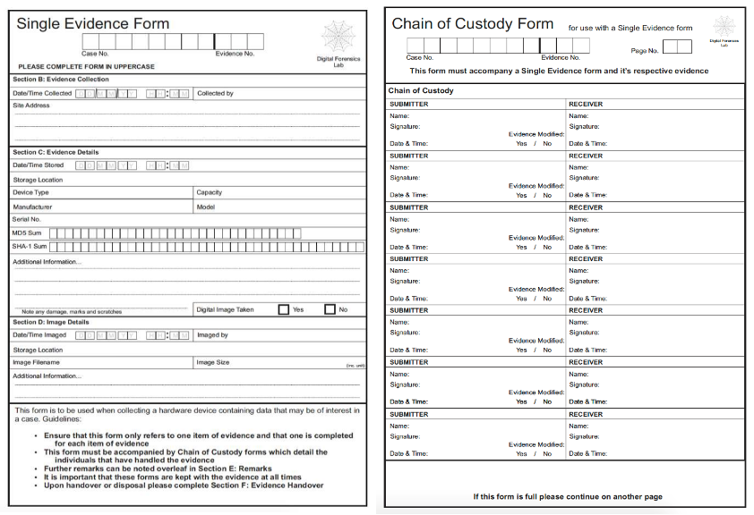
Chain of Custody Log Form
Notes:
The chain of custody is a document/form that must be filled out by the person who seizes the equipment. This document must always accompany the equipment itself, keeping a dated record of all persons who had custody of the equipment. An example of the chain of custody is presented (Figure 3 – Digital Forensics Lab).
Each step in the chain of custody process is critical to maintaining the authenticity, integrity, and admissibility of digital evidence. By following best practices, forensic investigators can ensure that evidence stands up to scrutiny in court or during internal investigations.
Source - Fundamentals of Digital Forensics: Chain of custody | CF

Slide 11
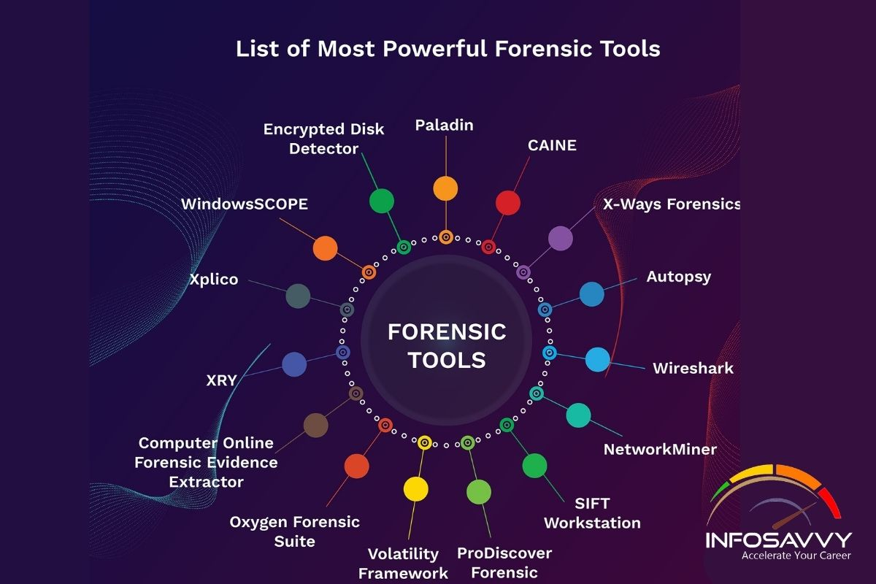
9.2 – Tool Validation
Notes:
Image Source - https://info-savvy.com/free-forensic-investigation-tools-for-it-security-expert/

Slide 12
Tool Validation
Tool validation in digital forensics is a critical process that ensures the accuracy, reliability, and credibility of forensic tools used to collect, analyze, and preserve digital evidence.
Validated tools help investigators maintain the integrity of evidence and ensure it is admissible in legal proceedings or compliance audits.
Notes:
We will cover specific tools used to collect evidence for forensic investigations, especially those related to ICS/OT, later in this lesson. For now, please understand that the process of validating tools is essential to ensure data integrity and avoid cross-examination issues that can arise if tools have not been validated.

Slide 13
Tool Validation (cont’d)
Ensures Evidence Integrity and Admissibility
Accuracy and Reliability of Results
Compliance with Industry Standards and Regulations
Compatibility with Specialized Systems (ICS/OT Challenges)
More on this later in the module
Detection and Prevention of Errors
Credibility and Professionalism in Investigations
Notes:
Ensures Evidence Integrity and Admissibility
Courts and regulatory bodies require forensic evidence to be collected and analyzed using scientifically validated methods. Using unvalidated or unreliable tools can result in:
Evidence being challenged or ruled inadmissible.
Loss of credibility in investigations.
Potential legal repercussions.
Validated tools provide assurance that the data remains unaltered and that the analysis reflects accurate findings.
Accuracy and Reliability of Results
In digital forensics, even minor errors in data acquisition, processing, or reporting can lead to incorrect conclusions. Tool validation ensures:
Accurate replication of results.
Repeatability and consistency across different environments.
Identification and minimization of false positives and negatives.
Compliance with Industry Standards and Regulations
Many industries, especially those dealing with critical infrastructure (e.g., energy, manufacturing, transportation), must adhere to regulations such as:
NIST (National Institute of Standards and Technology) guidelines.
ISO/IEC 27037 (Guidelines for evidence identification, collection, and acquisition).
IEC 62443 (Cybersecurity for industrial automation and control systems).
NERC CIP (Critical Infrastructure Protection standards).
Using validated forensic tools helps organizations meet compliance requirements and avoid regulatory penalties.
Compatibility with Specialized Systems (ICS/OT Challenges)
ICS and OT environments pose unique challenges due to their proprietary hardware, legacy systems, and real-time operational constraints. Many forensic tools designed for IT environments may not function properly in ICS environments, leading to:
Data collection failures or inaccuracies.
Potential system disruptions or downtime.
Inability to interpret proprietary protocols used in SCADA, DCS, or PLCs.
Validated tools are tested specifically for ICS/OT environments, ensuring they do not interfere with operations.
Detection and Prevention of Errors
Tool validation helps identify potential software bugs, compatibility issues, or incorrect handling of forensic artifacts. Without validation, investigators risk relying on flawed evidence, which can lead to:
Misinterpretation of incident causes.
Failure to detect critical threats.
Wasted resources and effort on inaccurate data.
Credibility and Professionalism in Investigations
Using validated forensic tools enhances the credibility of forensic investigators and their reports. Whether in a legal setting or within an organization, stakeholders expect professionals to use tools that have been rigorously tested and proven reliable.

Slide 14
Steps in Validating Forensic Tools
Identification of Tool Requirements
Testing Against Known Data Sets
Cross-Tool Verification
Repeatability and Reproducibility Testing
Performance Benchmarking
Compliance Testing
Documentation and Certification
Notes:
Identification of Tool Requirements
Determine the type of evidence the tool will process (e.g., file systems, memory, network traffic).
Assess compatibility with different operating systems and device types.
Testing Against Known Data Sets
Use reference data sets with known attributes to verify whether the tool can accurately process and report results.
Compare results against expected outcomes.
Cross-Tool Verification
Compare the results obtained from the tool under validation with results from other established forensic tools.
Discrepancies should be thoroughly investigated.
Repeatability and Reproducibility Testing
Conduct tests multiple times to ensure the tool produces consistent results.
Involve different investigators to assess reproducibility under varying conditions.
Performance Benchmarking
Evaluate the tool’s efficiency in terms of speed, resource usage, and scalability.
Ensure it meets operational demands without causing system strain.
Compliance Testing
Ensure the tool aligns with legal and regulatory standards, producing reports that meet court admissibility requirements.
Documentation and Certification
Maintain records of validation procedures, including test cases, results, and any corrective actions taken.
Obtain tool certification where applicable (e.g., NIST-approved tools).

Slide 15
Examples of Validated Tools
Disk and Memory Forensic Tools:
Encase
Autopsy
FTK
Network Forensics
Wireshark
Grassmarlin (ICS-specific network monitoring tool)
ICS/OT
Dragos Platform
Microsoft ICSpector
Notes:
Encase is a proprietary software suite heavily used in the field of digital forensics. Autopsy and FTK (including FTK Imager) are open-source software products that are similar in nature to Encase. Both Encase and FTK imager can create image files from hard drives, USB’s, and various other devices and logical volumes.
Grassmarlin is an open-source network monitoring tool specifically designed for ICS and OT environments.
Microsoft ICS Forensics Tools framework is an open-source forensics framework that enables the analysis of Industrial PLC metadata and project files. The framework provides investigators with a convenient way to scan for PLCs and identify any suspicious artifacts within ICS environments, which can be used for manual checking, automated monitoring tasks, or incident response operations to detect compromised devices. By being an open-source tool, ICS Forensics Tools allows investigators to review the output and customize it to their specific requirements. GitHub - microsoft/ics-forensics-tools: Microsoft ICSpector (ICS Forensics Tools framework) is an open-source forensics framework that enables the analysis of Industrial PLC metadata and project files.

Slide 16

9.3 – Data Integrity
Notes:
Image Source - https://astrixinc.com/blog/data-integrity/10-ways-to-ensure-data-integrity/

Slide 17
Data Integrity in Forensics
The assurance that digital evidence remains unaltered, accurate, and reliable throughout the forensic investigation process.
Prerequisite for Legal Admissibility
Credibility and Trustworthiness of the Data
ISA/IEC 62443
Chain of Custody Assurance
Notes:
Legal Admissibility:
Courts and regulatory bodies require proof that evidence has not been altered since collection.
Integrity ensures compliance with legal standards such as the Federal Rules of Evidence (FRE), GDPR, and industry-specific regulations like NERC CIP and ISA/IEC 62443.
The ISA/IEC 62443 series of standards define requirements and processes for implementing and maintaining electronically secure industrial automation and control systems (IACS). These standards set best practices for security and provide a way to assess the level of security performance. Their approach to the cybersecurity challenge is a holistic one, bridging the gap between operations and information technology as well as between process safety and cybersecurity. ISA/IEC 62443 Series of Standards - ISA
Credibility and Trustworthiness:
Investigators, law enforcement, and stakeholders must trust that forensic findings accurately reflect the events under investigation.
Any modification or contamination of data can undermine the credibility of an investigation.
Chain of Custody Assurance:
Data integrity helps maintain a documented trail of evidence handling, ensuring no unauthorized access or modifications have occurred.

Slide 18
Best Practices to Maintain Data Integrity (Forensics Focus)
Use of Cryptographic Hashing
Write-Blocking Technology
Software and Hardware
Forensic Imaging
Chain of Custody Documentation
Including Access Control Measures
Non-Intrusive Collection Techniques in ICS
Validating Forensic Tools
Compliance with Industry Standards
Notes:
Use of Cryptographic Hashing
Applying cryptographic hash functions (e.g., MD5, SHA-256) to digital evidence ensures data integrity by generating a unique fingerprint of the collected data.
Hashes should be calculated at multiple stages:
During acquisition (initial evidence collection).
Before and after forensic analysis.
Before presenting evidence in legal or compliance settings.
Example tools:
hashdeep, md5sum, sha256sum, openssh
Write-Blocking Technology
Use hardware or software write-blockers to prevent accidental or intentional alteration of the original evidence during acquisition.
Write-blockers ensure forensic tools can read data but not write or modify it.
Common tools: Tableau forensic write-blockers, open-source software write-blockers like AccessData FTK Imager.
Forensic Imaging
Creating a forensic image (bit-by-bit copy) of the original media instead of working on live data ensures that the original evidence remains unaltered.
Types of imaging techniques:
Full disk imaging.
Logical partition imaging.
Memory (RAM) imaging.
Tools: EnCase, FTK Imager, dd (Linux command-line tool).
Chain of Custody Documentation
Maintain detailed records of how evidence is collected, stored, analyzed, and transferred between parties.
Documentation should include timestamps, personnel involved, evidence identifiers, and hash values to prove data integrity.
Chain of custody logs should accompany evidence through every stage of the forensic process.
Non-Intrusive Collection Techniques in ICS
Passive network monitoring tools can be used to collect traffic data without interfering with the live system.
Specialized ICS forensic tools should be used that can extract logs and data without causing operational disruptions.
Example tools for ICS: Nozomi Guardian, Dragos Platform, GRASSMARLIN (for passive network monitoring).
Validation of Forensic Tools
Ensure that forensic tools used for evidence acquisition and analysis are validated and approved by standards such as NIST.
Regular tool testing and certification can prevent errors that might compromise evidence integrity.
Compliance with Industry Standards
Ensure adherence to applicable legal, regulatory, and industry frameworks that govern data integrity in digital forensics and ICS environments, such as:
NIST 800-86 (Guide to Integrating Forensic Techniques into Incident Response).
ISA/IEC 62443 (Security for Industrial Automation and Control Systems).
NERC CIP (Critical Infrastructure Protection standards for power utilities).
ISO/IEC 27037 (Guidelines for handling electronic evidence).
ISO 14971 – Medical Devices

Slide 19
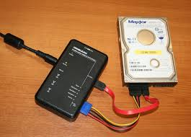
Hardware Write-Blocker
Notes:
The image above is a Tableau hardware write-blocker connected to a hard disk drive (HDD) via SATA cables, with an 8-pin power supply cable to the hard drive. A USB is typically connected to the write blocker one end and to a laptop or desktop compute on the other. A software program like Encase or FTK Imager can then be used to create an image of the HDD without writing a single bit to the device.
We can ensure the integrity of the data on the hard drive by first capturing an MD5 hash prior to creating the image and then running the MD5 hashing algorithm on the image itself. If this process produces the same hash, then we are certain the image created a bit-for-bit copy of the hard drive. A second hash of the hard drive after an image has been taken should result in the original hash. A different hash value would indicate that something was inadvertently written to the hard drive.
Source - Forensic disk controller - Wikipedia

Slide 20
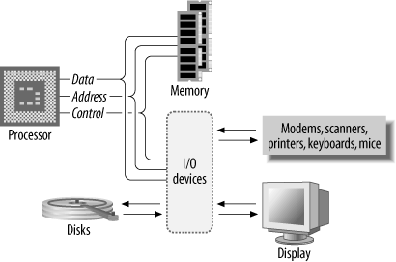
9.4 – Computer Architecture and Filesystems
Notes:
Image Source - https://www.oreilly.com/library/view/designing-embedded-hardware/0596007558/ch01.html

Slide 21
CPU and RAM
CPU (Central Processing Unit)
Contains the ALU (Arithmetic Logic Unit)
“Brains” of the computer
Active Processes, Instruction Execution
RAM (Random Access Memory)
Volatile information (lost when computer powered down)
Stores Encryption Keys and Passwords
Memory Forensics is a very useful skill to possess
Notes:
The CPU (Central Processing Unit) and RAM (Random Access Memory) are fundamental components of a computer system. In digital forensics, these components play a critical role in understanding and recovering evidence related to live system activity, malware, and volatile data. Here's an explanation of their relevance in dForensic Relevance of the CPU
Active Processes:
The CPU executes programs and processes running on the system. Investigators can analyze:
Active or recently terminated processes.
Malware that may have executed commands or tampered with system files.
Tools like Process Explorer or Volatility can retrieve and analyze process activity.
Instruction Execution:
Malware often manipulates CPU instructions to obfuscate its behavior. Forensic experts reverse-engineer these instructions to understand malware functionality.
Tracing System Logs:
The CPU’s scheduling and processing of events generate logs (e.g., error logs, kernel messages). These logs may serve as evidence in forensic investigations.
System Uptime and Timelines:
CPU activity helps determine how long the system has been running, aiding in timeline reconstruction for incidents.
Analysis of CPU Artifacts:
Low-level CPU data, such as registers or execution traces, can reveal:
Instructions executed by malware.
Rootkit or firmware attacks targeting the CPU.
2. Random Access Memory (RAM)
RAM is volatile memory used to store data that the CPU actively needs. It’s critical in digital forensics because it holds temporary and live data that disappears when the system is powered off.
Forensic Relevance of RAM
Volatile Evidence:
RAM stores temporary but valuable evidence, including:
Running processes.
Active network connections.
Open files and applications.
Encryption keys or passwords.
Since RAM is volatile, this data is lost if the system is shut down, making live memory acquisition essential.
Malware and Rootkits:
Malicious programs often reside in RAM to avoid detection. Forensic analysis can uncover:
Malware payloads.
Command-and-control instructions.
Indicators of compromise (IoCs).
Encryption Keys and Passwords:
RAM often holds decrypted versions of files and active encryption keys. For instance:
Tools like Volatility can extract these keys for decrypting encrypted drives or files.
RAM can also reveal passwords cached by applications.
Network Forensics:
Active connections and network traffic captured in RAM can provide:
IP addresses, ports, and protocols in use.
Data packets for deep analysis of communication.
Hidden and Deleted Data:
Residual data in RAM may include fragments of closed applications, deleted files, or terminated processes. These fragments can be pieced together to recover evidence.
Live System Artifacts:
Investigating RAM helps reconstruct the state of a system at a specific time. This includes:
Loaded drivers.
DLL injections by malware.
Execution of commands in the command line or terminal.
igital forensics:

Slide 22
Buses and Data Flow
Buses:
Data Bus
Address Bus
Control Bus
Data Flow:
Input, Processing, Storage, Output
Note: this is an advanced area of digital forensics, and usually involves a deeper understanding of Electrical Engineering and Digital Electronics.
Notes:
In digital forensics, understanding computer buses and data flow is essential for investigating how data moves within a system. This knowledge helps forensic analysts identify points where evidence can be intercepted,
analyzed, or reconstructed.
What Are Computer Buses?
A computer bus is a communication system that transfers data between components inside or connected to a computer. It acts as the backbone of the data flow, enabling communication between the CPU, memory, storage devices, peripherals, and other hardware.
Types of Buses
Data Bus:
Transfers data between components.
Example: Moving data from RAM to the CPU for processing.
Forensic relevance: Examining intercepted data in transit for evidence, such as RAM dumps or network packets.
Address Bus:
Carries memory addresses that the CPU uses to locate specific data or instructions.
Forensic relevance: Helps in tracing specific memory locations accessed by processes.
Control Bus:
Carries control signals (e.g., read, write, interrupt) between components.
Forensic relevance: Understanding control signals can help investigate how data was accessed, modified, or transmitted.
Expansion Bus:
Connects peripheral devices (e.g., USB, PCI, Thunderbolt).
Forensic relevance: Analyzing data transferred to/from peripherals, such as external storage or printers.
2. Data Flow in a Computer System
Data flow describes how data moves through a computer system, from input devices to processing units, storage, and output devices. Understanding this flow is critical for forensic investigations, as it identifies where data might be captured, stored, or transmitted.
Key Data Flow Components
Input:
Data enters the system through input devices (e.g., keyboard, mouse, USB drives, network).
Forensic relevance:
Investigating USB device logs for evidence of external media usage.
Tracing network data flow to analyze incoming and outgoing packets.
Processing:
The CPU processes the data using instructions fetched from memory.
Forensic relevance:
Live analysis of active processes and instructions in RAM.
Capturing CPU execution traces to understand malicious activity.
Storage:
Processed data is stored in memory (RAM, SSD, HDD) for temporary or long-term use.
Forensic relevance:
Analyzing memory dumps for volatile evidence.
Investigating storage media for deleted or hidden data.
Output:
Data is sent to output devices (e.g., monitor, printer, network).
Forensic relevance:
Recovering printed documents from spool files or logs.
Tracing data exfiltration via network logs.
Peripherals:
Data flows through buses to and from peripherals like external drives, cameras, or IoT devices.
Forensic relevance:
Intercepting data flow on USB or other expansion buses to trace data transfers.
Forensic Relevance of Buses and Data Flow
Forensic analysts focus on points in the data flow and bus architecture where evidence can be intercepted or analyzed. Key areas include:
a) Memory Buses
What It Does:
Connects the CPU and RAM for high-speed data transfer.
Forensic Relevance:
Analyzing memory dumps for running processes, encryption keys, or malware.
Investigating volatile data, such as logs or chat fragments stored in RAM.
b) Storage Buses
What It Does:
Connects storage devices (e.g., SSD, HDD) to the motherboard via interfaces like SATA, NVMe, or SCSI.
Forensic Relevance:
Imaging storage devices for forensic analysis.
Tracing how files were accessed or modified.
c) Peripheral Buses
What It Does:
Connects peripherals like USB devices, printers, and external drives using protocols such as PCIe, USB, or Thunderbolt.
Forensic Relevance:
Recovering data from external devices.
Analyzing logs to trace when peripherals were connected and what data was transferred.
d) Network Buses
What It Does:
Facilitates communication between the system and external networks via Ethernet or Wi-Fi.
Forensic Relevance:
Capturing and analyzing network packets (e.g., using Wireshark) to investigate data exfiltration or malware communication.
e) System Buses
What It Does:
Integrates the CPU, RAM, and peripherals using the front-side bus, system-on-chip (SoC), or unified memory architecture.
Forensic Relevance:
Identifying vulnerabilities or compromises in system-level communication.
Analyzing firmware-level attacks targeting the system bus.

Slide 23
Physical vs Logical
Logical
Logical structures do not have physical properties. Examples include:
Network ports
Partitions and volumes
Physical
A physical structure has form and mass; it can be directly interacted with. Examples include:
Hard Disk Drive
USB port
Notes:
In computing, the distinction between logical and physical is foundational for understanding how data is organized, processed, and accessed. These terms apply to various aspects of computing, including storage, memory, networks, and more. Here's an explanation of both concepts and how they differ:
Logical
The logical perspective refers to the abstract, virtual, or software-based view of data, resources, or systems. It represents how users, software, or operating systems perceive or interact with a resource, without directly referencing the underlying physical components.
Characteristics of Logical:
Abstract View: Focuses on how data or resources are organized and presented.
Human-Friendly: Often designed to simplify user interaction and hide complexity.
Independence from Physical Location: Logical entities can span or reference multiple physical resources.
Examples of Logical in Computing:
Logical Drives: A partition of a hard disk (e.g., C:, D:\ in Windows) that appears as an independent storage unit, even though it's part of the same physical disk.
Logical Memory: Virtual memory addresses used by programs, which are mapped to physical memory by the operating system.
Logical Networks: VLANs (Virtual Local Area Networks), where network segmentation is achieved without requiring separate physical hardware.
Logical Files: File structures as seen by the user, abstracted from how the data is stored on the physical medium.
Physical
The physical perspective refers to the tangible, hardware-based reality of computing resources. It deals with the actual components and mechanisms that store, process, or transmit data.
Characteristics of Physical Structures:
Hardware-Level: Refers to the actual devices and their properties.
Specific and Concrete: Physical entities have fixed locations, sizes, or configurations.
Underlying Foundation: Serves as the base for logical structures.
Examples of Physical Structures in Computing:
Physical Drives: A single hard disk, SSD, or other storage devices connected to the system.
Physical Memory: The physical RAM chips installed on a motherboard.
Physical Networks: The cables, switches, and routers that physically connect devices.
Physical Storage: The actual sectors, tracks, and platters of a hard disk or NAND cells in an SSD.
Regarding the previous slide, sectors and tracks are physical components, since the disk platter is divided into tracks and sectors. The concept of slack space, which is the space between the end of a sector and the end of data written to that sector, when said data does not cover the entire 512 bytes, is an example of a logical construct.

Slide 24
Disk vs Drive
Disk:
A physical magnetic platter containing sectors and tracks (more on this soon)
DO NOT confuse with the drive portion of a Hard Disk Drive
Drive:
Contains mechanical components used to read and write data from and to the disk, including:
Spindle
Actuator and Arm
Read/Write Head
Notes:
The terms disk and drive are often used interchangeably in casual conversation, but they have distinct meanings in computing and storage technologies. Understanding their differences and how they combine in the creation of a Hard Disk Drive (HDD) is essential for grasping storage device functionality.
Disk
A disk refers to the physical component or medium used for storing data. It is typically a flat, circular platter made of metal or glass, coated with a magnetic material that can hold data. The term "disk" emphasizes the storage medium itself, not the mechanisms for accessing or managing the data.
Characteristics of a Disk:
Storage Medium: The physical layer where data is written and read.
Magnetic or Optical: Most commonly magnetic (like in HDDs) but can also refer to optical discs (CDs, DVDs).
Passive: By itself, a disk cannot process, manage, or access data; it simply holds it.
Examples:
Magnetic Disks: Found inside hard drives, with a coating that stores data magnetically.
Optical Disks: CDs, DVDs, and Blu-ray discs.
Floppy Disks: An older storage medium with a similar concept but smaller capacity.
Drive
A drive refers to the entire device or system that reads from, writes to, and manages access to the disk. It includes all mechanical and electronic components required to interact with the storage medium.
Characteristics of a Drive:
Mechanical and Electrical Components: Includes motors, actuators, read/write heads, and electronic circuits.
Active: Drives perform the operations needed to access, retrieve, and modify data on the disk.
Interface with Computer: Drives have connectors (e.g., SATA, NVMe, USB) to communicate with the computer system.
Examples:
Hard Drives: Mechanical devices for reading and writing to magnetic disks.
Optical Drives: Devices for accessing CDs, DVDs, or Blu-rays.
Solid-State Drives (SSDs): These don't have disks but are still called drives, as they manage flash storage.

Slide 25
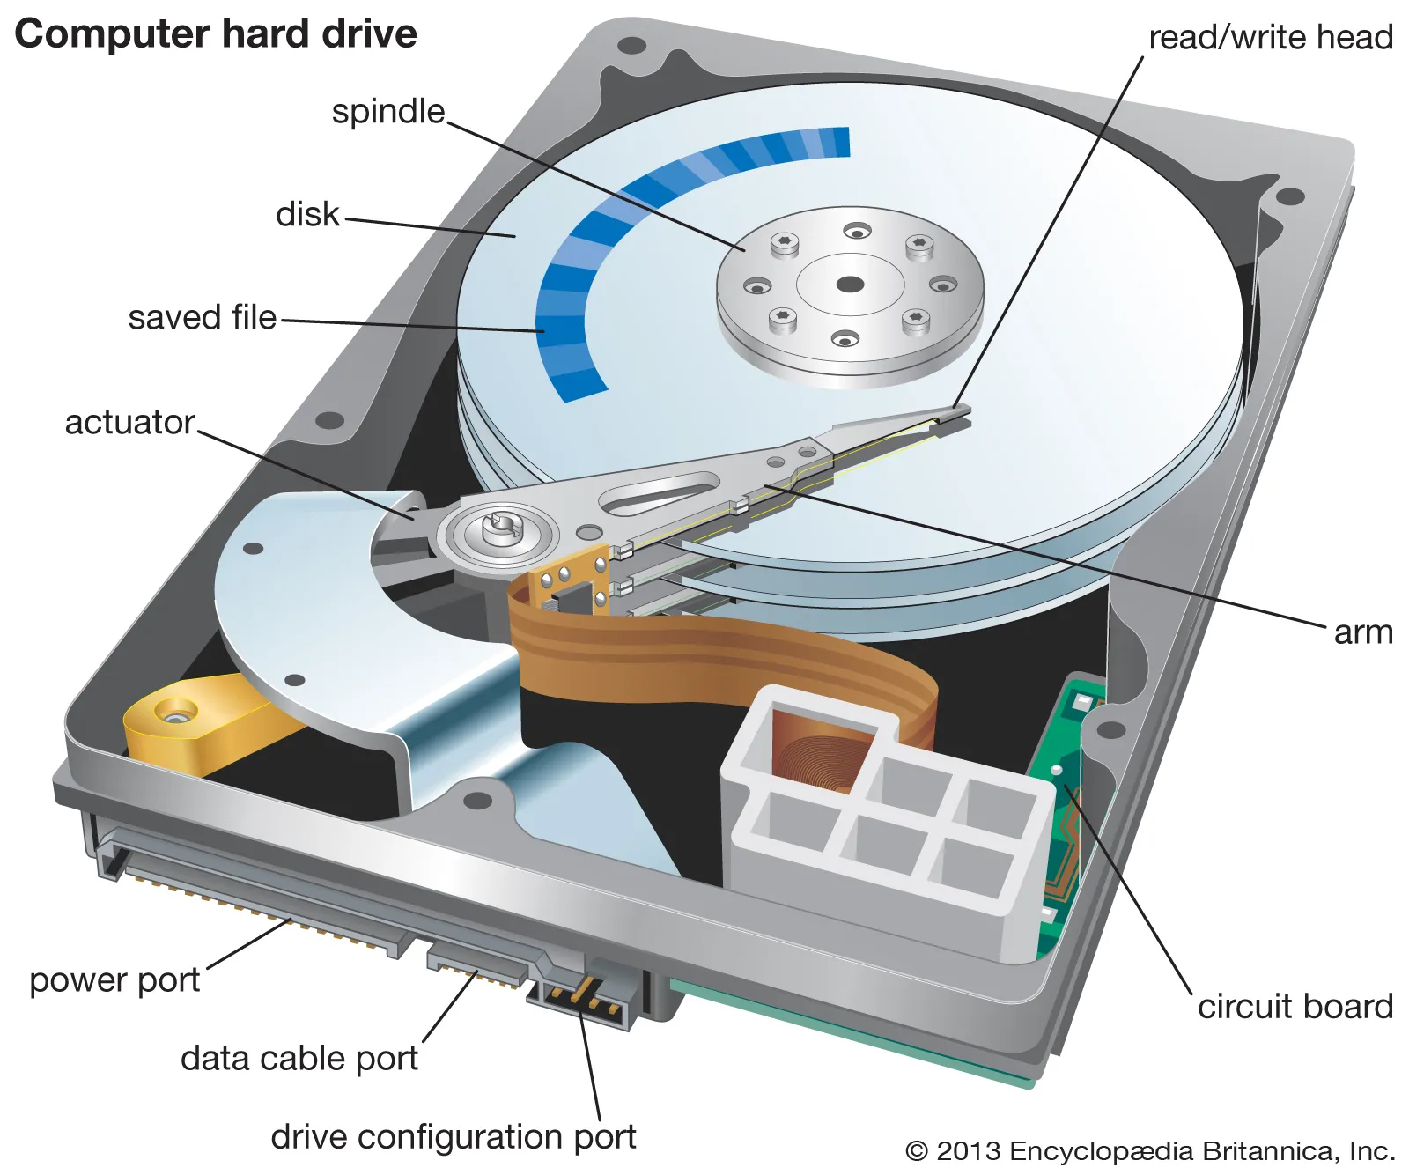
Example of Disk and Drive
Notes:
Image Source - https://www.britannica.com/technology/hard-disk

Slide 26
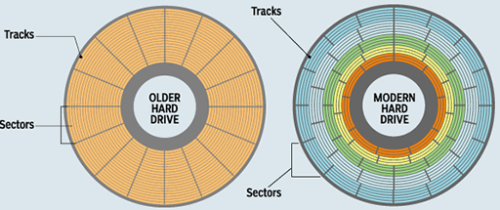
Sectors, Tracks, and Clusters
Notes:
The image above depicts the physical structure of an older hard disk (left) and a modern hard disk (right). Notice the indication of sectors and tracks. Sectors and tracks are physical constructs.
Each platter on a hard disk is divided into several concentric tracks. Each track is subsequently divided into sectors, which can store the same amount of data. A sector is the smallest physical storage unit on a disk, and on most file systems it is fixed at 512 bytes.
A cluster is a logical grouping of one or more sectors and is the smallest allocation unit used by a file system to store data.
Characteristics:
Logical Unit: Clusters are used by the operating system's file system (e.g., NTFS, FAT32) to manage files.
Variable Size: Cluster size depends on the file system and the size of the partition. Common sizes range from 4 KB to 64 KB. Most common however is 8 sectors, or 4KB (4096 bytes).
Purpose: Helps the file system organize and manage data on the disk more efficiently.
Image Source - Introducing computing and IT: 5.3 Formatting a hard disk | OpenLearn - Open University

Slide 27
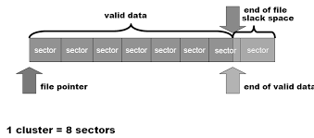
Slack Space
Notes:
Slack Space:
Slack space is the unused space on a hard drive between the end of a file and the end of the cluster that contains it. It's also called file slack space. If a file's size is smaller than the cluster size, the remaining space in the cluster is wasted but can sometimes hold remnants of old data, making it relevant in forensics.
Example:
If a cluster size is 4 KB and a file is 5 KB, the file will occupy two clusters (8 KB total), resulting in 3 KB of slack space.

Slide 28
Partitions and Volumes
Both are examples of logical constructs
Partitions:
Logical division of a storage device
Can act as a separate disk.
Contains the boot partition.
Volumes:
Any partition that has been formatted, has a file system, and contains a letter (“C:”).
In Windows OS the term should be volume, but Microsoft improperly uses drive. Example C drive, D drive.
Notes:
Partitions
A partition is a portion of a disk with a specific size. It’s literally just a “partition” of your available storage space. Although a partition can be detected by Windows, it doesn’t mean it can be accessed by you yet. A partition doesn’t necessarily have a file system or need to be formatted.¹
Volumes
A volume is a partition that has been formatted and has a file system and a “drive” letter. It’s the logical part of the disk that you can see and access within your file explorer. Whenever you connect an HDD, SSD, external drive, or flash drive, and it appears in your file browser, you’re seeing the volume. Volumes are sometimes referred to as volume drives or disk volumes, although this is rare¹.
1. Source - https://www.maketecheasier.com/difference-between-disk-drive-volume-partition-image/

Slide 29
Virtual Machines
Virtual Machines (VMs)
Complete emulation of a computer system, including:
Operating Systems
Virtual hardware
Applications
Uses its own Operating System (does not share the hosts)
Does rely on resources from the host, like RAM, and disk space
Notes:
A virtual machine is a complete emulation of a computer system, including its operating system (OS), virtual hardware, and applications. VMs run on top of a hypervisor that allocates physical resources from the host machine.
Key Features:
Isolation:
Each VM runs its own operating system, which provides complete isolation from other VMs and the host.
Full Virtualization:
VMs emulate physical hardware (e.g., CPU, memory, network adapters, storage).
Heavyweight:
VMs require significant resources due to the overhead of running a full OS in each instance.
Use Cases:
Running multiple operating systems on a single physical machine.
Legacy application support.
Testing and development environments.
Traditional server consolidation.

Slide 30
Containers
Lightweight virtualization method.
Unlike VMs, does not contain the underlying hardware.
Shares the host machines operating system kernel
Does not rely on hypervisor compatibility
Often used to run single applications or microservices
Tools:
Docker, Kubernetes.
Notes:
A container is a lightweight virtualization method that packages an application and its dependencies together into a single, portable unit. Containers share the host machine's operating system kernel but run in isolated user spaces.
Key Features:
Process-Level Isolation:
Containers share the host OS kernel while keeping their processes and resources separate.
Lightweight:
Containers are smaller and faster to start compared to VMs because they don’t require a full OS.
Portability:
Containers can run consistently across different environments (e.g., development, testing, production).
Use Cases:
Microservices architecture.
CI/CD pipelines.
Cloud-native applications.
Lightweight application development and testing.

Slide 31
Virtual Disks vs Virtual Partitions
Virtual Disks:
Used by Virtual Machines
Uses a file on the computer to store information required to run a particular VM
Virtual Partitions:
Two or more partitions that a computer can access
Not physically related on a disk
Made to appear like an actual partition
Notes:
Virtual Disk
A virtual disk is a software-based representation of a physical disk. It simulates the functionality of a physical hard drive but exists as a file (or a set of files) within a host operating system or a virtualization environment.
Characteristics:
Software-Based Disk: Created by virtualization platforms (e.g., VMware, VirtualBox, Hyper-V) or disk management software.
File Representation: The virtual disk is typically stored as a single file on the host system, such as .vmdk(VMware), .vdi (VirtualBox), or .vhd/.vhdx (Hyper-V).
Complete Storage Emulation: Acts as a standalone disk with its own file system, partitions, and data storage.
Use Cases:
Virtual machines use virtual disks to store operating systems and user data.
Disk imaging or backups (e.g., creating a virtual disk to store snapshots of physical disks).
Testing and sandboxing without using physical hardware.
Example:
A virtual disk file (MyVirtualDisk.vhd) is created to emulate a 500GB hard drive, which can be mounted and used in a virtual machine.
Virtual Partition
A virtual partition refers to a logical division within a physical or virtual disk. It is not a standalone entity like a virtual disk but rather a way to organize storage space on an existing disk.
Characteristics:
Logical Division: Splits a single disk (physical or virtual) into multiple isolated sections.
Dependent on a Disk: Requires a disk (physical or virtual) to exist as a container for the partition.
File System-Specific: Each partition can have its own file system (e.g., NTFS, FAT32, EXT4).
Use Cases:
Separating system files, application files, and user data on the same disk.
Running multiple operating systems on the same disk by isolating them into partitions.
Organizing storage within a virtual disk.
Example:
A 1TB virtual disk file is divided into three virtual partitions:
100GB for the operating system.
500GB for user data.
400GB for backups.
Practical Application
Virtual Disk:
Used to store the entire operating system, applications, and data for virtual machines.
Can be moved, copied, or mounted between different systems for portability.
Virtual Partition:
Used to divide storage within a virtual disk for better organization.
Allows running multiple operating systems or isolating user data on the same disk.
Analogy
Think of a virtual disk as a bookshelf, and virtual partitions as the shelves on that bookshelf:
The bookshelf (virtual disk) is a standalone unit that can be moved and used anywhere.
The shelves (virtual partitions) are divisions within the bookshelf to organize books (data).
This distinction is important in virtualization environments, disk imaging, and storage management.

Slide 32
Forensic Images
Bit for bit copy of all the data on a device
Captures data not visible to the OS.
Examples:
Sectors, clusters, and hidden data
Tools:
RAW/DD: A raw sector-by-sector copy with no additional metadata or compression.
E01 (EnCase Evidence File): Widely used, supports compression and metadata.
Notes:
A "forensic image" is a precise, bit-by-bit copy of a digital storage device, including all files, folders, and even deleted data, created for the purpose of digital forensics investigations, essentially capturing every piece of information on a drive, regardless of whether it's visible to the operating system, to preserve evidence for analysis without altering the original device; it's considered a crucial step in digital forensics investigations to maintain data integrity.
A forensic image can only be taken when a device is powered down. Also, forensic images are static in nature, so they will not show running processes, users logged on, active connections, and so on.
NOTE: You can use an image, typically with the extension, .img, to create a virtual machine. We will discuss how to do this later in the lesson.

Slide 33
System and Boot Partitions
System Partition:
Contains the operating system folder, known as system root - %systemroot%
Stores files used to boot (start) the computer.
Labeled “System Reserved”
Boot Partition (aka Boot Volume):
Contains the boot loader, a piece of software responsible for booting the OS.
Holds the boot sector and is labeled “Active.”
Notes:
System Partition
The System Partition is the partition where the files required for the initial stages of the boot process are located.
Purpose:
Contains the system's boot loader files and other necessary files for starting the boot process.
It is responsible for initializing the operating system startup.
Contents:
Boot-related files, such as:
For Windows: bootmgr (Windows Boot Manager), Boot Configuration Data (BCD), and other files required for booting.
For UEFI systems: Contains the EFI System Partition (ESP), formatted in FAT32, which stores the UEFI boot loaders.
File System:
Typically formatted as FAT32 (in UEFI systems) or NTFS.
Location:
It is usually the first partition on the primary storage device.
Example in Windows:
The system partition is labeled as "System Reserved" in Disk Management (in BIOS/MBR-based systems).
Boot Partition
The boot partition is a dedicated section of a storage device (such as a hard drive or SSD) that contains the operating system's boot loader and associated files necessary for initializing the system. It is one of the first partitions accessed during the boot process. Here's a breakdown:
Purpose: The boot partition is used to store the files required to load the operating system into memory. These files may include the boot loader (e.g., GRUB or BOOTMGR) and configuration data.
Location: It is usually located on the primary storage device and is commonly the first partition or one marked as "active.“
File System: The file system used by the boot partition varies depending on the operating system. For example:
Windows uses NTFS or FAT32 for its boot partition.
Linux commonly uses EXT4 or FAT32 for EFI System Partitions (ESP).
Types:
Primary Boot Partition: Stores the core boot loader files.
EFI System Partition (ESP): In UEFI systems, this is a specific partition formatted with FAT32 and used for booting.
Note: System Partition is used to boot the computer, Boot Partition is used to start the operating system.

Slide 34
BIOS/UEFI
BIOS (Basic Input Output System)
Firmware interface used to start the computer.
Performs the Power-On-Self-Test to check hardware functionality
Primarily used in older systems
UEFI (Unified Extensible Firmware Interface)
Modern replacement of BIOS.
Stored in EEPROM
Supports the GUID partition table.
Notes:
BIOS (Basic Input/Output System)
The BIOS is a firmware interface responsible for starting the computer and loading the operating system. It has been the standard boot firmware for decades, primarily used in older systems.
Key Features of BIOS:
Location:
Stored on a small ROM chip on the motherboard.
Function:
Performs the Power-On Self-Test (POST) to check hardware functionality.
Initializes hardware components (e.g., CPU, RAM, and storage devices).
Locates the bootloader in the Master Boot Record (MBR) to begin the operating system boot process.
Interface:
Text-based user interface with simple menus for configuring hardware settings.
Boot Process:
Relies on the MBR partitioning scheme, which supports up to 4 primary partitions and a maximum disk size of 2TB.
Compatibility:
Works with older hardware and operating systems.
Security:
Minimal security features, such as a password for accessing the BIOS menu.
UEFI (Unified Extensible Firmware Interface)
The UEFI is the modern replacement for BIOS, designed to overcome its limitations and provide enhanced functionality. It is used in most systems built after 2010.
Key Features of UEFI:
Location:
Stored in the EEPROM or flash memory on the motherboard.
Function:
Performs hardware initialization and starts the bootloader from the EFI System Partition (ESP).
Interface:
Graphical User Interface (GUI) with mouse support, along with more advanced configuration options.
Boot Process:
Supports the GUID Partition Table (GPT), which allows:
Up to 128 partitions per disk.
Disk sizes larger than 2TB.
Loads the bootloader from the EFI System Partition (ESP), formatted in FAT32.
Compatibility:
Backward-compatible with BIOS through CSM (Compatibility Support Module).
Security:
Advanced features like Secure Boot, which prevents unauthorized or malicious code from being executed during the boot process.

Slide 35
Master Boot Record (MBR)
A special structure located at the very beginning of a storage device, like a hard drive.
Found in sector 0 (the first 512 bytes of a storage device.
Bootloader Code (446 bytes)
Small program that executes during the system’s boot process
Partition Table
Holds information about the partitions (up to 4 primary partitions)
Unique Boot signature (2 bytes) – 0x55AA
Notes:
The Master Boot Record (MBR) is a special structure located at the very beginning (sector 0) of a storage device, like a hard drive. It contains critical information about how the device is partitioned and how to start the operating system. Here's a breakdown:
Location: The MBR is found in the first 512 bytes of a storage device.
Structure:
Bootloader Code (446 bytes): This section contains a small program that executes during the system's boot process to load the operating system's main boot loader.
Partition Table (64 bytes): Holds information about the partitions on the storage device (up to 4 primary partitions).
Boot Signature (2 bytes): A unique identifier (0x55AA) marking the end of the MBR.
Functionality:
Initializes the system by loading the operating system bootloader.
Defines the storage device’s partitioning scheme and layout.
Limitations:
Partition Support: Can only handle up to 4 primary partitions or 3 primary partitions plus an extended partition.
Storage Limit: Supports drives up to 2TB in size due to its 32-bit addressing limitation.
Compatibility: It is used in systems with a traditional BIOS firmware.

Slide 36
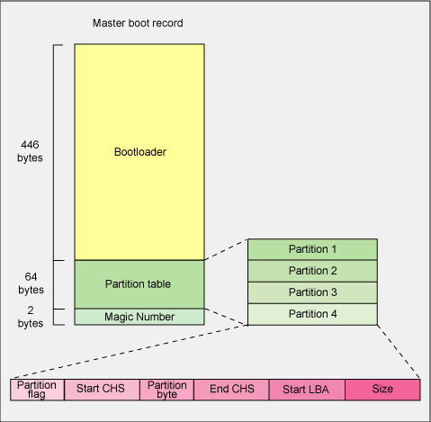
MBR (cont’d)
Notes:
The image above depicts a high-level view of the MBR, including its respective sections. The magic number refers to the unique hexadecimal signature, 0x55AA, which indicates the end of the MBR. This can also be used to immediately identify the MBR during a forensics examination.

Slide 37
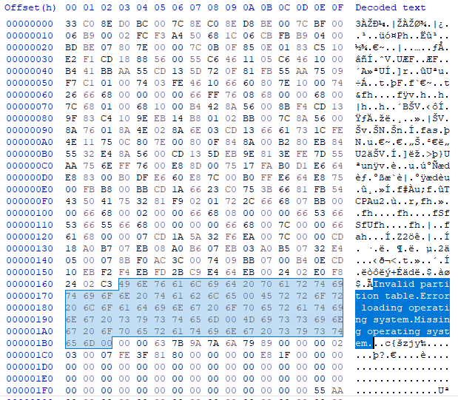
MBR in Hex Editor
Notes:
The image above shows the contents of a device’s MBR, which has been opened with a hex editor.

Slide 38
GUID (GPT) Partition Table
Modern partitioning scheme
Replaced the older MBR
Part of the UEFI
Key Features:
GUIDs (Globally Unique Identifiers) use to identify partitions
Supports up to 128 partitions
Can manage drives larger than 2TB.
Uses 64-bit addressing.
Improved security (CRC32 checksum)
Notes:
GUID Partition Table (GPT)
The GUID Partition Table (GPT) is a modern partitioning scheme for storage devices, designed to replace the older Master Boot Record (MBR). It is part of the Unified Extensible Firmware Interface (UEFI) standard and supports larger storage devices and more advanced features.
Key Features of GPT
Partitioning Structure:
Globally Unique Identifiers (GUIDs) are used to identify partitions, ensuring uniqueness across systems.
Supports up to 128 partitions per drive without the need for extended or logical partitions.
Storage Size:
Can manage drives larger than 2TB, unlike MBR, which is limited to 2TB.
Uses 64-bit addressing, allowing up to 9.4 Zettabytes of disk space.
Redundancy:
Stores partition information in multiple locations:
Primary partition table at the beginning of the disk.
Backup partition table at the end of the disk.
This redundancy improves recovery options in case of corruption.
Compatibility:
Works with modern UEFI-based systems.
Can be read by some legacy BIOS systems if configured correctly, but full compatibility requires UEFI.
Improved Security and Recovery:
Includes a CRC32 checksum for verifying the integrity of partition data.
Helps detect and recover from corruption.
Flexible Partitioning:
Unlike MBR, it does not have a fixed limit on the number of primary partitions.
Each partition has a unique identifier and descriptive label, making management easier.
Structure of GPT
A GPT disk is organized into the following sections:
Protective MBR:
A small structure at the beginning of the disk to prevent older tools from misinterpreting the GPT disk as unpartitioned.
It ensures backward compatibility by marking the entire disk as a single MBR partition.
Primary GPT Header:
Contains information about the disk, including:
Disk GUID.
Location of the partition table.
CRC32 checksum for integrity verification.
Partition Entry Array:
A table containing entries for all partitions on the disk.
Each entry includes:
GUID.
Partition type (e.g., EFI System Partition, Microsoft Reserved Partition).
Starting and ending block addresses.
Descriptive name.
Backup GPT Header and Table:
Located at the end of the disk for redundancy.

Slide 39
FAT, NTFS, EXT
FAT (File Allocation Table)
FAT12, FAT16, FAT32, and exFAT
FAT12 = floppy disks, exFAT = flash drives/SD.
NTFS (New Technology File System)
Limited compatibility with non-Windows OS.
Up to 16EB, 256TB in practical implementations.
EXT (Extended File System)
EXT2, EXT3, EXT4
Optimized for Linux
Notes:
FAT (File Allocation Table)
Key Features:
Developed by Microsoft in the 1980s.
Simple and widely compatible.
Variants include FAT12, FAT16, FAT32, and exFAT.
Common Variants:
FAT16:
Supports partition sizes up to 2GB.
Limited to 65,536 (64K) clusters.
FAT32:
Supports partition sizes up to 2TB.
Maximum file size: 4GB.
exFAT (Extended FAT):
Designed for flash drives and SD cards.
Supports files larger than 4GB and partitions up to 128PB.
Advantages:
Simple structure.
Cross-platform compatibility (Windows, macOS, Linux, and embedded systems).
Limitations:
No journaling (increased risk of data loss during crashes).
File size and partition size limitations (except exFAT).
Use Cases:
Removable storage (USB drives, SD cards).
Compatibility with devices like cameras and game consoles.
2. NTFS (New Technology File System)
Key Features:
Developed by Microsoft in 1993.
Default file system for Windows NT, 2000, XP, and later versions.
Capabilities:
Maximum Partition Size: Up to 16EB (theoretical), limited to 256TB in practical implementations.
Maximum File Size: Limited by the partition size.
Journaling: Tracks changes to files to protect against corruption.
File Permissions: Supports Access Control Lists (ACLs) for advanced security.
Compression & Encryption: Built-in support for file compression and encryption (EFS).
Advantages:
Robust journaling system.
Advanced security and access controls.
Handles large files and partitions.
Limitations:
Limited compatibility with non-Windows operating systems (read-only in macOS and some Linux systems without additional software).
Use Cases:
Internal storage for Windows-based systems.
Servers and enterprise environments.
3. EXT (Extended File System)
Variants:
EXT2:
Introduced in 1993 for Linux.
No journaling (faster performance but higher risk of data loss).
EXT3:
Adds journaling for improved data integrity.
Backward-compatible with EXT2.
EXT4:
Improved performance, larger file/partition size limits, and reduced fragmentation.
Default file system for most modern Linux distributions.
Capabilities:
Maximum Partition Size: 1EB (EXT4).
Maximum File Size: 16TB (EXT4).
Journaling: Supported in EXT3 and EXT4.
Advantages:
Optimized for Linux systems.
Reliable journaling and large file support.
Reduced fragmentation (EXT4).
Limitations:
Native support is primarily for Linux.
Requires additional tools for use in Windows or macOS.
Use Cases:
Linux-based systems (desktop, server, embedded).
Storage for virtual machines and containers.

Slide 40
HFS+ and APFS
HFS (Hierarchical File System Plus)
Used in MacOS until replaced by APFS
Supports journaling
APFS (Apple File System)
Introduced in MacOS High Sierra (2017).
Optimized for SSDs and flash storage
Features:
Snapshots for point-in-time backups
Notes:
HFS+ and APFS (Apple File Systems)
HFS+ (Hierarchical File System Plus):
Introduced by Apple in 1998.
Used in macOS until it was replaced by APFS.
Supports journaling and file compression.
APFS (Apple File System):
Introduced in macOS High Sierra (2017).
Optimized for SSDs and flash storage.
Features include:
Snapshots for point-in-time backups.
Space sharing for better disk management.
Encryption for improved security.
Use Cases:
HFS+: Older macOS versions and Time Machine backups.
APFS: Default for macOS, iOS, iPadOS, and watchOS.

Slide 41
Additional Filesystem Types
BTrfs (B-Tree File System)
Advanced features like snapshots and RAID support.
Developed for Linux by Oracle
ZFS (Zettabyte File System)
Combines file system and logical volume management.
Max partition size: 256 quadrillion zettabytes
XFS
High performance journaling system for Linux
Notes:
Btrfs (B-Tree File System)
Key Features:
Developed for Linux by Oracle.
Focused on scalability and advanced features like snapshots and RAID support.
Advantages:
Built-in data integrity checks (checksumming).
Snapshots for quick backups.
Supports large files and partitions.
Limitations:
Still maturing; not as widely supported as EXT4.
Use Cases:
Linux servers and high-availability storage solutions.
ZFS (Zettabyte File System)
Key Features:
Originally developed by Sun Microsystems.
Combines file system and logical volume management.
Capabilities:
Maximum Partition Size: 256 quadrillion zettabytes.
Snapshots and clones for versioning.
Data integrity through checksumming.
Advantages:
Advanced redundancy (RAID-Z).
Highly scalable.
Self-healing capabilities.
Limitations:
Higher memory and CPU usage.
Limited support on Linux (requires additional tools).
Use Cases:
Enterprise storage and backup systems.
Data-intensive applications.
XFS
Key Features:
Developed by SGI (Silicon Graphics, Inc.).
High-performance journaling file system for Linux.
Advantages:
Handles large files and volumes efficiently.
Good for high-throughput environments.
Limitations:
Lacks built-in snapshots (requires external tools).
Use Cases:
Enterprise servers and databases.

Slide 42
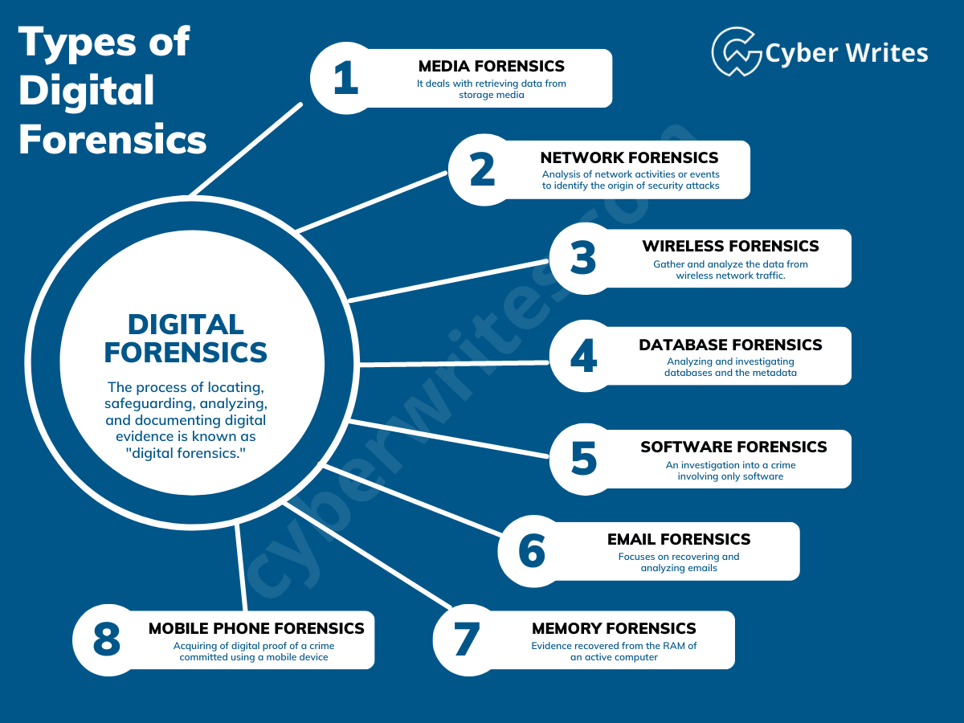
9.5 – Offline and Live Examinations
Notes:
Image Source - What is Digital Forensics? Tools, Types, Phases & History

Slide 43
Offline (Deadbox) Forensics
Offline (deadbox) analysis involves examining a powered-off device by creating a forensic image of said device
This results in a bit-for-bit copy of the device
Includes partitions, volumes, and hidden data.
Does not include running processes, active connections, and so on ..
Common device types are:
Laptops and desktop computers
Servers, switches, routers, and IoT devices
Mobile phones (requires a more advanced skillset)
Notes:
The following is a list of common devices that yield forensic artifacts during offline examinations.
Storage Media
Hard Disk Drives (HDDs) and Solid-State Drives (SSDs) – Primary targets for forensic imaging, containing operating systems, user files, logs, and deleted data.
USB Flash Drives – Often used for data transfer and may hold valuable forensic artifacts.
Memory Cards (SD, microSD, CF) – Common in mobile devices, cameras, and drones, storing images, videos, and documents.
Optical Discs (CDs, DVDs, Blu-ray Discs) – Sometimes used for archiving files and media.
External Hard Drives – Used for backups and additional storage, potentially containing sensitive historical data.
2. Computers & Servers
Desktops and Laptops – Analyzed for user activity, documents, internet history, and software logs.
Workstations – Used in enterprise environments and may contain business-critical data.
Servers – Often host databases, logs, and user credentials, essential in corporate or criminal investigations.
3. IoT and Embedded Systems
Security Cameras (CCTV DVR/NVR Systems) – Store video recordings that can be extracted for forensic analysis.
Printers & Multifunction Devices – Store print logs, scanned documents, and metadata that may provide evidence.
Automotive Infotainment Systems & Black Boxes – Contain GPS data, call logs, and other evidence useful in investigations.
4. Mobile & Handheld Devices (when analyzed in deadbox mode)
Smartphones & Tablets – If powered off and extracted using forensic imaging techniques, though they are more commonly analyzed live due to encryption.
GPS Navigation Devices – Store location history and waypoints.
Digital Media Players (MP3 Players, iPods, etc.) – May contain audio logs, recordings, or other forensic artifacts.
5. Specialized Industrial & Enterprise Devices
Point of Sale (POS) Systems – Contain transaction logs and customer data.
SCADA & ICS Devices (Supervisory Control and Data Acquisition) – Store operational logs relevant to critical infrastructure investigations. However, OT and SCADA present their own challenges and often cannot be imaged in the traditional sense. More on this soon (during the live analysis slides).
Medical Devices & Equipment – Store patient data and operational logs.
Offline forensics is primarily used to extract and analyze data from these devices without modifying them, ensuring evidence integrity. It is a crucial method for forensic investigations involving persistent storage media.

Slide 44
Evidence Revealed During Offline Examinations
File System Data
Deleted and Residual Data
System & Log Data
User Activity Data
Communication and Networking Data
except for active connections and other data found during a live examination
Time and Metadata
Forensics Carvings and Hidden Data
Notes:
File System Data
User Files & Documents – Text files, spreadsheets, presentations, PDFs, and other user-generated content.
Multimedia Files – Photos, videos, audio recordings, and metadata (e.g., timestamps, camera model).
Compressed Archives – ZIP, RAR, 7z files that may contain hidden or bundled data.
Encrypted Files – If encryption keys are available or weaknesses in encryption are exploited.
2. Deleted & Residual Data
Deleted Files – Recoverable files from unallocated space using forensic tools.
File Fragments & Slack Space Data – Partial files or remnants left in disk slack space.
Previous Versions of Files – Sometimes retrievable through shadow copies or forensic carving.
Wiped Data Traces – Partial recovery of data even after deletion attempts, unless securely wiped.
3. System & Log Data
Operating System Artifacts – System logs, event logs, registry files (Windows), and system preferences (Mac/Linux).
Installed Software & Application Logs – Information about software used, version history, and configuration settings.
Browser History & Cookies – Websites visited, search queries, and session tokens.
System Boot Records & MBR/GPT Data – Essential for analyzing system configurations and malware persistence.
4. User Activity Data
Login Credentials & Authentication Data – Stored passwords, authentication tokens, and security hashes (e.g., SAM registry in Windows).
Clipboard & Temporary Files – Data from system temp folders and user cache.
Recently Opened Files & Programs – MRU (Most Recently Used) lists from registry and OS logs.
USB & External Device History – Log records of connected USB drives, external HDDs, and removable media.
5. Communication & Networking Data
Email Archives – Outlook PST, Thunderbird MBOX, or webmail cached data.
Chat & Messaging Logs – Local storage of conversations from applications like Skype, WhatsApp (if unencrypted backups exist), or Signal.
Network Configuration & Connection History – SSIDs of connected Wi-Fi networks, VPN configurations, and previous network logs.
Peer-to-Peer & Torrent Data – Records of downloaded files and shared content.
6. Time & Metadata Information
Timestamps (MAC Times - Modified, Accessed, Created) – Useful for timeline reconstruction.
Geolocation Data – Extracted from EXIF metadata in photos, GPS logs, or mobile backups.
Time Zone & System Clock Settings – Important for establishing an accurate timeline of events.
7. Malware & Security-Related Artifacts
Malicious Files & Binaries – Executables and scripts related to malware infections.
Persistence Mechanisms – Registry modifications, scheduled tasks, startup entries.
Log Files Indicating Unauthorized Access – Failed login attempts, security alerts.
Hidden Partitions or Encrypted Volumes – Used for data hiding and anti-forensic techniques.
8. Forensic Carvings & Hidden Data
Steganographic Content – Hidden messages or files within images/audio.
Alternate Data Streams (ADS) in NTFS – Hidden files attached to standard files.
Virtual Machine & Snapshot Data – VirtualBox, VMware images storing entire system states.
Hibernation & Page Files – May contain RAM snapshots with valuable forensic data.

Slide 45
Tools used to Conduct Offline Examinations
Imaging Tools:
FTK Imager, Encase Imager, dd & dcfldd (Linux CLI), X-Way forensics, Magnet Acquire, Paladin (SUMURI)
File System and Data Recovery
Autopsy (Sleuth Kit)
X-Ways Forensics
Registry & OS Artifact Analysis
Registry Explorer (regedit)
macOS & iOS Foresnics (BlackLight, iLEAPP)
Windows Event Log Parser
Notes:
Forensic Imaging Tools (Disk Acquisition & Cloning)
These tools create exact bit-by-bit copies of digital storage devices for forensic examination.
🔹 FTK Imager – Creates forensic images (E01, DD) and verifies integrity with hash values.
🔹 EnCase Imager – A professional tool for acquiring forensic images, widely used in law enforcement.
🔹 dd & dcfldd (Linux CLI) – Command-line tools for imaging disks in raw format.
🔹 Guymager – A Linux-based GUI tool for forensic disk imaging.
🔹 X-Ways Forensics – A lightweight yet powerful forensic imaging and analysis tool.
🔹 Magnet Acquire – A free imaging tool from Magnet Forensics.
🔹 Paladin (SUMURI) – A forensic bootable Linux distribution with imaging capabilities.
2. File System & Data Recovery Tools
These tools help retrieve deleted, hidden, or corrupted data from storage media.
🔹 Autopsy (Sleuth Kit) – Open-source digital forensics platform for analyzing file systems.
🔹 X-Ways Forensics – Supports deep file system analysis, deleted file recovery, and hidden data detection.
🔹 R-Studio – Advanced recovery software capable of restoring lost partitions and files.
🔹 Recuva (Windows) – Lightweight recovery tool for deleted files.
🔹 EaseUS Data Recovery – User-friendly tool for recovering lost or formatted files.
🔹 TestDisk & PhotoRec – Open-source tools for recovering lost partitions and files.
3. Registry & OS Artifact Analysis Tools
These tools extract OS logs, user activities, and forensic artifacts from Windows, macOS, and Linux systems.
🔹 Registry Explorer (Eric Zimmerman Tools) – Analyzes Windows registry for forensic evidence.
🔹 ShellBags Explorer – Helps reconstruct user activity based on Windows shell artifacts.
🔹 Prefetch Explorer – Examines Windows Prefetch files to track program executions.
🔹 macOS & iOS Forensics Tools (BlackLight, iLEAPP) – Extract forensic data from Apple systems.
🔹 Windows Event Log Parser (EVTXParser) – Extracts forensic insights from event logs.

Slide 46
Offline Tools (cont’d)
File Carving & Data Extraction
Foremost
Scalpel
Bulk Extractor, PhotoRec
Email & Document Tools
MailXaminer
ExifTool
Browser and Internet History
BrowsingHistoryView
NirSoft
Notes:
File Carving & Data Extraction Tools
These tools recover fragmented or partially deleted files without relying on the file system.
🔹 Foremost – Open-source tool for extracting specific file types from raw disk images.
🔹 Scalpel – Advanced file carving tool for reconstructing fragmented data.
🔹 Bulk Extractor – Scans disk images for email addresses, credit card numbers, and other artifacts.
🔹 PhotoRec – Recovers media files from damaged or formatted drives.
5. Email & Document Forensics Tools
These tools extract and analyze emails, metadata, and document history.
🔹 MailXaminer – A forensic tool for analyzing email archives (PST, OST, MBOX).
🔹 Aid4Mail Forensic – Extracts, filters, and analyzes email data.
🔹 Metadata Analyzer (ExifTool) – Retrieves metadata from documents, images, and PDFs.
🔹 PDF Examiner – Analyzes PDF structures for embedded objects and hidden metadata.
6. Browser & Internet History Forensics
Tools for analyzing browsing activities, cookies, and cache.
🔹 BrowsingHistoryView – Extracts history from Chrome, Firefox, Edge, and more.
🔹 HstEx & NetAnalysis – Advanced tools for recovering and analyzing deleted browser history.
🔹 NirSoft Browser Tools – Various utilities for extracting passwords, cookies, and history.

Slide 47
Offline Tools (cont’d)
Password & Encryption Recovery
John the Ripper
Hashcat
Timeline & Correlation
Timesketch, X-Ways Forensics Timeline
Virtual Machine
Rekall
VMWare, VirtualBox
Notes:
Password & Encryption Recovery Tools
These tools help recover lost or encrypted data.
🔹 Passware Kit Forensic – Decrypts hard drives, documents, and archives.
🔹 John the Ripper – Open-source password cracking tool.
🔹 Hashcat – Advanced password recovery tool using GPU acceleration.
🔹 ElcomSoft Forensic Toolkit – Extracts and decrypts protected data.
8. Timeline & Correlation Analysis Tools
These tools help reconstruct events based on timestamps and system artifacts.
🔹 Plaso (Log2Timeline) – Generates forensic timelines from disk images.
🔹 Timesketch – Web-based tool for interactive timeline analysis.
🔹 X-Ways Forensics Timeline – Creates activity timelines from forensic images.
9. Virtual Machine & Memory Analysis
These tools analyze virtual environments and RAM snapshots.
🔹 Rekall – the offline investigations portion.
🔹 Hyper-V, VMware, VirtualBox Forensics – Examines snapshots and virtual disk images.

Slide 48
ICS Offline Analysis Tools
Grassmarlin
ICSpector
ICS Forensics Tools (for PLCs primarily)
SCADAfence
SANS ICS/OT Toolkit
FTK & X-Ways
Wireshark
Mostly for .pcap ingestion, since offline analysis cannot inspect live traffic.
Notes:
SCADA & ICS-Specific Forensic Tools
These tools specialize in analyzing SCADA logs, network traffic, and configuration files.
🔹 GRASSMARLIN (NSA) – Used for passive discovery and network mapping of ICS/OT environments. Can also ingest .pcap files.
🔹 SCADAfence – Provides forensic insights into industrial control system security incidents.
🔹 SANS ICS/OT Forensic Toolkit – A collection of tools used for forensic investigations in industrial environments.
🔹 Digital Bond’s Quickdraw – Analyzes logs and events from ICS/SCADA devices.
🔹 Snort (Offline Mode) – Analyzes captured network traffic logs for ICS/SCADA security threats. Wireshark can do this too.
🔹 Suricata (Offline PCAP Analysis) – Performs deep packet inspection on industrial control system traffic captures.
NOTE: “ICSpector is an open-source framework that facilitates examining the information and configurations of industrial programmable logic controllers (PLCs). The framework simplifies the process of locating PLCs and detecting any anomalous indicators that are compromised or manipulated and can assist in safeguarding the PLCs from adversaries who intend to harm or disrupt their operations.
Written in Python and available on GitHub, ICSpector is a framework with tools that enable investigators to scan their network for PLCs; extract project configuration and code from controllers; and detect any anomalous components within ICS environments. Security experts can use these forensic artifacts to identify compromised devices as part of manual verification, automated monitoring of tasks, or incident response. The framework’s modular, flexible design makes it convenient for investigators to customize it to their specific needs.
Furthermore, the framework provides investigators with a convenient way to scan for PLCs and identify any suspicious artifacts within ICS environments, which can be used for manual checking, automated monitoring tasks, or incident response operations to detect compromised devices. By being an open-source tool, ICS Forensics Tools allows investigators to review the output and customize it to their specific requirements.” - Microsoft debuts ICSpector framework to enable examining information and configurations of industrial PLCs - Industrial Cyber

Slide 49
Offline Tools for Malware Analysis
Ghidra
GDB
IDA Pro
YARA
Remnux
Flare VM
INL’s Sophia Tool (Idaho National Labs)
Firmware & Embedded Devices
Notes:
Static Analysis Tools (File & Binary Examination)
Static analysis examines malware without executing it, focusing on file structure, strings, and code.
🔹 PEStudio – Inspects Portable Executable (PE) files for suspicious characteristics.
🔹 Exeinfo PE – Provides PE file metadata, compiler info, and potential packer detection.
🔹 Binwalk – Extracts and analyzes firmware for embedded ICS/OT devices.
🔹 Ghidra (NSA) – A powerful reverse engineering tool for ICS/OT malware binaries.
🔹 IDA Pro – Industry-standard tool for decompiling and analyzing malware in ICS/OT environments.
🔹 Detect It Easy (DIE) – Identifies file signatures, packers, and obfuscation techniques.
🔹 Radare2 / Cutter – Open-source reverse engineering tools for malware analysis.
🔹 YARA – Uses rules-based scanning to detect malware signatures in files and memory.
2. Dynamic Analysis Tools (Behavioral Analysis)
These tools execute malware in a controlled environment and monitor its behavior.
🔹 Cuckoo Sandbox – Automated malware analysis with process monitoring and network capture.
🔹 Any.Run (Offline Mode) – Interactive malware analysis with process tracing.
🔹 Noriben – Lightweight behavioral analysis tool using Windows logs.
🔹 FakeNet-NG – Simulates network activity to trick malware into revealing behavior.
🔹 INetSim – A Linux-based tool that emulates common network services for malware analysis.
🔹 Malboxes (FlareVM) – Pre-configured Windows VMs for malware analysis.
🔹 Remnux (Linux-based) – Malware analysis distro with reverse engineering tools.
3. ICS/OT-Specific Malware Analysis Tools
Specialized tools for analyzing malware targeting industrial systems.
🔹 SCADAfence – Detects ICS/OT-specific malware and network threats.
🔹 INL’s Sophia Tool – Designed for industrial malware analysis in ICS/SCADA environments.
🔹 PLCScan – Analyzes programmable logic controllers (PLCs) for vulnerabilities and infections.
🔹 Wireshark (Offline Mode) – Analyzes ICS/OT-specific network traffic (Modbus, DNP3, IEC 60870).
🔹 Firmware-Mod-Kit – Extracts and reverse engineers ICS device firmware.
🔹 PLC Blaster – Identifies and analyzes malware targeting PLCs in industrial environments.
🔹 Industrial Malware Analysis Platform (IMAP) – ICS/OT-focused malware detection and intelligence platform.
4. Firmware & Embedded Device Malware Analysis
Analyzing ICS/OT firmware for malware and vulnerabilities.
🔹 Binwalk – Extracts ICS firmware for forensic examination.
🔹 Ghidra – Reverse engineers binary firmware for malware detection.
🔹 QEMU – Emulates embedded device firmware to analyze malware.
🔹 Firmadyne – Automates firmware extraction and dynamic analysis.
🔹 Flashrom – Dumps ICS/OT firmware for analysis.

Slide 50
Live Forensic Examinations
The process of collecting digital artifacts for use in a court of law from a running system.
Types of information that can be recovered during a live examination:
Volatile memory (RAM memory dumps)
Running processes
Active Connections
Users Logged on
Open Network Connections
Passwords and Decryption Keys
Notes:
Key Features of Live Forensic Analysis
Captures Volatile Data – Recovers data stored in RAM, active processes, network connections, and system logs that would disappear upon shutdown.
Preserves System State – Allows investigators to analyze the live behavior of a system, including malware execution, user activities, and network traffic.
Real-Time Incident Response – Useful for cybersecurity investigations, intrusion detection, and ransomware attacks where immediate action is required.
Supports Encrypted Data Recovery – Retrieves encryption keys from memory, which may allow access to encrypted files and disk volumes.
Non-Intrusive (in Some Cases) – Certain techniques minimize changes to the system, ensuring forensic integrity.
Data Collected During Live Forensic Analysis
Live forensics focuses on real-time evidence collection, which includes:
1. Volatile Memory (RAM) Data
Running Processes – Identifies active programs, including malware and suspicious executables.
Open Network Connections – Captures communication channels and potential data exfiltration.
Loaded DLLs & Drivers – Detects injected code, rootkits, and unauthorized modifications.
Clipboard Data – Recovers recently copied text or files.
Decryption Keys – Extracts encryption keys from memory for BitLocker, VeraCrypt, and similar tools.
2. System Information & Logs
Active Users & Sessions – Identifies logged-in users and remote connections (RDP, SSH).
System Uptime & Event Logs – Helps reconstruct a timeline of events.
Registry & Configuration Changes – Reveals system modifications, malware persistence, and executed commands.
Startup Items & Services – Lists auto-running programs that may indicate malware.
3. Network & Communication Data
Active Network Connections & Ports – Detects suspicious communications with external IPs.
DNS & ARP Cache – Maps out recent network activity.
Captured Packets (PCAP) – Stores real-time network traffic for offline analysis.
4. Disk & File System Information
Recently Accessed Files – Recovers opened documents, scripts, and deleted files.
Process Handles & File Locks – Shows which processes are interacting with specific files.

Slide 51
Tools Used in Live Forensic Analysis
Memory Forensics:
Volatility (2.6). Note: 3+ can be buggy and contain malware
Rekall
Belkasoft RAM Capturer
LiMe (Linux Memory)
System & Process Analysis:
Sysinternals (Windows)
Mandiant Redline
PowerShell Logging
Notes:
Memory Forensics
🔹 Volatility Framework – Extracts and analyzes memory artifacts (processes, registry, DLLs, etc.).
🔹 Rekall – Alternative memory forensics tool for Windows, Linux, and macOS.
🔹 Belkasoft RAM Capturer – Lightweight memory capture tool for live forensic investigations.
2. System & Process Analysis
🔹 Sysinternals Suite (Process Explorer, Autoruns, Handle, etc.) – Microsoft’s toolset for analyzing processes, registry changes, and startup programs.
🔹 Mandiant Redline – Captures live system data, including process execution and network activity.
🔹 PowerShell Logging (Get-Process, Get-NetTCPConnection, etc.) – In-built Windows commands for quick forensic analysis.

Slide 52
Tools Used in Live Forensics (cont’d)
Live Network Forensics Tools:
Wireshark
TCPView
Tshark & Tcpdump
File & Registry Analysis:
RegRipper
NirSoft
FTK Imager (Live Mode)
Notes:
Tools Used for Live Forensic Analysis
Live forensic analysis requires specialized tools to collect and analyze volatile data without significantly altering system integrity.
1. Memory Forensics
🔹 Volatility Framework – Extracts and analyzes memory artifacts (processes, registry, DLLs, etc.).
🔹 Rekall – Alternative memory forensics tool for Windows, Linux, and macOS.
🔹 Belkasoft RAM Capturer – Lightweight memory capture tool for live forensic investigations.
2. System & Process Analysis
🔹 Sysinternals Suite (Process Explorer, Autoruns, Handle, etc.) – Microsoft’s toolset for analyzing processes, registry changes, and startup programs.
🔹 Mandiant Redline – Captures live system data, including process execution and network activity.
🔹 PowerShell Logging (Get-Process, Get-NetTCPConnection, etc.) – In-built Windows commands for quick forensic analysis.
3. Network Forensics
🔹 Wireshark – Captures real-time network traffic and identifies suspicious connections.
🔹 TCPView – Monitors active network connections on Windows.
🔹 Tshark & Tcpdump – Command-line network packet capture tools.
4. File & Registry Analysis
🔹 RegRipper – Extracts and analyzes Windows Registry hives for forensic evidence.
🔹 NirSoft Tools – Suite of utilities for recovering browser history, USB device history, and passwords.
🔹 FTK Imager (Live Mode) – Captures active files and running process dumps.

Slide 53
Challenges with Offline Analysis in ICS/OT
Limited Device Accessibility
Proprietary & Legacy Systems
Encryption & Data Protection
System Downtime is NOT an Option
Limited File System & Log Retention
Firmware-level Attacks
Limited Memory Resources
Notes:
Limited Device Accessibility
Many ICS/OT devices are embedded systems, legacy systems, or proprietary controllers (PLCs, RTUs, HMIs) with no standard storage media for easy forensic imaging.
Some controllers lack built-in storage, making forensic data extraction difficult.
Proprietary & Legacy Systems
ICS devices use customized and proprietary operating systems (e.g., VxWorks, QNX, RTOS, Siemens TIA Portal).
Standard forensic tools (FTK, EnCase) may not support non-standard file systems used in ICS/OT devices.
Encryption & Data Protection
Many ICS/OT vendors use firmware encryption and proprietary data formats to prevent tampering.
Extracting meaningful forensic data may require reverse engineering firmware, which is complex.
System Downtime is NOT an Option
Unlike IT systems, ICS/OT devices run 24/7 in critical infrastructure (power grids, oil refineries, water treatment plants).
Shutting down a system for forensic imaging may cause operational failures or safety risks.
Limited File System & Log Retention
Many ICS devices do not generate detailed logs, or logs are stored in volatile memory.
Unlike IT environments, ICS logs may lack timestamps, authentication data, or event tracking.
Covert Threats & Firmware-Level Attacks
Malware like Stuxnet, Triton, and Industroyer resides within firmware or affects controller logic (PLCs).
Offline forensics often fails to detect ICS malware, since logic modifications persist after a reboot.

Slide 54
Challenges with Live Analysis in ICS/OT
Risk of System Instability and Disruption
Lack of Standardize Tools for ICS/OT (this is a big one)
Volatile Data Loss
Embedded & Proprietary Protocols
Modbus, DNP3
Malware Detection and Evasion Challenges
Lack of Logging & Security Visibility
Notes:
Live forensics involves analyzing a running system to capture volatile data such as RAM, running processes, active network connections, and system states. While effective for cyber incident response, ICS/OT environments introduce major difficulties, such as:
Risk of System Instability & Disruption
ICS/OT systems are highly sensitive to changes in CPU, memory, or process load.
Running forensic tools can slow down or crash critical processes, leading to equipment failures, financial losses, or safety hazards.
Lack of Standardized Tools for ICS/OT
Most forensic tools (Volatility, Sysinternals) are designed for IT environments (Windows/Linux), not industrial controllers.
ICS/OT devices use real-time operating systems (RTOS), SCADA software, and field devices that standard forensic tools cannot analyze directly.
Volatile Data Loss
ICS/OT systems often lack persistent logging—most event data is stored only in RAM and lost upon reboot.
If a system is restarted (e.g., after an attack), all volatile forensic evidence disappears.
Embedded & Proprietary Protocols
ICS/OT devices do not use standard network protocols (TCP/IP), making network forensics complex.
Investigators must analyze SCADA protocols (Modbus, DNP3, IEC 61850, PROFINET, etc.), requiring specialized expertise.
Malware Detection & Evasion Challenges
ICS-targeted malware (e.g., Industroyer, Triton) often hides inside process logic instead of traditional file systems.
Unlike IT malware, ICS malware may modify PLC logic to disrupt operations without triggering alarms.
Traditional antivirus/malware detection tools fail to detect ICS-specific threats.
Lack of Logging & Security Visibility
ICS/OT systems often lack security monitoring tools (SIEMs, EDRs) used in IT networks.
Many operators disable security logging to reduce CPU load, making forensic analysis difficult.
No centralized forensic collection – forensic logs are often stored locally on the controller or SCADA workstation instead of a SIEM.

Slide 55
Tutorial Walkthrough – Offline and Live Analysis
To help prepare you for the end-of-lesson exercise, you will learn how to acquire an image from a HDD and how to analyze said image in an offline capacity.
You will also learn how to capture memory from a live machine and inspect the memory contents using Volatility.
Notes:
Information related to this exercise is contained in the instructor’s supplemental folder, located in Lesson 7.4

Slide 56
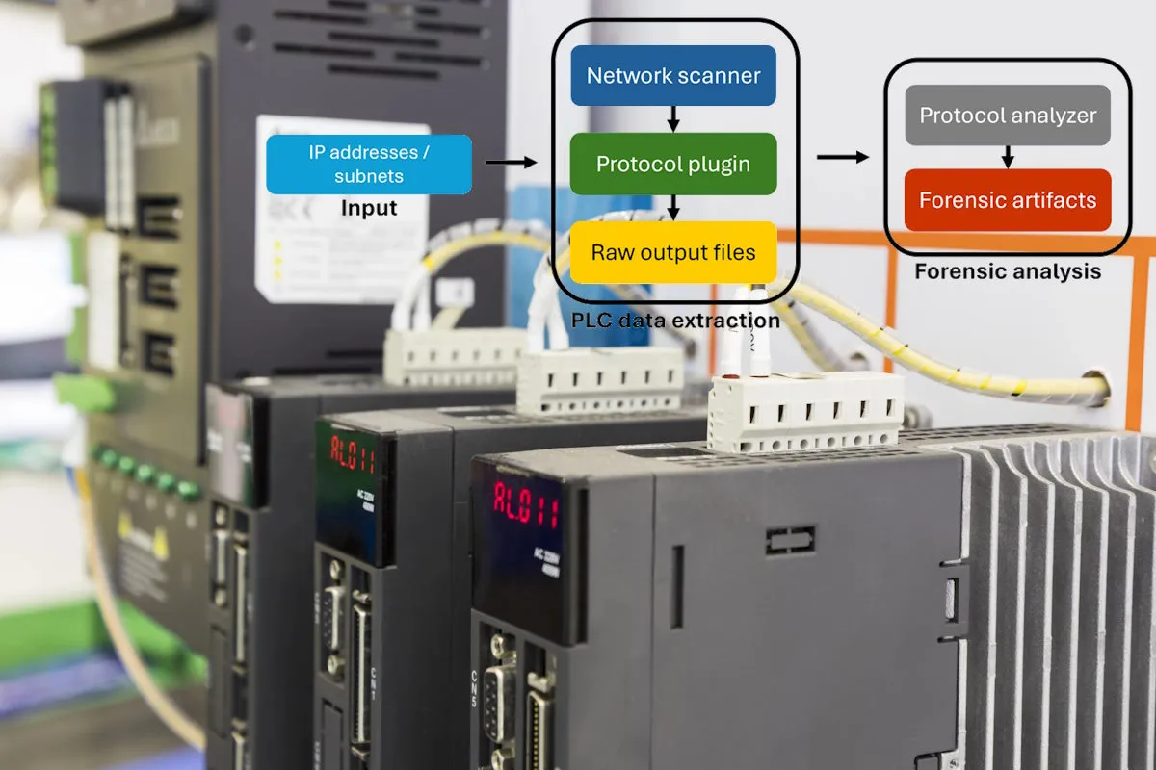
9.6 - OT Devices That can Yield Forensic Evidence
Notes:
Image Source - Microsoft debuts ICSpector framework to enable examining information and configurations of industrial PLCs - Industrial Cyber

Slide 57
Forensic Artifacts – IT Devices
Logs and Security Monitoring Systems
Workstations and Servers
Desktop computer, laptops, servers, VMs
Mobile Devices
Removable Storage Media (USBs, CDs, DVDs)
Network Devices
Routers, Firewalls, Switches, IDS/IPS, SIEM, VPNs
Cloud Services
Email, Web Browsers, & Internet Activity
Notes:
Workstations and Servers
Examples: Windows PCs, macOS computers, Linux servers, Virtual Machines (VMs)
Forensic Artifacts:
File system metadata (NTFS, APFS, ext4)
Memory dumps (RAM analysis for malware or volatile data)
Windows Registry (user activity, software execution, USB usage)
Event logs (Windows Event Viewer, Syslog)
User account history (logins, privilege escalations)
Installed software & execution history (prefetch files, shimcache)
Browser history, cache, cookies, and bookmarks
Deleted file recovery & timestamps
Remote access logs (RDP, SSH, Telnet)
Mobile Devices (Smartphones & Tablets)
Examples: Android, iOS, Windows Mobile
Forensic Artifacts:
Call logs and SMS/MMS messages
Application data (WhatsApp, Telegram, Signal, etc.)
GPS location history
Wi-Fi connections & Bluetooth pairings
Cloud backups (Google Drive, iCloud, OneDrive)
Browser history and autofill data
Installed apps and permissions
Deleted file recovery (SQLite databases, forensic tools)
File system & encrypted data analysis (Jailbroken/Rooted devices)
Networking Devices
Examples: Routers, Firewalls, Switches, IDS/IPS, VPN servers
Forensic Artifacts:
Firewall logs (blocked/unblocked connections)
Intrusion Detection/Prevention logs (Snort, Suricata, Zeek)
Packet captures (PCAPs)
DHCP logs (IP assignments to devices)
DNS logs (malicious domain resolution)
VPN connection logs (IP, session timestamps)
Routing tables & network configurations
Syslog events from connected devices
Storage Devices
Examples: Hard Drives (HDD, SSD), USB Flash Drives, NAS, Cloud Storage
Forensic Artifacts:
File system analysis (FAT32, NTFS, APFS, exFAT)
Deleted file recovery (shadow copies, file carving)
Metadata analysis (timestamps, creation/modification details)
Encrypted drive detection & decryption attempts
Cloud storage logs (Dropbox, Google Drive, OneDrive activity)
Cloud Services & Virtual Environments
Examples: AWS, Microsoft Azure, Google Cloud, Virtual Machines (VMWare, Hyper-V, VirtualBox)
Forensic Artifacts:
Cloud access logs (AWS CloudTrail, Azure Monitor)
Virtual disk analysis (VMDK, VHD, QCOW2)
Cloud storage and database access logs
API logs and misconfigured storage buckets (S3, Blob storage)
Account activity tracking (IAM roles, privilege changes)
Email & Messaging Platforms
Examples: Outlook, Gmail, Exchange, Microsoft Teams, Slack, Discord
Forensic Artifacts:
Sent/received emails and metadata (headers, timestamps)
Email attachments and embedded links
Deleted and archived messages
Spam and phishing detection
IP address of email senders
Chat logs and group message history
File transfers and shared links
Peripheral Devices
Examples: Printers, Scanners, External Drives, Smart Cards, IoT devices
Forensic Artifacts:
Print job logs (spool files, metadata)
Scanned document history
USB device logs (Windows Event Logs, registry analysis)
IoT device logs (smart cameras, home automation systems)
Smart card authentication logs
Web Browsers & Internet Activity
Examples: Chrome, Firefox, Edge, Safari
Forensic Artifacts:
Browsing history & session logs
Cookies & site tracking data
Autofill data (usernames, addresses, credit card information)
Download history
Cache files & offline website storage
Virtual Private Networks (VPNs) & Remote Access Systems
Examples: OpenVPN, Cisco AnyConnect, Palo Alto GlobalProtect, TeamViewer
Forensic Artifacts:
Connection logs (IP address, timestamps)
Remote desktop access logs (RDP, VNC)
Authentication failures and suspicious access attempts
Tunneling logs (split tunneling misuse, data exfiltration attempts)
Logs from Security and Monitoring Systems
Examples: SIEMs (Splunk, QRadar, ArcSight), Endpoint Detection & Response (EDR)
Forensic Artifacts:
Security alerts (malware detection, privilege escalations)
Process execution logs (Powershell, Command Line usage)
Insider threat detection (suspicious file transfers, anomalous logins)
USB device usage
Network traffic analysis (NetFlow, IDS/IPS logs)

Slide 58
Forensic Artifacts - OT/ICS Devices
We can extract forensic data from the following OT devices:
PLCs
RTUs (Remote Terminal Units)
Human Machine Interfaces (HMIs)
SCADA Systems
Industrial Firewalls and IDS
Industrial Switches and Gateways
Intelligent Electronic Devices (IEDs)
Data Historians
Notes:
Industrial Control Systems (ICS) Components
Programmable Logic Controllers (PLCs)
Vendors: Siemens, Allen-Bradley, Schneider Electric, GE, ABB, Omron
Forensic Artifacts:
Ladder logic and function block diagrams (programming logic)
Execution logs and event history
Communication logs (MODBUS, DNP3, OPC-UA, etc.)
Firmware and configuration backups
Memory dumps (volatile/non-volatile)
Remote Terminal Units (RTUs)
Vendors: SEL, Emerson, GE, ABB
Forensic Artifacts:
SCADA polling logs
Configuration and firmware versions
Event logs and time-stamped changes
Network traffic logs (IP, Serial, MODBUS, DNP3)
Distributed Control Systems (DCS)
Vendors: Honeywell, Yokogawa, Siemens, ABB
Forensic Artifacts:
Operator command history
Process control logs
Alarm and event logs
User authentication records
Supervisory Systems
a. Human-Machine Interfaces (HMI)
Vendors: Wonderware, GE iFIX, Rockwell, Inductive Automation (Ignition)
Forensic Artifacts:
Operator actions and logins
Screenshots and session records
Configuration files and event logs
Registry and log entries (Windows-based HMIs)
Network traffic logs (communications with PLCs/SCADA)
SCADA (Supervisory Control and Data Acquisition) Systems
Vendors: AVEVA, Siemens WinCC, Ignition, Honeywell Experion, GE CIMPLICITY
Forensic Artifacts:
Alarm logs and operator actions
Historian data (timestamped sensor values)
Network logs (firewall, IDS/IPS)
Authentication and role-based access logs
Network Infrastructure & Communication Devices
a. Industrial Firewalls & Intrusion Detection Systems (IDS)
Examples: Palo Alto, Cisco Firepower, Dragos, Nozomi, Claroty, Fortinet
Forensic Artifacts:
Packet captures (PCAPs)
Alert logs (intrusion attempts, malicious activities)
Syslog and NetFlow data
Industrial Ethernet Switches & Gateways
Examples: Hirschmann, Moxa, Cisco, Siemens SCALANCE
Forensic Artifacts:
Network traffic logs
MAC address tables
Port mirroring and SPAN session logs
Serial-to-IP Gateways & Converters
Examples: Digi, Moxa, Lantronix
Forensic Artifacts:
Serial communication logs
Device configuration files
Firmware versions
Sensors, Actuators, and Field Devices
Smart Sensors & IoT Devices
Vendors: Emerson, Honeywell, Schneider Electric
Forensic Artifacts:
Sensor data logs
Device configuration snapshots
Wireless communication logs
Intelligent Electronic Devices (IEDs)
Vendors: SEL, ABB, Siemens, GE
Forensic Artifacts:
Power system logs
Protection relay settings and events
Time-synchronized logs (IEEE 1588, GPS-stamped)
Variable Frequency Drives (VFDs)
Vendors: Rockwell, Siemens, Danfoss, Schneider Electric
Forensic Artifacts:
Operational logs and error history
Firmware versions and settings
Power usage logs
Endpoints & Engineering Workstations
Forensic Artifacts:
User activity logs
Installed software & patches
Remote access logs (RDP, SSH)
Malware indicators (IOC-based scans)
File system & registry analysis
Historian Systems & Databases
Examples: OSIsoft PI, GE Proficy, Honeywell PHD
Forensic Artifacts:
Historical process data
Operator input records
Unauthorized access attempts

Slide 59
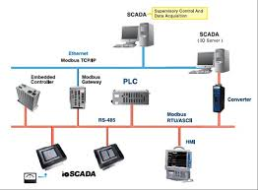
9.7 – Forensic Limitations in ICS
Notes:
Source Image - Computer Forensics: ICS/SCADA Forensics | Infosec

Slide 60
Forensic Recovery Limitations in ICS
Limited Logging & Monitoring Capabilities
Inaccessible & Proprietary File Systems
High Risk of System Disruptions
Limited IR Capabilities
Lack of Encryption and Authentication
Difficulty in Capturing Volatile Data
Compliance and Legal Barriers
Knowledge Gap
Notes:
Conducting forensic investigations in Industrial Control Systems (ICS) and Operational Technology (OT) environments presents unique challenges due to their architecture, operational constraints, and security considerations. Unlike IT systems, which are designed for flexibility and redundancy, ICS/OT systems prioritize availability and reliability, which limits forensic recovery capabilities.
Limited Logging & Monitoring
Challenges:
Many legacy ICS/OT devices (PLCs, RTUs, IEDs) have minimal or no logging capabilities.
Some industrial devices do not retain historical logs beyond a few hours or days.
Logs are often stored in volatile memory, which means they can be lost on power loss or reboot.
Lack of centralized logging—many ICS/OT systems do not integrate with SIEMs or forensic logging tools.
Implications:
Investigators may lack timestamped events needed for attack reconstruction.
Limited forensic traces make root cause analysis (RCA) difficult.
Inaccessible & Proprietary File Systems
Challenges:
Many industrial devices (PLCs, SCADA systems, RTUs) use proprietary firmware and file systems, making forensic analysis complex.
Vendor-locked architectures prevent direct access to raw forensic data.
Lack of open-source forensic tools for reverse engineering proprietary storage formats.
Implications:
Standard forensic tools (Autopsy, FTK, EnCase) may not work on ICS devices.
Requires specialized vendor tools or firmware extractions, which may void warranties.
High Risk of System Disruptions
Challenges:
Many ICS/OT devices operate in real-time control loops (e.g., power grids, manufacturing lines).
Performing forensic analysis on live systems can trigger faults, shutdowns, or safety hazards.
Memory dumps and forensic imaging can overload CPU and RAM on low-resource ICS devices.
Implications:
Investigators must use passive forensic techniques to avoid service disruptions.
Some forensic methods (e.g., disk imaging, volatile memory capture) cannot be performed safely on production systems.
Limited Incident Response & Recovery Capabilities
Challenges:
ICS/OT networks are often air-gapped or have strict firewall rules, limiting forensic data collection remotely.
Backup systems are rarely designed for forensic recovery, focusing instead on system restoration.
Many ICS operators lack forensic readiness plans due to a focus on uptime over security.
Implications:
Delayed forensic response, as investigators must coordinate with engineering teams to collect data.
Recovery efforts may depend on manual logs and human observations rather than automated forensic tools.
Lack of Encryption & Authentication
Challenges:
Many ICS/OT protocols (e.g., MODBUS, DNP3, PROFINET) lack authentication and encryption, making them vulnerable to data tampering.
Logs and network traffic can be altered or erased without forensic traces.
Some ICS logs use plaintext storage, making them easy to manipulate.
Implications:
Attackers can erase traces of cyber intrusions, making forensic recovery unreliable.
Investigators must correlate multiple data sources (network logs, operator logs, device logs) to validate findings.
Difficulty in Capturing Volatile Data
Challenges:
ICS devices such as PLCs, HMIs, and RTUs rely on volatile memory (RAM) for temporary data storage.
When a device reboots, logs and execution history may be lost permanently.
Many ICS devices lack forensic tools for memory dumping, making it difficult to capture live forensic artifacts.
Implications:
Limited forensic evidence after reboots—attackers may clear evidence by restarting systems.
No memory analysis tools—traditional forensic memory analysis (e.g., Volatility, Rekall) do not work on most ICS firmware.
Compliance & Legal Barriers
Challenges:
Some ICS environments operate under strict regulations (NERC CIP, NIST 800-82, IEC 62443), limiting forensic data collection.
Vendor agreements and warranties may prohibit forensic imaging or device tampering.
Cross-jurisdiction issues in global industrial operations complicate forensic evidence collection.
Implications:
Investigators may require legal approvals before extracting forensic data.
Some forensic techniques may not be legally admissible in ICS/OT environments.
Network Segmentation & Air-Gapped Systems
Challenges:
Many ICS networks are isolated (air-gapped) or use legacy serial connections (RS-232, RS-485).
Limited remote access makes forensic investigation time-consuming.
Some environments do not allow external forensic tools due to security policies.
Implications:
On-site investigation is often required, delaying incident response.
Investigators must use custom offline forensic techniques instead of traditional IT network forensics.
Limited Cybersecurity Expertise in ICS Teams
Challenges:
ICS teams prioritize operational reliability over cybersecurity.
Many ICS engineers are not trained in forensic investigation, making evidence collection inconsistent.
Security logging is often disabled to prevent system slowdowns.
Implications:
Poor forensic hygiene results in missing or incomplete evidence.
Investigators must collaborate with control system engineers to interpret forensic data.
Attackers Exploiting ICS-Specific Blind Spots
Challenges:
ICS malware (e.g., Stuxnet, Triton) is designed to avoid detection by traditional forensic tools.
Advanced threats can manipulate ICS logs and hide malicious activity.
Many ICS attacks focus on physical process manipulation, which is harder to trace digitally.
Implications:
Traditional IT forensic methods fail to detect ICS-specific cyberattacks.
Behavior-based anomaly detection (AI, ML) is needed to spot subtle attacks on industrial processes.

Slide 61

9.8 – ICS Forensic Investigation Tools
Notes:
Image Source - New Tool Extracts Hidden Forensics from HMIs/PLCs

Slide 62
ICS Forensic Investigation Tools
Forensic tools used exclusively for ICS and OT data collection, include:
Passive Network Monitoring and Threat Detection
Grassmarlin, Indegy Industrial, Cyberlens
SIEMs
SANS SOF-ELK, Tripwire
Endpoint & Device Forensic Tools
Dragos Platform, Seltools Suite, FTViewer, OSIsoft
Historian & Time-Series Data Analysis
Notes:
SIEM & Log Correlation Tools (Security Information and Event Management)
These tools focus on collecting, correlating, and analyzing logs for forensic investigations. Industries: Cross-industry (Energy, Manufacturing, Critical Infrastructure, Water, Oil & Gas)
SANS SOF-ELK – Open-source SIEM optimized for ICS log collection and correlation.
Tripwire Industrial Visibility – Monitors PLC, RTU, and HMI configuration changes.
OSIsoft PI System – Historian tool for process industry forensic analysis.
Passive Network Monitoring & Threat Detection Tools
These tools collect forensic data without disrupting operations by analyzing network traffic. Industries: Power, Oil & Gas, Water, Manufacturing, Transportation
Dragos Platform – Detects ICS-specific threats and collects forensic data.
Nozomi Networks Guardian – Monitors ICS traffic for anomalies and forensic evidence.
Claroty CTD (Continuous Threat Detection) – Passive network monitoring for OT.
GRASSMARLIN (NSA) – Passive asset discovery and network forensic mapping.
Indegy Industrial Cybersecurity – Captures PLC/HMI changes and forensic activity.
Cyberlens (Kaspersky) – Passive forensic monitoring of industrial control networks.
Endpoint & Device Forensic Tools
These tools collect forensic data from PLCs, RTUs, HMIs, and IEDs. Industries: Energy, Utilities, Manufacturing, SCADA/Automation
Dragos Platform – Collects forensic data from endpoints in OT networks.
Seltools Suite (SEL) – Collects relay event logs, fault data, and forensic timestamps in power grids.
FTViewer (Siemens) – Analyzes Siemens S7 PLCs for configuration changes.
Claroty CTD – Captures PLC, RTU, and ICS device activity for forensic analysis.
OSIsoft PI System – Analyzes time-series data from industrial control devices.
Network Packet Capture & Protocol Decoding
These tools capture and decode ICS-specific network protocols (MODBUS, DNP3, PROFINET, S7comm). Industries: Manufacturing, Energy, Water, Oil & Gas
Nozomi Networks Guardian – Analyzes ICS network traffic for forensic data.
Claroty CTD – Provides deep packet inspection (DPI) for ICS/OT networks.
RedSeal for ICS – Maps network traffic and forensic changes.
Wireshark (with ICS Protocol Support) – Captures and analyzes MODBUS, S7comm, DNP3, etc.
ICS Configuration & Change Monitoring
These tools track configuration changes, firmware updates, and unauthorized modifications in ICS/OT devices. Industries: Manufacturing, Oil & Gas, Utilities, Power
Tripwire Industrial Visibility – Monitors changes in PLC, RTU, and ICS device configurations.
Claroty CTD – Detects firmware updates and unauthorized changes in industrial devices.
Indegy Industrial Cybersecurity – Captures changes in industrial control systems.
Historian & Time-Series Data Analysis
These tools collect historical process data for forensic investigations in industrial environments. Industries: Oil & Gas, Manufacturing, Chemicals, Power
OSIsoft PI System – Analyzes historical process anomalies and operator actions.
CIMPLICITY Logs & Forensic Tools (GE) – Collects SCADA system logs and operator actions.
ICS Network Mapping & Asset Discovery
These tools provide passive discovery of ICS assets and forensic topology mapping. Industries: Critical Infrastructure, Oil & Gas, Manufacturing, Energy
GRASSMARLIN (NSA) – Passively maps ICS/OT networks for forensic analysis.
RedSeal for ICS – Provides forensic visibility into network traffic paths.

Slide 63
Summary Table – Categorized
Category | Tools
SIEM & Log Correlation | SANS SOF-ELK, Tripwire Industrial Visibility, OSIsoft PI System
Passive Network Monitoring & Threat Detection | Dragos, Nozomi Networks Guardian, Claroty CTD, GRASSMARLIN, Indegy, Cyberlens
Endpoint & Device Forensics | Dragos, SEL Seltools, FTViewer (Siemens), Claroty CTD, OSIsoft PI System
Packet Capture & Protocol Decoding | Nozomi Networks, Claroty CTD, RedSeal, Wireshark
ICS Configuration & Change Monitoring | Tripwire, Claroty CTD, Indegy
Historian & Process Data Analysis | OSIsoft PI System, CIMPLICITY Logs
Network Mapping & Asset Discovery | GRASSMARLIN, RedSeal
Notes:
Forensic tool selection depends on the industry, risk environment, and investigation needs. 🔹 Passive monitoring tools (Nozomi, Claroty, Dragos) are preferred for live ICS environments. 🔹 Packet capture tools (Wireshark, RedSeal) are useful for network-based forensic investigations. 🔹 Historian tools (OSIsoft PI) help in forensic process anomaly detection.
Remember, you can also extract data from devices like PLCs, RTUs, and various other devices using traditional methods (imaging for offline analysis), memory dumps (for live analysis) and accessing debug ports, like SPI, UART, and JTAG. Many techniques that work for Enterprise forensics will work on OT/ICS Devices; you should remember the limitations and challenges associated with forensic collection in ICS and OT systems/devices.

Slide 64
9.9 – Practical Exercise
You will be provided with an image of a Programmable Logic Controller. It is your job to analyze the image, recover forensic data from the image, and document your activities along the way.
You should assume the information you find can, and may, be used in a court of law.
Notes:
The instructions for this lab are included in the instructor’s folder, along with an image of a PLC and a copy of the solutions manual.
Supplementary Assignment: Require the students boot the PLC image in the ICS/OT range and conduct a live network forensics examination.

