Slide 1
CyberSkills2Work The National Cybersecurity Workforce Development Program

Slide 2
Industrial Control Systems Security
Acknowledgement
This program is funded by the National Security Agency National Centers of Academic Excellence in Cybersecurity (NCAE-C) Program.
For additional information, please visit www.CyberSkills2Work.org.
Course Title
CRN
©2024 CyberSkills2Work - Institution Name

Slide 3
Module 02 – ICS Components
Overview
Learn about the different components found in ICS.
Learn how OT devices interact with traditional IT services and components.
Quick primer on digital logic.
Learn how to program a Programmable Logic Controller (PLC) using Ladder Logic.
Complete Lab 02
Complete CISA ICS Certs
Course Title
CRN
©2021 CyberSkills2Work - Institution Name

Slide 4
Module 02 – ICS Components
ICS Components Slide Deck Order
Programmable Logic Controllers (PLCs)
Sensors & Actuators
Remote Terminal Units (RTUs)
Human Machine Interfaces (HMI)
Engineering Workstations
Data Historians
Intelligent Electronic Devices & Industrial Internet of Things
Digital Logic
Ladder Logic Programming
.
Course Title
CRN
©2021 CyberSkills2Work - Institution Name

Slide 5
Module 02 – ICS Components
Programmable Logic Controllers (PLCs)
Microprocessor-based controller for automation processes.
Interfaces with sensors and actuators via I/O modules.
Executes programmed logic continuously (scan cycle)
Supports industry-standard languages (Ladder Logic, FBD, Structured Text, Sequential Function Chart (SFC), and Instruction List)
Typically operates in harsh industrial environments
Course Title
CRN
©2021 CyberSkills2Work - Institution Name
Notes:
Instructor Notes:
PLCs are foundational elements in ICS environments, acting as the bridge between the digital and physical realms. Modern PLCs use real-time operating systems and perform deterministic logic cycles—reading inputs, executing logic, and outputting commands in milliseconds. Their rugged design allows them to operate for decades in remote or harsh industrial conditions.

Slide 6
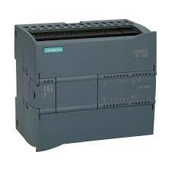
Module 02 – ICS Components
PLC Image
Course Title
CRN
©2021 CyberSkills2Work - Institution Name
Notes:
The image shows is a Siemens S7-1200 PLC.

Slide 7
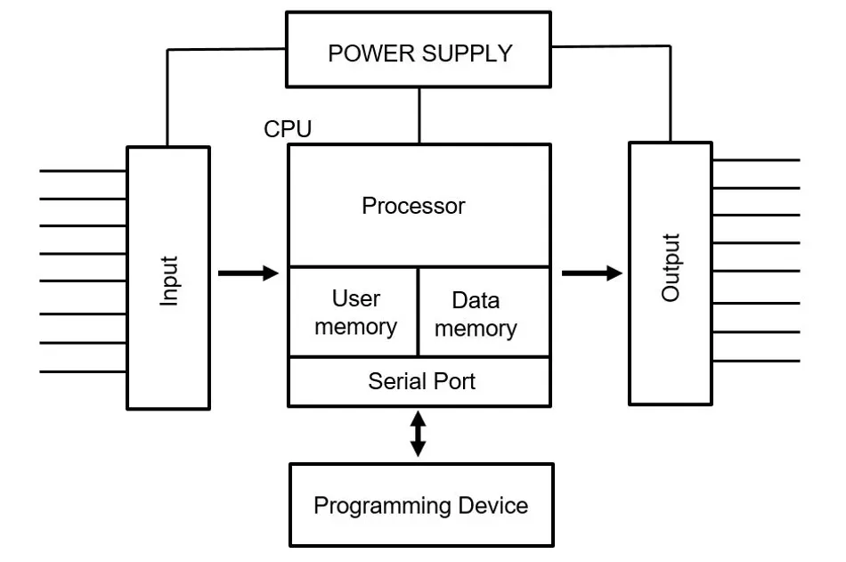
Module 02 – ICS Components
PLC Component Diagram
Course Title
CRN
©2021 CyberSkills2Work - Institution Name
Notes:
Power Supply: Provides the necessary electrical power for the PLC to operate.
CPU: The central processing unit, responsible for executing the programmed logic and controlling the PLC's operations.
Memory Stores the PLC's program and data, typically including RAM and ROM.
Input Modules: Allow the PLC to communicate with external devices, receiving input signals from sensors, switches, and other devices, and sending output signals to motors, lights, and other actuators. PLCs also utilize an optical layer component, which is a technique used to electrically separate circuits using light to transmit signals.
Definition of an Opto-Isolator: Opto-isolators, also called optocouplers or photocouplers, are optoelectronic components which can be used to transmit analog or digital electrical signals between two electrical circuits while providing electrical isolation. Source - https://www.rp-photonics.com/opto_isolators.html
Serial Port - A serial port on a Programmable Logic Controller (PLC) is primarily used for data communication with other devices, such as computers, HMIs (Human-Machine Interfaces), or other PLCs. It enables the transfer of data serially, one bit at a time, over a single wire, using protocols like RS-232 or RS-485.
Programming Device: Used to program the PLC and monitor its operation, often a computer with specialized software. Typically this would involve an Engineering Workstation.

Slide 8
Module 02 – ICS Components
PLC Programming Languages
Ladder Diagram. (LD)
Function Block Diagram. (FBD)
Structured Text. (ST)
Instruction List. (IL)
Sequential Function Chart (SCF)
Course Title
CRN
©2021 CyberSkills2Work - Institution Name
Notes:
Detailed Explanation:
Ladder Diagram (LD): Also known as ladder logic, LD is a graphical language that visually represents a relay control system. It uses rungs (vertical lines) and elements (e.g., normally open/closed contacts, coils) to represent logic and control sequences. LD is widely used due to its simplicity and ease of understanding for those with electrical or mechanical backgrounds.
Function Block Diagram (FBD): is another graphical language that uses blocks (functions, function calls) to represent control logic. It's suitable for more complex control algorithms and modular programming, where functions can be reused across different parts of the program.
Sequential Function Chart (SFC): is a graphical language specifically designed for programming sequential and parallel processes. It uses a visual representation of steps and transitions to control the sequence of operations in a system.
Structured Text (ST): is a text-based language that resembles programming languages like Pascal or C. It's suitable for complex logic, mathematical calculations, and data manipulation.
Instruction List (IL): is a text-based language that provides a more direct mapping to the PLC's internal instructions. It's often used for low-level programming and when precise control over the PLC's operation is needed.

Slide 9
Module 02 – ICS Components
Sensors and Actuators
Sensors detect physical conditions (e.g., temperature, pressure, flow)
Actuators perform physical actions (e.g., open valves, start motors)
Interface with PLCs and RTUs via digital or analog I/O modules
Critical for real-time feedback and control in field operations
Enable closed-loop control by transmitting measurements and receiving commands
Field-hardened to operate in harsh industrial environments
Course Title
CRN
©2021 CyberSkills2Work - Institution Name
Notes:
Instructor Notes:
Sensors and actuators form the foundation of real-world interaction in ICS.
Sensors serve as the system’s “eyes and ears,” monitoring key process variables like temperature, fluid levels, vibration, and pressure. Common types include thermocouples, RTDs, pressure transducers, and flow meters.
These sensors transmit signals—often in 4–20 mA current loops or digital form—to PLCs or RTUs, which interpret the data and make control decisions.
Actuators, on the other hand, are the system’s “hands.” Based on commands from a PLC or RTU, they carry out actions such as turning motors on or off, adjusting a valve position, or activating alarms. Examples include solenoids, motor starters, relays, and pneumatic valves.
The PLC (Programmable Logic Controller) acts as a local decision-maker. It constantly scans input from sensors, applies programmed logic, and updates outputs to actuators. This forms a closed-loop control system.
In remote sites, where a full PLC is not feasible or power is limited, RTUs (Remote Terminal Units) collect data from sensors and may send actuator commands via telemetry. These are commonly found in pipelines, electrical substations, and water towers.
Environmental considerations are critical. These devices must often withstand vibration, electromagnetic interference, humidity, dust, and extreme temperatures. They’re typically installed in protective enclosures rated NEMA or IP.

Slide 10
Module 02 – ICS Components
Remote Terminal Units
Used in remote or wide-area deployments
Interfaces with field devices and sensors
Communicates with control centers via WAN technologies (e.g., satellite, cellular)
Can operate autonomously or via polling from control centers
Incorporates analog/digital I/O and sometimes control logic
Course Title
CRN
©2021 CyberSkills2Work - Institution Name
Notes:
Instructor Notes: RTUs are often found in geographically distributed systems like power grids or water treatment networks. They gather telemetry data and forward it to a supervisory controller. Unlike PLCs, RTUs are optimized for long-distance communication and resilience against environmental extremes. They may independently take action during communication outages.
Key Differences:
Purpose and Location:
PLCs are primarily used for local control and automation within a plant or factory, whereas RTUs are designed for remote monitoring and control in field locations.
Environment:
RTUs are often deployed in harsh, remote, and outdoor environments, while PLCs typically operate in controlled factory settings.
Programming:
PLCs are generally programmed using specialized programming languages like Ladder Logic, while RTUs are often configured via a web interface.
I/O Capabilities:
RTUs are designed to handle a wide range of inputs and outputs and often have more local processing power to work with collected data before sending alerts. PLCs can be smaller and more modular, with a variety of I/O modules available.
Scalability:
PLCs are often more scalable and customizable due to their modular design, allowing for easy expansion of I/O. RTUs are more specialized for specific applications and may have fewer I/O options.
Communication:
PLCs often communicate with other devices and systems using local networks like Ethernet, while RTUs are more likely to use remote communication protocols like DNP3, Modbus, or SNMP.

Slide 11
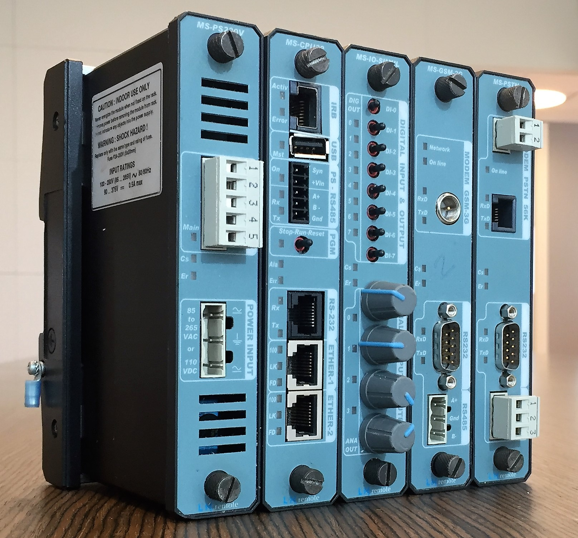
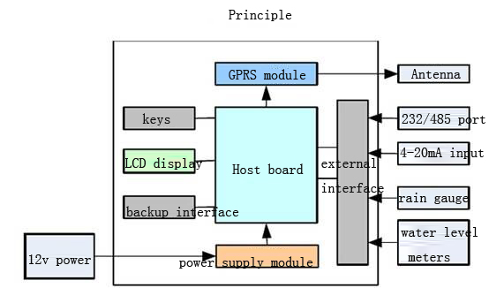
Remote Terminal Unit Components
Course Title
CRN
©2021 CyberSkills2Work - Institution Name
Notes:
An RTU monitors the field digital and analog parameters and transmits data to a SCADA Master Station. It runs setup software to connect data input streams to data output streams, define communication protocols, and troubleshoot installation problems in the field.
An RTU may consist of one complex circuit card consisting of various sections needed to do a custom-fitted function or may consist of many circuit cards including a CPU or processing with communications interface(s), and one or more of the following: (AI) analog input, (DI) digital (status) input, (DO/CO) digital (or control relay) output, or (AO) analog output card(s).
An RTU might even be a small process control unit with a small database for PID, Alarming, Filtering, Trending and other functions complemented with some BASIC (programming language) tasks. Modern RTUs typically support the IEC 61131-3 programming standard for programmable logic controllers. Since RTUs may be routinely deployed in pipeline and grid guarding systems, or in other hard-to-reach or extreme environments (for example in the Biosphere 2 project), they are required to operate under harsh conditions, and implement energy-saving measures (such as switching off IO modules when not in use). For example, it communicates via RS485 or wireless communication links in a multi-drop configuration. In this type of configuration it is a remote unit that collects data and performs simple control tasks. It does not have moving parts and uses extremely low power and is often solar powered.
Definition by Wikipedia. (which is good enough in this context).

Slide 12
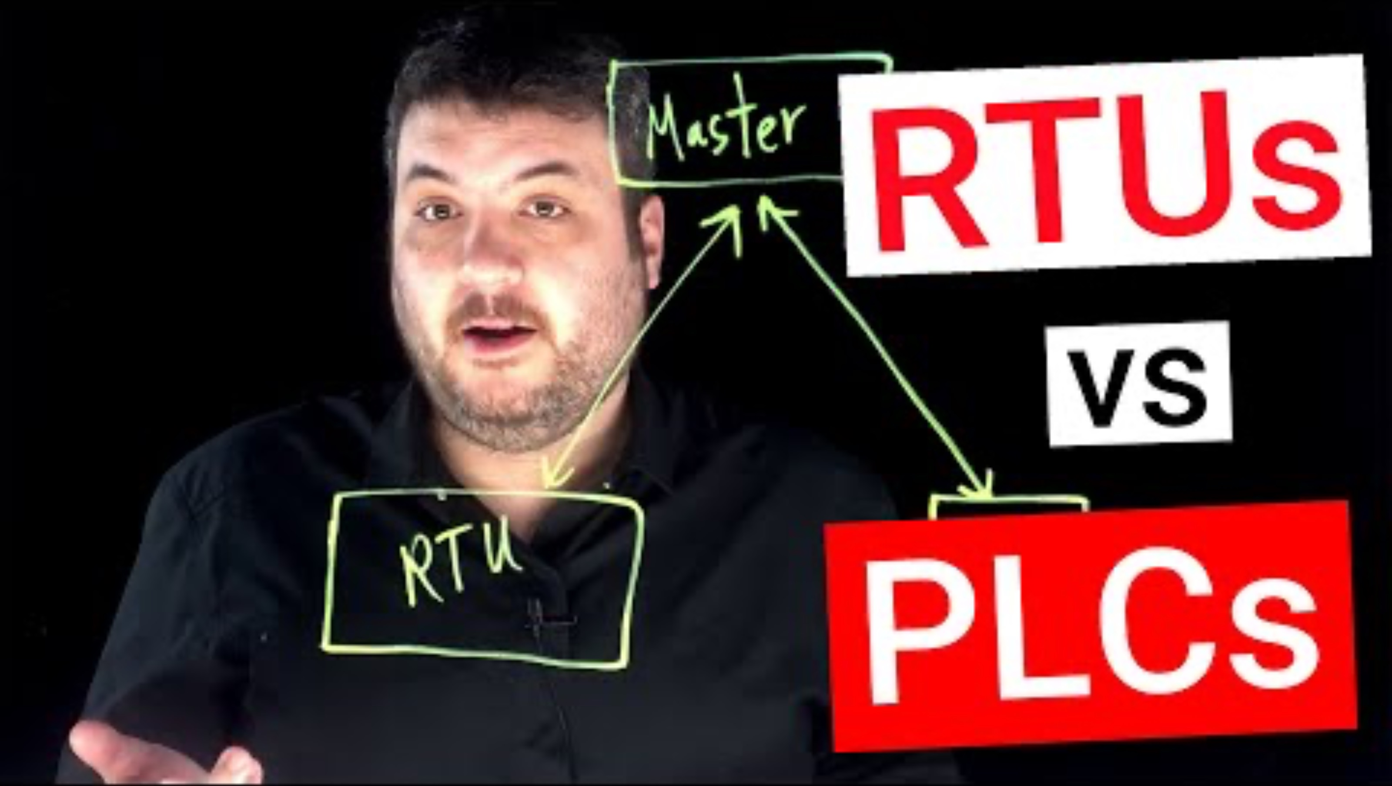
YouTube Video Describing Differences Between RTUs and PLCs
Course Title
CRN
©2021 CyberSkills2Work - Institution Name
Notes:
Self Explanatory.

Slide 13
Module 02 – ICS Components
Human Machine Interfaces
Provides visualization of the industrial process to operators
Displays alarms, trends, process variables, and controls
Allows manual control via touchscreen, mouse, or keyboard
Connects to PLCs and RTUs using industrial protocols (e.g., Modbus)
Course Title
CRN
©2021 CyberSkills2Work - Institution Name
Notes:
Instructor Notes: The HMI is the main interface through which operators interact with the control system. It translates real-time process data into visual dashboards and alerts. It can also issue commands to change operational states (e.g., adjusting setpoints or stopping pumps). Security of the HMI is vital, as it can serve as an attack vector if compromised.

Slide 14
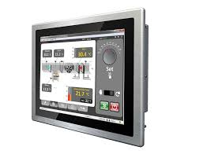
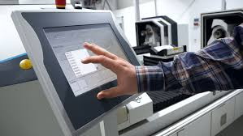
HMIs
Course Title
CRN
©2021 CyberSkills2Work - Institution Name
Notes:
Examples of HMIs.

Slide 15

Using Shodan to Find HMIs on the Public Internet
https://www.shodan.io/explore/category/industrial-control-systems
Course Title
CRN
©2021 CyberSkills2Work - Institution Name
Notes:
Instructor:
Access the website and show students how to search for HMIs that are on the public web. Be careful not to examine any Honeypots though. ☺
HMIs connected to the public internet is a serious cybersecurity vulnerability!!

Slide 16
Module 02 – ICS Components
Engineering Workstations
Hosts ICS programming software and project files
Used for logic programming, firmware updates, and configuration
Runs standard OS (e.g., Windows, Linux)
Essential for deployment and maintenance of ICS controllers
Course Title
CRN
©2021 CyberSkills2Work - Institution Name
Notes:
Engineering Workstations
serve as the development and deployment hub in an ICS. From here, engineers can push logic changes, troubleshoot controllers, or update firmware. Given its critical role, access should be restricted and monitored carefully, as compromise could allow adversaries to alter process control logic.
Function:
EWS are used for tasks like programming and debugging PLCs, configuring Human-Machine Interfaces (HMIs), and managing Supervisory Control and Data Acquisition (SCADA) systems.
Software:
They typically run specialized engineering software provided by equipment manufacturers, such as TIA Portal (Siemens) or GX Works (Mitsubishi).
Security Risk:
EWS are a significant cybersecurity vulnerability because they are often connected to the network, making them a potential entry point for attackers. In fact, they are often connected to the public internet.
Purdue Model:
EWS are typically positioned at the supervisory level (Levels 2 and 3) of the Purdue Model, which organizes ICS into different levels based on their function and security.
In essence, Engineering Workstations are the central tools for engineers to manage and interact with the various components of an ICS, but their vulnerability to cyberattacks necessitates robust security measures

Slide 17
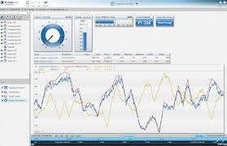
Module 02 – ICS Components
Data Historian Software
Course Title
CRN
©2021 CyberSkills2Work - Institution Name
Notes:
Examples of Data Historian Software:
AVEVA Historian: A widely used historian that supports various industrial applications.
Proficy Historian: A historian developed by GE Vernova, offering both on-premise and cloud-based solutions.
FactoryTalk Historian: Offered by Rockwell Automation, it focuses on capturing and managing data across an entire plant.
Dewesoft Historian: Provides data storage and monitoring capabilities for long-term measurement applications.
Open Automation Software Data Historian: Offers flexible data logging options and supports various databases.
TDengine: A next-generation data historian with connectors for various industrial systems.
InfluxData: Provides a database platform and solutions for time-series data.
Canary Labs Historian: A NoSQL time series database that focuses on loss-less compression

Slide 18
Module 02 – ICS Components
Intelligent Electronic Devices
Embedded microprocessor-based devices with communication capabilities
Perform protection, control, monitoring, and diagnostics
Common in power systems (e.g., protective relays, circuit breakers)
Communicate via protocols like IEC 61850, DNP3, or Modbus
Interface with SCADA systems, RTUs, and sometimes directly with HMIs
Course Title
CRN
©2021 CyberSkills2Work - Institution Name
Notes:
Instructor Notes:
Intelligent Electronic Devices (IEDs) are essential components in modern electrical and industrial systems. Unlike traditional field devices that only sense or act, IEDs integrate sensing, processing, and communication into one package.
Found primarily in substations and critical energy infrastructure, IEDs include digital protective relays, motor protection devices, reclosers, and smart switches.
An IED may detect a fault (e.g., overcurrent), isolate the problem by tripping a breaker, log the event, and communicate status and diagnostics to SCADA or a DCS in real time.
These devices support high-speed deterministic protocols and often implement peer-to-peer messaging for coordination between devices.
Their ability to act autonomously reduces response time during abnormal conditions—key for safety and grid stability.
IEDs are often configured via engineering workstations and support remote firmware updates, data logging, and configuration downloads.
Security is a concern due to their critical role; many IEDs now include encryption, authentication, and logging features to support secure operation.
Students should understand IEDs not just as smart sensors/actuators, but as autonomous agents in distributed control with built-in intelligence and communication capabilities.

Slide 19
Module 02 – ICS Components
Industrial Internet of Things
Network-enabled sensors, actuators, and embedded controllers
Enable real-time data collection, analytics, and remote access
Use standard IP-based protocols (e.g., MQTT, OPC UA, HTTP)
Facilitate predictive maintenance and process optimization
Often cloud-integrated and scalable for large deployments
Course Title
CRN
©2021 CyberSkills2Work - Institution Name
Notes:
Instructor Notes:
IIoT (Industrial Internet of Things) devices represent the convergence of traditional control systems and modern IT technologies. These are smart field devices equipped with embedded processors, network stacks, and sometimes edge-computing capability.
IIoT devices are used for monitoring machine health, energy usage, environmental conditions, and more. Examples include wireless vibration sensors, Wi-Fi enabled temperature probes, and AI-enabled edge cameras.
What sets IIoT apart is the standardization and openness of communication protocols. Devices use MQTT, CoAP, REST APIs, or OPC UA—making integration with cloud platforms, dashboards, and AI analytics engines much easier.
This connectivity enables advanced applications such as predictive maintenance, real-time asset tracking, and remote diagnostics.
IIoT allows data to be aggregated, filtered, and analyzed at the edge or pushed to the cloud for long-term insights.
However, the increased surface area introduces significant cybersecurity concerns, including supply chain risks, unsecured wireless links, and default credentials.
Unlike traditional ICS devices, IIoT components are often designed with mass scalability in mind, making them ideal for Industry 4.0 architectures.
For students, it's important to distinguish IIoT from legacy field devices—these are not just sensors with an IP address, but a shift toward data-driven, decentralized control in modern industrial systems.

Slide 20
Module 02 – ICS Components
Communication Gateways
Gateways connect incompatible ICS protocols and networks
Enable communication between:
Serial ↔ Ethernet
Legacy ↔ Modern systems
Proprietary ↔ Open protocols
Common examples:
Modbus RTU ↔ Modbus TCP
Profibus ↔ Profinet
OPC DA ↔ OPC UA
Can include protocol translation, address mapping, data buffering
Often used in Level 2–3.5 of the Purdue Model
Course Title
CRN
©2021 CyberSkills2Work - Institution Name
Notes:
Instructor Notes:
Communication gateways are critical components in ICS environments, enabling interoperability across disparate devices and networks. As many industrial systems include a mix of legacy and modern equipment, gateways allow these systems to exchange data by translating protocols, converting serial to Ethernet, and performing data model mapping.
For example, a gateway might translate Modbus RTU data from a legacy serial device into Modbus TCP to be read by an HMI or SCADA server. Other examples include converting Profibus (a fieldbus protocol) to Profinet (an Ethernet-based protocol), or acting as a bridge from OPC DA to OPC UA, enabling secure and modern communication.
However, gateways also introduce security concerns. They can become a point of attack if misconfigured or exposed to untrusted networks. Since they often handle raw protocol traffic, attackers can exploit vulnerabilities in gateway logic or use them to pivot between network layers.
Proper configuration, access control, logging, and segmentation are essential when deploying gateways in ICS architectures.
From the textbook: An example of this transformation is the translation from Modbus messages on a serial link (Recommended Standard-232 [RS-232]/RS-485) to OPC messages on Ethernet.

Slide 21
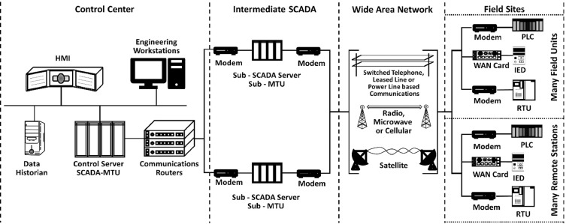
Tying All the Components Together
Course Title
CRN
©2021 CyberSkills2Work - Institution Name
Notes:
This image is a high-level architecture diagram of a SCADA (Supervisory Control and Data Acquisition) system, depicting its components and communication flow from control centers to field sites via an intermediate SCADA layer and wide-area communication networks.
Breakdown of Key Components:
1. Control Center (Left Side)
HMI (Human-Machine Interface): Displays system data and allows operators to interact with processes.
Engineering Workstations: Used for configuring devices, writing control logic, and performing diagnostics.
Control Server (SCADA-MTU): The Master Terminal Unit that supervises and controls field devices.
Data Historian: Collects and stores long-term time-series data from the system.
Communications Routers: Manage data flow to and from the control center, ensuring connectivity to remote sites.
2. Intermediate SCADA (Center-Left)
Sub-SCADA Server / Sub-MTU: Acts as a relay or local controller that can preprocess or buffer data before sending it to the main control center. Useful in large-scale or distributed networks.
Modems: Facilitate communication across wide-area networks (WANs).
3. Wide Area Network (Center)
Communication Technologies: Includes:
Switched Telephone, Leased Line, or Power Line
Radio, Microwave, or Cellular
Satellite Links
These enable data transfer over long distances between the control center and field sites.
4. Field Sites (Right Side)
Modems and WAN Cards: Interface devices for communication over WANs.
PLC (Programmable Logic Controller): Handles real-time local control at the site.
RTU (Remote Terminal Unit): Gathers data from sensors and may also control actuators.
IED (Intelligent Electronic Device): Often used in power systems for functions like protection and measurement.
Remember, there are 16 total critical infrastructure sectors, with 4 support sectors that all of the other rely on. These are: Water, Energy, Transportation, and Communications.
There are 4 types of sites: Site, Generation, Transmission, and Distribution.

Slide 22
Module 02 – ICS Components
Digital Logic
PLCs use logic gates to make decisions
Logic gates are basic building blocks of digital circuits
Evaluate input signals as binary (0 or 1) to produce outputs
Critical for safety interlocks and control sequences
Course Title
CRN
©2021 CyberSkills2Work - Institution Name
Notes:
Instructor Notes: Understanding digital logic is essential to programming and troubleshooting ICS control systems. PLCs often use ladder logic or Boolean expressions based on logic gates. For example, a pump might only turn on if both a tank is empty AND the valve is open. We'll explore common gates next.

Slide 23
Module 02 – ICS Components
Digital Logic Continued
AND Gate: Output = 1 only if all inputs = 1
OR Gate: Output = 1 if at least one input = 1
NOT Gate: Inverts the input (1 becomes 0, 0 becomes 1)
Used in ladder logic for basic decision-making
Course Title
CRN
©2021 CyberSkills2Work - Institution Name
Notes:
Instructor Notes: These three gates are the simplest forms of logic. The AND gate is used where multiple conditions must be met. OR allows action if any of the inputs are active. NOT is a simple inversion, often used to detect absence of a signal. These are implemented in PLCs through symbolic logic or graphical programming.

Slide 24
Module 02 – ICS Components
Digital Logic Continued …
NAND: NOT of AND; output = 0 only if all inputs = 1
NOR: NOT of OR; output = 1 only if all inputs = 0
XOR: Output = 1 if inputs differ
XNOR: Output = 1 if inputs are the same
Course Title
CRN
©2021 CyberSkills2Work - Institution Name
Notes:
Instructor Notes: These gates are often used in more complex logic or interlock systems. For instance, XOR gates are used in error detection mechanisms. NAND and NOR are universal gates—any logical function can be built using just one of them. In ICS, such gates are embedded in safety systems and interlocks.

Slide 25
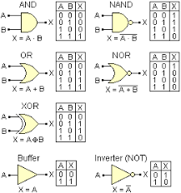
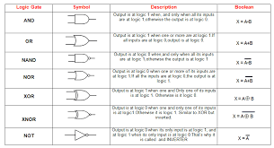
Module 02 – ICS Components
Digital Logic Table Overview
Course Title
CRN
©2021 CyberSkills2Work - Institution Name
Notes:
Instructor Notes: Describe the value and symbols in the two images in the slide.

Slide 26
Module 02 – ICS Components
Programming a PLC
Access Labtainer or download OpenPLC software
Use Ladder Logic to write a simple blinking light program.
Course Title
CRN
©2021 CyberSkills2Work - Institution Name
Notes:
Instructor Notes:
Use the OpenPLC software to show students an example of how to create a LL/LD program to create a blinking light. OpenPLC has a few pre-built programs, including the blinking light scenario. You can modify/improve this to show how a timing function can be added via FBD.

Slide 27
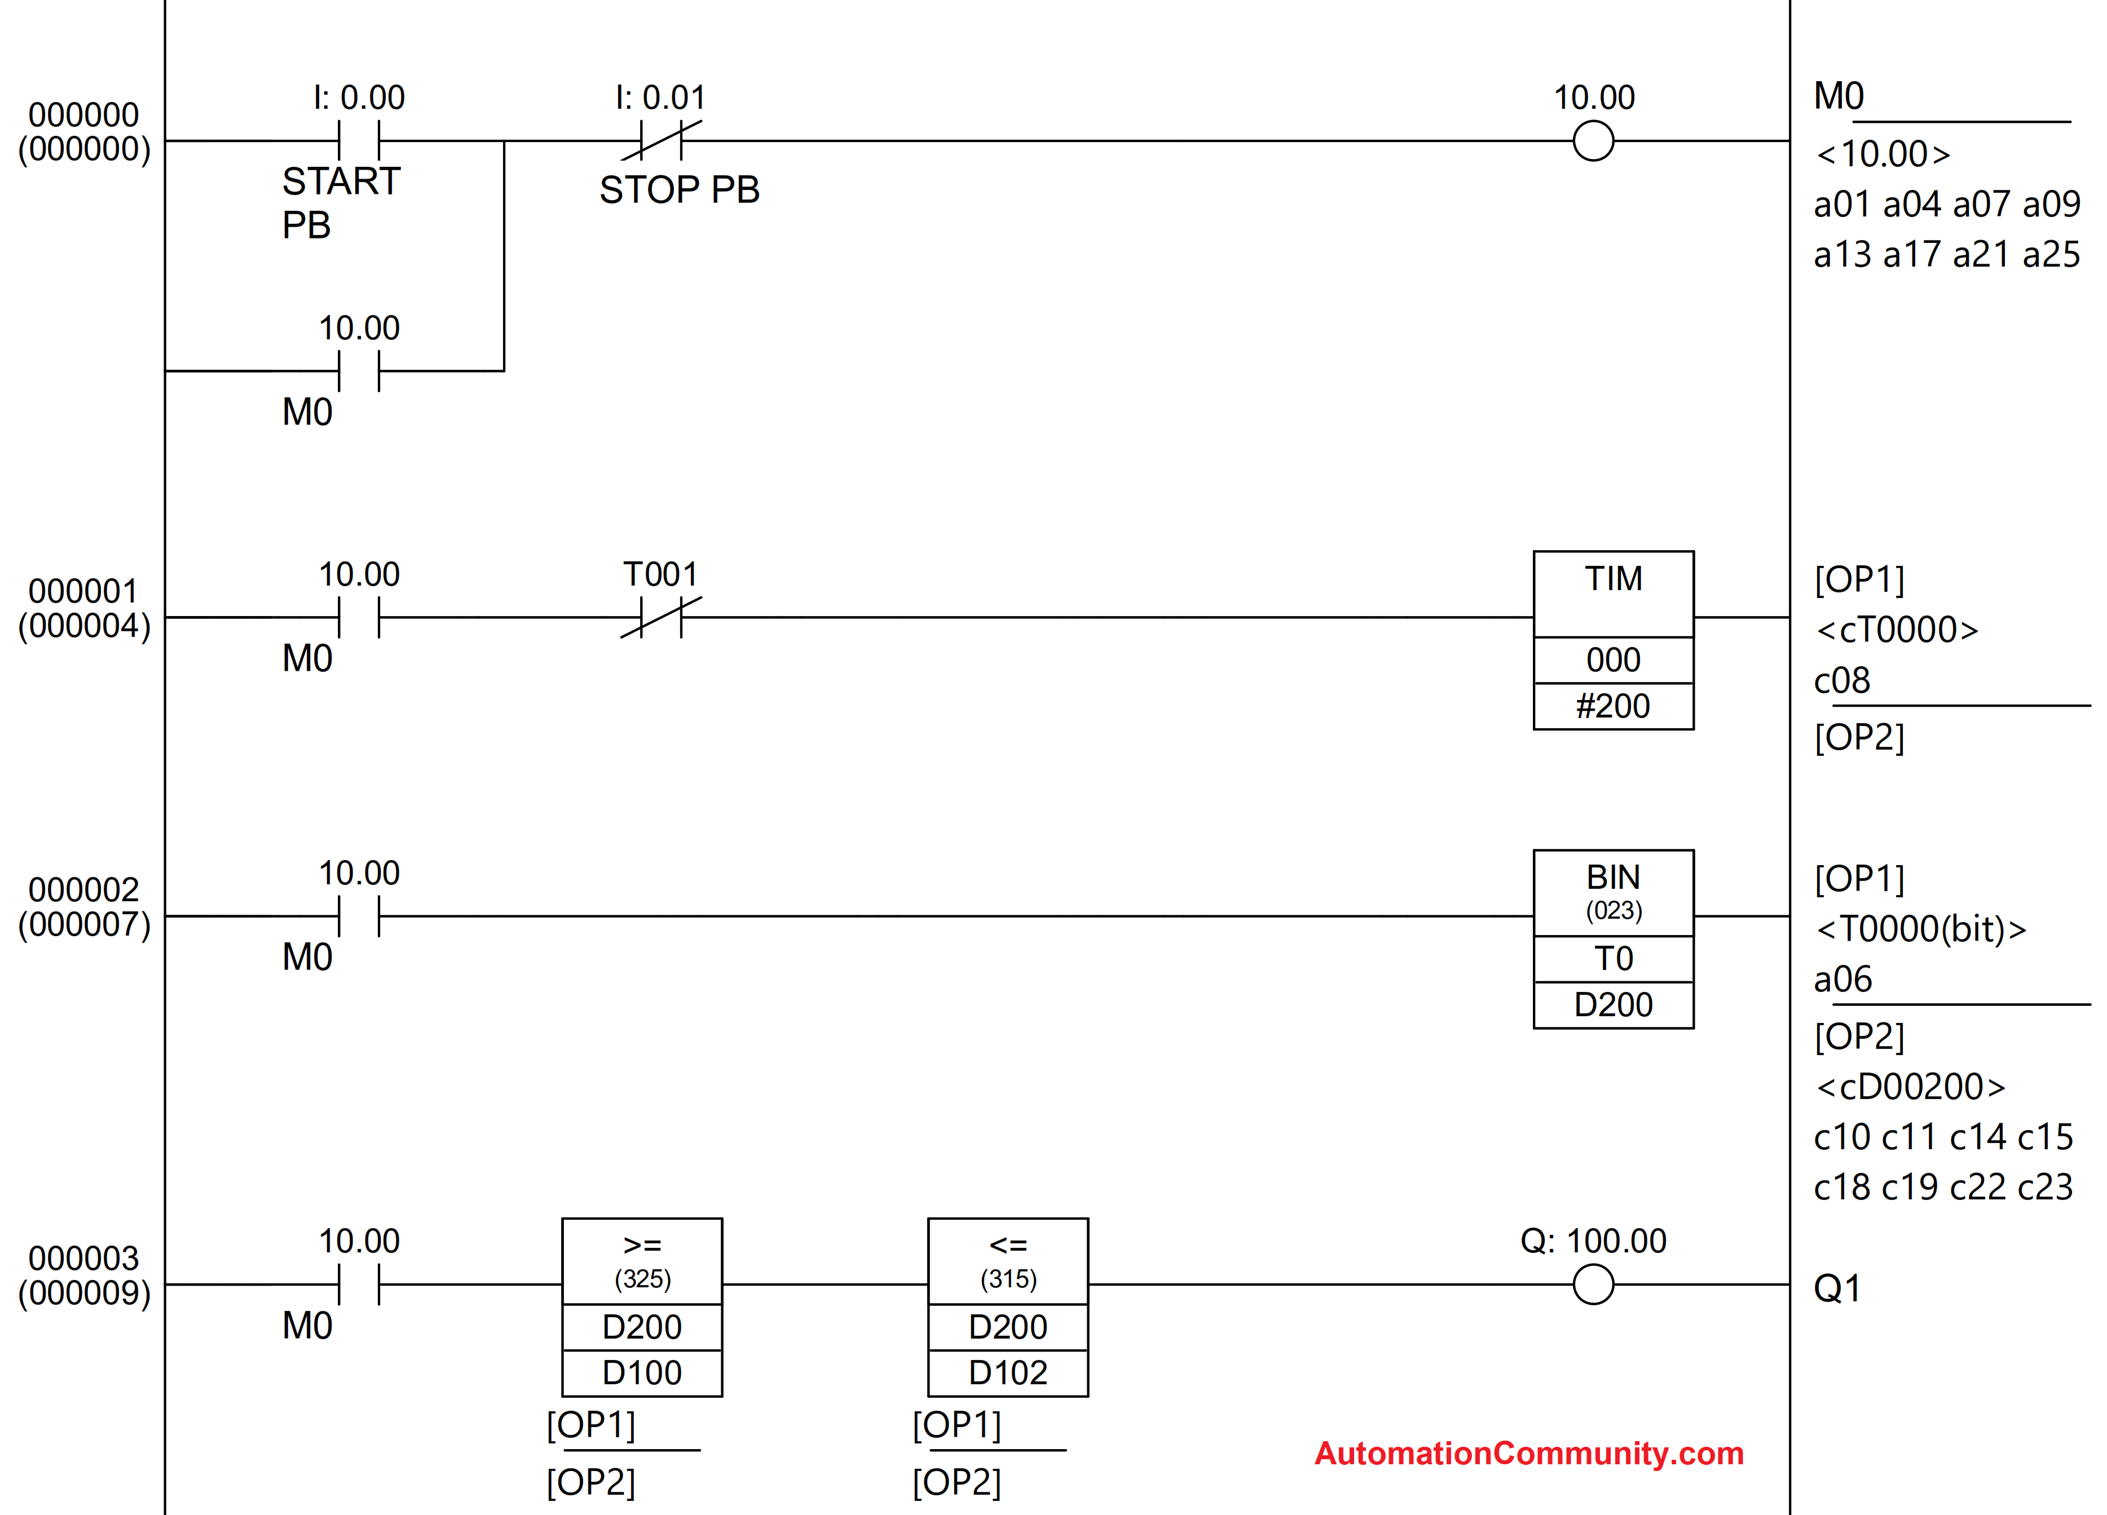
Example Ladder Logic Program
Course Title
CRN
©2021 CyberSkills2Work - Institution Name
Notes:
This is an example of a ladder logic program, using rungs, rails, coils, and contacts. The diagram also includes some function blocks on rungs 2, 3, and 4. It’s called Ladder Logic because it looks like a ladder, where each rung is a line representing the flow of electrical current and how it can be impacted via logical structures, like open or closed contacts and coils.

Slide 28
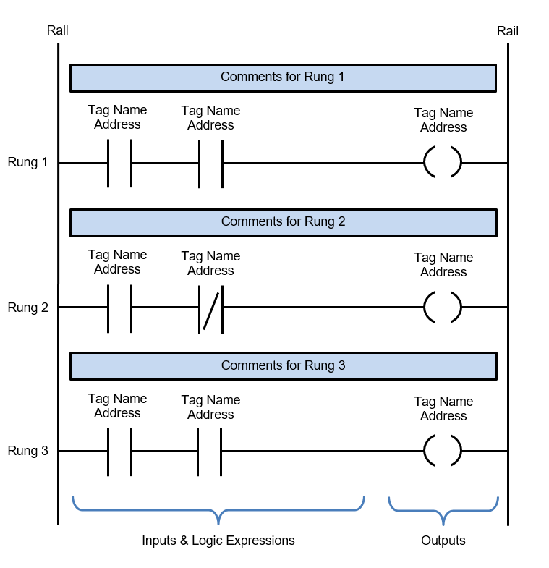
Ladder Logic Components
Course Title
CRN
©2021 CyberSkills2Work - Institution Name
Notes:
Rails – There are two rails in a ladder diagram which are drawn as vertical lines running down the far most ends of the page. If they were in a relay logic circuit they would represent the active and zero volt connections of the power supply where the power flow goes from the left hand side to the right hand side.
Rungs – The rungs are drawn as horizontal lines and connect the rails to the logic expressions. If they were in a relay logic circuit they would represent the wires that connect the power supply to the switching and relay components. Each rung is numbered in ascending sequential order.
Inputs – The inputs are external control actions such as a push button being pressed or a limit switch being triggered. The inputs are actually hardwired to the PLC terminals and represented in the ladder diagram by a normally open (NO) or normally closed (NC) contact symbol.
Outputs – The outputs are external devices that are being turned on and off, such as an electric motor or a solenoid valve. The outputs are also hardwired to the PLC terminals and are represented in the ladder diagram by a relay coil symbol.
Logic Expressions – The logic expressions are used in combination with the inputs and outputs to formulate the desired control operations.
Address Notation & Tag Names – The address notation describes the input, output and logic expression memory addressing structure of the PLC. The tag names are the descriptions allocated to the addresses.
Comments – Last but by not least, the comments are an extremely important part of a ladder diagram. Comments are displayed at the start of each rung and are used to describe the logical expressions and control operations being executed in that rung, or groups of rungs. Understanding ladder diagrams is made a lot easier by using comments.
** When we include logical structures, like AND, OR, NOR, NAND with the components of LD/LL, we can create any combination of commands needed to program a PLC. We will discuss logical structures in more detail on the following slides.

Slide 29
Module 02 – ICS Foundations
Lab 02 – Labtainer – SoftPLC (includes primer on Modbus)
https://nps.edu/web/c3o/labtainer-lab-summary1#Industrial%20Control%20Systems
Optional (in case Labtainer is buggy) – Download OpenPLC Software and use the SoftPLC PDF lab instruction, which can be downloaded from Labtainer.
https://autonomylogic.com/
Course Title
CRN
©2021 CyberSkills2Work - Institution Name
Notes:
Instructor:
Guide the students on how to setup Labtainer.
Also, encourage students to access the Modbus primer link provided in the SoftPlc instructions. We will discuss Modbus in greater detail in the next module.

Slide 30
Module 02 – ICS Foundations
CISA ICS Cert
https://www.cisa.gov/resources-tools/programs/ics-training-available-through-cisa
Course Title
CRN
©2021 CyberSkills2Work - Institution Name
Notes:
Instructor:
Students should complete module 210W-01 this week.

