Slide 1
CyberSkills2Work The National Cybersecurity Workforce Development Program

Slide 2
Industrial Control Systems Security
Acknowledgement
This program is funded by the National Security Agency National Centers of Academic Excellence in Cybersecurity (NCAE-C) Program.
For additional information, please visit www.CyberSkills2Work.org.
Course Title
CRN
©2024 CyberSkills2Work - Institution Name

Slide 3
Module 05 – IEDs and IIoT in ICS
Overview
Define IEDs and IIoT devices in the ICS context
Identify where they fit in the Purdue Model
Introduction to the Gartner Model
Understand the architecture and functions of IEDs
Recognize security risks and mitigation strategies
Analyze real-world examples and device specs
Course Title
CRN
©2021 CyberSkills2Work - Institution Name
Notes:
“Welcome everyone. Today we’re diving into Intelligent Electronic Devices, or IEDs, and the role of Industrial IoT—or IIoT—within Industrial Control Systems. We'll look at where these devices live in the Purdue Model, their typical specs and capabilities, and the security implications of bringing networked intelligence closer to the physical process layer.”

Slide 4
Module 05 – IEDs and IIoT in ICS
What is an Intelligent Electronic Device (IED)
Field-deployed embedded controllers with real-time decision-making
Handle protection, metering, automation, and communication
Common in substations, generation sites, and industrial plants
Course Title
CRN
©2021 CyberSkills2Work - Institution Name
Notes:
IEDs and embedded IoT devices are rapidly populating ICS environments such as smart grids, water systems, and industrial plants. Unlike traditional RTUs and PLCs, these devices often combine sensor interfaces, control logic, and communication modules into a single unit. They allow for more decentralized, real-time operation without relying solely on central SCADA systems.
“It’s important to understand that IEDs are more than just sensors—they’re autonomous control units that can detect a fault, make a decision, and actuate a response—often in milliseconds. They play critical roles in power grids, oil and gas, and manufacturing automation.”

Slide 5
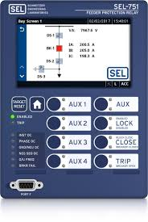
Module 05 – IEDs and IIoT in ICS
Course Title
CRN
©2021 CyberSkills2Work - Institution Name
Notes:
The image in the slide is an SEL-751 Feeder Protection Relay device. The SEL-751 provides complete protection for radial and looped distribution circuits. It offers arc-flash mitigation, fault location, high-impedance fault detection, broken conductor detection, event analysis, overcurrent protection, and more.
A feeder protection relay is a specialized electronic device that monitors and protects electrical power distribution systems, specifically feeders (lines that carry power from a substation to customers). It detects faults like short circuits or overloads and isolates the affected section to prevent further damage and ensure the safety of the electrical grid.
Here is why the 751-SEL is considered an IED:
Intelligent: It uses advanced algorithms and processing capabilities to analyze data, determine fault conditions, and initiate protective actions.
Electronic: It relies on electronic components and microprocessors to function.
Device: It's a standalone piece of equipment that performs a specific task in the power system.

Slide 6
Module 05 – IEDs and IIoT in ICS
Capabilities and Architecture of IEDs
Support for protection, control, metering, monitoring, and communication
Integration with SCADA through standard protocols (e.g., IEC 61850)
Often deployed in substations and field zones
CPU, memory, firmware (RTOS or embedded Linux)
Communication: Ethernet, RS-485, Fiber
Protection functions: overcurrent, undervoltage, breaker control
Time sync via GPS or PTP
Course Title
CRN
©2021 CyberSkills2Work - Institution Name
Notes:
“IEDs contain embedded processors and real-time firmware capable of executing logic independently. They often run deterministic OSs and support protocols like IEC 61850 GOOSE for sub-millisecond response times.”
IEDs also perform multiple functions, such as fault detection, relay operation, and event reporting. They are designed to interact with both electrical infrastructure and SCADA systems using standardized protocols. Their multifunctionality makes them a cornerstone in modern substations, providing automated, intelligent responses to grid events.
IEC 61850 is a widely adopted international standard for communication in substation automation systems. It defines a framework for data exchange between various Intelligent Electronic Devices (IEDs) (devices with processors that can send and receive data) within a substation, enabling efficient and reliable communication between protection, control, and measurement functions. It also facilitates communication between substations and control centers.
The GOOSE (Generic Object-Oriented Substation Event) protocol is a communication model defined by the IEC 61850 standard, which uses fast and reliable mechanisms to group any format of data (status, value) into a data set and transmit it across communication networks within 4 milliseconds.
It is most commonly used for data exchanges between IEDs (IED – Intelligent Electronic Device) in electrical substations over Ethernet. - https://www.igrid-td.com/smartguide/iec61850/goose-messaging/

Slide 7
Module 05 – IEDs and IIoT in ICS
More Examples of IEDs
Device | Function | Common Protocols | Vendor
SEL-351 | Feeder Protection | DNP3, IEC 61850 | Schweitzer
ABB REF615 | Overcurrent Relay | IEC 61850 | ABB
GE Multilin 850 | Breaker Automation | Modbus, DNP3 | GE Grid Solutions
Course Title
CRN
©2021 CyberSkills2Work - Institution Name
Notes:
“Here are some real-world examples. These are not theoretical—you’ll find SEL relays in almost every U.S. substation. ABB and GE both manufacture multifunction relays with built-in Ethernet, web servers, and even GPS time sync.” If you recall, ABB also develops DCS software.

Slide 8
Module 05 – IEDs and IIoT in ICS
IEDs in the Purdue Model
Level 0: Sensors and Actuators
Level 1: PLCs and RTUs
Level 0–2: IEDs
Communicate directly with SCADA/HMI or via gateways
Difficult to fully define a location
Intro to Gartner’s ICS Security Model
Course Title
CRN
©2021 CyberSkills2Work - Institution Name
Notes:
“In the Purdue Model, IEDs typically live between Level 0 and Level 2—closer to the physical world, but smart enough to talk IP. They serve as both data sources and control endpoints, which makes them highly valuable—and highly targeted.”
There is some serious debate regarding the relevance of the Purdue Reference Architecture in modern ICS environments, especially those implementing IEDs and IIoT, so I am going to show you to the Gartner Model in the next slide. According to Gartner's models, "intelligent electronic devices" are typically classified under the broader category of Artificial Intelligence (AI) and more specifically within the realm of Edge AI.
Here's how they fit:
Intelligence Anywhere Technologies: Gartner uses this term to encompass various AI and machine learning techniques, including those found in intelligent applications like virtual assistants and "intelligent things" like autonomous vehicles and drones.
Edge AI: This refers to the use of AI embedded within Internet of Things (IoT) devices, gateways, and edge servers to process data locally. This allows for real-time analysis and decision-making on the device itself, reducing reliance on cloud connectivity and boosting efficiency.

Slide 9
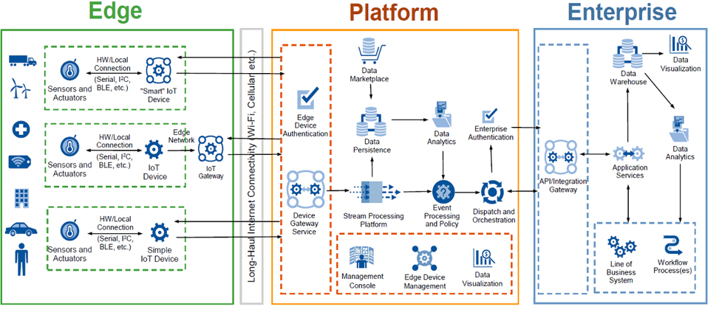
Module 05 – IEDs and IIoT in ICS
Garter Model
Course Title
CRN
©2021 CyberSkills2Work - Institution Name
Notes:
This is the Gartner IoT Reference Architecture
According to Gartner's models, "intelligent electronic devices" are typically classified under the broader category of Artificial Intelligence (AI) and more specifically within the realm of Edge AI.
Here's how they fit:
Intelligence Anywhere Technologies: Gartner uses this term to encompass various AI and machine learning techniques, including those found in intelligent applications like virtual assistants and "intelligent things" like autonomous vehicles and drones.
Edge AI: This refers to the use of AI embedded within Internet of Things (IoT) devices, gateways, and edge servers to process data locally. This allows for real-time analysis and decision-making on the device itself, reducing reliance on cloud connectivity and boosting efficiency.
.
Let’s break down the image
EDGE Layer (Field-Level Devices)
This section represents the on-site, real-world interactions with industrial assets like machines, vehicles, or medical equipment.
Edge devices are hardware components that sit at the "edge" of a network, closest to the physical process or user. In ICS/IIoT environments, these devices interface directly with sensors, actuators, machines, or controllers, and often perform data collection, processing, or local decision-making before sending information to a central platform or the cloud.
Sensors and Actuators
Collect physical data (e.g., temperature, pressure, motion) and control outputs (e.g., valve position, motor speed).
Connected via hardware interfaces: Serial, I²C, Bluetooth Low Energy (BLE), etc.
Device Types:
Smart IoT Device:
Performs local processing and decision-making.
May use AI/ML to filter or analyze data at the source.
IoT Device:
Collects data and transmits it to the platform or gateway.
Some limited local logic.
Simple IoT Device:
Barebones sensors or actuators with minimal or no processing.
Relies entirely on external systems for data handling.
IoT Gateway:
Aggregates and preprocesses data from multiple devices.
Connects to the platform over long-haul links like Wi-Fi, Ethernet, or cellular.
PLATFORM Layer (Data Processing and Control)
This middle layer manages data ingestion, filtering, event response, and orchestration before it reaches enterprise systems.
Key Components:
Stream Processing Platform: Filters, cleanses, and transforms incoming data.
Data Persistence: Stores data temporarily or permanently.
Event Processing and Policy: Detects anomalies, triggers alerts, or invokes business rules.
Dispatch and Orchestration: Sends commands back to devices or forwards information to the enterprise.
Data Analytics: Intermediate analytics before deeper enterprise insights.
Edge Device Management: Tools for configuring, updating, and securing edge devices.
Management Console & Visualization: Interfaces for operators and engineers.
Device Gateway Service & Authentication:
Secure communication and device identity validation.
ENTERPRISE Layer (Business and Decision Intelligence)
This layer is focused on strategic business processes and decision-making.
Data Warehouse: Central repository for structured industrial data.
Data Analytics & Visualization: Deeper analysis, dashboards, and reports used by management.
Application Services: Interfaces with line-of-business applications (ERP, CRM, etc.).
Workflow Processes: Automation of business decisions based on data (e.g., ordering parts when a machine is predicted to fail).
API/Integration Gateway:
Bridges industrial data with enterprise software stacks.
Ensures interoperability with external systems or cloud services.

Slide 10
Module 05 – IEDs and IIoT in ICS
Benefits of IEDs in ICS
Faster response times
Reduced dependence on central SCADA
Built-in diagnostics and alarms
Protocol diversity for integration
Course Title
CRN
©2021 CyberSkills2Work - Institution Name
Notes:
“IEDs enhance resilience by enabling autonomous, local responses. If a central controller goes offline, many IEDs can still isolate faults, trip breakers, and protect equipment—just as designed.”

Slide 11
Module 05 – IEDs and IIoT in ICS
What is Industrial IoT (IIoT)
Extension of IoT into industrial environments
Devices include smart sensors, gateways, edge processors
Emphasize interoperability, real-time data, remote access
Course Title
CRN
©2021 CyberSkills2Work - Institution Name
Notes:
“IIoT devices add cloud connectivity, wireless communication, and remote analytics capabilities to ICS. Think of them as the glue that connects physical process data to analytics and decision-making platforms.”
It involves connecting machines, sensors, and other devices in factories, manufacturing plants, and other industrial environments via the internet to collect, analyze, and act upon data
Key Aspects of IIoT:
Connectivity:
IIoT relies on a network of connected devices, allowing for real-time data exchange and remote monitoring.
Data Collection and Analysis:
IIoT enables the collection of data from sensors and other devices, which can then be analyzed using various techniques, including machine learning and big data.
Improved Efficiency:
By leveraging data insights, IIoT can help optimize industrial processes, reduce downtime, and improve productivity.
Industry 4.0 Integration:
IIoT is a key component of Industry 4.0, which emphasizes the integration of digital technologies in manufacturing and other industrial sectors.
Examples:
IIoT applications include smart manufacturing, asset tracking, supply chain management, and predictive maintenance.
Benefits of IIoT:
Enhanced Operational Efficiency:
.IIoT allows for real-time monitoring, control, and optimization of industrial processes.
Reduced Costs:
.By improving efficiency and reducing downtime, IIoT can significantly reduce operational costs.
Improved Product Quality:
Data-driven insights can be used to identify and address quality issues, leading to better product quality.
Increased Productivity:
IIoT enables faster decision-making and more efficient resource utilization, leading to increased productivity.
Better Decision-Making:
Real-time data and advanced analytics provide better insights for informed decision-making.

Slide 12
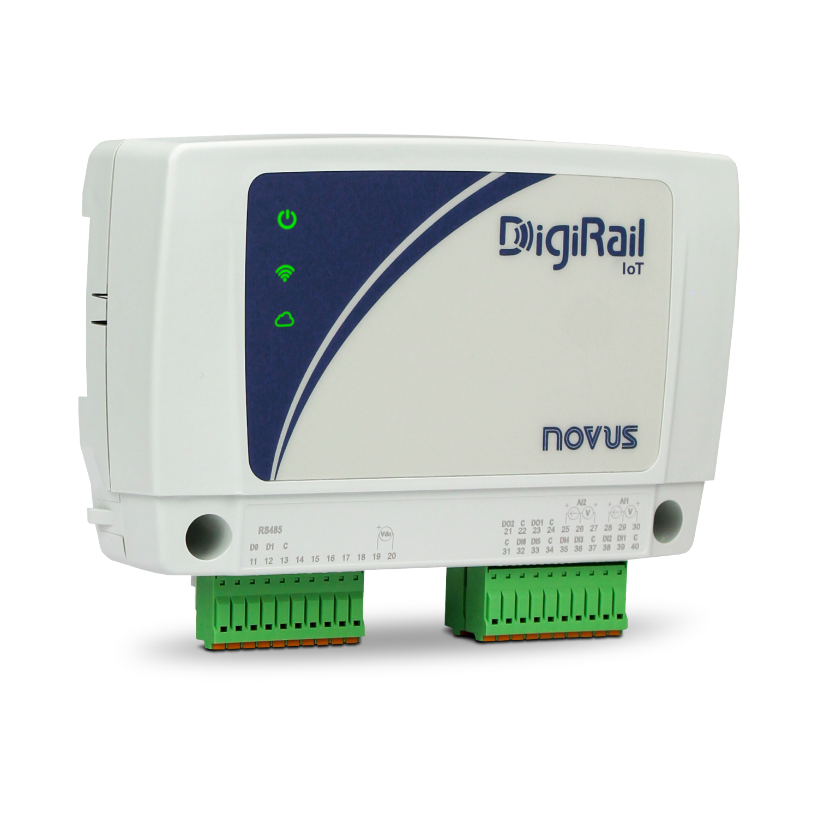
Module 05 – IEDs and IIoT in ICS
Example IIoT Device
Course Title
CRN
©2021 CyberSkills2Work - Institution Name
Notes:
This image shows a DigiRail IoT device manufactured by Novus, a company that produces industrial automation and data acquisition products.
What It Is:
A compact Industrial Internet of Things (IIoT) data acquisition module designed to collect analog and digital signals from industrial equipment and transmit them via networked protocols to supervisory systems, edge gateways, or cloud platforms.
Physical Features:
Three LED Indicators (left to right):
Power (top icon)
Wireless/Wi-Fi status
Cloud connection status
Branding/Label:
"DigiRail IoT" model identifier
"NOVUS" logo
Lower Terminal Block:
RS-485 communication port (left section, labeled)
Digital/Analog input/output terminals (green Phoenix connectors)
Numbered screw terminals (for field wiring)
Likely Functional Specifications (typical for this model series):
I/O Options:
Multiple configurable channels (digital inputs, analog inputs, relay outputs)
Communication Protocols:
Modbus RTU (via RS-485)
Modbus TCP or MQTT (via Wi-Fi or Ethernet)
Wireless Support:
Built-in Wi-Fi (visible via the green LED status)
Cloud/Edge Integration:
Connects to IoT platforms or SCADA systems
May support publishing sensor data to cloud services like AWS IoT or Azure
Where It Fits in ICS/IIoT Architecture:
Purdue Model: Level 0–1
IIoT Model: Edge layer
Functions as either a simple or smart IoT device, depending on configuration
Interfaces directly with field sensors/actuators
Use Cases:
Remote data acquisition for temperature, pressure, flow, or power systems
Retrofits for adding cloud connectivity to legacy industrial equipment
Edge processing and alarm generation in manufacturing, utilities, or energy sectors

Slide 13
Module 05 – IEDs and IIoT in ICS
Additional IIoT Examples
Device | Function | Protocols | Specs
Advantech UNO-1372G | Edge Gateway | MQTT, OPC UA | Intel Atom, 4GB RAM
HARTING MICA | Data Aggregator | Modbus, MQTT | ARM CPU, Docker support
Banner DXM100 | Wireless Node | Modbus, Proprietary RF | LTE + I/O ports
Course Title
CRN
©2021 CyberSkills2Work - Institution Name
Notes:
These IIoT devices act as bridges between field signals and higher-level apps. For example, the Advantech UNO can filter, preprocess, and publish data via MQTT to a cloud dashboard. They're compact, rugged, and programmable.”
As a reminder, MQTT, short for Message Queuing Telemetry Transport, is a lightweight, publish-subscribe-based messaging protocol designed for resource-constrained devices and networks. It's widely used in IoT (Internet of Things) applications to facilitate efficient communication between sensors, actuators, and other devices.
Proprietary Radio Frequency (RF) refers to RF communication systems that are not based on standardized protocols like Bluetooth or Wi-Fi, but rather are custom-designed for specific applications. These systems offer designers flexibility in how they utilize the radio spectrum, including the ability to use custom encryption algorithms and packet structures

Slide 14
Module 05 – IEDs and IIoT in ICS
Architecture of Typical IIoT Edge-Devices
Modular I/O for sensor integration
Embedded OS (Linux, Windows IoT, RTOS)
Supports MQTT, OPC UA, REST
Optional cloud connectors (AWS Greengrass, Azure IoT Edge)
Course Title
CRN
©2021 CyberSkills2Work - Institution Name
Notes:
“IIoT edge devices act like mini-servers on the plant floor. They aggregate multiple data streams, apply transformations, and forward data securely to cloud systems or historian software. Many support Dockerized services for modularity.”
More specifically, we have
Perception Layer (Device Layer):
Sensors:
Collect data from the physical world, such as temperature, pressure, light, etc.
Actuators:
Control or react to something in the IoT system, affecting the physical state of a product or environment.
Edge Devices:
Microcontrollers, single-board computers (e.g., Raspberry Pi), or other computing devices embedded within the edge.
2. Transport Layer (Network Layer):
Communication Protocols:
Techniques like WiFi, Bluetooth, cellular, or LoRaWAN to enable data transfer between devices.
Network Infrastructure:
Routers, gateways, and other network devices facilitating data communication.
3. Processing Layer (Edge Computing):
Edge Computing Devices: Hardware like microcontrollers or single-board computers with computational power to perform local data analysis.
Algorithms: Edge devices often use algorithms like anomaly detection, pattern recognition, or basic statistical analysis.
Edge Modules: Containers that run Azure services, third-party services, or custom code.
Edge Runtime: Manages the edge modules and executes them locally.
4. Application Layer:
Software Applications: Analyze processed data, derive insights, and trigger actions based on data patterns.
User Interfaces: Dashboards or visualizations for presenting data and insights.
Data Storage: Local storage or cloud-based storage for data retention and access.

Slide 15
Module 05 – IEDs and IIoT in ICS
IIoT in the Purdue Reference Architecture
Level 0–1: Smart sensors, actuators
Level 2–3: Gateways, edge analytics
Often cross traditional ICS-IT boundaries
Security segmentation is key
Course Title
CRN
©2021 CyberSkills2Work - Institution Name
Notes:
“Unlike IEDs, IIoT is more distributed. Some live at Level 0 as smart instruments, others at Level 3 as edge servers. They bring flexibility, but also complicate zone segmentation, especially when connected to cloud services.” Remember the Gartner model.

Slide 16
Module 05 – IEDs and IIoT in ICS
Benefits of IIoT in ICS
Real-time insight into process efficiency
Predictive maintenance with sensor data
Scalable deployment via wireless nodes
Cloud analytics and remote management
Course Title
CRN
©2021 CyberSkills2Work - Institution Name
Notes:
“IIoT unlocks value in existing ICS by delivering data where it was previously inaccessible. Instead of just knowing a pump failed, you can monitor temperature trends and predict failure days in advance.”

Slide 17
Module 05 – IEDs and IIoT in ICS
Key Differences between IIoT and IEDs
Distinct Characteristics and applications between the two types of devices
IIoT concerned with sending data to the cloud, more like smart sensors and actuators
IIoT designed for data-driven insights
IEDs concerned with monitoring, protection, and control.
IEDs more like the “brains,” capable of making decisions.
Course Title
CRN
©2021 CyberSkills2Work - Institution Name
Notes:
Key Differences
While both IIoT devices and IEDs contribute to the advancement of automation and control systems, they have distinct characteristics and applications.
IIoT Devices:
Focus: Connecting industrial equipment and processes to the internet for data collection, analysis, and optimization.
Purpose: Improve operational efficiency, enable predictive maintenance, enhance safety, and drive data-driven decision-making in industrial settings.
Scope: Part of the broader Industrial Internet of Things (IIoT), a subset of the Internet of Things (IoT) tailored for industrial applications.
Capabilities:
Collect data from sensors and industrial equipment.
Send data to the cloud for analysis and insights.
Enable remote monitoring and control of systems.
Support predictive maintenance based on real-time data analysis.
Facilitate integration with existing systems (e.g., ERP, MES).
Examples: Smart sensors, actuators, human-machine interfaces (HMIs), edge devices, and industrial machinery connected to IIoT platforms.
Intelligent Electronic Devices (IEDs):
Focus: Microprocessor-based controllers used in industrial control systems (ICS), particularly in the electric power industry, for monitoring, protection, and control.
Purpose: Provide advanced power system automation, collect data from sensors and power equipment, and issue control commands (e.g., tripping circuit breakers, adjusting voltage levels).
Scope: Specialized field devices designed for specific operational functions, often for protection or control within power systems.
Capabilities:
Acquire telemetry data from sensors and equipment.
Execute tailored control algorithms/actions based on customizable parameters/settings.
Communicate with SCADA systems or RTUs (Remote Terminal Units) using standard protocols (e.g., DNP3, IEC 61850).
Provide protection functions (e.g., protective relaying).
Examples: Protective relays, circuit breaker controllers, capacitor bank switches, recloser controllers, voltage regulators.
In Essence:
IIoT devices are designed for broader industrial connectivity and data-driven insights across various processes, facilitating optimization, predictive maintenance, and remote management.
IEDs are specialized devices, primarily in the electric power industry, focused on providing localized control, protection, and monitoring functions within critical infrastructure.
Think of it this way:
IIoT devices are like the smart sensors and actuators that collect data from industrial equipment and connect it to a central intelligence (IIoT platform) for analysis and decision-making.
IEDs are like the "brains" of specific pieces of industrial equipment (e.g., circuit breakers), capable of making local decisions and taking control actions based on collected data and pre-defined settings.

Slide 18
Module 05 – IEDs and IIoT in ICS
Cybersecurity Risks of IEDs
Outdated firmware and slow patching
Weak access controls or default passwords
Protocol spoofing (e.g., forged GOOSE messages)
Lack of encryption in legacy protocols
Course Title
CRN
©2021 CyberSkills2Work - Institution Name
Notes:
Intelligent Electronic Devices (IEDs), while providing numerous benefits like enhanced automation and communication in Industrial Control Systems (ICS), also introduce several cybersecurity risks. A successful cyberattack on an IED can have significant and even catastrophic consequences.
Here's a breakdown of the key cybersecurity risks:
Compromised Control of Physical Entities: If an attacker gains control of an IED, they can seize control of the physical equipment the IED manages, such as circuit breakers, transformers, and relays in power systems.
Operational Disruption and Manipulation: Attackers can disrupt operations by interrupting switch functions, sabotaging primary equipment, and manipulating measurements, impacting the stability and reliability of the controlled system.
Data Integrity and Manipulation: Compromised IEDs can be used to obtain and manipulate sensitive data, including critical operational information. This can lead to incorrect operational decisions, financial losses, and even equipment damage.
Bypassing Protection Mechanisms: Attackers controlling IEDs may be able to bypass existing protection and security mechanisms within the ICS.
Cascading Failures: Simultaneous attacks on multiple IEDs can trigger cascading failures across the industrial system, potentially leading to widespread disruptions and severe consequences, such as blackouts in power grids.
Vulnerability of Communication Protocols: Protocols used by IEDs for communication, such as IEC 61850 GOOSE, may have vulnerabilities that can be exploited for malicious purposes, including injecting false data or disrupting communication.
Insider Threats: Insider attacks, where authorized personnel exploit their access to compromise systems, pose a significant risk, especially as they can bypass traditional security measures.
Advanced Persistent Threats (APTs): Highly targeted and persistent cyberattacks, often state-sponsored, can aim for long-term undetected access to industrial control systems, posing a significant risk to critical infrastructure.

Slide 19
Module 05 – IEDs and IIoT in ICS
Cybersecurity Risks of IIoTs
Cloud exposure and remote APIs
Credential abuse or token leakage
Firmware integrity issues
Insecure wireless protocols
Course Title
CRN
©2021 CyberSkills2Work - Institution Name
Notes:
IIoT devices, when integrated into Industrial Control Systems (ICS), introduce a range of cybersecurity risks, including vulnerabilities to cyberattacks that can cause downtime, operational disruptions, and physical safety hazards. These risks are amplified by the increased connectivity and potential for malware infection. Common threats include man-in-the-middle attacks, device hijacking, DoS and PDoS attacks, and data theft.
Elaboration:
Increased Attack Surface:
.IIoT devices, by connecting ICS to the internet or wider networks, expand the attack surface, making it easier for attackers to gain access and exploit vulnerabilities.
Legacy Systems:
Integrating IIoT devices with legacy ICS systems can introduce vulnerabilities, as older systems may lack security features or be difficult to patch.
Data Breaches and Ransomware:
.Opens in new tabAttackers can target IIoT devices to steal sensitive data, disrupt operations, or launch ransomware attacks, potentially leading to costly downtime and recovery efforts.
Malware Infections:
.Opens in new tabIIoT devices can be infected with malware, which can be used to control them, create botnets, or launch attacks on other devices in the network.
Physical Safety Risks:
In some cases, compromised IIoT devices could even pose physical safety risks, such as causing industrial equipment to malfunction or even triggering accidents.
Denial of Service (DoS) and Permanent Denial of Service (PDoS):
Attackers can disrupt IIoT devices and ICS operations by flooding them with traffic (DoS) or damaging them so badly they require replacement (PDoS).
Device Hijacking:
Attackers can take control of IIoT devices, potentially using them to gain unauthorized access to the ICS or other devices.
Man-in-the-Middle Attacks:
Attackers can intercept or spoof communications between IIoT devices and other systems, potentially compromising data or gaining control of the devices.
Supply Chain Attacks:
Compromising the IIoT device supply chain can introduce malicious code or components, leaving devices vulnerable to attacks.
Physical Security Risks:
The physical accessibility of IIoT devices can make them susceptible to tampering, theft, or unauthorized access to sensitive data.

Slide 20
Module 05 – IEDs and IIoT in ICS
Mitigating IED and IIoT Threats
Role-based access control (RBAC)
Enforce signed firmware updates
Prioritize Security Measures
Use secure time synchronization
Monitor network behavior for anomalies
Course Title
CRN
©2021 CyberSkills2Work - Institution Name
Notes:
Secure Your Assets and Environment:
Establish and Maintain an Asset Inventory: A comprehensive and up-to-date asset inventory is the foundation for securing your IIoT environment. Understanding which devices are connected to your critical systems allows for effective risk and vulnerability management plans.
Segment Your Networks: Divide networks into isolated segments based on granular network policies to manage traffic flow and enhance security. This approach helps prevent an attacker from moving laterally throughout the network if they compromise one device.
Secure Physical Access: Prevent unauthorized physical access to critical infrastructure.
Implement Secure Access Controls: Many IIoT systems lack sufficient access controls, making them vulnerable to unauthorized access. Strong access control mechanisms, including multi-factor authentication and role-based access control, are crucial.
2. Prioritize Proactive Security Measures:
Implement Zero Trust Architecture: Embrace a Zero Trust model, where no device or user is inherently trusted. Organizations can minimize the risk of unauthorized access by only granting access to those with a legitimate need and closely monitoring communications.
Establish Robust Update Management: Implement secure firmware update policies and robust patch management procedures. This ensures devices are updated with the latest security patches and firmware updates, reducing vulnerabilities.
Manage Exposure: Prioritize the remediation of vulnerabilities based on their risk level, especially as many IIoT devices weren't designed with security in mind.
Develop Mitigation Strategies: Formulate specific safeguards to address identified vulnerabilities and risks.
Implement Virtual Patching: For systems that cannot be updated, use network-based controls to mitigate vulnerabilities.
3. Continuously Monitor and Respond to Threats:
Continuous Monitoring and Threat Detection: Implement continuous monitoring and detection policies and procedures to identify and respond to cybersecurity threats and anomalies. AI-powered tools can help analyze network traffic and detect suspicious activity.
Develop an Incident Response Plan: Create a documented incident response plan to quickly identify, deal with, and recover from cybersecurity threats. This plan should include detection, containment, remediation, and recovery steps.
4. Address Specific IIoT Security Gaps:
Secure Device Configuration: Change default device settings, configurations, and credentials to prevent attackers from easily gaining access.
Employ Strong Authentication: Utilize strong passwords, multi-factor authentication (MFA), and consider certificate-based authentication for device-to-device communication.
Ensure Data Encryption: Encrypt sensitive data transmitted between devices and systems.
Disable Unnecessary Services: Disable any services that are not essential for device operation to reduce the attack surface.
Address Supply Chain Risks: Carefully vet vendors and verify the integrity of device components and firmware.
Address Legacy Systems: Implement compensating controls to mitigate vulnerabilities in outdated systems that cannot be updated.
5. Prioritize People and Processes:
Promote Employee Training and Awareness: Educate employees on good security practices, including strong passwords and protecting company data.
Address the Skill Gap: Ensure you have qualified staff with specialized IIoT cybersecurity knowledge, or consider outsourcing some functions.
Adhere to Compliance Regulations: Stay informed of relevant regulations (e.g., GDPR, NERC CIP, IEC 62443) and ensure your organization meets compliance requirements.

Slide 21
Module 05 – IEDs and IIoT in ICS
Case Study: Iranian Hackers use IOCONTROL Malware to Target IoT devices
The Iranian threat group CyberAv3ngers used custom-built malware named IOCONTROL to target IoT and OT devices in the US and Israel.
CyberAv3ngers targeted industrial control systems (ICS) at water facilities in Ireland and the United States, including a water utility in Pennsylvania.
The attacks relied on the fact that many organizations leave ICS exposed to the internet and protected with default credentials that can be easily obtained.
Course Title
CRN
©2021 CyberSkills2Work - Institution Name
Notes:
In the Ireland attack, the hackers’ actions caused serious disruptions that led to the water supply being cut off for two days. The malware was used to target IoT, ICS and other OT devices, including IP cameras, routers, SCADA systems, PLCs, HMIs, and firewalls from vendors such as a Baicells, D-Link, Hikvision, Red Lion, Orpak, Phoenix Contact, Teltonika, and Unitronics.
The malware is based on a generic IoT/OT malware framework designed to target embedded Linux-based devices, with the attackers compiling different versions created specifically for each type of targeted system.
Let’s break down how this attack works:
The IOCONTROL attack is a malicious manipulation of I/O operations in Industrial Control Systems (ICS), in which an attacker compromises the logic or communication pathway between control devices (like PLCs or RTUs) and physical I/O modules (sensors and actuators). This results in deceptive control behavior—the system may appear normal to operators while executing harmful or unauthorized actions at the physical layer.
The IOCONTROL attack targets the Input/Output (I/O) control interface of an ICS device—either by compromising:
The control logic (e.g., ladder logic on a PLC), or
The communication layer between the PLC/IED and its I/O modules
The attack alters sensor readings (inputs) or fakes actuator commands (outputs) without raising immediate alarms at higher ICS levels (e.g., HMI or SCADA).
Example Steps:
Initial Access: Attacker gains access to the engineering workstation, PLC network, or firmware update service.
Compromise Control Logic: Modifies ladder logic, function blocks, or structured text to:
Suppress alarms
Change setpoints or I/O routing
Redirect outputs to unintended devices
Intercept or Forge I/O Signals:
Sensor values are spoofed to indicate safe operation when a dangerous condition exists
Actuator signals are manipulated to disable protection (e.g., disable pump shutoff)
Maintain Operational Illusion:
HMIs and SCADA continue to show “normal” values
Operators are unaware the process is behaving abnormally at the physical level

Slide 22
Module 05 – IEDs and IIoT in ICS
Case Study: Iranian Hackers use IOCONTROL Malware to Target IoT devices
Attack Surface | Technique | Example
PLC Logic Memory | Modify I/O mappings or disable outputs | Disable relay trip on overcurrent
Fieldbus Protocol | Man-in-the-middle on Modbus or Profibus | Spoof valve position feedback
Remote Access Tool | Upload altered project file | Change PID control logic remotely
IED Configuration | Alter protection thresholds | Increase voltage trip tolerance
Course Title
CRN
©2021 CyberSkills2Work - Institution Name
Notes:
IOCONTROL also uses the MQTT machine-to-machine network protocol for command and control (C&C) communications. It supports commands for executing arbitrary code and conducting port scans, enabling attackers to remotely control compromised devices and perform lateral movement.

Slide 23
Module 05 – IEDs and IIoT in ICS
Lab and CISA Certs
Lab 5 – Raspberry Pi Light Sensor https://www.uugear.com/portfolio/using-light-sensor-module-with-raspberry-pi/
CISA ICS Cert (210W-04)
https://www.cisa.gov/resources-tools/programs/ics-training-available-through-cisa
Then – Make the Raspberry into an IoT Device https://www.digikey.com/en/maker/tutorials/2019/how-to-set-up-a-raspberry-pi-as-an-iot-device
Course Title
CRN
©2021 CyberSkills2Work - Institution Name
Notes:
Instructor Notes:
Please complete Lab 5, the Raspberry Pi Light Sensor to gain a better understanding of how sensors work, then turn the Pi into an IoT device using the two links above. You can also change this to add a servo motor that moves when the light sensor detects light (say a flashlight) or switch out the light sensor for a temperature sensor. For instance, when the temperature goes above 100 degrees F* you turn the motor to the right 45 degrees and when it goes below 100 the motor turns to the left 45 degrees. You get the point.

