Slide 1
Setup
Did you follow setup instructions Jody sent?
Important for today
Install git
Get GitHub account
Setup SSH on GitHub
Notes:
Instructor: Refer to setup slides if needed.

Slide 2
STScI git training inspired by Software Carpentry

Slide 3
Kickoff
Tell us about you: name, division, why here
STScI Slack channel: #git_training_20190410
Box Folder: https://stsci.app.box.com/folder/72241627341
Boxnote: Crowd-sourced note taking https://stsci.app.box.com/notes/433890012518
Post-It notes

Slide 4
What is version control?
A tool to track the history of a project
Who changed what? When?
Individual or collaborative

Slide 5
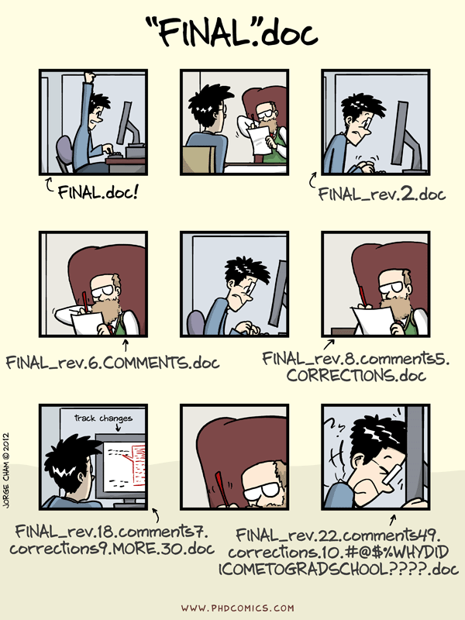
Why do I care about the history of a project?
Individual:
Fix (or undo) mistakes
What was done and why
Definitive (final?) version
Hard to delete accidentally
Collaborative
Who to ask if you have questions
Work simultaneously
Hard to overwrite

Slide 6
How does git differ from other version control systems?
Nearly every operation is local
git stores snapshots, not differences
Everything is checksummed before stored and is referred to by that checksum
git generally only adds data
git is distributed -- a clone is a complete copy of the original repo
Notes:
CVCS = Centralized Version Control System. Also see https://git-scm.com/book/en/v2/Getting-Started-Git-Basics

Slide 7
git configuration
git config --global user.name “Your Name”
git config --global user.email “YourEmail@email.edu”
git config --global color.ui “auto”
git config --global core.editor “nano”
git command format: git verb
verb: config
color: Color-coded output
editor: Set default editor
You can change these settings at any time
Try git config --list

Slide 8
The situation
Three people are collaborating on a project
Alpha, Beta, and Gamma
Research moving to another planet
Want to share their research

Slide 9
Creating a repository
Create a directory for the repository
cd
mkdir planets
cd planets
Make planets directory a repository
git init
ls -a
.git directory is where git stores the history of the project
git status

Slide 10
Tracking changes to files
Create a file to track
Open your text editor
Type: Cold and dry, but everything is my favorite color
Save file as mars.txt
Check in with git:
git status
Start tracking file:
git add mars.txt
Record current state:
git commit -m “Start notes on Mars as base”
-m : Commit message inline

Slide 11
Exercise 1
Create a file called jupiter.txt with a sentence about Jupiter in your planets directory
Start tracking and record the current state of jupiter.txt
Put up your green Post-It up when you are done
Hint:
git status
git add filename
git commit -m “commit message”

Slide 12
Viewing your history
git log
git log –-oneline
git help log
git log --stat

Slide 13
Changing a file
Open your mars.txt file and add:
The two moons may be a problem
Check the status of your files
git status
View the changes you made
git diff mars.txt
Tell git which files you want to record changes in
git add mars.txt
Save changes to revision history
git commit -m “Concerns about Mars’ moons”

Slide 14
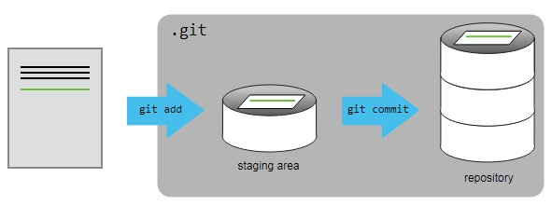

What are we doing?

Slide 15
Exercise 2
Open file jupiter.txt in your text editor
Add a line
View the change you made using git
Record your changes in the project’s history
View your project’s history
Put up your green Post-It when you are done
Bonus:
Make another change
Try any one of these variations
Commit without adding
View changes between adding and committing
Commit without the -m

Slide 16
A note on viewing changes
Changes between working directory and what was last staged
git diff
Changes between staging area and last commit
git diff --staged

Slide 17
Exploring history
Changes made in the last commit
git diff HEAD~1
Changes made in the last 2 commits
git diff HEAD~2
Changes made in the last 3 commits
git diff HEAD~3
Changes made since some commit hash
git diff 0b0d55e
First 7 characters
Use git log to find the desired commit

Slide 18
Recovering older versions
Overwrite mars.txt
echo “Gamma will like the dry air” > mars.txt
cat mars.txt
Recover last recorded version:
git checkout HEAD mars.txt
checkout HEAD : Revert to version in HEAD
Can use commit hash to revert to even older version
mars.txt : Tells git which file to revert
In git status, they list this option with -- instead of HEAD; This is a shortcut.

Slide 19
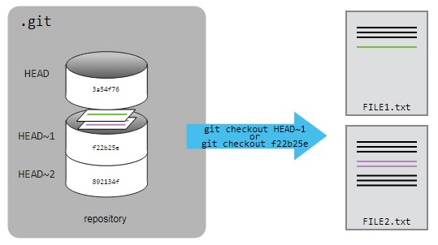
What is going on here?

Slide 20
Exercise 3
Overwrite and then recover jupiter.txt
Put up your green Post-It when you are done
Bonus:
Revert to the first saved version of jupiter.txt
Switch back to the most recent version of jupiter.txt

Slide 21
Ignoring things
Create some data files that you don’t want to track
mkdir results
touch a.dat b.dat c.dat results/a.out results/b.out
git status
Create .gitignore file with this content
*.dat
results/
git status
Add .gitignore to the project
git add .gitignore
git commit -m "Add the ignore file”
Now try the following
git add a.dat
git clean -xdn

Slide 22
Intermission: Short Break
Suggested Time: 10 mins
Notes:
Ideally it is 10:30 AM at this point.

Slide 23
Remote repository
Central location where everyone can see
Requires Internet
GitHub, GitLab, BitBucket, SourceForge
For grit and gitar, contact ITSD.
Public vs private
Notes:
Only will cover GitHub in this workshop.

Slide 24
Sign in at GitHub
Go to https://github.com
Sign into your account
Put up a green Post-It when you are done

Slide 25
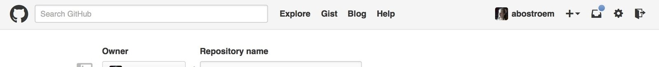
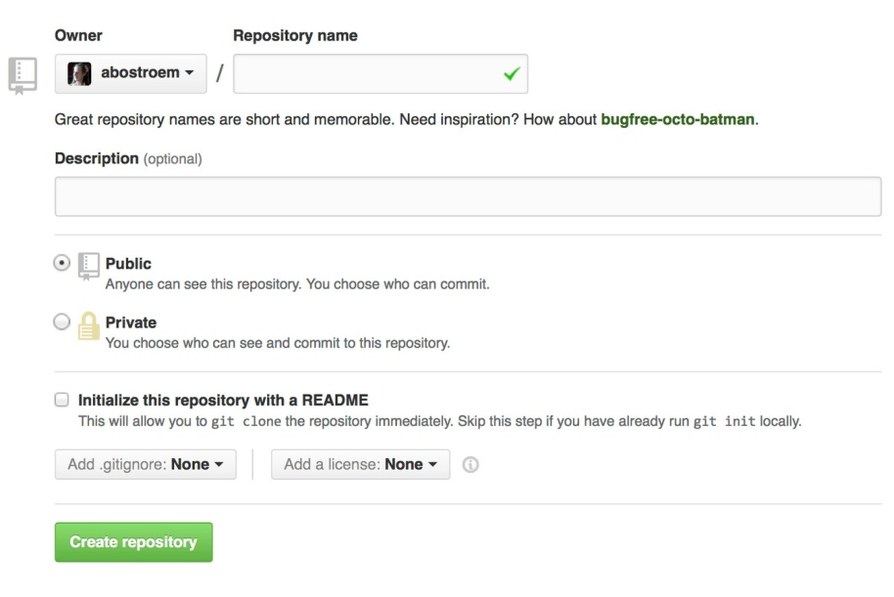
Create a new repository
Press create a new repo
Call your repo planets and “create repository”
Put up your green Post-It when done

Slide 26
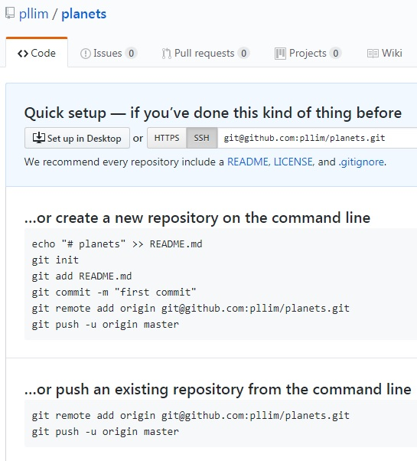
Connect your remote and local repositories
Copy and paste circled commands into the terminal where you create your local repository
git remote add : Gives the nickname origin to the URL of the remote repository
git push -u : Creates remote branch on origin called master
Notes:
SSH is easier if you have 2-factor set up.

Slide 27
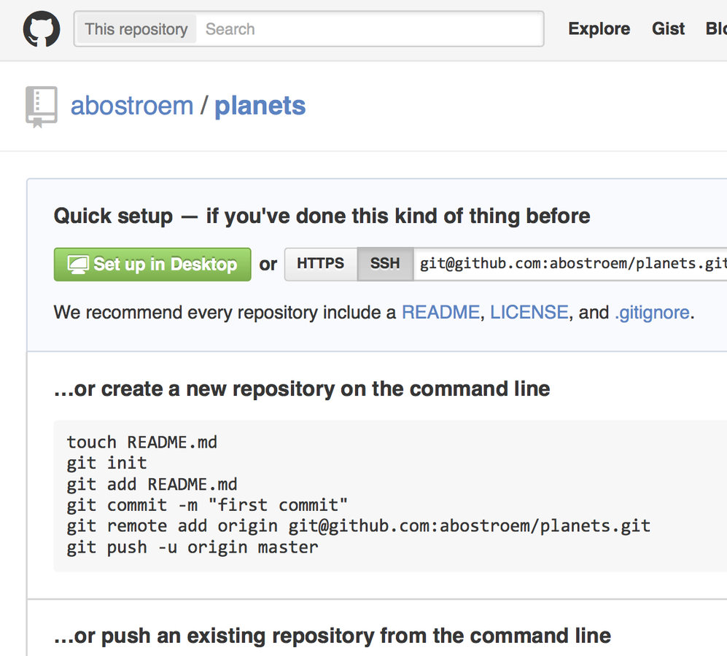
Exercise 4
At the top of the page, click username/planets
Refresh browser if needed
Explore…

Slide 28
More information
What branch am I on?
git branch
Default branch: master
What is my remote repository?
git remote -v
Default nickname: origin

Slide 29
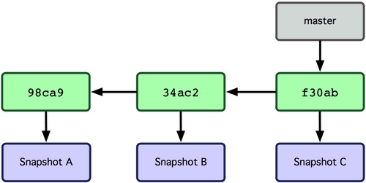
What is a branch?
Branches are very cheap in git
Use them often – new features, bug fix, testing
Notes:
Branch is a pointer to a series of snapshots.

Slide 30
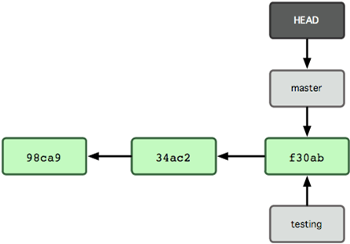
Creating a new branch
% git branch testing
% git branch
*master
testing

Slide 31
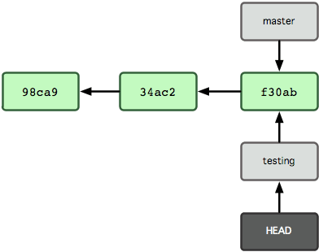
Switching branch
% git checkout testing
% git branch master *testing

Slide 32
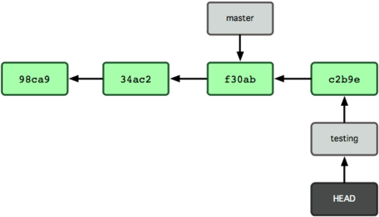
Adding commit to branch
% git commit –m “another change”

Slide 33
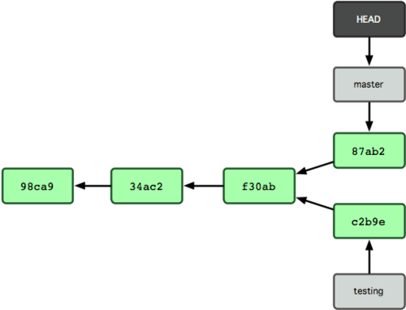
Diverging branches
% git checkout master
% git commit –m “another change to master”

Slide 34
Starting your collaboration
Find a partner
Decide who is Alpha and who is Beta
You will be using Alpha’s repository
Put up your green Post-It when done
Put up your red Post-It if you need a partner

Slide 35
The simplest workflow
one remote "central" repository
everyone clones it
everyone makes changes on the master branch of their clone
the branch is pushed to the remote repository
pull the remote master branch before making another change
Notes:
This explains the workflow of the next exercise.

Slide 36



The simplest workflow
alpha/code (master)
File1
File 2
File 3
Alpha
Beta
File1
File 2
File 3
File1
File 2
File 3
Notes:
This explains the workflow of the next exercise.

Slide 37
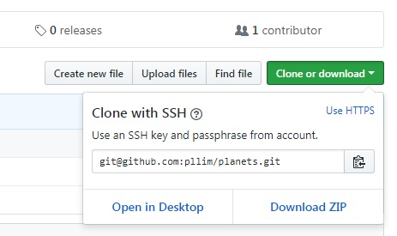
Beta: Cloning a repository
Create a new directory for collaboration
cd ..
mkdir planets_collab
cd planets_collab
Clone Alpha’s repository
git clone git@...
(Make sure it is set to SSH)
cd planets
Put up your green Post-It when done
Notes:
HTTPS is very painful with 2-factor authentication

Slide 38
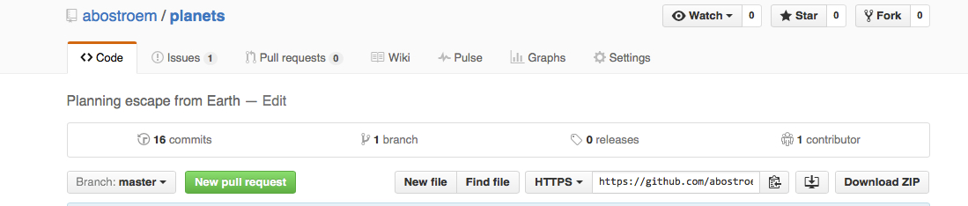
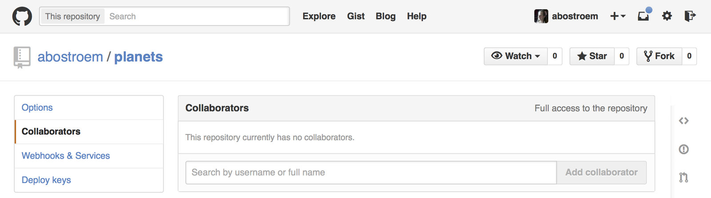
Alpha: Adding a collaborator
Anyone can clone; Only collaborators can write
Alpha only:
Click “Settings” on the RHS
Click “Collaborators” on the LHS
Add Beta’s GitHub username

Slide 39
Collaborating
1. Alpha
2. Beta (do this after Alpha)
Modify mars.txt
Save your changes
Add and commit your changes
Push your changes to the remote repository
git push origin master
Pull down Alpha’s changes
git pull origin master
Add a line to the end of mars.txt
Save your changes
Add and commit your changes
Push your changes to the remote repository

Slide 40
Merge without conflict
Alpha: Modify the first line of mars.txt, save, add, and commit
Beta: Modify the last line of mars.txt, save, add, and commit
Alpha: Pull down changes from Beta
You will be asked to save a merge commit message in your editor; Save and close
Alpha: Push your changes to the remote repository
Beta: Pull down changes from Alpha and save the commit message
Beta: Push your changes to the remote repository

Slide 41
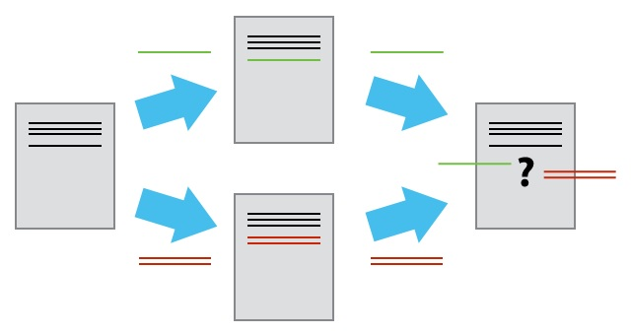
Merge with conflicts
Alpha: Edit the last line of the mars.txt, save, add, and commit
Alpha: Try to pull down changes from the remote repository

Slide 42
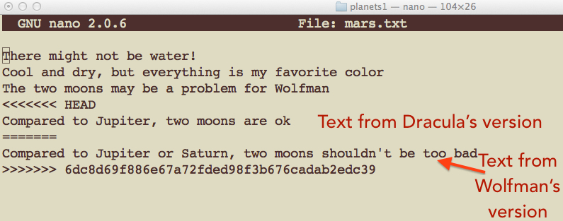
Resolving conflicts
Alpha: Open mars.txt
Alpha: Edit mars.txt to look like correct file
Remove extra text
Choose which lines you want to keep
Alpha: Save, add, commit, push
Text from Alpha’s version
Text from
Beta’s version

Slide 43
Exercise 5: Repeat for Beta
Beta: Pull down Alpha’s changes
Alpha: Change the first line of jupiter.txt
Alpha: Save, add, commit, push
Beta: Change the first line of jupiter.txt, add, commit
Beta: Pull down Alpha’s changes
You will get a conflict
Open jupiter.txt and edit to look like final version
Save changes to jupiter.txt
Add, commit, push

Slide 44
Class feedback
Green Post-It: What went well?
One item for content
One item for presentation
Red Post-It: What could improve?
One item for content
One item for presentation
Notes:
Last activity before lunch.

Slide 45
Intermission: Lunch Break
Suggested Time: 1 hr
Notes:
Ideally it should be 12 PM now.

Slide 46
Class feedback review

Slide 47
Open Science
Closed model
Research paper behind paywall
Code not always available
Results not always reproducible
Open model
Open access data (figshare, Zenodo, Dryad) with DOI
Paper and code on GitHub (separately)
arXiv pre-print
Published paper has links to pre-print, code, and data
Open scientific work is more useful and more highly cited than closed
Further reading
https://doi.org/10.1371/journal.pone.0000308
https://link.springer.com/book/10.1007/978-3-319-00026-8

Slide 48
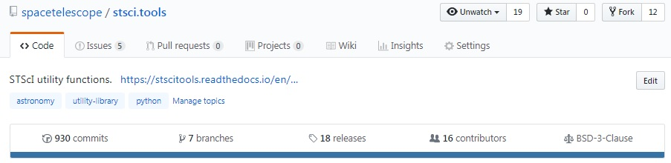
Licensing
File on repo: LICENSE, LICENSE.txt
Non-lawyers should not try to write licenses from scratch
General Public License (GPL) is infectious
The Creative Commons family of licenses allow mix and match
Check with your team/branch/division/mission/etc
Further reading:
https://choosealicense.com/
https://opensource.org/licenses
https://www.gnu.org/licenses/license-list.html

Slide 49
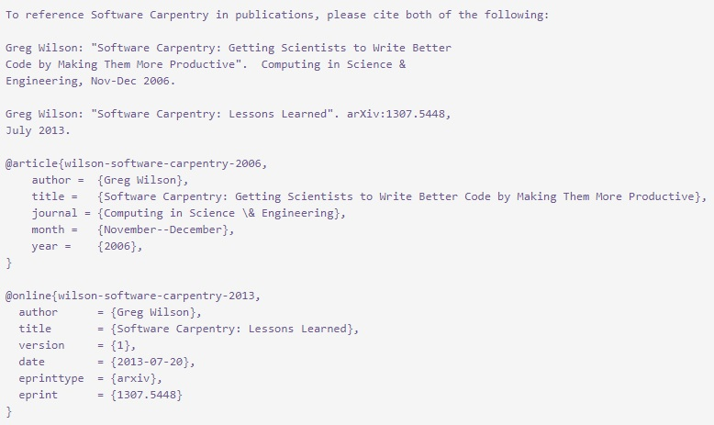
Citation
File on repo: CITATION, CITATION.txt
Explains how you want your work cited
BibTeX: @software
https://guides.github.com/activities/citable-code/

Slide 50
Hosting
Options
https://github.com/spacetelescope
GitLab (grit, gitar)
Considerations
Public collaboration
ITAR restriction
Ask ITSD
Notes:
This is the end of the official SWC materials.

Slide 51
A better workflow
one "central" repository
everyone clones it
changes are made on feature branches in the clones
the feature branches are pushed to the central repository
a PR is made in order to merge the feature branch into the master branch
to make the next change - pull master from the remote repository and start with a new branch

Slide 52
The simplest workflow
alpha/code (master)
File1
File 2
File 3
Alpha
Beta
File1
File 2
File 3
File1
File 2
File 3
Notes:
This explains the workflow of the next exercise.

Slide 53
A better workflow
PR
alpha/code (master)
File1
File 2
File 3
alpha/code
(branch1)
alpha/code
(branch2)
File1
File 2
File 3
File1
File 2
File 3
push
Alpha
Beta
File1
File 2
File 3
pull
File1
File 2
File 3
Notes:
Pull request (PR) will be explained in the next slide.

Slide 54
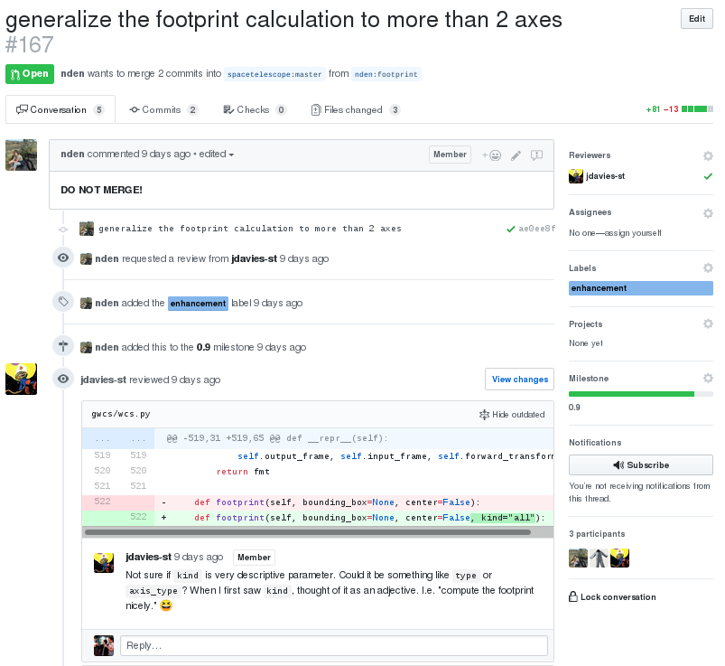
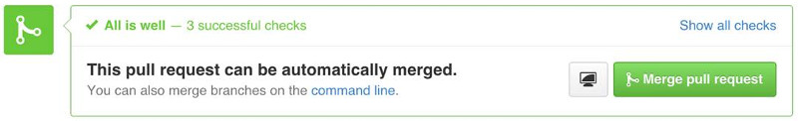
Pull Request (PR)
PR = Proposed change
Never use master
Meaningful title
Concise description (tip: fix #166 would auto-close it)
Include change log, test, and doc (if applicable)
Adhere to code of conduct
Address review comments
Maintainer: Labels, milestone, review, merge
Optional: Delete branch after merge

Slide 55
Exercise 6.1
Create a new feature branch in your clone
git checkout -b username-add-planet
git status
Create a new file and add some text
Commit and push to the repository
git add your_new_file
git commit –m “Some useful message”
git push origin username-add-planet

Slide 56
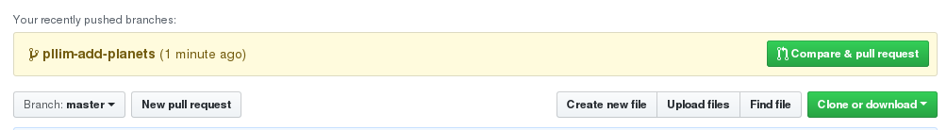

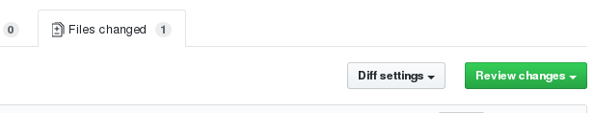
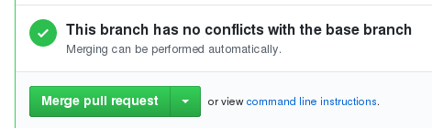
Exercise 6.2
Go to https://github.com/alpha/planets/
Create pull request
Ask partner for review and merge
Put up your green Post-It when done

Slide 57
An even better workflow
there's a "central" repository
everyone forks it to their github account
everyone clones their own fork
work is done on a feature branch in the cloned repository
push the branch with the changes to your fork
create a PR from the feature branch in your fork to the master branch in the "central" repo and merge with master
- to start a new feature branch, fetch (or pull) master from the central repo

Slide 58
The simplest workflow
alpha/code (master)
File1
File 2
File 3
Alpha
Beta
File1
File 2
File 3
File1
File 2
File 3
Notes:
This explains the workflow of the next exercise.

Slide 59
A better workflow
PR
alpha/code (master)
File1
File 2
File 3
alpha/code
(branch1)
alpha/code
(branch2)
File1
File 2
File 3
File1
File 2
File 3
push
Alpha
Beta
File1
File 2
File 3
pull
File1
File 2
File 3
Notes:
Pull request (PR) will be explained in the next slide.

Slide 60
A even better workflow
origin
upstream
you/code
fork
spacetelescope/code (master)
master
File1
File 2
File 3
branch1
PR
clone
push
You
File1
File 2
File 3
pull

Slide 61
Let’s dig down…
spacetelescope/code (master)
File1
File 2
File 3
You

Slide 62
origin
you/code
(master)
upstream
fork
spacetelescope/code (master)
File1
File 2
File 3
File1
File 2
File 3
You
Notes:
Only need to fork the repo once per user.

Slide 63
origin
you/code
(master)
upstream
spacetelescope/code (master)
File1
File 2
File 3
File1
File 2
File 3
clone
You
(master)
File1
File 2
File 3

Slide 64
origin
you/code
(master)
upstream
spacetelescope/code (master)
File1
File 2
File 3
File1
File 2
File 3
You
(branch1)
File1
File 2
File 3
Notes:
git checkout –b branch1, followed by modifying a file

Slide 65
origin
you/code
(branch1)
upstream
spacetelescope/code (master)
File1
File 2
File 3
File1
File 2
File 3
push
You
(branch1)
File1
File 2
File 3
Notes:
git push origin branch1

Slide 66

origin
you/code
(branch1)
upstream
spacetelescope/code (master)
File1
File 2
File 3
PR
File1
File 2
File 3
You
(branch1)
File1
File 2
File 3
Notes:
Open PR from branch1 on your fork. spacetelescope/code will not change until PR is merged.

Slide 67

origin
you/code
(branch1)
upstream
spacetelescope/code (master)
File1
File 2
File 3
File1
File 2
File 3*
You
PR
(branch1)
File1
File 2
File 3
Notes:
Let’s say someone else got their changes in upstream.

Slide 68
origin
you/code
(branch1)
upstream
spacetelescope/code (master)
File1
File 2
File 3
File1
File 2
File 3*
You
(branch2)
File1
File 2
File 3*
pull
Notes:
For the next set of changes: git checkout -b branch2; git pull upstream master (should fast forward if no conflict)

Slide 69
origin
you/code
(branch1)
upstream
spacetelescope/code (master)
File1
File 2
File 3
File1
File 2
File 3*
You
(branch2)
File1*
File 2
File 3*
Notes:
Make new changes in branch2.

Slide 70
origin
you/code
(branch2)
upstream
spacetelescope/code (master)
File1*
File 2
File 3*
PR
File1
File 2
File 3*
push
You
(branch2)
File1*
File 2
File 3*
Notes:
Make new changes in branch2. And so the cycle repeats.

Slide 71
Intermission: Short Break
Suggested Time: 10 mins
Notes:
Ideally it should be 2 PM now.

Slide 72

Exercise 7.1
Fork spacetelescope/training-ground repo
Clone your fork
cd
mkdir git_training_fork
cd git_training_fork
git clone git@github.com:username/training-ground.git
cd training-ground
Add remote to repo you cloned from
git remote add upstream git@github.com:spacetelescope/training-ground.git
git remote -v
Put up your green Post-It when done
Notes:
Live coding here would be very useful.

Slide 73
Exercise 7.2
Create a new feature branch
git checkout -b my-first-pr
Pull to ensure your local checkout is up-to-date
git pull upstream master
Instructor: Assign each a new number not in repo already
Create a new file in trainees directory
cd trainees
Filename: hello_nnn.txt (nnn = Assigned number)
Content: Hello world!
Add and commit the file, and then
git push origin my-first-pr
Put up your green Post-It when done
Notes:
Live coding here would be very useful.

Slide 74
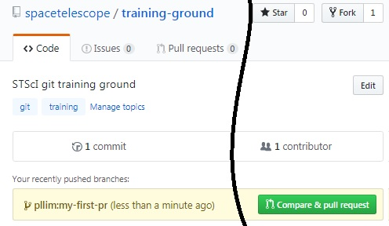
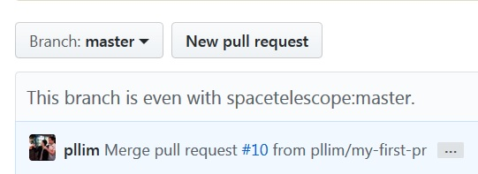
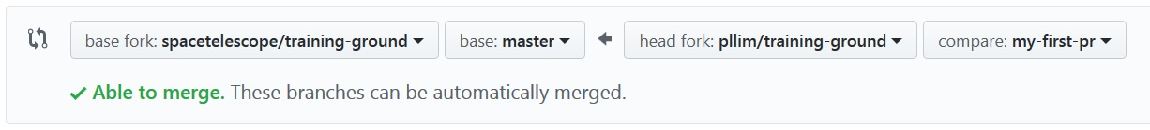
Exercise 7.3
Go to https://github.com/spacetelescope/training-ground/
OR go to https://github.com/username/training-ground/
Submit the PR
Put up your green Post-It when done

Slide 75
Exercise 7.4
Comment on your partner’s PR
Optional: Instructor submit a GitHub review
Instructor/helper: Merge the PRs
Sync your local repo
git checkout master
git pull upstream master
Clean your local repo
git branch -D my-first-pr
git remote prune origin
git push origin -–delete my-first-pr

Slide 76
Segue: Good coding practices
Code you can understand after 6 months
NO: blah = 42
YES: answer_to_everything = 42
Python: PEP 8
Documentation that new user can find and understand
Python: Sphinx
ReadTheDocs
Test everything (within reason)
Python: pytest, unittest
CI: Travis, Jenkins, Appyevor

Slide 77
Packaging: Brief intro
Astropy package template (Python)
https://github.com/astropy/package-template
Semantic versioning
https://semver.org/
Choosing a git workflow
https://www.atlassian.com/git/tutorials/comparing-workflows
Style Guides
https://github.com/spacetelescope/style-guides

Slide 78
Learning never stops
Advanced features of interest:
git stash
git squash
git rebase
GPG
https://help.github.com/articles/signing-commits-using-gpg/
… and much more!
INS RIAB git training:
http://stsci-riab.github.io/riatraining/version_control.html

Slide 79
Special Thanks
git Training Team (INS, ITSD, OED)
INS Training Team
Software Carpentry
Azalee Bostroem
Erik Tollerud

Slide 80
Class feedback
Green Post-It: What went well?
One item for content
One item for presentation
Red Post-It: What could improve?
One item for content
One item for presentation
Notes:
Last activity before workshop ends.

Slide 81
Bonus Materials
Exercises on rebase and squash
Notes:
If there is extra time and only if the instructor deems it appropriate.

Slide 82

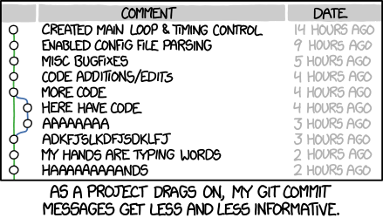
Rebase, squash
Disclaimer:
When in doubt, backup first
Rebase
git fetch upstream master
git rebase upstream/master
Pick up bug fixes
Resolve conflicts
Squash commits
git rebase -i HEAD~n
What to do when it gets ugly?
Abort
Ask an expert
https://xkcd.com/1296/
Notes:
Rebase/squash re-writes history. Never do it on “public” branch (e.g., master branch, release branch) unless you really mean to.

Slide 83
Exercise 8.1
Instructor: Modify https://github.com/spacetelescope/training-ground/blob/master/trainees/hello_000.txt directly on the web
Go back to your training-ground fork
cd ~/git_training_fork/training-ground
Create new feature branch
git checkout -b my-second-pr
cd trainees
Modify your hello_nnn.txt
Add and commit the file
Rebase (not pull) to sync with cloud
git fetch upstream master
git rebase upstream/master
Notes:
Illustrate when you have existing branch but upstream/master has changed, and how to keep your branch in sync with upstream/master.

Slide 84
Exercise 8.2
Push your branch out
git push origin my-second-pr
Open another pull request
Modify your hello_nnn.txt a second time
git log
Squash your two latest edits into one
git rebase -i HEAD~2
Follow terminal instructions
git log
Push your branch out again (with --force)
Inspect your pull request: What has changed?
Instructor: Merge/close pull requests
Notes:
Illustrate that you can rewrite history of PR and not having to create new PR when you add new commits to a branch that already has a PR.

Slide 85

Notes:
--force (get it?)

