Slide 2
Time Management
Isabel Martins Buta

Slide 3
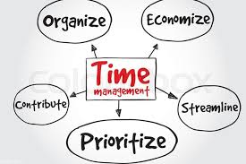
Time management
“Love the life you have while you create the life of your dreams. Don’t think you have to choose one over the other.” — Hal Elrod

Slide 4
Agenda
Time Management – History and Development
How can we apply?

Slide 5
What is time management? History and develop?
“Time is money" said Benjamin Franklin
The roots of all time management are in business.
The industrial revolution of the 19th century demanded a new relationship with time.
Schooling- Punctuality and productivity became the overarching goals.
Increase efficiency and productivity;
Nowadays has broadened to encompass our personal as well as our working lives, creating a work-life balance and happiness.

Slide 6
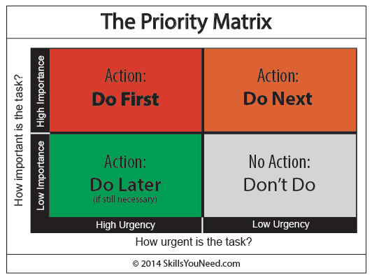

Slide 7
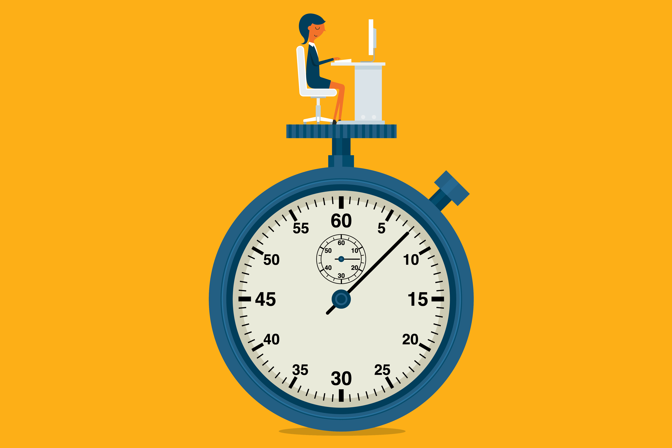
How can we apply?
Real time is mental
Take time to plan - schedule anything and everything (emails, after work, meetings, etc.)
The Pareto Principle (20% of your thoughts produce 80% of your results)
3BTT- 3 Big Things for Today
The Pomodoro Technique - 25minutes of focus work with a lot of techniques with 5 minutes break
50% of time pay attention
2minutes rule.

Slide 8

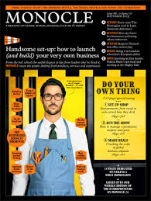
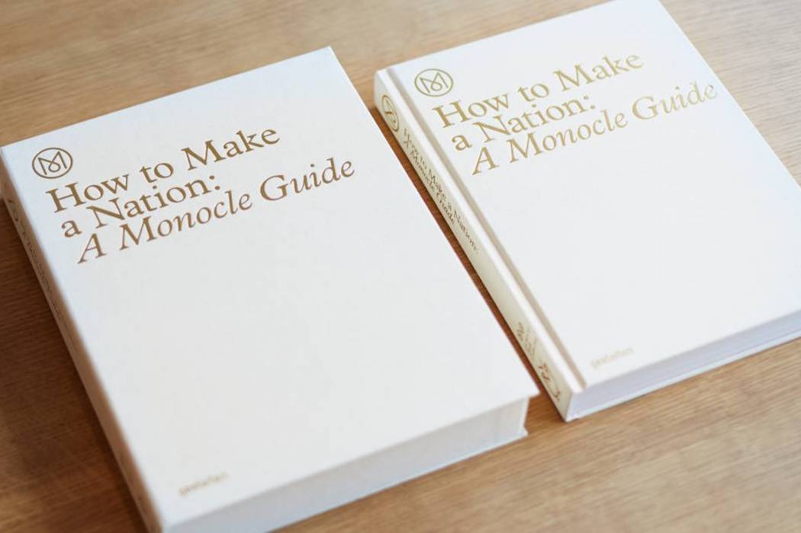
MONOCLE MAGAZINE
Media Enterprise – Business, Affairs, Design, Culture, Edits;
Diverse media: radio (arts shows, culture show, etc.), film, magazines, books, fashion, etc.;
Bookshop/Kiosk-cafe;
Design and Branding aesthetics;
Informative – globally and locally;
Promotion of business and initiatives around the world;

Slide 9
Thank you.
Questions?

