Slide 1
Behavioral Risk Factor Surveillance System
Group B Project 1
Indu Chandrasekharan, Kim Kane, Aziz Koyuncu, Carmen Wells

Slide 2


Created in 1984
15 States
In 2019:
All 50 States, including 3 territories and D.C.
400,000 annual responses
Notes:
Carm
https://www.healthy.arkansas.gov/programs-services/topics/health-surveys
https://en.wikipedia.org/wiki/Centers_for_Disease_Control_and_Prevention

Slide 3
Process:
Telephone-based survey
One response limit per household
Core questionnaire plus state add-on options
Uses Random Digit Dialing Systems (RDD)
Uses:
Target wellness programs
Track disease
Analyze connections between lifestyle and health
Notes:
Carm
https://www.healthy.arkansas.gov/programs-services/topics/health-surveys
https://en.wikipedia.org/wiki/Centers_for_Disease_Control_and_Prevention

Slide 4
Objective: Examine the correlation between health related behaviors and chronic health conditions.
Hypothesis: People who engage in riskier health behaviors have a higher incidence of chronic health conditions.
Notes:
Carm
https://www.healthy.arkansas.gov/programs-services/topics/health-surveys
https://en.wikipedia.org/wiki/Centers_for_Disease_Control_and_Prevention

Slide 5

Do people with a higher frequency of positive lifestyle factors have fewer chronic health conditions?
What is the correlation between education levels and chronic health conditions?
How do lifestyle behaviors vary by location and gender?
Notes:
Carm

Slide 6

Data Exploration and Cleanup
Challenges:
Categorical / Qualitative Data vs Quantitative Data
Few continuous variables
Reference documentation to decipher data set
High number of 'None/ or 'Refused to Answer'
Removed outliers
Modified python code to improve Jupyter Notebook performance
Jupyter
Notes:
Indu

Slide 7
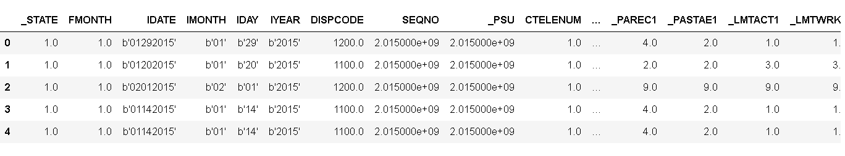
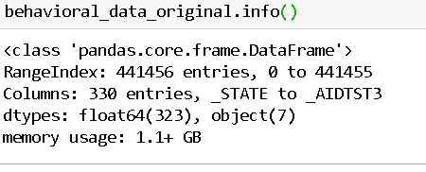
Original Data
Notes:
Indu

Slide 8
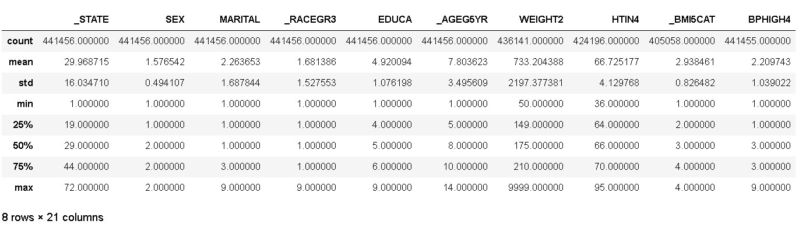
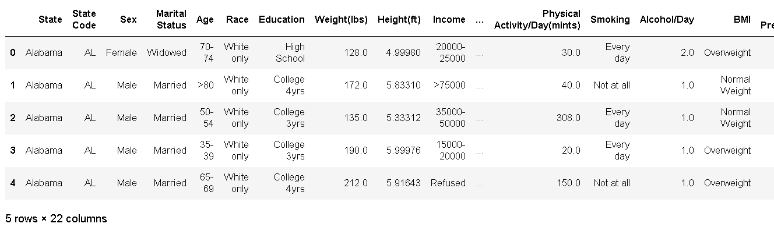
Data Cleanup Before and After
Notes:
Indu

Slide 9
Behaviors
Demographics
Diseases
Fruit and Vegetable intake per Day
Minutes of Physical Exercise per Day
Alcohol Consumption per Day
Smoking per Day
Body Mass Index (BMI)
State of Residence
Education Level
Gender
Age
Heart Disease
Cancer
Diabetes
High Blood Pressure
High Cholesterol
Notes:
Indu

Slide 10
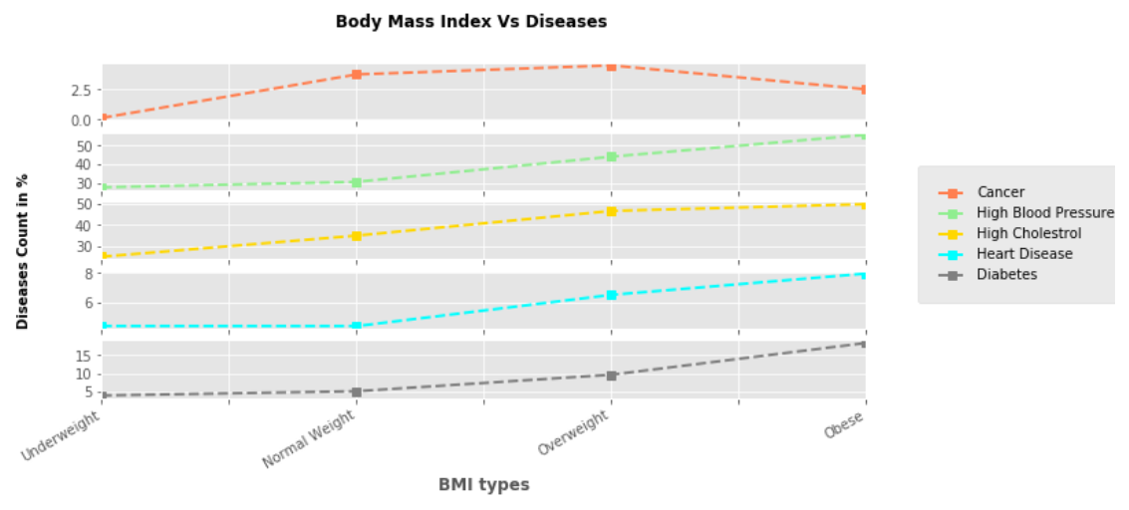
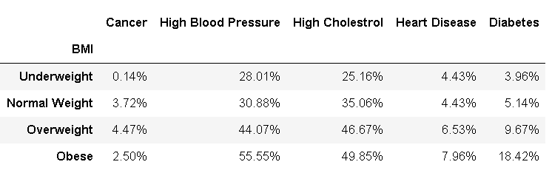
Notes:
Indu

Slide 11
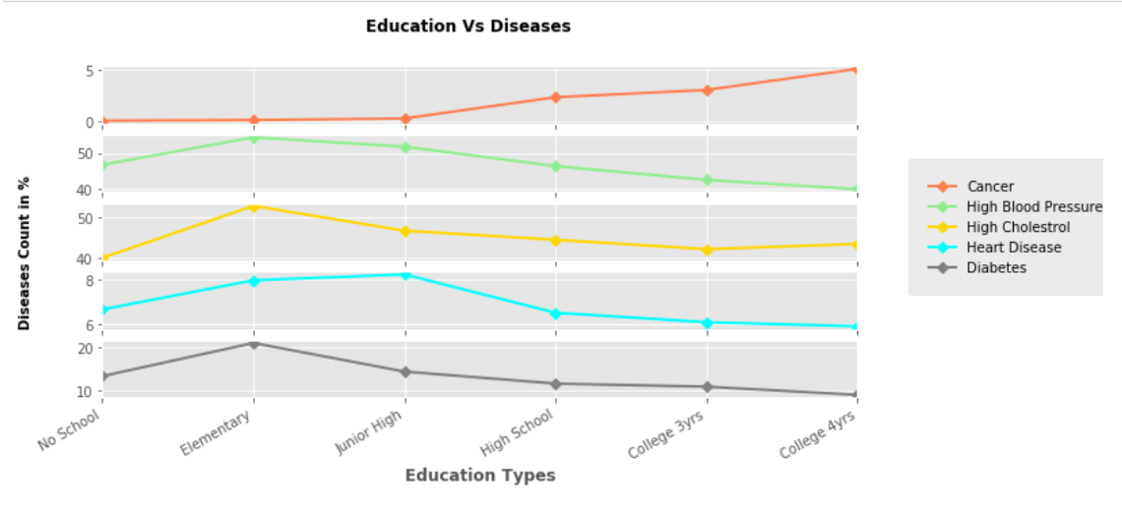
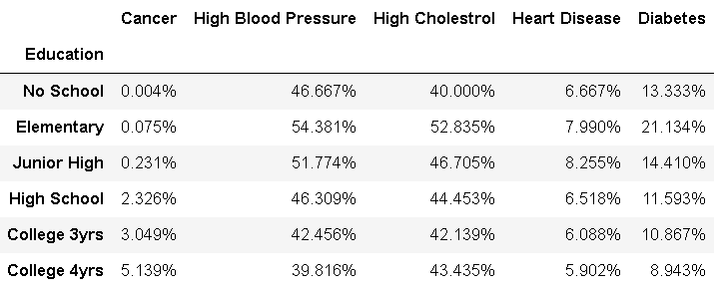
Notes:
Indu

Slide 12
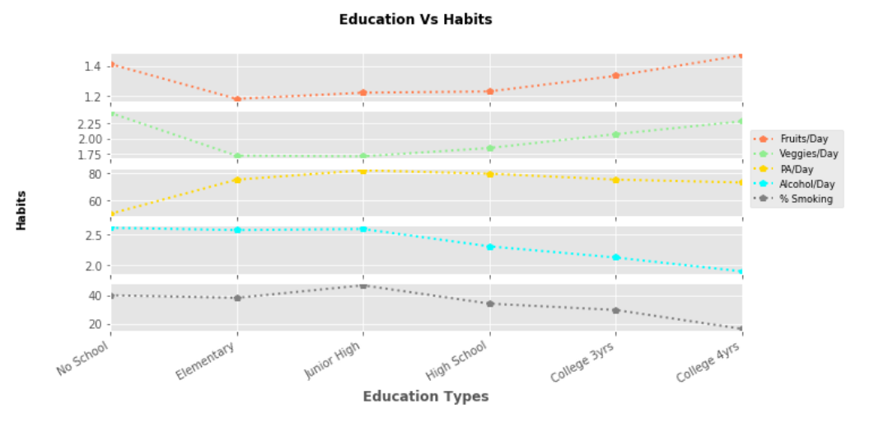
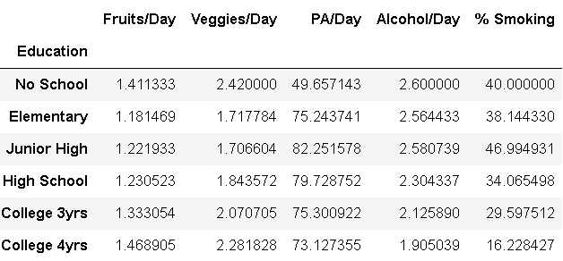
Notes:
Aziz

Slide 13
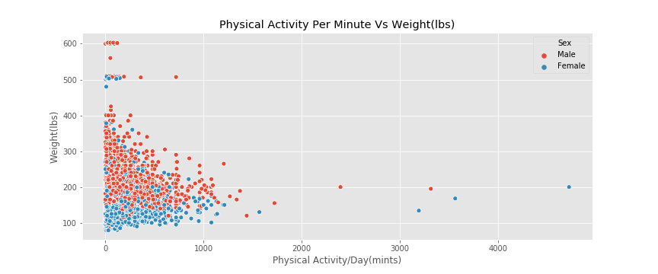
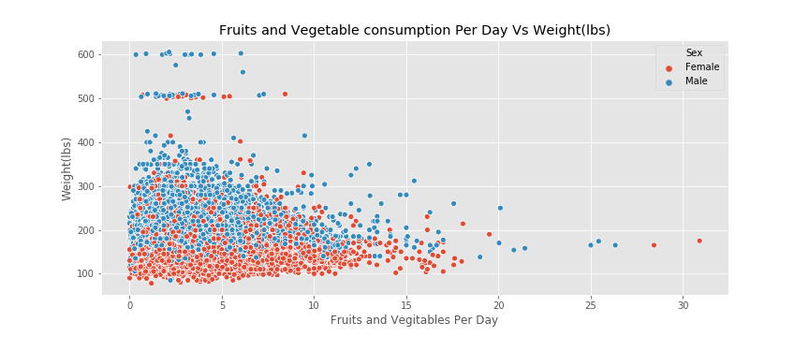
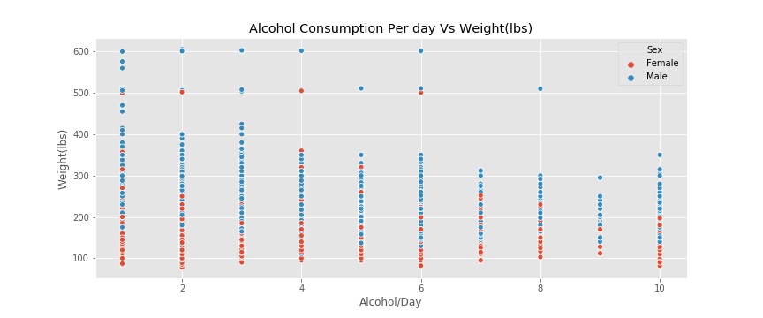
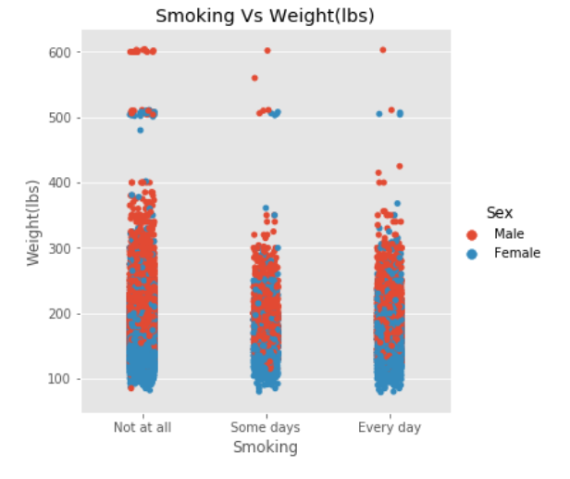
Positive & Negative Behavior on Weight
Notes:
Aziz

Slide 14
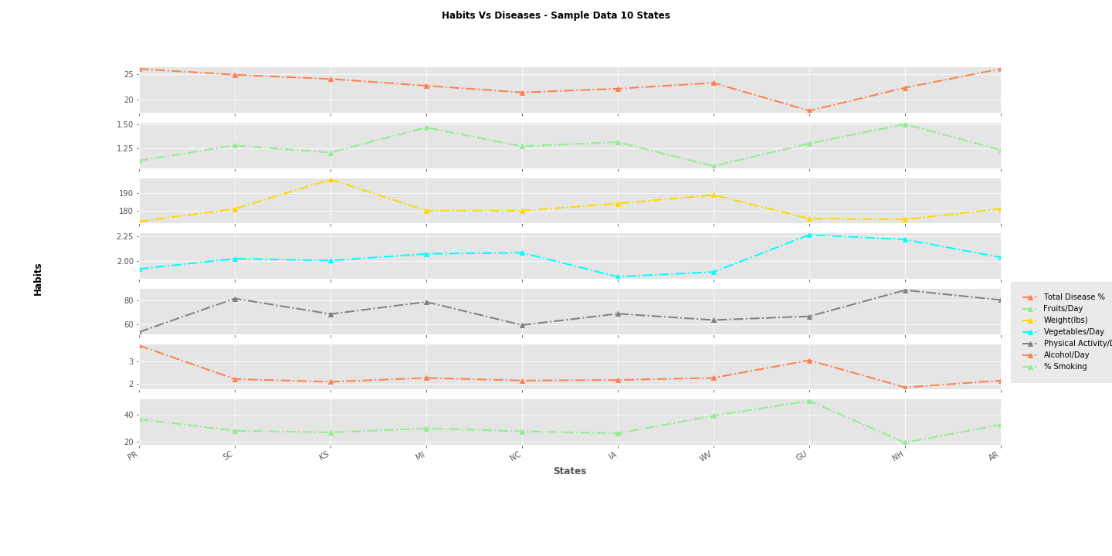
Notes:
Aziz

Slide 15
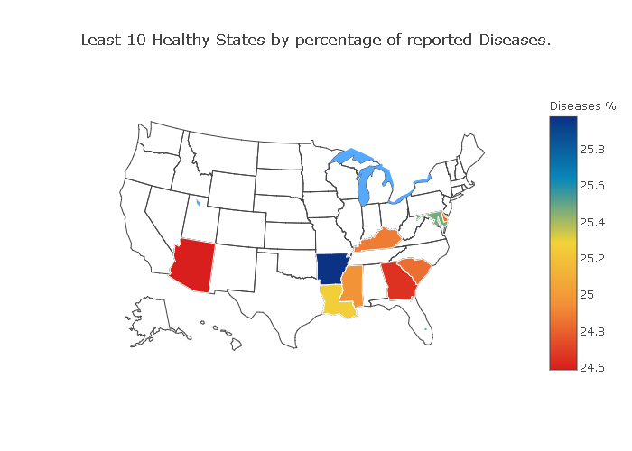
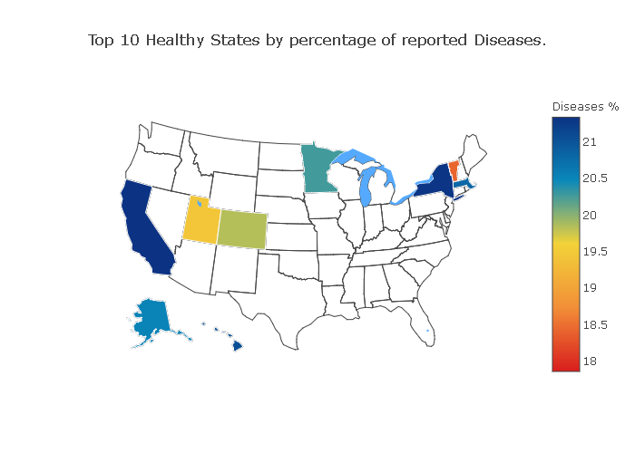
Most and Least Healthy States
Notes:
Aziz

Slide 16
Do people with a higher frequency of positive lifestyle factors have fewer chronic health conditions? In some cases. Inconsistent
What is the correlation between education levels and chronic health conditions? Most cases higher education fewer chronic diseases
How do lifestyle behaviors vary by location and gender?
a.) Most cases women practice more positive lifestyle factors.
b.) 10 least healthy states more negative lifestyle factors.
Notes:
Kim

Slide 17
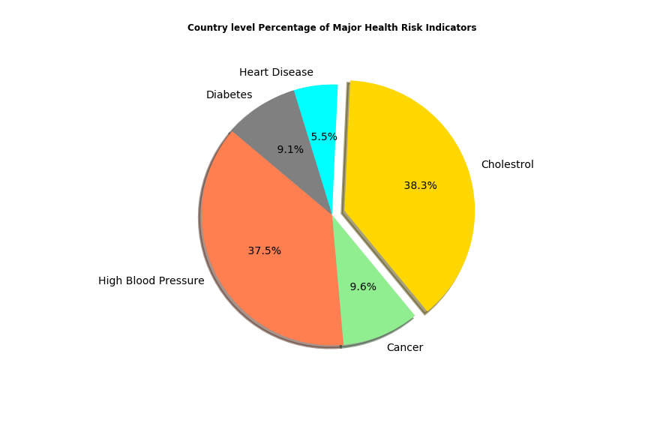
Validated Findings with CDC 2017
Project Data
CDC Facts
Cholestrol - 71 million American adults (33.5%)
Blood Pressure - 75 million American adults (32%)
Cancer -23.2 million American Adults (9.4%)
Heart Disease - 28.2 million Americans (11.5%)
Diabetes - 30.3 million Americans Adults (9.4%)

Slide 18
Post Mortem
Supplemented data with additional sources.
Added additional years of survey data and statistical analysis
Added more variables from our source data.
Expanded our topic to include spending on education and its effects on health.
Further exploration of demographics.
Usage of better visualization libraries in Python.
Notes:
Kim

Slide 19
End
Thank You
Questions?
Notes:
Kim

