Slide 1
Same Exposure, Different Clocks:
Price Discovery and Cost-Aware Trading in Matched ETFs
Silu Li (Princeton) · John M. Mulvey (Princeton) · Siyu Li (Westlake University)
ICAIF '26 Workshop on AI-Driven Market Microstructure
Milan, 14 November 2026
Notes:
Good afternoon, everyone. I am Siyu Li from Westlake University. This is joint work with Silu Li and John Mulvey from Princeton. The title is "Same Exposure, Different Clocks." The paper is about pairs of exchange-traded funds that hold exactly the same stocks. We ask how fast their prices move together, minute by minute, and whether a trader can make money from the small delays between them.
[Next slide]

Slide 2
Background: ETFs that hold the same stocks
An ETF (exchange-traded fund) is a fund that holds a basket of stocks and trades on an exchange like a single stock.
Several ETFs can hold exactly the same basket. QQQ and QQQM both hold the 100 companies of the Nasdaq-100 index.
QQQM is the same sponsor's cheaper version, but it trades far less than QQQ.
Because QQQ and QQQM hold the same stocks, their prices should move together. Do they also move at the same time, minute by minute?
 | QQQ | QQQM
Holds | Nasdaq-100 | Nasdaq-100
Fee, 2022–25 | 0.20% | 0.15%
Traded per day (2021) | $15 billion | $44 million
Notes:
Let me start with some background. An ETF, or exchange-traded fund, is a fund that holds a basket of stocks. It trades on an exchange like a single stock.
Several ETFs can hold exactly the same basket. For example, QQQ and QQQM both hold the one hundred companies of the Nasdaq-100 index. QQQM is a cheaper version from the same sponsor. Over our sample, its annual fee was 0.15 percent, against 0.20 percent for QQQ. But QQQM trades much less. In 2021, QQQ traded about 15 billion dollars a day, and QQQM about 44 million.
Because QQQ and QQQM hold the same stocks, their prices should move together. But do they also move at the same time, minute by minute?
[Next slide]

Slide 3
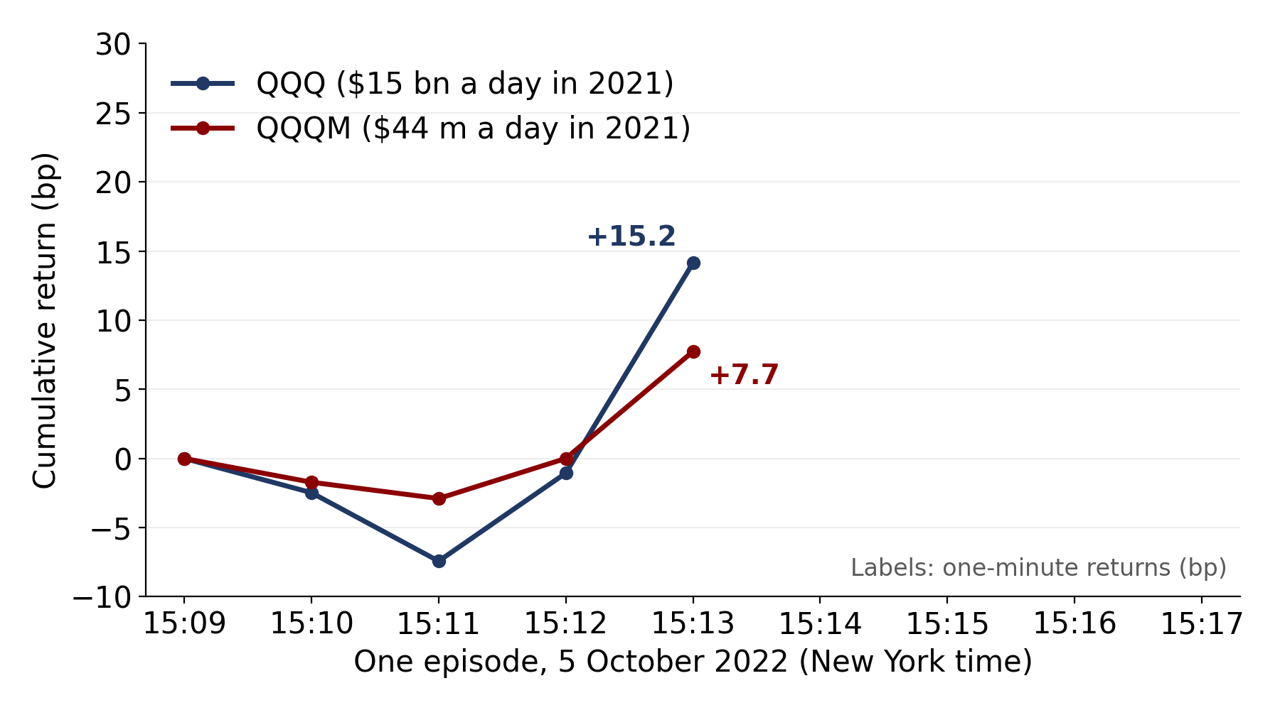
Same portfolio, same price?
QQQ and QQQM hold the same 100 Nasdaq companies.
In 2021, QQQ traded about $15 billion a day; QQQM about $44 million.
On 5 October 2022 at 15:13, QQQ rose 15.2 bp, but QQQM rose only 7.7 bp (1 bp = 0.01%).
Notes:
Let us look at the prices. This figure shows one real episode, on the fifth of October 2022, a few minutes after three p.m. in New York. The blue line is QQQ, and the red line is QQQM. Each point is the cumulative return in basis points. One basis point is one hundredth of one percent. On a 100-dollar share, it is one cent.
At 15:13, QQQ rose 15.2 basis points. But QQQM rose only 7.7 basis points.
[Next slide]

Slide 4
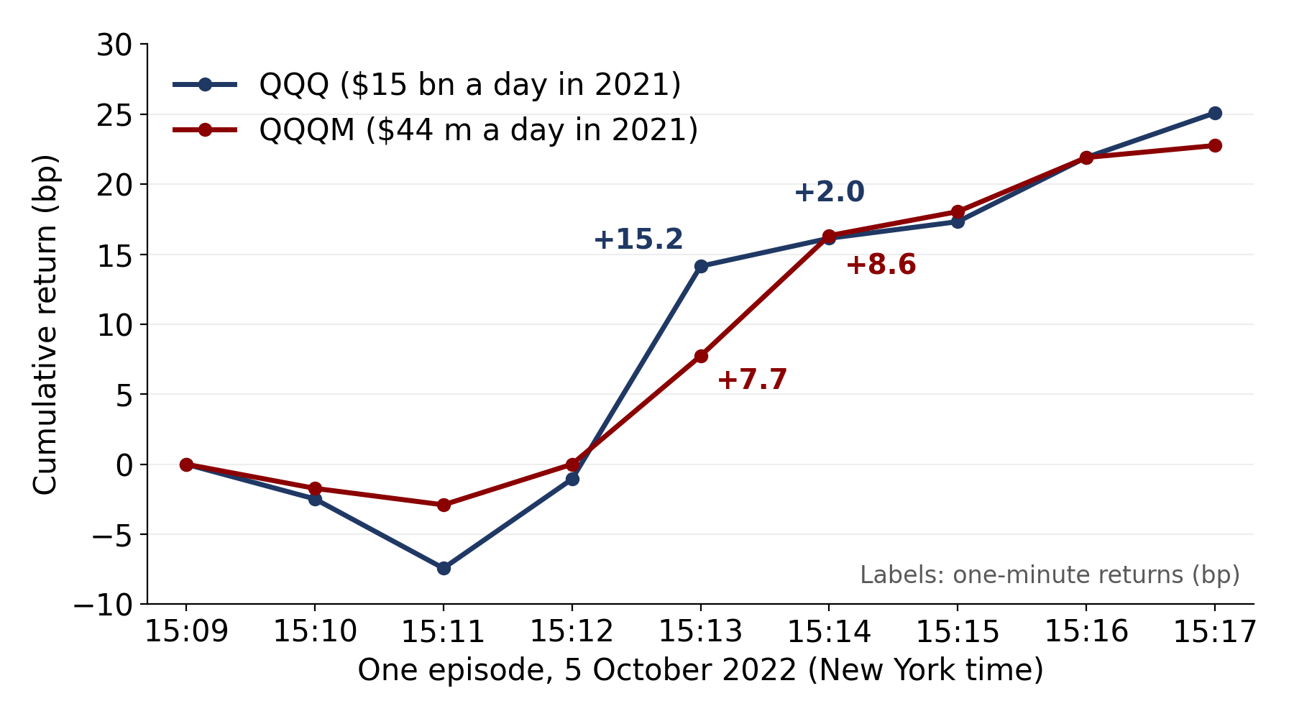
Same portfolio, same price?
QQQ and QQQM hold the same 100 Nasdaq companies.
In 2021, QQQ traded about $15 billion a day; QQQM about $44 million.
On 5 October 2022 at 15:13, QQQ rose 15.2 bp, but QQQM rose only 7.7 bp (1 bp = 0.01%).
At 15:14, QQQM rose another 8.6 bp, while QQQ rose 2.0 bp.
QQQM caught up with QQQ one minute later.
Notes:
Now look at the next minute. At 15:14, QQQM rose another 8.6 basis points, while QQQ rose only 2.0. So QQQM caught up with QQQ one minute later.
The two funds hold the same portfolio, but they do not run on the same clock. The rest of the talk asks three things: how general this pattern is, how large it is, and whether anyone can trade on it.
[Next slide]

Slide 5
Two questions
QQQ and QQQM hold the same stocks. So a delay between their two prices shows how fast information reaches each price.
Question 1: When the more liquid ETF moves, how much of the return gap does the less liquid ETF close in the next minute?
Question 2: Can a forecasting model trade on this delay after trading costs?
Earlier work on S&P 500 ETFs and the index measures which market leads price discovery (Xu and Yin 2017; Dao, McGroarty and Urquhart 2018).
Notes:
Because QQQ and QQQM hold the same stocks, any delay between their prices tells us how fast new information reaches each price.
We ask two questions. Question one: when the more liquid ETF moves, how much of the return gap does the less liquid ETF close in the next minute? Question two: can a forecasting model trade on this delay after trading costs?
Earlier work on S&P 500 ETFs and the index asks which market leads. We measure how much of the gap the slower fund closes, and whether this can be traded.
[Next slide]

Slide 6
Preview
1. In each of the four pairs, the more liquid ETF (the leader) moves first. In the next minute, the less liquid ETF (the follower) closes about half of the return gap.
2. This also holds in quote midpoints. It disappears when we break the minute-by-minute timing between the two ETFs.
3. An LSTM predicts the less liquid ETF out of sample. Whether these forecasts make money depends on how they are traded.
Notes:
Here is a preview of the answers.
First, in each of our four pairs, the more liquid ETF, which I will call the leader, moves first. In the next minute, the less liquid ETF, which I will call the follower, closes about half of the return gap.
Second, this also holds when we use quote midpoints instead of trade prices. And it disappears when we break the minute-by-minute timing between the two ETFs.
Third, an LSTM network predicts the follower out of sample. But whether these forecasts make money depends on how they are traded.
Let me start with the data.
[Next slide]

Slide 7
Four matched pairs, 2022–2025
Exposure | Leader | Follower | Daily $ volume, 2021
Gold | GLD | IAU | $1.4 bn vs $0.4 bn
Russell 2000 | IWM | VTWO | $6.5 bn vs $0.09 bn
Nasdaq-100 | QQQ | QQQM | $15.4 bn vs $0.04 bn
S&P 500 | VOO | SPLG | $1.7 bn vs $0.12 bn
Leader: the ETF with more dollar volume in 2021. Follower: the other ETF in the pair.
Return in a minute: the percentage change in price from the end of the previous minute to the end of this minute.
Return gap in minute t: the leader's return minus the follower's return in that minute.
Each ETF is compared only with its partner in the same row: IAU with GLD, VTWO with IWM, QQQM with QQQ, SPLG with VOO.
Data: one-minute trade prices, 09:45–15:45, on 980 trading days from February 2022 to December 2025; bid and ask quotes on 120 of these days (explained later).
Notes:
We study four matched pairs: gold, the Russell 2000, the Nasdaq-100, and the S&P 500. In each pair, the leader is the ETF with more dollar volume in 2021, and the follower is the other one. The leader trades from about three times to several hundred times more.
Each ETF is compared only with its partner in the same row: IAU with GLD, VTWO with IWM, QQQM with QQQ, and SPLG with VOO.
A return in a minute is the percentage change in price from the end of the previous minute to the end of this minute. The return gap is the leader's return minus the follower's return.
Our data are one-minute trade prices from 9:45 to 15:45, on 980 trading days from February 2022 to December 2025. On 120 of these days, we also have quotes.
[Next slide]

Slide 8
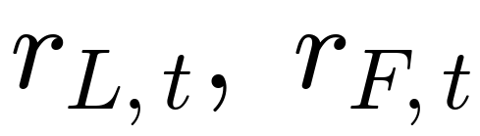


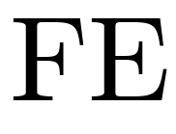
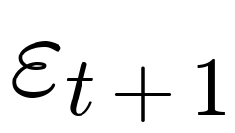
Measuring the lead–lag
Question: if the leader rose more than the follower in this minute, does the follower rise more in the next minute?
A regression answers this: it estimates, on average, how the follower's next-minute return responds to each of this minute's returns. Everything on the right-hand side is known when minute t ends.
leader's return and follower's return in minute t
how much the follower responds to the leader's return
how much the follower responds to its own return
separate intercepts for each pair, each day, and each minute of the day
error term
One row = one minute of one pair, e.g. QQQM's return in minute t+1 with QQQ's and QQQM's returns in minute t. Rows from all four pairs and all 980 days go into one regression, estimated once (not rolling). β for each pair: next slide.
Standard errors clustered by day. The reverse regression swaps leader and follower, giving β(F→L).
Pairs (leader → follower): GLD → IAU, IWM → VTWO, QQQ → QQQM, VOO → SPLG. Each follower is compared only with its own leader.
Notes:
How do we measure the lead and the lag? If the leader rose more than the follower in this minute, does the follower rise more in the next minute?
A regression answers this. On the left is the follower's return in minute t plus one. On the right are the leader's return and the follower's own return in minute t. Everything on the right is known when minute t ends.
Beta measures how much the follower responds to the leader. Phi measures how much it responds to its own return. FE are separate intercepts for each pair, each day, and each minute of the day. Epsilon is the error term.
One row of data is one minute of one pair. We put all four pairs and all 980 days into one regression, and estimate it once; it is not rolling. Standard errors are clustered by day. The reverse regression swaps leader and follower, and gives beta F to L.
[Next slide]

Slide 9
How much of the gap?
Four pairs together, one minute | Estimate
β: leader → follower | 0.48
φ: follower's own return | −0.44
β(F→L): follower → leader | 0.02
β = 0.48: if the leader's return is 1 bp higher this minute, the follower's return next minute is 0.48 bp higher.
φ = −0.44: if the follower's own return is 1 bp higher this minute, its return next minute is 0.44 bp lower.
β(F→L) = 0.02: the leader barely responds to the follower.
Each pair on its own | β
QQQ → QQQM | 0.52
IWM → VTWO | 0.50
GLD → IAU | 0.43
VOO → SPLG | 0.39
So the follower closes about half of the return gap.
Example: QQQ +10 bp and QQQM +6 bp in minute t. Return gap = 4 bp. QQQM is expected to rise about 2 bp in minute t+1.
Pairs (leader → follower): GLD → IAU, IWM → VTWO, QQQ → QQQM, VOO → SPLG. Each follower is compared only with its own leader.
Notes:
Here are the results, with the four pairs estimated together.
Beta is 0.48: if the leader's return is 1 basis point higher this minute, the follower's return next minute is 0.48 basis points higher. Phi is minus 0.44: if the follower's own return is 1 basis point higher, its next return is 0.44 lower. Beta F to L is only 0.02, so the leader barely responds to the follower.
Because beta is about minus phi, the follower's next return is about 0.48 times the return gap. So the follower closes about half of the gap. For example, if QQQ rises 10 basis points and QQQM rises 6, the gap is 4, and QQQM is expected to rise about 2 basis points in the next minute.
The small table shows each pair on its own: beta ranges from 0.39 to 0.52.
Does the follower give this catch-up back later?
[Next slide]

Slide 10
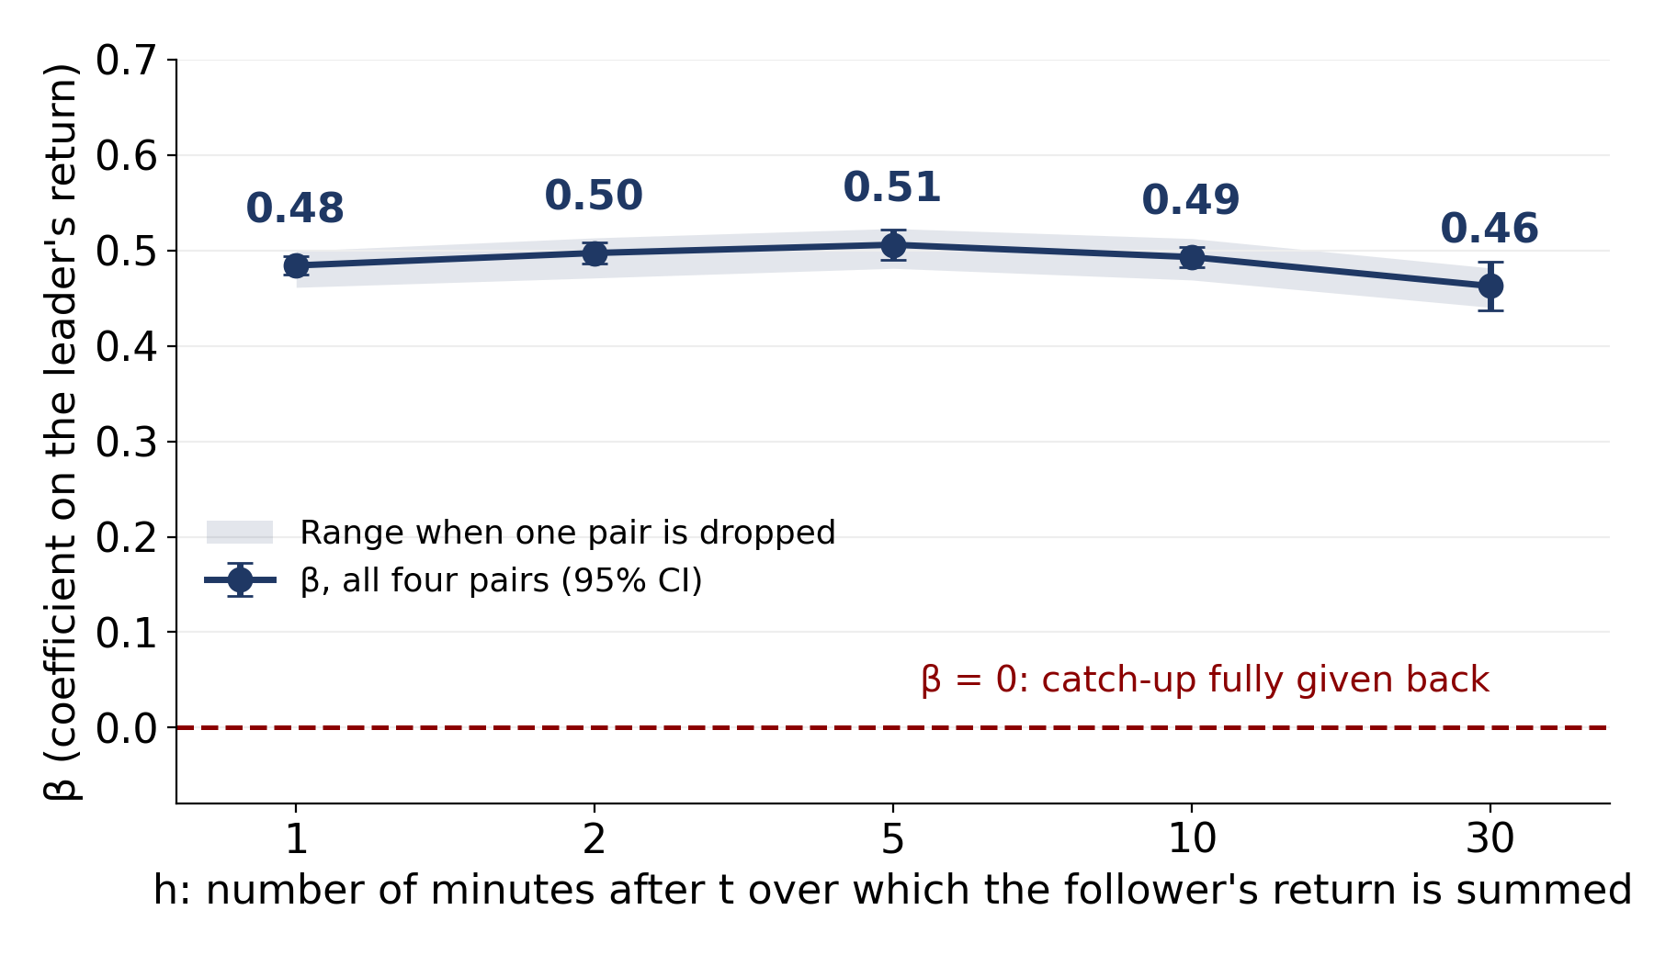
Does the follower give back its catch-up?
Same regression, but the left-hand side is the follower's return summed over minutes t+1 to t+h. The right-hand side is still the leader's move in minute t.
Why β does not grow with h: β is the response to that one leader move. Minutes t+2 to t+h add noise (wider intervals), but the leader's move does not predict them.
If the catch-up were later reversed, β would fall toward 0. Instead it stays near 0.5: 0.48 at 1 minute, 0.46 at 30 minutes. In the QQQ example, QQQM is still about 2 bp higher after 30 minutes.
Why it matters: a move that is later reversed would be noise or temporary price pressure. A move that lasts means the follower takes in the same information as the leader, one minute later.
Four pairs estimated together; day-clustered 95% CIs. Shaded band: range of β when one pair is left out.
The catch-up lasts: it is delayed price discovery, not noise.
Pairs (leader → follower): GLD → IAU, IWM → VTWO, QQQ → QQQM, VOO → SPLG. Each follower is compared only with its own leader.
Notes:
We keep the same regression, but the left-hand side is now the follower's return summed over minutes t plus one to t plus h. The right-hand side is still the leader's move in minute t.
Why does beta not grow with h? Beta is the follower's response to that one leader move. The extra minutes add noise, so the intervals get wider. But the leader's move in minute t does not predict them, so they add no response.
If the catch-up were later reversed, beta would fall toward zero, the red dashed line. Instead, it stays near 0.5: 0.48 at one minute and 0.46 at 30 minutes. In the QQQ example, QQQM is still about 2 basis points higher after 30 minutes.
Why does this matter? A move that is later reversed would just be noise, or temporary price pressure. A move that lasts means the follower takes in the same information as the leader, only one minute later. So the catch-up is delayed price discovery, not noise.
Next, we check the same relation in quotes.
[Next slide]

Slide 11
Background: trade prices and quotes
Trade price: the price of the last trade in a minute. If the follower has no new trade, its price stays old ("stale").
Quotes: at every moment, market makers post a bid (the highest price someone will pay) and an ask (the lowest price someone will sell at).
NBBO (National Best Bid and Offer): the highest bid and the lowest ask across all US exchanges at that moment. The quotes we use are the NBBO.
Midpoint = (bid + ask) / 2. It moves whenever quotes change, even without a trade.
Bid-ask spread: (ask − bid) / midpoint, in basis points (1 bp = 0.01% of the price). All spreads and costs in this talk are percentages of the price, not cents. Buying and then selling right away costs about one spread.
Quotes are used on a sample: 120 days spread evenly over 2022–2025, one 15-minute window per day.
So if the follower only looked slow because its trade price was stale, the delay would disappear in midpoints.
Example
Bid | $100.00
Ask | $100.02
Midpoint | $100.01
Ask − bid | $0.02
Spread | 0.02 / 100.01 ≈ 2 bp
Notes:
Some background on prices. A trade price is the price of the last trade in a minute. If the follower has no new trade, its price stays old. We call this stale.
Quotes are different. At every moment, market makers post a bid, the highest price someone will pay, and an ask, the lowest price someone will sell at. We use the NBBO, the best bid and ask across all US exchanges.
The midpoint is the average of the bid and the ask. It moves whenever quotes change, even without a trade.
The bid-ask spread is the ask minus the bid, divided by the midpoint. In the example, it is about 2 basis points. All spreads and costs in this talk are percentages of the price, not cents.
We use quotes on 120 days spread over 2022 to 2025, one 15-minute window per day. If the follower only looked slow because its trade price was stale, the delay would disappear in midpoints.
[Next slide]

Slide 12
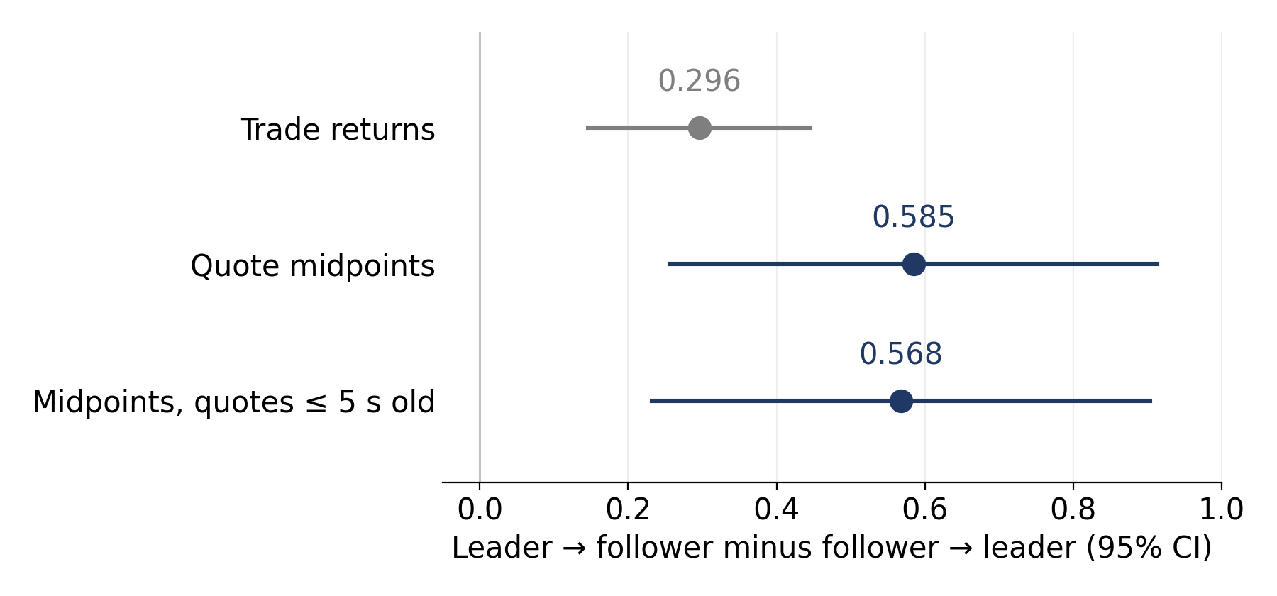
Stronger in quote midpoints than in trades
Why this test: the follower trades less often, so its last trade price can be minutes old. When it finally trades, its trade return "catches up" mechanically and looks like it follows the leader, even if its true value moved at the same time (Lo and MacKinlay 1990). Quote midpoints move without any trade, so this mechanical delay is absent there.
Δ = β(L→F) − β(F→L): the follower's response to the leader (the β of slide 9) minus the leader's response to the follower. Same minutes of the 120-day quote sample.
Δ in trades 0.296; in midpoints 0.585; in midpoints with quotes ≤ 5 s old 0.568.
Full trade data, minutes where both returns are non-zero (neither price is old): β = 0.46.
The delay is in the quotes themselves; it does not come from old trade prices.
Day-clustered 95% intervals. Leader quotes also update first: the follower's quote updates rise in the minute after the leader's.
Pairs (leader → follower): GLD → IAU, IWM → VTWO, QQQ → QQQM, VOO → SPLG. Each follower is compared only with its own leader.
Notes:
Why do we need this test? The follower trades less often, so its last trade price can be minutes old. When it finally trades, its return catches up mechanically, and it looks as if it follows the leader. This is the nonsynchronous trading problem of Lo and MacKinlay, 1990. Midpoints move without trades, so this mechanical delay is absent there.
We measure delta: beta L to F, the same beta as on slide 9, minus beta F to L, on the same minutes of the quote sample.
Delta is 0.296 in trade prices, 0.585 in midpoints, and 0.568 when quotes are at most 5 seconds old. And in the full trade data, in minutes where neither price is old, beta is still 0.46.
So the delay is in the quotes themselves. It does not come from old trade prices.
[Next slide]

Slide 13
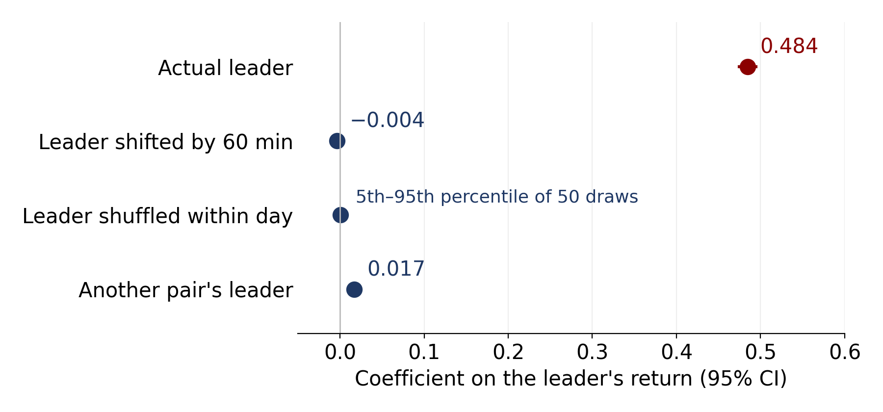
It needs the exact minute
Why these tests: β could be positive without a one-minute delay, e.g. if both ETFs drift the same way within a day, or if the follower reacts to any market move rather than to its own leader. Each test keeps one of these but breaks the exact-minute link to the pair's own leader. If β came from them, the "wrong" leader return would still get a positive coefficient.
Example: predicting QQQM's return at 11:31.
Actual leader: QQQ at 11:30 → 0.484.
Shifted by 60 min: QQQ at 10:30, same day → −0.004.
Shuffled within day: QQQ's returns of that day in random order, 50 times → middle 90%: −0.002 to 0.004.
Another pair's leader: VOO at 11:30, added next to QQQ → VOO 0.017; QQQ keeps 0.475.
Each row is one regression, four pairs estimated together. Another pair's leader: GLD/IAU gets IWM, IWM/VTWO gets QQQ, QQQ/QQQM gets VOO, VOO/SPLG gets GLD.
Almost all of the prediction comes from the matched leader's return in the same minute.
Pairs (leader → follower): GLD → IAU, IWM → VTWO, QQQ → QQQM, VOO → SPLG. Each follower is compared only with its own leader.
Notes:
Why do we need these tests? Beta could be positive without a one-minute delay, for example if both ETFs drift the same way within a day, or if the follower reacts to any market move. Each test keeps one of these features, but breaks the exact-minute link to the pair's own leader.
Take the example of predicting QQQM at 11:31. With the actual leader, QQQ at 11:30, the coefficient is 0.484. With QQQ from 60 minutes earlier, at 10:30, it is minus 0.004. If we shuffle QQQ's returns within the day, 50 times, the middle 90 percent lies between minus 0.002 and 0.004. And if we add VOO at 11:30 next to QQQ, VOO gets only 0.017, while QQQ keeps 0.475.
So almost all of the prediction comes from the matched leader's return in the same minute.
[Next slide]

Slide 14
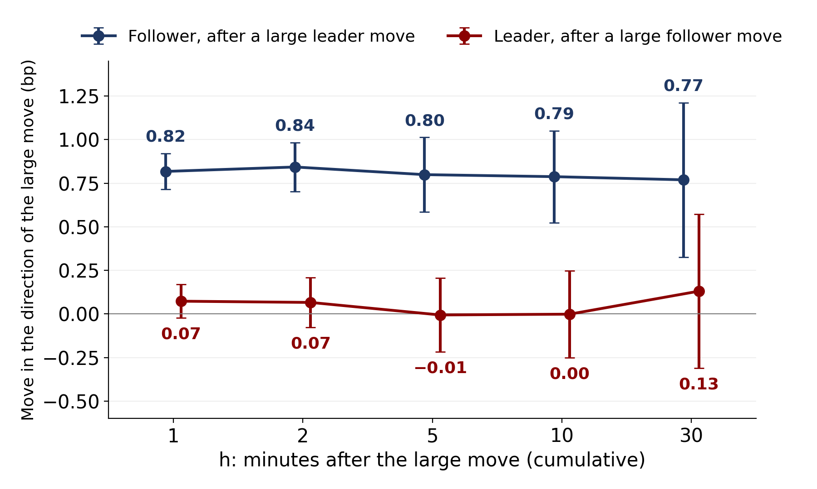
How large is the predictable move?
Large leader move: absolute return above that pair's 95th percentile (median 9.6 bp). Four pairs averaged together.
Blue line: the follower moves about 0.8 bp further in the direction of the leader's move, and keeps it for 30 minutes.
Red line: after a similarly large follower move (above its own 95th percentile, median 9.9 bp), the leader moves only about 0.07 bp.
The follower's quoted bid-ask spread is 1.2–2.6 bp. So the predictable 0.8 bp is smaller than the spread.
Pairs (leader → follower): GLD → IAU, IWM → VTWO, QQQ → QQQM, VOO → SPLG. Each follower is compared only with its own leader.
Notes:
How large is this move in basis points?
Here we look only at large leader moves: minutes when the leader's absolute return is above its 95th percentile. The median large move is 9.6 basis points.
The blue line shows the follower after a large leader move. It moves about 0.8 basis points further in the direction of the leader's move, and keeps this gain for 30 minutes.
The red line shows the reverse. After a similarly large follower move, the leader moves only about 0.07 basis points.
Now compare 0.8 basis points with the cost of trading. The follower's quoted bid-ask spread is 1.2 to 2.6 basis points. So the predictable move is smaller than the spread. Please keep this number in mind when we turn to trading.
[Next slide]

Slide 15
Background: forecasting out of sample
Now we ask whether a forecasting model can learn this delay.
LSTM: a type of neural network that reads a sequence of past values (here, 30 minutes of 16 features computed from both ETFs' past returns) and outputs a forecast of each ETF's next-minute return.
Out of sample: the model is trained only on earlier days, then forecasts days it has never seen. This is how it would be used in real time.
R²: the share of the ups and downs in next-minute returns that the forecast explains. 0% means no better than always forecasting the average return.
Notes:
Now we ask whether a forecasting model can learn this delay.
We use an LSTM. An LSTM is a type of neural network that reads a sequence of past values and outputs a forecast. Here, it reads 30 minutes of 16 features computed from both ETFs' past returns, and it forecasts each ETF's return in the next minute.
All forecasts are out of sample. This means the model is trained only on earlier days, and then forecasts days it has never seen. This is how it would be used in real time.
To measure accuracy, we use R squared: the share of the ups and downs in next-minute returns that the forecast explains. Zero percent means no better than always forecasting the average return.
[Next slide]

Slide 16
Out-of-sample forecasts
Follower, R² (%) | LSTM | Linear
QQQ/QQQM | 8.9 | 6.9
IWM/VTWO | 5.5 | 4.9
GLD/IAU | 4.7 | 3.8
VOO/SPLG | 1.5 | 1.7
Unlike the lead–lag regression, which is estimated once, the LSTM is rolled forward: every 5 days we train a new LSTM on the previous 20 trading days (blue) and forecast the next 5 days (red). 196 windows cover all 980 days.
Input: a 30-minute sequence of 16 features from both ETFs' past returns (backup slide). Target: each ETF's return in the next minute.
Benchmark: a linear regression on both ETFs' current returns, refit on the same 20-day windows.
The ranking across pairs matches the ranking of β. For the leader, R² is slightly below 0.
Pairs (leader → follower): GLD → IAU, IWM → VTWO, QQQ → QQQM, VOO → SPLG. Each follower is compared only with its own leader.
Notes:
Unlike the lead-lag regression, the LSTM is rolled forward. Every 5 days, we train a new LSTM on the previous 20 trading days, in blue, and forecast the next 5 days, in red. 196 windows cover all 980 days. The benchmark is a linear regression on both ETFs' current returns, refit on the same windows.
The table shows the out-of-sample R squared for the follower. For QQQM it is 8.9 percent, against 6.9 for the linear model. The ranking across pairs matches the ranking of beta. For the leader, R squared is slightly below zero.
The forecasts work. Do they make money?
[Next slide]

Slide 17
Background: from forecasts to trades
Portfolio: always fully invested in the two ETFs of a pair, long only. Every minute, the LSTM's two return forecasts set the weights:
μ̂: forecast of next-minute return; w: share of the portfolio in each ETF. Equal forecasts give 50/50; the ETF with the higher forecast gets more. τ sets how fast the weight tilts.
Example: QQQM's forecast is 1 bp above QQQ's → hold 62% QQQM and 38% QQQ. 4 bp above → 88% and 12%.
Sharpe ratio: average return divided by the volatility of returns, per year. Higher is better.
Trading cost: proportional to the amount traded. 1 bp one-way means $1 for every $10,000 bought or sold. For the follower, half the bid-ask spread is 0.6–1.3 bp, so 1 and 2 bp are realistic costs.
Notes:
To trade, we hold a portfolio that is always fully invested in the two ETFs of a pair, long only. Every minute, the two forecasts set the weights through this softmax formula.
If the two forecasts are equal, we hold 50 percent in each. The ETF with the higher forecast gets more. For example, if QQQM's forecast is 1 basis point above QQQ's, we hold 62 percent QQQM and 38 percent QQQ.
We judge performance by the Sharpe ratio: the average return divided by its volatility, per year.
Trading costs are proportional to the amount traded. A cost of 1 basis point one-way means 1 dollar for every 10,000 dollars traded. Half the follower's spread is 0.6 to 1.3 basis points, so 1 and 2 basis points are realistic costs.
[Next slide]

Slide 18
Trading the forecasts every minute
Sharpe ratio | Before costs | 1 bp one-way
QQQ/QQQM | 13.4 | −1.4
IWM/VTWO | 9.6 | −3.0
GLD/IAU | 6.8 | −8.9
VOO/SPLG | 4.3 | −5.6
Rule 1 (direct rule): every minute, move to the weights implied by the forecasts. The portfolio is always fully invested in the two ETFs; only the split between them changes.
Before costs, the Sharpe ratio is 4.3 to 13.4. With a one-way cost of 1 bp, Rule 1 loses money in every pair.
Why? Rule 1 trades 12,600 to 24,000 times its capital each year. At 1 bp, costs equal 126% to 240% of capital per year.
The predictable move (below 1 bp) cannot pay for this much trading.
Notes:
First, the simplest rule. Rule 1, the direct rule, moves to the weights implied by the forecasts every minute.
The table shows the Sharpe ratio. Before costs, the Sharpe ratio is 4.3 to 13.4, which is very high. But with a one-way cost of only 1 basis point, Rule 1 loses money in every pair.
Why? Because Rule 1 trades 12,600 to 24,000 times its capital each year. At 1 basis point, the costs equal 126 to 240 percent of capital per year.
The predictable move, which is below 1 basis point, cannot pay for this much trading. So the problem is not the forecast. The problem is when to trade.
[Next slide]

Slide 19
Rule 2: trade only when the gain beats the cost
Smart Trading Rule (STR; Li, Mulvey and Fabozzi 2026). Every minute, move to the new weights only if:
Left side: the expected gain from the trade, using the same forecasts as Rule 1.
Right side: the cost of the trade, c per unit traded.
If the gain is smaller than the cost, keep the current weights.
μ̂: forecasts of the two ETFs' next-minute returns; w: target weights; w̃: weights carried over from the previous minute.
Notes:
Rule 2 trades only when the gain beats the cost. This is the Smart Trading Rule, or STR, from Li, Mulvey and Fabozzi, 2026.
Every minute, we move to the new weights only if this inequality holds.
The left side is the expected gain from the trade, using the same forecasts as Rule 1. The right side is the cost of the trade, c per unit traded. If the gain is smaller than the cost, we keep the current weights. Here, w tilde is the weights carried over from the previous minute.
So STR uses exactly the same forecasts. It only changes when we trade.
[Next slide]

Slide 20
Same forecasts, different execution
Sharpe ratio | Rule 1, 1 bp | STR, 1 bp | STR, 2 bp | Hold follower
QQQ/QQQM | −1.4 | 5.7 | 2.2 | 0.4
IWM/VTWO | −3.0 | 3.2 | 0.9 | 0.05
GLD/IAU | −8.9 | 0.9 | 0.8 | 0.8
VOO/SPLG | −5.6 | 0.7 | 0.4 | 0.4
At 1 bp, STR trades 72–98% less than Rule 1, and its Sharpe ratio stays positive in all four pairs.
For QQQ/QQQM and IWM/VTWO, the 95% bootstrap interval of STR is above zero. For Rule 1, it is below zero in all pairs.
Hold follower: 100% in the follower, no trading. At 2 bp, STR still beats it in QQQ/QQQM and IWM/VTWO.
Notes:
Here are the results. The grey column repeats Rule 1, which loses money in every pair. The boxed column is STR at 1 basis point. Its Sharpe ratio is positive in all four pairs, from 0.7 to 5.7.
STR trades 72 to 98 percent less than Rule 1. For QQQ and QQQM, and for IWM and VTWO, its 95 percent bootstrap interval is above zero. For Rule 1, it is below zero in all pairs.
The last column holds 100 percent in the follower, without trading. At 2 basis points, STR still beats it in QQQ and QQQM, and in IWM and VTWO.
[Next slide]

Slide 21
Conclusion: same portfolio, different clocks
Question 1: How much of the return gap does the follower close in the next minute?
About half (β = 0.48), and it keeps this through the 30 minutes we track. The result is stronger in quote midpoints than in trade prices, and it disappears when the exact-minute timing is broken.
Question 2: Can a forecasting model trade on this delay after costs?
An LSTM predicts the follower out of sample, but the predictable move (about 0.8 bp) is smaller than the follower's spread (1.2–2.6 bp). Trading every minute loses money at 1 bp. STR, which trades only when the gain beats the cost, keeps a positive Sharpe ratio at 1 bp in all four pairs.
The delay is real price discovery. Whether it pays depends on when you trade.
Next: relate the size of the delay to trading volume, fees and quote activity in more matched products, such as standard and mini futures.
Notes:
To conclude, let me go back to our two questions.
Question one: how much of the return gap does the follower close in the next minute? About half, with a beta of 0.48. And it keeps this catch-up through the 30 minutes we track. The result is stronger in quote midpoints than in trade prices, and it disappears when we break the exact-minute timing.
Question two: can a forecasting model trade on this delay after costs? An LSTM does predict the follower out of sample. But the predictable move, about 0.8 basis points, is smaller than the follower's spread of 1.2 to 2.6 basis points. So trading every minute loses money at a cost of 1 basis point. STR, which trades only when the gain beats the cost, keeps a positive Sharpe ratio at 1 basis point in all four pairs.
So the delay is real price discovery. Whether it pays depends on when you trade.
As a next step, we want to relate the size of the delay to trading volume, fees and quote activity in more matched products, such as standard and mini futures.
[Next slide]

Slide 22
Thank you
Same Exposure, Different Clocks: Price Discovery and Cost-Aware Trading in Matched ETFs
Silu Li (sl3965@princeton.edu) · John M. Mulvey (mulvey@princeton.edu) · Siyu Li (lisiyu@westlake.edu.cn)
Questions are welcome.
Notes:
Thank you very much for your attention. I am happy to take questions.
[During Q&A: if a question matches a backup slide, jump to it. The list is on the next slide.]

Slide 23
Backup slides (for questions only)
These slides are not part of the talk. Open one only if a question asks for it.
24 Is it the same in every pair?
25 How does this relate to information shares?
26 Could stale trade prices produce this?
27 How is the quote sample built?
28 What goes into the LSTM, and how are costs charged?
29 How does STR behave as costs rise?
Notes:
Do not present this slide. It lists the backup slides, so you can jump to the right one during questions.

Slide 24
Is it the same in every pair?
One minute | β(L→F): leader → follower | β(F→L): follower → leader
QQQ/QQQM | 0.52 | 0.00
IWM/VTWO | 0.50 | 0.02
GLD/IAU | 0.43 | 0.05
VOO/SPLG | 0.39 | 0.12
Drop one pair, estimate on the other three | β
Without GLD/IAU | 0.49
Without IWM/VTWO | 0.48
Without QQQ/QQQM | 0.46
Without VOO/SPLG | 0.50
Time of day (four pairs together) | β
Open, 09:45–10:30 | 0.51
Midday, 10:30–15:00 | 0.48
Close, 15:00–15:45 | 0.46
So no single pair and no time of day drives the average β = 0.48. In VOO/SPLG the follower also carries some information of its own (β(F→L) = 0.12).
Pairs (leader → follower): GLD → IAU, IWM → VTWO, QQQ → QQQM, VOO → SPLG. Each follower is compared only with its own leader.
Notes:
BACKUP. Use only if asked whether the result holds in every pair.
Yes. This table shows each pair on its own. Beta from leader to follower is between 0.39 and 0.52 in every pair, and beta from follower to leader is between 0.00 and 0.12.
If we drop one pair and estimate on the other three, beta stays between 0.46 and 0.50. By time of day, beta is 0.51 at the open, 0.48 at midday, and 0.46 at the close. So no single pair and no time of day drives the average.
In VOO and SPLG, the follower also carries some information of its own, with a reverse beta of 0.12.

Slide 25
How does this relate to information shares?
1. Information shares (Hasbrouck 1995) and component shares (Gonzalo and Granger 1995) are standard measures of which market leads price discovery. Each gives one number between 0 and 1.
2. The component share depends on how fast each price moves to close the gap between the two prices.
3. Our regression gives these two speeds directly: per minute, the follower closes 0.48 of the gap and the leader closes 0.02. The implied component share of the leader is about 0.48 / (0.48 + 0.02) ≈ 0.96. So the standard measure would also say that the leader leads.
4. We report the regression because it also gives the size in bp, the speed, and whether the move lasts. These decide whether the delay can be traded.
0.96 is approximate: our regression uses returns and the return gap, not a full error-correction model of price levels.
Notes:
BACKUP. Use only if asked about information shares or standard price discovery measures.
Information shares, from Hasbrouck 1995, and component shares, from Gonzalo and Granger 1995, are the standard measures of which market leads price discovery. Each gives one number between zero and one.
The component share depends on how fast each price moves to close the gap between the two prices.
Our regression gives these two speeds directly. Per minute, the follower closes 0.48 of the gap, and the leader closes only 0.02. So the implied component share of the leader is about 0.48 divided by 0.50, which is about 0.96. The standard measure would also say that the leader leads. This number is approximate, because our regression uses returns, not a full error-correction model.
We report the regression because it also gives the size in basis points, the speed, and whether the move lasts. These are what decide whether the delay can be traded.

Slide 26
Could stale trade prices produce this?
Check (four pairs estimated together) | Estimate
β, minutes where both trade returns are non-zero (86%) | 0.46 (t = 86)
Δ in trade returns, quote sample | 0.296
Δ in midpoint returns, same minutes | 0.585 (t = 3.5)
Δ in midpoint returns, quotes ≤ 5 s old | 0.568 (t = 3.3)
Quote updates: leader → follower minus follower → leader | 0.19 (t = 4.9)
A stale follower price would make the follower look slow in trades but not in quote midpoints. The relation is stronger in midpoints.
Δ = β(L→F) − β(F→L). R² after the intercepts: leader's return alone 0.82%; follower's own return alone 0.01%; both together 4.79%.
Notes:
BACKUP. Use only if asked whether stale trade prices produce the result.
This table collects the checks. In minutes where both trade returns are non-zero, which is 86 percent of minutes, beta is 0.46. In the quote sample, delta is 0.296 in trades, 0.585 in midpoints, and 0.568 with quotes at most 5 seconds old. Leader quote updates also predict more follower quote updates than the reverse, with a difference of 0.19.
A stale follower price would make the follower look slow in trades, but not in midpoints. The relation is stronger in midpoints.

Slide 27
How is the quote sample built?
120 dates spread evenly over 2022–2025.
On each date, one 15-minute window; six start times across the day.
At each minute-end: the prevailing NBBO, with crossed quotes dropped. We record the midpoint, the time-weighted spread, the number of quote updates and the age of the latest quote.
Δ = β(L→F) − β(F→L) is estimated on the same pair-minutes for trades and midpoints.
Notes:
BACKUP. Use only if asked how the quote sample is built.
We take 120 dates spread evenly over 2022 to 2025. On each date, we use one 15-minute window, with six different start times across the day.
At each minute end, we take the prevailing NBBO and drop crossed quotes, where the bid is above the ask. We record the midpoint, the time-weighted spread, the number of quote updates, and the age of the latest quote.
Delta is estimated on the same pair-minutes for trades and for midpoints.

Slide 28
What goes into the LSTM, and how are costs charged?
A 30-minute sequence of 16 features. For each ETF: volatility-scaled returns (5, 15, 60 min), volatility (15, 60 min), Bollinger %b and drawdown. For the pair: the return gap and a 60-minute correlation.
One LSTM layer with 32 hidden units, trained with AdamW; the last 15% of each training window is used for early stopping.
Weights: a softmax of the two forecasts with τ = 2 bp; long-only and fully invested.
Costs: 1 and 2 bp one-way on turnover. Half the follower's spread is 0.6–1.3 bp.
Notes:
BACKUP. Use only if asked about the model or the costs.
The input is a 30-minute sequence of 16 features. For each ETF: volatility-scaled returns over 5, 15 and 60 minutes, volatility over 15 and 60 minutes, Bollinger percent b, and drawdown. For the pair: the return gap and a 60-minute correlation.
The network has one LSTM layer with 32 hidden units. It is trained with AdamW, and the last 15 percent of each training window is used for early stopping.
Weights are a softmax of the two forecasts with tau equal to 2 basis points, long only and fully invested. Costs are 1 and 2 basis points one-way on turnover.

Slide 29
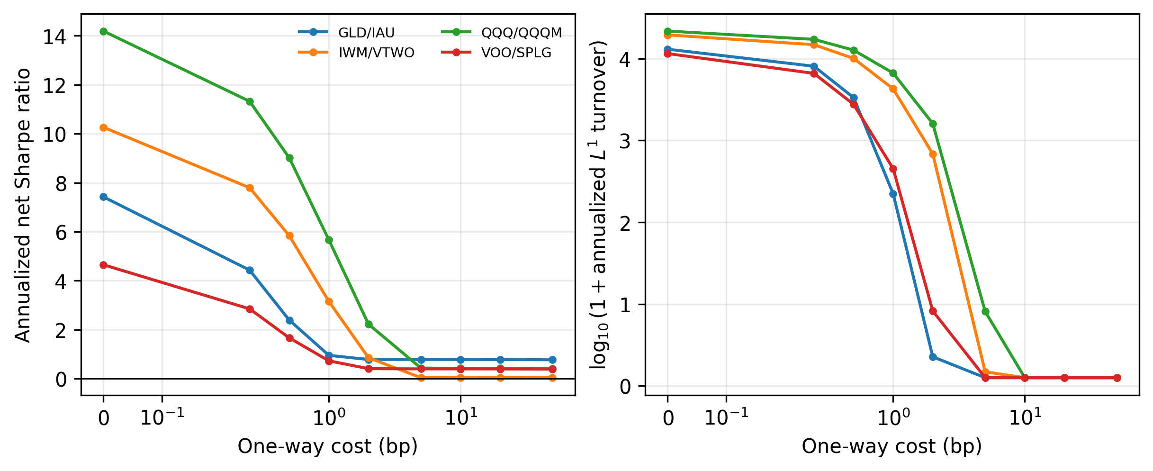
How does STR behave as costs rise?
As the cost rises, STR trades less and its Sharpe ratio falls toward that of holding the ETFs. GLD/IAU turnover falls from 13,054 to 222 times capital per year as the cost rises from 0 to 1 bp.
Notes:
BACKUP. Use only if asked how STR behaves as costs rise.
The left panel shows the Sharpe ratio, and the right panel shows turnover, both against the one-way cost.
As the cost rises, STR trades less, and its Sharpe ratio falls toward that of simply holding the ETFs. For GLD and IAU, turnover falls from 13,054 to 222 times capital per year as the cost rises from 0 to 1 basis point.

