Slide 1

Candidozyma (Candida) auris
What sets the thermal limit?
Why a WHO critical-priority pathogen grows where its closest relatives die — and why the answer is not metabolic
20
22–44 °C
4
isolates, 7 lineages
12 temperatures
main findings + a model

Slide 2


THE PROBLEM
Body heat is a barrier. C. auris crossed it.
~6% per °C
WHO critical
Grows at fever
of fungal species are excluded for every degree of body temperature above ambient (Bergman & Casadevall 2010)
one of four fungi in the top priority tier for research and public health
thrives on skin, on hospital surfaces, and inside a febrile host — where most relatives cannot
2

Slide 3



THE EXPERIMENT
One assay, every isolate, twelve temperatures
Dissolved-oxygen respirometry
THE PANEL
20 isolates · 7 lineages · 5 wells each · 22–44 °C
C. auris clades I–IV · 3 isolates each
Growth + respiration, hierarchically
C. haemulonii 3 isolates
Bayesian fits, isolates nested within clades
C. duobushaemulonii 2 isolates
Carbon-use efficiency
derived per cell — scale-free where it counts
C. parapsilosis 3 isolates · outgroup
3

Slide 4
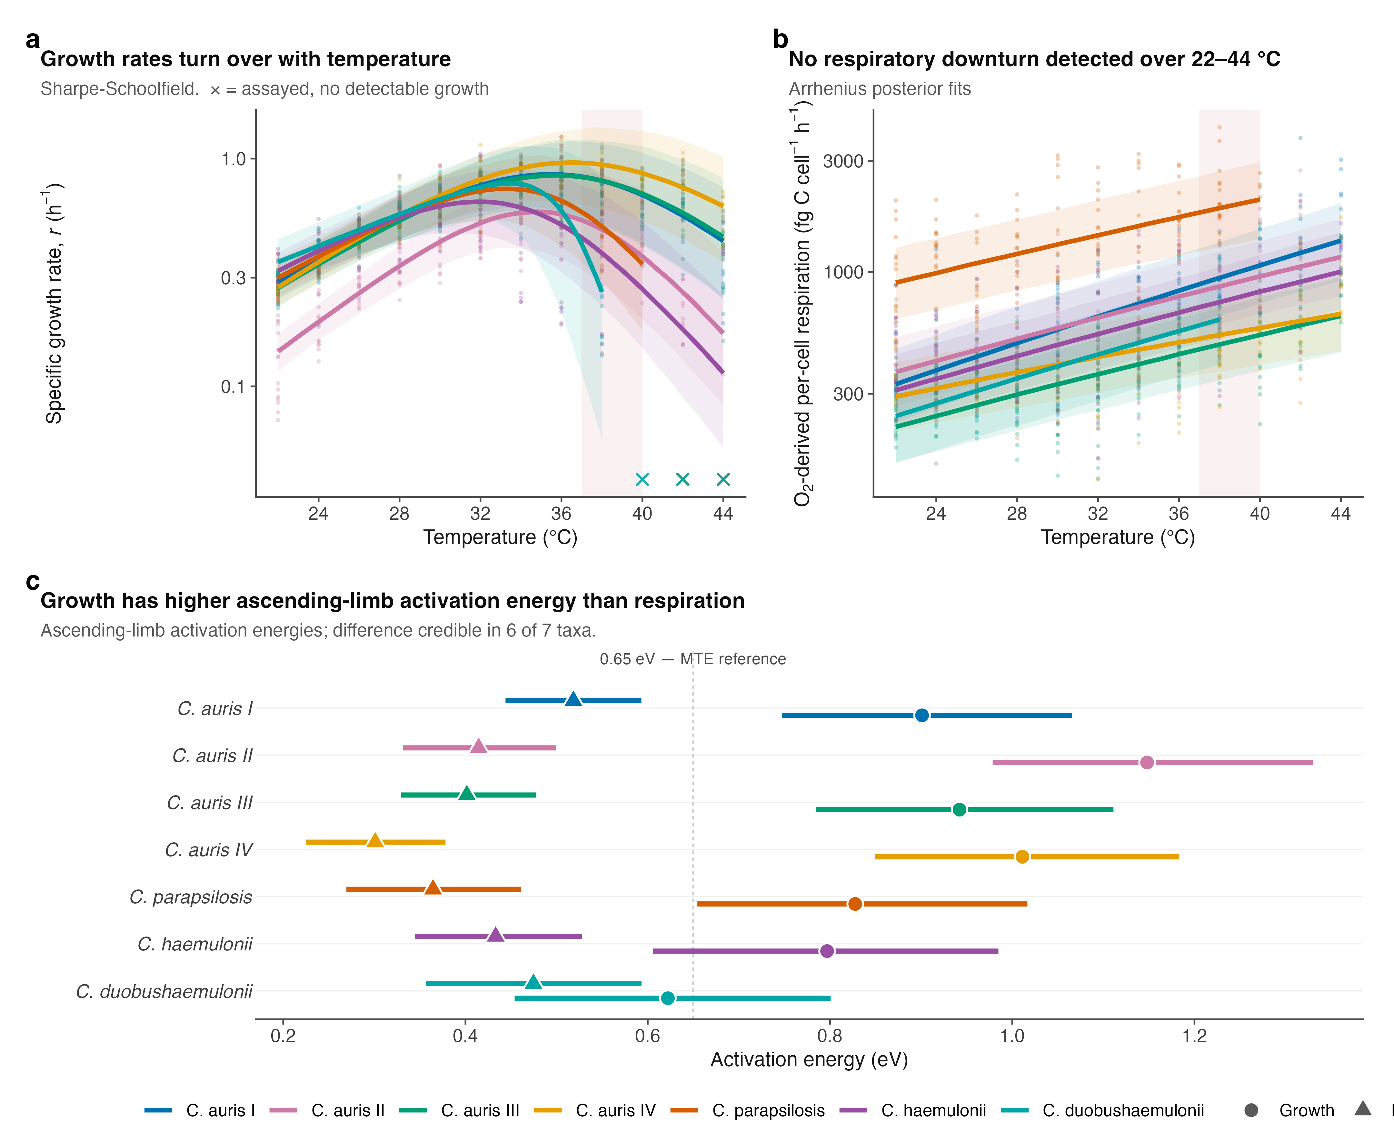
FINDING 1 · FIGURE 1
Growth turns over; respiration does not
Carbon efficiency peaks below body temperature
Growth peaks ~33–36 °C, respiration keeps rising.
So carbon-use efficiency peaks at 26–31 °C — below 37 °C in every group.
Holds scale-free: no assumption about cell number or carbon content.
4

Slide 5
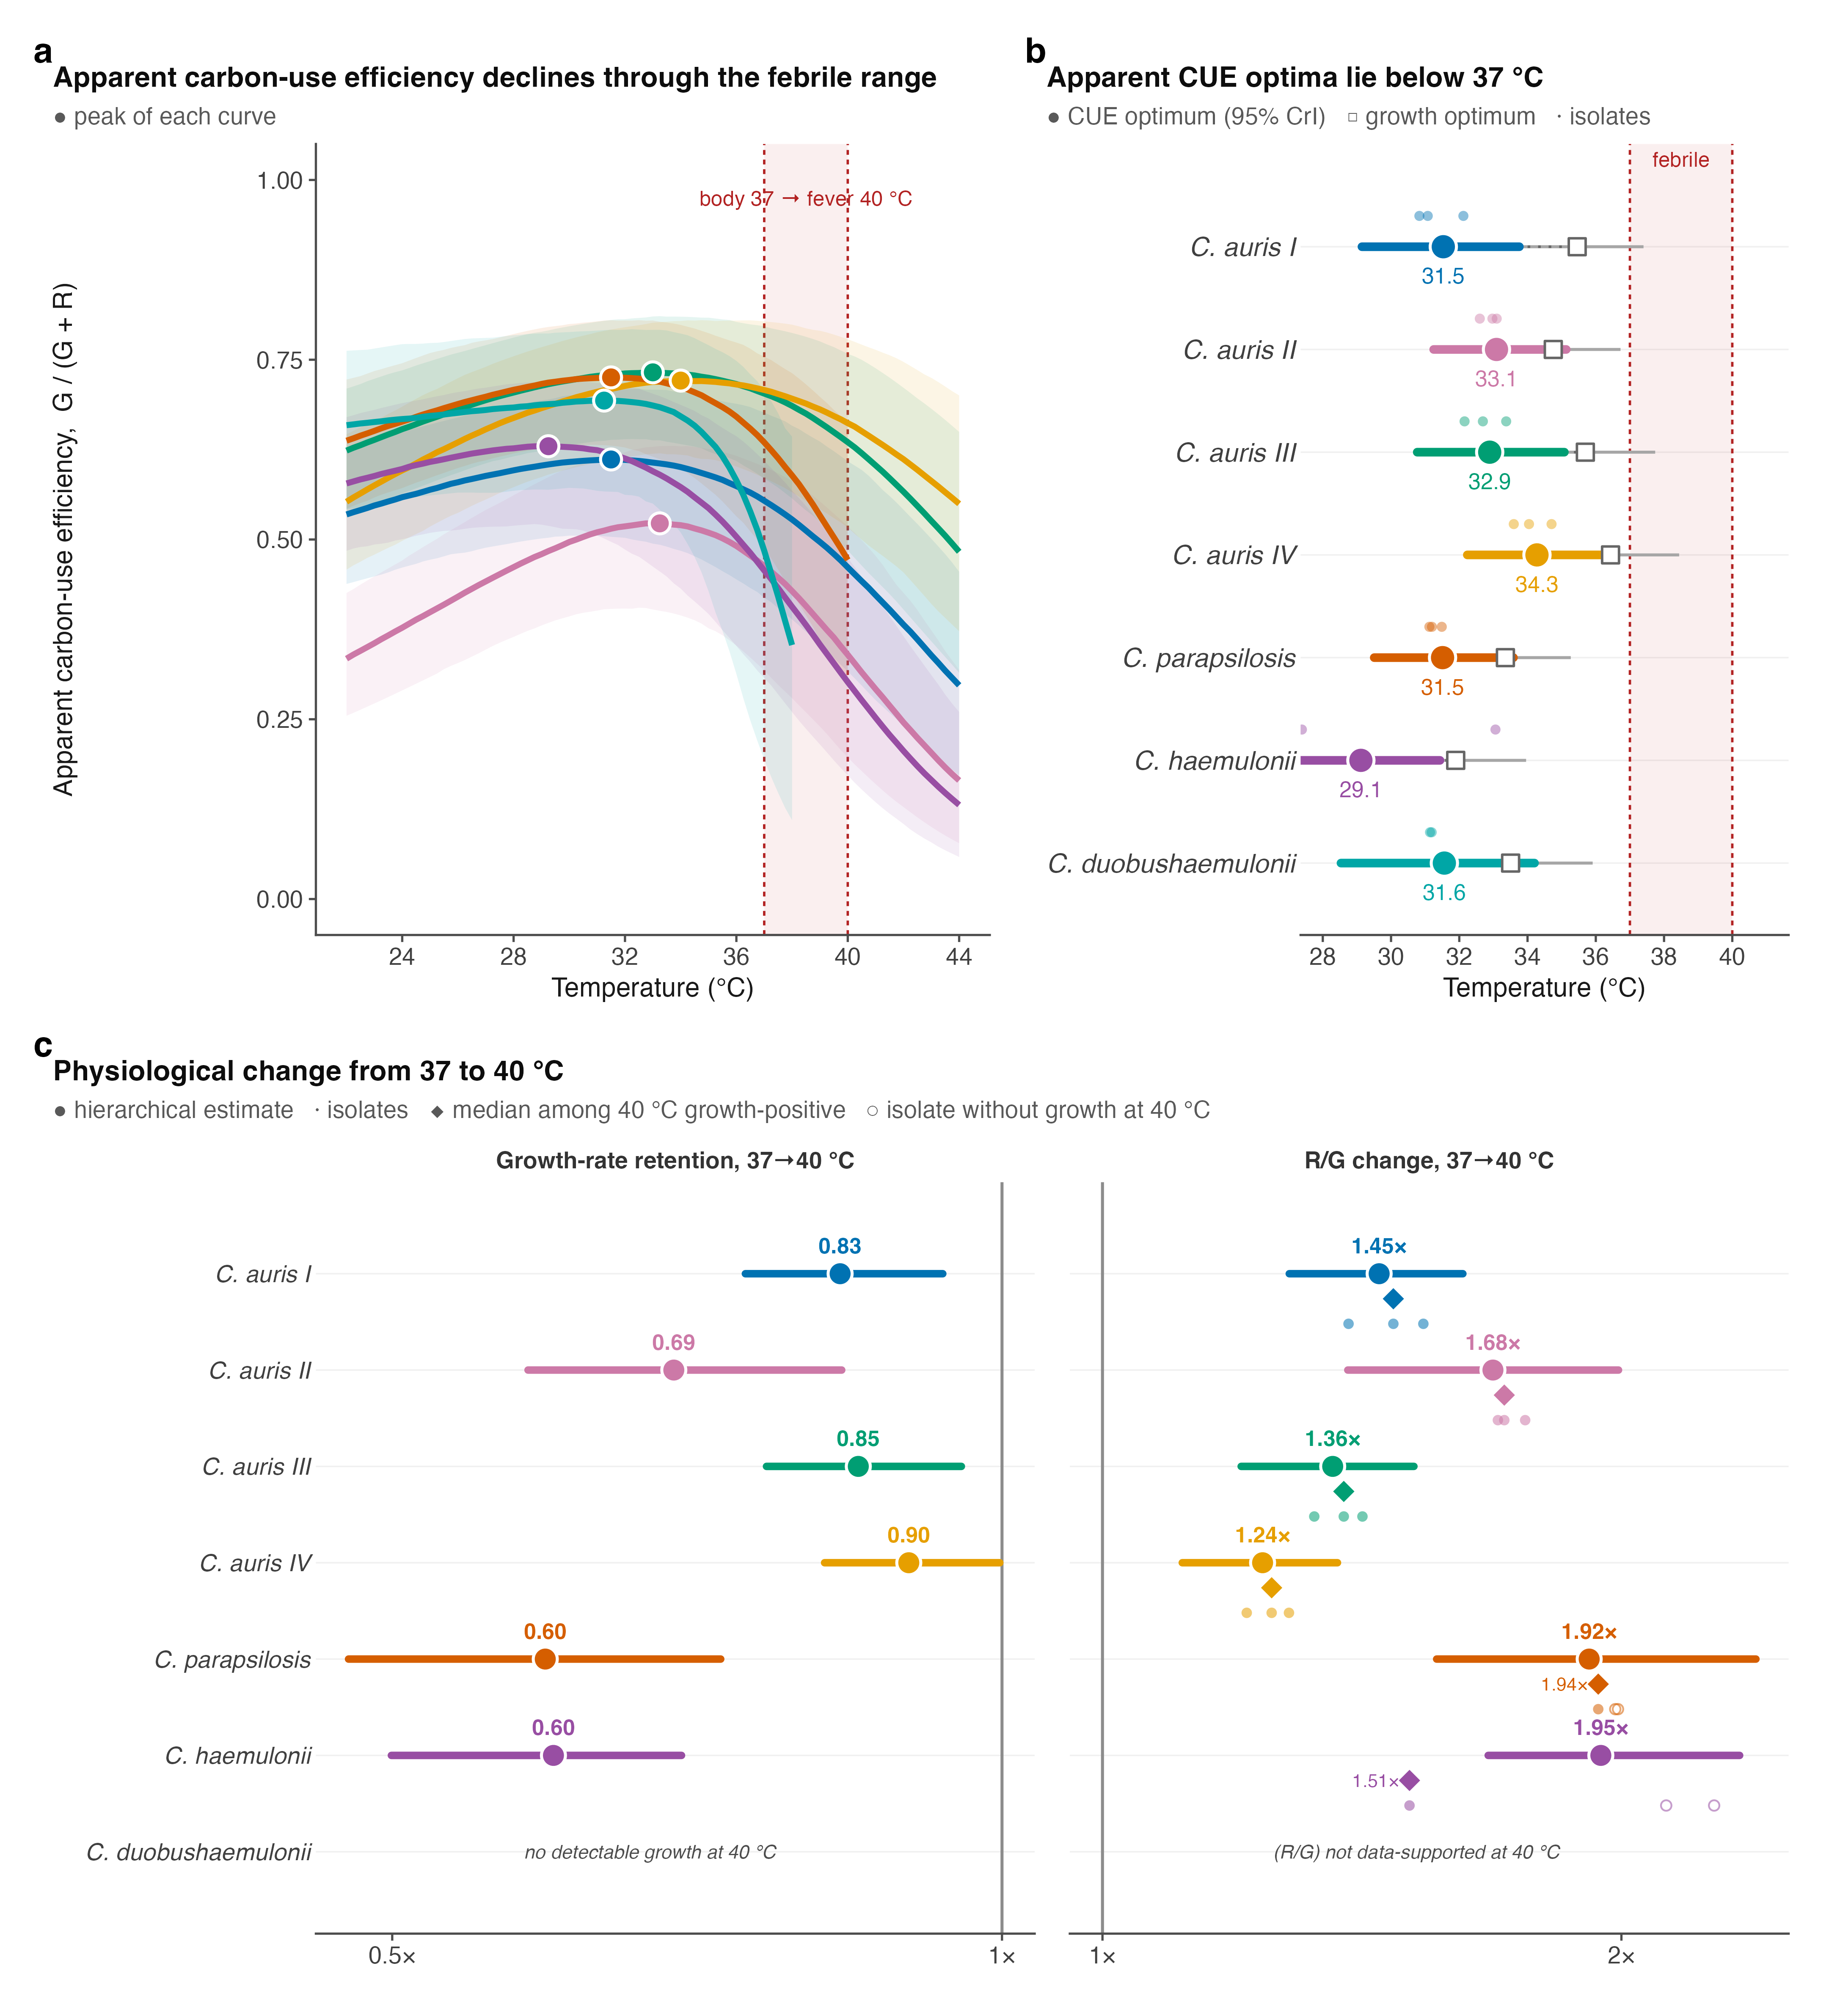

FINDING 2 · FIGURE 2
A fever carries a carbon cost — and it differs
Warm-adapted taxa pay less to run a fever
1.34×
3.13×
C. auris Clade IV
cost at 40 °C
C. parapsilosis
cost at 40 °C
The more thermotolerant the taxon, the cheaper its fever.
5

Slide 6
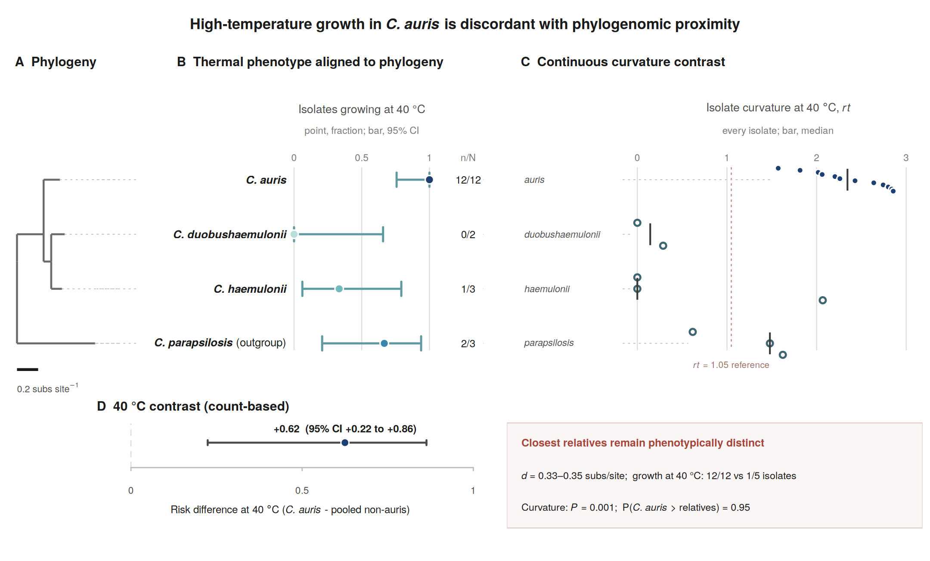

FINDING 3 · FIGURE 3
Thermotolerance does not follow the family tree
C. auris stands apart from near-identical kin
12/12 vs 3/8
isolates growing at 40 °C: C. auris vs its relatives (risk difference +0.63)
6

Slide 7


FINDING 4 · COMPARATIVE GENOMICS
The genome does not predict the phenotype
99.4–100%
Invariant
25× closer
whole-proteome identity across the four C. auris clades — yet they differ up to 2× in growth
copy number of every canonical heat-response gene (HSP90, trehalose, calcineurin…) across 10 genomes
the four clades differ in phenotype at 25× less divergence than the nearest species split
Thermal performance is evolutionarily labile — it is not written in gene content.
7

Slide 8
THE MODEL · UNDER THE HOOD
Data in, a thermal growth curve out
INPUTS & DATABASES
THE MODEL
OUTPUT
Genomes · 4 species
Metabolic network
NCBI Datasets
1
Curated networks
Enzyme protein cost
iRV973 · iDC1003 (BioModels)
2
Reaction rates (kcat)
Temperature a(T)
DLKcat
3
Enzyme Tm & Topt
growth vs temperature, per species
Seq2Tm / Seq2Topt (ESM2)
one shared protein budget
Σ MW/(k_{cat}·a(T))·v ≤ P
Growth medium
→ Figure 4
YMS
hotter enzyme → slower → costs more
4 parameters (σ, w, P, scale) fit on C. auris, then frozen
What we changed: we fixed one real error (a reaction running backwards in one species, corrected before Figure 4), then made three unrealistic shortcuts more lifelike. The model’s answer barely moved.
8

Slide 9

THE MODEL
An enzyme- & temperature-constrained metabolic model
1
Metabolic network
every reaction the genome encodes
How heat kills growth, in the model
2
Enzyme cost
Hot enzymes work slower, so they cost more protein.
The shared budget fills up.
Growth has to fall.
Tuned on C. auris alone, then frozen — the other three are pure prediction.
each reaction needs protein; one shared budget
3
Temperature
each enzyme has an optimum & a melting point, from sequence
9

Slide 10

THE MODEL · THE REALITY CHECK
We tried ten explanations. None survives a reality check.
What each test asks
Was the model unfair to itself?
1
Pick a possible explanation
We started from published models with a few unrealistic shortcuts. We checked each one:
e.g. “C. auris enzymes are more heat-stable”
2
Ask the model how big a change it needs
✓ A “perpetual-energy” loop
to make C. auris grow hot while relatives die
made energy from nothing — switched off (it barely did anything)
3
Compare that to real cells
✓ How it breathed
is the required change anything we actually measure?
was building itself from free amino acids — tightened
✓ How sharply proteins break with heat
Result: only 2 of 10 could work at all — and needed changes 3–34× bigger than anything real cells show.
was too gradual — set to how real proteins behave
Every shortcut made the model kinder to heat — and it still failed.
10

Slide 11
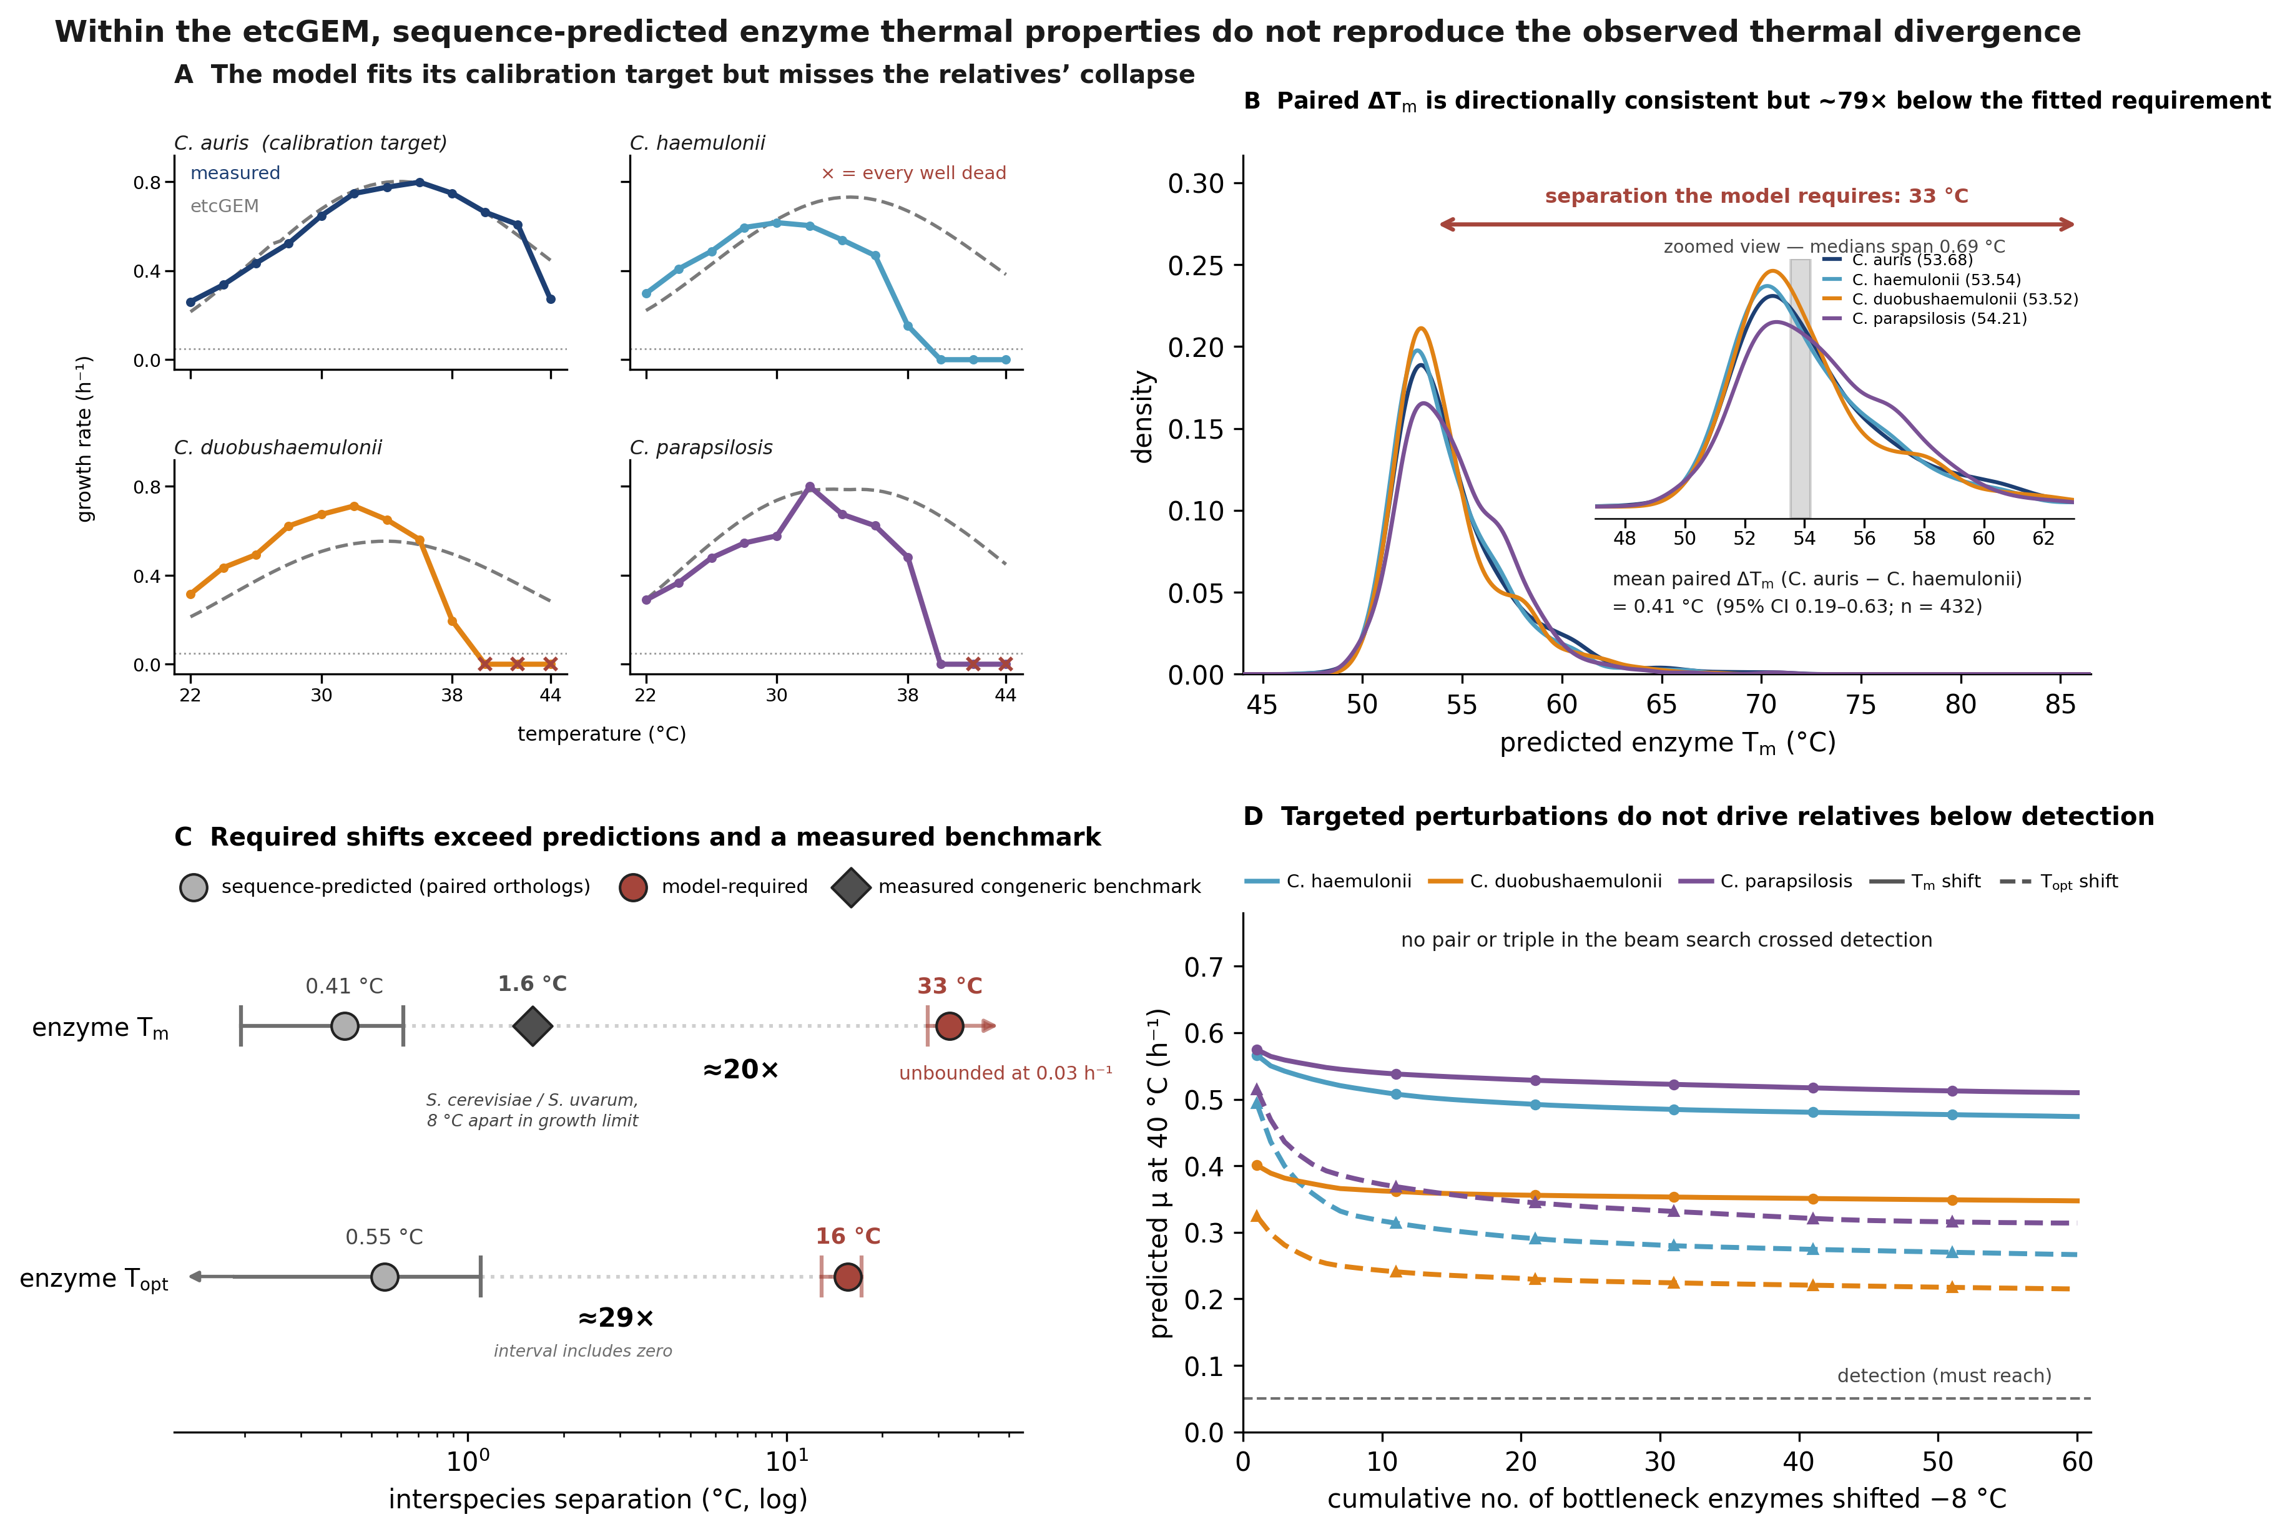
FINDING 5 · FIGURE 4
The model fits C. auris — and misses every relative
The parameters simply don’t differ
To reproduce reality the model needs 33 °C of difference in enzyme melting point.
Sequences differ by 0.4 °C.
11

Slide 12
THE PUNCHLINE
The cells die long before the model says they should
9–14 °C gap
40°
44°
45°
50°
53°
56°
relatives die
~40 °C
C. auris dies
~45 °C
model predicts
failure ~53 °C
The gap is not a modelling artefact. Even after we made the model as realistic as possible — and every fix made it more forgiving of heat — its predicted limit barely moved. Metabolism never set the limit; something else does.
12

Slide 13

THE LANDSCAPE
What the field knows — and the hole in the middle
What we know
What no one has done
One direct study (Xiao 2025): pyruvate & oxidative-stress control help heat survival — but in all three species, and only up to 41 °C.
Endothermy is a real barrier (Casadevall).
The C. auris lipidome is catalogued — but only at 30 °C (Shahi 2020).
Evolving yeast to heat hits sterols (Caspeta 2014); Cryptococcus hits stress signalling — no single answer.
Profiled membranes, proteostasis and mitochondria across the same thermal gradient, in the same cells.
Resolved which system fails FIRST at the thermal limit — answered in animals, never in fungi.
Moved the growth limit itself — shown any intervention lets a relative grow hotter, or pushed past 41 °C to where cells die.
13

Slide 14

THE LANDSCAPE · IN DETAIL
Three suspects: each studied, none decisive
CANDIDATE SYSTEM
WHAT IS KNOWN
THE GAP
Full C. auris lipidome — 582 species — is catalogued (Shahi 2020). Evolving yeast to heat converges on sterol change (Caspeta 2014).
Only ever measured at 30 °C, never across the thermal gradient or at the death point.
Membranes
Protein melting points mapped across the tree of life by thermal proteome profiling (Jarzab 2020). Hsp90 well studied in Candida.
No Candida pathogen in that atlas; no measure of which proteins actually aggregate inside a cell at its limit.
Proteostasis
In animals, mitochondrial capacity sets the thermal limit. Xiao 2025 links heat survival to oxidative-stress control (shared across species); our data show respiration rising as growth collapses.
Never tested in fungi as the limiting system; our lineage screen hints at it but does not prove it.
Mitochondria
No study has profiled all three across one thermal gradient — or asked which fails first.
14

Slide 15


THE PROPOSAL
Find the process that sets the limit
AIM 1
AIM 2
AIM 3
Find the limit & the order of failure
Prove which system controls it
Let evolution answer
Pin the death temperature, then watch whether membranes, protein quality control or mitochondria fail first.
Disrupt each in turn; measure absolute protein allocation and carbon content across temperature.
Evolve the relatives to higher heat; see if independent lines converge — and on what.
15

Slide 16
The one-line story
C. auris grows where its relatives die — and metabolism cannot explain why.
A defined 13 °C gap between what the model can explain and where cells actually die points to an unmapped failure process. We will find it.
membranes · proteostasis · mitochondria — which fails first?

