Slide 1

US Real EState Market – Housing price prediction
I
Idrees Andarr, Jennifer Ilyayeva, Ingrid camacho

Slide 2
Objective
The goal of this project is to analyze housing prices and build a predictive model to estimate home values based on various factors.
Understanding key determinants of price variation across different locations and property attributes.
Identify the best performing regression model

Slide 3
Key Questions
What factors impact housing prices the most?
What is the distribution of housing prices across the states?
How do prices vary across different states and cities?
Can we build an accurate machine learning model to predict house prices?
How does preprocessing impact the dataset?
Which regression model performs best?

Slide 4
Project objective
DataBase available for north east states of US, including
Price
# bedrooms
# bathroom
Acre lot
City
State
Zip code
House size
Prev. Sold date
Analyzed the industry for the North East Region (CT, Del, DC, MA,MD,NH,NJ,NY, PA,RI, VT,VI)
Ran several models: linear regression, Forrest Tree, KNeighborsRegressor ,sklearn model, GradientBoostingRegressor,

Slide 5
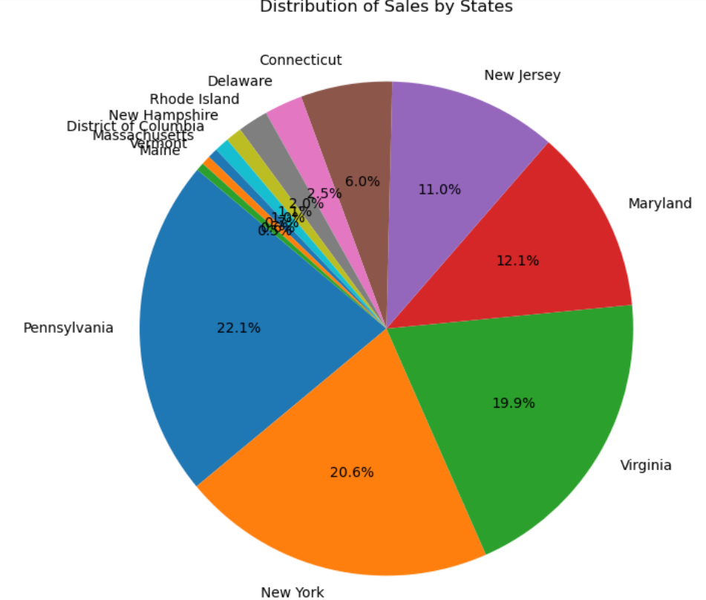
NE Real Estate OVERVIEW
Landscape shows:
Most Populated Estates have also the largest numbers of transactions
Tri state (NY, PA, VI ) which are the most populated, accounts for 62 % of the volume of sales
NJ & ML the 4th most populated accounts for 23 % of the sales.

Slide 6
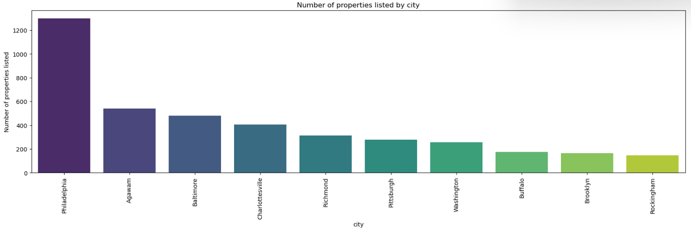
NE Real Estate OVERVIEW
By City the top 10 cities with the largest listing of properties are Philly, Agawarn, Baltimore, Charlotesville and Richmond

Slide 7
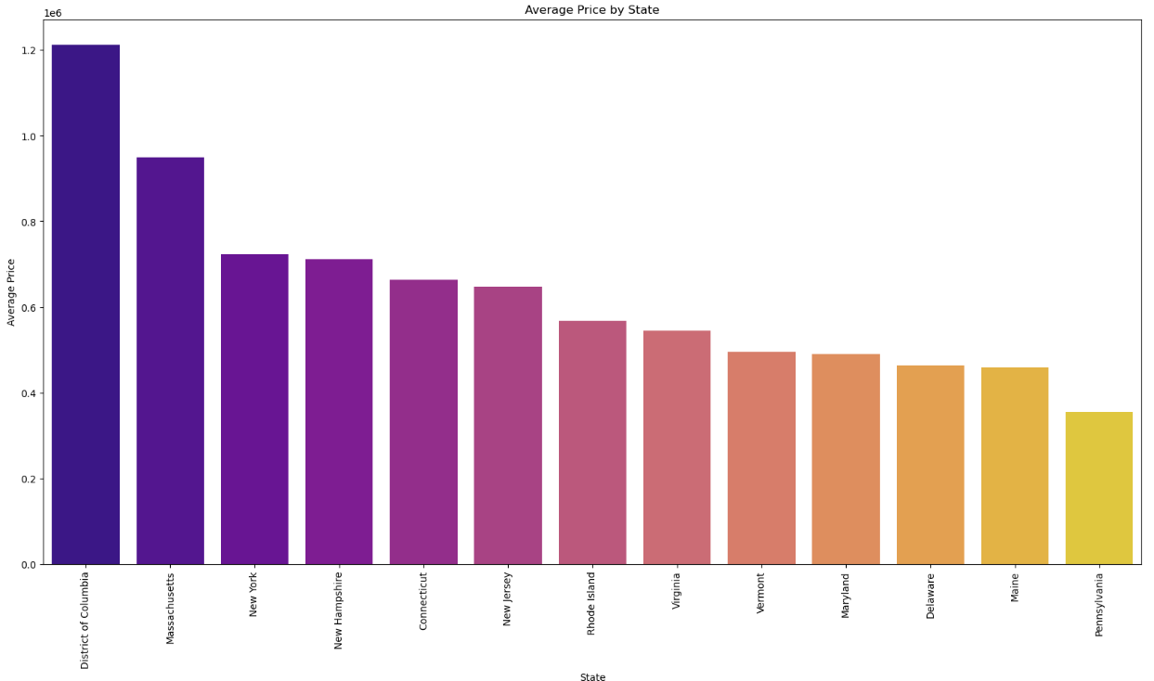
NE Real Estate OVERVIEW
Insight:
District of Columbia holds the highest average price of the set, being significant higher than Massachusetts 33%
Pennsylvania holds the lowest average price of the NE

Slide 8
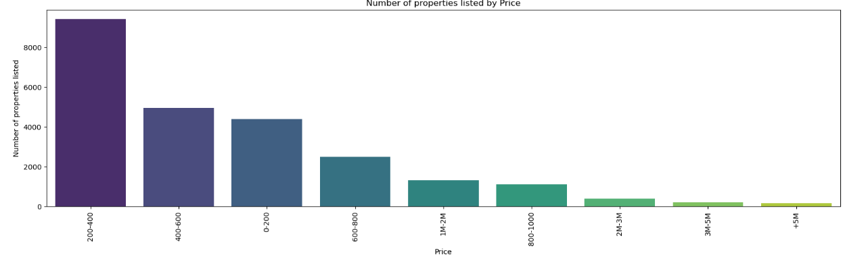
NE Real Estate OVERVIEW
Insight:
Per price the highest amount of houses listed are in the range of $200K to $400K
Supply drops almost to half for the next bucket $400K –$600K and then maintains for lower than $200K
$1M -$2M supply is higher than $800k - $1M

Slide 9
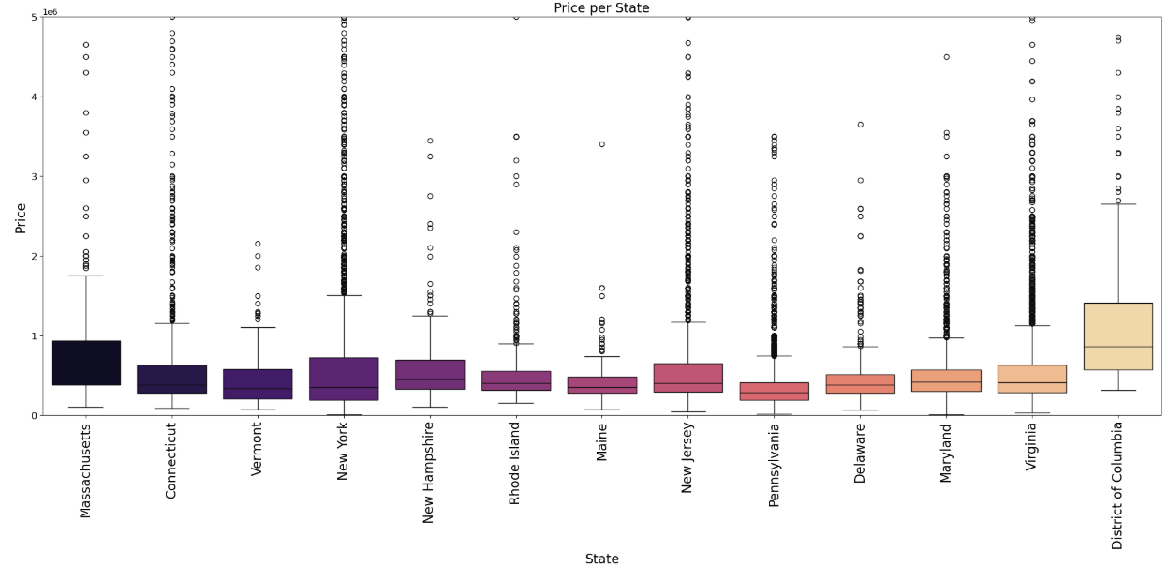
NE Real Estate OVERVIEW
Insight:
Price per state has a high dispersion especially in New York, Connecticut, New Jersey, Pennsylvania and Virginia
Most of the prices range below $1MM. However, District of Columbia sets prices way above the rest of the states.

Slide 10
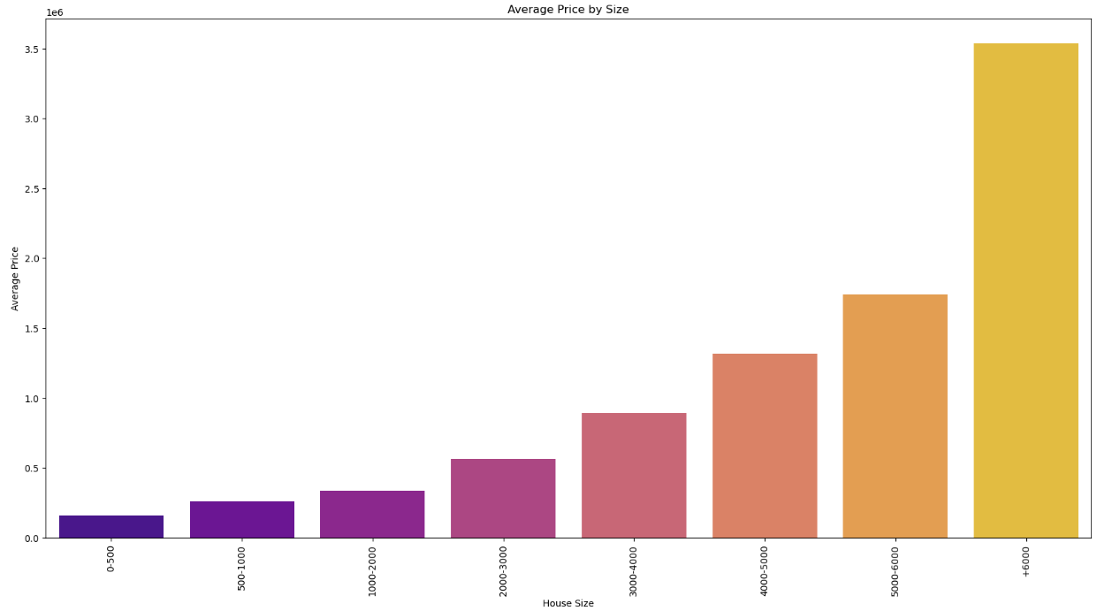
NE Real Estate OVERVIEW
Insight:
Average price seems to have a direct relationship with the size of the property

Slide 11
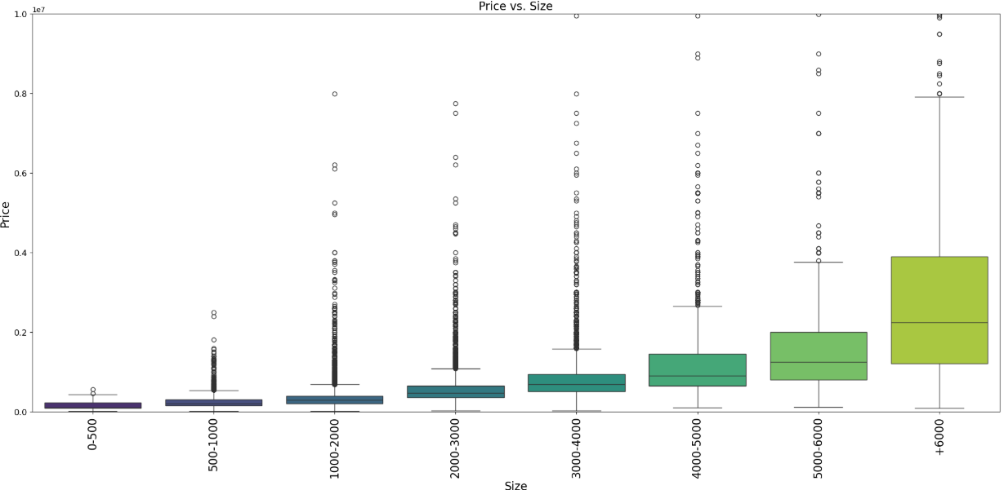
NE Real Estate OVERVIEW
Insight:
Price per size has an increasing relationship as the area increases the price also does.
However there is dispersion of prices specially in 1,000-3,000 sf , in these buckets prices can be as high as 6,000 sf average price.
Prices can be impacted by area but definitely can be other variables impacting them

Slide 12
Feature Engineering
Converted categorical variables using pd.get_dummies()
Normalized numerical features using StandardScaler()
Filtered dataset to include only recent home sales (2018-2023) for better predictions

Slide 13
Model implementation
Used Decision tree, KNN, Gradient Boosting regressors
Split dataset into training 80% and testing 20%
Selected features: bed, bath, house size, zip code, prev sold date
Target Variable: price
Applied feature scaling to standardize numerical inputs

Slide 14
Regression models & performance
Decision Tree Regression:
R^2 Score: 0.37 (low accuracy)
K-Nearest Neighbors (KNN) Regression:
R^2 Score: 0.63 (performs better but still room for improvement)
Gradient Boosting Regression:
R^2 Score 0.74 (Most accurate individual model)
Mean Squared Error (MSE): 179,675,782,813.27

Slide 15
Analysis:
Mean Squared Error (MSE):
The Mean Squared Error is quite large, indicating that the predicted values deviate significantly from the actual values. This value depends on the scale of the target variable, so if your target values are in a large range, a higher MSE might be expected.
R-squared (R²):
The R² value of 0.7411 implies that approximately 74.11% of the variance in the target variable can be explained by the model. This is a relatively good fit, showing that the model captures a significant portion of the data's underlying patterns.
However, there is still about 25.89% of the variance that is not explained by the model, suggesting room for improvement.

Slide 16
Summary of Findings
Key variables affecting price: bedrooms, location, previous sale date.
Gradient Boosting Regression gave the best accuracy.
Housing prices vary significantly by state.
Feature scaling improved model performance.
Conclusion:
Strengths: Gradient Boosting Regressor model shows a decent performance with an R² of 0.7411, indicating it explains a significant portion of the variance in your data.
Weaknesses: The high MSE suggests that there might be issues with overfitting or the presence of outliers.

Slide 17
Future Improvements
Improve model accuracy by:
Trying additional feature selection methods
Performing hyperparameter tuning on models
Incorporate more external factors such as:
Interest rates and economic indicators
Neighborhood crime rates and school ratings
Explore deep learning approaches for further improvement

