Slide 1
Universal Acceptance (UA) Readiness Evaluation of
Programming Languages and Development Frameworks – Phase 3
Cofomo / 15 November 2021

Slide 2
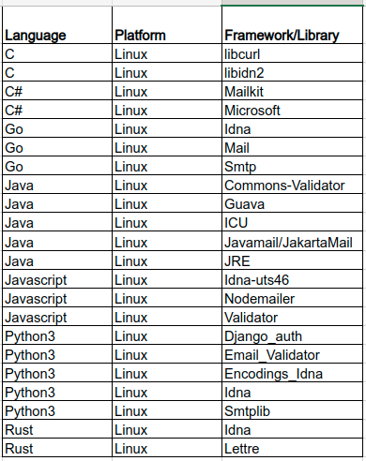
First & second phases
22 libraries
Only on Linux

Slide 3
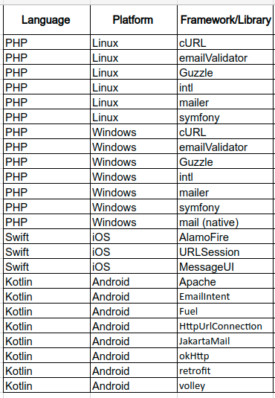
This third phase
This third phase add 25 libraries to the set;
Target 4 platforms:
Linux
Windows
IOS
Android

Slide 4
Methodology
4 Datasets (Updated with all instances in UASG004A)
H_DNS: syntactic check on a domain name (IDNA2008)
H_ES: syntactic check on an email address (EAI)
L_A2U: Conversion from A-LABEL to U-LABEL (IDNA2008)
L_U2A: Conversion from U-LABEL to A-LABEL (IDNA2008)
Code
Each library is tested upon its correspondent dataset with a pytest runner triggering a program written in the tested language;
Some programs are command line apps others are mobile apps
For mobile apps, a ui-crawler is sometimes necessary to simulate a real user tapping the interface

Slide 5
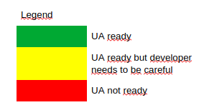
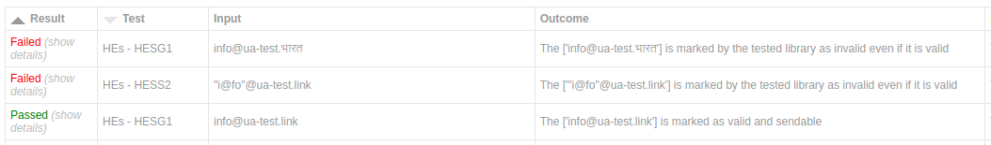
Two result formats
General / Brief:
Detailed:

Slide 6

IOS Swift results
MessageUI : MFMailComposeViewController not compliant. The developer needs to send the user through the iOS native Mail app by creating a mailto: url. (EAI)
URLSession : Not compliant (IDNA2008)
Alamofire : Not compliant (IDNA2008)
IDNA-Cocoa : Compliant. Ensure to take master branch for IDNA2008 (released versions are only IDNA2003 compatible) (IDNA2008)

Slide 7
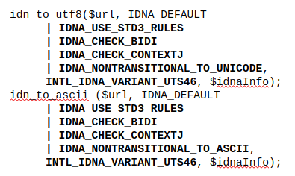
Windows 10 & Linux PHP results
Native mail (Windows only) : Not compliant Does not send SMTPUTF8 (EAI);
EmailValidator : Email validation compliant (EAI);
Guzzle : Http client fully compliant (IDNA2008);
Intl : Disallowed characters sometimes not detected; compliant (IDNA2008). Ensure you use the right flag when calling this lib:
PHPMailer : Not compliant: rejects unicode (IDNA2008);
Notes:
Native mail function: The PHP team is not opened to make the fix: https://bugs.php.net/bug.php?id=81615
PHPMailer: Maintainer not opened to make the fix.

Slide 8
Windows 10 & Linux PHP results (continue)
Symphony (http-client) : Compliant (IDNA2008);
Symphony (Polyfill-intl-idn) : Compliant (IDNA2008);
Symphony (mailer) : Compliant (EAI);
Windows cURL PHP extension : Rely during compilation on Windows utilities supporting only IDNA2003;
Linux cURL PHP extension : Use libidn2 which is fully IDNA2008 compliant (see our second phase report).

Slide 9
Android Kotlin results
okHttp : Not compliant (IDNA2008). Use java.net.IDN that use ICU4J but with the wrong flags, thus supporting IDNA2003;
HttpUrlConnection : Not compliant (IDNA2008). Based on okHttp;
Retrofit : Not compliant (IDNA2008). Based on okHttp;
Fuel : Not compliant (IDNA2008). Uses HttpUrlConnection;
Volley : Not compliant (IDNA2008). Uses HttpUrlConnection;
Apache HttpClient : Not compliant (IDNA2008);
Jakarta Mail : Compliant but consider some scripts invalid (EAI).
Email Intent : Provide data as-is to a mail client (EAI)
Notes:
okHttp: Wasn't open to make it compliant in 2020. Seems to be now after our suggestions to use ICU4J: https://github.com/square/okhttp/issues/6910

Slide 10
IOS - Conclusion
Developer tools (MessageUI-MFMailComposeViewController, ​URLComponents, URL) provided by Apple has a poorer compliance ​than their end-user application (Safari, Mail). When possible, sending the user through an Apple native app is better than opening modals inside the application.
Alamofire & URLSession are based on the same bogus Foundation framework
Notes:
okHttp: Wasn't open to make it compliant in 2020. Seems to be now after our suggestions to use ICU4J: https://github.com/square/okhttp/issues/6910

Slide 11
Windows - Conclusion
Despite, the effort made in the Microsoft .NET Framework to support IDNA2008, many lib like cURL rely on the C windows.h file which provide a "IdnToUnicode/IdnToAscii" which is IDNA2003 compliant only;
This cause cURL to be only compliant with IDNA2003 on windows and all extension of cURL, like the PHP ones or all the C lib using windows.h;
Notes:
See warning at https://docs.microsoft.com/en-us/windows/win32/api/winnls/nf-winnls-idntounicode

Slide 12
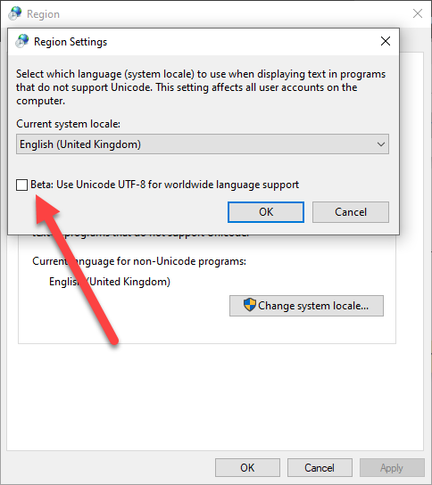
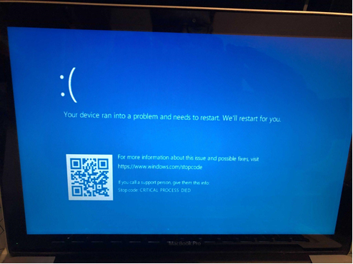
Windows – Conclusion (continue)
During testing, all our Windows batch files were failing to pass idn domains to the PHP cmdline apps. We realized an obscure setting should be used to enable the UTF-8 support:

Slide 13
Android– Conclusion
Most http libs are based on the Android stack. We provided simple suggestions to the community that could fix most of the problems we saw: https://github.com/square/okhttp/issues/6910 and https://issuetracker.google.com/issues/206015971
Jakarta is widely used and EAI compliant, but Android developers will probably use Email Intent instead and delegate the responsibility of sending and validating the email to another end-user app.

Slide 14
Resources
All resources, bug reports, detailed results and the likes are available at this url: https://cofomo.github.io/universal-acceptance/

