Slide 1
Universal Acceptance (UA) Readiness Evaluation of
Programming Languages and Development Frameworks – Phase 3
Cofomo / February 09, 2022

Slide 2
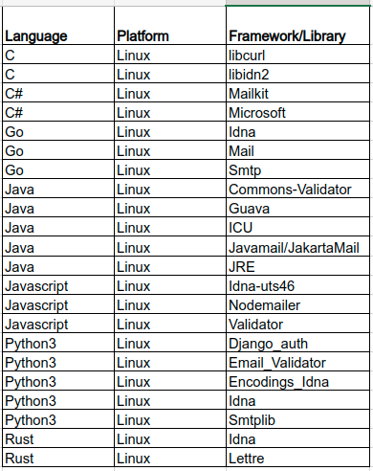
First & second phases
22 libraries
Only on Linux

Slide 3
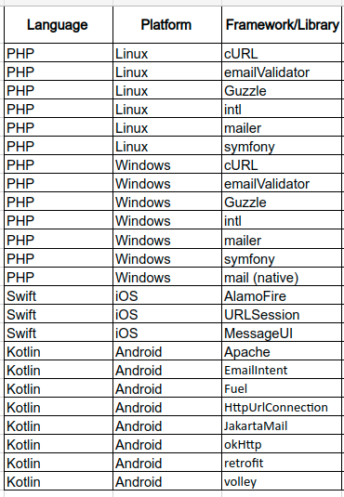
This third phase
This third phase add 18 libraries to the set;
Target 4 platforms:
Linux
Windows
IOS
Android
Test framework inherited from the first phase

Slide 4
Methodology
4 Datasets (Updated with all instances in UASG004A)
H_DNS: syntactic check on a domain name (IDNA2008)
H_ES: syntactic check on an email address (EAI)
L_A2U: Conversion from A-LABEL to U-LABEL (IDNA2008)
L_U2A: Conversion from U-LABEL to A-LABEL (IDNA2008)
Code
Each library is tested upon its correspondent dataset with a pytest runner triggering a program written in the tested language;
Some programs are command line apps others are mobile apps
For mobile apps, a ui-crawler is sometimes necessary to simulate a real user tapping the interface

Slide 5
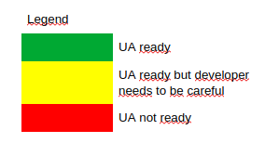
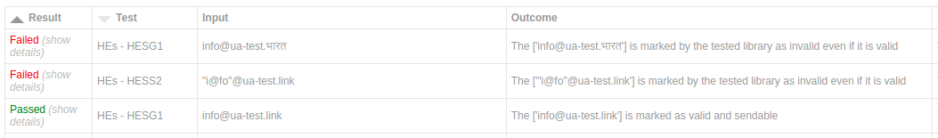
Two result formats
General / Brief:
Detailed:

Slide 6

IOS Swift Results
MessageUI : MFMailComposeViewController not compliant. The developer needs to send the user through the iOS native Mail app by creating a mailto: url. (EAI)
URLSession : Not compliant (IDNA2008)
Alamofire : Not compliant (IDNA2008)
IDNA-Cocoa : Compliant. Ensure to take master branch (sha=870ba3e) for IDNA2008 (released versions are only IDNA2003 compatible) (IDNA2008)

Slide 7
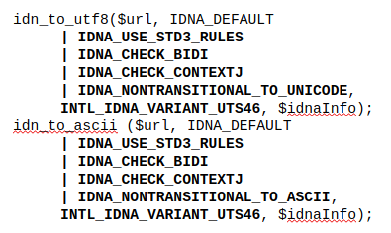
Windows 10 & Linux PHP Results
Native mail (Windows only) : Not compliant. Does not send SMTPUTF8 (EAI);
Windows cURL PHP extension : Use windows.h IdnToUnicode/IdnToAscii method which are based on IDNA2003.
Linux cURL PHP extension : Use libidn2 which is fully IDNA2008 compliant (see our second phase report).
EmailValidator : Email validation compliant (EAI);
Guzzle : Http client fully compliant (IDNA2008);
Intl : Disallowed characters sometimes not detected; compliant (IDNA2008). Ensure you use the right flag when calling it:
Notes:
Native mail function: The PHP team is not opened to make the fix: https://bugs.php.net/bug.php?id=81615
PHPMailer: Maintainer not opened to make the fix.

Slide 8
Windows 10 & Linux PHP Results (continue)
PHPMailer : Not compliant: rejects unicode (EAI);
Symphony (http-client) : Compliant but not using all flags for IDN conversion to A-Label (IDNA2008);
Symphony (Polyfill-intl-idn) : Compliant (IDNA2008);
Symphony (mailer) : Not compliant: does not send SMTPUTF8 flag (EAI);

Slide 9
Android Kotlin results
okHttp : Not compliant (IDNA2008). Use java.net.IDN that use ICU4J but with the deprecated methods, thus supporting IDNA2003;
HttpUrlConnection : Not compliant (IDNA2008). Implemented using okHttp;
Retrofit : Not compliant (IDNA2008). Based on okHttp;
Fuel : Not compliant (IDNA2008). Uses HttpUrlConnection;
Volley : Not compliant (IDNA2008). Uses HttpUrlConnection;
Apache HttpClient : Not compliant (IDNA2008);
Jakarta Mail : Compliant but consider some scripts invalid (EAI).
Email Intent : Provide data as-is to a mail client (EAI)
Notes:
okHttp: Wasn't open to make it compliant in 2020. Seems to be now after our suggestions to use ICU4J: https://github.com/square/okhttp/issues/6910

Slide 10
Bug reports
15 bug reports
4 code fixes have been submitted
3 merged upstream by the maintainers
1 pending to be merged upstream
Key elements to write a bug report:
Write clear and precise report,
Suggest ways to resolve the problem whenever possible,
Follow the rules of the project.
Watch and provide answers in the bug report
If possible, provide new code to solve the issue in the form of a patch in a pull request
Notes:
okHttp: Wasn't open to make it compliant in 2020. Seems to be now after our suggestions to use ICU4J: https://github.com/square/okhttp/issues/6910

Slide 11
Bug reports
Language | Platform | Library | Resolution
Swift | iOS | MessageUI | No answer yet
Swift | iOS | URLSession & Alamofire | Being discussed & maintainer assigned to the issue
PHP | Windows | mail | This does not claim to support RFC6531, this would be a new feature
PHP | Windows | cURL | This is a Windows issue
PHP | Windows & Linux | intl | This is a ICU issue
PHP | Windows & Linux | PHP Mailer | Fix submitted and merged upstream
PHP | Windows & Linux | Symfony HttpClient | Fix submitted and merged upstream
PHP | Windows & Linux | Symfony Mailer | 3 different bug reports: Fix submitted and merged upstream Being discussed No answer yet
Kotlin | Android | Jakarta Mail | No answer yet
Kotlin | Android | HttpUrlConnection | Transmitted to the engineering teams
Kotlin | Android | OkHttp | Closed after Q&A as IDNA 2008 is not uniformly supported or implemented by clients and servers
Kotlin | Android | Fuel | Fix submitted and pending to be merged upstream
Kotlin | Android | Apache HttpClient | No answer yet
Notes:
okHttp: Wasn't open to make it compliant in 2020. Seems to be now after our suggestions to use ICU4J: https://github.com/square/okhttp/issues/6910

Slide 12
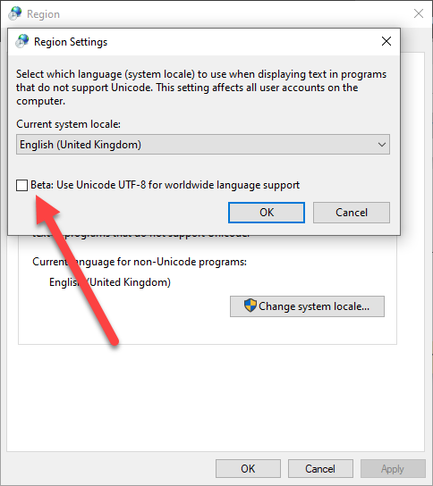
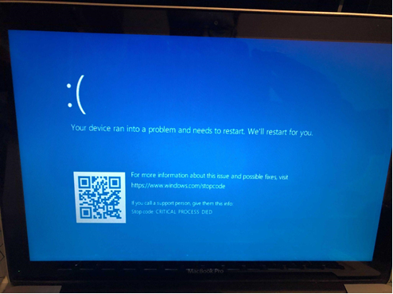
Windows – Note
During testing, all our Windows batch files were failing to pass idn domains to the PHP cmdline apps. We realized an obscure setting should be used to enable the UTF-8 support:

Slide 13
IOS - Conclusion
Developer tools (MessageUI-MFMailComposeViewController, ​URLComponents, URL) provided by Apple has a poorer compliance ​than their end-user application (Safari, Mail). When possible, sending the user through an Apple native app is better than opening modals inside the application.
Alamofire & URLSession are based on the same bogus Foundation framework
Notes:
okHttp: Wasn't open to make it compliant in 2020. Seems to be now after our suggestions to use ICU4J: https://github.com/square/okhttp/issues/6910

Slide 14
Windows - Conclusion
Despite, the effort made in the Microsoft .NET Framework to support IDNA2008, many lib like cURL rely on the C windows.h file which provide a "IdnToUnicode/IdnToAscii" which is IDNA2003 compliant only;
This cause cURL to be only compliant with IDNA2003 on windows and all extension of cURL, like the PHP ones or all the C lib using windows.h;
Notes:
See warning at https://docs.microsoft.com/en-us/windows/win32/api/winnls/nf-winnls-idntounicode

Slide 15
Android – Conclusion
Most http libs are based on the Android stack. We provided simple suggestions to the community that could fix most of the problems we saw: https://github.com/square/okhttp/issues/6910 and https://issuetracker.google.com/issues/206015971
Jakarta is widely used and EAI compliant, but Android developers will probably use Email Intent instead and delegate the responsibility of sending and validating the email to another end-user app.

Slide 16
Linux – Conclusion
Linux operating system did not have any impact on the tested libraries compliance or non-compliance
Unlike Windows, cURL is using libidn2 which fully supports IDNA 2008.

Slide 17
Bug reports – Conclusion
Some successful fixes have been approved and included in the libraries
Providing code patches significantly increases the likelihood of a fix to be included in the source code
Demonstration of both technical competency on the issue (i.e. UA) and on the software being patched gives more chances to be answered

Slide 18
Resources
All resources, bug reports, detailed results and the likes are available at this url: https://cofomo.github.io/universal-acceptance/

