Slide 1


GROUP 14
Stat 333 Project 2:
Predicting
Yelp Ratings
By Evangeline Lim, Stella Kim, William Han

Slide 2
STAT 333 | Group 14 Report
Presentation Outline
Prediction Error Results
First Steps: Data Cleaning
Finding New Predictors
The Model: Lasso
Strengths and Weakness
Future Reference
TOPIC HIGHLIGHTS

Slide 3
PREDICTION ERROR RESULTS
83.3%
ROOT MEAN OF SQUARES ERROR FOR VALIDATE AND TEST
based on Kaggle Leaderboard

Slide 4
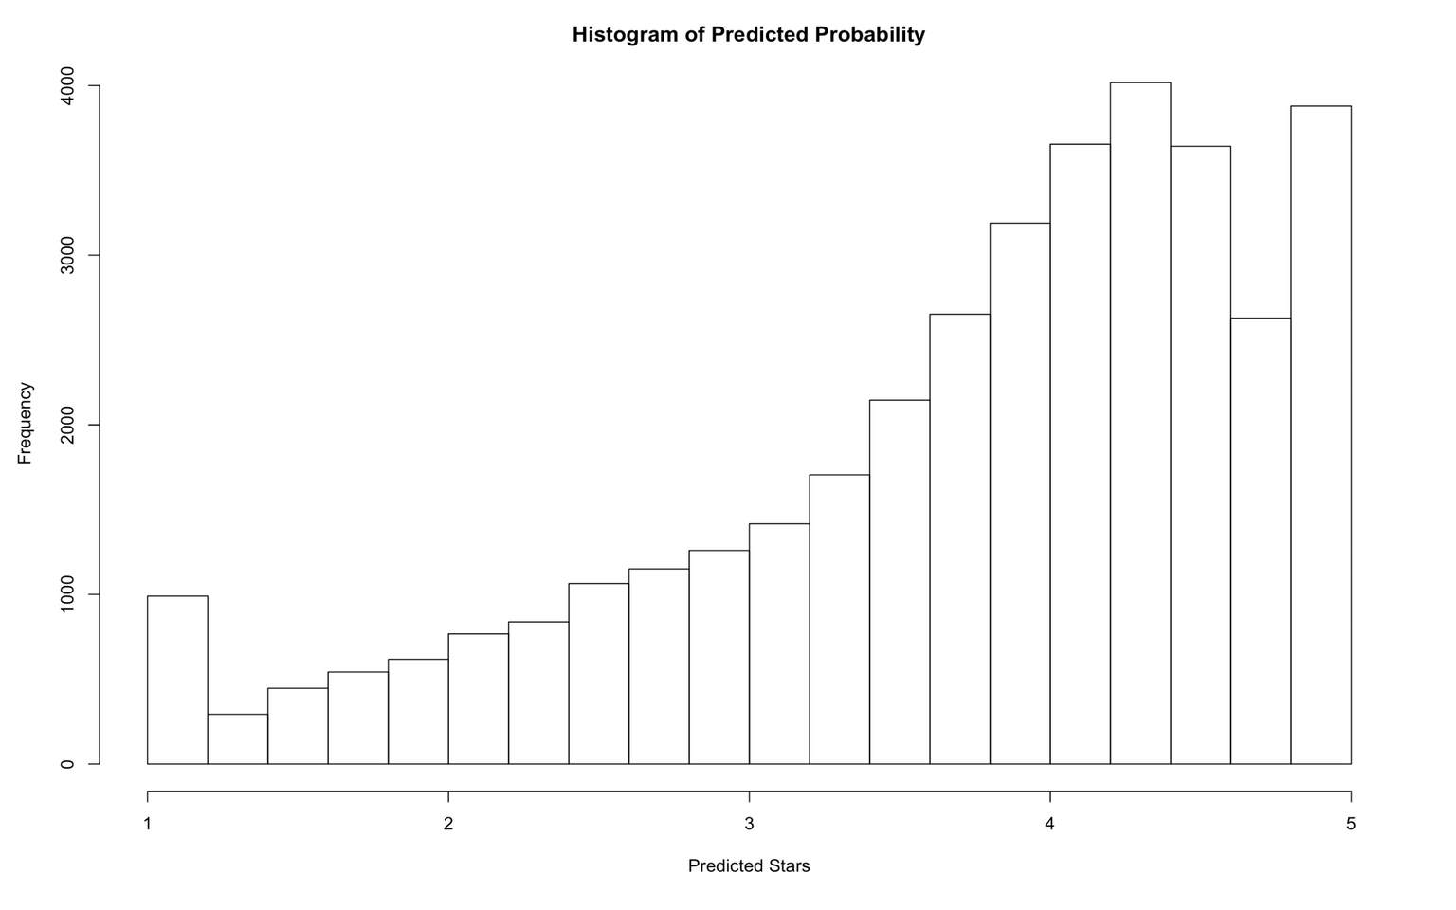
STAT 333 | Group 14 Report

Slide 5
STAT 333 | Group 14 Report
OUTLIERS
Using MLR and then findind the Cook's distance to determine influential points.
CAPITALIZATION AND PUNCTUATION
Reading review text into simple characters.
REMOVING UNWANTED VARIABLES
First Steps: Data Cleaning
Like ID, date, categories etc.

Slide 6
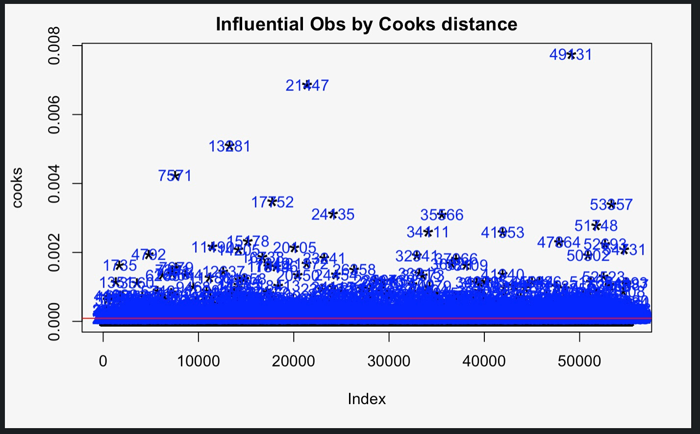
Cook's Distance Plot
CUT OFF IS 4X THE MEAN

Slide 7
FINDING NEW PREDICTORS
INTIAL SEARCH
CHOOSE ADVERBS & ADJECTIVES
Found the 8000 most common words in the overall train dataset
Using tidytext and tidyverse.
Narrowed down to a couple of thousand words
WORD COUNT
Made a dictionary to keep track of all the words that have been used in review text.

Slide 8
STAT 333 | Group 14 Report
THE MODEL
USING LASSO METHOD
Number of useful predictors: 1404

Slide 9
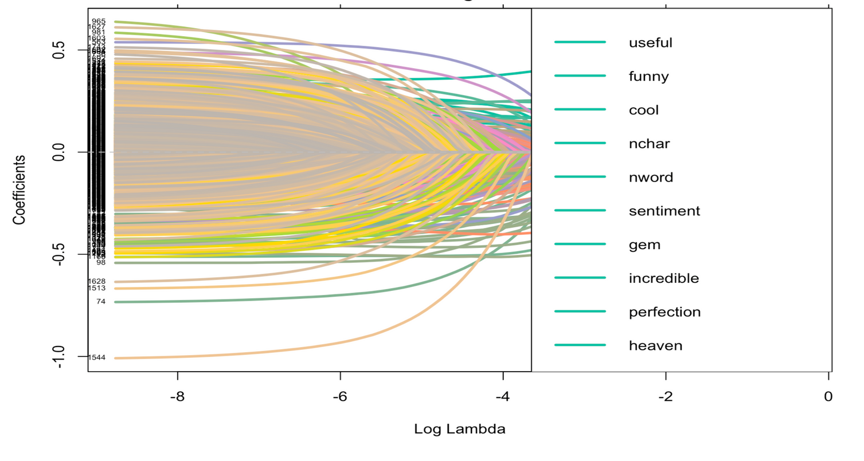
STAT 333 | Group 14 Report
Lasso Method

Slide 10
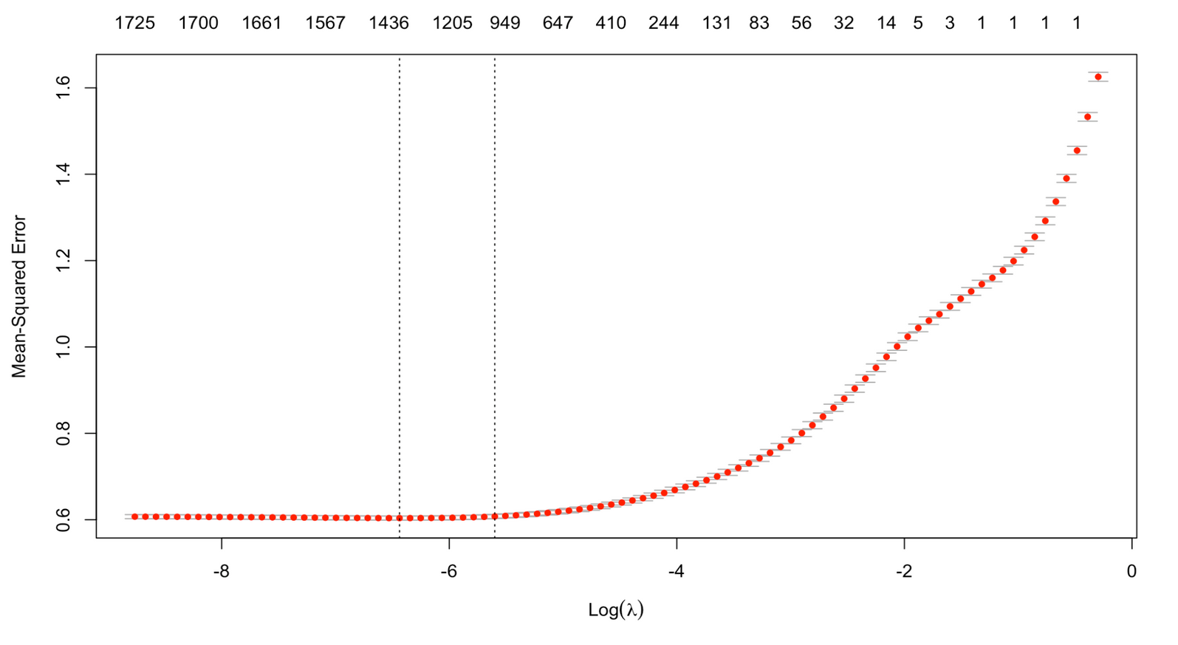
Lasso Cross Validation

Slide 11

STRENGTHS
AVOIDS OVERFITTING
AUTOMATIC VARIABLE SELECTION
BETTER MODEL INTERPRETABILITY

Slide 12

WEAKNESSES
LOSS OF RELEVANT DATA
AUTOMATIC
Minimizes by shrinking coefficients to zero. Hence, some important data might be lost.
Because it is automatic, we cannot increase efficiency manually so, for big datasets, it might take a long time.
MULTICOLLINEARITY
For highly correlated features, lasso might select only one or part of them

Slide 13



FUTURE REFERENCE
INTERACTION EFFECTS
Explore interaction relationships among words and other predictors
MORE PREDICTORS
Examine effects of other predictors (i.e. restaurant type)
EFFICIENT CODE
Work on developing code that requires less processing from R to scan for important words/predictors

Slide 14
STAT 333 | Group 14 Report
WILLIAM HAN
Member 1
Thank you!
Questions?
STELLA KIM
Member 2
EVANGELINE LIM
Member 3

