Slide 1
Making a Search Engine with LSI

Slide 2
What is LSI?
LSI(Latent Semantic Indexing) is a linear technique for searching for documents inside of a larger set of documents.
LSI compares documents relatedness by translating the documents into vectors based on their word frequencies. This is essentially just an application of PCA(Principal Component Analysis) to word documents.
Susan Dumais, a researcher at Microsoft, invented the technology at Bell Labs. LSI was patented in the late 1980s. This patent has since expired.

Slide 3
How it works

Slide 4
pre-processing
The first pre-processing step is to extract the word frequencies per page. This is done so that things like longer pages, which might use a particular word x number of times, don't precede smaller pages, which use the word more frequently but fewer times.
Another important pre-processing step is take out “stop words”, words that come up frequently among all documents and therefore don't carry meaning. e.g. “the”,”a”,”at” and “here”.

Slide 5
Term Frequency - Inverse Document Frequency(TF-IDF)
TF-IDF is used to accomplish this.
An typical equation for the TF-IDF of a word on a particular document is...
(Term frequency on document)*
LOG((number of documents)/(number of documents where term appears))
This will ensure rare words that show up a lot on the current page get high scores while common words are penalized.
TF-IDF is available in sklearn.

Slide 6
Computation
To compute LSI, center the TF-IDF vectors and take the singular value decomposition(SVD) on the matrix of TF-IDF vectors.
This allows one to get orthogonal eigenvectors that will be used to represent the axes of variance. The singular values will represent the amount of variance in the vector's direction.

Slide 7
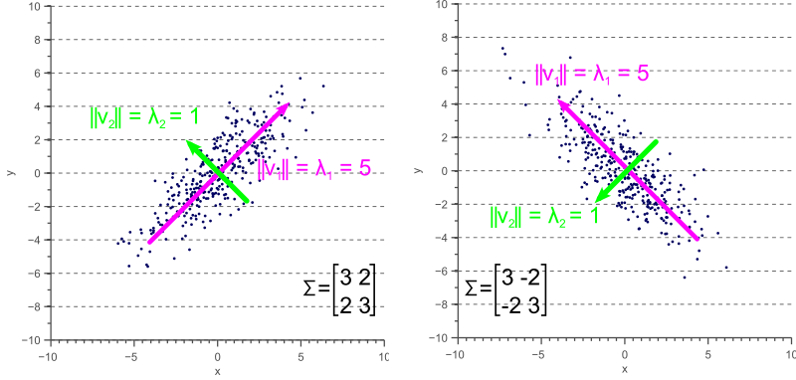
Principal Components, eigenvectors and eigenvalues of Co-variance Matrices

Slide 8
Principal Components, eigenvectors and eigenvalues of Co-variance Matrices

Slide 9
SVD Equations
Where Q and V are orthogonal bases of the column and row
spaces of A, respectively and S is a diagonal matrix containing
the singular values of A, Which are the square roots of the
eigenvalues corresponding to Q and V as well.

Slide 10
The software

Slide 11
My Project
For my project I made a small web crawler to grab pages from Wikipedia and store them in a database. The crawler started on pages related to Wikipedia's homepage and its article on Law.
I grabbed a around 200,000 web pages (15.7gb). Which still didn't seem to be enough since it did not find a lot of the relationships.
I filtered the words with a list of 20,000 common words. Then I used TF-IDF to get word frequency vectors for web pages and calculated PCA on the web pages with 200 principal components.

Slide 12
Cont...
I used sklearn, which has a bunch of different SVD and PCA functions. For my project I used truncatedSVD, which is an approximation of SVD that only computes a small fraction of the principal eigenvectors, saving memory.
I also stored the data in Sparse matricies.
Then I used the embedding feature of Tensorboard to display the vectors of the documents. Which gave a 3D projection of the data, by extracting 3 Principal components.
Demo...

Slide 13
Possible reasons for bad results
It is possible that given the variety of topics and richness of the pages on Wikipedia I did not collect enough data to make the LSI effective.
Also, LSI might still outperform a literal search on the open web with of different types of websites since a literal search may be more likely to retrieve bad quality sites whereas LSI should somewhat be able to filter for composition quality.
More principal components. Dumais used 350 in her original experiment.

Slide 14
If I did it again what would I do differently

Slide 15
Different algorithms
I would have used incremental PCA(IPCA). Which is a version of PCA that works by doing computations on one document at a time, so you don't have to store documents. This is version is also available in sklearn.
To do this I would need to have an incremental TF-IDF as well.
Written a multi threaded web crawler to do many page requests at once(I/O bound threads) to get data faster, especially since there are less memory constraints with IPCA.

Slide 16
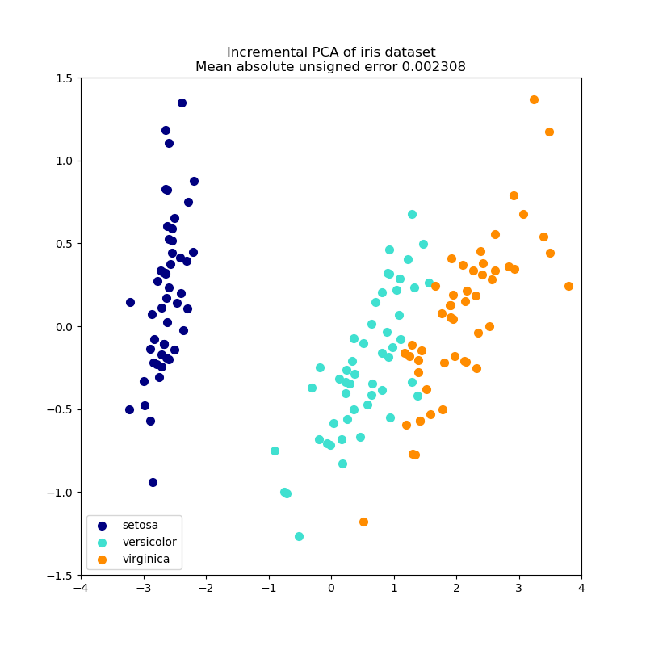
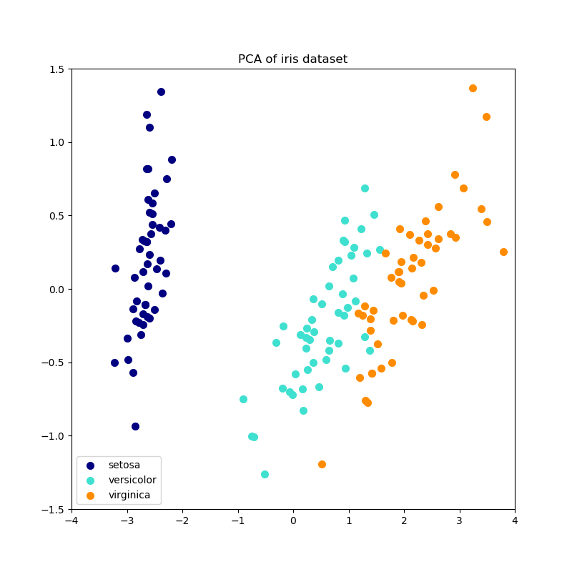
IPCA approximation error

Slide 17
Adding information with parts of speech tagging experiment
Also, I wanted to see if an unsupervised parts of speech tagger would have aided in getting better results.
I hypothesized that having a parts of speech tagger would increase the engine accuracy since having tags concatenated with the words would add more information to the text. In particular the contextual information from the word's position in the text, which is lost when only looking at word's frequency.

Slide 18
Cont..
Furthermore, an unsupervised parts-of-speech tagger a supervised tagger in theory, due to it's unsupervised nature will pick up more than just grammatical relationships words but also semantic relationships of words. e.g. sentiment analysis, bias or accent, which is helpful for information retrieval.
I actually implemented an unsupervised parts of speech tagger, using the baum welch algorithm, however, it was not parallel so it wouldn't have finished before this presentation, also it was inaccurate.

