Slide 1
VQSR in WGS/WES pipline
Yizhou Wang

Slide 2
Workflow
InsertSize Calculation
Organize results
Create folder
Alignment QC
Variants calling
Generate MultiQC report
Alignment
Index recalibrated BAM
Merge VCF
Evaluate SNP/INDEL
Sort BAM
Apply base recalibration
Variant recalibration (SNP, INDEL)
Annotate SNPs/INDEL
Mark duplicates
Base recalibration
Apply variant recalibration (SNP, INDEL)
Extract SNP/INDEL

Slide 3
Hard filtering (traditional way)
QualByDepth (QD)
FisherStrand (FS)
StrandOddsRatio (SOR)
RMSMappingQuality (MQ)
MappingQualityRankSumTest (MQRankSum)
ReadPosRankSumTest (ReadPosRankSum)
Choose threshold values and throw out any variants that have annotation values above or below the set thresholds
What is the problem for this way?

Slide 4
What is VQSR?
Variant quality score recalibration
Basic idea: training on high-confidence known sites to determine the probability that other sites are true
To balance sensitivity and specificity

Slide 5
VQSR in GATK4
VariantRecalibrator
Create a Gaussian mixture model by looking at the annotations values over a high quality subset of the input call set and then evaluate all input variants
(2) ApplyRecalibration:
Apply the model parameters to each variant in input VCF files producing a recalibrated VCF file

Slide 6
Workflow
1. Creat training set
We use known, highly validated variant resources to select a subset of variants within our callset that we’re really confident are probably true positives
2. Learn rules about good variants
We look at the annotation profiles of those variants in training set, and from that we learn some rules about how to recognize good variants, and build the Gaussian mixture model (GMM)
3. Learn rules about bad variants

Slide 7
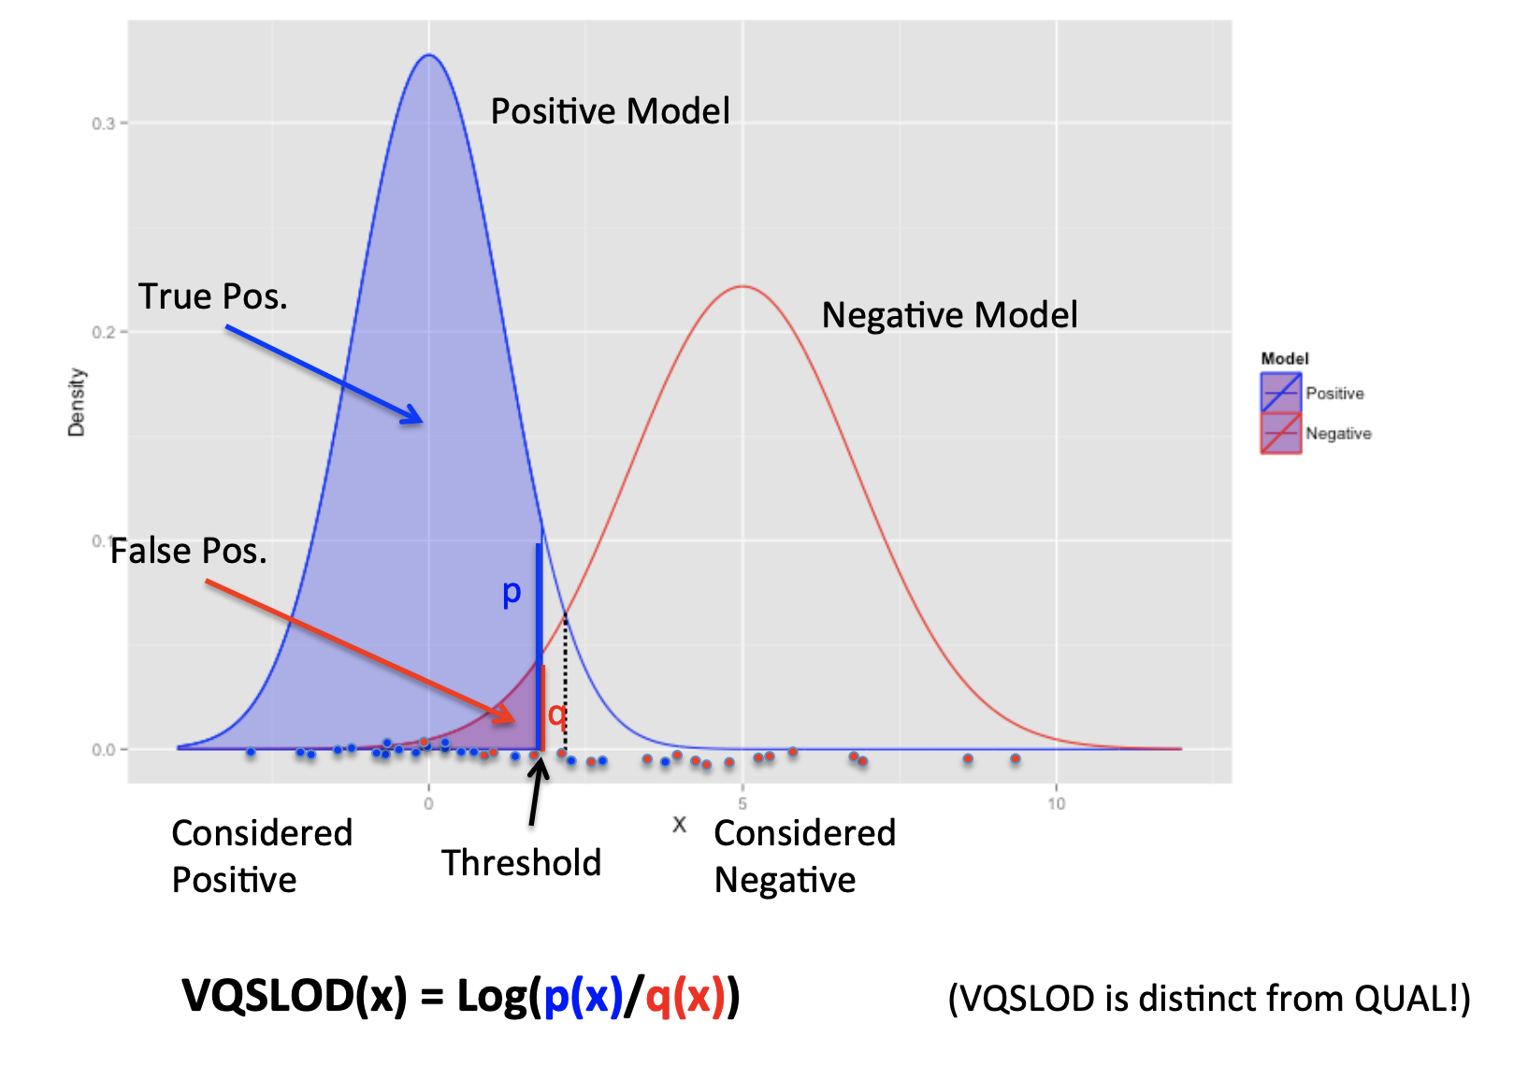
Workflow
4. Apply rules
We apply the rules to all the sites, which yields a single score (VQSLOD) for each variant that describes how likely it is based on all the examined dimensions.

Slide 8
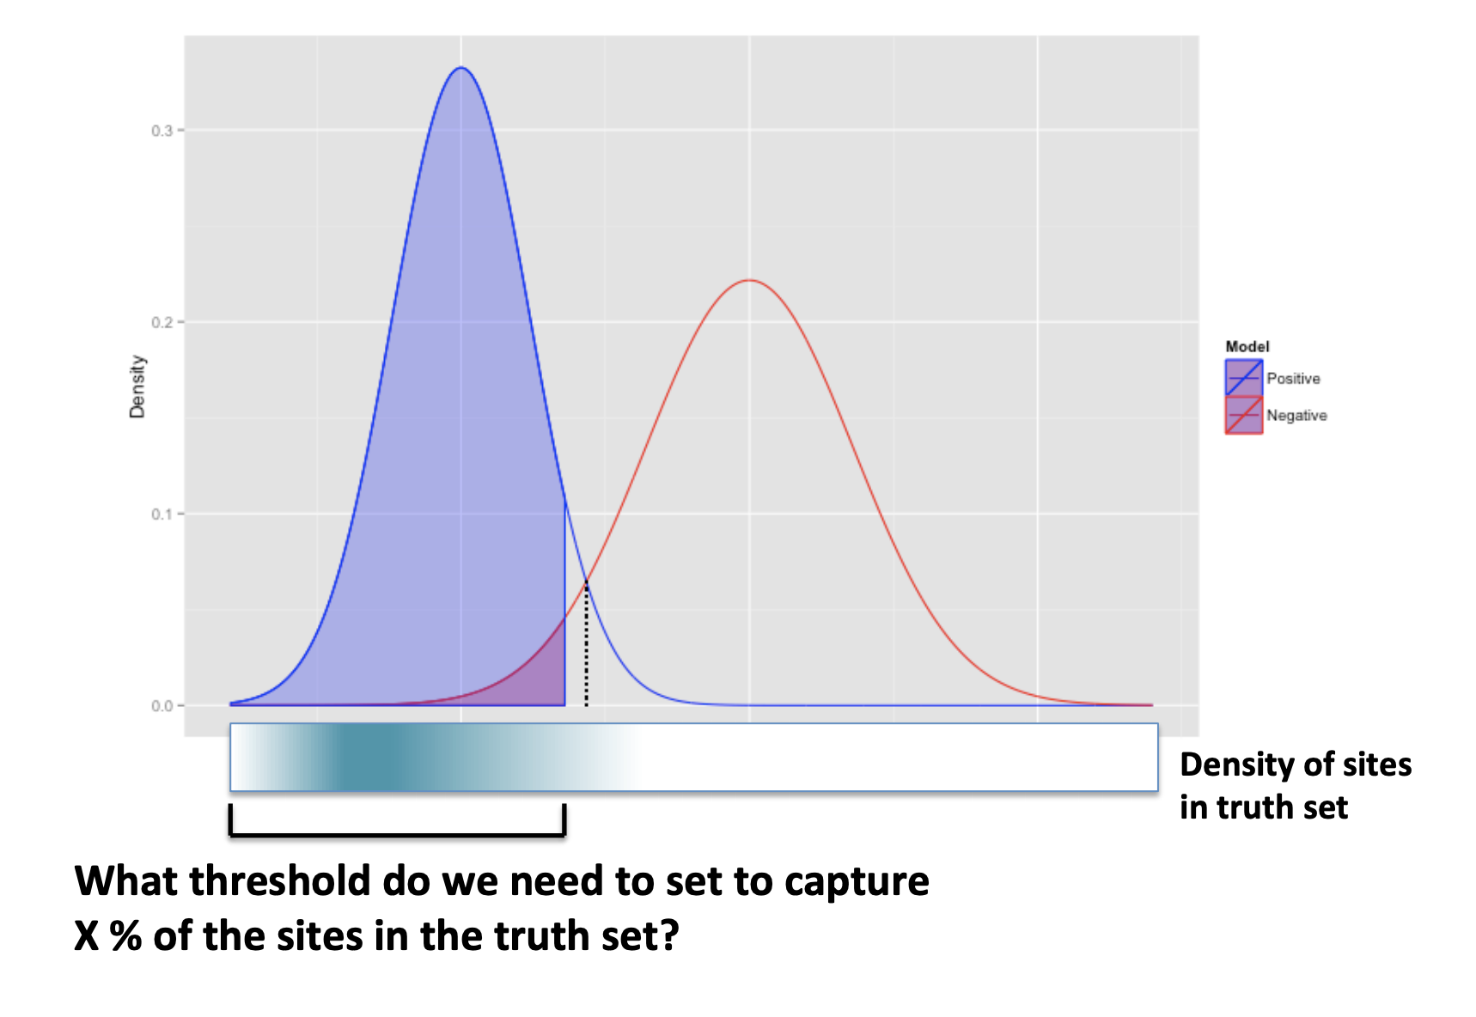
Workflow
5. Pick threshold value
”What score do I need to choose so that 99% of the variants in my callset that are also in hapmap will be selected?”

Slide 9
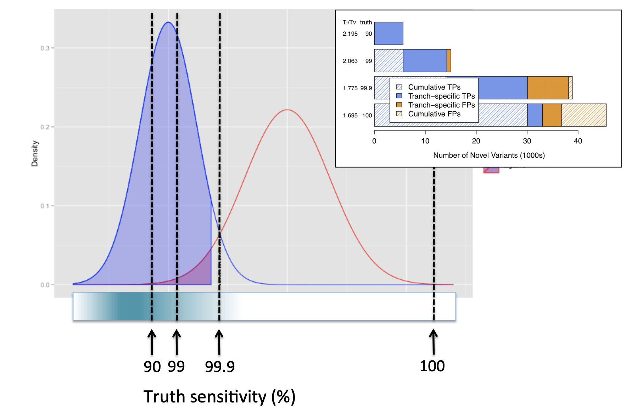
Workflow
5. Pick threshold value
”What score do I need to choose so that 99% of the variants in my callset that are also in hapmap will be selected?”

Slide 10
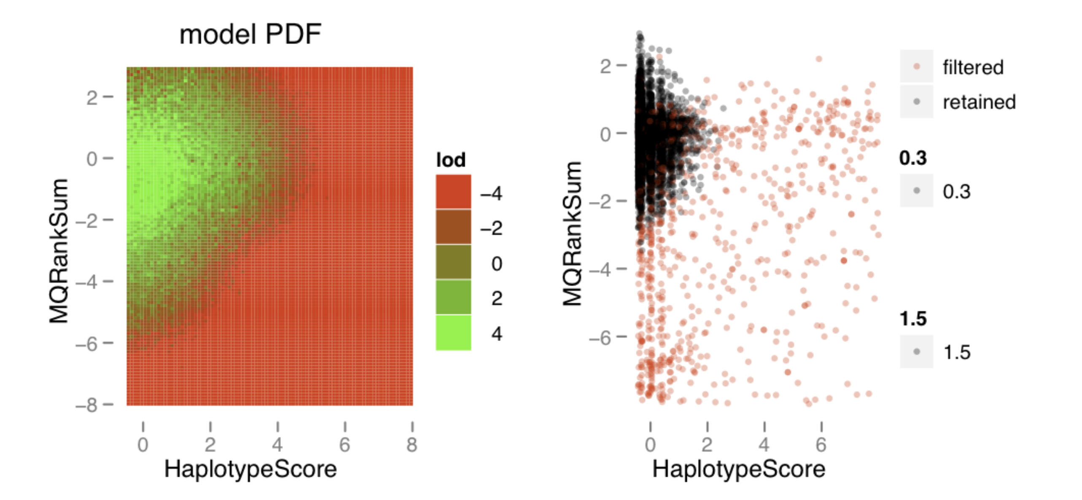
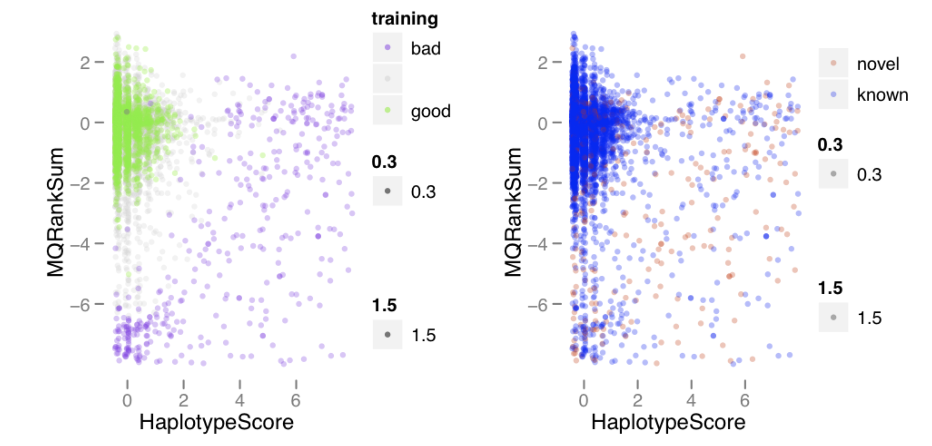
Plot for diagnosis

Slide 11
Recalibration must be separately for SNP and INDEL!!

Slide 12
Command line in VQSR
Resource
Hapmap
Omini
1000G
dbsnp
known = only for reporting purposes, not used in any calculations
training = use input variants that overlap with these training sites to build the model
truth = use these truth sites to train the recalibration model and determine where to set the cutoff in VQSLOD sensitivity
prior = phred-scaled estimate of data accuracy

Slide 13
Limitation of VQSR
Greedy for data
- expect large numbers of variant sites in order to achieve decent modeling with the GMM.
Annotations are tricky
- VQSR assumes that the distribution of annotation values is gaussianly distributed. Some annotations violated the assumption would destabilize the model
Well annotated databases are required

Slide 14
Questions?

