Slide 1
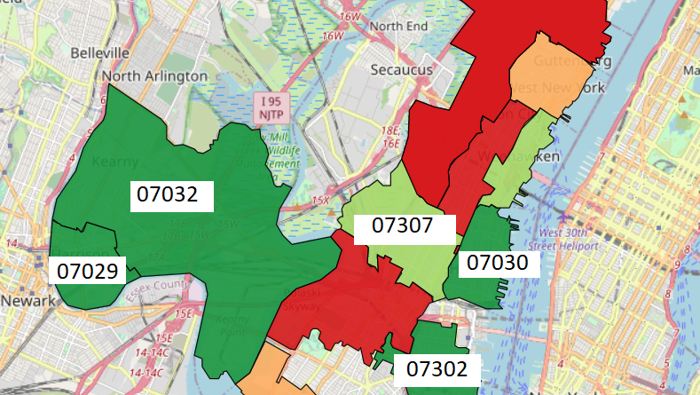
Finding the best areas to invest in Hudson County, NJ
Isaiah Capel

Slide 2
BUSINESS UNDERSTANDING
Thanks for hiring me . It’s May 2018 and you, a Private Equity company, want to invest in Hudson County, NJ real estate.
You know that Hudson County real estate has been very profitable over the past 20 years.
The question you have is: which zip codes should you invest in?
Investment Horizon: 5 Years

Slide 3
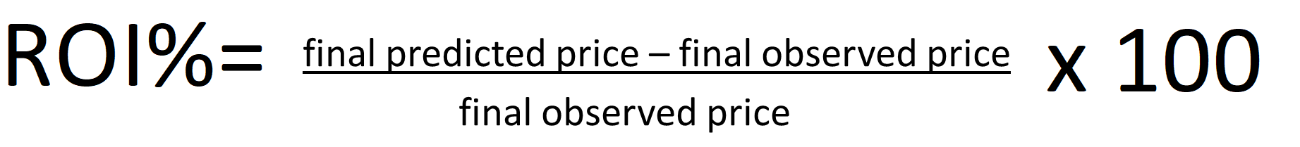
GOAL: FIND THE 5 ZIP CODES WITH THE HIGHEST ROI%

Slide 4
DATA UNDERSTANDING
1996–2018
I used an outstanding dataset from Zillow that contains monthly average sales data from almost every zip code in the United States from 1996-2018.
2018–2023
Using that data, I used a SARIMAX model to calculate which of Hudson County’s zip codes would have the highest ROI% from 2018-2023.

Slide 5
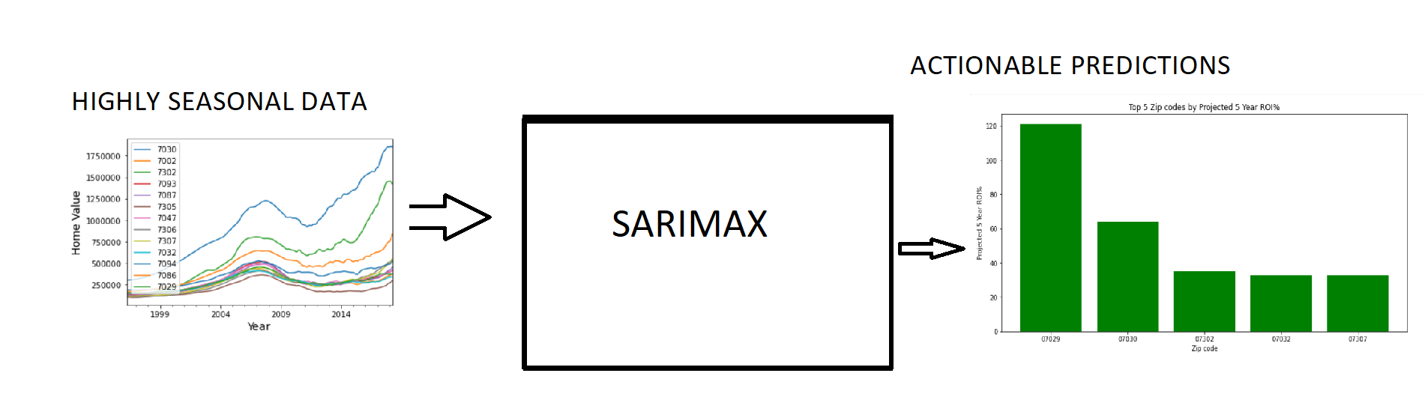
MODELING
I used a Seasonal Autoregressive Integrated Moving Average with eXogenous factors(SARIMAX) model to predict the highest returners.
Why SARIMAX? SARIMAX specializes in making predictions with seasonal data(data that has regular and predictable changes).

Slide 6
RESULTS

Slide 7

RESULTS-MAPPING

Slide 8
RECOMMENDATIONS
Invest in 07029, 07030, 07302, 07032, and 07307.
If you are looking for homes below 500k, target 07029 and 07032.

Slide 9

NEXT STEPS
Include 07304 and 07310. For some reason, the Zillow dataset did not contain any data on those zip codes.
Another ML model may yield more fruitful results. An XGBoost Regressor or a neural network model may yield better and more meaningful results.

Slide 10

Thanks!
Github:https://github.com/icapeli/Phase_4_Time_Series
A view of Jersey City, NJ from the Hudson River.

