Slide 1
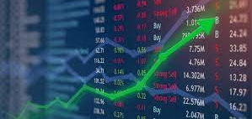
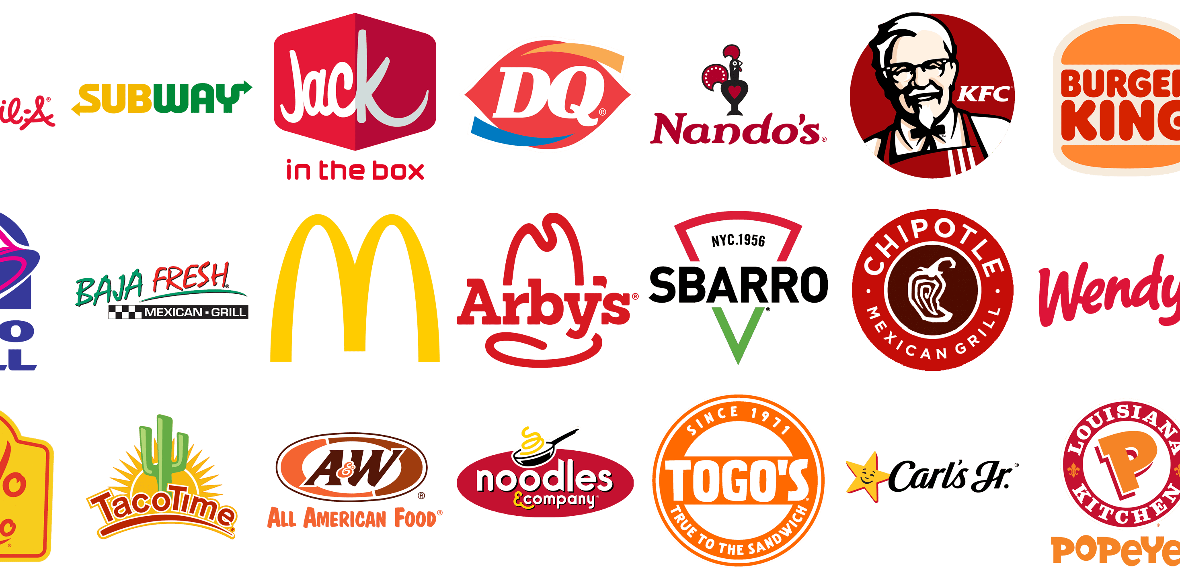
PREDICTING Q4 RESTAURANT EQUITY PRICES
Isaiah Capel

Slide 2
BUSINESS UNDERSTANDING
Stakeholder: New York State Transportation Workers Pension Fund.
Task: Predicting top 3 Q4 American restaurant equity performers and picking top 3 worse restaurant equity performers.

Slide 3


DATA UNDERSTANDING
In order to predict future equity prices, I need past equity prices. I used over 5 years of closing prices from Yahoo Finance.
In order to predict future COVID deaths, I need past COVID death numbers. I obtained those from the CDC.

Slide 4
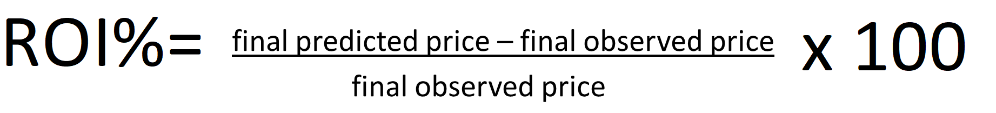
ROI%

Slide 5
MODELING
To calculate the daily number of COVID deaths for the rest of the year, I used an algorithm from Facebook called Prophet.
To calculate the stock prices with the COVID number generated from Prophet, I used a Long Short Term Memory neural network (LSTM) .

Slide 6
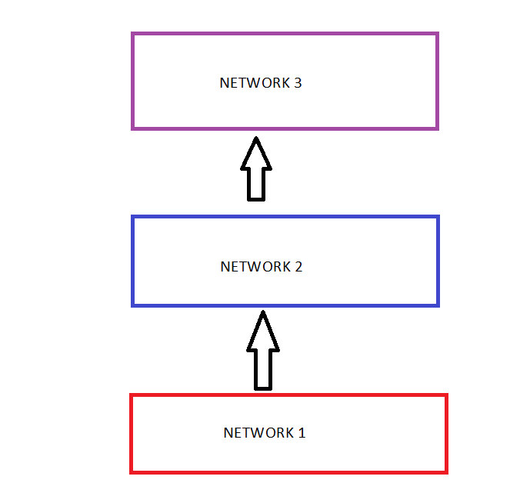
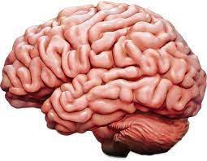
LSTM (Long Short Term Memory)
An LSTM is a type of neural network (a computing system modeled on the human brain) that handles long term data especially well, can learn from data multiple times, and can potentially learn and improve with each pass.

Slide 7
RECOMMENDATION: TOP 3 PERFORMERS
The top 3 performers were Dominos, Papa Johns, and Chipotle.

Slide 8
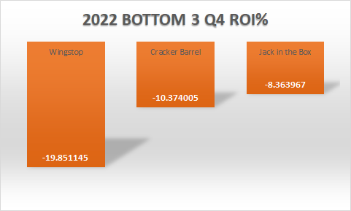



RECOMMENDATION: BOTTOM 3 PERFORMERS
The bottom 3 performers were Wingstop, Cracker Barrel, and Jack in the Box.

Slide 9
CONCLUSION
The top 3 performers were Dominos, Papa Johns, and Chipotle while bottom 3 performers were Wingstop, Cracker Barrel, and Jack in the Box.
2 pizza chains in the top 3 is fascinating and suggests their immunity to Q4 problems like COVID surges and bad weather.

Slide 10
NEXT STEPS
Improving the COVID Death predictions. My predictions had a mediocre MAPE( Mean Absolute Percentage Error) among the predictors that the CDC lists at their website. The predictions could be improved by including other variables like mask use and weather into the model
Using COVID infection rates instead of death rates may yield better results.
Adding more variables like inflation rate, interest rates, and commodities prices to the price prediction model may provide illuminating results.

Slide 11
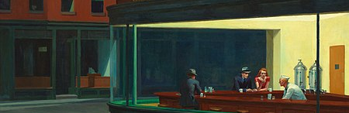
Thanks
Github:https://github.com/icapeli/Restaurant_Sector_2022_LSTM

