Slide 1

HOLLYWOOD? BEWARE!

Slide 2

Big Dreams? Big Hopes? Off to Hollywood?

Slide 3

HOLD UP! Did you know that Hollywood is one of the world’s most diverse and dynamic sectors? DON’T RUSH IN!!

Slide 4

THE Old GUard

Slide 5




Barbarians at the Gate

Slide 6

HOW DOES THE FILM BUSINESS OPERATE?

Slide 7

LET’S USE DATA INSTEAD!

Slide 8

FROM WHERE?

Slide 9


Starting in 2012. Why? Nothing Special. Just need a cutoff date where at least some of the relevant players were already involved

Slide 10
Let’s see how the Budget correlates to returns!

Slide 11
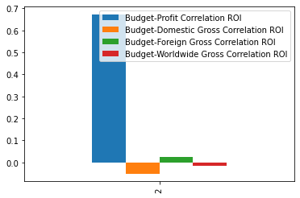
Interesting. Budget has no correlation to Domestic, Foreign and Total ROI. On the other hand, profits and budget do correlate fairly strongly.

Slide 12
What to make of this?
Business recommendation #1: Splash the cash on big projects.
That’s the most surefire way to make a profit.
Otherwise, there’s a lot of uncertainty.

Slide 13

Does this make sense?

Slide 14
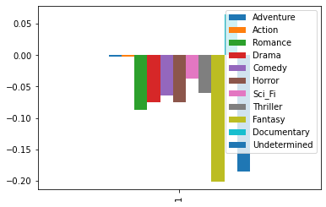
DOMESTIC ROI CORRELATIONBY GENRE

Slide 15
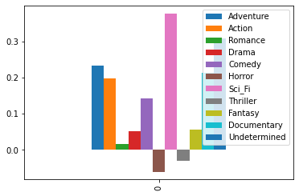
FOREIGN ROI CORRELATION BY GENRE

Slide 16
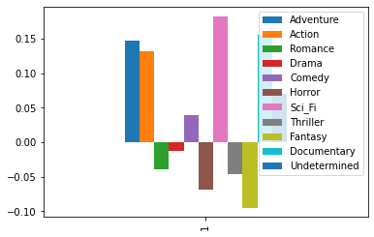
WORLDWIDE ROI CORRELATION BY GENRE

Slide 17
Analysis +Recommendation
Most genres have negative or no correlation to success.
Recommendation #2: STICK WITH ACTION, ADVENTURE OR SCI-FI FILMS!
They make money

Slide 18


Slide 19


Slide 20
RECOMMENDATION AND ANALYSIS
RECOMMENDATION: Longer movies are most likely to make big money. You can clearly see ROIs increase at around 80 minutes in both the foreign and domestic charts. MAKE MOVIES BETWEEN 80-150 MINUTES!!
That’s the sweet spot. There are drop-offs after that. Although, the data shows it’s still better to go longer than short.

Slide 21
RECAP
Recommendation #1: Splash the cash on big projects because both profits and budget go together. They had the strongest correlation of anything in this analysis. Profit matters. If the market hears that your new film made a $500 mil. Profit then your stock will jump and your value improve by well over $500 mil.
Recommendation #2: Stick with Action, Adventure, and Sci-Fi films because they have the best relationship with ROI.
Recommendation #3: Stick with medium to long films. They are the best investments. Longer films also have some correlation to budget.

Slide 22
Bonus Recommendation and Further Exploration
RECOMMENDATION #4: Make films that foreign markets will enjoy. This is what your competitors have been doing for over 10 years. Also, the correlations were generally stronger for foreign than domestic markets.
See: https://www.businessinsider.com/hollywood-is-making-films-for-foreign-markets-2012-9
RECOMMENDATION #5: Get a streaming service. Many people do not go to movies. In the last 10 years, streaming services have taken a big chunk of cash from the silver screen.

Slide 23

Exploration
EXPLORATION: Find out which movies are based on pre-existing intellectual property. I have a feeling that book and comic based films like Harry Potter and Marvel Comics. Those films are probably also Action, Adventure, and Sci-Fi films. You should probably find some already popular IP and acquire it. Otherwise, well…

