Slide 1
ICAPS Diversity and Inclusion Report
Shirin Sohrabi
June 20, 2022

Slide 2
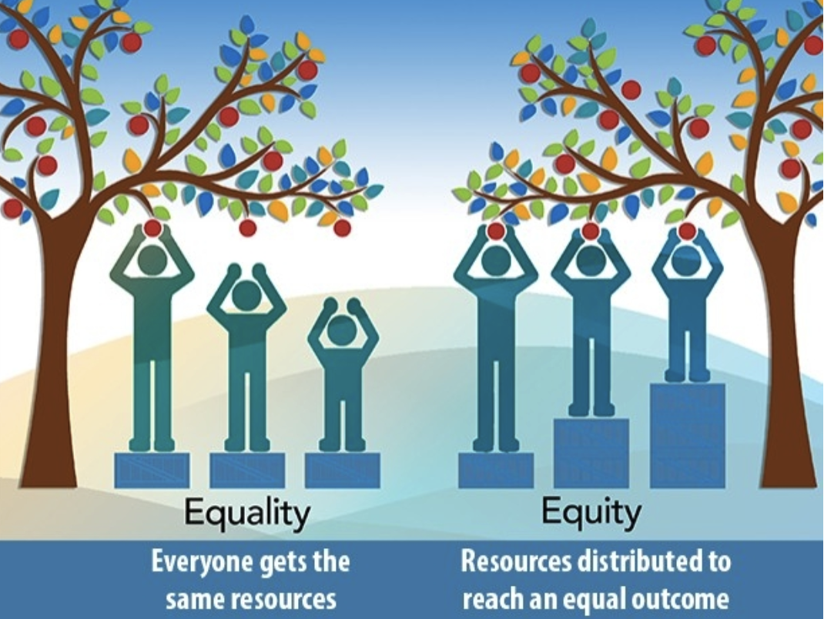
Diversity and Inclusion
Diversity (outcome) reflects the differences that exists amongst us, be it our research agenda, background, affiliation, religion, age, disability, race, or gender. Inclusion (outcome) is an environment where every individual feels respected, valued, safe, is heard, and is accepted and gives the individual the feeling of “I Belong”.
Equity (process): Access to opportunities

Slide 3
Gender Statistics
ICAPS 2019 attendees
~6:1 men/women ratio
ICAPS 2020 on self-reported survey
~4.3:1 men/women ratio
*16 prefer not to say
ICAPS 2021 registrants
~5:1 he/him to she/her ratio *3 they/them, 36 no pronouns given
ICAPS 2022 registrants
~3.6:1 male to female ratio *17 prefer to not answer, 1 non-binary
Computer Science Degrees
~4:1 men/women ratio women only earn 18% of computer science bachelor’s degrees
Stanford & Berkeley
~1:1 men/women ratio in intro courses
~2.5:1 men/women ratio graduating
Population as a whole
~1:1 women/men ratio
https://www.techrepublic.com/article/the-state-of-women-in-computer-science-an-investigative-report/
Notes:
For 2022: as of June 7:
https://www.computerscience.org/resources/women-in-computer-science/
https://www.techrepublic.com/article/the-state-of-women-in-computer-science-an-investigative-report/
There could be many reasons for why there is far fewer women graduating – based on the interviews:
Lack of support and favoritism based on stereotypes of women
challenges with isolation, and confidence still remain.
Two interesting finds from the article regarding confidence:
1) Male students even sometimes sign up to be teaching assistants for courses they never took themselves, because they feel confident enough to take on that role, Guo said. Female students, on the other hand, are more likely to justify not signing up by saying, “I’ve never taken the class, so I have no expertise and shouldn’t be a TA,” Guo added.
2) “A lot of women tend to leave the major even though they have better grades than the guys who stay, because they’re not confident in their abilities,” Ericson said.
A 2016 study from Harvard’s Women in Computer Science Advocacy Council found that women with up to eight years of programming experience report the same level of confidence as men with zero to one year of programming experience.

Slide 4
Geographic Statistics
Region | Wealth Rank | Share % | ~Attendee 2021 % | ~Attendee 2022 %
Asia | 1 | 36.5% | 27% | 14%
North America | 2 | 32.6% | 30% | 34%
Europe | 3 | 24.7% | 36% | 45%
South America | 4 | 2.6% | 1% | 1%
Oceania | 5 | 2.5% | 5% | 6%
Africa | 6 | 1.2% | <1% | <1%
Wealth Rank / ICAPS 2021 Registrants / World Population / Executive Council (EC)*
https://en.wikipedia.org/wiki/List_of_countries_by_total_wealth

Slide 5
ICAPS’s Efforts
Committee of 5 in 2019 brought to motion: 1) approve the code of conduct to use in future ICAPS conferences
2) create a permanent role of inclusion chair
3) approve conduct policy and guidelines
- Incident reports
- Remind attendees about the code of conduct
- Conference chairs arrange for 2 ICAPS advocate for each ICAPS -> 2 advocates in 2020, and 2021 -> In 2022 diversity and inclusion chair

Slide 6
ICAPS’s Efforts
In October 2021, council approved:
Formulation of the diversity and Inclusion Committee:
Committee of 5 – confidential (from both in and outside of the council)
Diverse in its composition
Members will be rotating (each serve for 2 years).
Everyone has gone through diversity training (3hr+ ACM videos training)
Address incident reports
Their decision would be final
2) Diversity and inclusion statement – adapted from AAAI

Slide 7
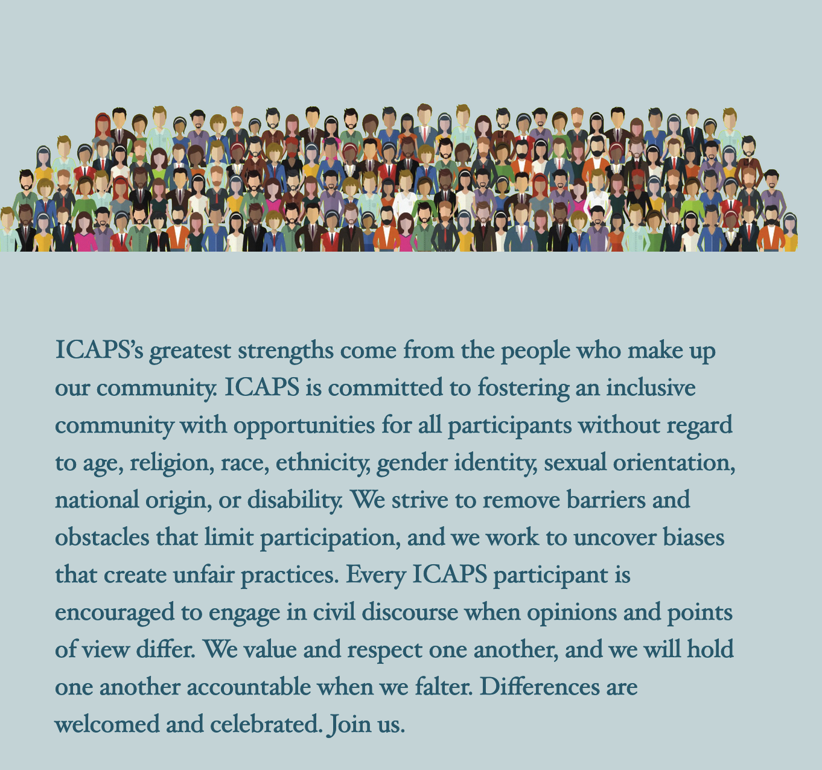
Diversity Statement

Slide 8
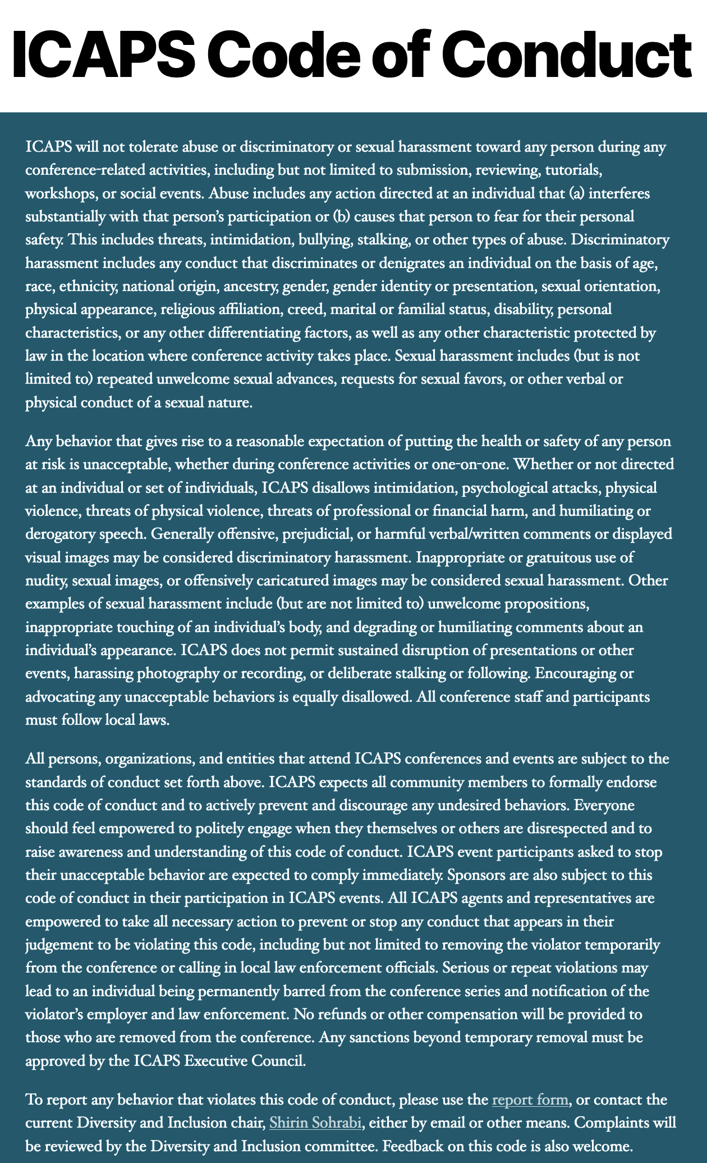
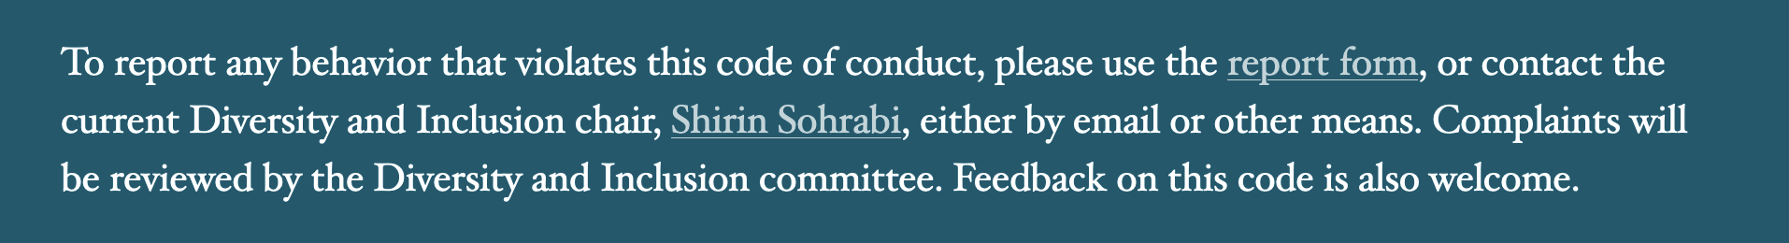
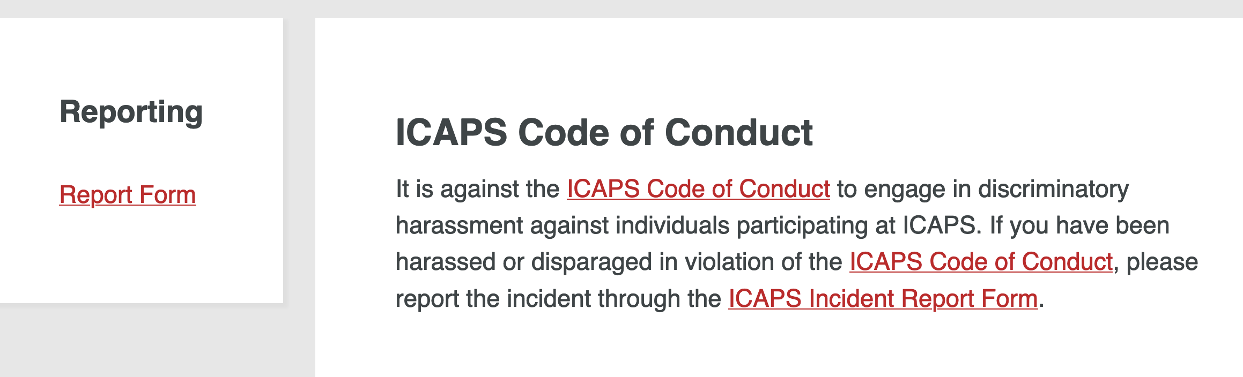

Slide 9
ICAPS Diversity Events @ 2020, and 2021
Introductions
Invited Speakers
Breakout sessions – discussion dialogues
Women @ ICAPS
Underrepresented Regions @ ICAPS

Slide 10
Diversity & Inclusion Starts Everywhere
Welcome people.
Protect people from harassment, other inappropriate behavior.
Mentorship, peer mentorship.
Praise people openly.
Don’t expect less but be open to see values in alternative ways.
Correct poor behavior, including your own.
Suggest proposals and volunteer to see it through.
Notes:
Listen, don’t assume

