Slide 1

Security Engineering with Generative AI
Instructor: Dr. Ionut Cardei

Slide 2
About the course
A primer on using generative AI and LLMs
A primer on building applications that utilize them
A primer on securing generative applications
A tour of security problems that can be aided by generative AI
Course adopted from CS 465 Generative Security Application Engineering from Portland State University, created by Prof. Wu-chang Feng
with NSF funding
Moving target: technology evolves very rapidly
Portland State University CS 475/575 Generative Security Application Engineering

Slide 3
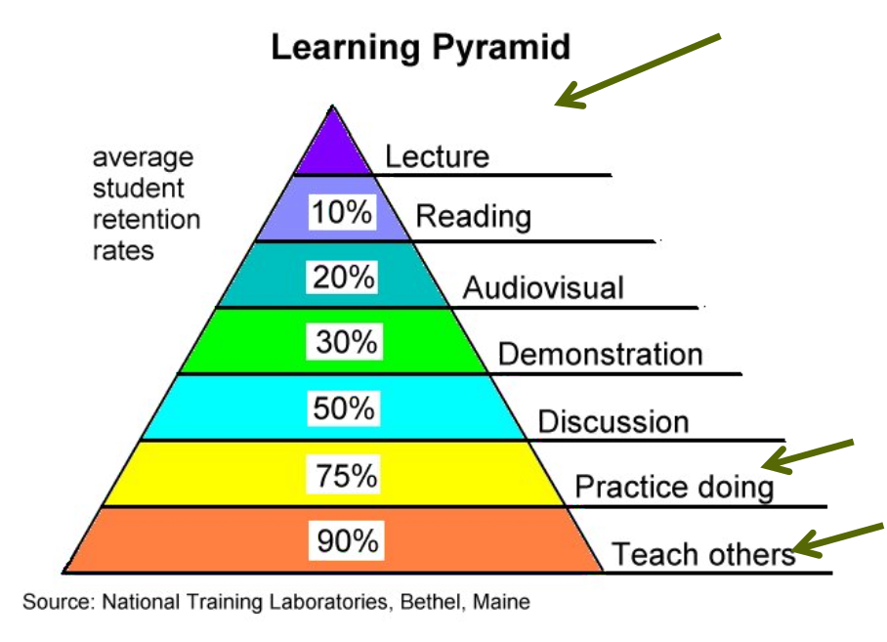
Course Format
Lecture
Hack-a-thon approach each week
Topic introduced
Lab exercises (started in class)
Labs & Homework
Labs screenshots delivered for each module
Individual assignments with screencast walkthroughs
Due Mondays


Portland State University CS 475/575 Generative Security Application Engineering

Slide 4
Assumptions
Knowledge of Python or willingness to do work outside of class to learn it
Labs and homeworks all in Python
Some knowledge of security helpful
But will provide content in-place when needed

Slide 5
Grading
Attendance and participation
Lab notebooks PDF for each module, Canvas upload
Homework programs on Github repository and screencasts (video link)
Final project
Cheating policy
Homework programs must be developed individually
But, use of LLMs mandatory ☺
All code submitted must be explained and source cited (e.g. prompt and prompt output must be given)

Slide 6
Course support
Canvas
Instructor office hours
Course resources, schedule, due dates, assignment guidelines, grading
Homework Q&A Discussion Forum:
ask for help and contribute answers

Slide 7
Ethics
You will learn techniques and tools for compromising users and systems.
Do *NOT* use them against any site outside of those you own or are given permission to access.

Slide 8
How to Get Started
Complete these Module 1 labs starting from the Labs and Homeworks main page:
01.1 Setup
01.2 Ollama
01.3 Programmatic Model Access
Install Visual Studio Code (VSCode): follow the steps from the corresponding on Canvas :
recommended (not required): install an AI Coding Agent (such as OpenAI Codex, Github Copilot, Google Antigravity, Anthropic Claude Code

