Slide 1
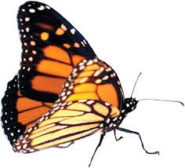
illuminate
A Curriculum Mapping Tool
Notes:
“Illuminate” comes from the Latin, “to enlighten”. It is the goal of the project to create a tool that will not only be useful to teachers in the planning stages of an expedition, but also to identify any gaps in instruction over a child’s 9 years at Monarch. Closing these gaps will give students a stronger educational foundation and prepare them for further education.

Slide 2
illuminate
Monarch EL
Tutorials
Reports
Purpose
Curriculum MAP
Toolbox
Archive
LINKS
Expeditionary Learning
Transformation Education
Monarch Academy Glen Burnie
Anne Arundel County Public Schools
MD State Curriculum
Common Core Standards
Monarch Academy Expeditionary Learning
Monarch Academy Public Charter School is a tuition-free public charter school serving children K-8 in Anne Arundel County. The school's mission is to educate all students to be self-motivated, creative, critical thinkers and life-long learners who are productive contributors to the global community in the 21st century. Monarch Academy is a place where children are encouraged to think critically, to question, reflect and participate in a rigorous, highly interactive instructional program that integrates arts and technology across the curriculum.
Monarch Academy has partnered with Expeditionary Learning, a national network serving 150 schools across the United States. The Expeditionary Learning model supports the achievement and engagement of every student through active learning, character development and teamwork. At Monarch Academy, students spend much of their time engaged in learning expeditions and in-depth studies of compelling topics that engage students in comprehensive research of a subject, hands-on learning experiences, and unique projects that address authentic audiences in the community.

Slide 3
illuminate
Monarch EL
Purpose
Tutorials
Toolbox
Reports
Archive
Curriculum MAP
LINKS
University of MD Baltimore College
Curriculum Mapping Data
Purpose of ILLUMINATE
Illuminate is a curriculum mapping project being created by Ian Carnaghan specifically for monarch academy. It will serve as a partial requirement for a Doctoral project through the UMBC doctoral Program.
Why Create Illuminate?
Increase collaboration & add cohesion & “flow” between grade levels, systematic increases of complexity from grade to grade,
communication among whole staff
Promote even coverage of common core standards & big ideas over student’s 9 years at monarch
locates gaps, repetitions & areas of improvement
Will serve as a Dynamic, working document to be changed over time
Aligns with the needs of an expeditionary learning school
Increase accountability for skills & standards
Collection of Tools for Pacing, instruction & planning
Documentation of the expedition process
Notes:
Illuminate is being created in order to fulfill the requirements of Ian’s doctoral project. He is hoping to create a tool that would have real and lasting impact in the educational world. Short term goals for the project are to create an easily accessible and customizable framework of STAs to document our expeditions. Long term goals for the project include additional tools for teachers (like an online lesson plan book, a toolbox of expedition & responsive classroom resources, reports to identify alignment of standards & topics, tutorials for using the program, and an archive that will save past year’s STAs and plans for reference).
More great reasons for curriculum maps: http://www.ius.edu/oira/program-assessment/resources/curriculum-mapping.html
Resources for Backward design (I have the textbooks for this as well. It is a great tool for building a curriculum and includes some good framework/structure building advice.): http://www.authenticeducation.org/ubd/ubd.lasso
Look into Curriculum Mapping Research Online: http://www.curriculummapping101.com/materials/curriculum-mapping-research

Slide 4
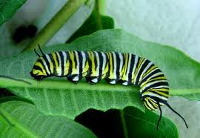
illuminate
Curriculum MAP
Monarch EL
Purpose
Tutorials
Toolbox
Reports
Archive
EXPEDITION
OVERVIEWS
K-8 Topics Map
Kindergarten fall Mini Spring
First Grade fall Mini Spring
Second Grade fall Mini Spring
Third Grade
fall Mini Spring
Fourth grade
fall Mini Spring
Fifth Grade
fall Mini Spring
Sixth Grade
fall Mini Spring
Seventh grade
fall Mini Spring
Eighth Grade
fall Mini Spring
Monarch Curriculum Map
Notes:
When the curriculum map tab is clicked on, it will open this page. The user can choose where they would like to navigate to from the menu on the left.

Slide 5
illuminate
Curriculum MAP
Monarch EL
Purpose
Tutorials
Toolbox
Reports
Archive
EXPEDITION
OVERVIEWS
K-8 Topics Map
Kindergarten fall Mini Spring
First Grade fall Mini Spring
Second Grade fall Mini Spring
Third Grade
fall Mini Spring
Fourth grade
fall Mini Spring
Fifth Grade
fall Mini Spring
Sixth Grade
fall Mini Spring
Seventh grade
fall Mini Spring
Eighth Grade
fall Mini Spring
K-8 Expedition Topics Map
Grade | Fall | Mini | Spring
K | Ants | Mini Expedition | Spring Expedition
1 | Maps | Mini Expedition | Monarchs
2 | Into the Woods | Geology Rocks | Culture
3 | Colonial People | Mini Expedition | Spring Expedition
4 | Bread | Simple Machines | Spring Expedition
5 | Eastern Oyster | Mini Expedition | Rights
6 | Gun Control | Mini Expedition | Pompeii
7 | Fall Expedition | Mini Expedition | Spring Expedition
8 | Fall Expedition | Mini Expedition | Spring Expedition
Notes:
The K-8 Topics map will look like our old curriculum map and provide a simple grid of the compelling topics that are being explored at each grade level.

Slide 6
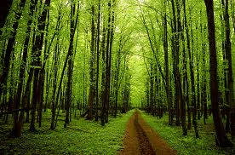
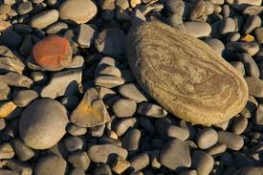
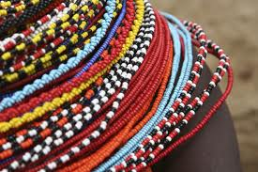
illuminate
Curriculum MAP
Monarch EL
Purpose
Tutorials
Toolbox
Reports
Archive
EXPEDITION
OVERVIEWS
K-8 Topics Map
Kindergarten fall Mini Spring
First Grade fall Mini Spring
Second Grade fall Mini Spring
Third Grade
fall Mini Spring
Fourth grade
fall Mini Spring
Fifth Grade
fall Mini Spring
Sixth Grade
fall Mini Spring
Seventh grade
fall Mini Spring
Eighth Grade
fall Mini Spring
Second Grade Expedition Overviews
Fall: Into the Woods
Mini: GEOLOGY ROCKS!
Spring: Ancient Civilizations
Notes:
If a specific grade level is chosen (in this case, “Second Grade”), the user can then choose which expedition to view.

Slide 7
illuminate
Curriculum MAP
Monarch EL
Purpose
Tutorials
Toolbox
Reports
Archive
EXPEDITION
OVERVIEWS
K-8 Topics Map
Kindergarten fall Mini Spring
First Grade fall Mini Spring
Second Grade fall Mini Spring
Third Grade
fall Mini Spring
Fourth grade
fall Mini Spring
Fifth Grade
fall Mini Spring
Sixth Grade
fall Mini Spring
Seventh grade
fall Mini Spring
Eighth Grade
fall Mini Spring
Into The Woods
Expedition Overview (STA)
Last Updated | 8/31/2012
Summary | jkhkjhkjhkhkhkhkhkhkhkjhkhkjhkjhkjhkhkhkjhkjhkjhkkjhkjgkgnvhgfhdgfhvjgvjvjvjhkvkbkb.
Guiding /Questions | What belongs in the woods?
Science Big Ideas | Systems, Interdependence
Social Studies Big Ideas | Geographic Relationships
Kickoff/Hook | Visit to patuxent to identify plants & animals
Case Studies | Study 1: HGUFLJLAYGLJKGA Study 2: KGLJGDKJBDK:UD>KDJBKDJB
Field Work | Patuxent Wildlife park, romey forest
Experts | Rangers, tree man, Romey,
Service Learning | Trail cleanup
Final Product | Trail guide to add to Patuxent backpacks
Wingspan | Turn the gym into our Patuxent trail, guide visitors
Content Standards
Calendar of Events
Lesson Plans
Overview/ STA
Notes:
When the user opens a specific expedition, he/she will be taken to the expedition’s STA. Users can choose to view content standards, a calendar of events, or lesson plans using the buttons at the bottom of the page.

Slide 8
illuminate
Curriculum MAP
Monarch EL
Purpose
Tutorials
Toolbox
Reports
Archive
EXPEDITION
OVERVIEWS
K-8 Topics Map
Kindergarten fall Mini Spring
First Grade fall Mini Spring
Second Grade fall Mini Spring
Third Grade
fall Mini Spring
Fourth grade
fall Mini Spring
Fifth Grade
fall Mini Spring
Sixth Grade
fall Mini Spring
Seventh grade
fall Mini Spring
Eighth Grade
fall Mini Spring
Into The Woods
Content Standards, Learning Targets & Assessment
Subject | Common Core & VSC Content Standards | Long Term Targets | Short Term Targets | Assessments of & For Learning
Literacy | RL.2.1. Ask and answer such questions as who, what, where, when, why, and how to demonstrate understanding of key details in a text. | ¤ | ¤
Mathematics | 2.OA.1. Use addition and subtraction within 100 to solve one- and two-step word problems | ¤ | ¤
Science | 6.0 Environmental Science: Students will use scientific skills and processes to explain the interactions of environmental factors | ¤ | ¤
Social Studies | 3.0 Geography: Students will use geographic concepts and processes to understand location and its relationship to human activities. | ¤ | ¤
Content Standards
Calendar of Events
Lesson Plans
Overview/ STA
Notes:
The content standards button will link users to a listing of the standards that the expedition is aligned with. Standards will be chosen from the Common Core (Mathematics & Literacy) as well as from the MD Voluntary State Curriculum (Social Studies, Science, etc.).

Slide 9
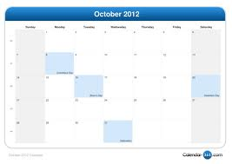
illuminate
Curriculum MAP
Monarch EL
Purpose
Tutorials
Toolbox
Reports
Archive
EXPEDITION
OVERVIEWS
K-8 Topics Map
Kindergarten fall Mini Spring
First Grade fall Mini Spring
Second Grade fall Mini Spring
Third Grade
fall Mini Spring
Fourth grade
fall Mini Spring
Fifth Grade
fall Mini Spring
Sixth Grade
fall Mini Spring
Seventh grade
fall Mini Spring
Eighth Grade
fall Mini Spring
Into The Woods
Calendar of Events
Content Standards
Calendar of Events
Lesson Plans
Overview/ STA
Notes:
The calendar function will be linked to Google Calendars so that teams can easily update their own calendars with expert visits, field work, kickoff dates, service opportunities, projects and other events.

Slide 10
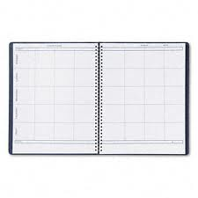
illuminate
Curriculum MAP
Monarch EL
Purpose
Tutorials
Toolbox
Reports
Archive
EXPEDITION
OVERVIEWS
K-8 Topics Map
Kindergarten fall Mini Spring
First Grade fall Mini Spring
Second Grade fall Mini Spring
Third Grade
fall Mini Spring
Fourth grade
fall Mini Spring
Fifth Grade
fall Mini Spring
Sixth Grade
fall Mini Spring
Seventh grade
fall Mini Spring
Eighth Grade
fall Mini Spring
Into The Woods
Lesson Plans
Content Standards
Calendar of Events
Lesson Plans
Overview/ STA
Notes:
The lesson plans page can be used as an online lesson planning book for grade level teams to record the day-to-day events that build to the enduring understandings of the big ideas.

