Slide 1
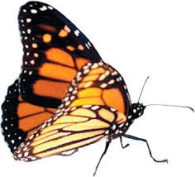
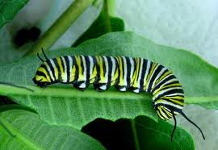
illuminate
Curriculum MAP
Monarch EL
Purpose
Tutorials
Toolbox
Reports
Archive
EXPEDITION
OVERVIEWS
K-8 Topics Map
Kindergarten fall Mini Spring
First Grade fall Mini Spring
Second Grade fall Mini Spring
Third Grade
fall Mini Spring
Fourth grade
fall Mini Spring
Fifth Grade
fall Mini Spring
Sixth Grade
fall Mini Spring
Seventh grade
fall Mini Spring
Eighth Grade
fall Mini Spring
Monarch Curriculum Map
Notes:
When the curriculum map tab is clicked on, it will open this page. The user can choose where they would like to navigate to from the menu on the left.

Slide 2
illuminate
Curriculum MAP
Monarch EL
Purpose
Tutorials
Toolbox
Reports
Archive
EXPEDITION
OVERVIEWS
K-8 Topics Map
Kindergarten fall Mini Spring
First Grade fall Mini Spring
Second Grade fall Mini Spring
Third Grade
fall Mini Spring
Fourth grade
fall Mini Spring
Fifth Grade
fall Mini Spring
Sixth Grade
fall Mini Spring
Seventh grade
fall Mini Spring
Eighth Grade
fall Mini Spring
K-8 Expedition Topics Map
Grade | Fall | Mini | Spring
K | Ants | Mini Expedition | Spring Expedition
1 | Maps | Mini Expedition | Monarchs
2 | Into the Woods | Geology Rocks | Culture
3 | Colonial People | Mini Expedition | Spring Expedition
4 | Bread | Simple Machines | Spring Expedition
5 | Eastern Oyster | Mini Expedition | Rights
6 | Gun Control | Mini Expedition | Pompeii
7 | Fall Expedition | Mini Expedition | Spring Expedition
8 | Fall Expedition | Mini Expedition | Spring Expedition
Notes:
The K-8 Topics map will look like our old curriculum map and provide a simple grid of the compelling topics that are being explored at each grade level.

Slide 3
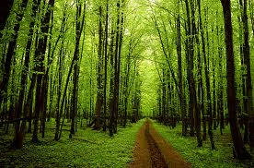
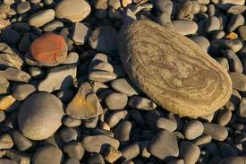
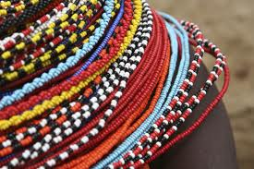
illuminate
Curriculum MAP
Monarch EL
Purpose
Tutorials
Toolbox
Reports
Archive
EXPEDITION
OVERVIEWS
K-8 Topics Map
Kindergarten fall Mini Spring
First Grade fall Mini Spring
Second Grade fall Mini Spring
Third Grade
fall Mini Spring
Fourth grade
fall Mini Spring
Fifth Grade
fall Mini Spring
Sixth Grade
fall Mini Spring
Seventh grade
fall Mini Spring
Eighth Grade
fall Mini Spring
Second Grade Expedition Overviews
Fall: Into the Woods
Mini: GEOLOGY ROCKS!
Spring: Ancient Civilizations
Notes:
If a specific grade level is chosen (in this case, “Second Grade”), the user can then choose which expedition to view.

Slide 4
illuminate
Curriculum MAP
Monarch EL
Purpose
Tutorials
Toolbox
Reports
Archive
EXPEDITION
OVERVIEWS
K-8 Topics Map
Kindergarten fall Mini Spring
First Grade fall Mini Spring
Second Grade fall Mini Spring
Third Grade
fall Mini Spring
Fourth grade
fall Mini Spring
Fifth Grade
fall Mini Spring
Sixth Grade
fall Mini Spring
Seventh grade
fall Mini Spring
Eighth Grade
fall Mini Spring
Into The Woods
Expedition Overview (STA)
Last Updated | 8/31/2012
Summary | jkhkjhkjhkhkhkhkhkhkhkjhkhkjhkjhkjhkhkhkjhkjhkjhkkjhkjgkgnvhgfhdgfhvjgvjvjvjhkvkbkb.
Guiding /Questions | What belongs in the woods?
Science Big Ideas | Systems, Interdependence
Social Studies Big Ideas | Geographic Relationships
Kickoff/Hook | Visit to patuxent to identify plants & animals
Case Studies | Study 1: HGUFLJLAYGLJKGA Study 2: KGLJGDKJBDK:UD>KDJBKDJB
Field Work | Patuxent Wildlife park, romey forest
Experts | Rangers, tree man, Romey,
Service Learning | Trail cleanup
Final Product | Trail guide to add to Patuxent backpacks
Wingspan | Turn the gym into our Patuxent trail, guide visitors
Content Standards
Calendar of Events
Lesson Plans
Overview/ STA
Notes:
When the user opens a specific expedition, he/she will be taken to the expedition’s STA. Users can choose to view content standards, a calendar of events, or lesson plans using the buttons at the bottom of the page.

Slide 5
illuminate
Curriculum MAP
Monarch EL
Purpose
Tutorials
Toolbox
Reports
Archive
EXPEDITION
OVERVIEWS
K-8 Topics Map
Kindergarten fall Mini Spring
First Grade fall Mini Spring
Second Grade fall Mini Spring
Third Grade
fall Mini Spring
Fourth grade
fall Mini Spring
Fifth Grade
fall Mini Spring
Sixth Grade
fall Mini Spring
Seventh grade
fall Mini Spring
Eighth Grade
fall Mini Spring
Into The Woods
Content Standards, Learning Targets & Assessment
Subject | Common Core & VSC Content Standards | Long Term Targets | Short Term Targets | Assessments of & For Learning
Literacy | RL.2.1. Ask and answer such questions as who, what, where, when, why, and how to demonstrate understanding of key details in a text. | ¤ | ¤
Mathematics | 2.OA.1. Use addition and subtraction within 100 to solve one- and two-step word problems | ¤ | ¤
Science | 6.0 Environmental Science: Students will use scientific skills and processes to explain the interactions of environmental factors | ¤ | ¤
Social Studies | 3.0 Geography: Students will use geographic concepts and processes to understand location and its relationship to human activities. | ¤ | ¤
Content Standards
Calendar of Events
Lesson Plans
Overview/ STA
Notes:
The content standards button will link users to a listing of the standards that the expedition is aligned with. Standards will be chosen from the Common Core (Mathematics & Literacy) as well as from the MD Voluntary State Curriculum (Social Studies, Science, etc.).

Slide 6
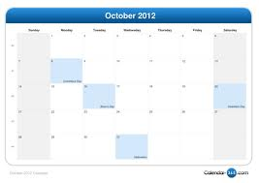
illuminate
Curriculum MAP
Monarch EL
Purpose
Tutorials
Toolbox
Reports
Archive
EXPEDITION
OVERVIEWS
K-8 Topics Map
Kindergarten fall Mini Spring
First Grade fall Mini Spring
Second Grade fall Mini Spring
Third Grade
fall Mini Spring
Fourth grade
fall Mini Spring
Fifth Grade
fall Mini Spring
Sixth Grade
fall Mini Spring
Seventh grade
fall Mini Spring
Eighth Grade
fall Mini Spring
Into The Woods
Calendar of Events
Content Standards
Calendar of Events
Lesson Plans
Overview/ STA
Notes:
The calendar function will be linked to Google Calendars so that teams can easily update their own calendars with expert visits, field work, kickoff dates, service opportunities, projects and other events.

Slide 7
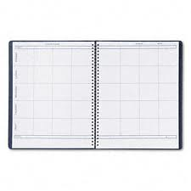
illuminate
Curriculum MAP
Monarch EL
Purpose
Tutorials
Toolbox
Reports
Archive
EXPEDITION
OVERVIEWS
K-8 Topics Map
Kindergarten fall Mini Spring
First Grade fall Mini Spring
Second Grade fall Mini Spring
Third Grade
fall Mini Spring
Fourth grade
fall Mini Spring
Fifth Grade
fall Mini Spring
Sixth Grade
fall Mini Spring
Seventh grade
fall Mini Spring
Eighth Grade
fall Mini Spring
Into The Woods
Lesson Plans
Content Standards
Calendar of Events
Lesson Plans
Overview/ STA
Notes:
The lesson plans page can be used as an online lesson planning book for grade level teams to record the day-to-day events that build to the enduring understandings of the big ideas.

