Slide 1
Web-Based Curriculum Mapping
An Exploratory Eye Tracking Study
Notes:
1

Slide 2

Web-Based Curriculum Mapping
Introduction
What is Curriculum Mapping?
Process of documenting lessons, activities and assessment methods used within different grade levels and classes within an educational institution.
In recent years web-based technology solutions have been implemented to provide real-time access to vital curriculum data and reports, enabling school administration to ensure there are no gaps between grade levels.
Curriculum Mapping

Slide 3



Web-Based Curriculum Mapping
Who are the User Groups?
Parents and Guardians
By providing an accessible system, it is easier to can keep track of where their child should be academically.
Parents and guardians will have an opportunity to reinforce at home the focus of learning that takes place at school.
Teachers
Curriculum Mapping systems can provide teachers a tool to update, document and share lesson plans with others.
Common core standards are more easily tracked to ensure lessons are fulfilling the required objectives.
Administrators
A dashboard system can provide administrators a means to be able to manage curriculum across grade levels.
Management of learning outcomes and learning opportunities across different elements of the curriculum.

Slide 4
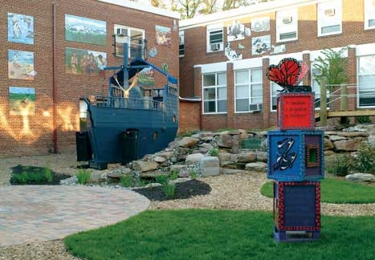

Web-Based Curriculum Mapping
Preliminary Study to Benefit Monarch Academy
Research Study
Monarch Academy has informally implemented a form of Curriculum Mapping using desktop applications.
The current system has not been centralized, nor easily accessible by staff and administrators.
Commercial tools were researched; however none met the unique requirements of Expeditionary Learning.
Atlas Rubicon came closest to meeting the school’s requirements.
Notes:
Monarch Academy schools aim to educate Maryland students to be self-motivated, creative, critical thinkers and life-long learners who are productive contributors to the global community in the 21st century.

Slide 5


Web-Based Curriculum Mapping
Atlas Rubicon and Oakland School System
Atlas is a Web-based curriculum management tool that electronically: Incorporates curriculum mapping, tracks gaps and repetition in instruction, addresses the Why in performance testing, aligns curriculum to benchmarks and standards, produces updated reports to encourage partnerships, facilitates sharing of ideas and communicating them rapidly across buildings, schools and grades and shares requirements with students.
Oakland Public School system has implemented Atlas Rubicon for all grade levels.
They provide a public website for parents and guardians to review courses, units and other curriculum information.
This study will test the current system that Oakland uses as an exploratory study in determining what works well and what doesn’t in the current system.

Slide 6
Web-Based Curriculum Mapping
Methodology
Recruitment
User Tasks
Analysis
Parents and guardians of children or grandchildren currently in school.
Older relations of children currently in school.
Demographic background and characteristics were not taken into consideration for this study.
Six user tasks were administered using Tobii to test the information retrieval of curriculum information.
These tasks were initially piloted and then refined based on the results of the pilot test.
Data was exported from Tobii Studio.
Videos of the tasks were analysed using Morea Manager.
Wireframes and recommendations were produced from findings.

Slide 7
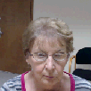





Web-Based Curriculum Mapping
Recruitment
Characteristics of Population
All participants indicated a high comfort level with using the Internet.
One of the participants has used a curriculum mapping application before.
4 of the participants have a child or grandchild currently in school. The remaining participants have a younger relation in school.
Ages range between mid 20s to over 60s.
Daily Hours Spent Online
* Because of small group size, participants were not recruited based on demographics.

Slide 8
Web-Based Curriculum Mapping
User Tasks
1
Locate Oakland's Grade 2 math lesson plan and find out which weeks 'Unit 3: Adding and Subtracting Whole Numbers' is taught.
2
You want to know if Cell Theory is taught within Biology in Oakland. Use Atlas to locate if the Biology subject has a 'Cell Theory' unit.
3
Use Atlas to see if there is a unit for probability, and if so, what course is it taught under?
4
Locate the key concepts taught in the 'Gas Laws' unit within tenth grade Chemistry.
5
Locate the second grade Social Studies unit 'What is a Community' and find the 'Content Expectations' information for this unit.
6
Some education terms are unfamiliar to you. Access the 'References' section of Atlas and find the 'Glossary'.

Slide 9
Web-Based Curriculum Mapping
Task Results
Task Description | Completed with Ease | Completed with some level of difficulty | Did not complete
Task 1 | 5 | 1 | 0
Task 2 | 4 | 2 | 0
Task 3 | 1 | 0 | 5
Task 4 | 1 | 4 | 1
Task 5 | 4 | 0 | 2
Task 6 | 6 | 0 | 0
Total | 58% | 19% | 22%

Slide 10



Web-Based Curriculum Mapping
Findings
Course Listings
Search Limitations
Organization of Information
Search results are cluttered, too much information provided by result.
Search links are not obvious.
Confusion between use of Browse and Search tools.
No synonym or spelling alternative suggestions.
Facets do not provide any depth - one level, does not accomodate units within courses well.
Browse keyword yields no change course doesn’t exist.
Homepage Information
Core standards need to be seperate from actual curriculum
Draft lessons should not be publically available at this level

Slide 11
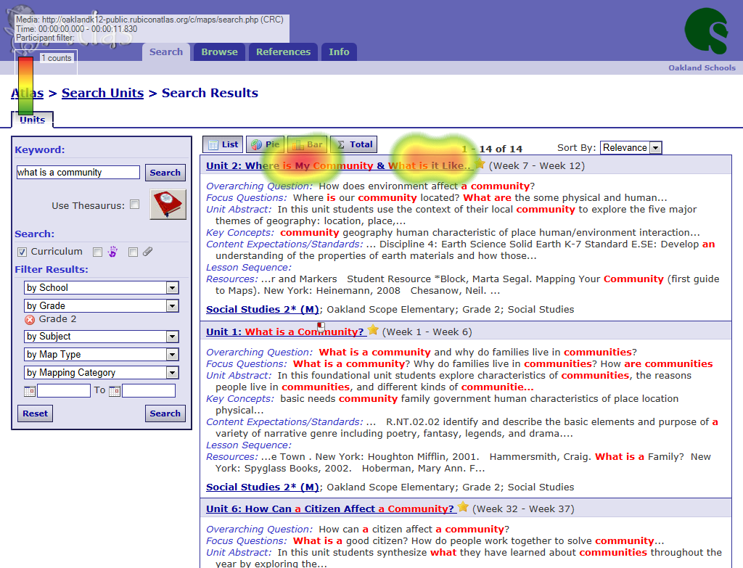

Web-Based Curriculum Mapping
Course Listings
Red Text
Users had a tendency to look at the result set, but hesitate to click on the link to the unit(s)
From comments received by the users, both formatting of this section and red text caused distraction
Identified Problem Areas
Format / Organization caused users to miss links
Encouraged reliance on summary information
Confusion with topic and unit links per result.
Clarification needed on browse vs search.
Red text should be revisited.

Slide 12
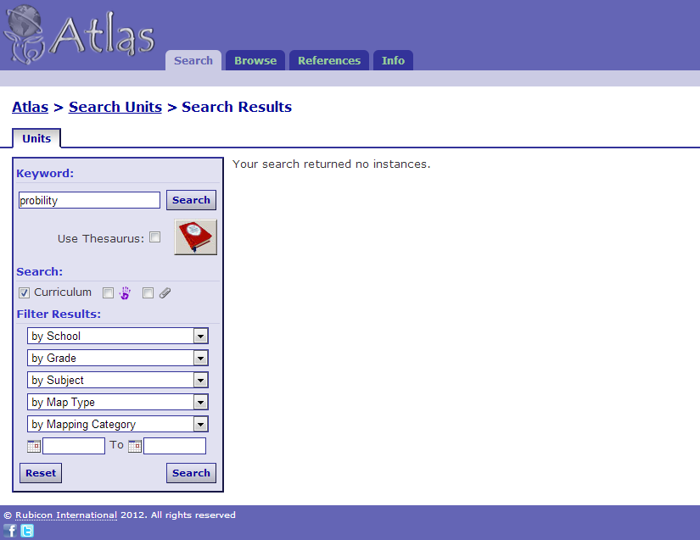

Web-Based Curriculum Mapping
Search Limitations
No Results
A common problem with the system was the lack of suggestions when no results were found
Spelling / Synonym recognition is either not a feature or not configured correctly
Identified Problem Areas
Course listings are limited on facets
Search within categories is not available
Facets can be confusing to the user
Search provides for no flexibility in terms
No spelling / synonym capabilities

Slide 13
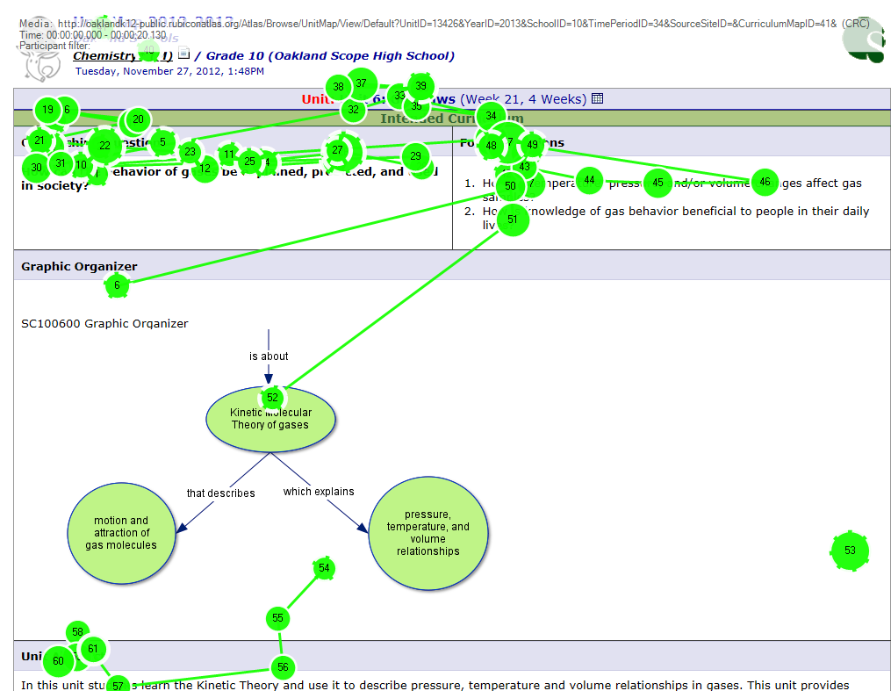
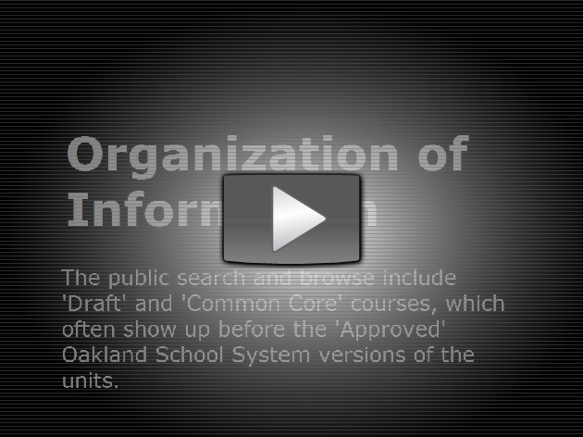
Web-Based Curriculum Mapping
Organization of Information
Issues with the Unit Page
Most users fixated on the top of this page
To find information, much scrolling was needed
Better formatting of this unit pages/documents should be considered for web format
Identified Problem Areas
Distinction between public and internal (drafts) information needed
'Common Core' needs explanation
Better use of homepage information
Instructions for site functionality

Slide 14
Web-Based Curriculum Mapping
Recommendations
Provide Instructions
Use the landing page to provide helpful prompts for new users
Build in some of the main functionality into the homepage
Simplify Search
Improve facets by removing cluttered buttons and improving categories
Consolidate or properly differentiate between ‘browse’ and ‘search’
Explain Content
Terms like ‘draft’ and ‘common core’ need to be understood by this user group or made visable only to teachers and administrators
Users should not have to navigate through a massive ‘info’ area
Improve Format
Search results should be simplified and made easier to read
Links should be ‘obvious’
Unit pages should be ‘webified’

Slide 15

Web-Based Curriculum Mapping
Proposed Wireframes for Home, Search and Unit Pages
Wireframes

Slide 16
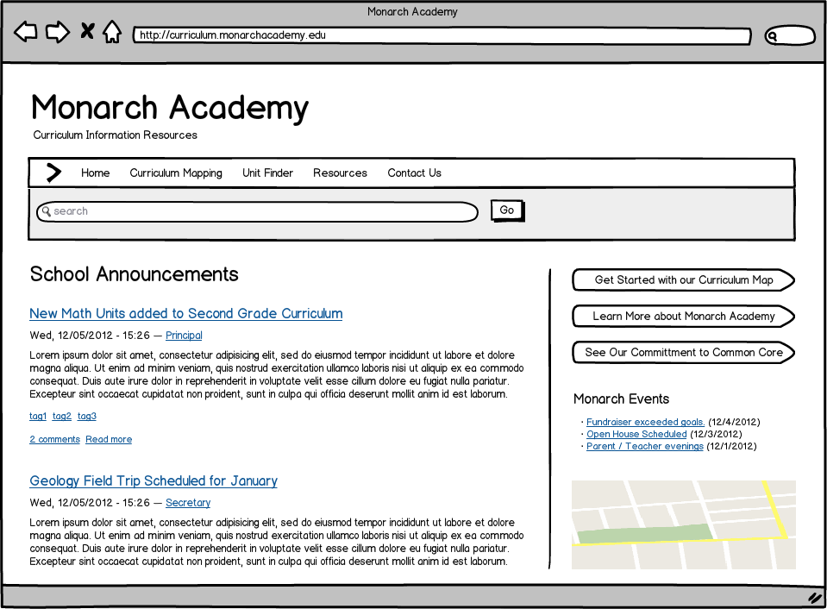
Web-Based Curriculum Mapping
Your text

Slide 17
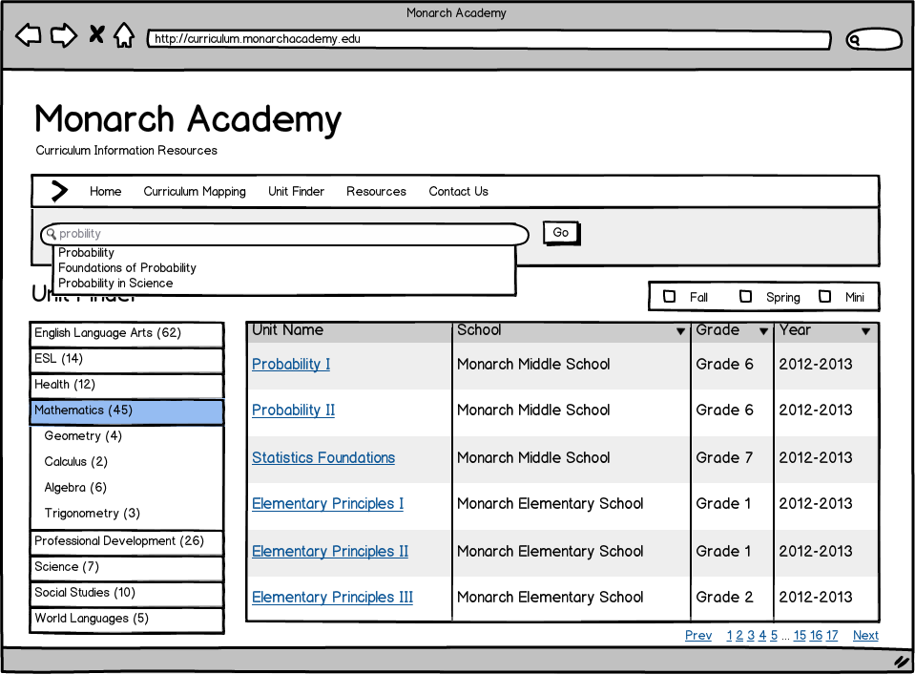
Web-Based Curriculum Mapping
Wireframes

Slide 18
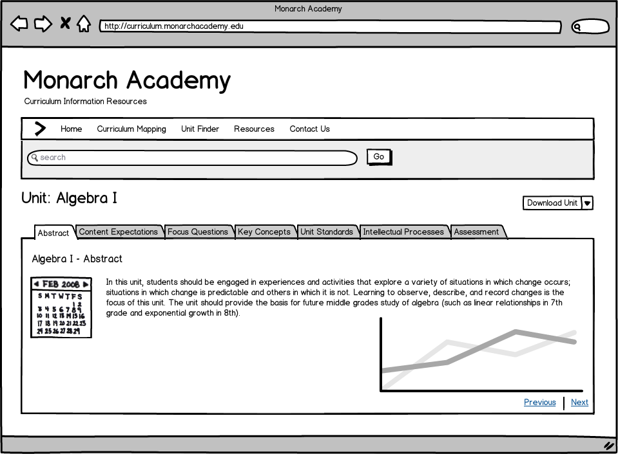
Web-Based Curriculum Mapping
Your text

Slide 19
Web-Based Curriculum Mapping
Concluding Thoughts
Oakland Public Schools Atlas Rubicon provided much information on the current limitations and challenges with the system
The information gathered in this study can be used to facilitate the development of a custom curriculum mapping solution for Monarch Academy
While the results of this research are helpful, it should be noted that because of the size of the user population, further research will be required moving forward.
Consideration also needs to be given to the fact that many of the flaws discovered here could have been attributed to the way Atlas was implemented at Oakland.

Slide 20
?
Questions?
?
?

