Slide 1
PROJETO DE ENSINO - MATERIAL DIDATICO DA DISCIPLINA “TEORIA DA COMPUTAÇÃO”
Apresentação do Ruby
Bolsista: Ícaro A. Souza.
Coordenador: César Alberto Bravo Pariente.

Slide 2
Instalando
Primeiro instale o Ruby em sua maquina. O instalador pode ser encontrado em: http://www.ruby-lang.org/pt/downloads/
Agora copie a pasta “ruby teoria” para o diretório: “ C:\ ”
Para compilar um dos exemplos que ficam na pasta “casouso” de acada capitulo é só ir ao diretório do arquivo através do programa do ruby e digitar:
“ruby nome_do_arquivo_que_deseja_executar”

Slide 3
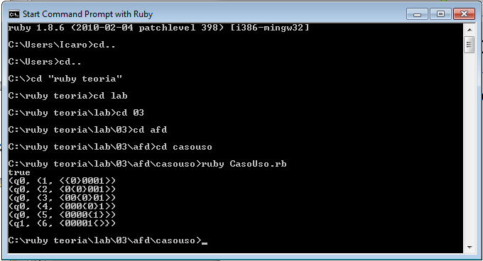
Exemplo
Compilando um arquivo no ruby:

Slide 4
Exemplos Linguagens Recursivas
Capítulo 6

Slide 5
Exemplo 6.1.p554: L(M) = abc(a|b|c)*
O diagrama de transições do autômato :
a/(a,D), b/(b,D), c/(c,D)
a / (a,D)
b / (b,D)
c / (c,D)
B / (B,D)
q₀
q₁
q₂
q₃
q₄

Slide 6
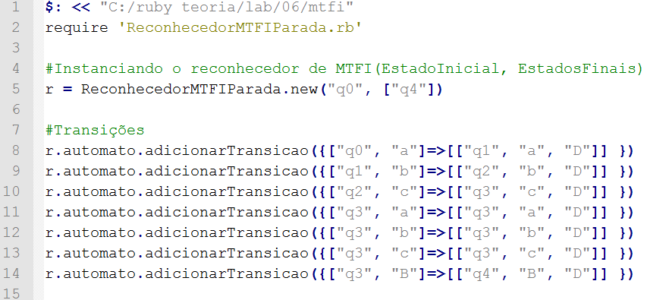
Exemplo 6.1.p554: L(M) = abc(a|b|c)*
Código em Ruby:

Slide 7
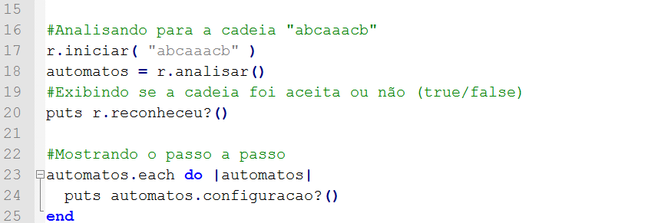
Exemplo 6.1.p554: L(M) = abc(a|b|c)*
Código em Ruby: (Continuação)

Slide 8
Exemplo 6.1.p554: L(M) = abc(a|b|c)*
Analisando a cadeia “abcaaacb”
Através do diagrama de transição do autômato.
Comparando o Resultado com a execução do código em Ruby.

Slide 9
Exemplo 6.1.p554: L(M) = abc(a|b|c)*
Cadeia = (<,q₀, abcaaacb)
a/(a,D), b/(b,D), c/(c,D)
a / (a,D)
b / (b,D)
c / (c,D)
B / (B,D)
q₀
q₁
q₂
q₃
q₄

Slide 10
Exemplo 6.1.p554: L(M) = abc(a|b|c)*
Cadeia = (<,q₀,abcaaacb)⊢(<a,q₁, bcaaacb)
a/(a,D), b/(b,D), c/(c,D)
a / (a,D)
b / (b,D)
c / (c,D)
B / (B,D)
q₀
q₁
q₂
q₃
q₄

Slide 11
Exemplo 6.1.p554: L(M) = abc(a|b|c)*
Cadeia = (<,q₀,abcaaacb)⊢(<a,q₁,bcaaacb) ⊢(<ab,q₂,caaacb)
a/(a,D), b/(b,D), c/(c,D)
a / (a,D)
b / (b,D)
c / (c,D)
B / (B,D)
q₀
q₁
q₂
q₃
q₄

Slide 12
Exemplo 6.1.p554: L(M) = abc(a|b|c)*
Cadeia = (<,q₀,abcaaacb)⊢(<a,q₁,bcaaacb) ⊢(<ab,q₂,caaacb)⊢(<abc,q₃,aaacb) ⊢(<abc,q₃,aaacb)
a/(a,D), b/(b,D), c/(c,D)
a / (a,D)
b / (b,D)
c / (c,D)
B / (B,D)
q₀
q₁
q₂
q₃
q₄

Slide 13
Exemplo 6.1.p554: L(M) = abc(a|b|c)*
Cadeia = (<,q₀,abcaaacb)⊢(<a,q₁,bcaaacb) ⊢(<ab,q₂,caaacb)⊢(<abc,q₃,aaacb) ⊢(<abc,q₃,aaacb)⊢(<abca,q₃,aacb)
a/(a,D), b/(b,D), c/(c,D)
a / (a,D)
b / (b,D)
c / (c,D)
B / (B,D)
q₀
q₁
q₂
q₃
q₄

Slide 14
Exemplo 6.1.p554: L(M) = abc(a|b|c)*
Cadeia = (<,q₀,abcaaacb)⊢(<a,q₁,bcaaacb) ⊢(<ab,q₂,caaacb)⊢(<abc,q₃,aaacb) ⊢(<abc,q₃,aaacb)⊢(<abca,q₃,aacb)
⊢(<abcaa,q₃,acb)
a/(a,D), b/(b,D), c/(c,D)
a / (a,D)
b / (b,D)
c / (c,D)
B / (B,D)
q₀
q₁
q₂
q₃
q₄

Slide 15
Exemplo 6.1.p554: L(M) = abc(a|b|c)*
Cadeia = (<,q₀,abcaaacb)⊢(<a,q₁,bcaaacb) ⊢(<ab,q₂,caaacb)⊢(<abc,q₃,aaacb) ⊢(<abc,q₃,aaacb)⊢(<abca,q₃,aacb)
⊢(<abcaa,q₃,acb) ⊢(<abcaaa,q₃,cb)
a/(a,D), b/(b,D), c/(c,D)
a / (a,D)
b / (b,D)
c / (c,D)
B / (B,D)
q₀
q₁
q₂
q₃
q₄

Slide 16
Exemplo 6.1.p554: L(M) = abc(a|b|c)*
Cadeia = (<,q₀,abcaaacb)⊢(<a,q₁,bcaaacb) ⊢(<ab,q₂,caaacb)⊢(<abc,q₃,aaacb) ⊢(<abc,q₃,aaacb)⊢(<abca,q₃,aacb)
⊢(<abcaa,q₃,acb)⊢(<abcaaa,q₃,cb)
⊢(<abcaaac,q₃,b)
a/(a,D), b/(b,D), c/(c,D)
a / (a,D)
b / (b,D)
c / (c,D)
B / (B,D)
q₀
q₁
q₂
q₃
q₄

Slide 17
Exemplo 6.1.p554: L(M) = abc(a|b|c)*
Cadeia = (<,q₀,abcaaacb)⊢(<a,q₁,bcaaacb) ⊢(<ab,q₂,caaacb)⊢(<abc,q₃,aaacb) ⊢(<abc,q₃,aaacb)⊢(<abca,q₃,aacb)
⊢(<abcaa,q₃,acb)⊢(<abcaaa,q₃,cb)
⊢(<abcaaac,q₃,b)⊢(<abcaaacb,q₃,B)
a/(a,D), b/(b,D), c/(c,D)
a / (a,D)
b / (b,D)
c / (c,D)
B / (B,D)
q₀
q₁
q₂
q₃
q₄

Slide 18
Exemplo 6.1.p554: L(M) = abc(a|b|c)*
Cadeia = (<,q₀,abcaaacb)⊢(<a,q₁,bcaaacb) ⊢(<ab,q₂,caaacb)⊢(<abc,q₃,aaacb) ⊢(<abc,q₃,aaacb)⊢(<abca,q₃,aacb)
⊢(<abcaa,q₃,acb)⊢(<abcaaa,q₃,cb)
⊢(<abcaaac,q₃,b)⊢(<abcaaacb,q₃,B)
⊢(<abcaaacbB,q₄,B)
a/(a,D), b/(b,D), c/(c,D)
a / (a,D)
b / (b,D)
c / (c,D)
B / (B,D)
q₀
q₁
q₂
q₃
q₄

Slide 19
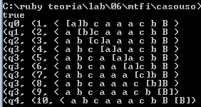
Comparando os resultados com o Ruby
(<,q₀,abcaaacb)
(<a,q₁,bcaaacb) (<ab,q₂,caaacb)
(<abc,q₃,aaacb)
(<abca,q₃,aacb) (<abcaa,q₃,acb)
(<abcaaa,q₃,cb) (<abcaaac,q₃,b)
(<abcaaacb,q₃,B)
(<abcaaacbB,q₄,B)

Slide 20
Exemplo 6.2.p555: L(M) = { ww^{R} : w∈{a, b}*}
O diagrama de transições do autômato :
a/(a,D), b/(b,D)
a/(a,E), b/(b,E)
X / (X,E)
B / (B,E)
Y / (Y,E)
a / (X,E)
q₁
q₂
q₃
a / (X,D)
X / (X,D)
q₀
X / (X,E)
B / (B,E)
Y / (Y,E)
Y / (Y,D)
b / (Y,D)
b / (Y,E)
q₄
q₅
q₆
a/(a,D), b/(b,D)
a/(a,E), b/(b,E)

Slide 21
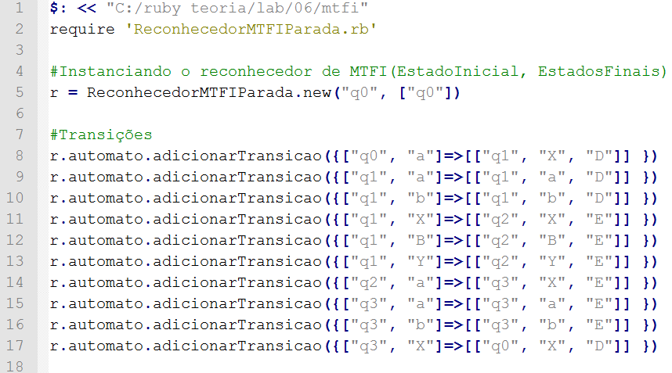
Exemplo 6.2.p555: L(M) = { ww^{R} : w∈{a, b}*}
Código em ruby:

Slide 22
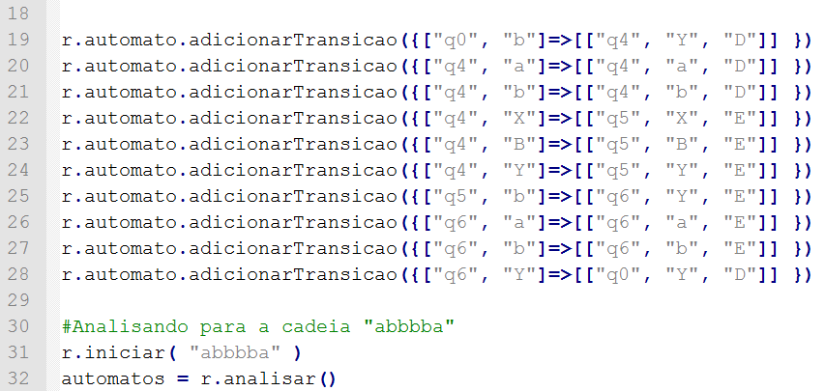
Exemplo 6.2.p555: L(M) = { ww^{R} : w∈{a, b}*}
Código em ruby (Continuação):

Slide 23
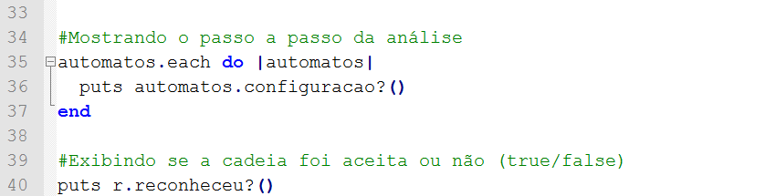
Exemplo 6.2.p555: L(M) = { ww^{R} : w∈{a, b}*}
Código em ruby (Continuação):

Slide 24
Exemplo 6.2.p555: L(M) = { ww^{R} : w∈{a, b}*}
Analisando a cadeia “abbbba”
Através do diagrama de transição do autômato.
Comparando o Resultado com a execução do código em Ruby.

Slide 25
Exemplo 6.2.p555: L(M) = { ww^{R} : w∈{a, b}*}
a/(a,D), b/(b,D)
a/(a,E), b/(b,E)
X / (X,E)
B / (B,E)
Y / (Y,E)
a / (X,E)
q₁
q₂
q₃
a / (X,D)
X / (X,D)
q₀
X / (X,E)
B / (B,E)
Y / (Y,E)
Y / (Y,D)
b / (Y,D)
b / (Y,E)
q₄
q₅
q₆
a/(a,D), b/(b,D)
a/(a,E), b/(b,E)
Cadeia = (<,q₀, abbbba)

Slide 26
Exemplo 6.2.p555: L(M) = { ww^{R} : w∈{a, b}*}
a/(a,D), b/(b,D)
a/(a,E), b/(b,E)
X / (X,E)
B / (B,E)
Y / (Y,E)
a / (X,E)
q₁
q₂
q₃
a / (X,D)
X / (X,D)
q₀
X / (X,E)
B / (B,E)
Y / (Y,E)
Y / (Y,D)
b / (Y,D)
b / (Y,E)
q₄
q₅
q₆
a/(a,D), b/(b,D)
a/(a,E), b/(b,E)
Cadeia = (<,q₀, abbbba)⊢(<X,q₁, bbbba)

Slide 27
Exemplo 6.2.p555: L(M) = { ww^{R} : w∈{a, b}*}
a/(a,D), b/(b,D)
a/(a,E), b/(b,E)
X / (X,E)
B / (B,E)
Y / (Y,E)
a / (X,E)
q₁
q₂
q₃
a / (X,D)
X / (X,D)
q₀
X / (X,E)
B / (B,E)
Y / (Y,E)
Y / (Y,D)
b / (Y,D)
b / (Y,E)
q₄
q₅
q₆
a/(a,D), b/(b,D)
a/(a,E), b/(b,E)
Cadeia = (<,q₀, abbbba)⊢(<X,q₁, bbbba)⊢(<Xb,q₁, bbba)

Slide 28
Exemplo 6.2.p555: L(M) = { ww^{R} : w∈{a, b}*}
a/(a,D), b/(b,D)
a/(a,E), b/(b,E)
X / (X,E)
B / (B,E)
Y / (Y,E)
a / (X,E)
q₁
q₂
q₃
a / (X,D)
X / (X,D)
q₀
X / (X,E)
B / (B,E)
Y / (Y,E)
Y / (Y,D)
b / (Y,D)
b / (Y,E)
q₄
q₅
q₆
a/(a,D), b/(b,D)
a/(a,E), b/(b,E)
Cadeia = ⊢*(<X,q₁, bbbba)⊢(<Xb,q₁, bbba)⊢(<Xbb,q₁, bba)

Slide 29
Exemplo 6.2.p555: L(M) = { ww^{R} : w∈{a, b}*}
a/(a,D), b/(b,D)
a/(a,E), b/(b,E)
X / (X,E)
B / (B,E)
Y / (Y,E)
a / (X,E)
q₁
q₂
q₃
a / (X,D)
X / (X,D)
q₀
X / (X,E)
B / (B,E)
Y / (Y,E)
Y / (Y,D)
b / (Y,D)
b / (Y,E)
q₄
q₅
q₆
a/(a,D), b/(b,D)
a/(a,E), b/(b,E)
Cadeia = ⊢*(<Xb,q₁, bbba)⊢(<Xbb,q₁, bba)⊢(<Xbbb,q₁, ba)

Slide 30
Exemplo 6.2.p555: L(M) = { ww^{R} : w∈{a, b}*}
a/(a,D), b/(b,D)
a/(a,E), b/(b,E)
X / (X,E)
B / (B,E)
Y / (Y,E)
a / (X,E)
q₁
q₂
q₃
a / (X,D)
X / (X,D)
q₀
X / (X,E)
B / (B,E)
Y / (Y,E)
Y / (Y,D)
b / (Y,D)
b / (Y,E)
q₄
q₅
q₆
a/(a,D), b/(b,D)
a/(a,E), b/(b,E)
Cadeia = ⊢*(<Xbb,q₁, bba)⊢(<Xbbb,q₁, ba)⊢(<Xbbbb,q₁,a)

Slide 31
Exemplo 6.2.p555: L(M) = { ww^{R} : w∈{a, b}*}
a/(a,D), b/(b,D)
a/(a,E), b/(b,E)
X / (X,E)
B / (B,E)
Y / (Y,E)
a / (X,E)
q₁
q₂
q₃
a / (X,D)
X / (X,D)
q₀
X / (X,E)
B / (B,E)
Y / (Y,E)
Y / (Y,D)
b / (Y,D)
b / (Y,E)
q₄
q₅
q₆
a/(a,D), b/(b,D)
a/(a,E), b/(b,E)
Cadeia = ⊢*(<Xbbb,q₁, ba)⊢(<Xbbbb,q₁,a) ⊢(<Xbbbba,q₁,B)

Slide 32
Exemplo 6.2.p555: L(M) = { ww^{R} : w∈{a, b}*}
a/(a,D), b/(b,D)
a/(a,E), b/(b,E)
X / (X,E)
B / (B,E)
Y / (Y,E)
a / (X,E)
q₁
q₂
q₃
a / (X,D)
X / (X,D)
q₀
X / (X,E)
B / (B,E)
Y / (Y,E)
Y / (Y,D)
b / (Y,D)
b / (Y,E)
q₄
q₅
q₆
a/(a,D), b/(b,D)
a/(a,E), b/(b,E)
Cadeia = ⊢*(<Xbbbba,q₁,B)⊢(<Xbbbba,q₁,B)⊢(<Xbbbb,q₂,a)

Slide 33
Exemplo 6.2.p555: L(M) = { ww^{R} : w∈{a, b}*}
a/(a,D), b/(b,D)
a/(a,E), b/(b,E)
X / (X,E)
B / (B,E)
Y / (Y,E)
a / (X,E)
q₁
q₂
q₃
a / (X,D)
X / (X,D)
q₀
X / (X,E)
B / (B,E)
Y / (Y,E)
Y / (Y,D)
b / (Y,D)
b / (Y,E)
q₄
q₅
q₆
a/(a,D), b/(b,D)
a/(a,E), b/(b,E)
Cadeia = ⊢*(<Xbbbba,q₁,B)⊢(<Xbbbb,q₂,a)⊢(<Xbbb,q₃,bX)

Slide 34
Exemplo 6.2.p555: L(M) = { ww^{R} : w∈{a, b}*}
a/(a,D), b/(b,D)
a/(a,E), b/(b,E)
X / (X,E)
B / (B,E)
Y / (Y,E)
a / (X,E)
q₁
q₂
q₃
a / (X,D)
X / (X,D)
q₀
X / (X,E)
B / (B,E)
Y / (Y,E)
Y / (Y,D)
b / (Y,D)
b / (Y,E)
q₄
q₅
q₆
a/(a,D), b/(b,D)
a/(a,E), b/(b,E)
Cadeia = ⊢*(<Xbbbb,q₂,a)⊢(<Xbbb,q₃,bX)⊢(<Xbb,q₃,bbX)

Slide 35
Exemplo 6.2.p555: L(M) = { ww^{R} : w∈{a, b}*}
a/(a,D), b/(b,D)
a/(a,E), b/(b,E)
X / (X,E)
B / (B,E)
Y / (Y,E)
a / (X,E)
q₁
q₂
q₃
a / (X,D)
X / (X,D)
q₀
X / (X,E)
B / (B,E)
Y / (Y,E)
Y / (Y,D)
b / (Y,D)
b / (Y,E)
q₄
q₅
q₆
a/(a,D), b/(b,D)
a/(a,E), b/(b,E)
Cadeia = ⊢*(<Xbbb,q₃,bX)⊢(<Xbb,q₃,bbX) ⊢(<Xb,q₃,bbbX)

Slide 36
Exemplo 6.2.p555: L(M) = { ww^{R} : w∈{a, b}*}
a/(a,D), b/(b,D)
a/(a,E), b/(b,E)
X / (X,E)
B / (B,E)
Y / (Y,E)
a / (X,E)
q₁
q₂
q₃
a / (X,D)
X / (X,D)
q₀
X / (X,E)
B / (B,E)
Y / (Y,E)
Y / (Y,D)
b / (Y,D)
b / (Y,E)
q₄
q₅
q₆
a/(a,D), b/(b,D)
a/(a,E), b/(b,E)
Cadeia = ⊢*(<Xb,q₃,bbbX)⊢(<X,q₃,bbbbX)⊢(<,q₃,XbbbbX)

Slide 37
Exemplo 6.2.p555: L(M) = { ww^{R} : w∈{a, b}*}
a/(a,D), b/(b,D)
a/(a,E), b/(b,E)
X / (X,E)
B / (B,E)
Y / (Y,E)
a / (X,E)
q₁
q₂
q₃
a / (X,D)
X / (X,D)
q₀
X / (X,E)
B / (B,E)
Y / (Y,E)
Y / (Y,D)
b / (Y,D)
b / (Y,E)
q₄
q₅
q₆
a/(a,D), b/(b,D)
a/(a,E), b/(b,E)
Cadeia = ⊢*(<X,q₃,bbbbX)⊢(<,q₃,XbbbbX)⊢(<X,q₀,bbbbX)

Slide 38
Exemplo 6.2.p555: L(M) = { ww^{R} : w∈{a, b}*}
a/(a,D), b/(b,D)
a/(a,E), b/(b,E)
X / (X,E)
B / (B,E)
Y / (Y,E)
a / (X,E)
q₁
q₂
q₃
a / (X,D)
X / (X,D)
q₀
⊢(<X,q₀,bbbbX)
X / (X,E)
B / (B,E)
Y / (Y,E)
Y / (Y,D)
b / (Y,D)
b / (Y,E)
q₄
q₅
q₆
a/(a,D), b/(b,D)
a/(a,E), b/(b,E)
Cadeia = ⊢*(<X,q₀,bbbbX)⊢(<XY,q₄,bbbX)⊢(<XYb,q₄,bbX)

Slide 39
Exemplo 6.2.p555: L(M) = { ww^{R} : w∈{a, b}*}
a/(a,D), b/(b,D)
a/(a,E), b/(b,E)
X / (X,E)
B / (B,E)
Y / (Y,E)
a / (X,E)
q₁
q₂
q₃
a / (X,D)
X / (X,D)
q₀
⊢(<X,q₀,bbbbX)
X / (X,E)
B / (B,E)
Y / (Y,E)
Y / (Y,D)
b / (Y,D)
b / (Y,E)
q₄
q₅
q₆
a/(a,D), b/(b,D)
a/(a,E), b/(b,E)
Cadeia = ⊢*(<XY,q₄,bbbX)⊢(<XYb,q₄,bbX)⊢(<XYbb,q₄,bX)

Slide 40
Exemplo 6.2.p555: L(M) = { ww^{R} : w∈{a, b}*}
a/(a,D), b/(b,D)
a/(a,E), b/(b,E)
X / (X,E)
B / (B,E)
Y / (Y,E)
a / (X,E)
q₁
q₂
q₃
a / (X,D)
X / (X,D)
q₀
⊢(<X,q₀,bbbbX)
X / (X,E)
B / (B,E)
Y / (Y,E)
Y / (Y,D)
b / (Y,D)
b / (Y,E)
q₄
q₅
q₆
a/(a,D), b/(b,D)
a/(a,E), b/(b,E)
Cadeia = ⊢*(<XYb,q₄,bbX)⊢(<XYbb,q₄,bX)⊢(<XYbbb,q₄,X)

Slide 41
Exemplo 6.2.p555: L(M) = { ww^{R} : w∈{a, b}*}
a/(a,D), b/(b,D)
a/(a,E), b/(b,E)
X / (X,E)
B / (B,E)
Y / (Y,E)
a / (X,E)
q₁
q₂
q₃
a / (X,D)
X / (X,D)
q₀
⊢(<X,q₀,bbbbX)
X / (X,E)
B / (B,E)
Y / (Y,E)
Y / (Y,D)
b / (Y,D)
b / (Y,E)
q₄
q₅
q₆
a/(a,D), b/(b,D)
a/(a,E), b/(b,E)
Cadeia = ⊢*(<XYbb,q₄,bX)⊢(<XYbbb,q₄,X)⊢

Slide 42
Exemplo 6.2.p555: L(M) = { ww^{R} : w∈{a, b}*}
a/(a,D), b/(b,D)
a/(a,E), b/(b,E)
X / (X,E)
B / (B,E)
Y / (Y,E)
a / (X,E)
q₁
q₂
q₃
a / (X,D)
X / (X,D)
q₀
⊢(<X,q₀,bbbbX)
X / (X,E)
B / (B,E)
Y / (Y,E)
Y / (Y,D)
b / (Y,D)
b / (Y,E)
q₄
q₅
q₆
a/(a,D), b/(b,D)
a/(a,E), b/(b,E)
Cadeia = ⊢*(<XYbbb,q₄,X)⊢(<XYbb,q₅,bX) ⊢(<XYb,q₆,bYX)

Slide 43
Exemplo 6.2.p555: L(M) = { ww^{R} : w∈{a, b}*}
a/(a,D), b/(b,D)
a/(a,E), b/(b,E)
X / (X,E)
B / (B,E)
Y / (Y,E)
a / (X,E)
q₁
q₂
q₃
a / (X,D)
X / (X,D)
q₀
⊢(<X,q₀,bbbbX)
X / (X,E)
B / (B,E)
Y / (Y,E)
Y / (Y,D)
b / (Y,D)
b / (Y,E)
q₄
q₅
q₆
a/(a,D), b/(b,D)
a/(a,E), b/(b,E)
Cadeia = ⊢*(<XYbb,q₅,bX) ⊢(<XYb,q₆,bYX)⊢(<XY,q₆,bbYX)

Slide 44
Exemplo 6.2.p555: L(M) = { ww^{R} : w∈{a, b}*}
a/(a,D), b/(b,D)
a/(a,E), b/(b,E)
X / (X,E)
B / (B,E)
Y / (Y,E)
a / (X,E)
q₁
q₂
q₃
a / (X,D)
X / (X,D)
q₀
⊢(<X,q₀,bbbbX)
X / (X,E)
B / (B,E)
Y / (Y,E)
Y / (Y,D)
b / (Y,D)
b / (Y,E)
q₄
q₅
q₆
a/(a,D), b/(b,D)
a/(a,E), b/(b,E)
Cadeia = ⊢*(<XYbb,q₅,bX) ⊢(<XYb,q₆,bYX)⊢(<X,q₆,YbbYX)

Slide 45
Exemplo 6.2.p555: L(M) = { ww^{R} : w∈{a, b}*}
a/(a,D), b/(b,D)
a/(a,E), b/(b,E)
X / (X,E)
B / (B,E)
Y / (Y,E)
a / (X,E)
q₁
q₂
q₃
a / (X,D)
X / (X,D)
q₀
⊢(<X,q₀,bbbbX)
X / (X,E)
B / (B,E)
Y / (Y,E)
Y / (Y,D)
b / (Y,D)
b / (Y,E)
q₄
q₅
q₆
a/(a,D), b/(b,D)
a/(a,E), b/(b,E)
Cadeia = ⊢*(<XYb,q₆,bYX)⊢(<X,q₆,YbbYX)⊢(<XY,q₀,bbYX)

Slide 46
Exemplo 6.2.p555: L(M) = { ww^{R} : w∈{a, b}*}
a/(a,D), b/(b,D)
a/(a,E), b/(b,E)
X / (X,E)
B / (B,E)
Y / (Y,E)
a / (X,E)
q₁
q₂
q₃
a / (X,D)
X / (X,D)
q₀
⊢(<X,q₀,bbbbX)
X / (X,E)
B / (B,E)
Y / (Y,E)
Y / (Y,D)
b / (Y,D)
b / (Y,E)
q₄
q₅
q₆
a/(a,D), b/(b,D)
a/(a,E), b/(b,E)
Cadeia = ⊢* (<X,q₆,YbbYX)⊢(<XY,q₀,bbYX)⊢(<XYY,q₄,bYX)

Slide 47
Exemplo 6.2.p555: L(M) = { ww^{R} : w∈{a, b}*}
a/(a,D), b/(b,D)
a/(a,E), b/(b,E)
X / (X,E)
B / (B,E)
Y / (Y,E)
a / (X,E)
q₁
q₂
q₃
a / (X,D)
X / (X,D)
q₀
⊢(<X,q₀,bbbbX)
X / (X,E)
B / (B,E)
Y / (Y,E)
Y / (Y,D)
b / (Y,D)
b / (Y,E)
q₄
q₅
q₆
a/(a,D), b/(b,D)
a/(a,E), b/(b,E)
Cadeia = ⊢*(<XY,q₀,bbYX)⊢(<XYY,q₄,bYX)⊢(<XYYb,q₄,YX)

Slide 48
Exemplo 6.2.p555: L(M) = { ww^{R} : w∈{a, b}*}
a/(a,D), b/(b,D)
a/(a,E), b/(b,E)
X / (X,E)
B / (B,E)
Y / (Y,E)
a / (X,E)
q₁
q₂
q₃
a / (X,D)
X / (X,D)
q₀
⊢(<X,q₀,bbbbX)
X / (X,E)
B / (B,E)
Y / (Y,E)
Y / (Y,D)
b / (Y,D)
b / (Y,E)
q₄
q₅
q₆
a/(a,D), b/(b,D)
a/(a,E), b/(b,E)
Cadeia = ⊢* (<XYY,q₄,bYX)⊢(<XYYb,q₄,YX) ⊢(<XYY,q₅,bYX)

Slide 49
Exemplo 6.2.p555: L(M) = { ww^{R} : w∈{a, b}*}
a/(a,D), b/(b,D)
a/(a,E), b/(b,E)
X / (X,E)
B / (B,E)
Y / (Y,E)
a / (X,E)
q₁
q₂
q₃
a / (X,D)
X / (X,D)
q₀
⊢(<X,q₀,bbbbX)
X / (X,E)
B / (B,E)
Y / (Y,E)
Y / (Y,D)
b / (Y,D)
b / (Y,E)
q₄
q₅
q₆
a/(a,D), b/(b,D)
a/(a,E), b/(b,E)
Cadeia = ⊢*(<XYYb,q₄,YX)⊢(<XYY,q₅,bYX)⊢(<XYY,q₆,YYX)

Slide 50
Exemplo 6.2.p555: L(M) = { ww^{R} : w∈{a, b}*}
a/(a,D), b/(b,D)
a/(a,E), b/(b,E)
X / (X,E)
B / (B,E)
Y / (Y,E)
a / (X,E)
q₁
q₂
q₃
a / (X,D)
X / (X,D)
q₀
⊢(<X,q₀,bbbbX)
X / (X,E)
B / (B,E)
Y / (Y,E)
Y / (Y,D)
b / (Y,D)
b / (Y,E)
q₄
q₅
q₆
a/(a,D), b/(b,D)
a/(a,E), b/(b,E)
Cadeia = ⊢*(<XYY,q₅,bYX)⊢(<XYY,q₆,YYX)⊢(<XYYY,q₀,YX)

Slide 51
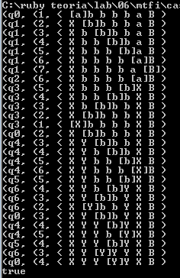
Comparando os resultados com o Ruby
(<,q0,abbbba)
(<X,q1,bbbba)
(<Xb,q1,bbba)
(<Xbb,q1,bba)
(<Xbbb,q1,ba)
(<Xbbbb,q1,a)
(<Xbbbba,q1,B)
(<Xbbbb,q2,a)
(<Xbbb,q3,bX)
(<Xbb,q3,bbX)
(<Xb,q3,bbbX)
(<,q3,XbbbbX)
(<X,q0,bbbbX)
(<XY,q0,bbYX)
(<XYY,q4,bYX)
(<XYYb,q4,YX)
(<XYY,q5,bYX)
(<XYY,q6,YYX)
(<XYYY,q0,YX)

