Slide 1
Introduction to Optical Design Yuzuru Takashima, Ph.D.
Associate Professor College of Optical Sciences University of Arizona 1630 E. University Blvd. Tucson, AZ 85721 ytakashima@optics.arizona.edu www.optics.arizona.edu

Slide 2
Introduction to Optical Design Lecture #1
Yuzuru Takashima
College of Optical Sciences
ytakashima@optics.arizona.edu

Slide 3
Design Procedure
How to design lens system?
Exercise 1: Use catalog lens in CodeV
Review of 1st order optics
Why 1st order ? How 1st order optics are related to 3rd order aberrations?
Ray-trace

Slide 4
Design Procedure
1. Statement of problem to be solved:
Objective
Marketing and Technical statement
2. Alternative designs:
Several options for solving the stated problem/objective
1) Statement of problem to be solved:
Objective
Technical statement (PRD: Product Requirement Document)
Marketing statement (MRD: Marketing Requirement Document), which translates into a technical statement
2) Alternative designs:
Several options for solving the stated problem/objective
3) First order designs: geometrical design of optics
4) Evaluate against objectives
5) Select the most promising solution(s) (1st order. solution)
6) Carry out ray tracing design of most promising first order design
7) Evaluate design against objectives; optimize against “cost” factor
8) Go through loop 6, 7, 6, 7 until satisfactory results emerge, or 3, 4, 5, 6, 7
9) Carry out tolerance analysis, manufacturing and cost analysis, repeat 3-8 if necessary
10) Write report
3. First order designs:
4. Evaluate
against objectives
No
Yes
5. Select most promising solution(s)
(1st order solution)
6. Carry out 3rd order analysis
(3rd order solution)
7. Evaluate
against objectives
No
Yes
8. Carry out ray tracing design of most promising 1st order design
9. Carry out tolerance analysis, manufacturing and cost analysis
10. Evaluate
against objectives

Slide 5
Waterfall v.s. Agile Process
Waterfall process
Mainly used for a hardware design.
It is very important to follow the process!
A self-reviewing process
Logical development
Easy to recover errors

Slide 6
Agile Process
Agile Process
For software development, it is generally difficult to define PRD completely.
Look & Feel
User experience.
Specification
MRD
PRD
Testing

Slide 7
Example: 1) Statement of problem to be solved
Marketing statement:
I want to focus (and scan) a laser beam on a sample inside a vacuum chamber. Size of the chamber is 80mm in diameter.
Technical statement:
Focal length of 40mm is required, i.e. from requirements for scanning speed.
Wavelength:
Spot size:
f’=40mm.
Working distance (=fb) > 45mm.
Less number of elements is desirable for alignment.
Anything else?
Chamber
Laser
45mm
Optical
System
Sample
Scanning
mirror
80mm

Slide 8
2) Alternative designs 3) First order designs: geometrical design of optics
f’=-40
f’=+40
Start!
F’_{sys}
F’_{sys}
f’=40
Ray matrix
Graphical ray tracing
40
40
Single thin lens
f’=40mm
Two thin element system
f’_{sys}=40, fb = 80
Thick lens
(01LDX313,f=40mm)
Thick lens
01LDK117
f=-40mm
Thick lens
01LDX313
f=40mm
fb=39
n
F’_{sys}
F’_{sys}
F’_{sys}
H H’
H H’
H
H’
f’=40
40 n
80
40
79
Single thick lens
Single thick lens
Two thick lenses

Slide 9
4) Evaluate against objectives 5) Select most promising solution (1st order. solution)
fb=39
n
F’_{sys}
F’_{sys}
F’_{sys}
H H’
H H’
H
H’
f’=40
40 n
80
40
79
1) Single thick lens
2) Single thick lens
3) Two thick lenses
 | 1) Single thick lens | 2) Single thick lens | 3) Two thick lenses
1. λ=532nm | 532 | 532 | 532
2. f’sys =40mm | 40 | 40 | 40
3. fb>45mm | 39 (< 45) | 80 | 79
4. # of elements | 1 | 1 | 2
5. Spot size<10μm | 2.44λ(F/#)=4.15μm, (F/#)=3.2 | Need further evaluation by ray tracing (Step 6 and thereafter.) Note: too thick! (~60mm) | 2.44λ(F/#)=8.3μm, (F/#)=6.4 Need further evaluation by ray tracing (Step 6 and thereafter.)

Slide 10
Law of geometrical optics
1) Rays propagate along straight line in a homogeneous and isotropic medium.
2) Light is refracted from the boundary between two media having different propagation speeds, or indices of refraction (n=C_{o}/C, C_{o}: speed of light in vacuum). The incoming ray, the refracted ray, and the surface normal lie in a plane.
Snell’s Law (Law of refraction)
3) Upon reflection, the incoming, reflected ray and the surface normal lie in a plane.
Law of reflection

Slide 11
Law of geometrical optics
Besides the three law of geometrical optics, there are extremely important principles, which can be derived from the law of geometrical optics and vise versa
Huygens’ Principle (1690)
Fermat’s Principle (1650)
Eikonal Equation (1911)

Slide 12
Huygens’ Principle (1690)
Each element of a wavefront may be regarded as the center of a secondary disturbance which gives rise to spherical wavelets. The position of the wavefront at any later time is the envelope of all such wavelets. (Assume wavelets propagates in the direction of ray)

Slide 13
Fermat’s Principle (1650)
A light ray always forms a trajectory that makes the optical path length (OPL) a stationary value: in general a minimum, sometimes a maximum.

Slide 14
Eikonal Equation (1911)
The square of the gradient of the Ekonal* is equal to the index of refraction squared.

Slide 15
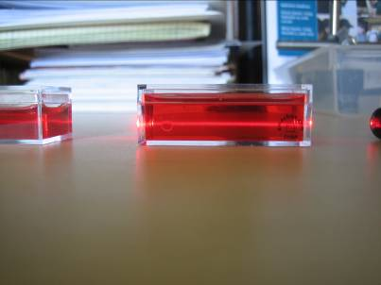
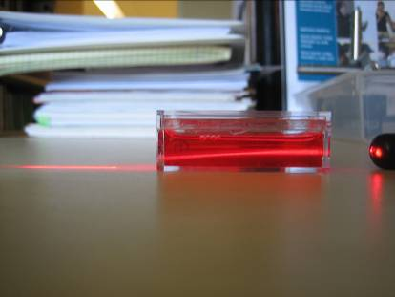

Jell-O Gradient Index Lens

Slide 16
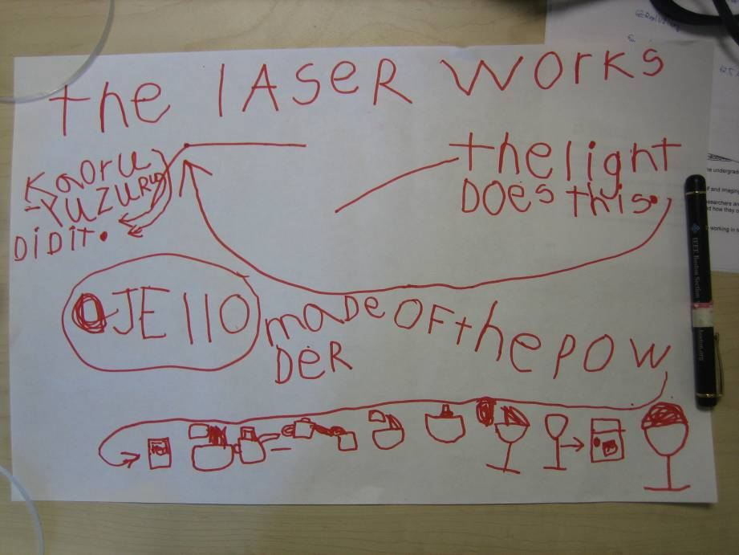
Fabrication Recipe

Slide 17
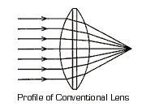
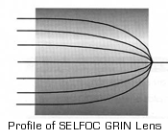
GRIN lens
n ~ 1.5
Light wave
Light wave
n: Index of refraction ~ 1.5
Velocity in glass = c/n

Slide 18

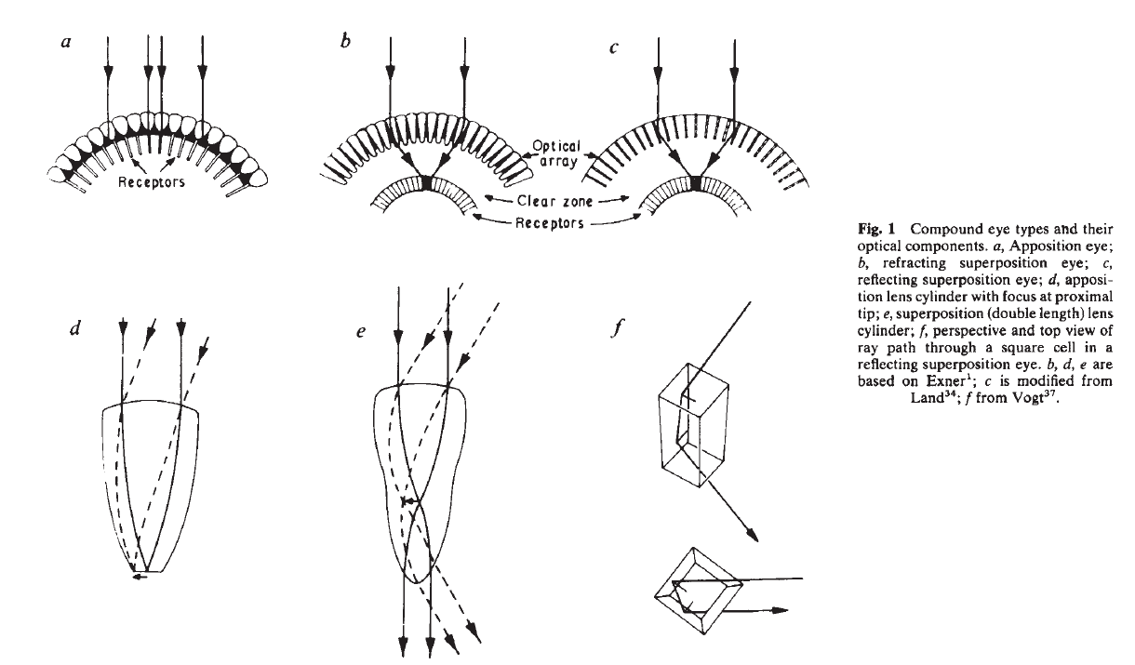
Two types of compound eyes
http://www.nature.com/nature/journal/v287/n5784/pdf/287681a0.pdf
Apposition Eyes
2) Superposition Eyes
(nocturnal insects, crustaceans)

Slide 19
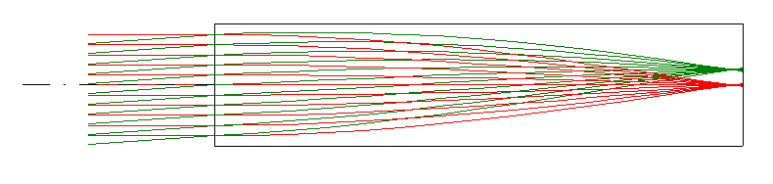
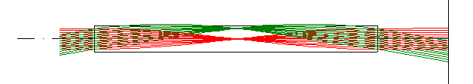
Modeling of Compound Eyes Apposition and Superposition Eyes
Apposition Eyes
GrinSingleFocus.seq
2) Superposition Eyes
GrinUnitTele.seq

Slide 20
Review: 1st order optics

Slide 21
Geometrical Theory of Optical System
A single refractive surface divides the space
in two half spaces.
Propagation direction
Optical Axis (z)
Left-hand space
(un-dashed qty)
Right-hand space
(dashed qty)
(-)
(+)
Distance

Slide 22
Geometrical Theory of Optical System
Conjugate quantities
The image is conjugate to the object.
Refracted ray is conjugate to the incident ray
The plane through the object and image are conjugate planes

Slide 23
Geometrical Theory of Optical System
An optical system can be completely described by its cardinal planes.
Two focal planes (F.P.)
Two principal planes (P.P.)
Two nodal points (N.P.)

Slide 24
Cardinal points
1st F.P.
1st P.P.
2nd P.P.
2nd F.P.
z
n
n’
f
f’
x
x’
l
l’

Slide 25
Cardinal points/planes
First focal plane:
The first focal plane on the plane in the left-hand space that is perpendicular to the axis and is conjugate to a similar plane at Infinity in the right-hand space.
Second focal plane:
Left-hand -> Right-hand
Infinity -> -Infinity

Slide 26
Cardinal points/planes
Principal Planes
The principal planes are two conjugate planes for which the lateral magnification is unity.
Nodal Points
The Nodal points are two conjugate points for which the angular magnification is unity.

Slide 27
Sign Conventions
R₁
R₂
Propagation direction
R₂<0
R₁>0
Optical Axis (z)
Angle (+)
C₂
C₁
Angle (-)
(-)
t (>0)
(+)
Distance
Left-hand space: LHS
Right-hand space: RHS

Slide 28
Sign Conventions
Ray travels from left to right
Object is in LHS space, image in at RHS space of lens system.
Radius “R” has a sign.
“C” center of radius of curvature
“C” is in RHS with respect to the surface, R>0.
“C” is in LHS with respect to the surface, R<0.
Distance, “t” (or “d”) has a sign

Slide 29
Sign Conventions
Distance, “t” (or “d”) has a sign
See the example
Angles: angles are measured from reference.
CCW: Positive
CW: Negative
Remember: The conventions is applicable when you use CodeV.

Slide 30
Graphical Ray Trace
Lens 1
Lens 2
F₁
F₂
F₁’
F₂’

Slide 31
Graphical Ray Trace
Lens 1 (-f)
Lens 2 (+f)
f

Slide 32
Ray Matrices
Question: How can we calculate the location of the principal planes with respect to the system components?
I: Input Plane
II: Output Plane
Ray
P’
F’
Height: x₁
Angle: x₁’ = 0
s₂
t₂
f’_{sys}

Slide 33
Ray Matrices
Assumptions
Paraxial approximation: sin(theta) ~ theta
Rays are described by angle(y’) and height (y)
Problem to be solved.
Given ,at the input plane (I)
calculate at the output plane (II)
Them use the table to locate cardinal points with respect to the planes I or II.

Slide 34
Ray Matrices
Plane 1
Plane 2
Height: y₂
Angle: y₂’
Ray
y₁
P’
y₂
Height: y₁
Angle: y₁’
Lens surfaces

Slide 35
Ray Matrices
Question: How can we calculate the location of the principal planes with respect to the system components?
I: Input Plane
II: Output Plane
Ray
Cy₁
P’
F’
Height: x₁
Angle: x₁’ = 0
Ay₁
s₂
t₂
f’_{sys}

Slide 36
Ray Matrices
I: Input Plane
II: Output Plane
Ray
Cy₁
P’
F’
Height: y₁
Angle: y₁’ = 0
Ay₁
s₂
t₂
f’_{sys}

Slide 37
Cardinal Points

Slide 38
Components of System Matrix: M_{sys} 1. Free space propagation
y₁
y₂
y’₂
y’₁
Optical Axis (z)
l

Slide 39
Components of System Matrix 2. Refraction at curved interface
Refracted ray
θ₂
θ₁
θ₂
n
n’
y₂’
y₁’
y₁=y₂
α (<0)
Incoming ray
R=Inf
Curved interface
Planar interface

Slide 40
1: Thin lens
F N P I II P’ N’ F’

Slide 41
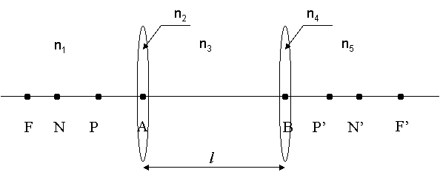
2: System of two thin lenses
I
II

Slide 42
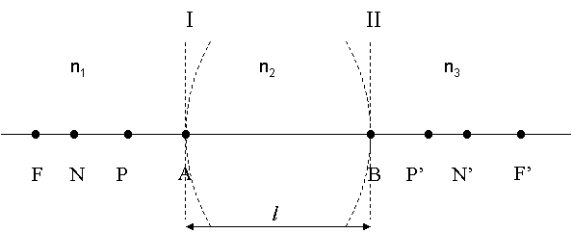
3: Thick Lens
I
II

Slide 43
Imaging Condition
I
II
y’_{I}
y_{I}
Optical Axis (z)
y_{II}
y’_{II}

Slide 44
Design Project #1
Implement the 1st order design by using off-the-shelf lens (catalog lens) in CodeV
File to be used
DP1BlankLens.seq
search.seq (CodeV macro)
Lens drawing commands
“pim”: Paraxial image solve.
“del pim”: Delete pim
“vie;go”: Draw the lens
“lis”: List first order quantities.
“wrl MySinglet”: Save lens as MySinglet.seq (text format, editable)
“in MySinglet”: Load the lens file, MySinglet.seq

Slide 45
Example: Bi-concave thick lens Melles Griot 01LDK117

Slide 46
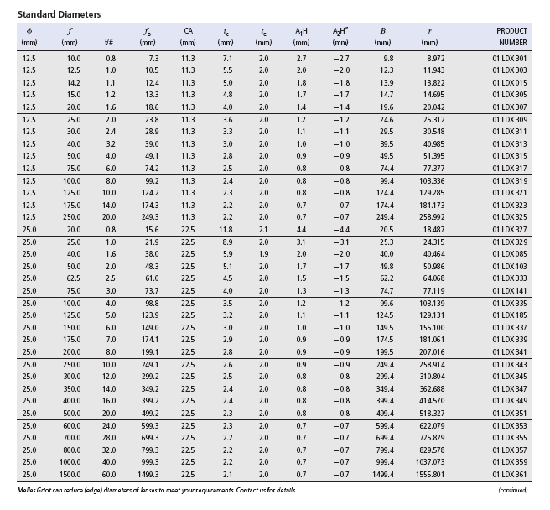
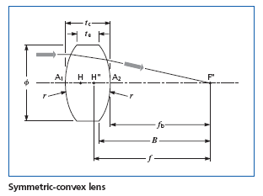
Example: Bi-convex thick lens Melles Griot 01LDX313

Slide 47
CodeV Lens Database
Copy C:\CODEV104\macro\search.seq in the working directory, C:\CVUSER104\
In the command window, type “in search”
“pim”: Paraxial image solve.
“del pim”: Delete pim
“vie;go”: Draw the lens
“lis”: List first order quantities.
“wrl MySinglet”: Save lens as MySinglet.seq (text format, editable)
“in MySinglet”: Load the lens file, MySinglet.seq

Slide 48
Introduction to Optical Design Lecture #2
Yuzuru Takashima
College of Optical Sciences
ytakashima@optics.arizona.edu

Slide 49
Aberration of the rotationally symmetric Optical System
Paraxial systems are perfect in terms of,
A point is imaged to a point.
Lateral magnification has no ray height/angle dependence.
Remember the matrix component “A” has no y, y’ dependence.
Aberrations describe the deviation of real systems from the perfection.
Paraxial image is used as a reference to measure aberrations.

Slide 50
Aberration of the rotationally Symmetric Optical System
An aberrated system will have image locations and magnifications approximately the same as those predicted by the paraxial analysis.
Aberrations result from the breakdown of the paraxial assumptions.

Slide 51
Aberration of the rotationally Symmetric Optical System
The breakdown of the paraxial assumptions.
Real angles must be used. Not paraxial angles.
This removes linearity of ray traces. Real rays do not scale.
Surface sag have to be considered.
Refraction occurs at the surface of the sphere, not at its vertex plane.
Ray rays may leave the meridional (y-z) plane.: Skew Rays.
These aberrations exist for perfectly manufactures systems.(Remember the demo of the exact ray trace.)
Spherical surfaces are true spheres, and there are no-tilted or de-centered elements.

Slide 52
Expansion of Sin(i) in Snell’s Law
Paraxial
approximation
Third order contributions

Slide 53
Coordinate System
A ray is specified by object height and pupil coordinate.
y
y_{p}
y
The angle θ is measured
from the y_{p} axis
x
X_{p}
x
h
z
Paraxial
Image
Exact
ray location
Object plane
Pupil plane
Image plane
h: Object height
Ray aberration measured
from the paraxial image point

Slide 54
Tangential (meridional) Rays
Confined to the y-z plane.
Object: (x, y)=(0,h)
Pupil (x_{p}, y_{p})=(0, y_{p}), or θ =0, 180
0 ≦ ρ ≦1
y
y_{p}
y
x
X_{p}
x
h
z
Object plane
Pupil plane
Image plane

Slide 55
Skew Rays
NOT Confined to the y-z plane.
Object: (x,y)=(0,h)
Pupil (x_{p}, y_{p})=(x_{p}, y_{p}), or θ ≠ 0, 180
0 ≦ ρ ≦1
y
y_{p}
y
x
X_{p}
x
h
z
Paraxial
Image
Object plane
Pupil plane
Image plane

Slide 56
Sagittal Rays
Skew ray with θ = 90, or 270 deg.
y
y_{p}
y
x
X_{p}
x
h
z
Object plane
Pupil plane
Image plane

Slide 57
Ray and wavefront, recap.
To describe aberrations, we use both of the ray error and wavefront error.
They are related with each other (To Be Addressed).
Ray aberrations (with respect to the paraxial image point)
Transverse ray error: (ε_{x}, ε_{y})
Meridional Ray
Sagittal Ray
Longitudinal (axial) ray error: (ε_{z})
Transverse and longitudinal (axial) ray error are related with each other (TBA).

Slide 58
Transverse ray aberration : (ε_{x}, ε_{y}) On-axis object, Meridional rays
Consider an on-axis object (h=0), and meridional rays.
ε_{y}
y
y_{p}
y
x
X_{p}
x
h=0
y_{p}
z
-1
+1
Object plane
Pupil plane
Image plane
Edge of the Pupil

Slide 59
Transverse ray aberration : (ε_{x}, ε_{y}) On-axis object, Sagittal rays
Consider an on-axis object (h=0), and Sagittal rays.
ε_{x}
y
y_{p}
y
x
X_{p}
x
h=0
x_{p}
z
Object plane
Pupil plane
Image plane

Slide 60
Transverse ray aberration : (ε_{x}, ε_{y}) Off-axis object, Meridional rays
Consider an off-axis object (h ≠ 0) and meridional rays.
ε_{y}
y
y_{p}
y
x
X_{p}
x
h
z
y_{p}
-1
+1
Object plane
Pupil plane
Image plane

Slide 61
Transverse ray aberration : (ε_{x}, ε_{y}) Off-axis object, Sagittal rays
Consider an off-axis object (h=0), and Sagittal rays.
ε_{x}
y
y_{p}
y
h
x
X_{p}
x
z
x_{p}
-1
+1
Object plane
Pupil plane
Image plane

Slide 62
Longitudinal (axial) ray aberration: (ε_{z})
y
y_{p}
y
ε_{z}(y_{p})
x
X_{p}
x
h=0
z
Object plane
Pupil plane
Image plane

Slide 63
Longitudinal (axial) ray aberration: (ε_{z})
Consider an on-axis object (h = 0) and meridional rays.
y_{p}
y
y_{p}
y
x
X_{p}
x
h=0
ε_{z}
z
Object plane
Pupil plane
Image plane

Slide 64
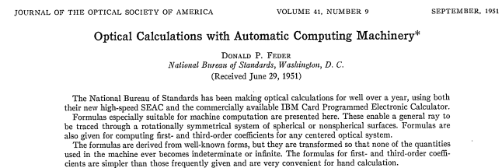
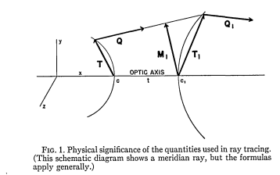
Exact Ray Trace

Slide 65
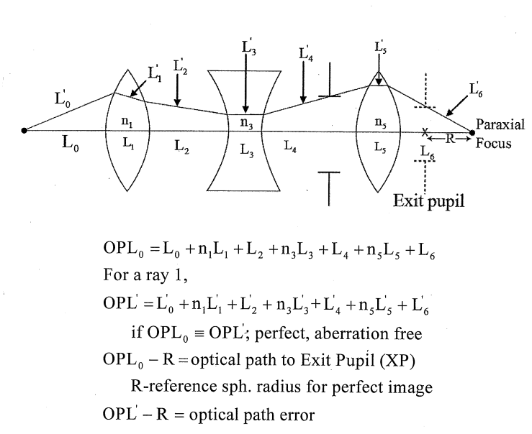
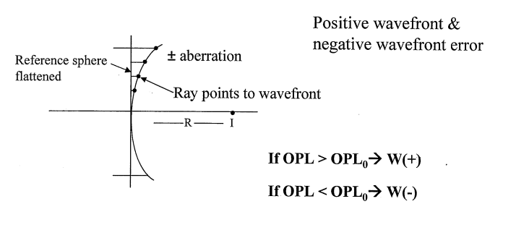
Wavefront aberration expansion
Fig. from E. Dreniak’s Class Note

Slide 66
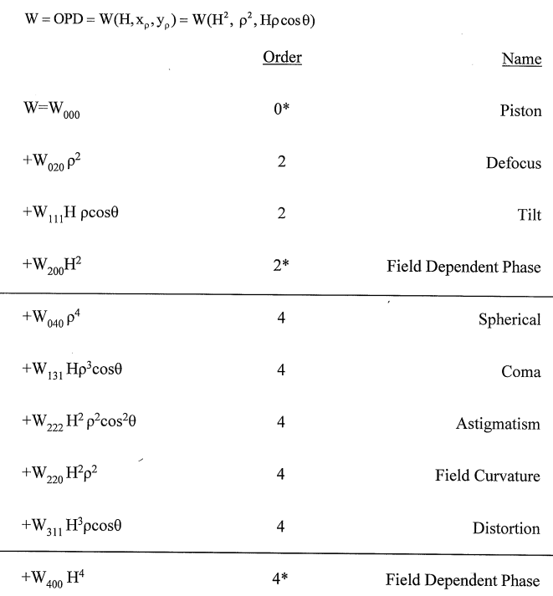
Wavefront aberration expansion
Fig. from E. Dreniak’s Class Note

Slide 67
Seidel Monochromatic Aberration Coefficients and WFE
Spherical Aberration: W₀₄₀=(1/8) S_{I}
Coma: W₁₃₁=(1/2) S_{II}
Astigmatism: W₂₂₂=(1/2) S_{III}
Field Curvature: W₂₂₀=(1/4) S_{IV}+(1/4) S_{III}
Distortion: W₃₁₁=(1/2) S_{V}

Slide 68
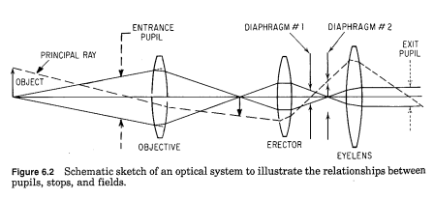
Marginal Ray, Chief Ray
W. J. Smith, Modern Optical Engineering, 2nd ed.

Slide 69
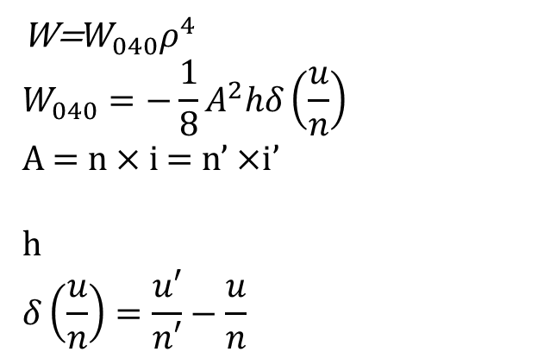
Spherical Aberration
Surface Normal
Refracted Marginal ray
i = hc + u
i’
u’
u
h
Incoming Marginal ray
n
n’
R=1/c
W=$W_{040}ρ^{4}$
$$W_{040}=−\frac{1}{8}A^{2}hδ\left(\frac{u}{n}\right)$$
A = n $×$i = n’ $×$i’
h $$δ\left(\frac{u}{n}\right)=\frac{u′}{n′}−\frac{u}{n}$$
Aberration expansion of SA
Wave aberration coefficient of SA for single refractive interface
Paraxial Snell’s law for marginal ray
Paraxial Ray incident marginal height

Slide 70
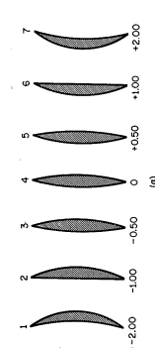


Spherical Aberration of a thin lens, Shape factor and conjugate factor
R₁=1/C₁
R₂=1/C₂
Marginal Ray
u
u’
n
Shape Factor
$$B=\frac{C_{1}+C_{2}}{C_{1}−C_{2}}=\frac{R_{2}+R_{1}}{R_{2}−R_{1}}$$
Shape Factor : B
Conjugate Factor
$$B=\frac{u_{1}+u_{2}}{u_{1}−u_{2}}$$
C=-1
C=0
C=+1
Conjugate Factor : C

Slide 71
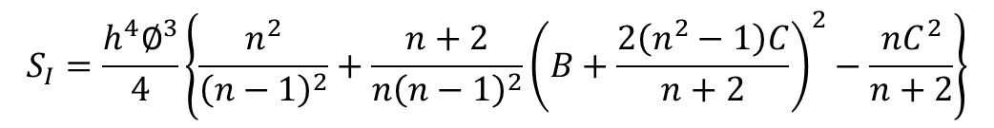
Spherical Aberration of a thin lens
$$S_{I}=\frac{h^{4}∅^{3}}{4}\left\{\frac{n^{2}}{{\left(n−1\right)}^{2}}+\frac{n+2}{n{\left(n−1\right)}^{2}}{\left(B+\frac{2\left(n^{2}−1\right)C}{n+2}\right)}^{2}−\frac{nC^{2}}{n+2}\right\}$$
h: incident height of marginal ray
φ: power of the lens (=1/f)
Observations:
S_{I} can be positive or negative for positive and negative powers, respectively.
S_{I} scales (h/f)³ -> High NA lens has more SA
S_{I} scales h⁴ -> W040
Important: S_{I} is a quadratic function of B!! -> S_{I} can be minimized for given C.
Lens Bending

Slide 72
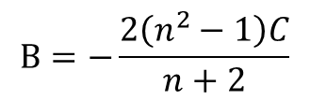
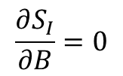

Minimum SA condition
$$\frac{∂S_{I}}{∂B}=0$$
$$B=−\frac{2\left(n^{2}−1\right)C}{n+2}$$
Example 1: 1 to 1 imaging (magnification = -1)
B=0 : Optimum Shape is bi-convex!
C=0
Example 2: Focusing (C=-1), n= 1.5
B=0.714 : Optimum Shape is close to
Convex-Plano
$$\frac{R_{1}}{R_{2}}=−\frac{1}{6}$$

Slide 73
Minimize SA by bending for given conjugate factor
Lens bending: Vary shape factor B while keeping focal length as a constant.
By lens bending, SA can be minimized for a given conjugate factor C.

Slide 74
Design Project #2
Singlet with minimum SA
N=1.5 (in CodeV, use 500.550 as a glass)
d-line (587.5617nm)
f=50mm,
tc=5mm
EPD 10mm
Stop at 1st surface

Slide 75
1st order design
Ratio of radius for the minimum SA condition
Power of the lens
Obtain R1 and R2 for f=50mm, n= 1.5

Slide 76
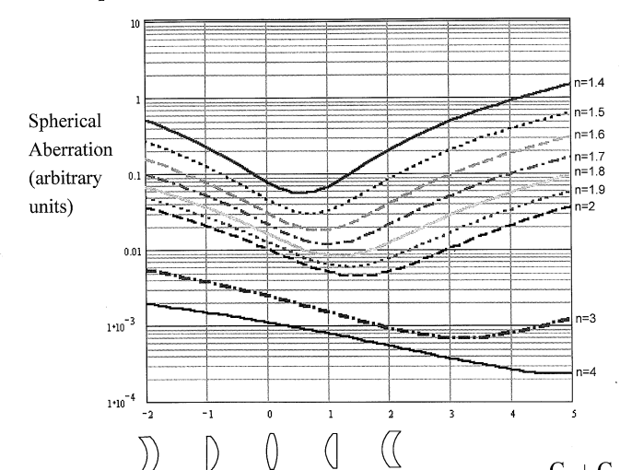
Effect of Index of Refraction
Fig. from E. Dreniak’s Class Note
Higher n -> Smaller SA

Slide 77
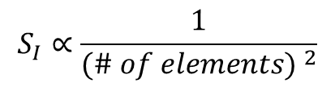

Effect of splitting lens
=
=
= ……
φ
(φ/2)+(φ/2)
(φ/3)+(φ/3)+(φ/3)
Consider splitting a singlet having a power φ into 2, 3, and more lenses
while keeping the system power the same φ.
$$S_{I}∝ ∅^{3}$$
$$S_{I}∝\frac{1}{{(\# of elements) }^{2}}$$
Remember: the equation is an approximation. Shape factor for each element
has to be appropriately taken into account.

Slide 78
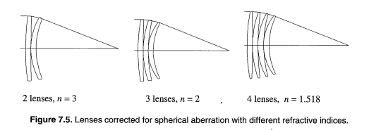
Effect of splitting lens
Fig. from Fundamental Optical Design, M. J. Kidger
Remember: the equation is an approximation. Shape factor for each element
has to be appropriately taken into account.

Slide 79
Design Example of Lens Splitting
Consider an optical system consisting of two positive thin lens elements having power of p1=0.01[1/mm] and p2=0.01[1/mm] (see Fig. 1). The index of refraction of the thin lens is n =1.5. Object is located at –Infinity. For simplicity, we assume zero air spacing between the thin lens elements.

Slide 80
Procedure
Step 1: Calculate paraxial marginal ray angles, u1’, u2’. Assume the marginal ray height in the object space is 1 mm.
Step 2: Calculate conjugate factors C1 and C2 for Lens #1 and #2.
Step 3: Calculate the optimum shape factor B1 and B2.
Step 3: Based on B1, B2, and n=1.69, calculate r1,r2,r3, and r4 by using the procedure used in design project #2.

Slide 81
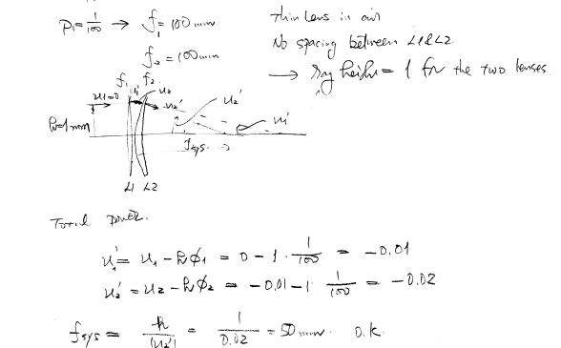

Slide 82
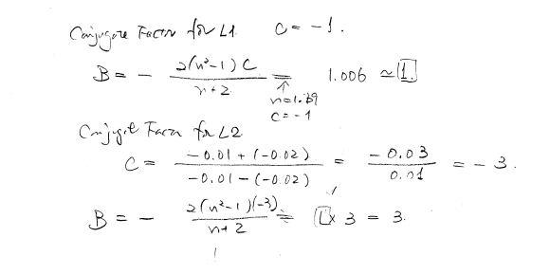

Slide 83
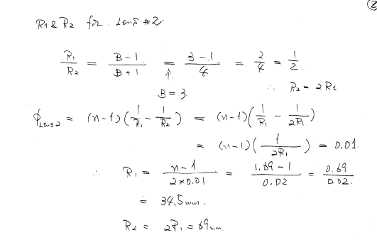

Slide 84
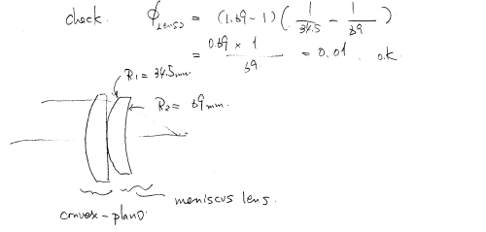

Slide 85
Other important techniques
Negative + Positive element
Aspheric Surfaces
Concentric Surface: Marginal ray is not refracted (A=0)
Aplanatic Surface: δ(u/n)=0 (To be discussed)
n
n’
u’
u
n
n’

Slide 86
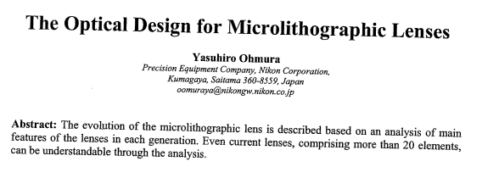
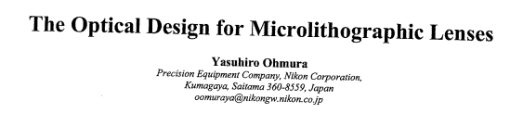
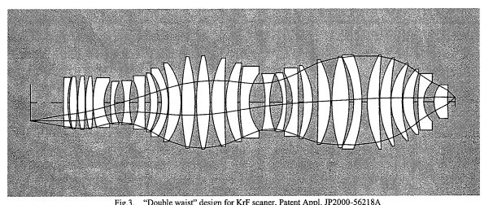
Case Study Which technique are used?

Slide 87
Introduction to Optical Design Lecture #3
Yuzuru Takashima
College of Optical Sciences
ytakashima@optics.arizona.edu

Slide 88
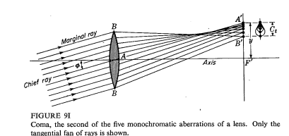
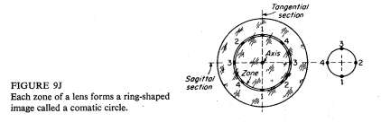
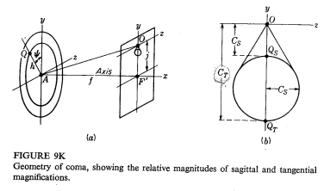
Coma

Slide 89
Coma Function of Marginal Ray and Chief ray
Surface Normal
Refracted Chief ray
θ₁
Incoming Chief ray
n
n’
R=1/c
Wave aberration of Coma at a spherical interface
Wave aberration coefficient at single spherical interface
Paraxial Snell’s Law for a marginal ray
Paraxial Snell’s Law for a chief ray
Paraxial marginal ray incident height, chief ray incident height

Slide 90
Coma Thin lens, stop at the lens
Zero-Coma condition for
Given conjugate factor C,
Example 1: 1:1 imaging system (C=0)
B=0 : Optimum Shape for zero Coma is bi-convex!
Remember: B=0 for min SA too!
C=0
Why-> Due the symmetry: Coma ~ h!

Slide 91
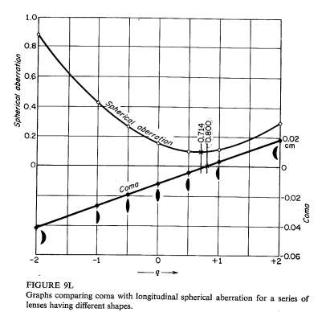
Coma and SA: for C=-1 (Focusing)
Example 2: Focusing (C=-1)
n | B_zero Coma | B_min SA
1.5 | 0.87 | 0.71
2.0 | 1.67 | 1.50
2.5 | 2.57 | 2.33
B_zero_Coma ~ B_min_SA
B=0.7~0.8 : Optimum Shape for zero Coma is close to
min SA condition too!
C=-1
If we use one aspheric surface, SA can be compensated too

Slide 92
Mini Design Project 3 Aplanatic Aspheric Singlet

Slide 93
Design Project 3 Aplanatic Aspheric Singlet
785nm
NA 0.45
f=3mm
1.4mm
Disk (BK7 1.2mm)
1.2mm
0.05mm

Slide 94
Specifications
Focal length : 3mm
NA: 0.45
Wave length : 785nm
Glass : Low melting temp. for glass molding (PBK40, n=1.503@785nm)
Beam diameter: 3mm
Object height: +- 0.05 mm
Wave front error < 0.02 waves in RMS
Working distance : 1.4mm
Cover glass: 1.2mm BK7

Slide 95
Design strategy
Since the image height is small (0.05mm), we only think about SA and Coma, then we can use a single lens.
A single lens can NOT attain both zero SA and zero Coma, then we introduce two aspherical surfaces to obtain zero SA and zero Coma simultaneously.

Slide 96
Design procedure
1st and 3rd order design
Start with minimum SA condition
Q= 0.718, R1=1.76, R2=-10.55
Optimization
Use two conic constant K of the two aspherical surfaces
Optimization using CODEV
Image evaluation
Aberration plots, Spot diagrams, Wave front error

Slide 97
Aplanatic Surface
An optical system free of both spherical aberration and Coma is said to be Aplanatic
There is a spherical surface having zero SA and zero Coma: “an Aplanatic Surface”
The Aplanatic surface is an extremely useful in lens design, such as an oil immersion microscope, high NA lens.

Slide 98
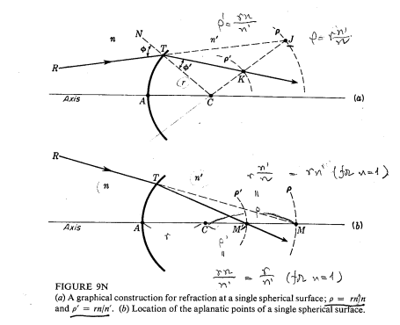
Aplanatic Surface

Slide 99
Aplanatic Surface:
Surface
Normal
C: center of curvature
C
M’
M
Aplanatic Optical System
(No SA, No Coma)
Aplanatic Surface
(No SA, No Coma)
Aplanatic System
(No SA, No Coma)
+

Slide 100
Aplanatic Surface
Given, n, n’ and L obtain r and location of final image M’ so that the surface induces no SA, Coma (and Astigmatism).
Relations
L, n’ n are known.
Location of M’

Slide 101
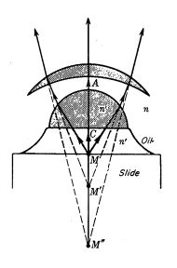
Aplanatic Surface An oil immersion lens
Surface | SA | Coma | Astigmatism
Aplanatic | 0 | 0 | 0
Concentric | 0 | 0 | /=0
Aplanatic | 0 | 0 | 0

Slide 102
Abbe’s Sine Condition
For a lens corrected for Spherical Aberration, Coma is also corrected if,
U, U’: Exact Marginal ray angle
u, u’: Paraxial Marginal ray angle
Special case U=0, (Object is at –Infinity)
Principal plane not a plane, but a sphere!
y

Slide 103
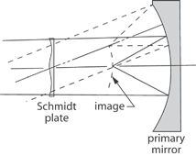
Case Study: Schmidt Camera
http://www.photonics.com/EDU/Term.aspx?TermID=6884

Slide 104
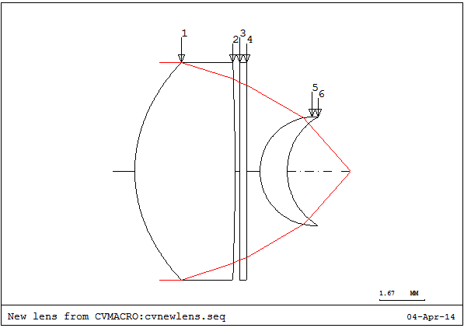
Design Project 4 Aspheric Singlet + Aplanatic surface

Slide 105
Introduction to Optical Design Lecture #4
Yuzuru Takashima
College of Optical Sciences
ytakashima@optics.arizona.edu

Slide 106
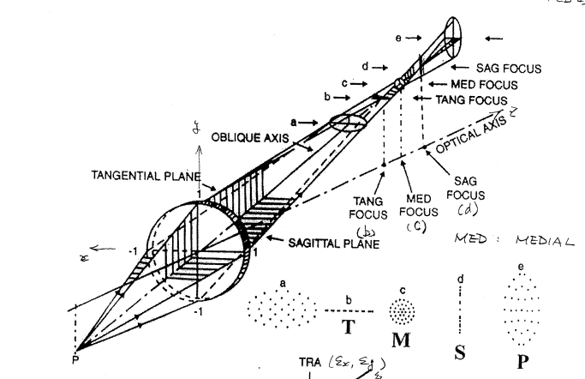
Astigmatism

Slide 107
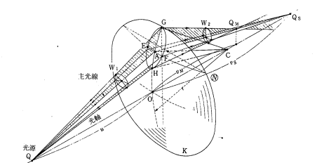
Origin of Astigmatism
I. Ogura, Modern Lens and Camera Technologies (in Japanese)

Slide 108
Astigmatism: Surface contribution
Surface Normal
Refracted Chief ray
θ₁
Incoming Chief ray
n
n’
R=1/c
Wave aberration of Astigmatism at a spherical interface
Wave aberration coefficient at single spherical interface
Paraxial Snell’s Law for a chief ray
Paraxial marginal ray incident height

Slide 109
Astigmatism Thin lens, stop at the lens
Thin lens, stop at the lens, there is not much we can do…
We have to use stop location as a design parameter.
In singlet, it is possible to compensate for astigmatism by shifting the stop. However, stop shift equation requires that Coma has to be intentionally introduced to compensate for Astigmatism.
In general, Anastigmat (SA, Coma and Astigmatism are all compensated) needs two or more lens elements and significant separation amount between the lens elements.

Slide 110
Field Curvature
Consider imaging along the auxiliary axis. We assume Spherical aberration, Coma, and Astigmatism are compensated.
S’ _{off-axis}
S _{off-axis}

Slide 111
Field Curvature
By examining the figure, and in the absence of astigmatism, the sagittal and tangential surface collapse on the a curved image surface: Petzval surface.
For a given optical system, how large is the radius of the Petzval surface?

Slide 112
Field Curvature
Consider a single interface and imaging along the auxiliary axis.
ρ’
n
n’
ρ
r
Aperture Stop
c
Auxiliary Axis (Chief Ray)
R. Kingslake, Lens Design Fundamentals

Slide 113
Field Curvature
By placing an small aperture at the center of curvature c, there is no Coma, no Astigmatism. Why?
Also, Spherical aberration is negligible due to the small aperture.
Under the construction, an object and image are concentric circles having
Object distance
Image distance
Lens law along the auxiliary axis

Slide 114
Now consider optical system having k surfaces (k = 1, 2, 3, …)
Surface #1
Surface #2
Surface #k-1
Surface #k

Slide 115
Take a sum over the k surfaces
Surface #1
+
Surface #2
+
…..
+
Surface #k-1
+
Surface #k
Radius of image plane
Radius of object plane

Slide 116
Sign convention
z
z
Definition by Kingslake
Definition by CodeV
Important!!
Petzval curvature is function of n & r only!!
1st order design determins Petzval curvature!!

Slide 117
Petzval Curvature : Examples
Example 1: Thin lens in air
r1
r2
Petzval Surface, radius ρ₃
n
z
S1
S2
S3 (image surface)
Petzval curvature is function of
n & φ only!!

Slide 118
Example 2: Field Flattener: A negative (or positive) lens placed close to the image surface
Flat field
n=1.5
n=1.8
n=1.5
f=100mm
f=200mm
Field Flattener
Field radius ~ -100mm
Note:
produces a good design.

Slide 119
Correction of Field Curvature
Positive + Negative power
A thick meniscus element
Field Flattener
Mirror optics (Positive power, and Positive F.C.!)
Curved detector array

Slide 120
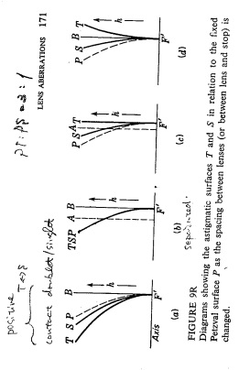
Field curvature and Astigmatism
Given power arrangement, shape factor, stop location, lens bending do NOT affect Petzval curvature.
However, Tangential and Sagittal surfaces change their shape in a manner such that, PT:PS=3:1, in 3rd order.

Slide 121
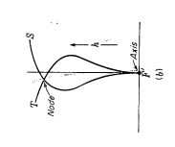
Field curvature and Astigmatism
Anastigmatic lens is a lens for which Spherical aberration, Coma, Astigmatism + Field curvature are corrected.
Specifically, 3rd, 5th order Astigmatism are balanced under an appropriate amount of the field curvature.
P
P:Petzval
3rd+5th
order
T:Tangential
S:Saggital
3rd
order

Slide 122
Seidel Aberration Coefficient of Field Curvature
Wavefront error by Field Curvature
Wavefront aberration coefficient
Seidel coefficient (Single surface)
Seidel coefficient (Thin Lens)
Lagrange invariant
Curvature of surface
Power of thin lens

Slide 123
Distortion
Suppose, we corrected for Spherical Aberration, Coma, Astigmatism, and Field Curvature, we still have distortion of the image.

Slide 124
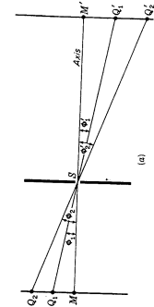
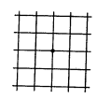
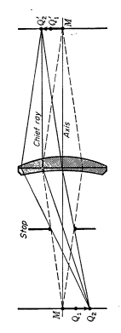
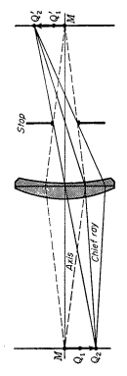
Effect of Stop Location
?
Thin Lens stop at the lens
?
Stop in front of the lens
?
Object (Rect Grid)
Stop behind the lens
Image

Slide 125


Effect of Stop Location
Thin Lens stop at the lens
Barrel
Distortion
Stop in front of the lens
Pincushion
Distortion
Object (Rect Grid)
Stop behind the lens
Image

Slide 126

Solution: Symmetry with respect to the stop location
Object (Rect Grid)
Image

Slide 127
Seidel Aberration Coefficient of Distortion
Wavefront error by Field Curvature
Wavefront aberration coefficient
Seidel coefficient (Single surface)
Lagrange invariant
Curvature of surface

Slide 128


Design Project 5 (Optional) A Landscape Lens

